Slide 1
Clustering Methods on Vertebral Column Data
Kimberly Glock, Andre Louie, and Charlie Napier
MSDS 5163-99

Slide 2
METHODS: Hierarchical
Generates a type of tree called a dendogram which is the structure of the data and this is spilt to obtain clusters
Connectivity based = distance between objects
Data can be divided/divisive or united/agglomeration
Initially each data point starts out as one cluster called a leaf. We observe these initial clusters by looking at the distance between them. We then agglomerate/merge proximate clusters together into a single cluster. We keep assessing distance and merging until only a single cluster remains (all data points) called the root or until we reach our selected cluster preference and then combining stops.

Slide 3
METHODS: Hierarchical
PROS
Hierarchical clustering is deterministic = same results every time
Does not require a distance so is good with variety

Slide 4
METHODS: Hierarchical
CONS
Highly affected by noise and outliers
Inapplicable in datasets with little to no hierarchy
Agglomerative hierarchical clustering aims at finding the best step at each cluster (greedy algorithm) which results in a potentially suboptimal solution
High space complexity so cannot be used with huge data.

Slide 5
METHODS: PAM
PAM stands for “partition around medoids”
Compactness based = minimizing the distances between the non-medoid objects and the medoid (the cluster center)
The most centrally located data point in each cluster is the medoid. At the medoid, the average dissimilarity between it and all other members of the cluster is minimal.
Initially we set k medoids. Then we calculate the dissimilarity matrix which uses the Euclidean or Manhattan distances. Next we assign every object to its closest medoid. Next there is the SWAP phase. In this phase if at least one medoid has changed then back to assigning objects to their nearest medoid.

Slide 6
METHODS: PAM
PROS
Less sensitive to noise and outliers because it does not use the mean

Slide 7
METHODS: PAM
CONS
Not suitable for clustering non-spherical (arbitrary shaped) groups of objects
May obtain different results for different runs on the same dataset, can depend on the initial (typically randomly determined) starting points

Slide 8
METHODS: Spectral
Connectivity based = distance between objects
Uses eigenvectors computed from the Laplacian matrix which is computed from the similarity matrix
Data points are treated as nodes of a graph therefore clustering is treated as a graph partitioning problem.
Initially we compute a similarity graph. The data points/nodes are mapped to a Euclidean space and formed into clusters.

Slide 9
METHODS: Spectral
PROS
Not affected by noise and outliers
Clusters can be any shape

Slide 10
METHODS: Spectral
CONS
Uses k means on final step so cluster results are not always the same

Slide 11
DATASET
https://archive.ics.uci.edu/ml/datasets/Vertebral+Column
310 instances
7 dimensions/columns/attributes
Column 7 provides the classes of the data. Three classes: Normal (NO) 100 patients, Disk Hernia (DH) 60 patients or Spondylolisthesis (SL) 150 patients. Notice the varying densities.
SIZE, ATTRIBUTES, NUMERICAL WITH ONE TEXT/CLASS COLUMN, HOW MANY CLASSES, PIC OF HEAD OF DATASET, WEBSITE

Slide 12
DATASET
Numeric data, no nulls
The first 6 columns are 6 biomechanical attributes derived from the shape and orientation of the pelvis and lumbar spine (in this order): pelvic incidence, pelvic tilt, lumbar lordosis angle, sacral slope, pelvic radius and grade of spondylolisthesis

Slide 13
DATASET
CONS
Missing important attributes such as age and BMI
There is no indicator of units for the measurements or how the measurements were taken

Slide 14
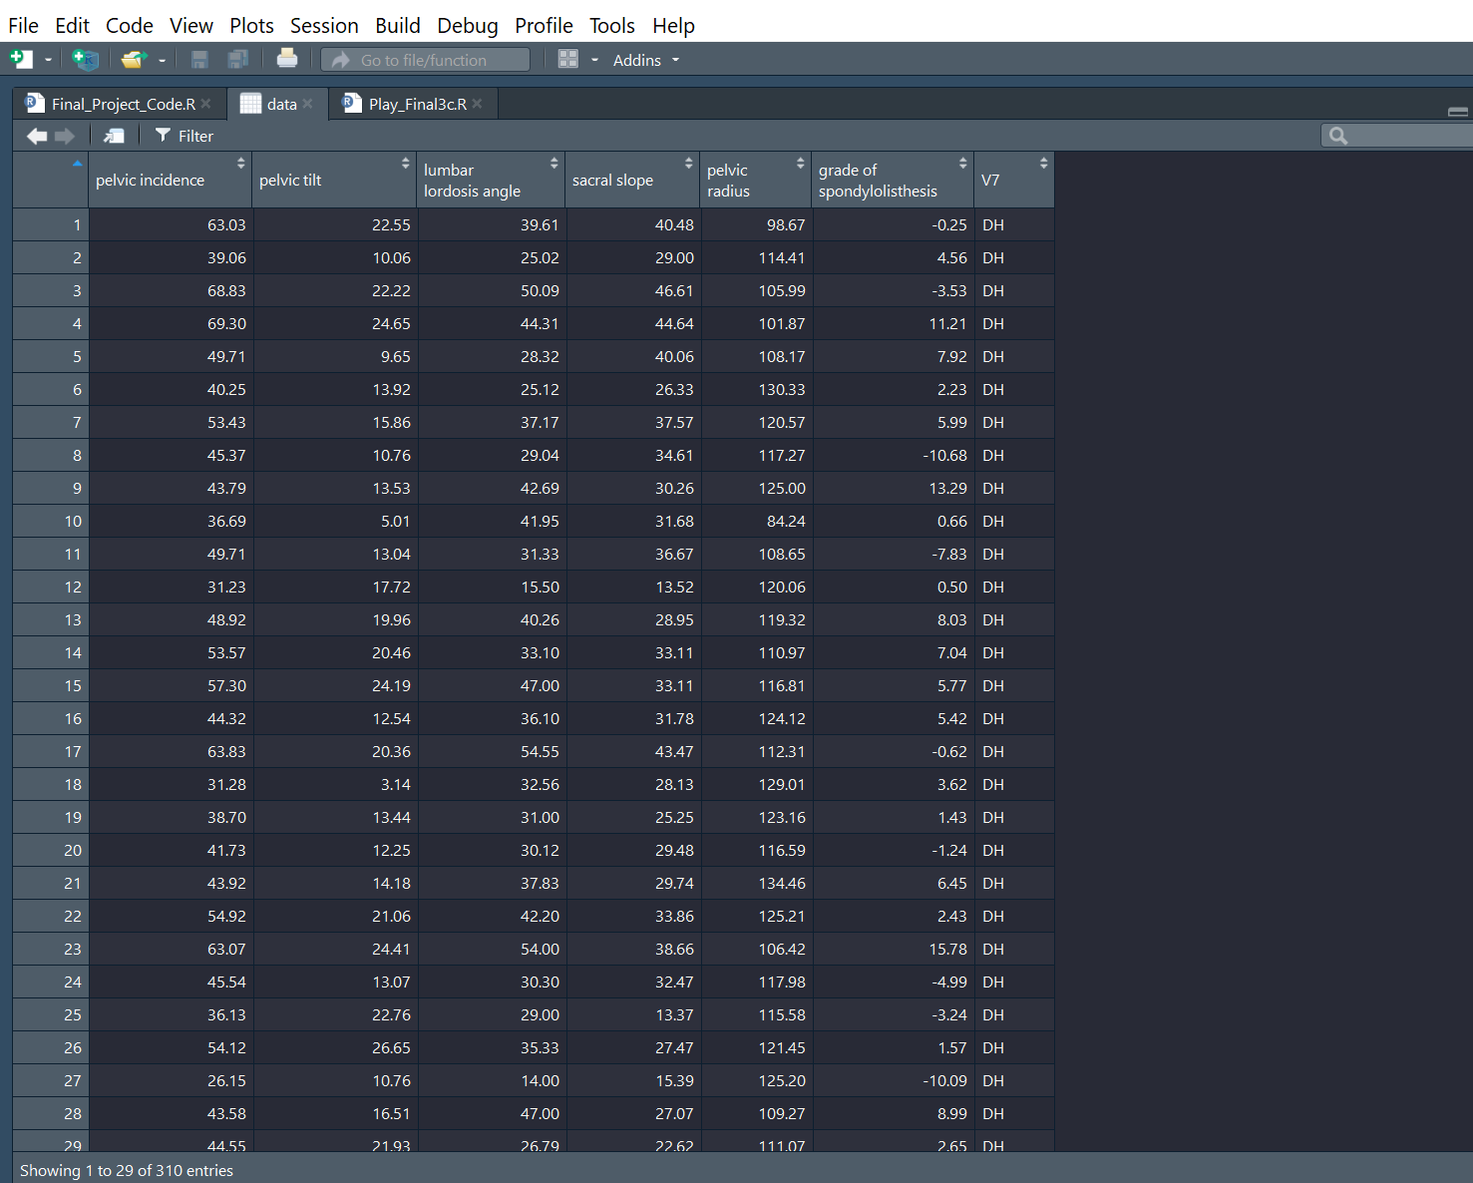
DATASET

Slide 15
DATASET
Disk Hernia = the rubbery disks that lie between the vertebrae in your spine consist of a soft center (nucleus) surrounded by a tougher exterior (annulus). A herniated disk occurs when a portion of the nucleus pushes through a crack in the annulus.
Spondylolisthesis = slipping of vertebra that mostly occurs at the base of the spine. It is a defect or fracture of one or both wing-shaped parts of a vertebra and can result in vertebrae slipping backward, forward, or over a bone

Slide 16
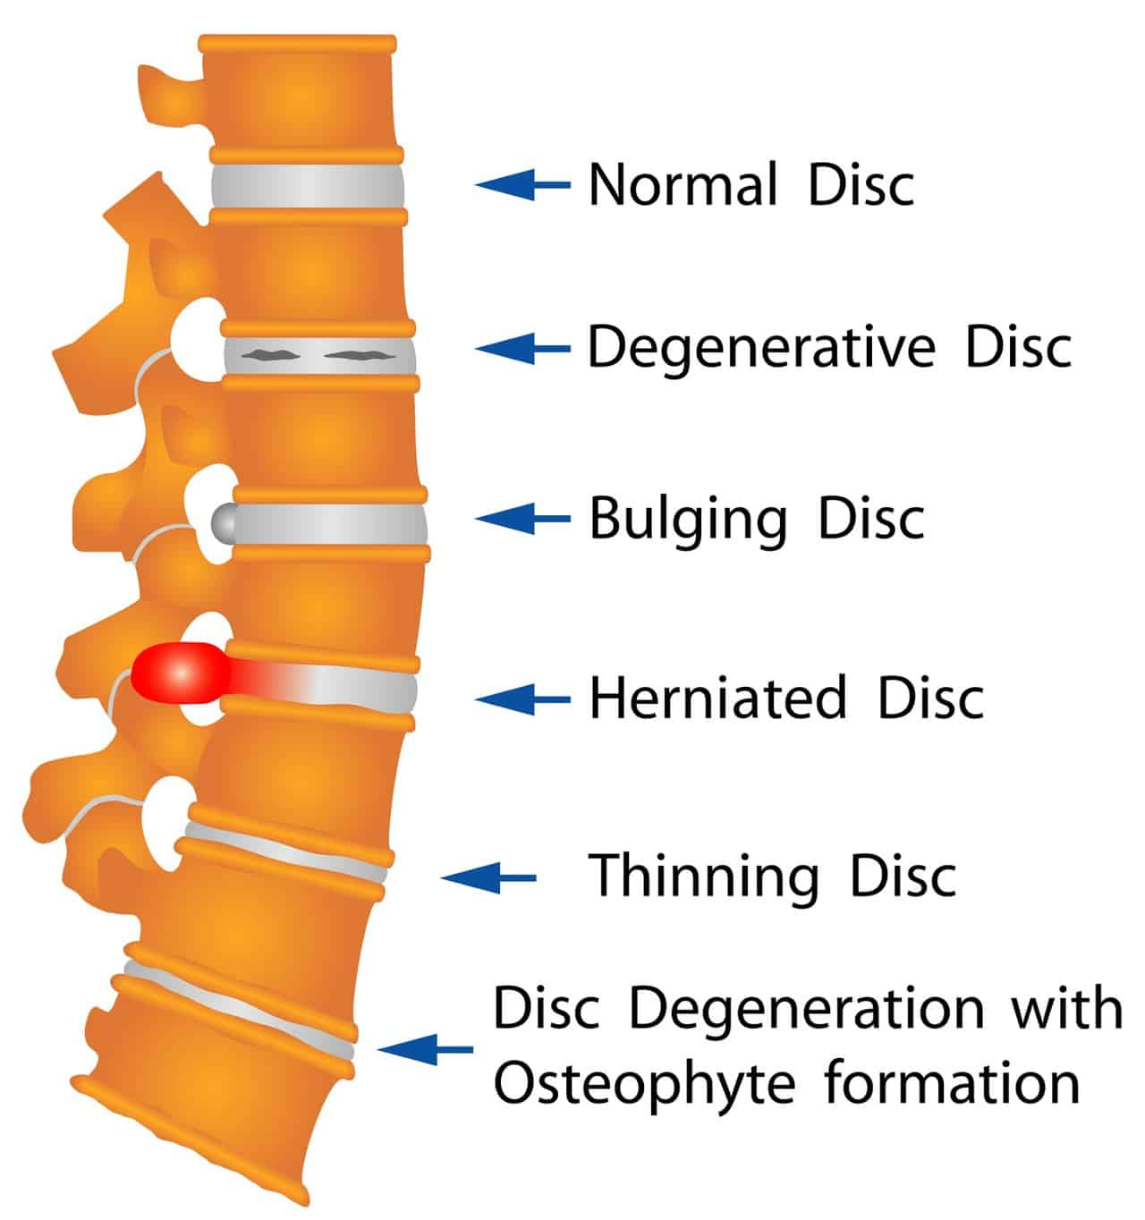
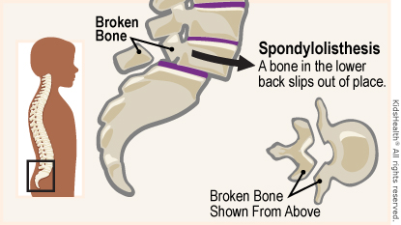
DATASET

Slide 17
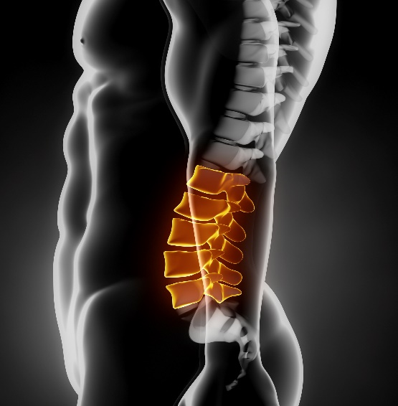
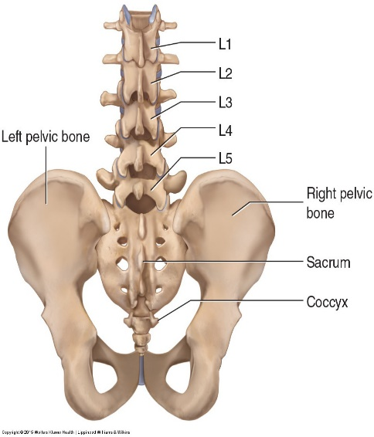
DATASET
Lumbar and Pelvic Region

Slide 18
HYPOTHESIS
Null Hypothesis = our data will not cluster
Alternative Hypothesis = our data is clusterable

Slide 19
RESULTS
Cluster Validation Statistics
get_cluster_tendency( )
If Hopkins statistic is below 0.5 then data is clusterable
Our result is .12 so clusterable
clValid( )
Uses connectivity, Dunn, and silhouette as measures
Our result is hierarchical 2 clusters

Slide 20
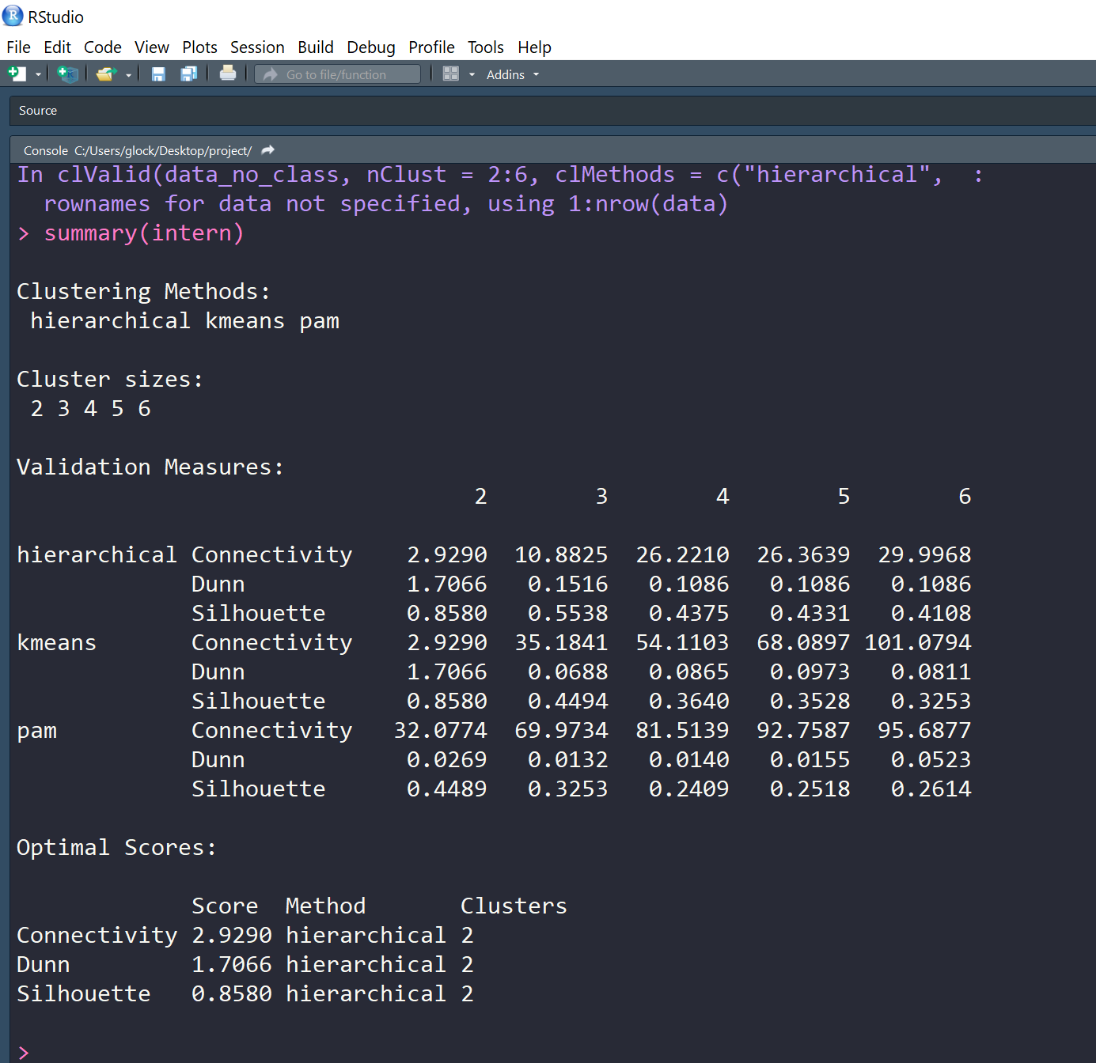
RESULTS

Slide 21
RESULTS
Cluster Validation Statistics
NbClust( )
Gives us the Hubert index which is a graphical method of determining optimal k#
Look for the knee of the plot for the optimal k#
Our results = 12 indices proposed 4 clusters

Slide 22
RESULTS
Clustering Method Stats
Cluster.stats( )
average.between = average distance between clusters (want it large)
average.within = average distance within clusters (want it small)

Slide 23
RESULTS
Clustering Method Stats
Cluster.stats( )
Dunn Index (D) = if clusters are compact around medoid and are well separated the diameter of cluster should be small and distance between clusters should be large (larger is better)
Rand Index = measurement for assessing the similarity between two partitions (-1 no agreement and +1 perfect agreement)

Slide 24
RESULTS
Clustering Method Stats
Silhouette( )
Measures how well a data point is clustered and estimates the average distance between clusters (close to 1 is a well clustered object and close to -1 is poorly clustered)

Slide 25
RESULTS
Clustering Method Stats
confusionMatrix( )
accuracy = overall how often is the model correct
sensitivity aka recall aka true positive rate = TP(correct P pred)/total of P (closer to 1 is good and 0 is not)
specificity = aka true negative rate = TN(correct N pred)/ total of N (best is 1 and bad is 0)

Slide 26
RESULTS
Clustering Method Stats
confusionMatrix( )
p value = (caret package definition) one-sided test to see if the accuracy is better than the "no information rate“ which is the majority class in your dataset (accuracy % should be higher than this %)

Slide 27
HIERARCHICAL
STATS | 2 Clusters | 3 Clusters | 4 Clusters
AVG BETWEEN | 69.789 | 70.105 | 70.781
AVG WITHIN | 44.426 | 38.340 | 36.263
DUNN | 0.007 | 0.015 | 0.041
RAND | 0.431 | 0.267 | 0.263
ACCURACY | 0.28 | 0.50 | na
P VALUE | 1.0 | 0.23 | na
SENSITIVITY | 0.167/0.77/0.0 | 0.167/0.77/0.467 | na
SPECIFICITY | 0.348/0.714/1.00 | 0.636/0.714/0.988 | na
AVG SIL WID | 0.329 | 0.287 | 0.296
Notes:
Red = best stat in each method (methods = hier, pam, spec)
Peach = best stat out of all methods

Slide 28
PAM
STATS | 2 Clusters | 3 Clusters | 4 Clusters
AVG BETWEEN | 79.418 | 71.131 | 66.974
AVG WITHIN | 42.065 | 36.736 | 34.166
DUNN | 0.027 | 0.013 | 0.014
RAND | 0.299 | 0.271 | 0.312
ACCURACY | 0.19 | 0.487 | na
P VALUE | 1.0 | 0.477 | na
SENSITIVITY | 1.00/0.010/0.00 | 0.117/0.76/0.453 | na
SPECIFICITY | 0.440/0.481/1.00 | 0.616/0.700/1.00 | na
AVG SIL WID | 0.449 | 0.325 | 0.241

Slide 29
SPECTRAL
STATS | 2 Clusters | 3 Clusters | 4 Clusters
AVG BETWEEN | 76.705 | 73.853 | 73.014
AVG WITHIN | 41.855 | 37.146 | 35.075
DUNN | 0.010 | 0.025 | 0.029
RAND | 0.423 | 0.310 | 0.351
ACCURACY | 0.31 | 0.48 | na
P VALUE | 1.0 | 0.617 | na
SENSITIVITY | 0.0/0.96/0.0 | 0.950/0.00/0.607 | na
SPECIFICITY | 0.488/0.591/1.00 | 0.592/0.786/0.906 | na
AVG SIL WID | 0.432 | 0.367 | 0.339

Slide 30
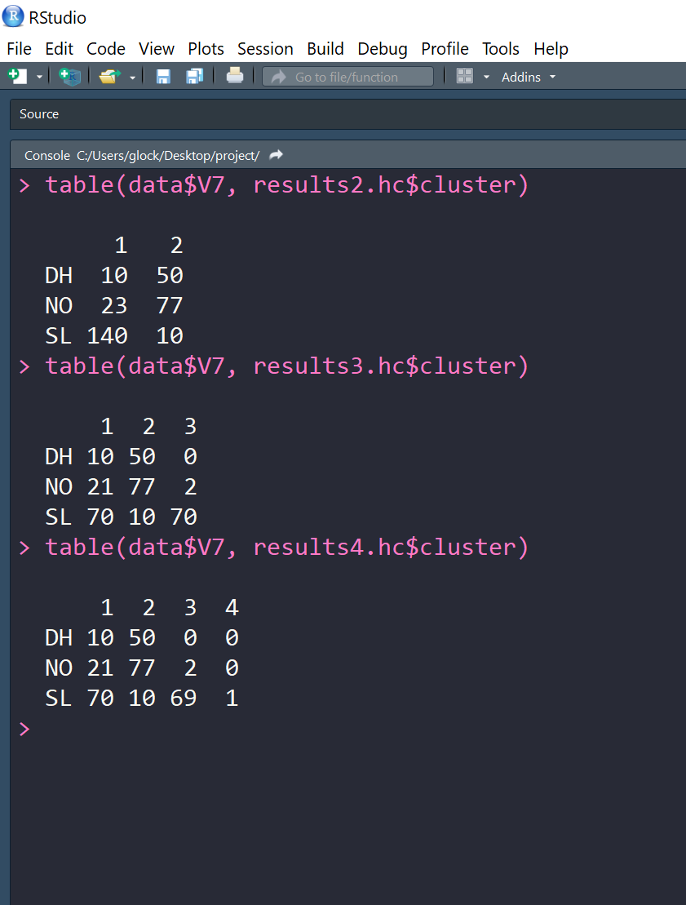
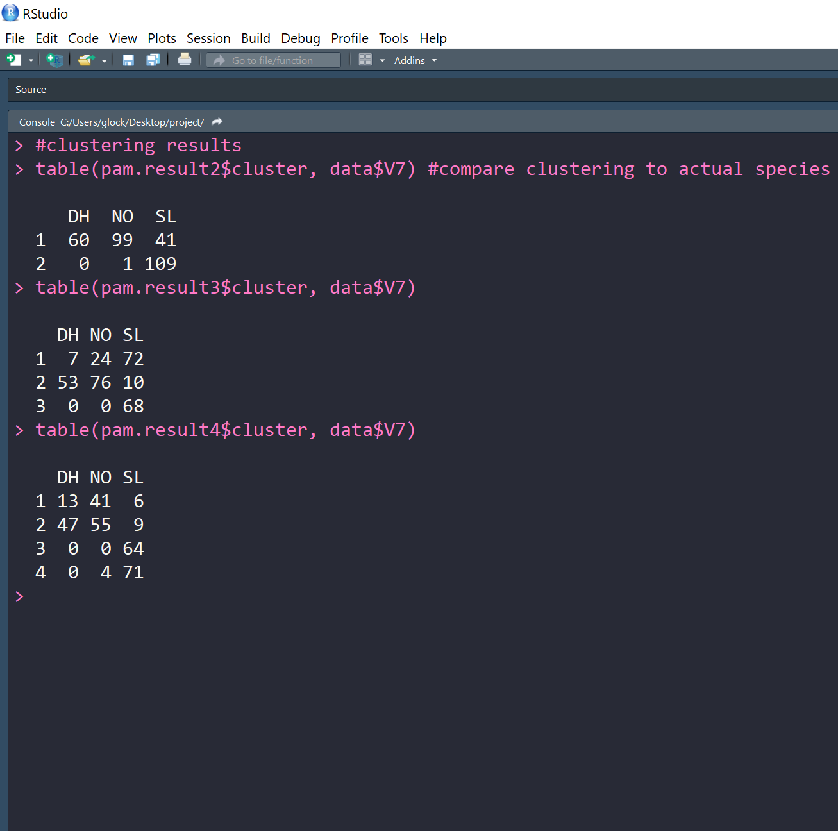
RESULTS-TABLES

Slide 31
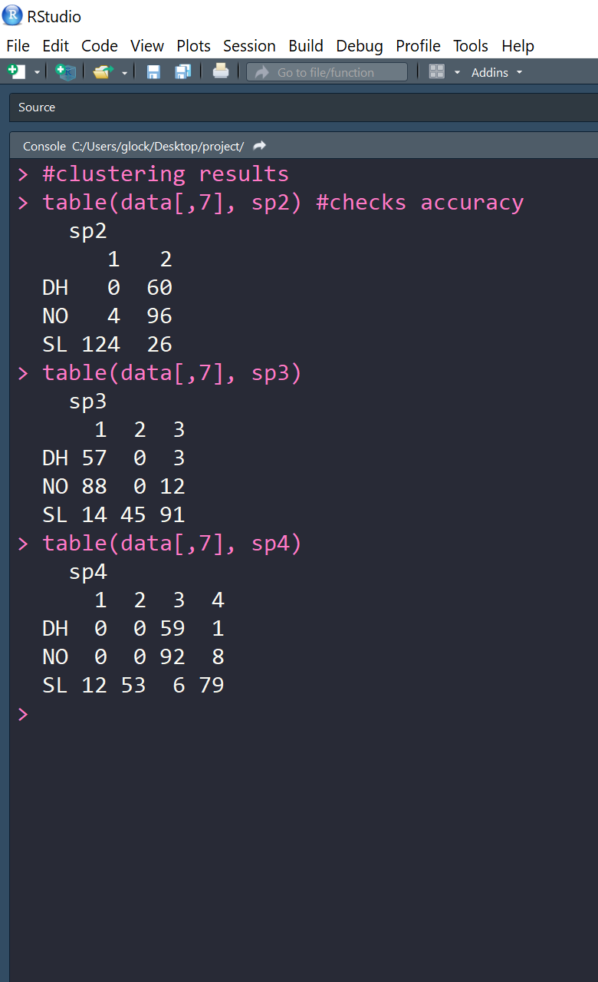
RESULTS-TABLES

Slide 32
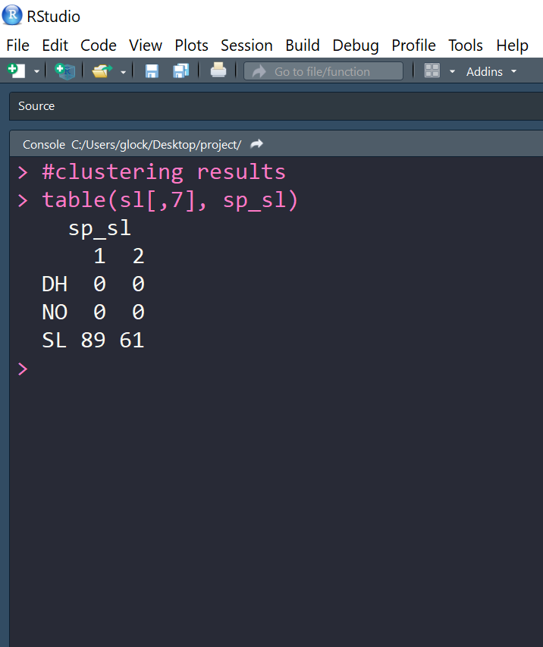
SL (Spondylolisthesis) SPECTRAL
STATS | 2 Clusters
AVG BETWEEN | 70.904
AVG WITHIN | 45.456
DUNN | 0.303
RAND | NULL
ACCURACY | na
P VALUE | na
SENSITIVITY | na
SPECIFICITY | na

Slide 33
CONCLUSION
We cannot accept or reject the null hypothesis at present.
We were not able to properly calculate the p-values so we do not have statistics to support this. But our visuals clearly suggest that our data is clusterable. Further investigation is needed.

Slide 34
NOTES:
In clustering this particular dataset, we found that our data mostly wants to partition into two sets even with when setting our cluster number to 3 or 4 in the algorithm. The attributes in our dataset are bone measurements excluding the attribute, grade of SL. The DH and NO groups like to cluster together into one group overall. We hypothesize this happens because DH is a herniated disk and probably does not affect bone measurements nor does it cause bone misplacement. DH clusters with normal measurements and isn’t a distinguishable diagnosis using clustering methods. The SL class liked to cluster to itself and further more into two different clusters. We did a separate spectral clustering using 2 clusters of a subset of the SL data. It did cluster into two distinct clusters. This deems further investigation in a future study. We hypothesize that SL clusters to itself because the dataset attributes are bone measurements and a SL diagnosis involves broken and misplaced bones. Hence clustering was able to distinguish this diagnosis.

Slide 35
NOTES:
We also hypothesize that SL further clusters down into two distinct clusters due to the grade of SL with one cluster perhaps being a lower grade and the other cluster a higher grade of SL. In theory, perhaps clustering could be used to capture and diagnose patients with SL versus NO patients and perhaps even distinguish patients with low grade SL versus patients with high grade SL. Further investigation and research is needed.

Slide 36
EL FIN!

