Slide 1

Click and Connect Telecom
Decrease Customer Churn Project
B. Moragne and K. Glock, Data Science Department

Slide 2

Goals
Business Goals:
find out which customers will churn and why
intervene before customers leave to decrease churn rate
Data Science Goals:
build a logistic regression model for classification of the binary outcome: churn or no churn
discover which variables are associated with churn
target metric: AUC greater than 82%
Time Frame: 2 weeks
Cost Benefit Analysis:
project cost: $40,000 charged to marketing department
$64.00 is the monthly average charge, paid by a customer each month
1394 churns over the last 5 years which is averaged to be a loss of around 23 customers per month. This is an estimated total monthly charges loss of $1472 each month
for each customer retained, we keep the averaged $64 monthly charge revenue plus the money spent to acquire the customer (estimated to be around $5)

Slide 3
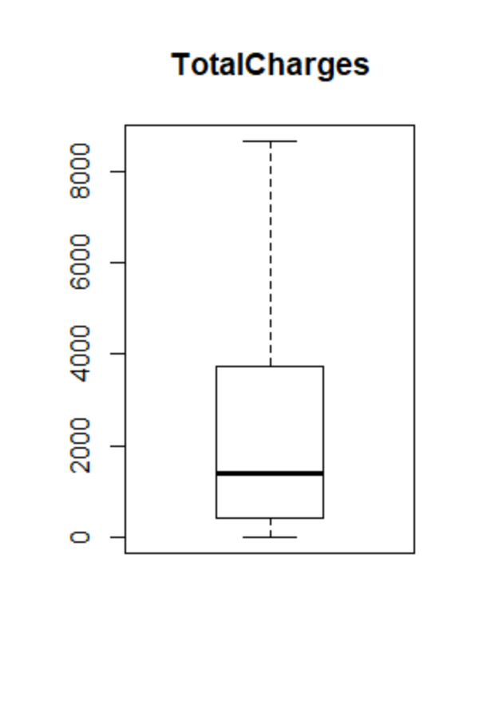
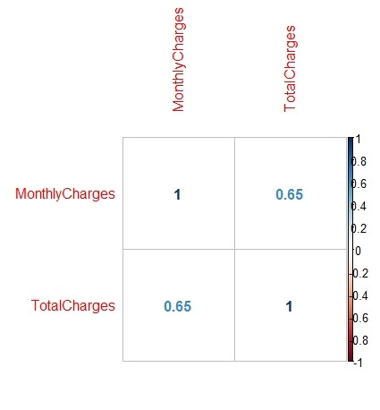
Exploratory Data Analysis
Data: received initial data from IT, stored in an AWS S3 Bucket, future data uploaded once per week
7043 total rows: 5282 in train and 1761 in test with 21 attributes
dependent variable: Churn
26% churn rate in train data, 1394/5282
Data Quality Issues: missing values in TotalCharges column
Few Data Observations (Train):
Internet Service Fiber Optic: 2297 customers choose fiber optic. More than 50% of these fiber optic customers churn. There is little churn in DSL.
Tech Support: 2625 customers do not have tech support. Approximately 75% of those churn. Not much churn with support.
Payment Method: customers are approximately equally distributed in how they pay. 1782 customers pay by electronic check and almost 75% of these churn. Other methods churn 25% or less.
Tenure and Contract Month-to-Month: the tenure variable shows a high churn rate at the lowest tenures around 0-2 years. 2913 customers have contracts that are month-to-month with high churn at around 75%.
MonthlyCharges and TotalCharges are correlated

Slide 4
Data Preprocessing
Quality Issues Addressed:
imputed missing data with 0 in TotalCharges
factored Churn and SeniorCitizen
combined levels in multiple variables (adds no new information): No and No Phone Service and No and No Internet Sevice
scaled TotalCharges, right skewed
deleted MonthlyCharges (multicollinearity with TotalCharges)
binned Tenure into 12 month intervals
Experimented:
one-hot encoding
concatenated columns, association rule mining
merged TotalCharges/MonthlyCharges = Tenure
Feature Selection:
lasso regression
significant p-values
stepAIC
Top 3 Variables with Negative Coefficients, descending: Contract.Two.year -1.72, binned 24-36 months -1.08 and InternetService.No -.92
Top 3 Variables with Positive Coefficients, descending: InternetService.Fiber.optic +.94, StreamingTV.Yes +.39 and PaperlessBilling.Yes +.36
Final Dataset for Model: (14 predictor variables associated with churn): binned, Contract, InternetService, TotalCharges, PhoneService, TechSupport, OnlineSecurity, PaperlessBilling, PaymentMethod, StreamingTV, StreamingMovies, SeniorCitizen, OnlineBackup and MultipleLines

Slide 5
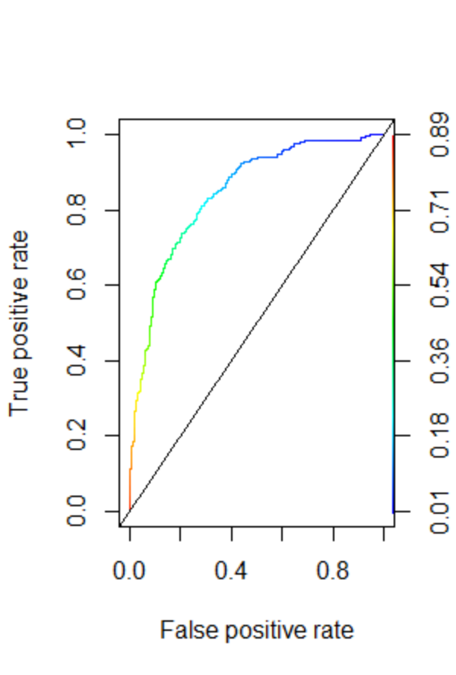
Model Selection
Data Partitioning: nested holdout with k-fold CV
divided the train dataset into a 80% train subset to train the model and a 20% test subset (to check if the model generalizes well). The test dataset was used to score the model with the AUC metric.
Model Selected: logistic regression with an 84% AUC = 84% of the time the model distinguishes classes by ranking a positive instance higher (closer to 1) and a negative instance (closer to 0). The black dashed diagonal line represents an AUC of .50.
Model Assumptions: binary target variable, sensitive to outliers and independent predictor variables (not correlated with each other)
Confusion Matrix:
specificity/TP rate/recall = 0.51 (correctly predicted positives with regards to all ground truth positive data points (higher TPR means fewer positive data points missed)
precision = 0.69 (correctly predicted positives with regards to total positive predictions from model)
Confusion Matrix | Reference NO | Reference YES
Prediction NO | 703 TN | 141 FN
Prediction YES | 66 FP | 147 TP

Slide 6
Summary
Progress to Date:
successfully created our data science & business goals
received data from IT and adequately cleaned data
successfully created a logistic regression model to predict customer churn
Are We Meeting Our Goals?:
Business Goals - Yes!
we were able to identify which customers are leaving
implemented a plan to “save” at-risk customers
Data Science Goals - Yes!
created a logistic regression model to predict the binary outcome of customer churn
identified the variables closely related to customer churn
AUC of 84%
Should Click & Connect Go or No Go?:
GO!
we have met our business and data science goals
we pinpointed at-risk customers
we built a successful model to predict whether those at-risk customers will churn
with this model, we can subsequently construct a plan to keep at-risk customers but also retain loyal customers

Slide 7
Deployment
Plan for Deployment:
IT will recode the model into C++ for production
IT will use a model lifecycle tool to track packages/dependencies and configurations used to create the model for consistency and reproducibility. They will also have a data processing and model building pipeline for reproducibility.
model will be integrated to an AWS on demand API (web based interface for users) for a serverless solution and access
upon deployment, we will enable gradual releases of predictions so we can monitor for initial issues
Monitoring and Maintenance:
all incoming data will need to be reviewed for quality such as missing data and consistency
predictions will be delivered to the AWS RDS database for access
IT will use tools with alerts to help monitor for model performance issues and anomalies
will validate the model once per month with offline tests and assess performance with any alerts
will retrain the model and revalidate upon any changes in model performance such as a drop in AUC to 82% or below or changes in data (data drift)
any changes to data processing, model configurations, inputs, outputs (predictions) and anomalies must be logged and tracked

