Slide 1
Factory in a Box

Slide 2
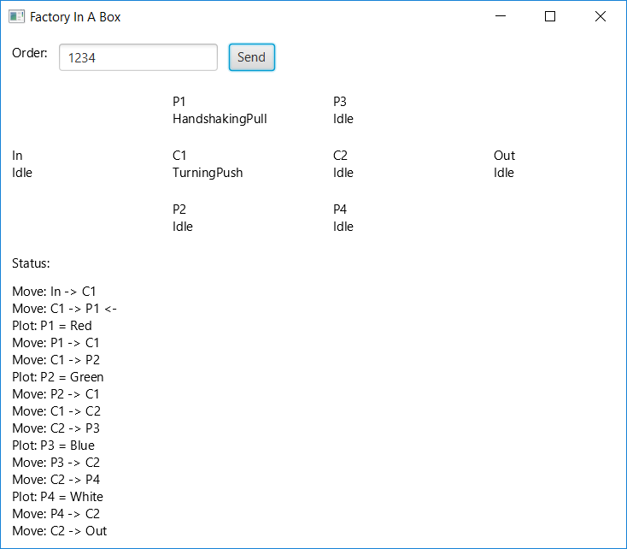
Application
1234
[INFO] [akka://…/order-1/action-1/move-1] MOVE: In -> C1
[INFO] [akka://…/order-1/action-2/move-2] MOVE: C1 -> P1
[INFO] [akka://…/order-1/action-3/plot-3] PLOT: P1 - Red
[INFO] [akka://…/order-1/action-4/move-4] MOVE: P1 -> C1
[INFO] [akka://…/order-1/action-5/move-5] MOVE: C1 -> P2
[INFO] [akka://…/order-1/action-6/plot-6] PLOT: P2 - Green
[INFO] [akka://…/order-1/action-7/move-7] MOVE: P2 -> C1
[INFO] [akka://…/order-1/action-8/move-8] MOVE: C1 -> C2
[INFO] [akka://…/order-1/action-9/move-9] MOVE: C2 -> P3
[INFO] [akka://…/order-1/action-10/plot-10] PLOT: P3 - Blue
[INFO] [akka://…/order-1/action-11/move-11] MOVE: P3 -> C2
[INFO] [akka://…/order-1/action-12/move-12] MOVE: C2 -> P4
[INFO] [akka://…/order-1/action-13/plot-13] PLOT: P4 - White
[INFO] [akka://…/order-1/action-14/move-14] MOVE: P4 -> C2
[INFO] [akka://…/order-1/action-15/move-15] MOVE: C2 -> Out
[INFO] [akka://system/user/main/factory/orders] DONE: Order(1,ArraySeq(Red, Green, Blue, White))

Slide 3
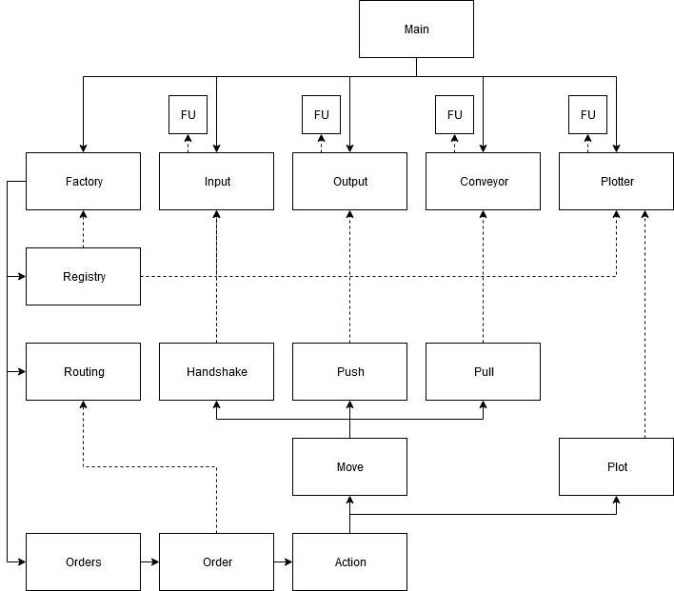
Architecture

Slide 4
Discussion / Takeaways
Thinking about how to get actor references is important. Polling with actorSelection feels bad. Receptionist to the rescue?
Keeping actors small and state inside of each individual actor to a minimum makes the system much easier to work with.
Message-based communication takes some getting used to, but is much nicer than having to deal with synchronization.
Building distributed, reliable and fault tolerant systems is hard. Akka does provide the tools, but you still have to put in the effort.
Scala is great.

