Slide 1
Large-Scale Software Metrics Calculation in Azure

Slide 2
Motivation / Problem Statement

Slide 3
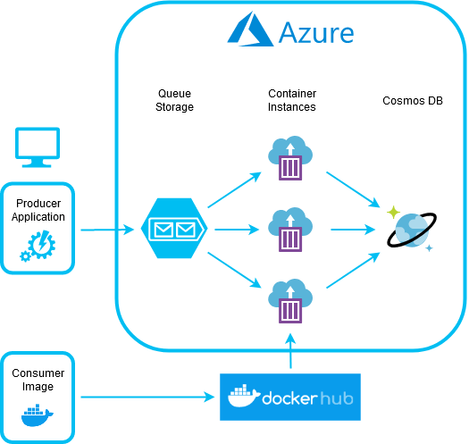
Architecture

Slide 4
Producer - Implementation
@SpringBootApplication
public class ProducerApp implements CommandLineRunner {
@Override
public void run(String... args) {
ActorSystem system = ActorSystem.create();
Source.from(Arrays.asList(this.indexer.getArtifactInfos()))
.map(artifactInfo -> new Project(artifactInfo))
.map(project -> new CloudQueueMessage(this.gson.toJson(project)))
.runWith(AzureQueueSink.create(() -> this.queue), system);
}
...
}

Slide 5
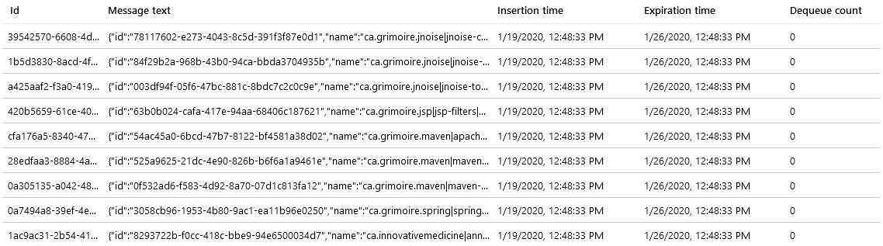
Producer - Results

Slide 6
Consumer - Implementation
@SpringBootApplication
public class ConsumerApp implements CommandLineRunner {
@Override
public void run(String... args) {
ActorSystem system = ActorSystem.create();
AzureQueueSource.create(() -> this.queue)
.map(message -> {
Project project = this.gson.fromJson(message.asString(), Project.class);
this.downloadProject(project); // download from Maven Central Repository
this.unpackProject(project); // execute "unzip ..."
this.calculateMetrics(project); // execute "java –jar jhawk.jar ..."
this.persistMetrics(project); // read metrics XML + write to Cosmos DB
return message;
}).runWith(AzureQueueDeleteSink.create(() -> this.queue), system);
}
...
}

Slide 7
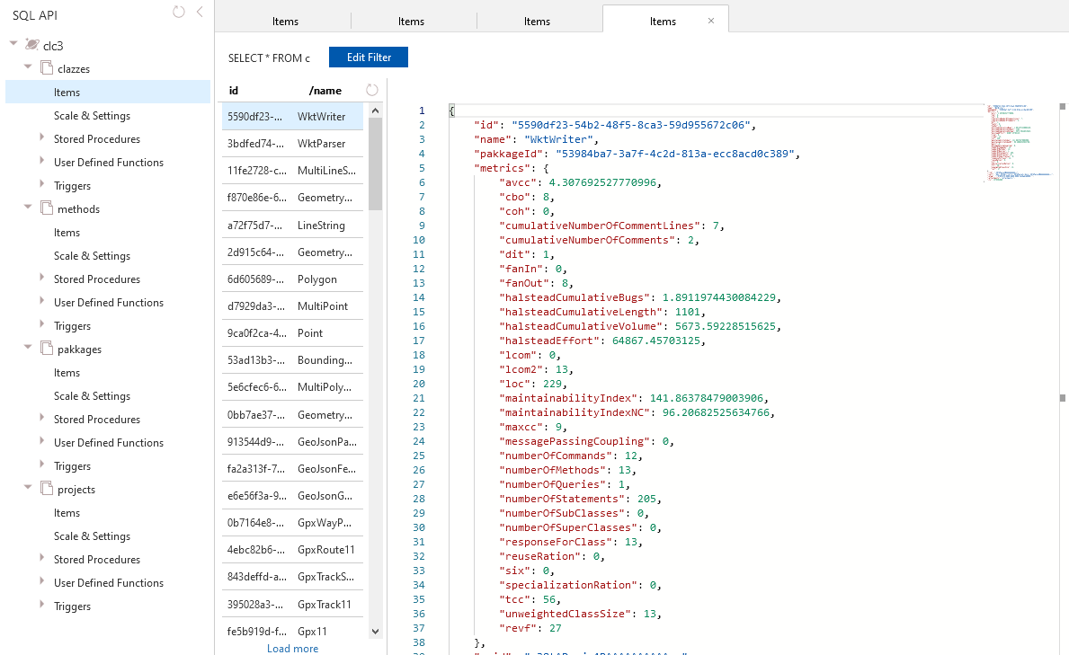
Consumer - Results

Slide 8
Course Questions
Automated Infrastructure Provisioning?
Scalability?
Fault Tolerance / Resilience?
NoSQL?
Replication?
Costs?

Slide 9
Costs
Container instances:
Memory: $4,32 (6s * 240.000 projects * 2GB * 0,0000015$/GB-s)
vCPU: $19,44 (6s * 240.000 projects * 0,0000135$/vCPU-s)
Cosmos DB instance:
- RU: $33,90 (240.000 * 635RU * 0,000000222$/RU @ 10% utilization)
Storage: $30/month (240.000 * 0.5MB * 0,25$/month)

Slide 10
Architecture Discussion
Why not use Azure Functions or Batch?
Why not use Azure (Spot) VMs?
Why not use Azure Container Registry?

