Slide 1
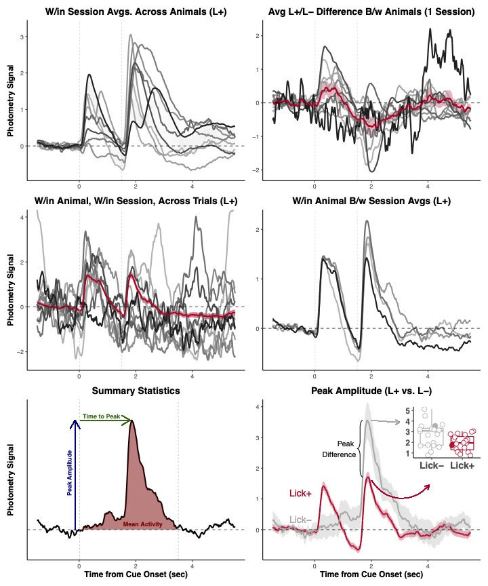

Slide 2
Example Within-Subjects Design
Example Between-Subjects Design
Animals
Sessions
Trials
Conditions (e.g., CS+/CS-)
Group (e.g., Treatment/Control)
Animals
Sessions
Trials
Example source of
between-subject
variability
Example sources of
within-subject
variability

Slide 3
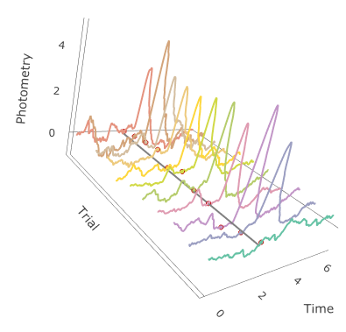

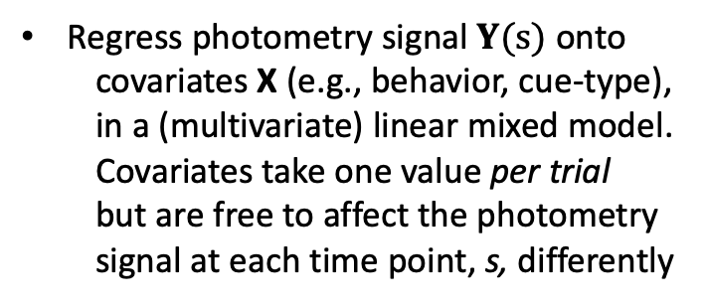

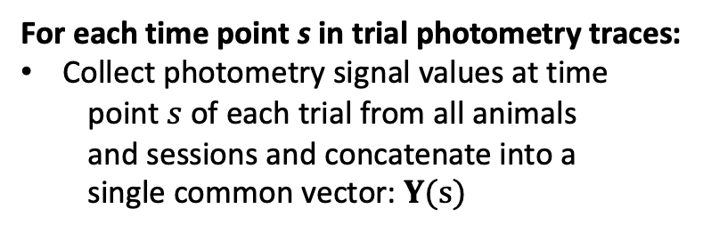
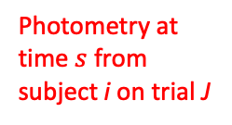
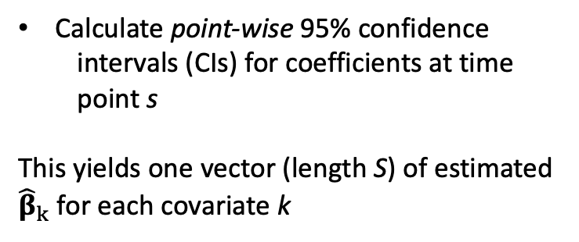

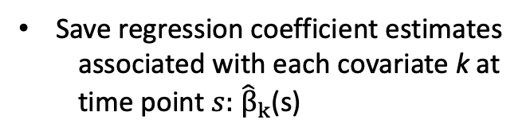
For each time point s in trial photometry traces:
Collect photometry signal values at time
point $s$ of each trial from all animals
and sessions and concatenate into a
single common vector: $Y(s)$
$$s$$
Photometry at
time $s$ from
subject i on trial J
Regress photometry signal $Y(s)$ onto
covariates X (e.g., behavior, cue-type),
in a (multivariate) linear mixed model.
Covariates take one value per trial
but are free to affect the photometry
signal at each time point, s, differently
Save regression coefficient estimates
associated with each covariate k at
time point $s:$ ${\hat{β}}_{k}$(s)
s
$$s$$
$$s$$
Calculate point-wise 95% confidence
intervals (CIs) for coefficients at time
point s
This yields one vector (length S) of estimated
${\hat{β}}_{k}$ for each covariate k
Notes:
Caption: One covariate could be treatment effect (Treatment/Control), animal specific, but takes on one value for each animal (and is the same for all sessions/trials within animal). We might also include a trial-specific effect (e.g., latency to rmethod_fig1.pdfespond), a variable that will likely take on a different value for each animal-trial pair. Coefficient interpretation at each time point, t, is the average (across animals and trials) effect of a one unit change of covariate j on the photometry signal at time point t.

Slide 4


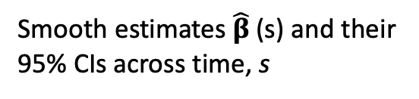
Smooth estimates ${\hat{β}}_{ }$(s) and their
95% CIs across time, s
Calculate joint 95% CIs for the entire curve.
Intervals for which joint 95% CI does not
contain 0 anywhere are jointly statistically
significant and points where pointwise CI
does not contain 0 are pointwise significant.
Notes:
Caption: One covariate could be treatment effect (Treatment/Control), animal specific, but takes on one value for each animal (and is the same for all sessions/trials within animal). We might also include a trial-specific effect (e.g., latency to respond), a variable that will likely take on a different value for each animal-trial pair. Coefficient interpretation at each time point, t, is the average (across animals and trials) effect of a one unit change of covariate j on the photometry signal at time point t.

Slide 5
Age
Notes:
Caption: One covariate could be treatment effect (Treatment/Control), animal specific, but takes on one value for each animal (and is the same for all sessions/trials within animal). We might also include a trial-specific effect (e.g., latency to respond), a variable that will likely take on a different value for each animal-trial pair. Coefficient interpretation at each time point, t, is the average (across animals and trials) effect of a one unit change of covariate j on the photometry signal at time point t.

Slide 7
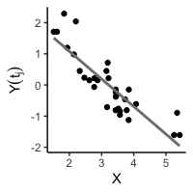


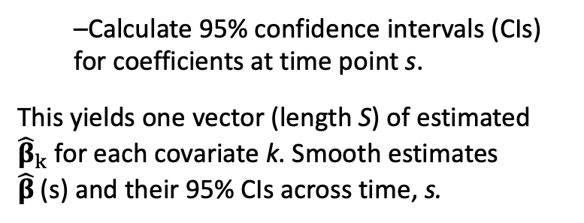
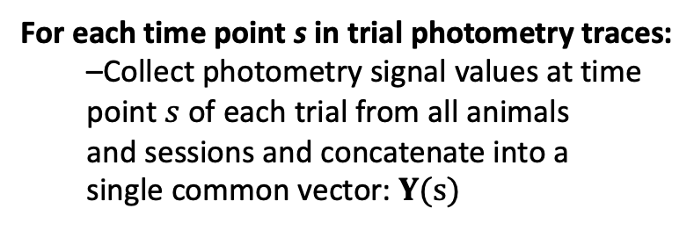
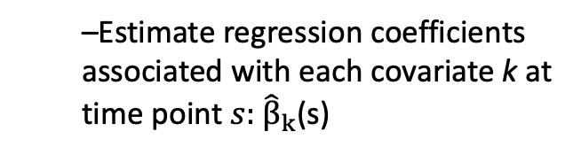
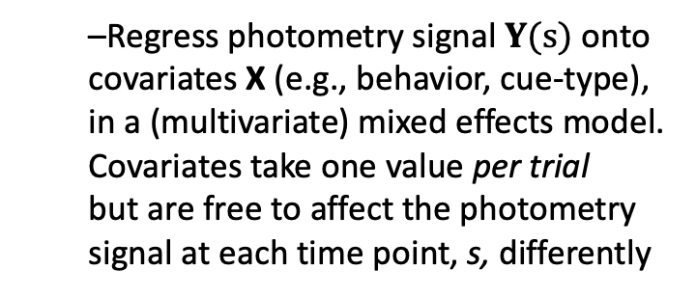
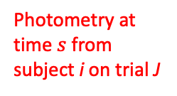
For each time point s in trial photometry traces:
–Collect photometry signal values at time
point $s$ of each trial from all animals
and sessions and concatenate into a
single common vector: $Y(s)$
$$s$$
Photometry at
time $s$ from
subject i on trial J
–Regress photometry signal $Y(s)$ onto
covariates X (e.g., behavior, cue-type),
in a (multivariate) mixed effects model.
Covariates take one value per trial
but are free to affect the photometry
signal at each time point, s, differently
–Estimate regression coefficients
associated with each covariate k at
time point $s:$ ${\hat{β}}_{k}$(s)
s
$$s$$
$$s$$
–Calculate 95% confidence intervals (CIs)
for coefficients at time point s.
This yields one vector (length S) of estimated
${\hat{β}}_{k}$ for each covariate k. Smooth estimates
${\hat{β}}_{ }$(s) and their 95% CIs across time, s.
Calculate joint 95% CIs for the entire curve.
Portions of curve for which joint 95% CIs do
not contain 0 are statistically significant.
Notes:
Caption: One covariate could be treatment effect (Treatment/Control), animal specific, but takes on one value for each animal (and is the same for all sessions/trials within animal). We might also include a trial-specific effect (e.g., latency to respond), a variable that will likely take on a different value for each animal-trial pair. Coefficient interpretation at each time point, t, is the average (across animals and trials) effect of a one unit change of covariate j on the photometry signal at time point t.

Slide 8
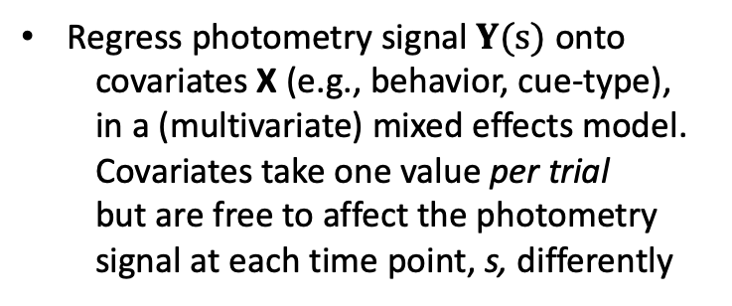
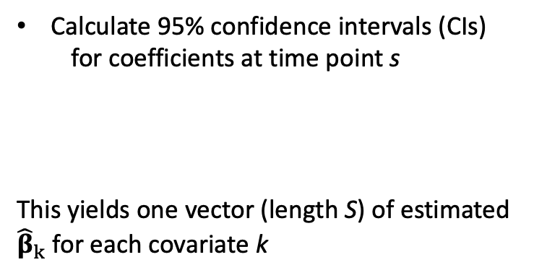
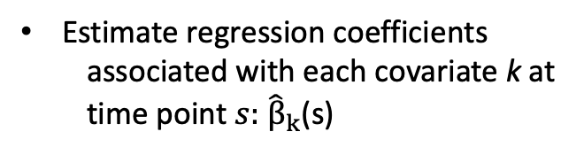
For each time point s in trial photometry traces:
Collect photometry signal values at time
point $s$ of each trial from all animals
and sessions and concatenate into a
single common vector: $Y(s)$
$$s$$
Photometry at
time $s$ from
subject i on trial J
Regress photometry signal $Y(s)$ onto
covariates X (e.g., behavior, cue-type),
in a (multivariate) mixed effects model.
Covariates take one value per trial
but are free to affect the photometry
signal at each time point, s, differently
Estimate regression coefficients
associated with each covariate k at
time point $s:$ ${\hat{β}}_{k}$(s)
s
$$s$$
$$s$$
Calculate 95% confidence intervals (CIs)
for coefficients at time point s
This yields one vector (length S) of estimated
${\hat{β}}_{k}$ for each covariate k
Notes:
Caption: One covariate could be treatment effect (Treatment/Control), animal specific, but takes on one value for each animal (and is the same for all sessions/trials within animal). We might also include a trial-specific effect (e.g., latency to rmethod_fig1.pdfespond), a variable that will likely take on a different value for each animal-trial pair. Coefficient interpretation at each time point, t, is the average (across animals and trials) effect of a one unit change of covariate j on the photometry signal at time point t.

Slide 9
Within-Subjects Design
Between-Subjects Design
Animals
Sessions
Trials
Condition (e.g., CS+/CS-)
Group (e.g., Treatment/Control)
Animals
Sessions
Trials
Example sources of within-subject variability
Example source of between-subject variability

Slide 10

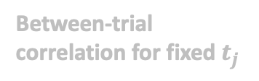


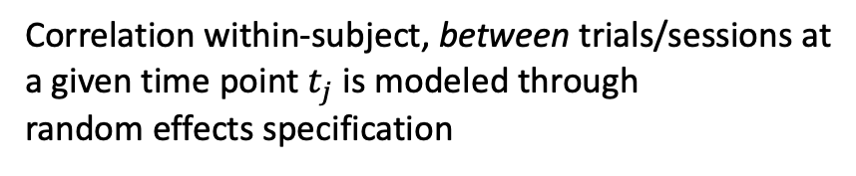
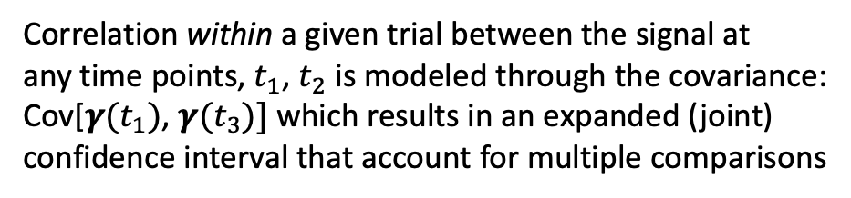
Example Within-Subjects Design
Example Between-Subjects Design
Animals
Sessions
Trials
Conditions (e.g., CS+/CS-)
Group (e.g., Treatment/Control)
Animals
Sessions
Trials
Example source of
between-subject
variability
Example sources of
within-subject
variability
Correlation within-subject, between trials/sessions at
a given time point $t_{j}$ is modeled through
random effects specification
$$t_{j}$$
$$Y_i (t_{j})=X_i(β\left(t_{j}\right)+γ_{i\left(t_{j}\right)})+ε$$
$$Y(t_{j})=X\left(β\left(t_{j}\right)+ γ\left(t_{j}\right)\right)+ε$$
Between-trial
correlation for fixed $t_{j}$
Correlation within a given trial between the signal at
any time points, $t_{1}$, $t_{2}$ is modeled through the covariance:
Cov[$γ(t_{1})$, $γ(t_{3})]$ which results in an expanded (joint)
confidence interval that account for multiple comparisons
Within-trial
correlation

Slide 11
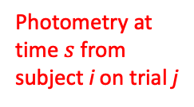
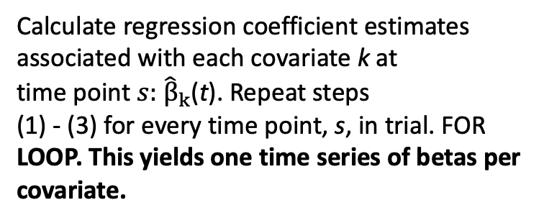
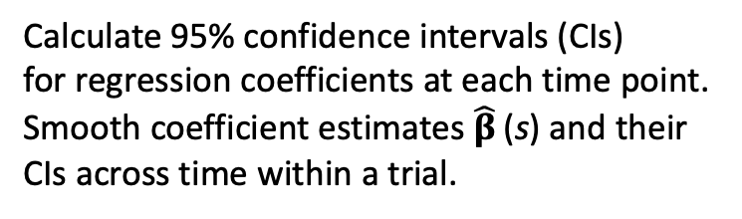
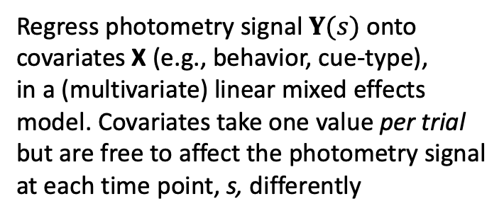

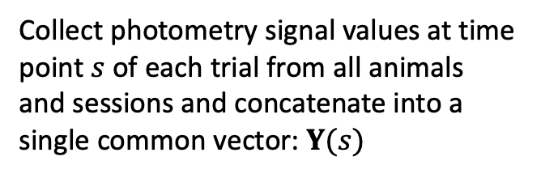
Collect photometry signal values at time
point $s$ of each trial from all animals
and sessions and concatenate into a
single common vector: $Y(s)$
$$s$$
Photometry at
time $s$ from
subject i on trial j
Regress photometry signal $Y(s)$ onto
covariates X (e.g., behavior, cue-type),
in a (multivariate) linear mixed effects
model. Covariates take one value per trial
but are free to affect the photometry signal
at each time point, s, differently
$$Y(s)=Xβ(s)+Zγ(s)+ε$$
Calculate regression coefficient estimates
associated with each covariate k at
time point $s:$ ${\hat{β}}_{k}$(t). Repeat steps
(1) - (3) for every time point, s, in trial. FOR
LOOP. This yields one time series of betas per
covariate.
s
$$s$$
$$s$$
Calculate 95% confidence intervals (CIs)
for regression coefficients at each time point.
Smooth coefficient estimates ${\hat{β}}_{ }$(s) and their
CIs across time within a trial.
Calculate joint 95% CIs for the entire curve.
Portions of curve for which joint 95% CIs do
not contain 0 are statistically significant.
Notes:
Caption: One covariate could be treatment effect (Treatment/Control), animal specific, but takes on one value for each animal (and is the same for all sessions/trials within animal). We might also include a trial-specific effect (e.g., latency to respond), a variable that will likely take on a different value for each animal-trial pair. Coefficient interpretation at each time point, t, is the average (across animals and trials) effect of a one unit change of covariate j on the photometry signal at time point t.

Slide 12
Unbalanced designs

Slide 13
Results: What do you get?

