Slide 1
SCTP DTLS Chunk
draft-ietf-tsvwg-sctp-dtls-chunk-04
Magnus Westerlund
John Preuß Mattsson
Claudio Porfiri
Michael Tüxen

Slide 2
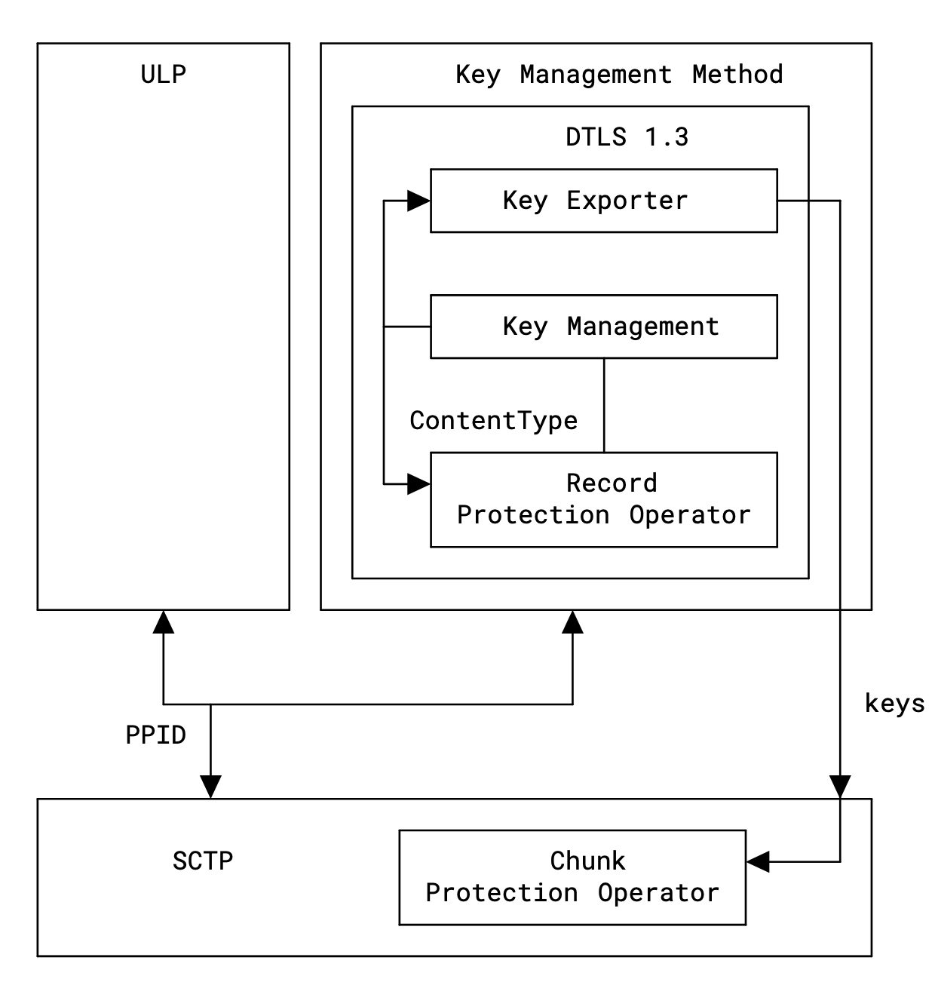
Introduction
DTLS Chunk
SCTP Chunk
Encrypted and Integrity protected encapsulation of all other SCTP Chunks
Uses DTLS 1.3 record format as is
API to set Keys and Cipher Algorithm
Negotiate DTLS Key-Management Method
Uses Clear text SCTP Parameter in INIT/INIT-ACK
Downgrade attack through input to Key-Derivation Process
One IPR Declaration: https://datatracker.ietf.org/ipr/6219/

Slide 3
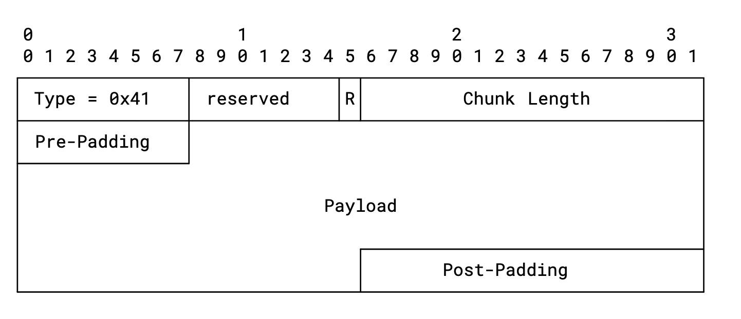
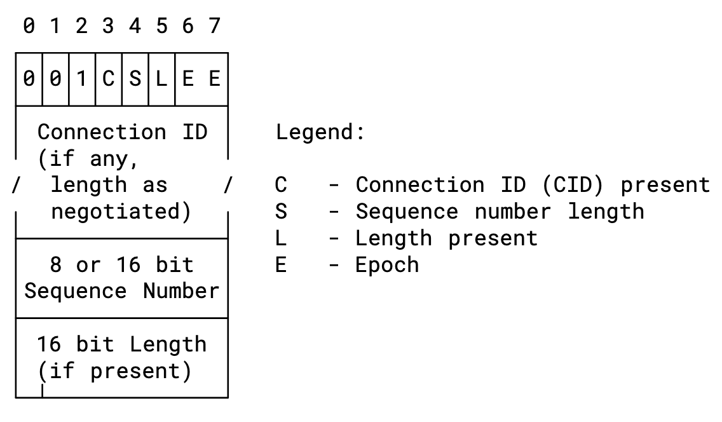
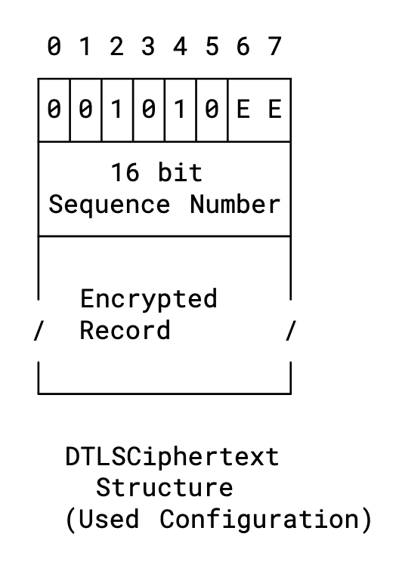
DTLS Chunk (Updated)
Standard Chunk Header
R: Indicate Restart Security Context used to protect this Packet
Removed Pre padding indicator
Payload is DTLS 1.3 Record layer per RFC 9147
DTLS 1.3 Header Usage become Fixed
E E: Epoch indicate key context (2 LSBs)
Don’t use Connection ID
Sequence Number: 16-bit mandated
No Length field
1 byte Pre-Padding always used

Slide 4
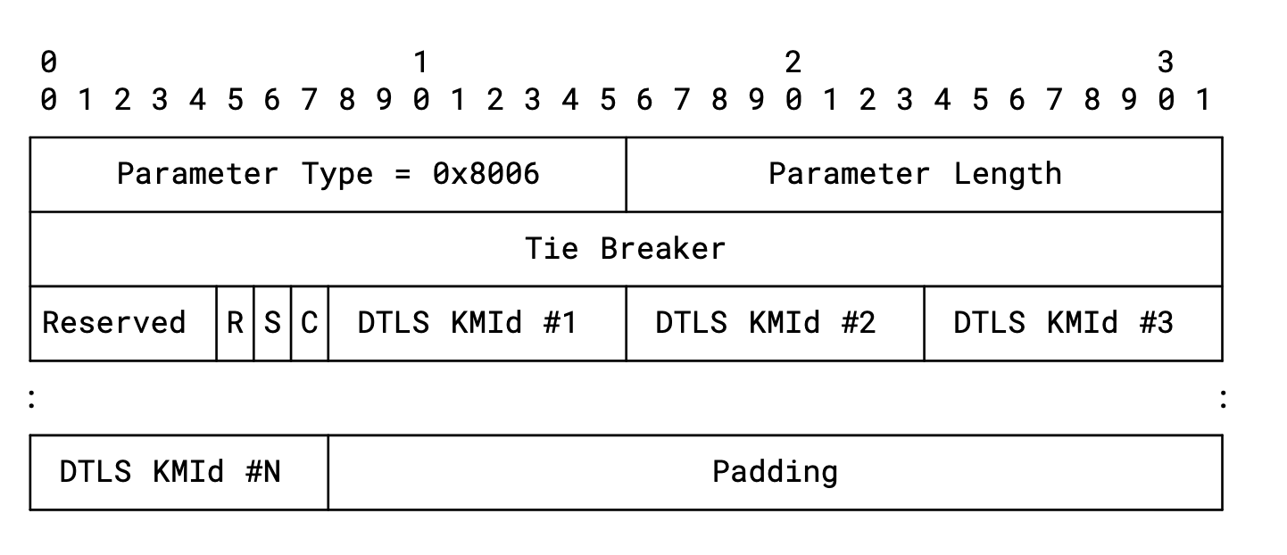
Changes
Clarified Mandatory to Implement Ciphers that unless something else specifies it one MUST/SHOULD implement:
TLS_AES_128_GCM_SHA256
TLS_AES_256_GCM_SHA384
TLS_CHACHA20_POLY1305_SHA256
Clarified error indication in the establishment procedure
API Updates to match changes and to fix implementation experience
Lots of editorial improvements
Added support for simultaneous open of SCTP Association
Indicate Supported Role
Tiebreaker to determine if both indicate both roles
Two new Error Cause Codes
Updated size of DTLS Key management ID

Slide 5
Interoperability
Interoperability achieved between Redhat’s Linux SCTP Implementation and Ericsson’s user space stack using the key-management method of draft-porfiri-tsvwg-sctp-dtls-handshake-01
Test APP
KM Method
WolfSSL
Test APP
KM Method
Ericsson SCTP
OpenSSL
WolfSSL
Raw Socket
Socket API
Ubuntu Linux Kernel
Fedora Linux Kernel
Linux SCTP

Slide 6
What has been tested
Pre-shared Key has been used for validating the DTLS 1.3 implementation in Linux Kernel SCTP versus the WolfSSL implementation
Implementation of the TLS 1.3 based Key Management of draft-porfiri-sctp-dtls-handshake to validate its specification
Simple traffic cases for PSK and TLS 1.3 Key Management
Single and multiple rekeying for TLS 1.3 KM
Association Restart for TLS 1.3 KM

Slide 7
Status
The Design Team considers DTLS Chunk specification to be stable when it comes to format and functionality
Two independent implementations
Interoperability tests has shown that specification works
Specification text has improved significantly
Have requested early allocation of error causes
The Design Team requests reviews of the DTLS Chunk
Consider to send LS to 3GPP on progress and request reviews

Slide 8
Open Issue
Do the specification need both the abstract API and the Socket API?
They are different and shows that there are multiple implementations possible
It is a lot of text

