Slide 1
FastFood Report

Slide 2
RKS vs. FastFood
Comparing FastFood and RKS implementations with each other measuring approximation error, projection time, and overall accuracy.
Replicating paper results, graphs, and reinforcing personal understanding of algorithms.
Implementations:
Scikit-Learn-extra FastFood implementation
Scikit-Learn Approximation RBF Sampler
Personal RKS implementation
Structured-Nets FastFood implementation
OnLearningTheKernel FastFood implementation

Slide 3
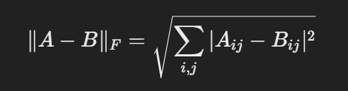
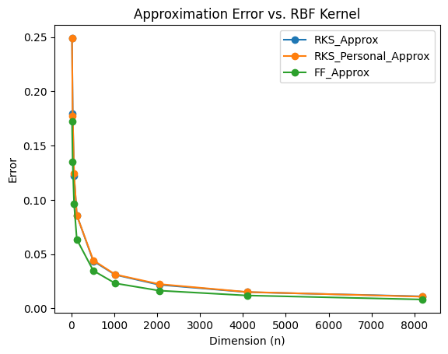
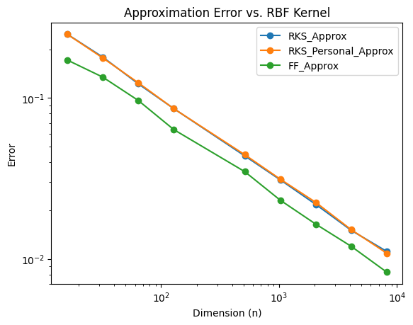
Approximation Error
4,000 random data points, dim=10, pulled from normal distribution
Fit and transformed personal RKS, RBF Sampler, and Sklearn FastFood
Expansion dimensions: [16,32,64,128,512,1024,2048,4096,8192]
Error Function:
Graph Generated:
Log Results

Slide 4
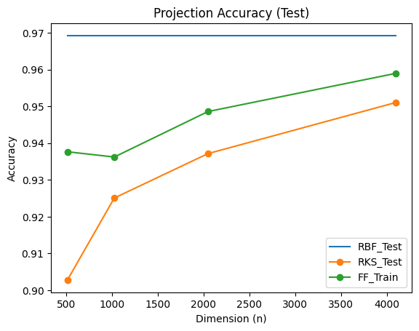
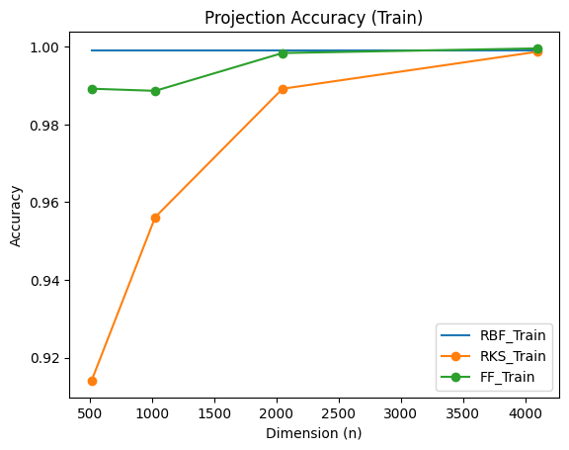
Projection Performance
MNIST and Iris data sets as training data
Applied Standard Scalar to data
Linear SVC with RBF Kernel, personal RKS, and Sklearn FastFood
Expansion Dimensions: [512, 1024, 2048, 4096], Scale = 20
Measured Accuracy between projections:

Slide 5
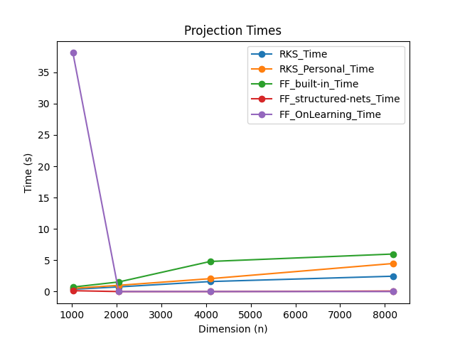
Projection Time
20,000 data points, dim = 256, from normal distribution
RBF Sampler, personal RKS, Sklearn FastFood, structure-nets FastFood, OnLearningTheKernel FastFood
Timed projection/transform operation
Graphed feature projection dimension vs. transformation time.
(OnLearningTheKernel has strange projection time for first dimension but after that matches structured-nets FastFood)

Slide 6
Outcomes So Far
Leveraging GPU with a custom-built function using cpp and cuda to perform Walsh-Hadamard transform increases compute speed significantly.
As dimension increases, approximation error for FF and RKS compared to an RBF kernel approaches 0, replicates paper findings.
As expansion dimension increases, FF and RKS are able to reach close to accuracy set by a RBF kernel in a linear SVC when training on MNIST and Iris
As RKS implementations projection time increases with dimension, FF starts faster and continues to project faster then RKS as dimensions increase.

