Slide 1
Git Intro

Slide 2
agenda
source code management (SCM) tools
git
  design
  usage
Presentation is @
  git clone git://github.com/glonnon/git-demo.git git-demo

Slide 3
Who is Greg?
SCM geek...
  SCCS,RCS, CVS, SVN,clearcase,perforce, and now git
Master Architect @ HP
  FutureSmart product line
    enterprise imaging products
  YouTube FutureSmart Video
I still use the <blink> tag...
  I don't care about IE...

Slide 4
SCM???
Attributes of a SCM tool
  ”Track” (folders and files)
    Individually or in sets (change sets)
  ”Branch”
    Parallel development
    Release, feature development, etc...
  ”Merge”
    Combine 2..N branches into 1
  ”History”
    What, when, why questions

Slide 5
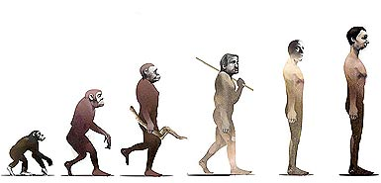
SCM Evolution
clearcase
perforce
git/hg/bazaar
SVN
CVS
RCS
tar/zip

Slide 6
SCM: the new guys
git, hg, bazaar
peer to peer architecture
atomic ”change set” based
  file changes are grouped together as a transaction
takes advantage of local machine features
  CPU and Disk

Slide 7
What is git?
One of the new guys
A directory content management system
  with SCM'ish commands (branch, merge)
Developed for Linux kernel
  Linus Torvald wrote the first version
  Ported to Windows, OSX, any posix based OS
  Many GUI clients

Slide 8
git Storage Design
git storage design is the key concept to understand
It's simple, based on...
  Cryptography theory
  Database theory
  Graph theory
  Set theory

Slide 9
git storage (repository)
Object based Storage
  (Key,Data) tuple
    key = SHA1(data)
    keys are 20 byte arrays.
    SHA1 algorithm – cypto algorithm
  Data
    blobs : file content, sym-links
    trees : directories
    commit : points to a tree, and other commits
    tag : points to a commit

Slide 10
Git: blobs
Blobs: files (text and binary), symlinks
#include <stdio.h>
int main()
{
printf(“hello world”);
return 0;
}

Slide 11
git: tree
Trees: aka directories
permission
object
hash
name
100644
blob
82354a1...
README
100755
blob
02342c5...
02342c...
a.out
040000
tree
a67ef32...
src

Slide 12
git: commit
date
Mon Dec 20 16:10:41 2010 -0700
author
joe developer <joe@gmail.com>
parent
commits
234ab23...
comment
Fixed the border defect
tree
89023a2...

Slide 13
git: tag
date
Mon Dec 20 16:10:41 2010 -0700
tagger
joe developer <joe@gmail.com>
commit
234ab23...
comment
Release 1.0

Slide 14
git: repo
mkdir T2
git mv B1 B2 T2
cp T2/B1 B3
git add B3
git commit
C3
C3
T1
T3
T2
T2
B2
B2
B1
B1
Time
C2
C2
T1
T2
B2
B2
echo “world” > B2
git add B2
git commit
B1
B1
C1
C1
T1
T1
git init
echo “hello” > B1
git add B1
git commit
git init
echo “hello” > B1
git add B1
git commit
B1
B1

Slide 15
git: repo
C3
C3
T1
T3
C2
C2
T1
T2
B2
C1
C1
T1
T1
B1
B1

Slide 16
git : DAG
Wikipedia...
  In mathematics and computer science, a directed acyclic graph (commonly abbreviated to DAG), is a directed graph with no directed cycles. That is, it is formed by a collection of vertices and directed edges, each edge connecting one vertex to another, such that there is no way to start at some vertex v and follow a sequence of edges that eventually loops back to v again.”

Slide 17
git : DAG
master
HEAD
git references
  branches (master, work_br)
  tags : immutable (V1.0)
  commit hash
C1
C8
work_br
C1
C6
C7
V1.0
C1
C3
C5
C1
C2
C4
C1
C1

Slide 18
git: DAG
git init
echo “hello” > B1
git add B1
git commit
master
HEAD
C1
C1

Slide 19
git: DAG
git branch work_br
master
HEAD
work_br
C1
C1

Slide 20
git: DAG
echo “world” >> B2
git add B2
git commit
master
HEAD
C1
C2
work_br
C1
C1

Slide 21
git: DAG
echo “from” >> B1
git add B1
git commit
master
HEAD
C1
C3
C1
C2
work_br
C1
C1

Slide 22
git: DAG
git checkout work_br
echo “A” > B2
git add B2
git commit
master
C1
C3
HEAD
work_br
C1
C2
C4
C1
C1

Slide 23
git: DAG
echo “B” >> B2
git add B2
git commit
master
HEAD
work_br
C1
C3
C5
C1
C2
C4
C1
C1

Slide 24
git: DAG
HEAD
git checkout master
git merge work_br
master
C1
C6
work_br
C1
C3
C5
C1
C2
C4
C1
C1

Slide 25
git: DAG
master
HEAD
work_br
C1
C6
C7
git checkout work_br
echo “C” >> B2
git add B2
git commit
C1
C3
C5
C1
C2
C4
C1
C1

Slide 26
git: DAG
master
HEAD
C1
C8
work_br
C1
C6
C7
git checkout master
echo “boise” >> B1
git add B1
git commit
C1
C3
C5
C1
C2
C4
C1
C1

Slide 27
git repository
Each git repo contains complete history
  All git objects are stored in the repo
  Peer to Peer Design
.git directory
  objects
  references
    branches, tags : files that contain commit hash
    HEAD : current checkout hash

Slide 28
git clone
http:/github.com/<user>/<repo>
origin
local
master
origin/master
origin/work_br
work_br
master
HEAD
C1
C3
C5
C1
C3
C5
C1
C2
C4
C1
C2
C4
C1
C1
git clone http://github.com/<user>/<repo> local
git clone copies the remote objects/references to a
new repository
The remote repo is nicknamed origin, a remote tracking branch
is created to track origin/master

Slide 29
git fetch
local
origin/work_br
origin/master
work_br
master
HEAD
git fetch origin
C3
C5
origin
C2
C4
C1
master
work_br
C6
C3
C5
local
C2
C4
C1
origin/master
work_br
C6
origin/work_br
master
C3
C5
Fetch moves C6 commit objects to
the local repo, and updates the tracking branch
origin/master
HEAD
C2
C4
C1

Slide 30
git push
origin
local
master
work_br
C6
git push origin
C3
C5
origin/master
work_br
C2
C4
C6
C7
origin/work_br
C1
master
C3
C5
HEAD
C2
C4
origin
C1
work_br
master
Push local to origin.
The local work_br is a proper superset of
the origin work_br branch, and the origin is
updated.
The local master push fails, it is NOT a
not a proper superset of the origin master branch
C6
C7
C3
C5
C2
C4
C1

Slide 31
git pull
git pull
  git fetch + git merge

Slide 32
git: merge algorithms
git merge
  Merges 1..N branches into current branch (HEAD)
git merge --squash
  ”git merge” with no parent tracking (”merge tracking”)
git cherry-pick
  Calculates the file differences of the commit and applies them to current branch (HEAD)
git rebase
  Moves a related set of commits to a new ”base” reference.

Slide 33
git merge
master
HEAD
work_br
master
HEAD
C1
C3
C5
C1
C6
work_br
C1
C2
C4
C1
C3
C5
git merge work_br
C1
C1
C1
C2
C4
Merges 1 or more branch into the current branch.
C1
C1

Slide 34
git merge --squash
master
HEAD
work_br
master
HEAD
C1
C3
C5
C1
C6
work_br
C1
git merge
--squash work_br
C2
C4
C1
C3
C5
C1
C1
C1
C2
C4
Merges a branch, but does not track the merge.
Useful in large repositories with a lot of activity.
C1
C1

Slide 35
git cherry-pick
HEAD
master
C5'
master
HEAD
work_br
work_br
C1
C3
C5
C1
C3
C5
C1
git cherry-pick C5
C2
C4
C1
C2
C4
C1
C1
C1
C1
Calculates and applies the file changes of a commit.
Useful for moving changes between a release branch and main development

Slide 36
git rebase
work_br
HEAD
C5'
master
HEAD
work_br
C1
C3
C5
C4'
master
C1
C2
C4
C1
C3
C5
git rebase master
C1
C1
C1
C2
C4
Moves a “family” of commits to a new “base”
Useful for developers to “refresh” their branch.
C1
C1

Slide 37
git rebase: a closer look
work_br
HEAD
C5'
d2
Step 2: Apply d2 to C4'
C4'
d1
Step 1: Apply d1 to C3
master
C1
C3
C5
d2
C1
C2
C4
d1
C1
C1

Slide 38
git commands poreclain
Repository
  git init, git clone, git fetch, git pull, git push, git gc, git config
Working tree
  git checkout, git reset, git clean, git add, git commit
Branch
  git branch, git tag, git merge, git rebase, git cherry-pick, git revert, git mergetool
History
  git log, git diff, git difftool, git reflog

Slide 39
git commands plumbing
Git low level commands
  Easy to parse output
  Stable API
  Use them for scripting git
  100+ commands...

Slide 40
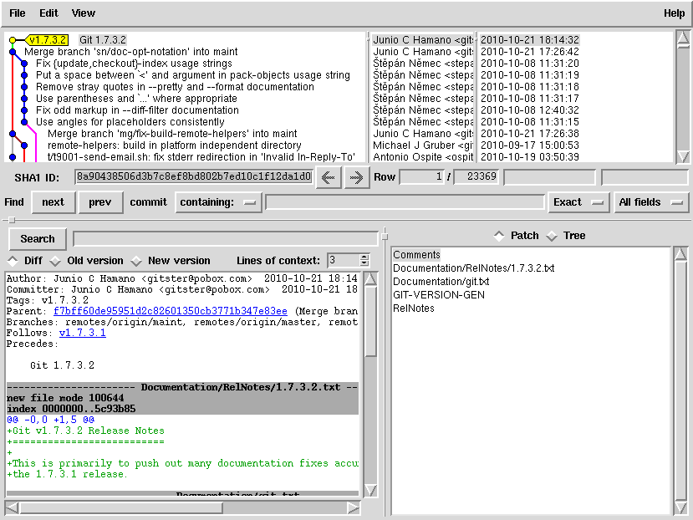
gitk

Slide 41
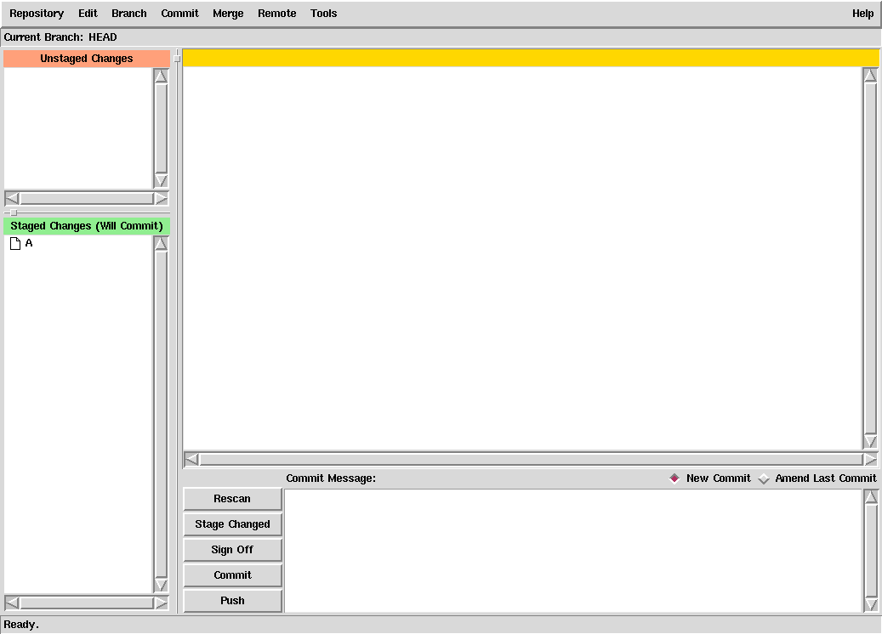
git gui

Slide 42
git hints
Commit
  When something compiles, passes a test, before refactoring, before going to lunch/home/sleep, or... when you have nothing else to do...
  Use commits to seperate out features, debug, temporary work, etc...
  git != svn, don't treat it like svn...
  Use git reflog to find ”lost commits”
Create a sandbox (git init) and play...

Slide 43
git: usages
SCM
Web Deployment (ruby on rails)
Wiki backend
Backup system
???

Slide 44
git : Web Resources
Use google...
  http://git-scm.com/
Free Pro Git book
  http://progit.org/book/
Free Webcasts
  http://gitcasts.com/
  http://oreillynet.com/pub/e/1394
Free Open Source Hosting (cheap commerical hosting)
  https://github.com/
Gitolite : git server
  supports complex security models
  https://github.com/sitaramc/gitolite
Windows executable
  Git-extensions or msysgit

