Slide 1
CS4100:
Formal Languages and Compilers
Gordon Stewart
Assistant Professor, School of EECS
Office: Stocker 355
gstewart@ohio.edu

Slide 2
Administrative Stuff
http://ace.cs.ohio.edu/~gstewart/courses/4100-17
Logistics: Lecture T/Th 1:30-2:50pm
ARC 315
Professor: Gordon Stewart
355 Stocker
gstewart@ohio.edu
OH: Tuesdays, Thursdays 11am-12pm
TA: Alex Bagnall (ab667712@ohio.edu)

Slide 3
What’s a Formal Language?
Informally:
A set of strings of symbols with precise meaning, designed to be understood, or interpreted, by some sort of computing device (a Turing machine, an Intel X86 chip, a compiler, a bytecode interpreter, etc.)
Examples:
Commonly used programming languages: C, C++, Perl, Haskell, Ocaml, Fortran, Java, Rust, Python, Lisp, Prolog, Ada, etc.
Turing machine descriptions (to be interpreted by a universal Turing machine)
x86 assembly, MIPS assembly, etc.

Slide 4
What’s a Compiler?
A piece of software that translates programs in a source (formal) language to functionally equivalent programs in a target (formal) language
Source languages: C, C++, Python, Java, JavaScript, Haskell, OCaml, VHDL, Verilog, …
Target languages: x86, ARM, PPC, LLVM, C, …
Compilers also:
Optimize your programs
Find errors early (syntax errors, type errors, etc.) before they manifest at runtime
Save you time and make you a better programmer!

Slide 5
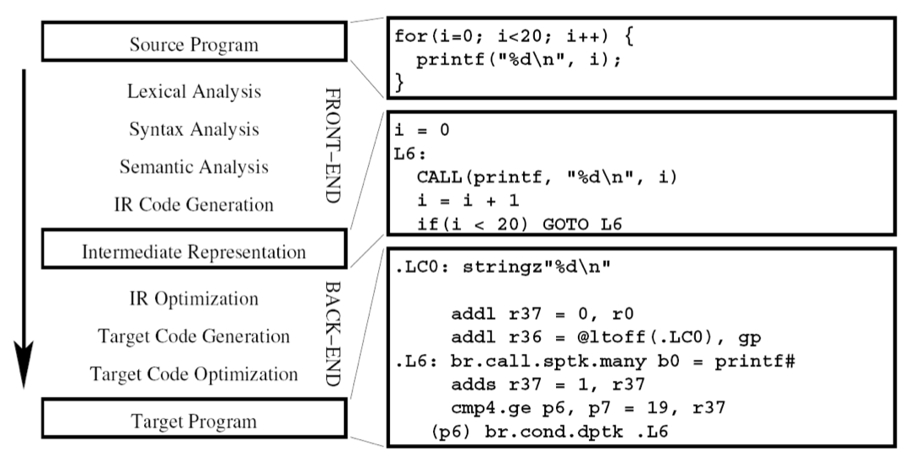
What’s a Compiler?

Slide 6
Why Learn About Compilers?
Compilers are everywhere!
The usual places:
C, C++ -> Assembly (gcc, icc, clang, …)
Java, Python -> Bytecode (javac, python)
Rust, Haskell -> LLVM (rustc, ghc, …)
But also
Assembly -> machine code (assembler/linker)
Machine instructions -> microcode (e.g., x86)
SystemVerilog (HDL) -> FPGA layout
Bluespec (higher-level HDL) -> SystemVerilog
Publishing: LaTeX -> PDF

Slide 7
Why Learn About Compilers?
Almost all code is
compiled
Linux
C = 2,558,100 lines
Assembly = 12,164 lines
Almost 99.5% C!
1 / (14*14) * 100 = ~0.5%

Slide 8
Why Learn About Compilers?
Compiler can teach us about:
Programming Languages
Why are some PL features easy to implement on current hardware? Why are some difficult?
How do we develop performant implementations? (Time, energy, memory usage, …)
Take advantage of parallelism, new hardware, GPUs?
Computer Architecture
How do instruction set architectures (ISAs) affect compilation? What’s the right level of abstraction? CISC vs. RISC (an ongoing debate…cf. RISC-V)?

Slide 9
Why Learn About Compilers?
Programming Languages: Can we compile existing languages (e.g. C) to take advantage of massively parallel hardware like GPUs?
Which are the right abstractions to expose to the programmer? CUDA? OpenCL? Something new?
Is it possible to automatically parallelize sequential programs to parallel hardware?
ATI Radeon (~80 stream processing units)

Slide 10
Why Learn About Compilers?
Compilers can also teach us about abstractions and architecture design: Which abstractions can/should ISAs expose to the language implementer?
ISAs aren’t always in hardware!

Slide 11
Why Learn About Compilers?
target datalayout = "e-m:e-i64:64-f80:128-n8:16:32:64-S128"
target triple = "x86_64-apple-macosx10.10.0"
declare i32 @putchar(i32)
define i32 @show_density(i32 %i) {
%_t3 = icmp slt i32 %i, 2
br i1 %_t3, label %true6, label %false8
true6:
%_t4 = call i32 @putchar(i32 42)
br label %true_end7
true_end7:
br label %end10
false8:
%_t14 = icmp slt i32 %i, 4
br i1 %_t14, label %true17, label %false19
true17:
%_t15 = call i32 @putchar(i32 43)
br label %true_end18
true_end18:
…
}

Slide 12
Why Learn About Compilers?
…
define i32 @mandelbrot() {
%x = alloca double
store double 0.000000, double* %x
%y = alloca double
store double 0.000000, double* %y
br label %branch130
branch130:
%_t133 = load double* %y
%_t128 = fcmp olt double %_t133, 50.000000
br i1 %_t128, label %body131, label %done132
body131:
store double 0.000000, double* %x
…
}
define i32 @main() {
%_t1 = call i32 @mandelbrot()
%_t0 = call i32 @show_newline()
ret i32 %_t0
}

Slide 13
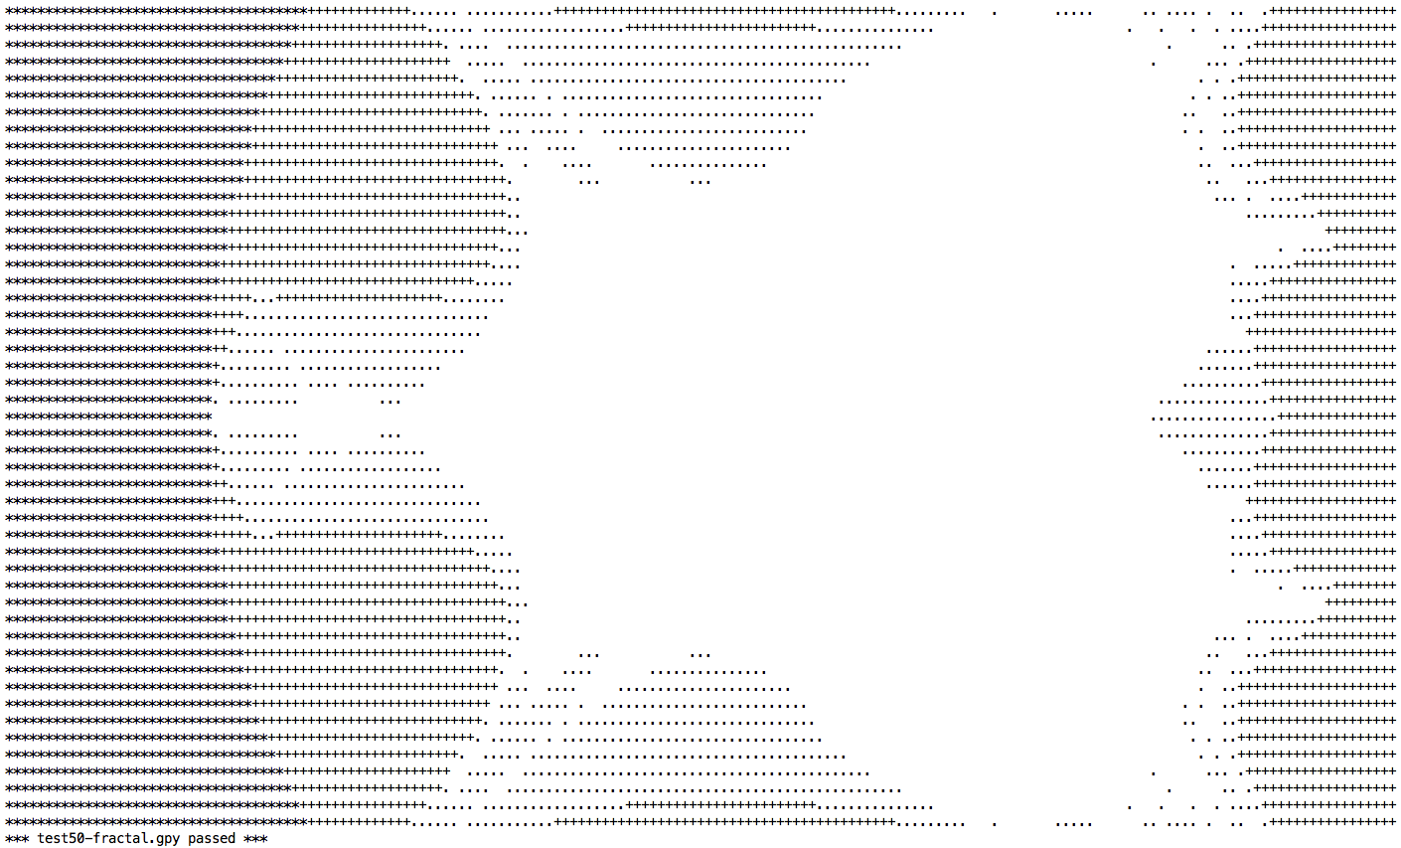

Slide 14
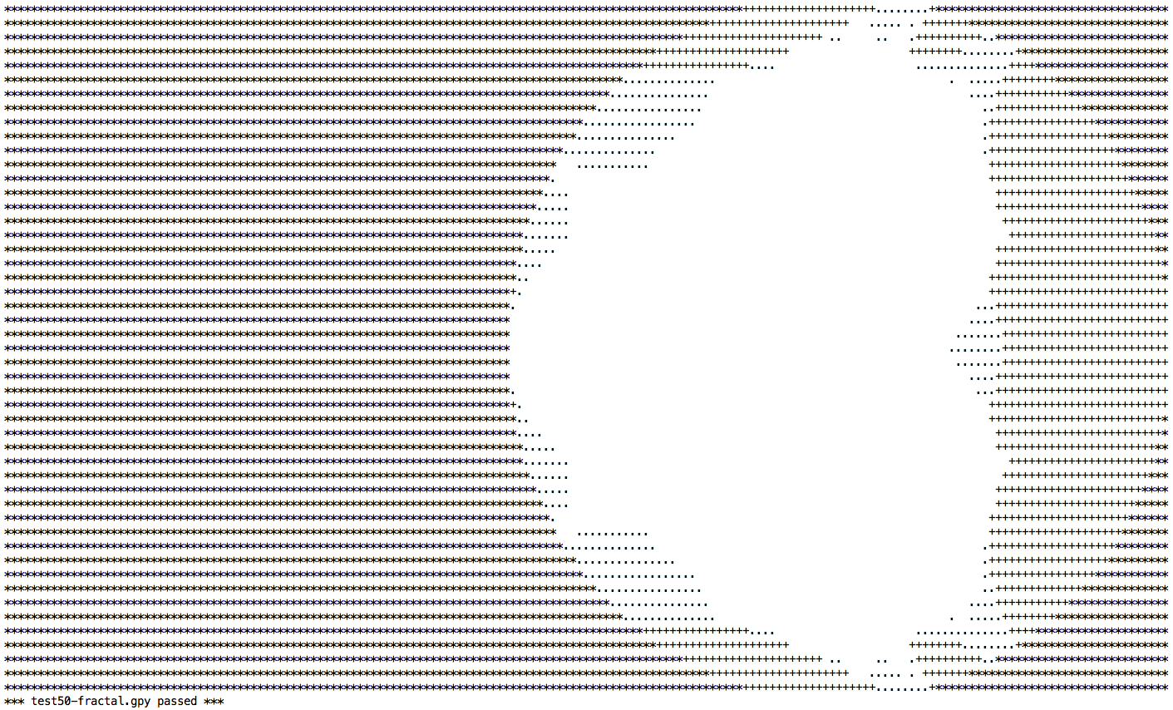

Slide 15

Mandelbrot Sets
f_{c}(z) = z² + c
Mandelbrot = { c | $∀$n. $|iter n fc 0|$ $≤2$ }
The set of complex c for which f_{c}(0) does not “escape” to infinity

Slide 16
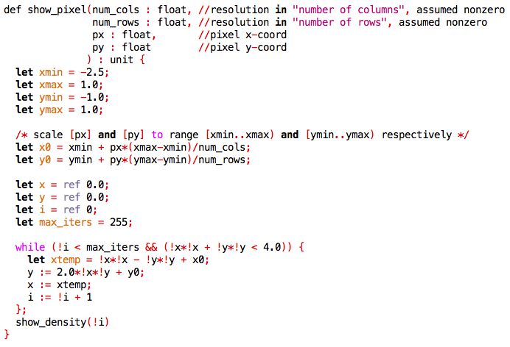
Mandelbrot in grumpy
Draw (px,py) with density proportional to #iters before “escape”

Slide 17
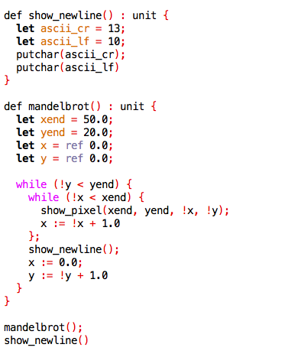
Mandelbrot in grumpy
Dimensions of “canvas”

Slide 18


Slide 19
Textbook
Modern Compiler Implementation in ML
Andrew W. Appel
Available free online for OU students
Supplementary Texts:
Real World OCaml
the OCaml language manual
the OCaml Batteries Included documentation
the LLVM reference manual
Types and Programming Languages (TAPL)

Slide 20
Website & Syllabus
http://ace.cs.ohio.edu/~gstewart/courses/4100-17

Slide 21
Grading
 | %Grade
Course Project Assignments | 40
Lecture Attendance and Participation | 5
Midterm Exam | 15
Final Exam | 25
Quizzes | 10
+5
?

Slide 22
Course Project
Implement your own compiler for a small imperative language, Grumpy , over the course of about 12 weeks.
FRONTEND
Weeks 3-5:
A2: Lexical Analysis (Lexing)
A3: Syntax Analysis (Parsing)
Building on: REs, DFAs, NFAs, context-free grammars, recursive descent parsing, predictive parsing, …
Weeks 6-9:
A4: Typechecking
Building on: symbol tables, abstract syntax, type systems, subtyping, …

Slide 23
Course Project
Implement your own compiler for a small imperative language, Grumpy , over the course of about 12 weeks.
BACKEND
Weeks 10-12:
A5: Static Single Assignment (SSA)
Stack layout and activation records, control-flow graphs, dominator computation, optimizations
Weeks 13-15:
A6: Code generation (targeting LLVM)
LLVM assembly and the LLVM compiler toolkit
Other stuff: runtimes, garbage collection, instruction selection, register allocation

Slide 24
Late Homework Policy
Up to 24 hours late, no deduction
But no more than 2 homeworks late per student over the course of the semester
> 24 hours late = 0%
3rd late homework = 0%
Why only 24 hours? Why not 1 week?
Late homeworks make it much more difficult to get graded assignments back to you in a timely fashion
Typically, we’ll be grading all the assignments in batch mode, using an automated testsuite

Slide 25
Participation
PROS
+ Showing up to lecture on time, being engaged and
asking questions
+ Coming to office hours
Try to come at least once; I want to meet all of you!
+ Seeking help, if you need it, during lab hours
CONS
- Missing lecture
- Disrupting class (showing up late, sleeping)
- Being rude to the TA (i.e., Alex)

Slide 26
Exams
The usual sort of thing:
Midterm (~15%)
Projected date: Thursday 2/25 (subject to change)
The week right before Spring Break
Final Exam (~25%)
Projected date: Sometime during finals period
Fair game on both exams:
Anything we cover in class
Anything in required readings
Questions related to course assignments

Slide 27
Quizzes
Every Tuesday, we’ll have a quiz with probability 1/3
Typically one question; graded leniently
On weeks when no assignment is due, we’ll also have offline quizzes (in Blackboard)
?
?
?
2
3
1

Slide 28
Quizzes
Every Tuesday, we’ll have a quiz with probability 1/3
Typically one question; graded leniently
Quiz!
Quiz!
Quiz!
?
?
?
?
?
2
3
1

Slide 29
Quiz 0
On the FRONT of your note card, please write:
Your name
Your year (e.g., junior, senior)
Which programming languages are you most comfortable with?
Have you used a functional PL before?
On the BACK:
It’s possible to convert any NFA to an equivalent DFA (True, False, or Wha?!?)

Slide 31
Assignment 0
Due date:
Tuesday 1/17, before the beginning of class (1:30pm)
Goals:
To get you set up with a working environment for the remainder of the course
To get you started with programming in OCaml

Slide 32
Lab Hours
Monday, 1/16
Stocker 307
4-5pm
Goals:
To help you get set up with a working environment for the remainder of the course
Both Alex and I will be there, at least for lab hours 0

Slide 33
Piazza
This year’s Piazza page:
https://piazza.com/ohio/spring2017/cs41005100/home
2016:
https://piazza.com/ohio/spring2016/cs41005100/home

Slide 35
OCaml
Functional programming language in development since c. 1985
Higher-order functions
twice f x = f (f x)
twice : (int -> int) -> int -> int
Algebraic data types & pattern-matching
type intlist = nil
| cons of int * intlist;;
let l = cons (3, nil) in
match l with
| nil -> (*do something*)
| cons (hd, tl) -> (*do something else*)

Slide 36
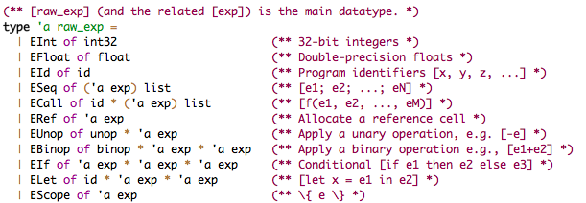
Why OCaml?
Algebraic data types and pattern matching make it super easy to define the abstract syntax of programming languages
Higher-order functions: generic transformations over abstract syntax
Strong module system: clean interfaces among components

