Slide 1
Regular Expressions
CS 4100
Gordon Stewart
Ohio University

Slide 2
Quizzes
Every Tuesday, we’ll have a quiz with probability 1/3
Typically one question; graded leniently
?
?
?
1
2
3

Slide 3
Quizzes
Every Tuesday, we’ll have a quiz with probability 1/3
Quiz!
?
?
?
?
?
1
2
3

Slide 4
Quiz 2
On a sheet of paper (or half a sheet borrowed from a friend), write
Your name
The answer to the following question:
What is the result of
the OCaml expression
let b=42 in let b=43 in b-1
?

Slide 5
REVIEW: 3000

Slide 6
Sets
A set is a collection of elements (of some type T) that supports the following operations:
empty : set (* the empty set *)
contains (S : set) (t : T) : bool (* does set S contain t? *)
insert (S : set) (t : T) : set (* add t to set S *)
union (S T : set) : set (* all elements in either S or T *)
intersect (S T : set) : set (* all elements in S and T *)

Slide 7
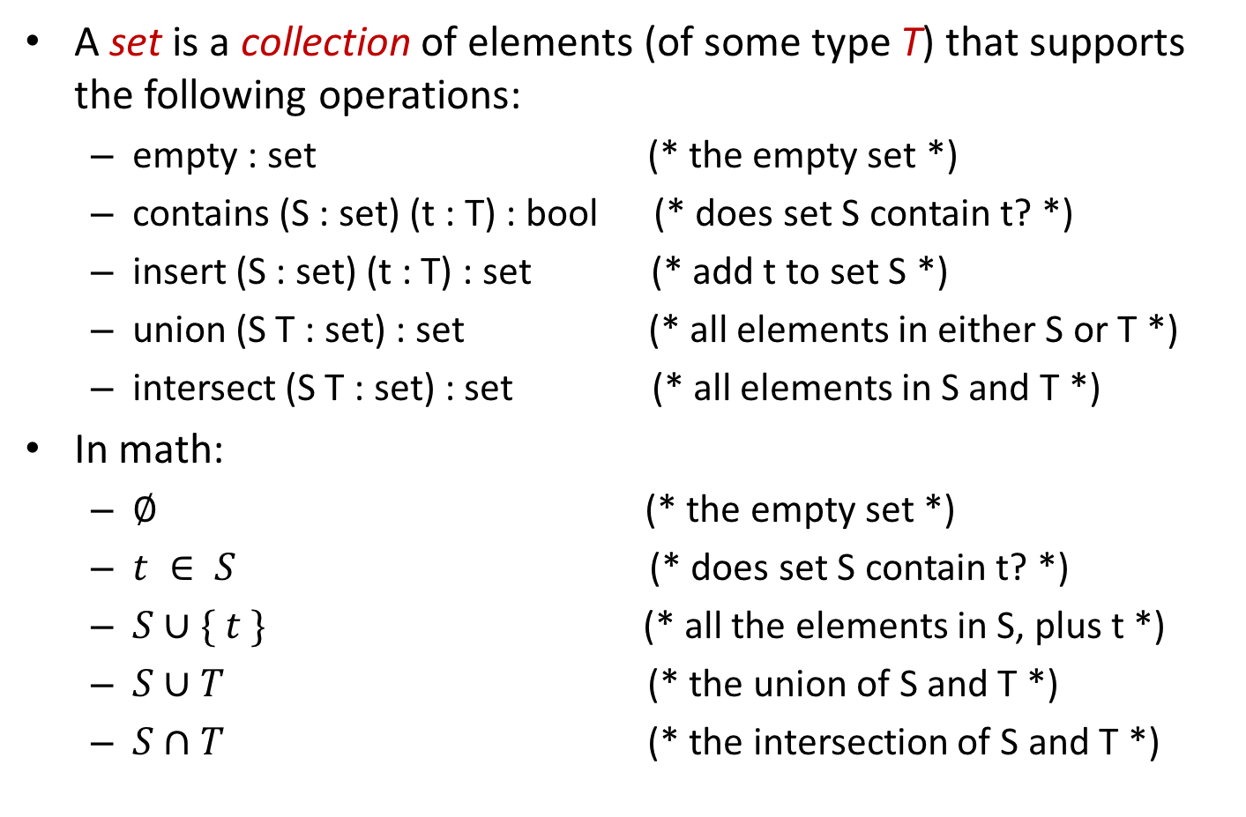
Sets
A set is a collection of elements (of some type T) that supports the following operations:
empty : set (* the empty set *)
contains (S : set) (t : T) : bool (* does set S contain t? *)
insert (S : set) (t : T) : set (* add t to set S *)
union (S T : set) : set (* all elements in either S or T *)
intersect (S T : set) : set (* all elements in S and T *)
In math:
$∅$ (* the empty set *)
$t ∈ S$(* does set S contain t? *)
$S∪\{ t \}$ (* all the elements in S, plus t *)
$S∪T$ (* the union of S and T *)
$S∩T$ (* the intersection of S and T *)

Slide 8

Derived Operations on Sets
Set Inclusion
S is a subset of T: $S⊆T≔∀s. s∈S→s∈T$
S is a superset of T: $S⊇T≔∀t. t∈T→t∈S$

Slide 9

Derived Operations on Sets
Set Inclusion
S is a subset of T: $S⊆T≔∀s. s∈S→s∈T$
S is a superset of T: $S⊇T≔∀t. t∈T→t∈S$
Set Equality
S equals T $S=T≔S⊆T ∧ T⊆S$

Slide 10
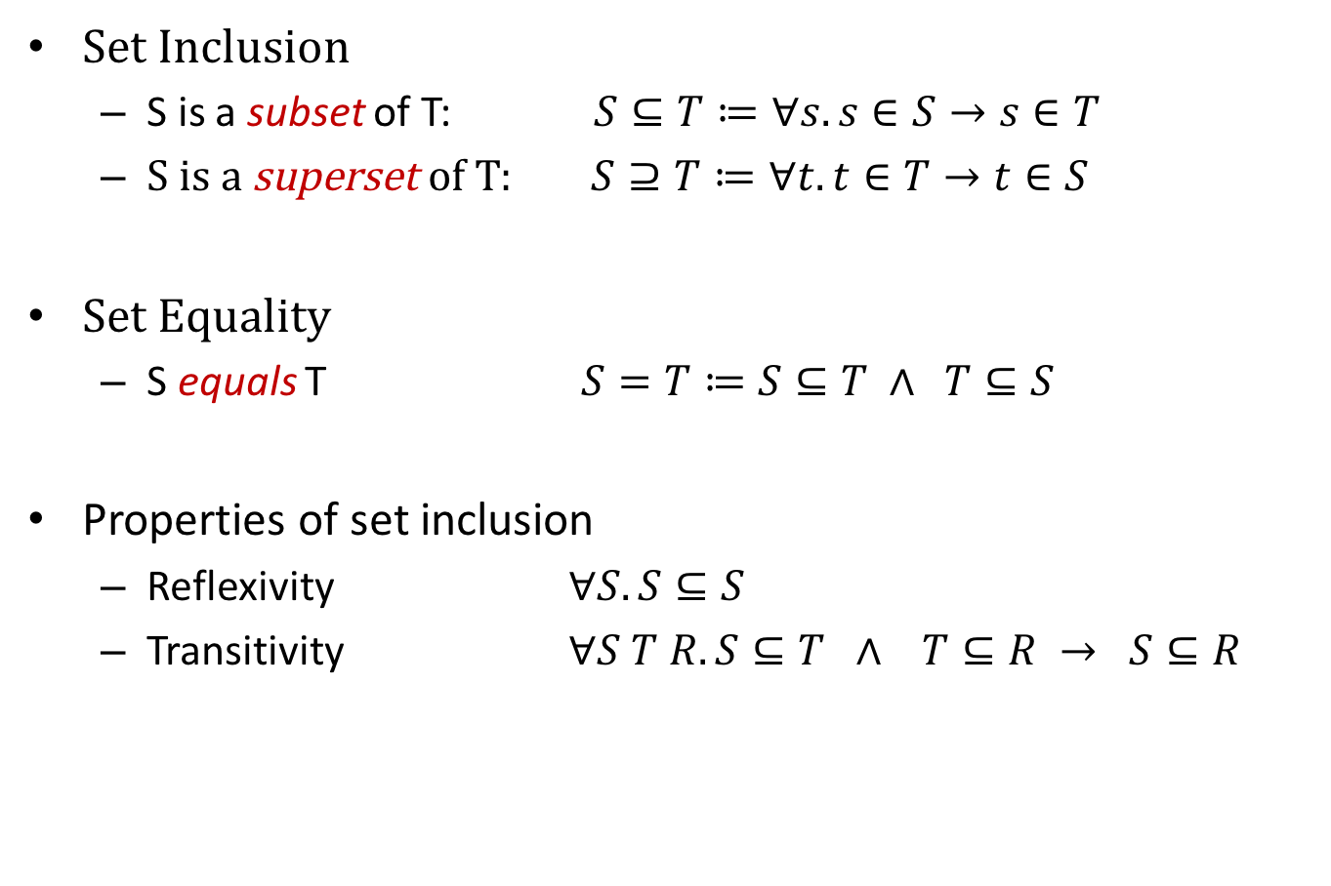
Derived Operations on Sets
Set Inclusion
S is a subset of T: $S⊆T≔∀s. s∈S→s∈T$
S is a superset of T: $S⊇T≔∀t. t∈T→t∈S$
Set Equality
S equals T $S=T≔S⊆T ∧ T⊆S$
Properties of set inclusion
Reflexivity $∀S. S⊆S$
Transitivity $∀S T R. S⊆T ∧ T⊆R → S⊆R$

Slide 11
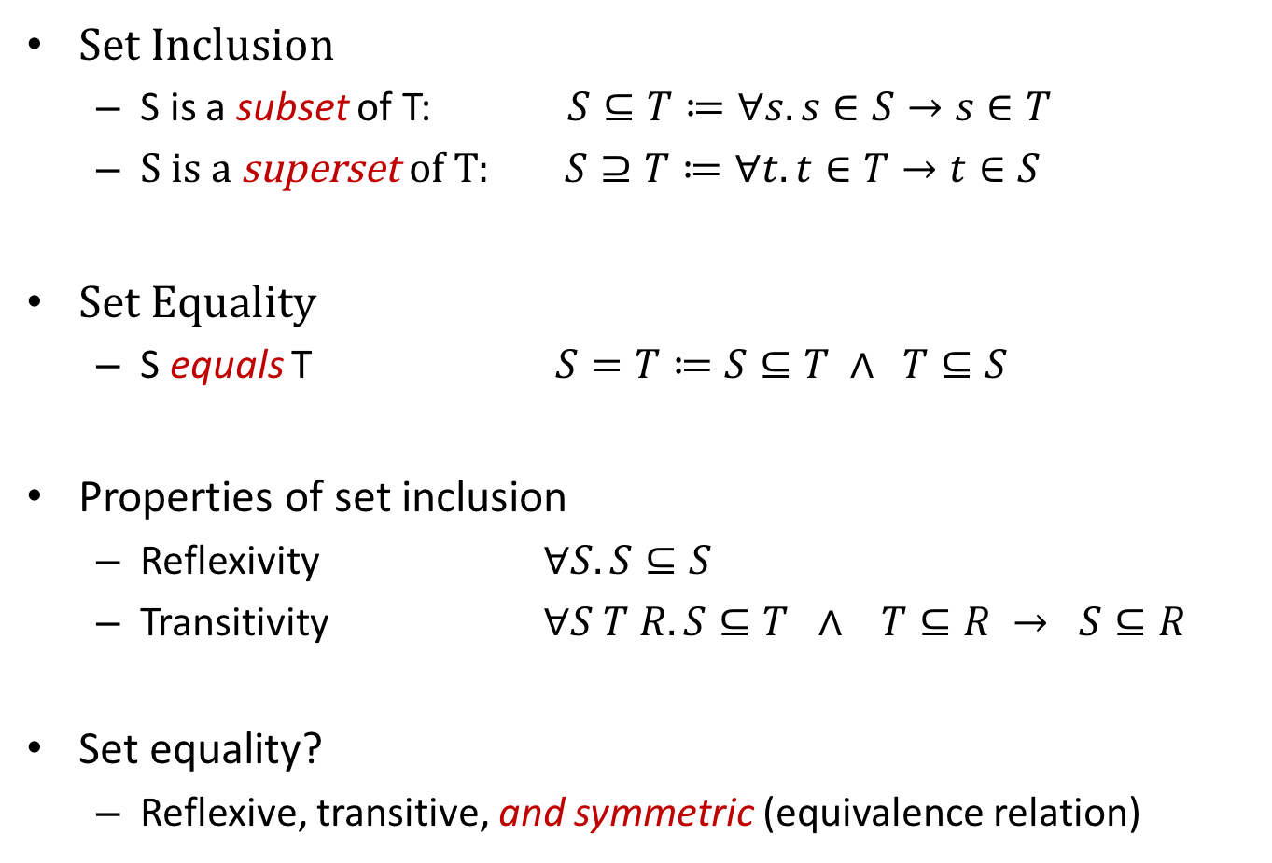
Derived Operations on Sets
Set Inclusion
S is a subset of T: $S⊆T≔∀s. s∈S→s∈T$
S is a superset of T: $S⊇T≔∀t. t∈T→t∈S$
Set Equality
S equals T $S=T≔S⊆T ∧ T⊆S$
Properties of set inclusion
Reflexivity $∀S. S⊆S$
Transitivity $∀S T R. S⊆T ∧ T⊆R → S⊆R$
Set equality?
Reflexive, transitive, and symmetric (equivalence relation)

Slide 12

A Couple Questions…
$$\left\{a\right\}∪\left\{b\right\}⊆\left\{a\right\}?$$

Slide 13

A Couple Questions…
$$\left\{a\right\}∪\left\{b\right\}⊆\left\{a\right\}?$$
No...Why?

Slide 14
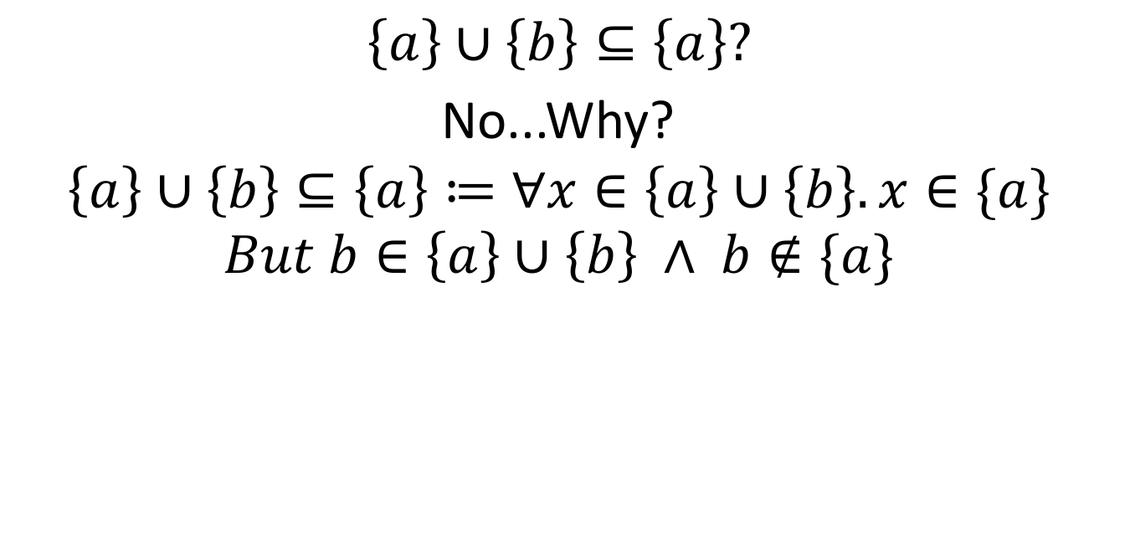
A Couple Questions…
$$\left\{a\right\}∪\left\{b\right\}⊆\left\{a\right\}?$$
No...Why?
$$\left\{a\right\}∪\left\{b\right\}⊆\left\{a\right\}≔∀x∈\left\{a\right\}∪\left\{b\right\}. x∈\{a\}$$
$$But b∈\left\{a\right\}∪\left\{b\right\} ∧ b∉\{a\}$$

Slide 15
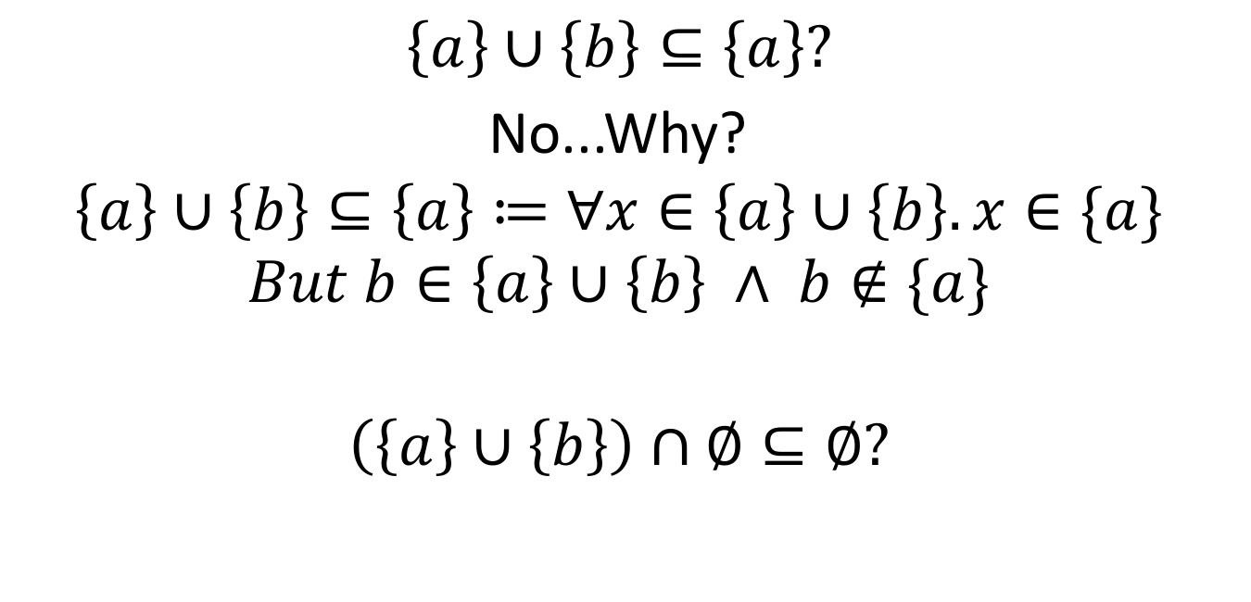
A Couple Questions…
$$\left\{a\right\}∪\left\{b\right\}⊆\left\{a\right\}?$$
No...Why?
$$\left\{a\right\}∪\left\{b\right\}⊆\left\{a\right\}≔∀x∈\left\{a\right\}∪\left\{b\right\}. x∈\{a\}$$
$$But b∈\left\{a\right\}∪\left\{b\right\} ∧ b∉\{a\}$$
$$\left(\left\{a\right\}∪\left\{b\right\}\right)∩∅⊆∅?$$

Slide 16
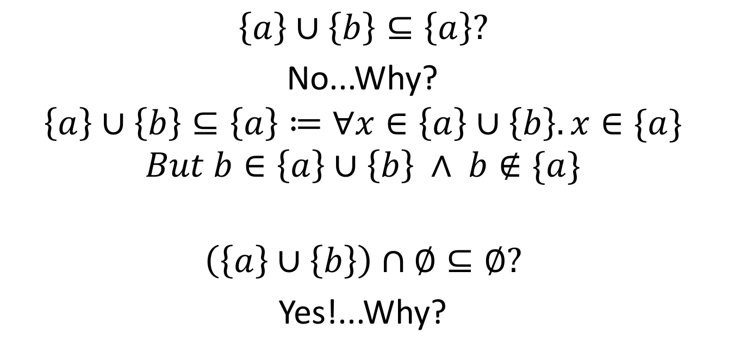
A Couple Questions…
$$\left\{a\right\}∪\left\{b\right\}⊆\left\{a\right\}?$$
No...Why?
$$\left\{a\right\}∪\left\{b\right\}⊆\left\{a\right\}≔∀x∈\left\{a\right\}∪\left\{b\right\}. x∈\{a\}$$
$$But b∈\left\{a\right\}∪\left\{b\right\} ∧ b∉\{a\}$$
$$\left(\left\{a\right\}∪\left\{b\right\}\right)∩∅⊆∅?$$
Yes!...Why?

Slide 17

Operations on Sets (II)
Set Comprehension
$\left\{ n∈Z \right| n≥0 \}$ The natural numbers (N)

Slide 18

Operations on Sets (II)
Set Comprehension
$\left\{ n∈Z \right| n≥0 \}$ The natural numbers (N)
$\left\{ n∈N \right| n mod 2=0 \}$ The even natural numbers

Slide 19

Operations on Sets (II)
Set Comprehension
$\left\{ n∈Z \right| n≥0 \}$ The natural numbers (N)
$\left\{ n∈N \right| n mod 2=0 \}$ The even natural numbers
$\left\{ a∈A \right| a∈S ∧ a∉T \}$ The set of elements in A that
are also in S but not in T

Slide 20
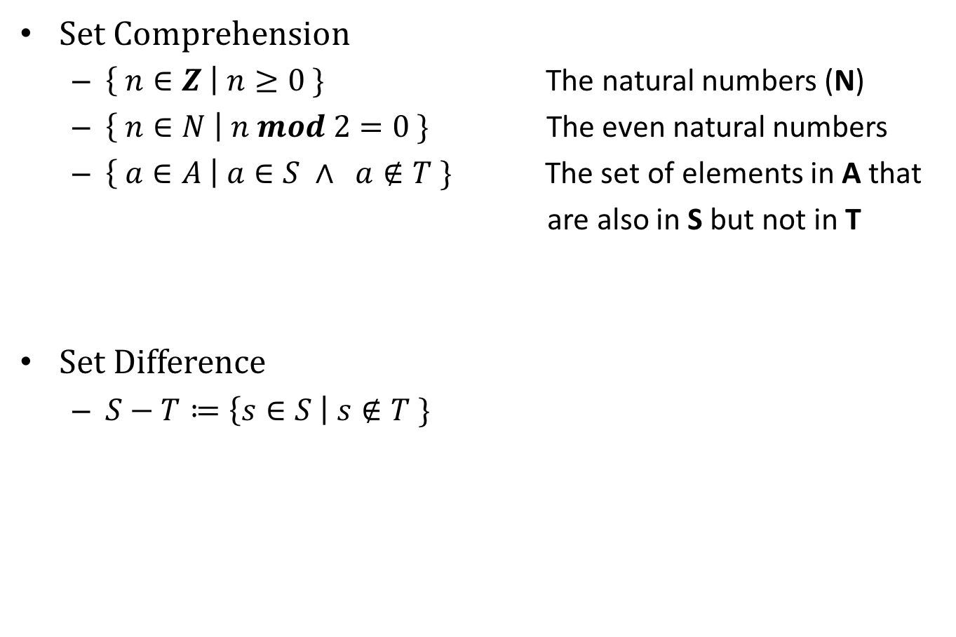
Operations on Sets (II)
Set Comprehension
$\left\{ n∈Z \right| n≥0 \}$ The natural numbers (N)
$\left\{ n∈N \right| n mod 2=0 \}$ The even natural numbers
$\left\{ a∈A \right| a∈S ∧ a∉T \}$ The set of elements in A that
are also in S but not in T
Set Difference
$S−T≔\left\{s∈S \right| s∉T \}$

Slide 21
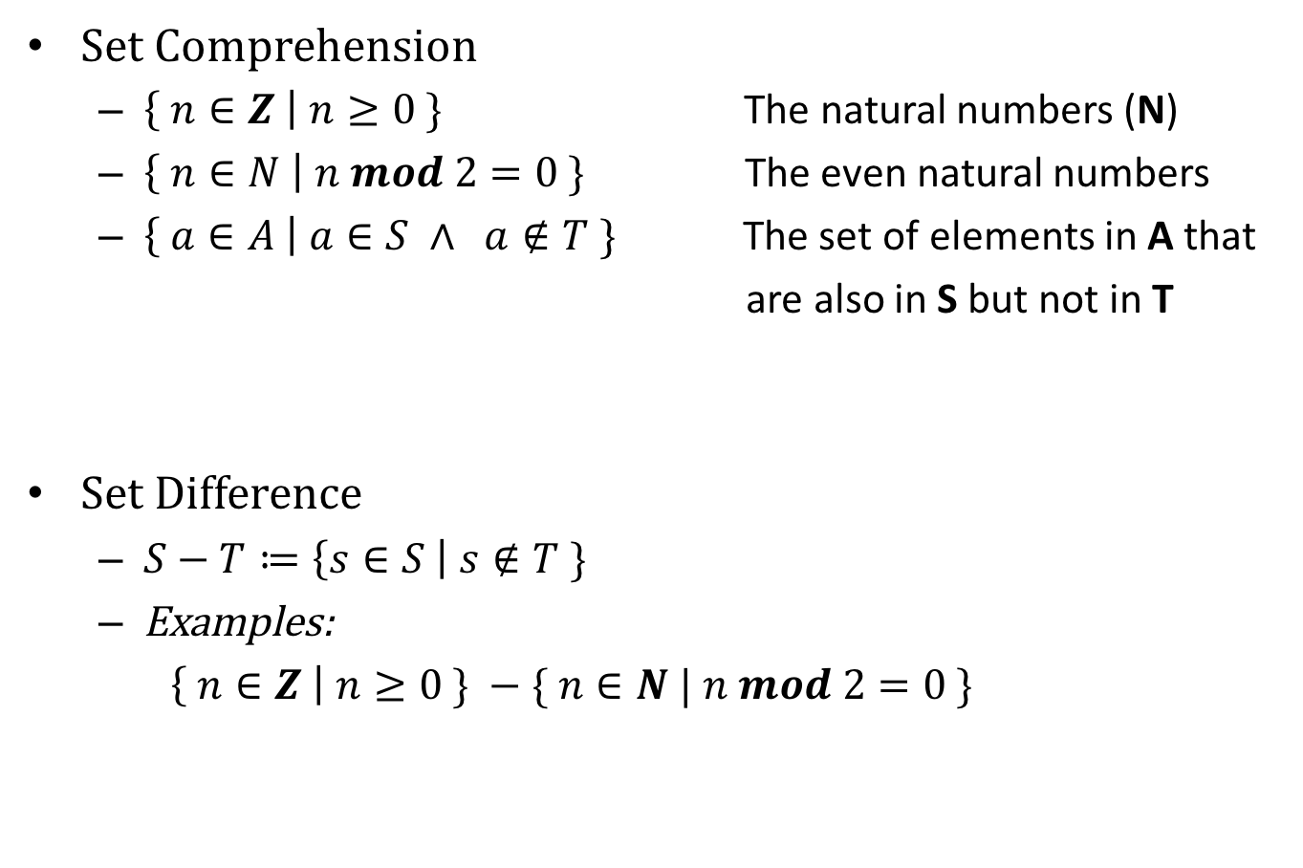
Operations on Sets (II)
Set Comprehension
$\left\{ n∈Z \right| n≥0 \}$ The natural numbers (N)
$\left\{ n∈N \right| n mod 2=0 \}$ The even natural numbers
$\left\{ a∈A \right| a∈S ∧ a∉T \}$ The set of elements in A that
are also in S but not in T
Set Difference
$S−T≔\left\{s∈S \right| s∉T \}$
Examples:
$\left\{ n∈Z \right| n≥0 \} −\{ n∈N | n mod 2=0 \}$

Slide 22
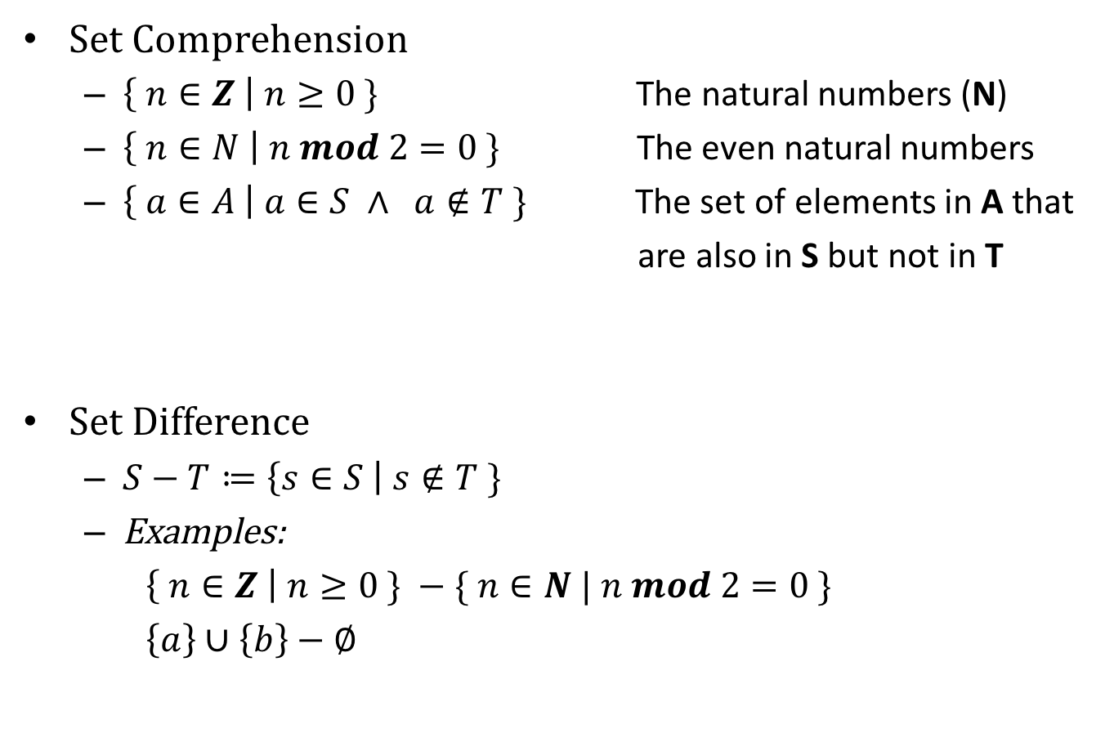
Operations on Sets (II)
Set Comprehension
$\left\{ n∈Z \right| n≥0 \}$ The natural numbers (N)
$\left\{ n∈N \right| n mod 2=0 \}$ The even natural numbers
$\left\{ a∈A \right| a∈S ∧ a∉T \}$ The set of elements in A that
are also in S but not in T
Set Difference
$S−T≔\left\{s∈S \right| s∉T \}$
Examples:
$\left\{ n∈Z \right| n≥0 \} −\{ n∈N | n mod 2=0 \}$
$\left\{a\right\}∪\left\{b\right\}−∅$

Slide 23
A Simple Proof
Theorem: Set Equality is Symmetric.

Slide 24

A Simple Proof
Theorem: Set Equality is Symmetric.
$$By the definition of symmetric, we need to show that:$$
$$\left(1\right) ∀S T. S=T→T=S$$

Slide 25
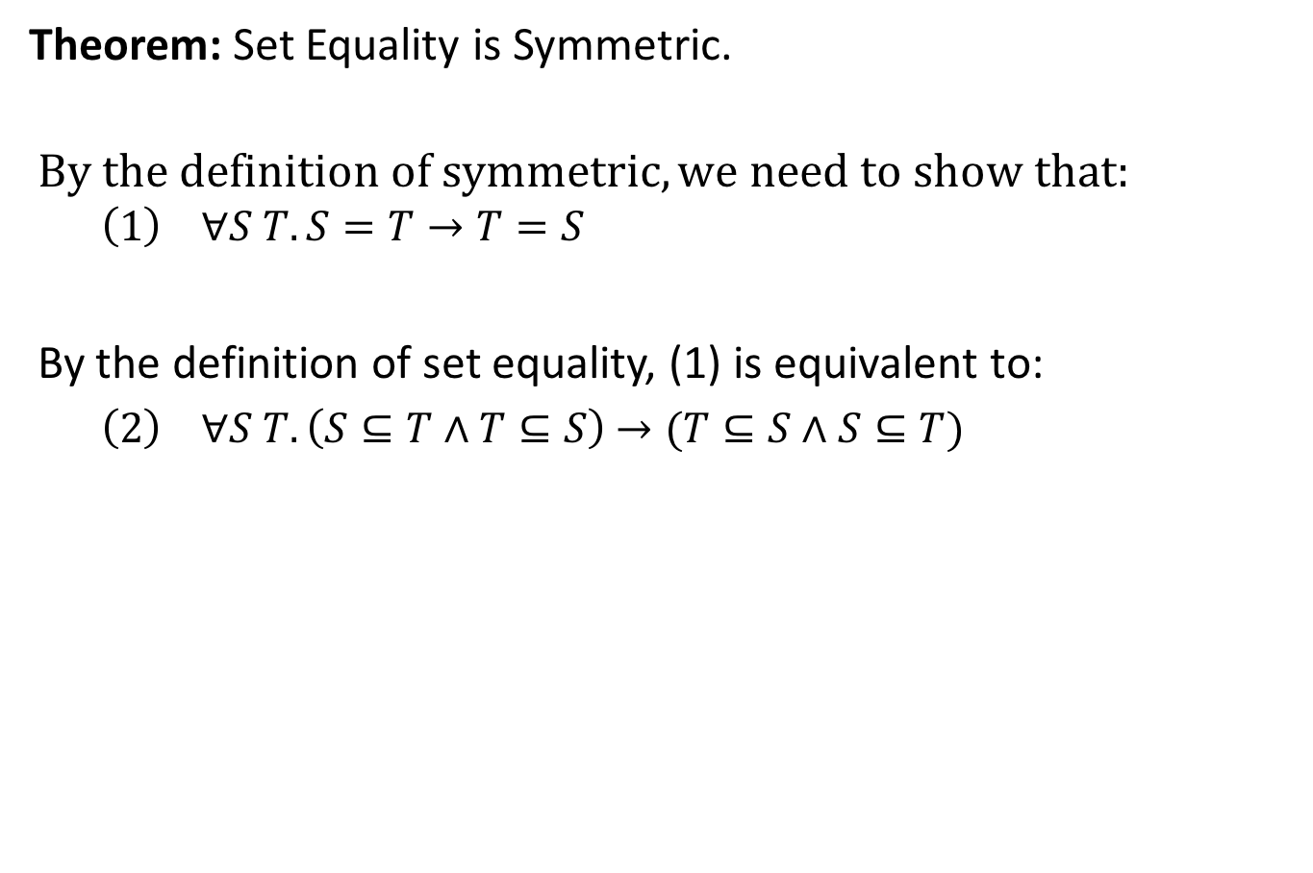
A Simple Proof
Theorem: Set Equality is Symmetric.
$$By the definition of symmetric, we need to show that:$$
$$\left(1\right) ∀S T. S=T→T=S$$
By the definition of set equality, (1) is equivalent to:
$\left(2\right) ∀S T. \left(S⊆T∧T⊆S\right)$ $→(T⊆S∧S⊆T)$

Slide 26
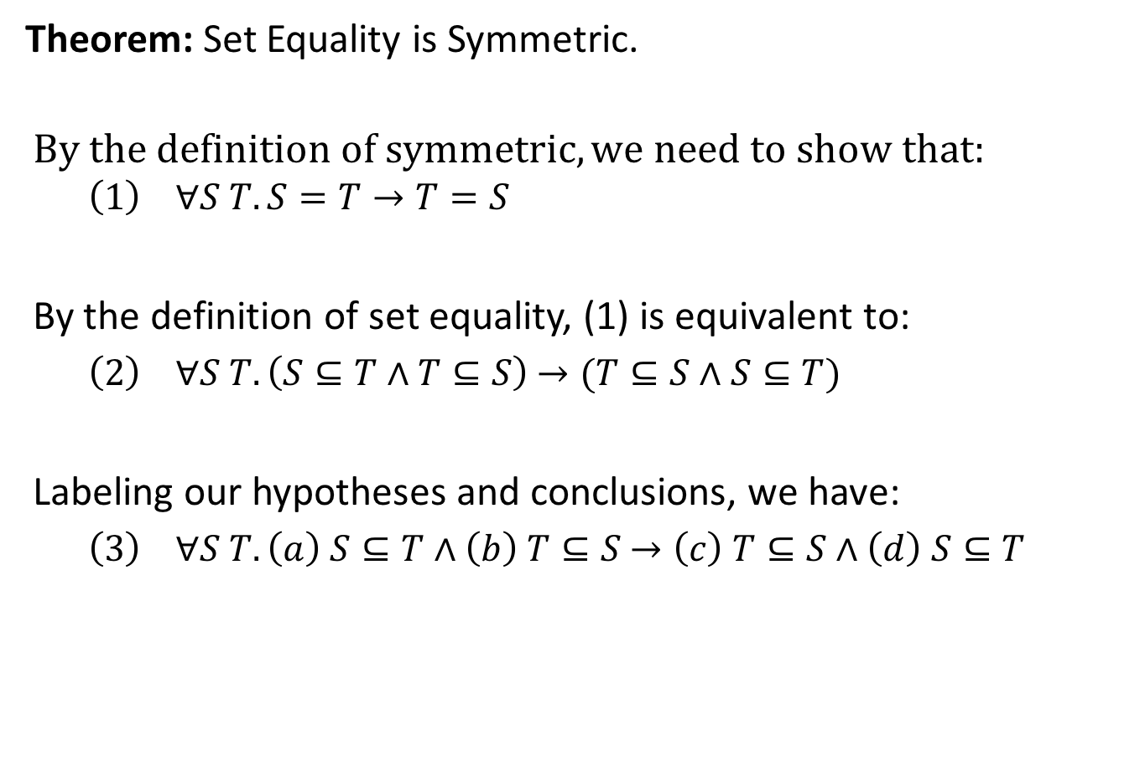
A Simple Proof
Theorem: Set Equality is Symmetric.
$$By the definition of symmetric, we need to show that:$$
$$\left(1\right) ∀S T. S=T→T=S$$
By the definition of set equality, (1) is equivalent to:
$\left(2\right) ∀S T. \left(S⊆T∧T⊆S\right)$ $→(T⊆S∧S⊆T)$
Labeling our hypotheses and conclusions, we have:
$\left(3\right) ∀S T. \left(a\right) S⊆T∧\left(b\right) T⊆S$ $→\left(c\right) T⊆S∧\left(d\right) S⊆T$

Slide 27
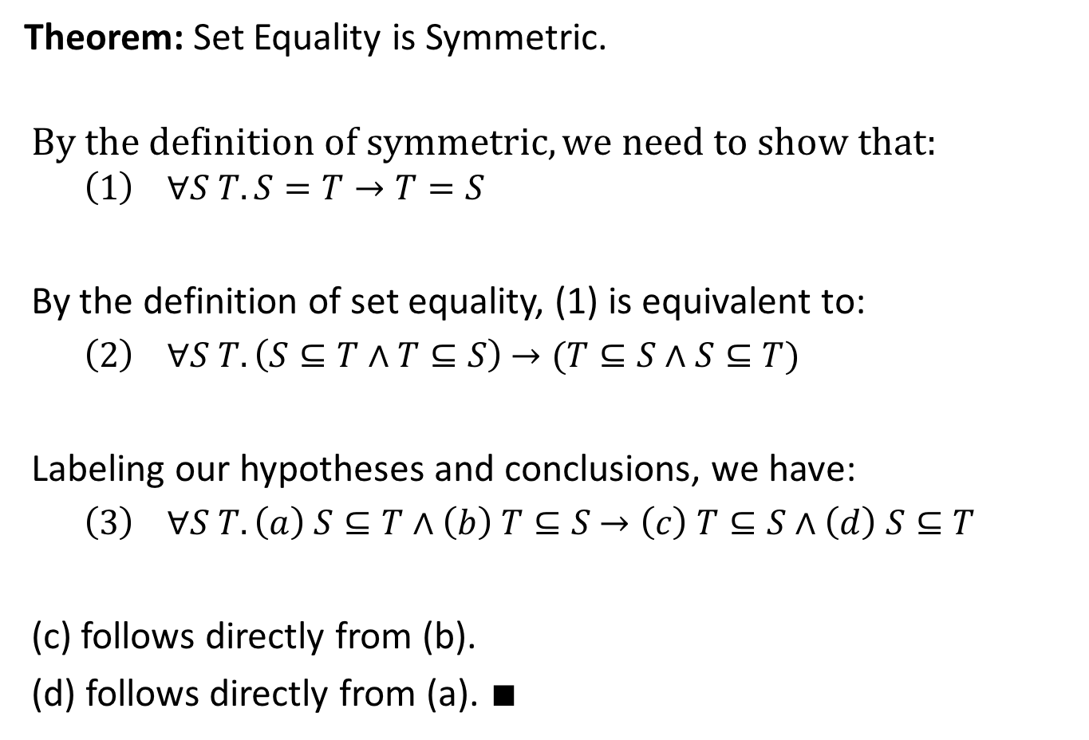
A Simple Proof
Theorem: Set Equality is Symmetric.
$$By the definition of symmetric, we need to show that:$$
$$\left(1\right) ∀S T. S=T→T=S$$
By the definition of set equality, (1) is equivalent to:
$\left(2\right) ∀S T. \left(S⊆T∧T⊆S\right)$ $→(T⊆S∧S⊆T)$
Labeling our hypotheses and conclusions, we have:
$\left(3\right) ∀S T. \left(a\right) S⊆T∧\left(b\right) T⊆S$ $→\left(c\right) T⊆S∧\left(d\right) S⊆T$
(c) follows directly from (b).
(d) follows directly from (a). $∎$

Slide 28
REGULAR EXPRESSIONS IN OCAML

Slide 29
Regular Expressions
In OCaml:
# #load “str.cma”;; (*load the regexp library*)
# open Str;;

Slide 30
Regular Expressions
In OCaml:
# #load “str.cma”;; (*load the regexp library*)
# open Str;;
# let r = regexp “hello, .*”;;
- : val r : Str.regexp = <abstr>

Slide 31
Regular Expressions
In OCaml:
# #load “str.cma”;; (*load the regexp library*)
# open Str;;
# let r = regexp “hello, .*”;;
- : val r : Str.regexp = <abstr>
# string_match r "hello world!" 0;;

Slide 32
Regular Expressions
In OCaml:
# #load “str.cma”;; (*load the regexp library*)
# open Str;;
# let r = regexp “hello, .*”;;
- : val r : Str.regexp = <abstr>
# string_match r "hello world!" 0;;
- : bool = false

Slide 33
Regular Expressions
In OCaml:
# #load “str.cma”;; (*load the regexp library*)
# open Str;;
# let r = regexp “hello, .*”;;
- : val r : Str.regexp = <abstr>
# string_match r "hello world!" 0;;
- : bool = false
# string_match r "hello, cs4100" 0;;

Slide 34
Regular Expressions
In OCaml:
# #load “str.cma”;; (*load the regexp library*)
# open Str;;
# let r = regexp “hello, .*”;;
- : val r : Str.regexp = <abstr>
# string_match r "hello world!" 0;;
- : bool = false
# string_match r "hello, cs4100" 0;;
- : bool = true

Slide 35
OCaml Regexp Syntax
. Matches any character except newline.
r* Matches the expression r zero, one or several times
r+ Matches the expression r one or several times
r? Matches the expression r once or not at all
[..] Character set. Ranges are denoted with -, as in [a-z].
An initial ^, as in [^0-9], complements the set.
^ Matches at beginning of line
$ Matches at end of line
r1|r2 Alternative between two expressions r1 and r2
…

Slide 36
Examples
A regexp that matches the positive integers
… rejecting integers that begin with leading zeros.
One possibility:
let posints = “[1-9]+[0-9]*”
in
A regexp that matches the positive floating-point numbers
… rejecting floats with leading zeros.
One possibility:
let posfloats = posints ^ “\.[0-9]+”

Slide 37
REGULAR EXPRESSIONS, FORMALLY

Slide 38
Backus-Naur Form (BNF)
A notation for expressing context-free grammars (CFGs)
If you don’t know what a CFG is, don’t worry!
A lot more about CFGs in the next two weeks…

Slide 39
Backus-Naur Form (BNF)
A notation for expressing context-free grammars (CFGs)
If you don’t know what a CFG is, don’t worry!
A lot more about CFGs in the next two weeks…
A small example:
<expr> ::= <int> (*integers*)
| <expr> + <expr> (*addition*)
| <expr> * <expr> (*multiplication*)
| ( <expr> )
The name of the piece of syntax we’re defining (in this case, <expr>, for expression)
Each “production” after a pipe “|”
corresponds to a different way to build an
<expr>

Slide 40
Backus-Naur Form (BNF)
A small example:
<expr> ::= <int> (*integers*)
| <expr> + <expr> (*addition*)
| <expr> * <expr> (*multiplication*)
| ( <expr> )
Strings in the “language” defined by the grammar above:
1
(1)
(1 + 2) * 3 + (4 * 5)
…

Slide 41
BNF in OCaml
Traditional BNF
<expr> ::= <int> (*integers*)
| <expr> + <expr> (*addition*)
| <expr> * <expr> (*multiplication*)
| ( <expr> )

Slide 42
BNF in OCaml
Traditional BNF
<expr> ::= <int> (*integers*)
| <expr> + <expr> (*addition*)
| <expr> * <expr> (*multiplication*)
| ( <expr> )
The same data type in OCaml
type expr =
| Eint of int
| Eplus of (expr * expr)
| Etimes of (expr * expr
| Eparen of expr

Slide 43

A Language of Regular Expressions
Regular Expressions in BNF Style
r ::= $empty$ (*match no strings*)
| $ϵ$ (*match the empty string*)
| ‘A’ | ‘B’ | ‘C’ (*characters A, B, C*)
| r1 . r2 (*concatenation: r1 then r2*)
| r* (*Kleene star: 0 or more*)
| r1 || r2 (*r1 or r2*)
| r1 && r2 (*r1 and r2*)
| $¬$r (*not r*)
| ( r ) (*paranthesized r*)
Examples:
‘A’ . ‘B’ . ‘C’
$¬empty$
(‘A’ . ‘B’)*

Slide 44
OCaml Regexp Syntax
. Matches any character except newline.
r* Matches the expression r zero, one or several times
r+ Matches the expression r one or several times
r? Matches the expression r once or not at all
…

Slide 45
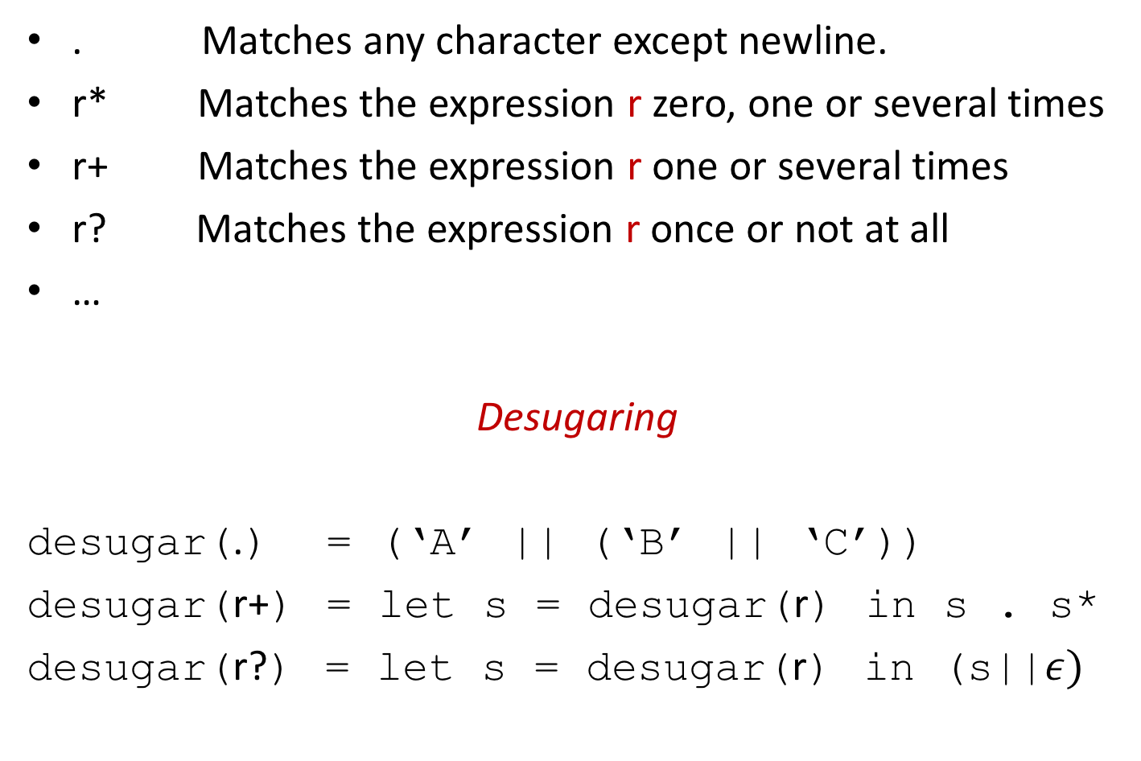
OCaml Regexp Syntax
. Matches any character except newline.
r* Matches the expression r zero, one or several times
r+ Matches the expression r one or several times
r? Matches the expression r once or not at all
…
Desugaring
desugar(.) = (‘A’ || (‘B’ || ‘C’))
desugar(r+) = let s = desugar(r) in s . s*
desugar(r?) = let s = desugar(r) in (s||$ε)$

Slide 46
INTERPRETING REGULAR EXPRESSIONS

Slide 47

What Do Regexps Mean?
Every regexp r is denoted by a set of strings (language)
Alternatively, the denotation of a regular expression is some set of strings, or language
A string is a sequence of characters (0 or more) drawn from some alphabet (typically written $Σ)$
$Σ^{∗}$: The set of all possible strings over alphabet $Σ$
de·no·ta·tion
ˌdēnōˈtāSHən/
noun
noun: denotation; plural noun: denotations
PHILOSOPHY the object or concept to which a term refers, or the set of objects of which a predicate is true.
<Google Search Result>
“is interpreted as”

Slide 48

Enumerate the strings of…
$Σ=\left\{a\right\}$

Slide 49

Enumerate the strings of…
$Σ=\left\{a\right\}$
$Σ^{∗}=\{“”, “a”, “aa”, “aaa”, …\}$

Slide 50

Enumerate the strings of…
$Σ=\left\{a\right\}$
$Σ^{∗}=\{“”, “a”, “aa”, “aaa”, …\}$
$Σ=\left\{a,b\right\}$

Slide 51

Enumerate the strings of…
$Σ=\left\{a\right\}$
$Σ^{∗}=\{“”, “a”, “aa”, “aaa”, …\}$
$Σ=\left\{a,b\right\}$
$Σ^{∗}=\{“”, “a”, “b”, “aa”, “ab”, “ba”, “bb”,$
$“aaa”, “aab”, …\}$

Slide 52

Enumerate the strings of…
$Σ=\left\{a\right\}$
$Σ^{∗}=\{“”, “a”, “aa”, “aaa”, …\}$
$Σ=\left\{a,b\right\}$
$Σ^{∗}=\{“”, “a”, “b”, “aa”, “ab”, “ba”, “bb”,$
$“aaa”, “aab”, …\}$
$Σ=∅$

Slide 53

Enumerate the strings of…
$Σ=\left\{a\right\}$
$Σ^{∗}=\{“”, “a”, “aa”, “aaa”, …\}$
$Σ=\left\{a,b\right\}$
$Σ^{∗}=\{“”, “a”, “b”, “aa”, “ab”, “ba”, “bb”,$
$“aaa”, “aab”, …\}$
$Σ=∅$
$Σ^{∗}=\{“”\}$

Slide 54
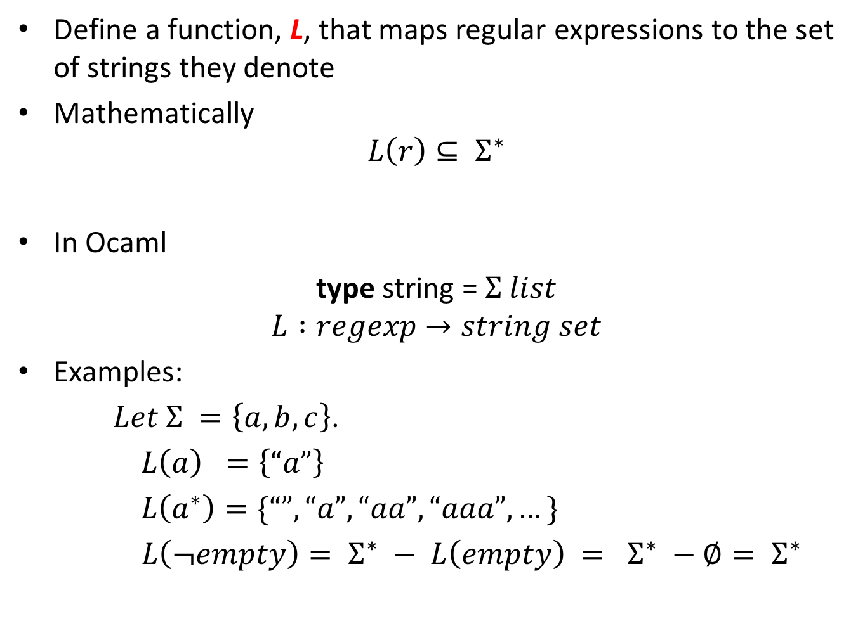
Interpreting Regexps
Define a function, L, that maps regular expressions to the set of strings they denote
Mathematically
$$L\left(r\right)⊆ Σ^{∗}$$
In Ocaml
type string = $Σ list$
$$L :regexp→string set$$
Examples:
$Let Σ =\left\{a,b,c\right\}$.
$L\left(a\right) =\left\{“a”\right\}$
$L\left(a^{∗}\right)=\{“”, “a”, “aa”, “aaa”, …\}$
$L\left(¬empty\right)= Σ^{∗} − L\left(empty\right) = Σ^{∗} −∅= Σ^{∗}$

Slide 55
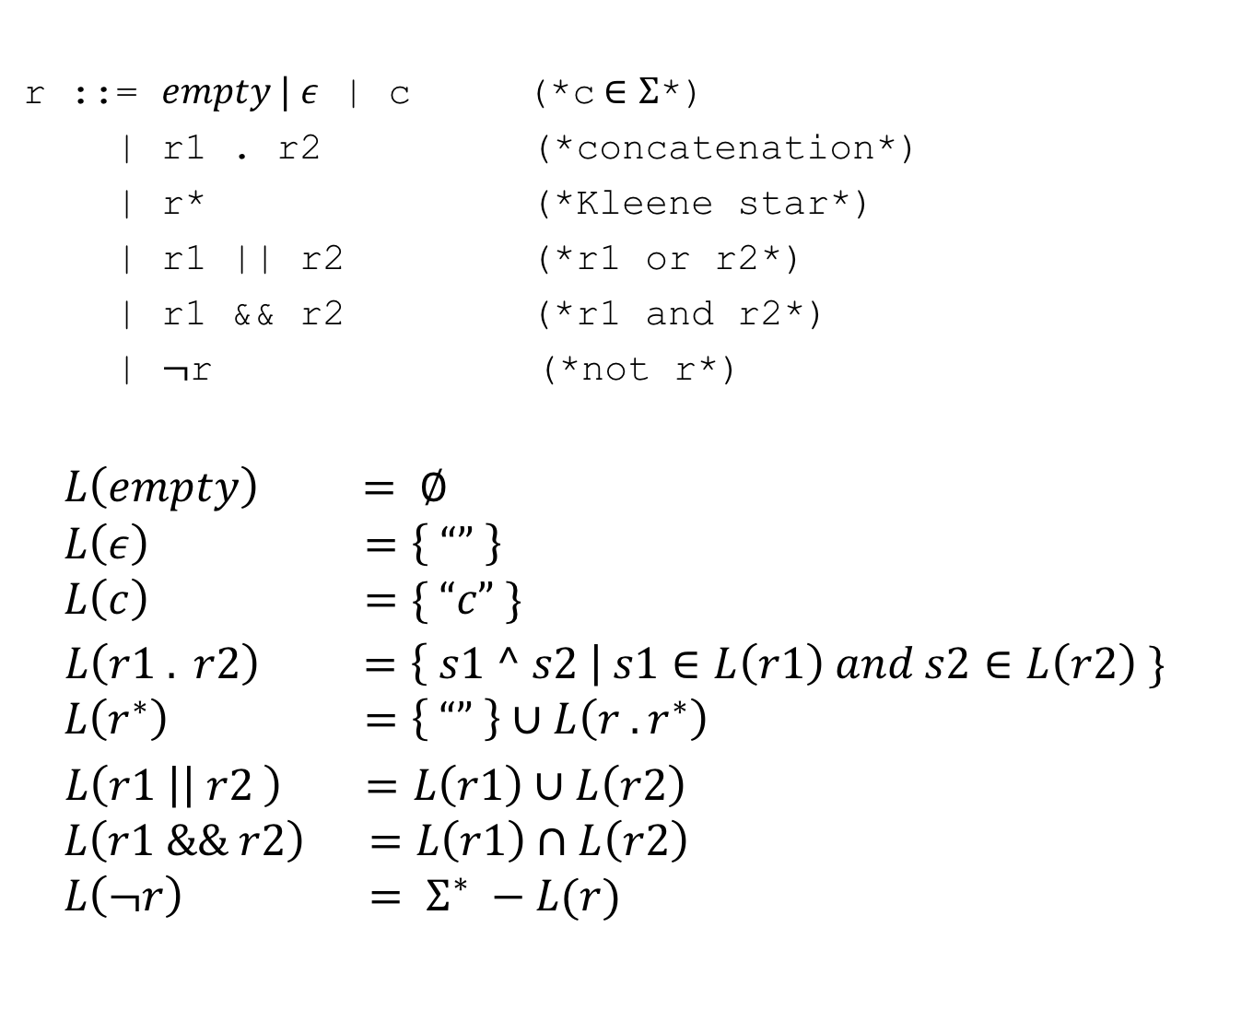
Interpreting Regexps In General
r ::= $empty | ε$ | c (*c$∈Σ$*)
| r1 . r2 (*concatenation*)
| r* (*Kleene star*)
| r1 || r2 (*r1 or r2*)
| r1 && r2 (*r1 and r2*)
| $¬$r (*not r*)
$$L\left(empty\right) = ∅$$
$$L\left(ε\right) =\left\{ “” \right\}$$
$$L\left(c\right) =\{ “c” \}$$
$L\left(r1 . r2\right) =\left\{ s1 ^ s2 \right| s1∈L\left(r1\right) and s2∈L\left(r2\right) \}$
$$L\left(r^{∗}\right) =\left\{ “” \right\}∪L\left(r . r^{∗}\right)$$
$L\left(r1 \right|\left| r2 \right) =L\left(r1\right)∪L\left(r2\right)$
$$L\left(r1 \&\& r2\right) =L\left(r1\right)∩L\left(r2\right)$$
$$L\left(¬r\right) = Σ^{∗} −L(r)$$

Slide 56
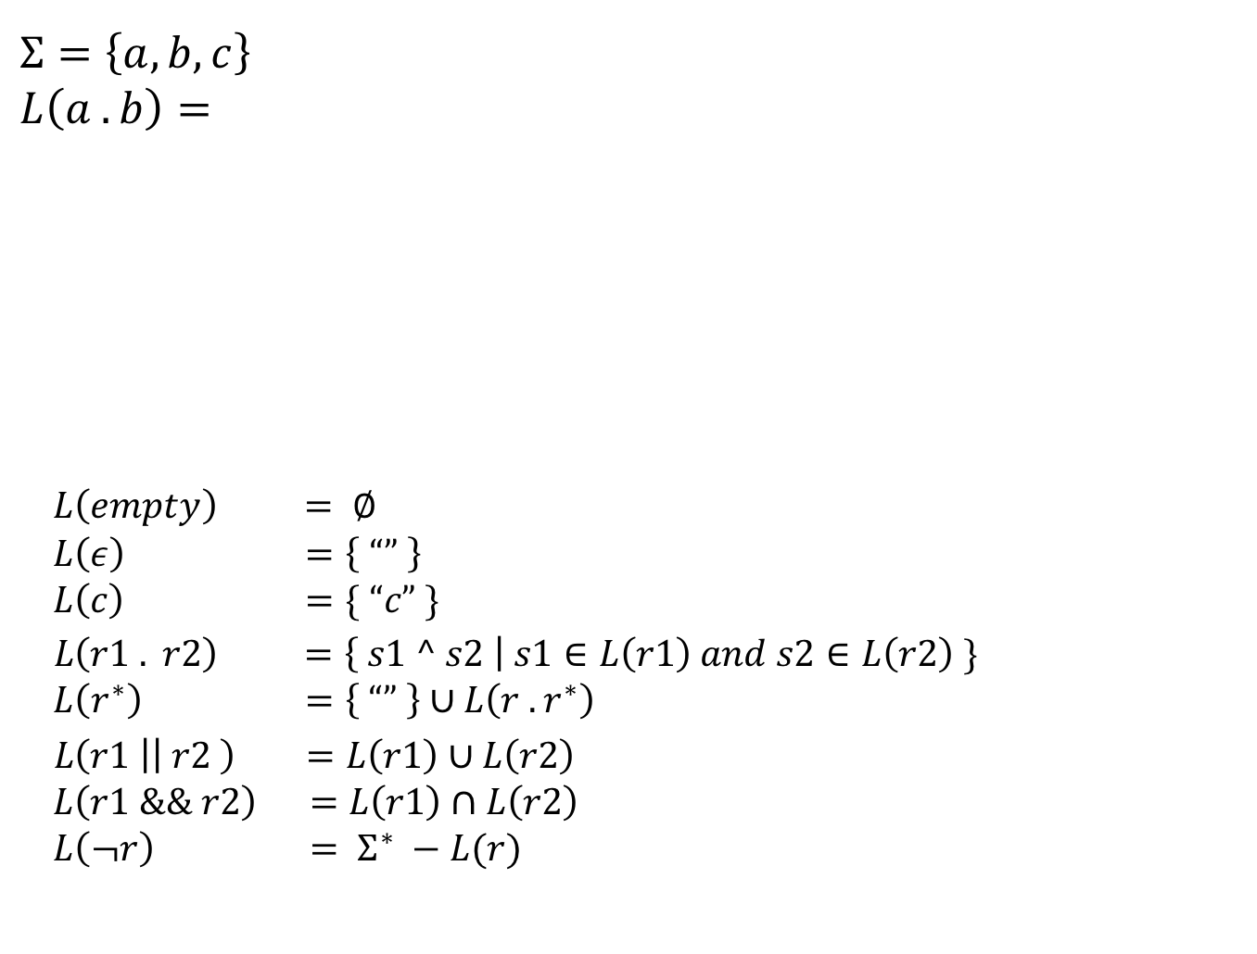
Some Examples
$$Σ=\left\{a, b, c\right\}$$
$$L\left(a . b\right)=$$
$$L\left(empty\right) = ∅$$
$$L\left(ε\right) =\left\{ “” \right\}$$
$$L\left(c\right) =\{ “c” \}$$
$L\left(r1 . r2\right) =\left\{ s1 ^ s2 \right| s1∈L\left(r1\right) and s2∈L\left(r2\right) \}$
$$L\left(r^{∗}\right) =\left\{ “” \right\}∪L\left(r . r^{∗}\right)$$
$L\left(r1 \right|\left| r2 \right) =L\left(r1\right)∪L\left(r2\right)$
$$L\left(r1 \&\& r2\right) =L\left(r1\right)∩L\left(r2\right)$$
$$L\left(¬r\right) = Σ^{∗} −L(r)$$

Slide 57
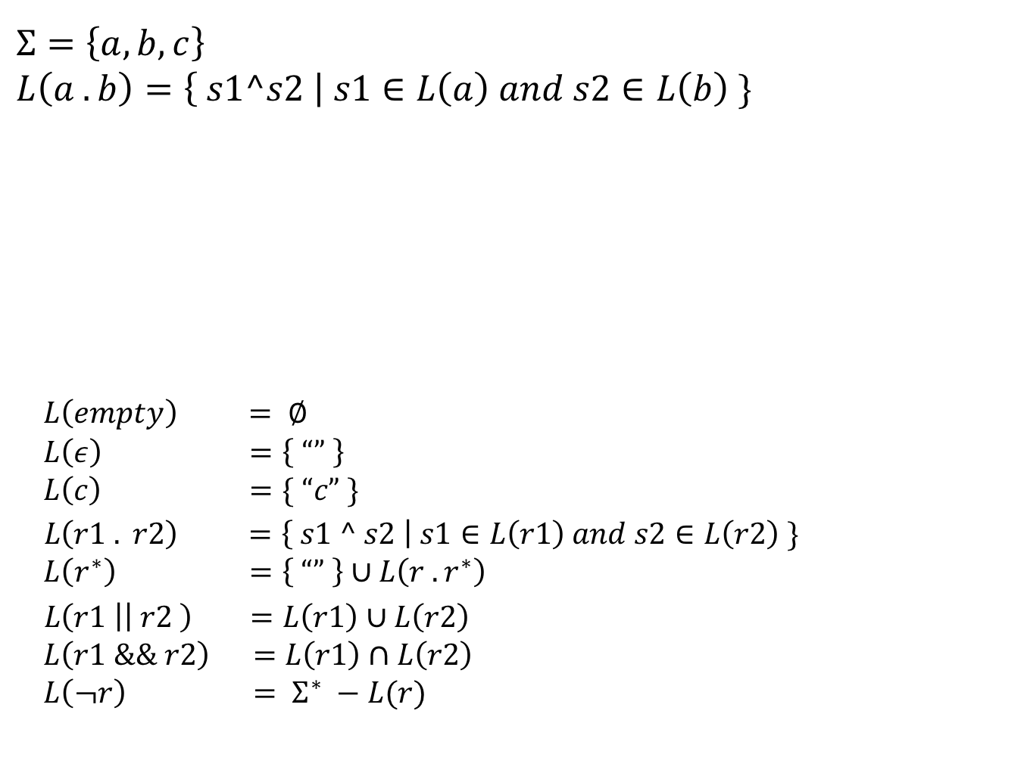
Some Examples
$$Σ=\left\{a, b, c\right\}$$
$$L\left(a . b\right)=\left\{ s1^s2 \right| s1∈L\left(a\right) and s2∈L\left(b\right) \}$$
$$L\left(empty\right) = ∅$$
$$L\left(ε\right) =\left\{ “” \right\}$$
$$L\left(c\right) =\{ “c” \}$$
$L\left(r1 . r2\right) =\left\{ s1 ^ s2 \right| s1∈L\left(r1\right) and s2∈L\left(r2\right) \}$
$$L\left(r^{∗}\right) =\left\{ “” \right\}∪L\left(r . r^{∗}\right)$$
$L\left(r1 \right|\left| r2 \right) =L\left(r1\right)∪L\left(r2\right)$
$$L\left(r1 \&\& r2\right) =L\left(r1\right)∩L\left(r2\right)$$
$$L\left(¬r\right) = Σ^{∗} −L(r)$$

Slide 58
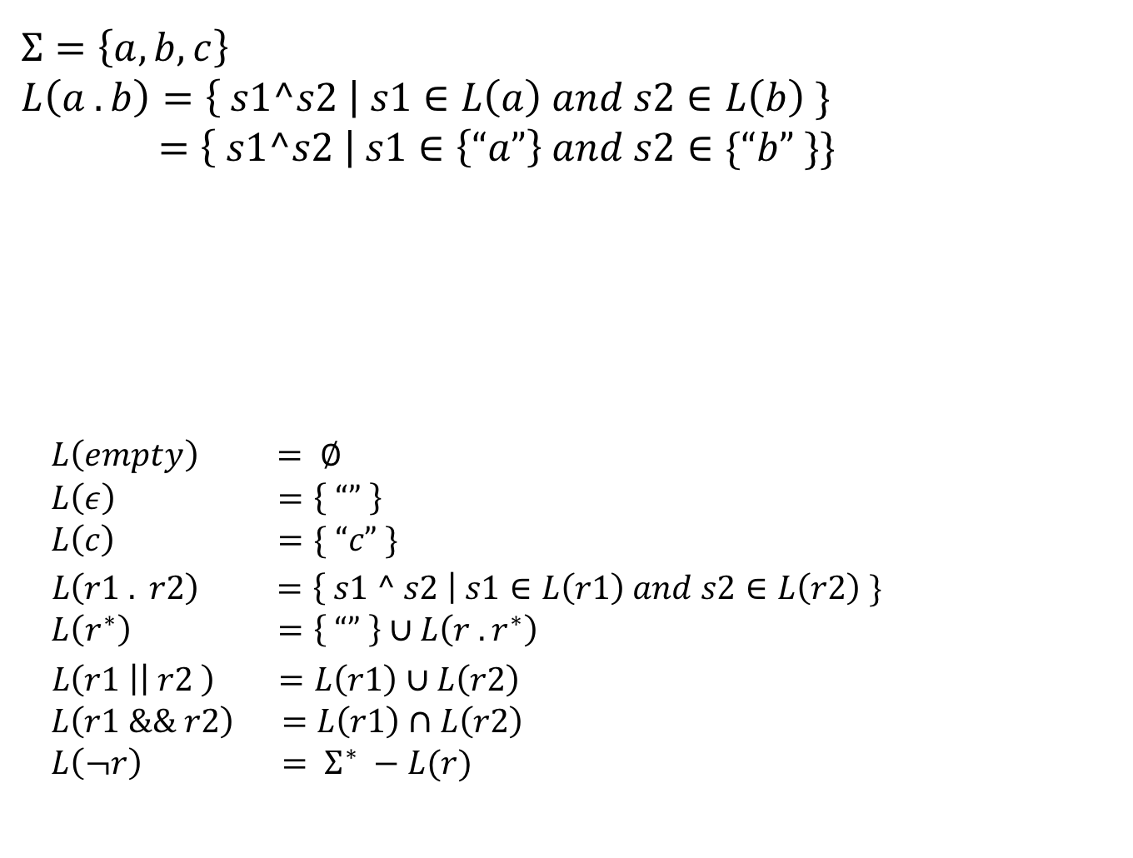
Some Examples
$$Σ=\left\{a, b, c\right\}$$
$$L\left(a . b\right)=\left\{ s1^s2 \right| s1∈L\left(a\right) and s2∈L\left(b\right) \}$$
$$=\left\{ s1^s2 \right| s1∈\left\{“a”\right\} and s2∈\{“b” \}\}$$
$$L\left(empty\right) = ∅$$
$$L\left(ε\right) =\left\{ “” \right\}$$
$$L\left(c\right) =\{ “c” \}$$
$L\left(r1 . r2\right) =\left\{ s1 ^ s2 \right| s1∈L\left(r1\right) and s2∈L\left(r2\right) \}$
$$L\left(r^{∗}\right) =\left\{ “” \right\}∪L\left(r . r^{∗}\right)$$
$L\left(r1 \right|\left| r2 \right) =L\left(r1\right)∪L\left(r2\right)$
$$L\left(r1 \&\& r2\right) =L\left(r1\right)∩L\left(r2\right)$$
$$L\left(¬r\right) = Σ^{∗} −L(r)$$

Slide 59
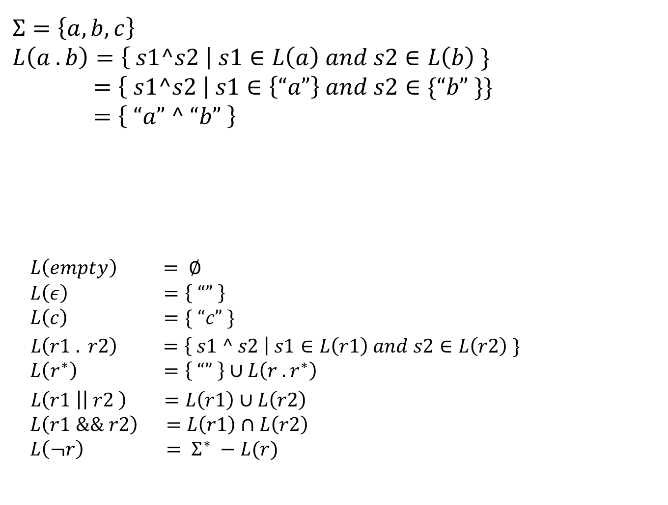
Some Examples
$$Σ=\left\{a, b, c\right\}$$
$$L\left(a . b\right)=\left\{ s1^s2 \right| s1∈L\left(a\right) and s2∈L\left(b\right) \}$$
$$=\left\{ s1^s2 \right| s1∈\left\{“a”\right\} and s2∈\{“b” \}\}$$
$$=\left\{ “a” ^ “b” \right\}$$
$$L\left(empty\right) = ∅$$
$$L\left(ε\right) =\left\{ “” \right\}$$
$$L\left(c\right) =\{ “c” \}$$
$L\left(r1 . r2\right) =\left\{ s1 ^ s2 \right| s1∈L\left(r1\right) and s2∈L\left(r2\right) \}$
$$L\left(r^{∗}\right) =\left\{ “” \right\}∪L\left(r . r^{∗}\right)$$
$L\left(r1 \right|\left| r2 \right) =L\left(r1\right)∪L\left(r2\right)$
$$L\left(r1 \&\& r2\right) =L\left(r1\right)∩L\left(r2\right)$$
$$L\left(¬r\right) = Σ^{∗} −L(r)$$

Slide 60
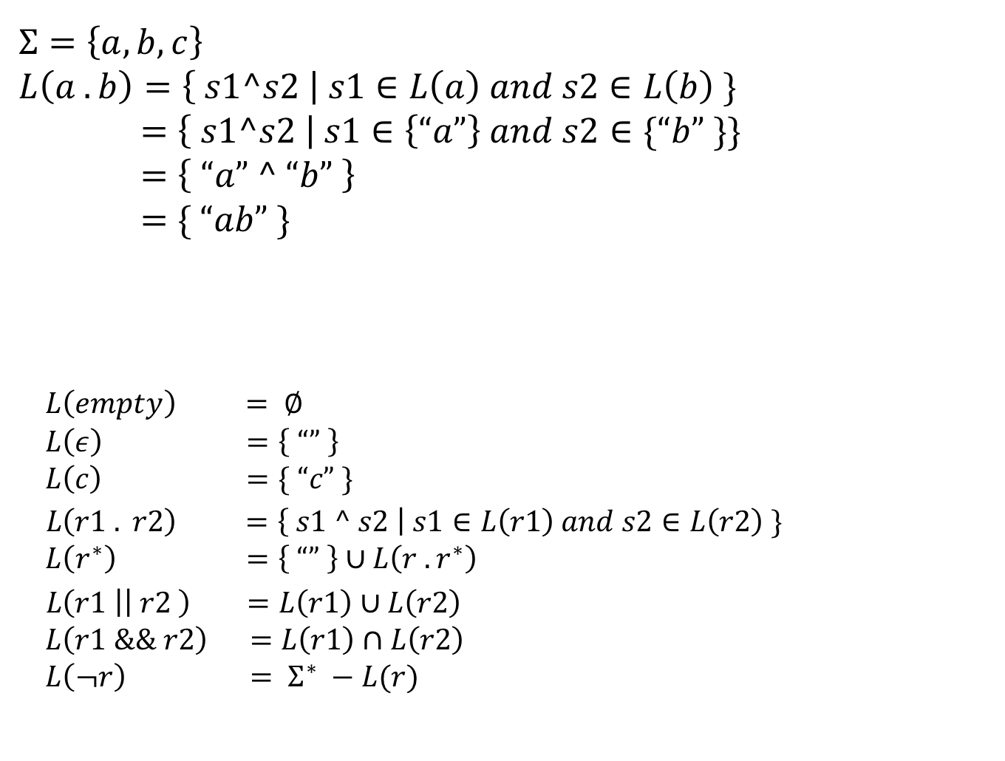
Some Examples
$$Σ=\left\{a, b, c\right\}$$
$$L\left(a . b\right)=\left\{ s1^s2 \right| s1∈L\left(a\right) and s2∈L\left(b\right) \}$$
$$=\left\{ s1^s2 \right| s1∈\left\{“a”\right\} and s2∈\{“b” \}\}$$
$$=\left\{ “a” ^ “b” \right\}$$
$$=\{ “ab” \}$$
$$L\left(empty\right) = ∅$$
$$L\left(ε\right) =\left\{ “” \right\}$$
$$L\left(c\right) =\{ “c” \}$$
$L\left(r1 . r2\right) =\left\{ s1 ^ s2 \right| s1∈L\left(r1\right) and s2∈L\left(r2\right) \}$
$$L\left(r^{∗}\right) =\left\{ “” \right\}∪L\left(r . r^{∗}\right)$$
$L\left(r1 \right|\left| r2 \right) =L\left(r1\right)∪L\left(r2\right)$
$$L\left(r1 \&\& r2\right) =L\left(r1\right)∩L\left(r2\right)$$
$$L\left(¬r\right) = Σ^{∗} −L(r)$$

Slide 61

A Trickier One…
$$Σ=\left\{a, b, c\right\}$$
$$L\left({empty}^{∗}. a\right)$$

Slide 62

A Trickier One…
$$Σ=\left\{a, b, c\right\}$$
$$L\left({empty}^{∗}. a\right)$$
$=\left\{ s1^s2 \right| s1∈L\left({empty}^{∗}\right) and s2∈L\left(a\right) \}$

Slide 63

A Trickier One…
$$Σ=\left\{a, b, c\right\}$$
$$L\left({empty}^{∗}. a\right)$$
$=\left\{ s1^s2 \right| s1∈L\left({empty}^{∗}\right) and s2∈L\left(a\right) \}$
$$=\left\{ s1^s2 \right| s1∈(\left\{“”\right\}∪L\left(empty . {empty}^{∗}\right)) and s2∈\{“a” \}\}$$

Slide 64

A Trickier One…
$$Σ=\left\{a, b, c\right\}$$
$$L\left({empty}^{∗}. a\right)$$
$=\left\{ s1^s2 \right| s1∈L\left({empty}^{∗}\right) and s2∈L\left(a\right) \}$
$$=\left\{ s1^s2 \right| s1∈(\left\{“”\right\}∪L\left(empty . {empty}^{∗}\right)) and s2∈\{“a” \}\}$$
$$=\left\{ s1^“a” \right| s1∈\left(\left\{“”\right\}∪L\left(empty . {empty}^{∗}\right)\right)\}$$

Slide 65

A Trickier One…
$$Σ=\left\{a, b, c\right\}$$
$$L\left({empty}^{∗}. a\right)$$
$=\left\{ s1^s2 \right| s1∈L\left({empty}^{∗}\right) and s2∈L\left(a\right) \}$
$$=\left\{ s1^s2 \right| s1∈(\left\{“”\right\}∪L\left(empty . {empty}^{∗}\right)) and s2∈\{“a” \}\}$$
$$=\left\{ s1^“a” \right| s1∈\left(\left\{“”\right\}∪L\left(empty . {empty}^{∗}\right)\right)\}$$
$=\left\{ s1^“a” \right| s1∈\left(\left\{“”\right\}∪∅\right)\}$

Slide 66
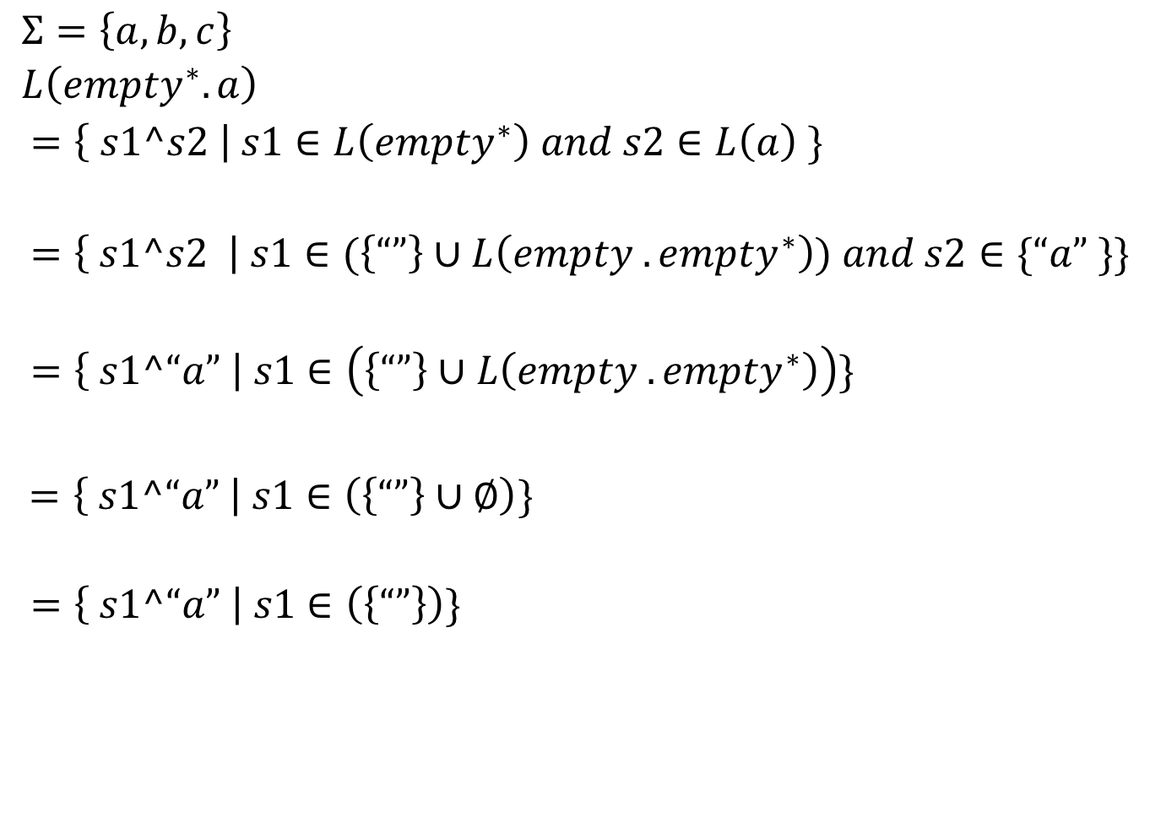
A Trickier One…
$$Σ=\left\{a, b, c\right\}$$
$$L\left({empty}^{∗}. a\right)$$
$=\left\{ s1^s2 \right| s1∈L\left({empty}^{∗}\right) and s2∈L\left(a\right) \}$
$$=\left\{ s1^s2 \right| s1∈(\left\{“”\right\}∪L\left(empty . {empty}^{∗}\right)) and s2∈\{“a” \}\}$$
$$=\left\{ s1^“a” \right| s1∈\left(\left\{“”\right\}∪L\left(empty . {empty}^{∗}\right)\right)\}$$
$=\left\{ s1^“a” \right| s1∈\left(\left\{“”\right\}∪∅\right)\}$
$$=\left\{ s1^“a” \right| s1∈\left(\left\{“”\right\}\right)\}$$

Slide 67
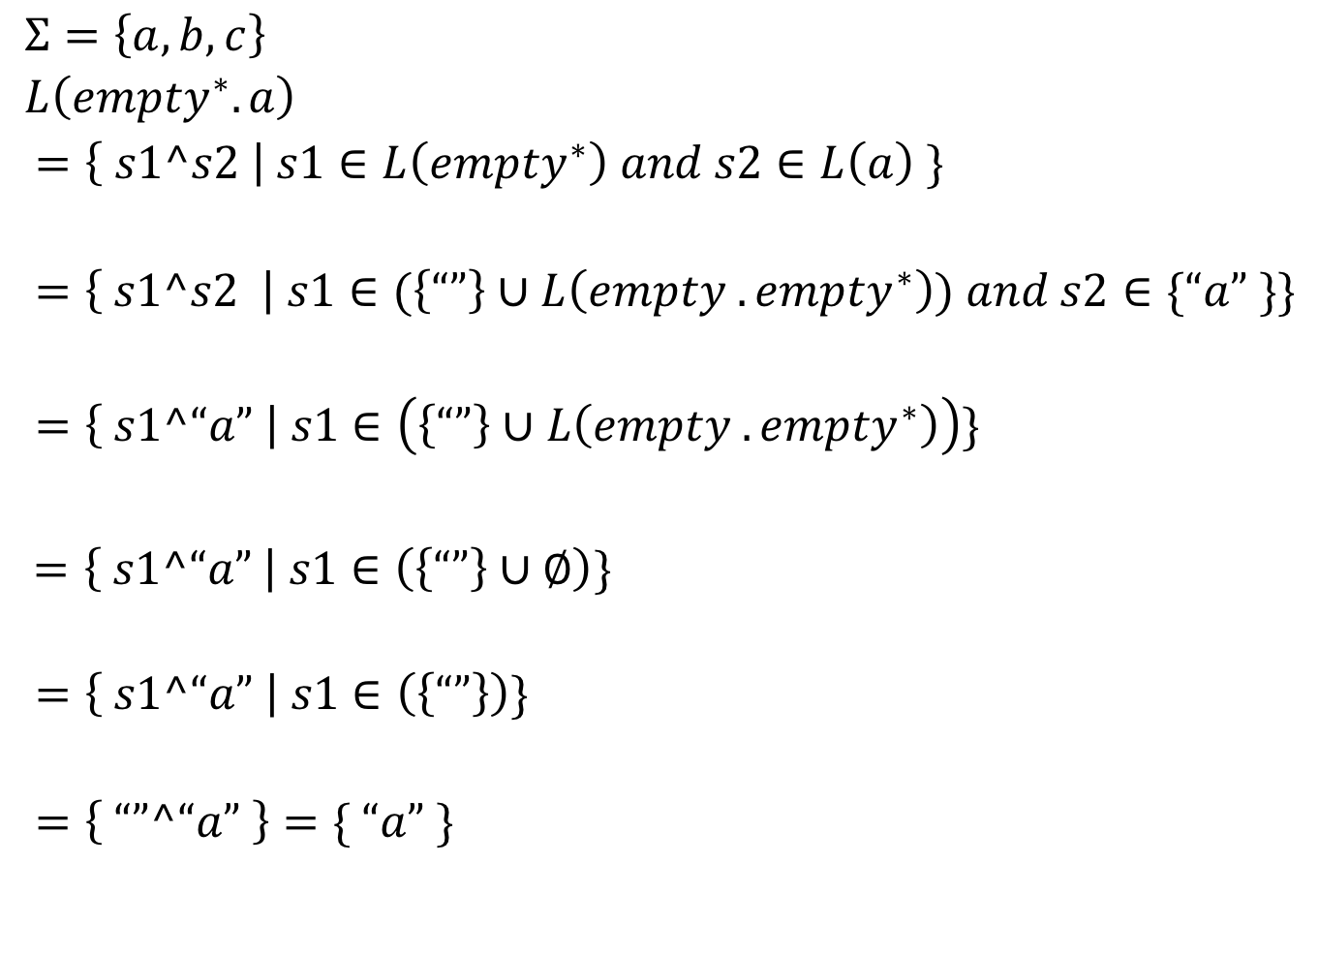
A Trickier One…
$$Σ=\left\{a, b, c\right\}$$
$$L\left({empty}^{∗}. a\right)$$
$=\left\{ s1^s2 \right| s1∈L\left({empty}^{∗}\right) and s2∈L\left(a\right) \}$
$$=\left\{ s1^s2 \right| s1∈(\left\{“”\right\}∪L\left(empty . {empty}^{∗}\right)) and s2∈\{“a” \}\}$$
$$=\left\{ s1^“a” \right| s1∈\left(\left\{“”\right\}∪L\left(empty . {empty}^{∗}\right)\right)\}$$
$=\left\{ s1^“a” \right| s1∈\left(\left\{“”\right\}∪∅\right)\}$
$$=\left\{ s1^“a” \right| s1∈\left(\left\{“”\right\}\right)\}$$
$$=\left\{ “”^“a” \right\}=\{ “a” \}$$

Slide 68
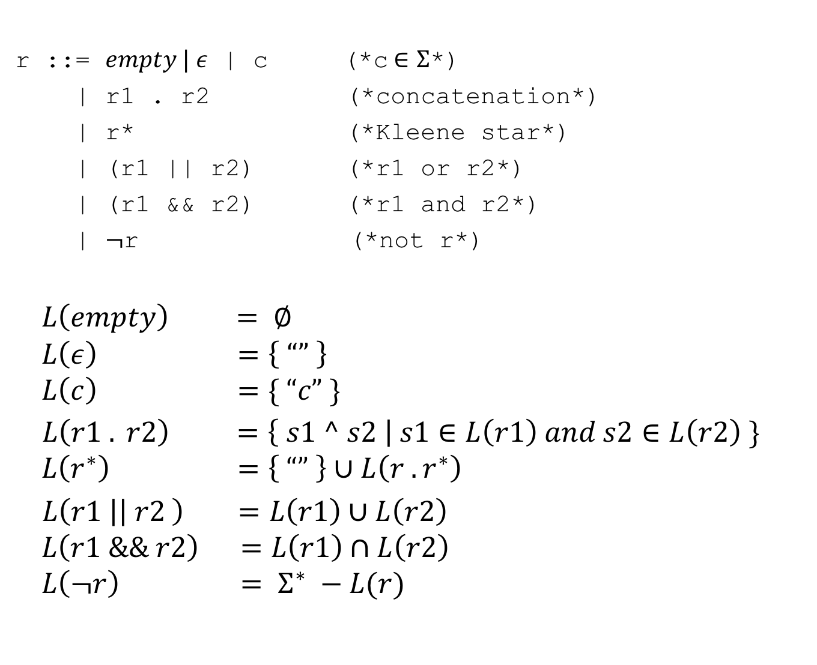
Interpreting Regexps In General
r ::= $empty | ε$ | c (*c$∈Σ$*)
| r1 . r2 (*concatenation*)
| r* (*Kleene star*)
| (r1 || r2) (*r1 or r2*)
| (r1 && r2) (*r1 and r2*)
| $¬$r (*not r*)
$$L\left(empty\right) = ∅$$
$$L\left(ε\right) =\left\{ “” \right\}$$
$$L\left(c\right) =\{ “c” \}$$
$L\left(r1 . r2\right) =\left\{ s1 ^ s2 \right| s1∈L\left(r1\right) and s2∈L\left(r2\right) \}$
$$L\left(r^{∗}\right) =\left\{ “” \right\}∪L\left(r . r^{∗}\right)$$
$L\left(r1 \right|\left| r2 \right) =L\left(r1\right)∪L\left(r2\right)$
$$L\left(r1 \&\& r2\right) =L\left(r1\right)∩L\left(r2\right)$$
$$L\left(¬r\right) = Σ^{∗} −L(r)$$

Slide 69
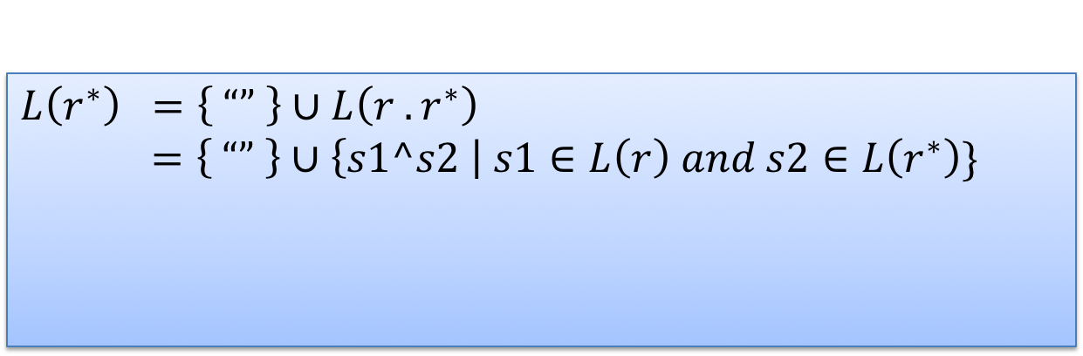
Interpreting Regexps In General
r ::= $empty | ε$ | c (*c$∈Σ$*)
| r1 . r2 (*concatenation*)
| r* (*Kleene star*)
| (r1 || r2) (*r1 or r2*)
| (r1 && r2) (*r1 and r2*)
| $¬$r (*not r*)
$$L\left(empty\right) = ∅$$
$$L\left(ε\right) =\left\{ “” \right\}$$
$$L\left(c\right) =\{ “c” \}$$
$L\left(r1 . r2\right) =\left\{ s1 ^ s2 \right| s1∈L\left(r1\right) and s2∈L\left(r2\right) \}$
$$L\left(r^{∗}\right) =\left\{ “” \right\}∪L\left(r . r^{∗}\right)$$
$L\left(r1 \right|\left| r2 \right) =L\left(r1\right)∪L\left(r2\right)$
$$L\left(r1 \&\& r2\right) =L\left(r1\right)∩L\left(r2\right)$$
$$L\left(¬r\right) = Σ^{∗} −L(r)$$
$$L\left(r^{∗}\right) =\left\{ “” \right\}∪L\left(r . r^{∗}\right)$$
$=\left\{ “” \right\}∪\left\{s1^s2 \right| s1∈L\left(r\right) and s2∈L\left(r^{∗}\right)\}$
L(r*) is defined in terms of itself!

Slide 70

Kleene Star Take 2
Kleene Star Take 1
$$L\left(r^{∗}\right)= \left\{“”\right\}∪L\left(r . r^{∗}\right)$$
Kleene Star Take 2
$$L\left(r^{∗}\right)=\bigcup_{n :nat}{iter n L(r)}$$
Iteration
$$iter :nat→\left(Σ list\right) set→\left(Σ list\right) set$$
iter 0 $S=\{“”\}$
iter n S $=\left\{s1 ^ s2 \right| s1∈S and s2∈iter \left(n−1\right) S\}$

Slide 71
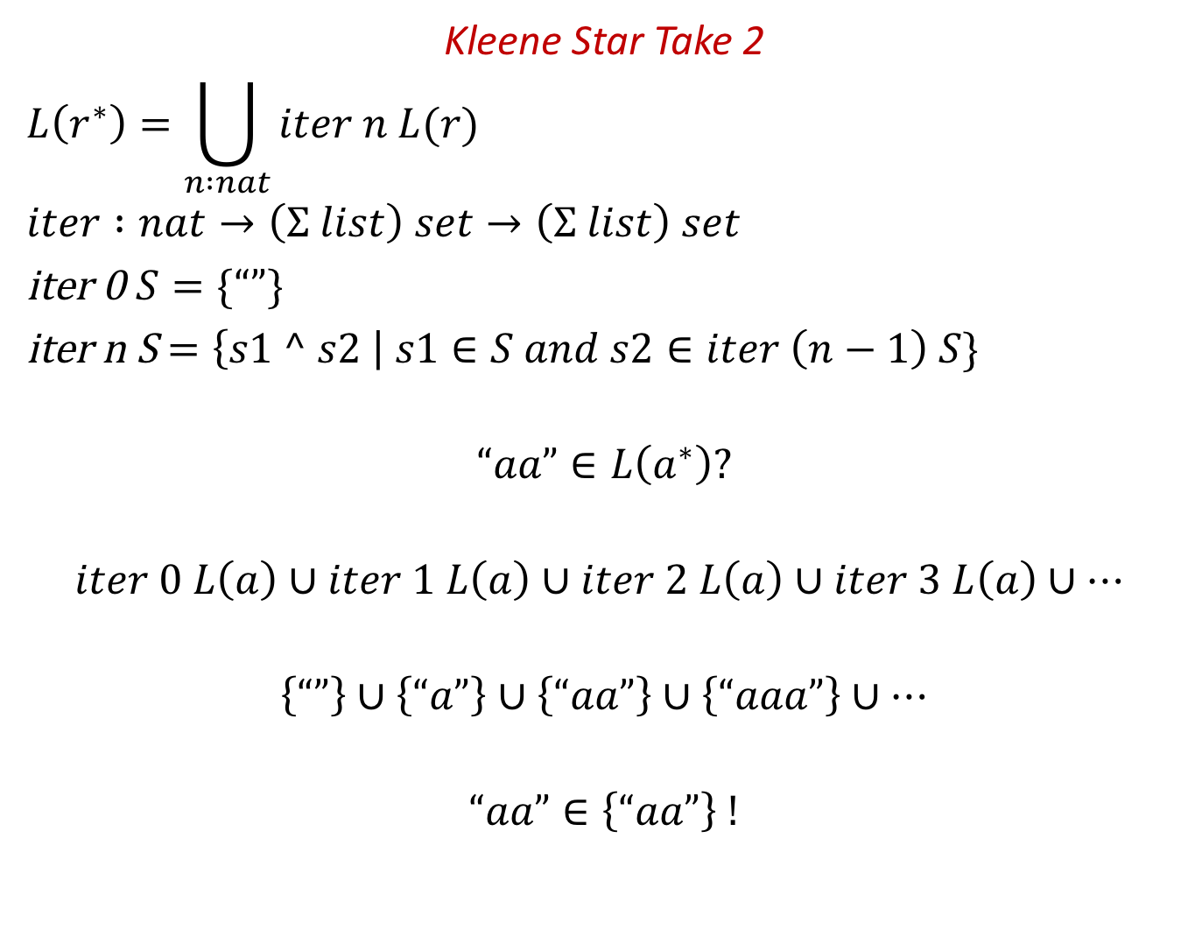
An Example
Kleene Star Take 2
$$L\left(r^{∗}\right)=\bigcup_{n :nat}{iter n L(r)}$$
$$iter :nat→\left(Σ list\right) set→\left(Σ list\right) set$$
iter 0 $S=\{“”\}$
iter n S $=\left\{s1 ^ s2 \right| s1∈S and s2∈iter \left(n−1\right) S\}$
$$“aa”∈L\left(a^{∗}\right)?$$
$$iter 0 L\left(a\right)∪iter 1 L\left(a\right)∪iter 2 L\left(a\right)∪iter 3 L\left(a\right)∪…$$
$$\left\{“”\right\}∪\left\{“a”\right\}∪\left\{“aa”\right\}∪\left\{“aaa”\right\}∪…$$
$$“aa”∈\left\{“aa”\right\} !$$

Slide 72
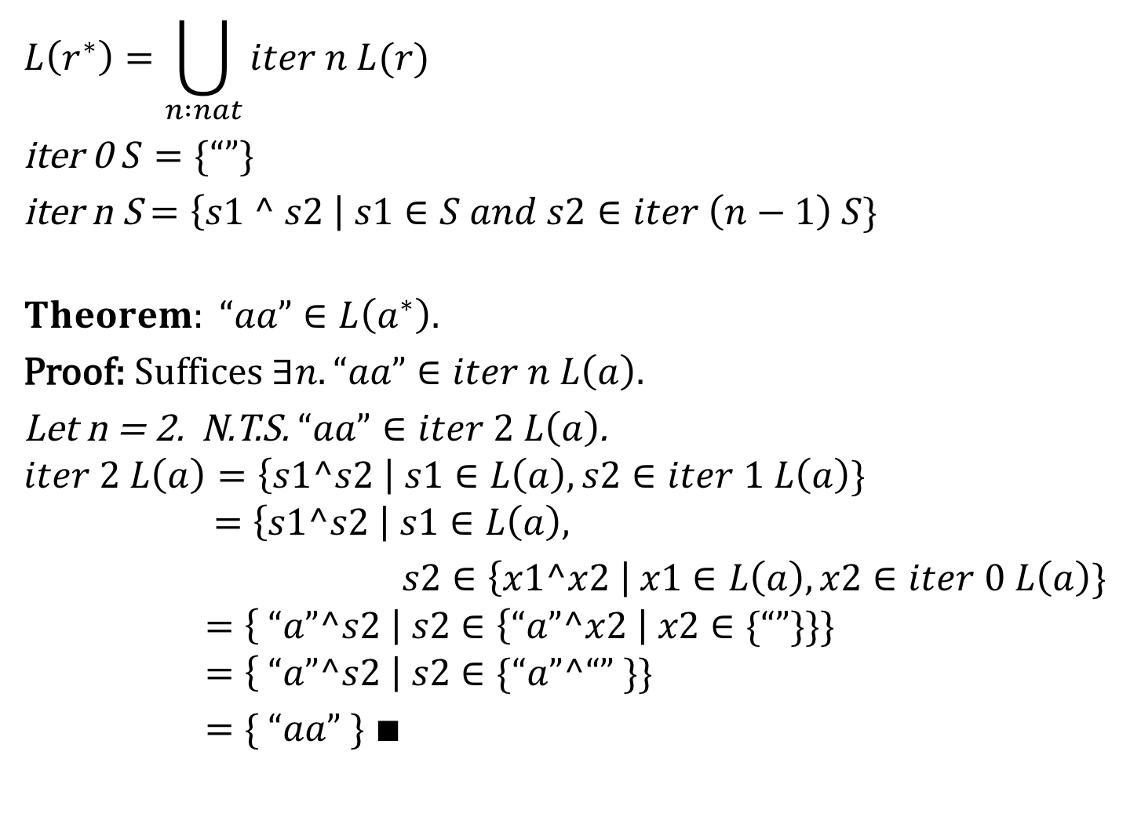
A Theorem
$$L\left(r^{∗}\right)=\bigcup_{n :nat}{iter n L(r)}$$
iter 0 $S=\{“”\}$
iter n S $=\left\{s1 ^ s2 \right| s1∈S and s2∈iter \left(n−1\right) S\}$
$$Theorem: “aa”∈L\left(a^{∗}\right).$$
Proof: $Suffices ∃n. “aa”∈iter n L\left(a\right).$
Let n = 2. N.T.S. $“aa”∈iter 2 L\left(a\right)$.
$$iter 2 L\left(a\right)=\left\{s1^s2 \right| s1∈L\left(a\right), s2∈iter 1 L\left(a\right)\}$$
$$=\left\{s1^s2 \right| s1∈L\left(a\right),$$
$s2∈\left\{x1^x2 \right| x1∈L\left(a\right), x2∈iter 0 L\left(a\right)\}$
$$=\left\{ “a”^s2 \right| s2∈\left\{“a”^x2 \right| x2∈\{“”\}\}\}$$
$$=\left\{ “a”^s2 \right| s2∈\{“a”^“” \}\}$$
$=\{ “aa” \}$ $∎$

Slide 73

A Slightly Trickier Theorem
$$L\left(r^{∗}\right)=\bigcup_{n :nat}{iter n L(r)}$$
iter 0 $S=\{“”\}$
iter n S $=\left\{s1 ^ s2 \right| s1∈S and s2∈iter \left(n−1\right) S\}$
$$Theorem:∀r. L\left(r^{∗}\right)⊆L\left(r^{∗∗}\right).$$
Proof: $Exercise$ ☺ $∎$

Slide 74
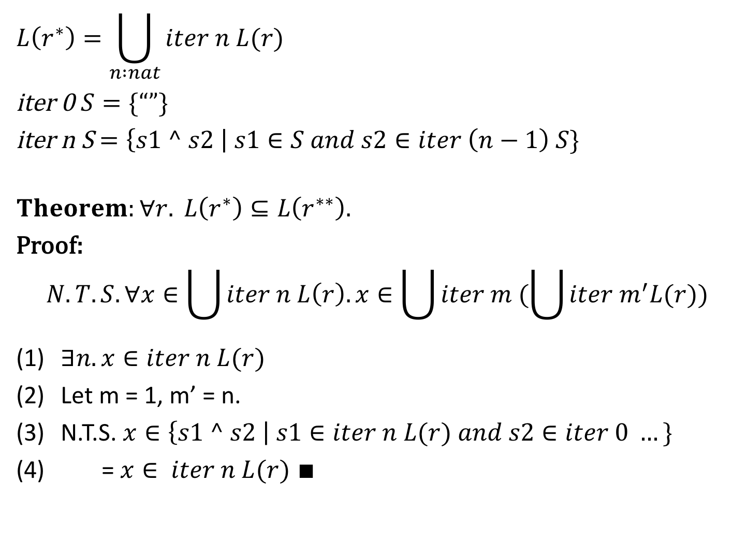
A Slightly Trickier Theorem
$$L\left(r^{∗}\right)=\bigcup_{n :nat}{iter n L(r)}$$
iter 0 $S=\{“”\}$
iter n S $=\left\{s1 ^ s2 \right| s1∈S and s2∈iter \left(n−1\right) S\}$
$$Theorem:∀r. L\left(r^{∗}\right)⊆L\left(r^{∗∗}\right).$$
Proof:
$$N.T.S. ∀x∈\bigcup{iter n L\left(r\right). x∈\bigcup{iter m (\bigcup{iter m^{′}L(r))}}}$$
$∃n. x∈iter n L(r)$
Let m = 1, m’ = n.
N.T.S. $x∈\left\{s1 ^ s2 \right| s1∈iter n L(r) and s2∈iter 0 …\}$
= $x∈ iter n L(r)$ $∎$

