Slide 1
Website Analysis
THE ESCALANTE LOOP
A Pitch for a Stronger Online Presence
Gloria Hansen

Slide 2
The Current Site
What's working
Opportunities to Improve
Local community focus is clear
Events are listed and actively maintained
Each business has its own dedicated page
Authentic personality — not corporate or generic
Site is secure and browser-trusted
No consistent colors, fonts, or visual style
Too many navigation items making the site overwhelming and hard to use
No consistent header or footer
No online form or clear path to rent the space
The site is not optimized for mobile visitors

Slide 3
The Vision
A site that works as hard as you do; welcoming visitors, informing locals, supporting small businesses, and renting beautiful spaces.
Clear Identity
Brand colors, consistent fonts, and a logo that reflects the landscape and community spirit of Escalante.
Rent Spaces
An online form so potential tenants can reach out directly.
Simpler Navigation
Fewer pages, smarter structure. Visitors find what they need in one click.
Mobile-friendly
Most visitors will find you on their phone. The new site will look great on any screen.
Events at a Glance
A clean, always-current events section with full dates and details.

Slide 4
New Site Structure
Home
About the Loop
Our Businesses
Events
Rent the Space
Contact
Momentum Yoga
Solace and Stone
Highway 12 Nails
Main page
Nav section
Instructor Training
Mackenzie Hair
Brooke Hair
Business card

Slide 5
Visual Direction
A few ideas based on the your local landscape

Slide 6
Typography
Retro & Authentic: matches the logos vintage script personality
Display: Abril
Body: Lato
Warm & Editorial: elevated but still approachable
Display: Playfair Display
Body: Source Sans Pro
Clean & Modern: lets the colors do the talking
Display: Montserrat
Body: Open Sans

Slide 7
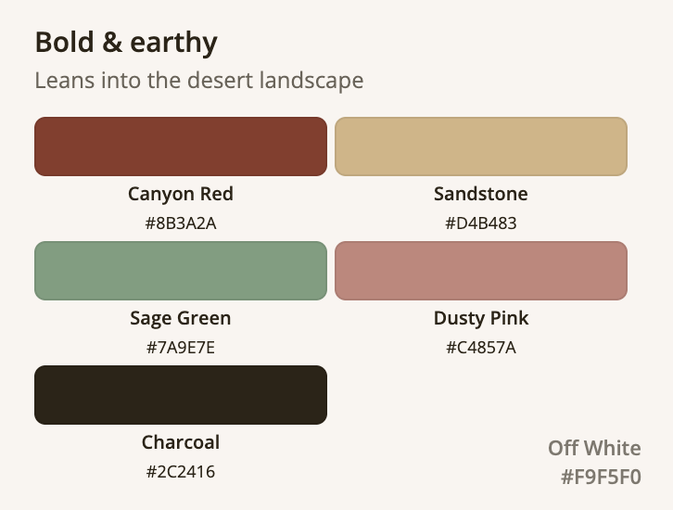
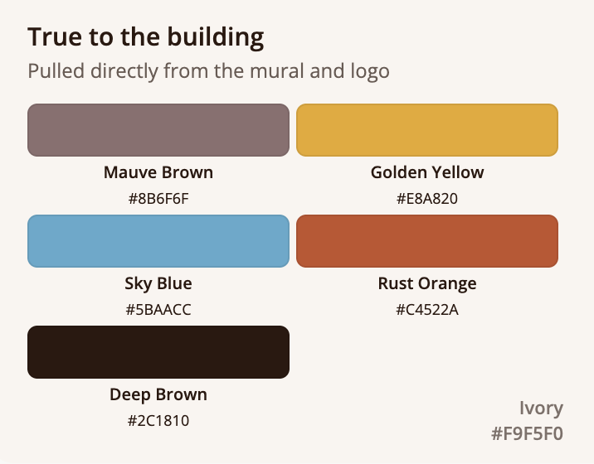
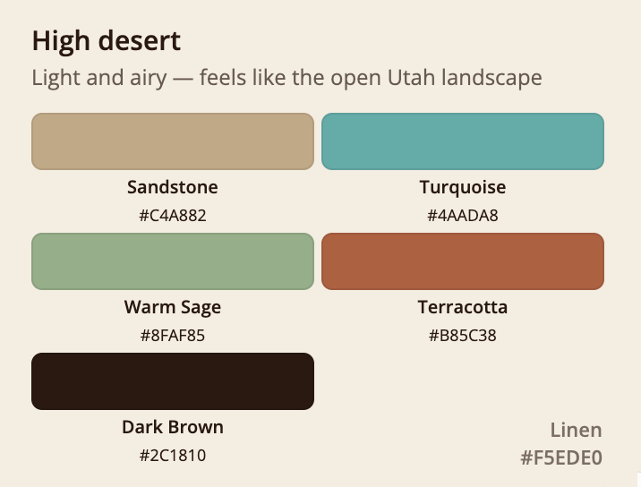
Color Palette

Slide 8






Key Features to Add
Global Header and Footer
Consistent navigation and contact info on every single page.
Event Section
Clean event cards with full dates, times, and descriptions. Easy for you to update in Wix.
Rent the Space Form
Online inquiry form — name, dates, intended use, contact info.
Business Showcase
Each business gets a clean card with their specialty, hours, and booking form.
Mobile Design
Designed to look great on phones. Most visitors will look you up via a mobile device.
Brand Identity
A cohesive palette, font system, and visual style that reflects Escalante and the Loop.

Slide 9
Questions for You
Your answers will help decide every design decision.
1
Who is the main audience? Locals, tourists, a bit of both?
4
Do you have existing brand colors or logos you would like to keep?
2
What do you want most people to do when they visit your site?
5
Do you have professional photos of the space and businesses?
3
Are you using Wix? If not, how are you coding/ hosting your site?
6
Are there any sites you love the look or feel of?

Slide 10
Fee and Scope
What’s included:
Brand identity (color palette, typography, visual style)
Global header and footer
Homepage redesign
Business showcase page (with buttons to individual pages)
Events section with full date formatting
Rent the Space inquiry form
Contact page
Mobile-friendly design throughout
One round of revisions
Launch walkthrough and training
I estimate this project will take me about 40-50 hours (4 to 5 weeks)
This analysis is free!
FLAT FEE
$700
50% upfront
50% at launch
HOURLY RATE
$18
Hours logged and
paid weekly

Slide 11
Next Steps
1)
Content gathering
Photos, text, business info, hours, and social links. The more you provide, the better the result.
2)
Mood board & wireframes
I'll share a visual direction and page layouts for your feedback before any building begins.
3)
Build in Wix
Full site build with your approved design. You'll review at each stage.
4)
Review & revisions
One round of revisions based on your feedback to get everything just right.
5)
Launch & training
Final walkthrough, training on how to update events yourself, and go live.

Slide 12
Let’s build something the community is proud of!
THE ESCALANTE LOOP
Questions? Ideas? Let’s talk.

