Slide 1
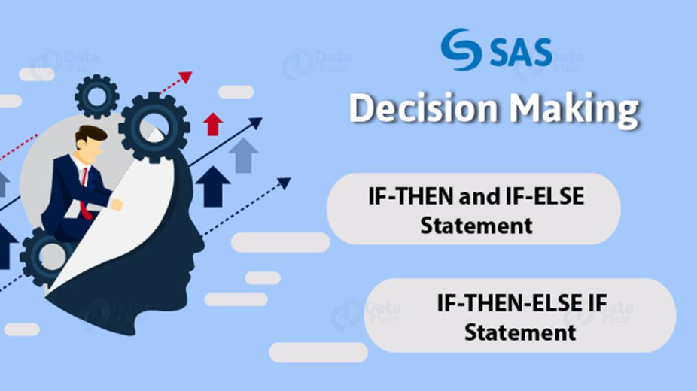
Notes:
SAS Decision making helps a programmer apply specific conditions on a statement or set of statements and then evaluate it. If the criteria are met, the program then falls to another set of conditions, if it fails it goes back to the beginning.

Slide 2
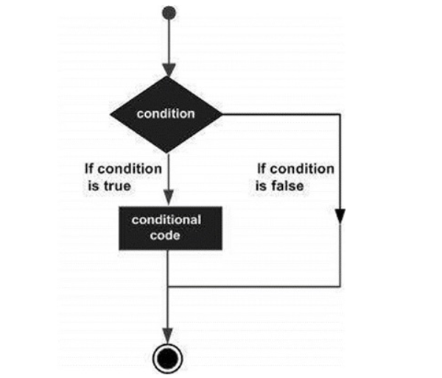
Notes:
Decision making structures require the programmer to specify one or more conditions to be evaluated or tested by the program, along with a statement or statements to be executed if the condition is determined to be true, and optionally, other statements to be executed if the condition is determined to be false.
Here is the general form of a typical decision making structure found in most of the programming languages
1IF Statement.An if statement consists of a condition. If the condition is true then the specific data is fetched.
2IF-THEN-ELSE Statement.An if statement followed by else statement, which executes when the boolean condition is false.
3IF-THEN-ELSE-IF Statement.An if statement followed by else statement, which is again followed by another pair of IF-THEN Statement.
4IF-THEN-DELETE Statement.An if statement consists of a condition, which when true deletes the specific data from the observations.

Slide 3
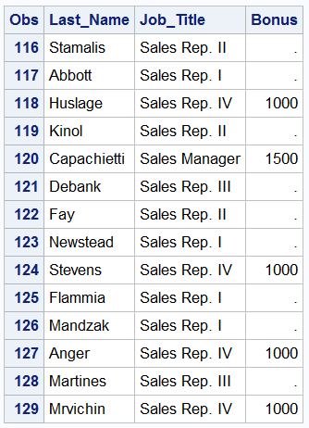
DATA comp1;
SET sales;
IF Job_Title='Sales Rep. IV' THEN Bonus=1000;
IF Job_Title='Sales Manager' THEN Bonus=1500;
IF Job_Title='Senior Sales Manager' THEN Bonus=2000;
IF Job_Title='Chief Sales Officer' THEN Bonus=2500;
RUN;
Notes:
Here we create a variable called “Bonus”, but assign the values based on a certain set of conditions that are defined by an employee’s job title.
You will see in that that several observations have missing values. This is due to the fact that we did not assign values for “Bonus” for all of the job titles.

Slide 4
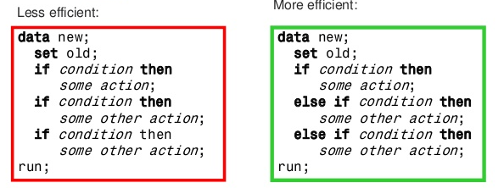
Notes:
A related statement to IF-THEN is the ELSE statement that can be used when creating conditional statements around mutually exclusive groups.
SAS process the first IF statement and if it is not true it moves to the next and so on. SAS continues to test the IF-THEN statement until it finds one that is true, which at that point it stops and will not test the remaining conditions. SAS evaluates the expression in the else-if statement only when the previous expression is false. In other words, this can speed up the processing of large datasets.
However, as was the case with the first IF-THEN example, we will end up with a lot of missing values using this syntax.

Slide 5
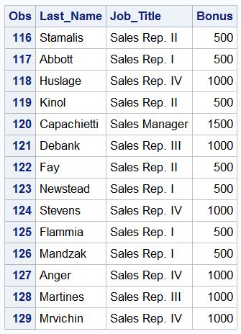
DATA comp3;
SET sales;
IF Job_Title='Sales Rep. III' or Job_Title='Sales Rep. IV' THEN Bonus=1000;
ELSE IF Job_Title='Sales Manager' THEN Bonus=1500;
ELSE IF Job_Title='Senior Sales Manager' THEN Bonus=2000;
ELSE IF Job_Title='Chief Sales Officer' THEN Bonus=2500;
ELSE Bonus=500;
RUN;
Notes:
What if we had a scenario where we wanted to give all the remaining categories, that did not fulfill the prescribed conditions, one bonus value. We can do that using a final ELSE statement with no IF-THEN. In the SAS code below, we add an additional ELSE statement assigning all of the job titles a bonus value of 500.

Slide 6
DATA drop;
SET sales;
IF Job_Title IN('Sales Manager', 'Senior Sales Manager', 'Chief Sales Officer') THEN DELETE;
RUN;
Notes:
There are a number of ways to use If then else. In this example, you can see that we have defined a IN class. If Job_Title rings true for any of these conditions. We will delete the record from the temporary data set of drop.

Slide 7
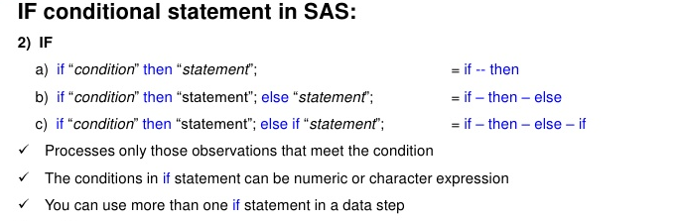

Slide 8


Questions????

Slide 9


Slide 10
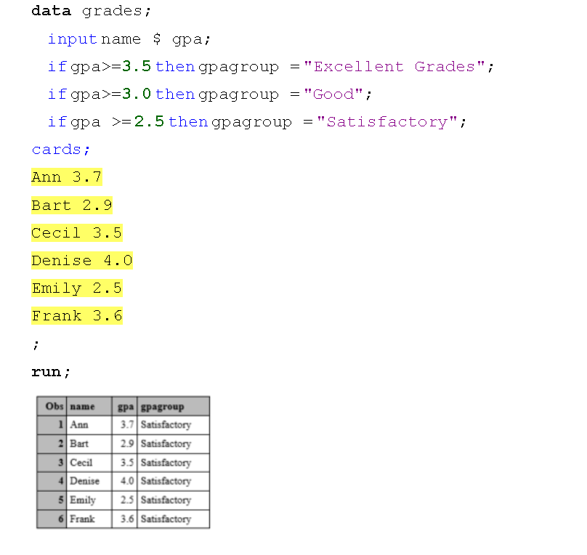
Notes:
What went wrong?
We should instead use if-then-else statements as follows:

Slide 11
Which DATA step ensures that all observations are assigned a non-missing value for Bonus? a. data work.bonus; set orion.sales; if Country='US' then Bonus=500; else if Country='AU' then Bonus=300; run: b. data work.bonus; set orion.sales; if Country='US' then Bonus=500; else Bonus=300; run:
Notes:
Correct answer is b

Slide 12
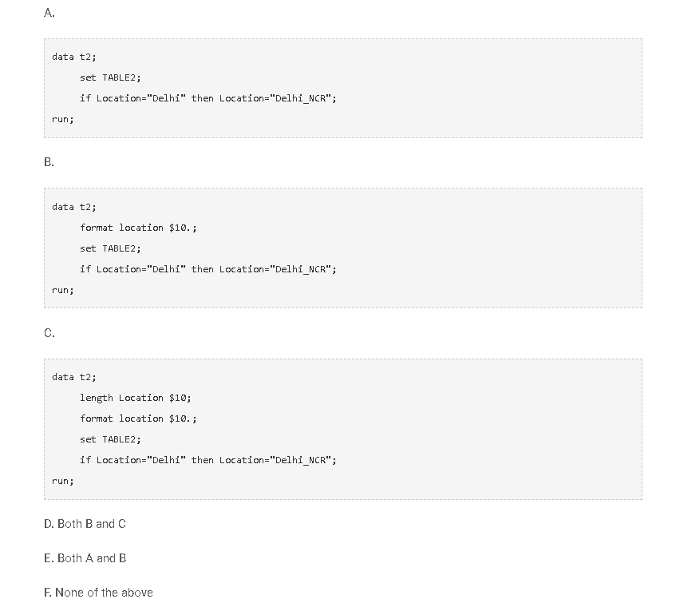
Notes:
Location name ‘Delhi’ has been wrongly put, need to replace this with ‘Delhi_NCR’. Which of the following code will complete this task?
Solution: (D)
The length of field “Location” in table2 is 8 so first we need to change the format of “Location”. Here in both options B and C, we have changed the length of field “Location”.

Slide 13
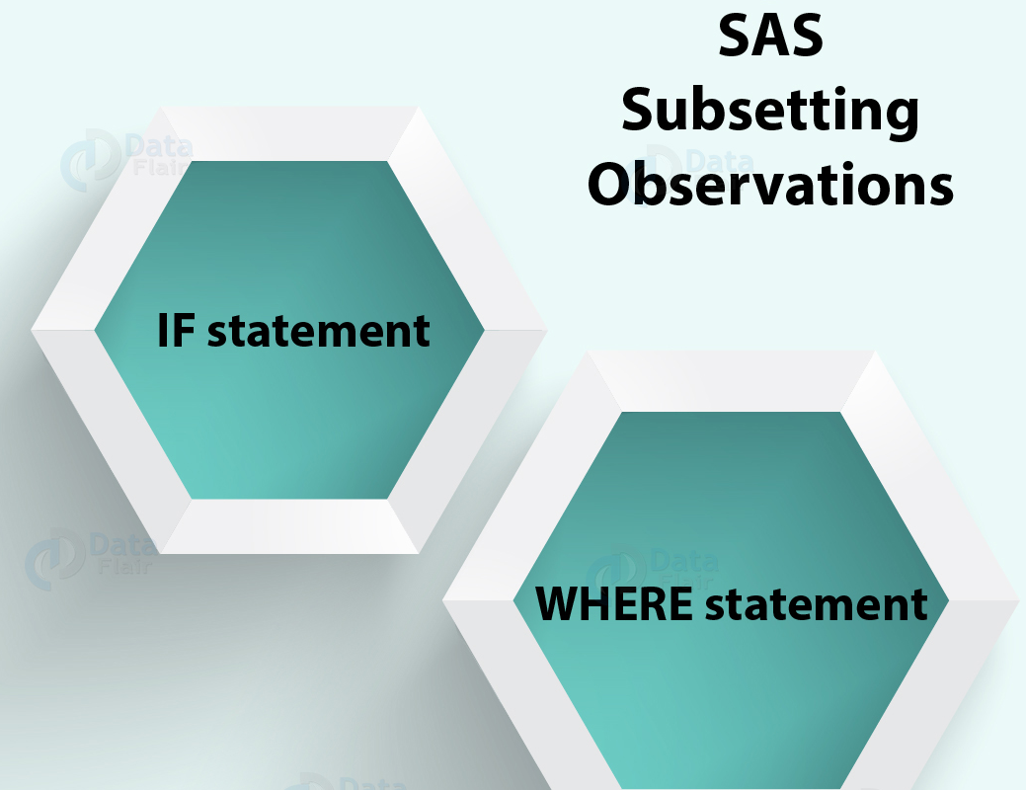

Slide 14
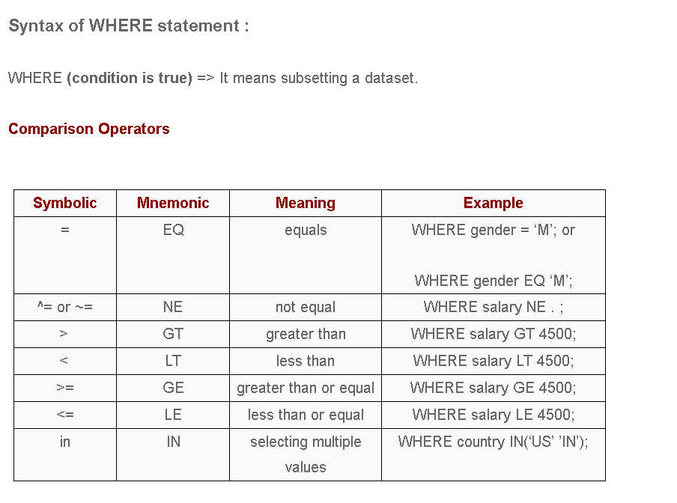
Notes:
Using where statement, we can create subset of data for reporting (temporary) and storage(permanent). If we write where statement in procedure block its create subset data for reporting and data set block for storage.
The WHERE statement is an alternative to IF statement when it comes to subsetting a dataset. It is important to know the difference between these two statements.

Slide 15
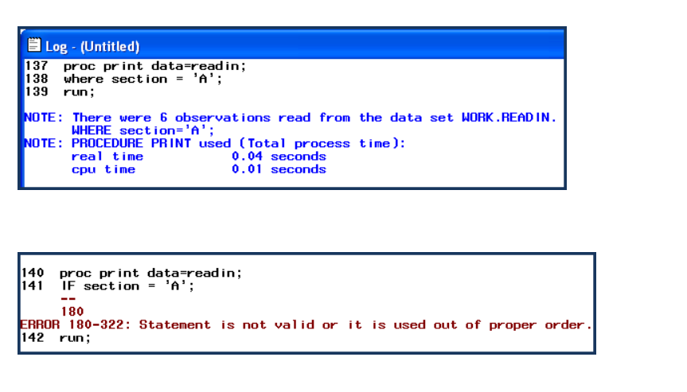
Notes:
The WHERE statement can be used in procedures to subset data while IFstatement cannot be used in procedures. WHERE can be used as a data set option while IF cannot be used as a data set option.

Slide 16
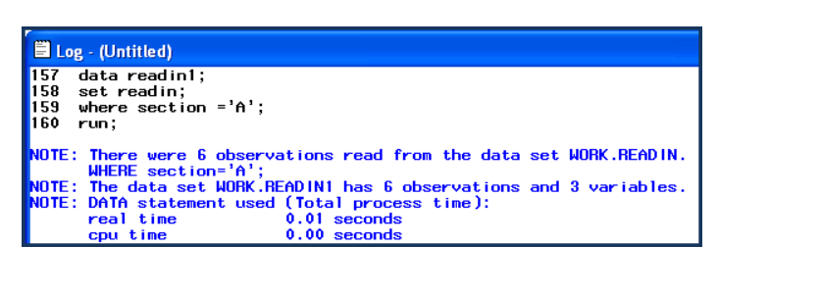
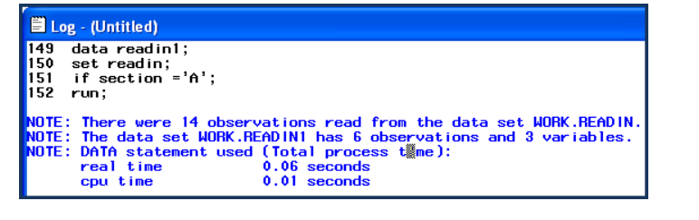
Notes:
The WHERE statement is more efficient than IF statement. It tells SAS not to read all observations from the data set. Look at the LOG (shown below) after using WHERE statement, you only see a count of the number of observations that meet the criteria in the WHERE statement. Only 6 observations were read from the dataset READIN. In actual, the dataset READIN contains 14 observations. All 14 observations are read and the 6 that meet the IF criteria are placed in the PDV. Program Data Vector is the area of memory where data sets are created through SAS system i.e. one at a time. When program is executed an input buffer is created which will read the data values and make them assign to their respective variables.
The where clause sends only those records that meet condition to the data set, IF statement sends all the records to the data set and removes the records that do not meet condition before they get sent to the output buffer. WHERE Emp_Name =* 'Red'

Slide 17
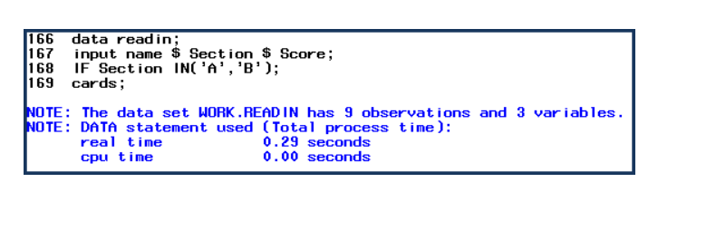
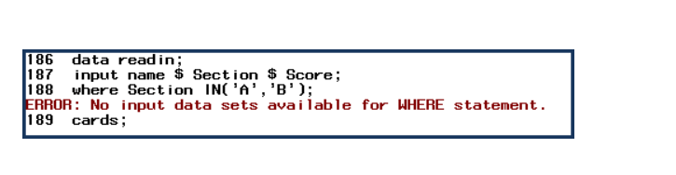
Notes:
When reading data using INPUT statement. IF Statement can be used when specifying an INPUT statement, WHERE statement can not be used when specifying an input statement.

Slide 18
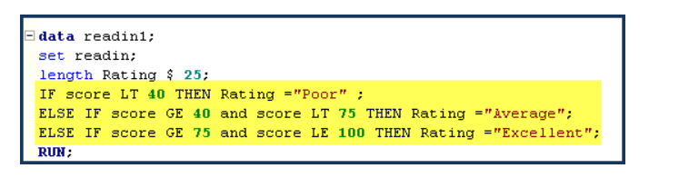
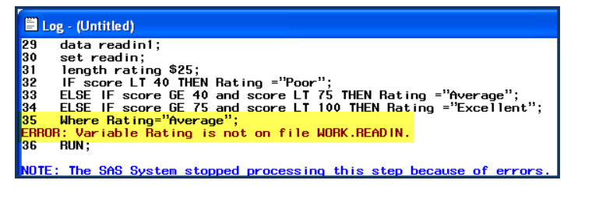
Notes:
Suppose, you have data for college students’ mathematics scores. You want to rate them on the basis of their scores. Conditions : 1. If a score is less than 40, create a new variable named “Rating” and give “Poor” rating to these students. 2. If a score is greater than or equal to 40 but less than 75, give “Average” rating to these students. 3. If a score is greater than or equal to 75 but less than or equal to 100, give “Excellent” rating to these students. This can be easily done using IF-THEN-ELSE IF statements. However, WHERE statement requires variables to exist in the data set.

Slide 19
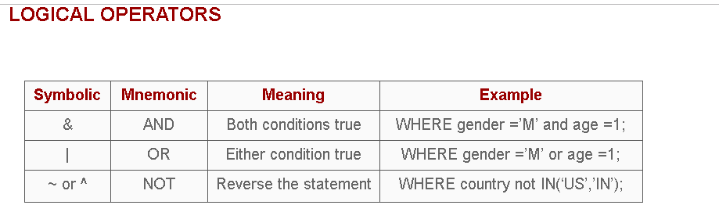
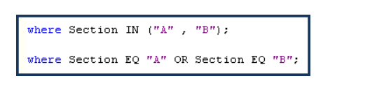
data readin;
input name $ Section $ Score;
cards;
Tom A 84
Raj A 80
Ram B 71
Atul A 77
Priya B 45
Sandy A 67
Sam A 57
David B 39
Wolf B 34
Rahul A 95
Sahul C 84
Lahul C 44
;
run;
Notes:
Suppose you want to select section A and B students. You know the variable Section contains information for students' sections.

Slide 20
Tom A 84
Raj A 80
Ram B 71
Atul . 77
Priya . 45
Sandy A 67
Sam A 57
David B 39
Wolf B 34
Rahul . 95
Sahul C 84
Lahul C 44
data readin1;
set readin;
where Section is missing;
run;

Slide 21
Tom A 84
Raj A 80
Ram B 71
Atul . 77
Priya . 45
Sandy A 67
Sam A 57
David B 39
Wolf B 34
Rahul . 95
Sahul C 84
Lahul C 44
data readin1;
set readin;
where name like 'S%';
run;
Notes:
The LIKE operator selects observations by comparing the values of a character variable to a specified pattern. It is case sensitive.
There are two special characters available for specifying a pattern: 1. percent sign (%) - Wildcard Character 2. underscore ( _ ) - Fill in the blanks
where name like 'S%'; OR where name like 'Sa%’;
You can also write this statement like ..... where name like '%am'; where name like '_ahu_’; where name like '_ahu__';

Slide 22
Questions????

Slide 24
Given the following SAS error log
44 data WORK.OUTPUT;
45 set SASHELP.CLASS;
46 BMI=(Weight*703)/Height**2;
47 where bmi ge 20;
ERROR: Variable bmi is not on file SASHELP.CLASS.
48 run;
What change to the program will correct the error?
A. Replace the WHERE statement with an IF statement
B. Change the ** in the BMI formula to a single *
C. Change bmi to BMI in the WHERE statement
D. Add a (Keep=BMI) option to the SET statement
Notes:
The correct answer is A. Where can not be used like IF in a data step.

Slide 25
The following SAS program is run on the above table “Emp”
proc print data = emp;
where Name like '_R%';
run;
How many records will it print?
A. 1
B. 2
C. 3
D. None of the above
Notes:
Solution: (D)
Like operator acts as case sensitive and in above table there is no-one whose second character of the name is capital R.

Slide 26
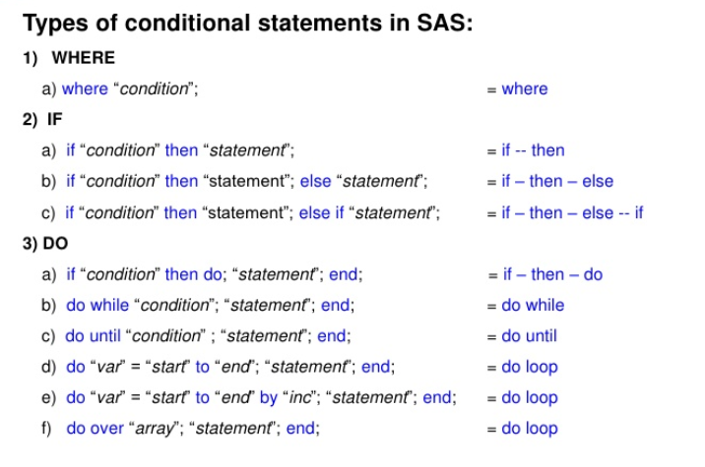
Next Subject that we will look
Notes:
Conditional processing in SAS allows the user to manipulate and output portions of data instead of the whole file. In previous section you have seen several examples of the WHERE statement. Alternatively, SAS also allows for the use of IF statements. Both can accomplish similar tasks; however ,while both WHERE and IF can be used with a Data step, only WHERE is allowed in a Proc step.
Data steps will accept both WHERE and IF statement, however only an IF can be used for assignment statements.
Moreover, you will notice that SAS allows you to create a variable and use it in an IF statement in the same Data step. This is something you can accomplish with an IF but not WHERE. The reason for this has to do with when SAS executes conditional statements. When using a WHERE condition SAS only selects the observations that meets this particular condition and then continues executing any other operations in the Data Step. This makes for more efficient processing of data especially with large amounts of data.

Slide 27


