Slide 1
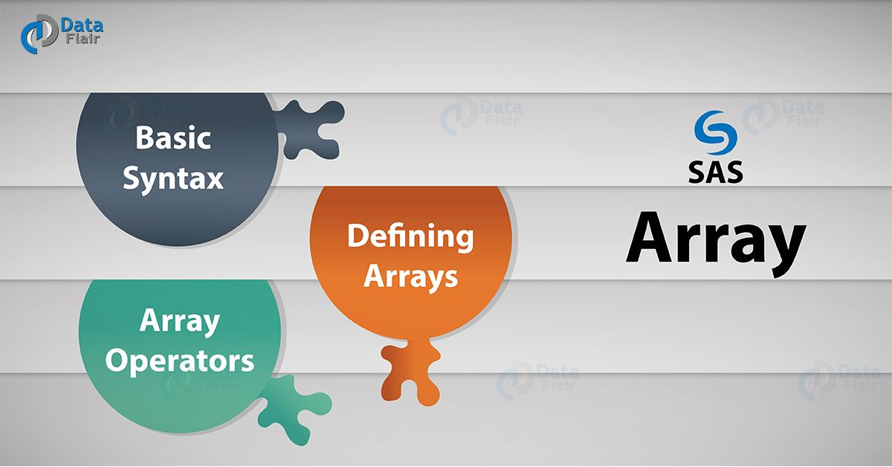
Notes:
Welcome to the SAS Array presentation. Generally, programmers use SAS arrays to simplify their code which results in less error-prone and more efficient programs.

Slide 2
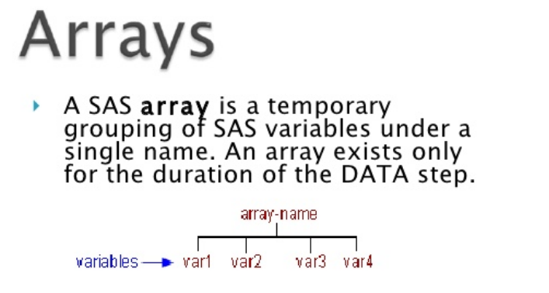
Notes:
A SAS array groups similar variables for processing inside the data step. After SAS array is defined, the tasks performed by variables at different times can be performed using a single array. This saves time and does not require multiple statements to be written.

Slide 3
Let’s Consider This Problem
net_sav1 = inc1- exp1; net_sav2 = inc2- exp2; . . . . . . . net_sav3 = inc3- exp3; net_sav11 = inc11-exp11; net_sav12 = inc12- exp12;
Notes:
Consider, SAS Array example, a savings data set (savings) that contains 24 monthly variables for a single year, 12 variables for income(Inc1–Inc12), and 12 variables for expenses (Exp1 – Exp12). To calculate the net savings for each month, the SAS program needs 12 statements. Yikes…. This method for calculating the net savings is repetitive. As the amount of data increases, more statements are required to calculate net savings for each month. Arrays can be used to perform these calculations with few statements.

Slide 4

What is An Array
Notes:
An array is a way of arranging things in rows and columns. When you buy things like a pack of cookies, a pack of toy cars, or even a carton of eggs, the items in the package are lined up to create an array. An array always has rows and columns. The rows are the horizontal lines that go from left to right. The columns are the vertical lines that go from top to bottom. Things that are arranged in an array create a rectangular shape or a square shape.
So in our doughnut box, we have 3 rows and 4 columns.
Number sentences for an array can be written as a repeated addition sentence or a multiplication sentence. The multiplication sentence for this array is 4 * 3 = 12. This is because there are 4 doughths in each column and 3 doughnuts in each row. You can look at the first column and first row to see this information, so 4 * 3 = 12. You also can count each item one by one and you still see that there are 12 doughts.

Slide 5


Questions????

Slide 6


Slide 7
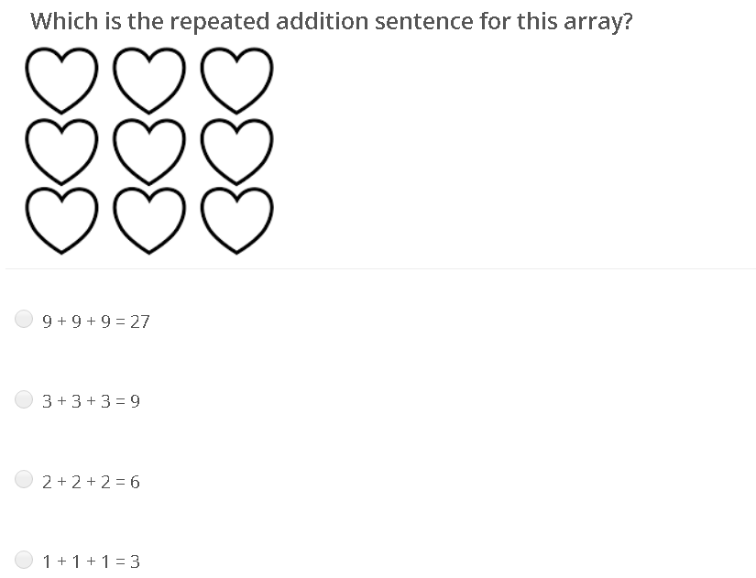
Notes:
The answer here is 3 + 3 + 3 = 9

Slide 8
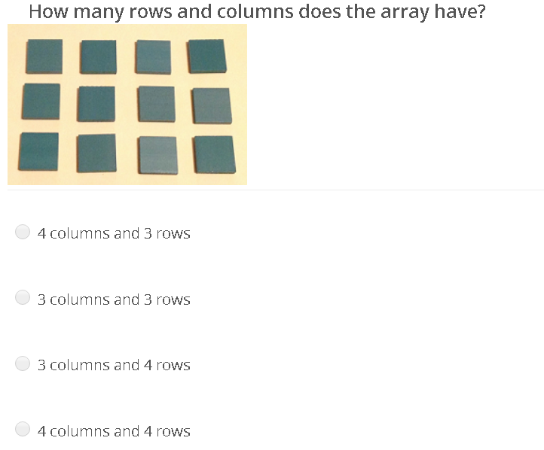
Notes:
The answer here is 4 columns and 3 rows

Slide 9
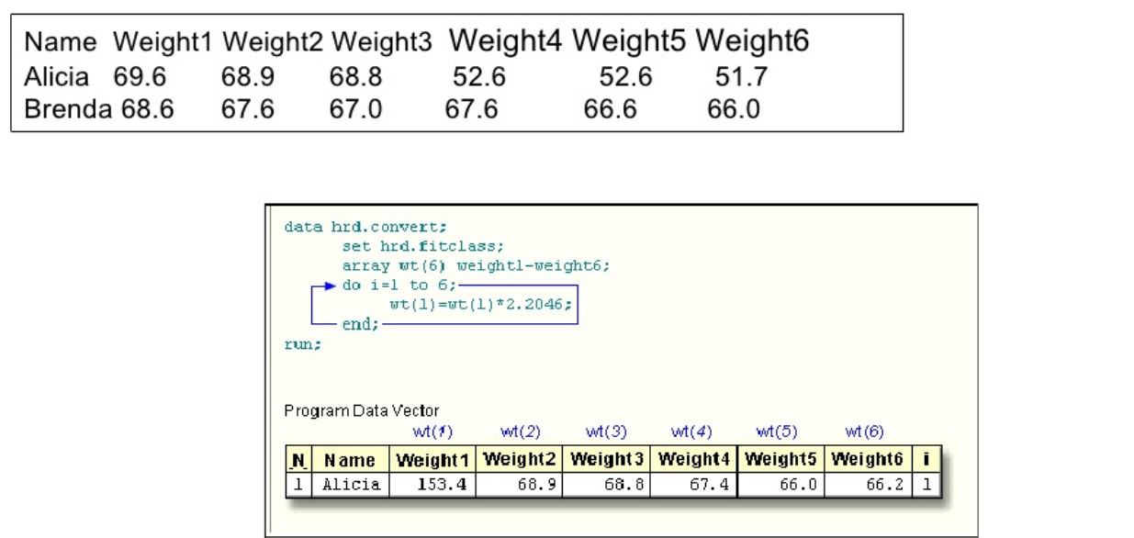
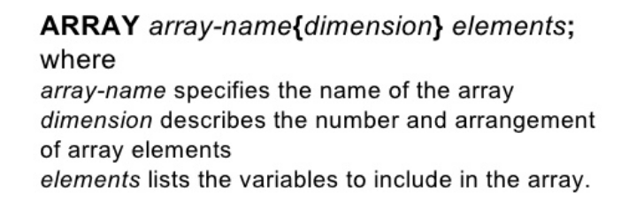
Notes:
The SAS array name can be followed by either a pair of parentheses ( ), braces { }, or square brackets [ ]. By specifying a value inside the bracket, we can assign the same number of variables to the array.
For example, using this example, we can create an array and add 6 variables to it, one for each weight, instead of writing statements for those 6 variables.

Slide 10
# Declare an array of length 4 named age with values. ARRAY age[4] (11 1 2 62);
# Declare an array of length 8 named colors with values starting at index 0. ARRAY colors (0:5) A B C D E F G H I;
# Declare an array of length 5 named books which contain character values. ARRAY books(1:5) $ b1-b5;
# Declare an array of required length depending on the number of values supplied. ARRAY ANS(*) A1-A10;
Notes:
There are several ways to define an array.
In the example one, age is an array-name, 4 implies the number of variables in array and “11 1 2 62" are the fields that make up the array. In the example two, colors is the array-name, start at 0 to 5, it contain 6 values. Colors(0) – A, Colors(1)-B…. Colors(6)-I
In the example four, SAS would automatically calculate the number of variables in array. This initial value is missing value.
In example three, there the book variable contains the B1 value and contains the B2 value, etc.
But there are key points to remember.
array-name – Any valid SAS name
n – Number of elements within the array
$ - Indicates the elements within the array are character type variables
length – A common length for the array elements
array-elements – List of SAS variables to be part of the array
initial values – Provides the initial values for each of the array elements

Slide 11
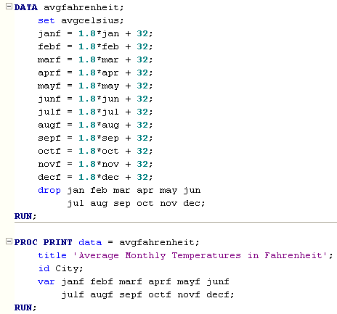
Notes:
Suppose that we don't feel particularly comfortable with understanding Celsius temperatures, and therefore, we want to convert the Celsius temperatures into Fahrenheit temperatures for which we have a better feel. The following SAS program uses the standard conversion formula:
Fahrenheit temperature = 1.8*Celsius temperature + 32;
So, I convert the Celsius temperatures in the avgcelsius data set to Fahrenheit temperatures stored in a new data set called avgfahrenheit:
As you can see by the number of assignment statements necessary to make the conversions, the exercise becomes one of patience. Because there are twelve average monthly temperatures, we must write twelve assignment statements. Each assignment statement performs the same calculation.

Slide 12

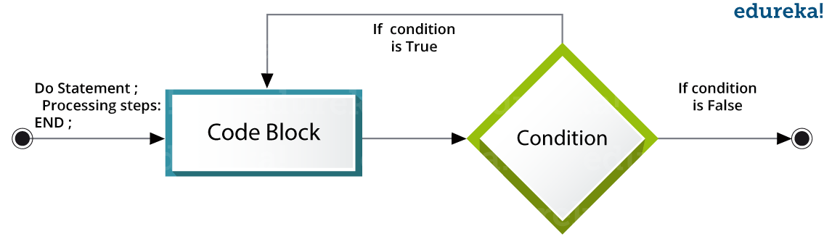
Notes:
There must be a simpler way to process the same algorithm over and over. While doing SAS programming, we may encounter situations where we repeatedly need to execute a block of code several number of times. It is inconvenient to write the same set of statements again and again. This is where loops come into picture. In SAS, the Do statement is used to implement loops. It is also known as the Do Loop.
The types of DO loops in SAS:
Index: The loop continues from the start value till the stop value of the index variable.
While: The loop continues as long as the While condition becomes false.
Until: The loop continues till the Until condition becomes True.

Slide 13

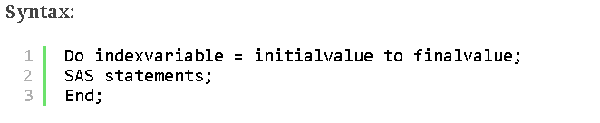
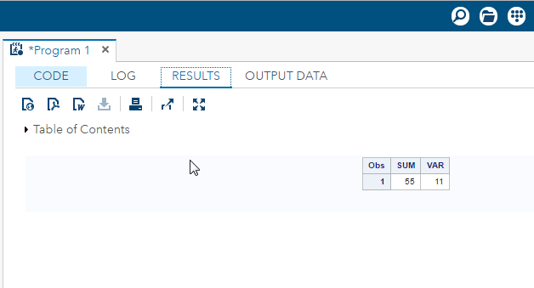
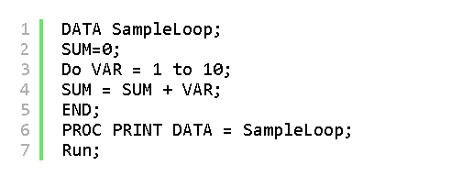
Notes:
We use an index variable as a start and stop value for Do Index loop. The SAS statements get executed repeatedly till the index variable reaches its final value.

Slide 14

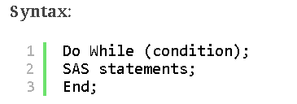
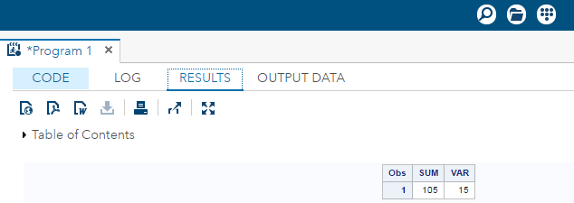
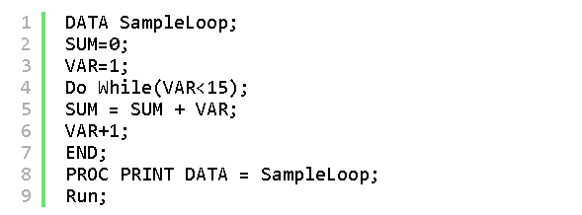
Notes:
The Do While loop uses a WHILE condition. This Loop executes the block of code when the condition is true and keeps executing it, till the condition becomes false. Once the condition becomes false, the loop is terminated.

Slide 15


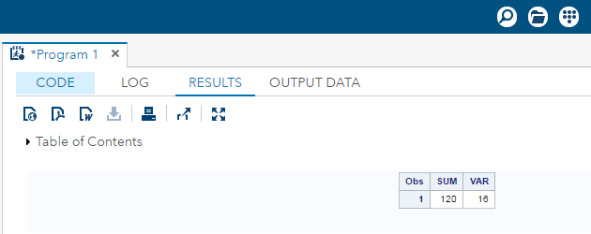
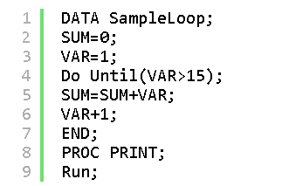
Notes:
The Do Until loop uses an Until condition.This Loop executes the block of code when the condition is false and keeps executing it, till the condition becomes true. Once the condition becomes true, the loop is terminated.

Slide 16
Questions????

Slide 18
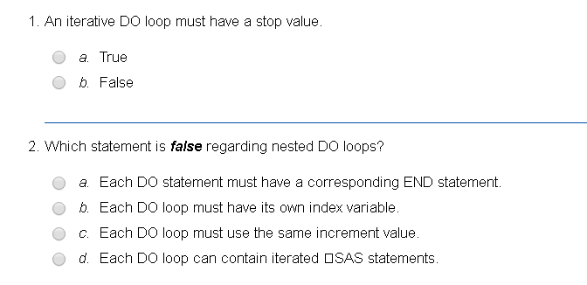
Notes:
Correct answer: b It might have a list of values
Correct answer: c When you nest DO loops, you must use different index variables for each loop, and you must be certain that each DO statement has a corresponding END statement. Each DO loop can use different increment values.

Slide 19
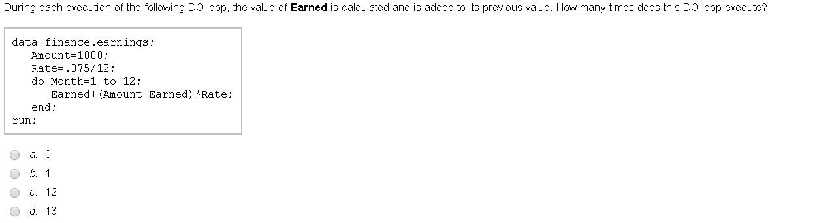
Notes:
Correct answer: c The number of iterations is determined by the DO statement's stop value, which in this case is 12.

Slide 20
Notes:
So let’s look at this problem again.

Slide 21
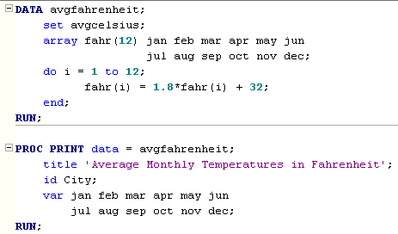
Notes:
If you compare this program with the previous program, you can see the statements that replaced the twelve assignment statements. The ARRAY statement defines an array called fahr. It tells SAS that you want to group the twelve month variables, jan , feb, ... dec, into an array called fahr. The (12) that appears in parentheses is a required part of the array declaration.
Called the dimension of the array, it tells SAS how many elements, that is, variables, you want to group together. When specifying the variable names to be grouped in the array, we simply list the elements, separating each element with a space. As with all SAS statements, the ARRAY statement is closed with a semicolon (;).
Once we've defined the array fahr, we can use it in our code instead of the individual variable names. We refer to the individual elements of the array using its name and an index, such as, fahr(i). The order in which the variables appear in the ARRAY statement determines the variable's position in the array. For example, fahr(1) corresponds to the jan variable, fahr(2) corresponds to the feb variable, and fahr(12) corresponds to the dec variable. It's when you use an array like fahr, in conjunction with an iterative DO loop, that you can really simplify your code, as we did in this program.
The DO loop tells SAS to process through the elements of the fahr array, each time converting the Celsius temperature to a Fahrenheit temperature. For example, when the index variable i is 1, the assignment statement becomes:
fahr(1) = 1.8*fahr(1) + 32;
which you could think of as saying:
jan = 1.8*jan + 32;
The value of jan on the right side of the equal sign is the Celsius temperature. After the assignment statement is executed, the value of jan on the left side of the equal sign is updated to reflect the Fahrenheit temperature.

Slide 22
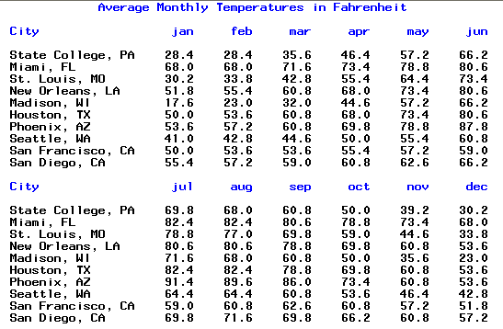

Slide 23
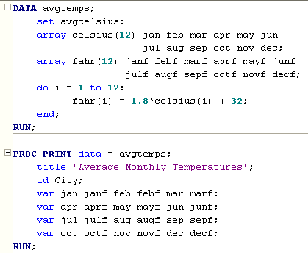
Notes:
We can also create new variables in an ARRAY statement by omitting the array elements from the statement. When our ARRAY statement fails to reference existing variables, SAS automatically creates new variables for us and assigns default names to them. The first ARRAY statement tells SAS to group the jan, feb, ..., dec variables in the avgcelsius data set into a one-dimensional array called celsius. The second ARRAY statement tells SAS to create twelve new variables called janf, febf, ..., and decfand to group them into an array called fahr.

Slide 24
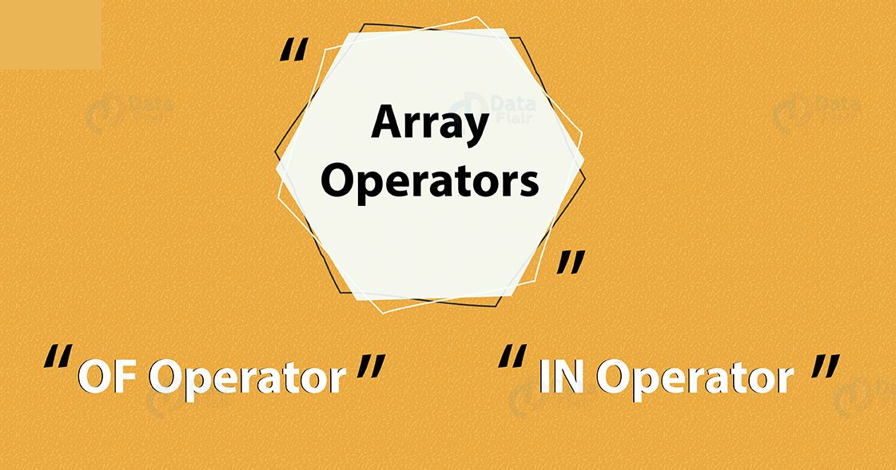

Slide 25
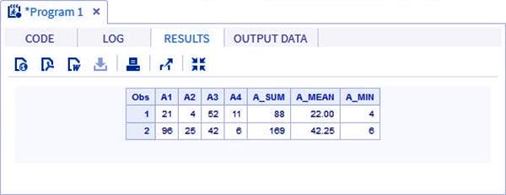
DATA example_OF;
INPUT A1 A2 A3 A4;
ARRAY A(4) A1-A4;
A_SUM=SUM(OF A(*));
A_MEAN=MEAN(OF A(*));
A_MIN=MIN(OF A(*));
DATALINES;
21 4 52 11
96 25 42 6;
RUN;
PROC PRINT DATA=example_OF;
RUN;
Notes:
The OF operator is used when a calculation is to be performed on all the variables or elements of the array.

Slide 26
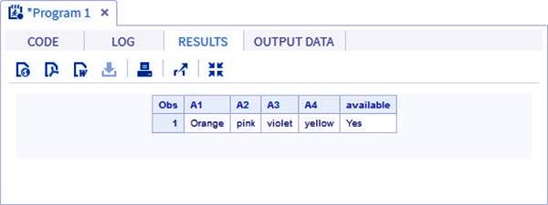
DATA in_example;
INPUT A1 $ A2 $ A3 $ A4 $;
ARRAY COLOURS(4) A1-A4;
IF 'yellow' IN COLOURS THEN available='Yes'; ELSE available='No';
DATALINES;
Orange-pink violet yellow;
RUN;
PROC PRINT DATA=in_example;
RUN;
Notes:
If we want to look for a particular value in the array and check for its presence, IN operator can be made use of. In the below example we check for the availability of the color “Pink” in the data. The keyword IN is case sensitive.

Slide 27

Notes:
Once an array is created, you can refer to a value in a array by specifying an index value. So, here we are apply the value in the 5 position of the array to apply to the expression.

Slide 28
Questions????

Slide 30
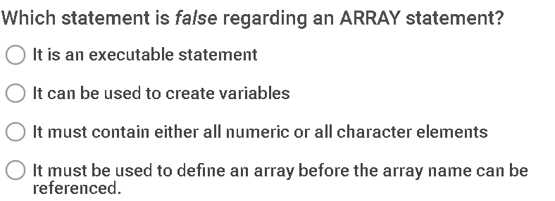
Notes:
Answer is “It is an executable statement”. An array statement is not an executable statement. It defines an array.

Slide 32
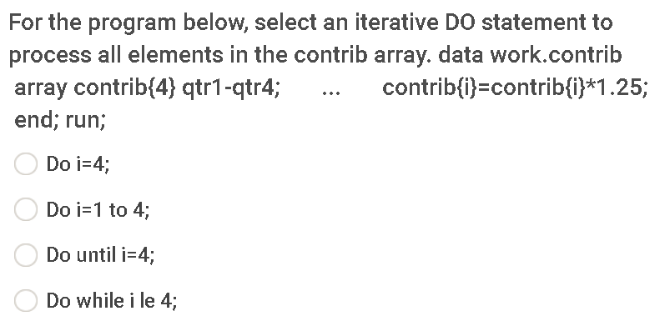
Notes:
Answer” 2 “Do I = 1 to 4”
In the Do statement you specify the index variable that represents the values of the array elements. We specify the start and stop positions of the array element.

