Slide 1

Classification of Kickstarter’s successful or failed projects
based on data crawled by a scraper robot
Promotion février 2020
Gloria González Curto

Slide 2
Problem definition and goal
Kickstarter: a global crowdfunding platform focused on creativity.
Creators propose projects and fix an economic goal and a deadline.
If the goal is reached, the pledged money is collected from backers.

Slide 3
Problem definition and goal
Goal
Predict if a project is going to succeed or fail its crowdfunding campaign based on data crawled by a web robot from the kickstarter site.
Interest of the project
Guide creators to succeed in the set up of their project campaign.
Guide creators to decide to launch a campaign on kickstarter based on their project’s general subject

Slide 4
Description of raw data
Raw data were collected from https://webrobots.io/kickstarter-datasets/
Crawl executed on February 13 2020
57 CSV files with 3500 to 4000 rows each and 38 variables (redundant)
category, creator, location, photo, profile, and urls are JSON encoded
Other variables are related to:
name and text description
location
goal, pledged, currency, index for conversion into USDs
dates (UNIX time)
profile related
state of the project (TARGET)

Slide 5
Description of raw data
Dataset statistics (pandas profiling package)
Number of variables 38
Number of observations 206174
Missing cells 824297
Missing cells (%) 10.5%
Duplicate rows 0
Duplicate rows (%) 0.0%
Total size in memory 1.2 GiB
Average record size in memory 6.1 KiB
Variable types
  CAT 18
  NUM 12
  BOOL 7
  URL 1

Slide 6
data pre-processing
Sources of data leaks:
Rows(projects):
  Errors parsing JSON due to ambiguous encoding:
    Tried to fix errors with regexp and replaces
    Filter out problematic rows (forecast of 22800 → 206174 rows)
  Text in several languages
    Translation
    Detection of language and translation
    Custom made filter to select English text
Columns (features):
  Variables with high amounts of missing values
  Redundant or low information
  High correlation to target or information not available for ongoing projects

Slide 7
data pre-processing:
new variables
Creation of variables:
Dummification of categorical variables
Date derived variables
  Year, month, day (created, deadline, launched, state change at)
  Initial duration of the project
  Project set-up
Profile (integer score accounting for profile completeness)
Frequency score :
  Selection of 200 keywords (200 more frequent words) by category and state, and its frequency (computed on training sets)
  Add the frequency for occurrences of successful keywords
  Subtract the frequency for occurrences of failed keywords
  Normalize by text length

Slide 8
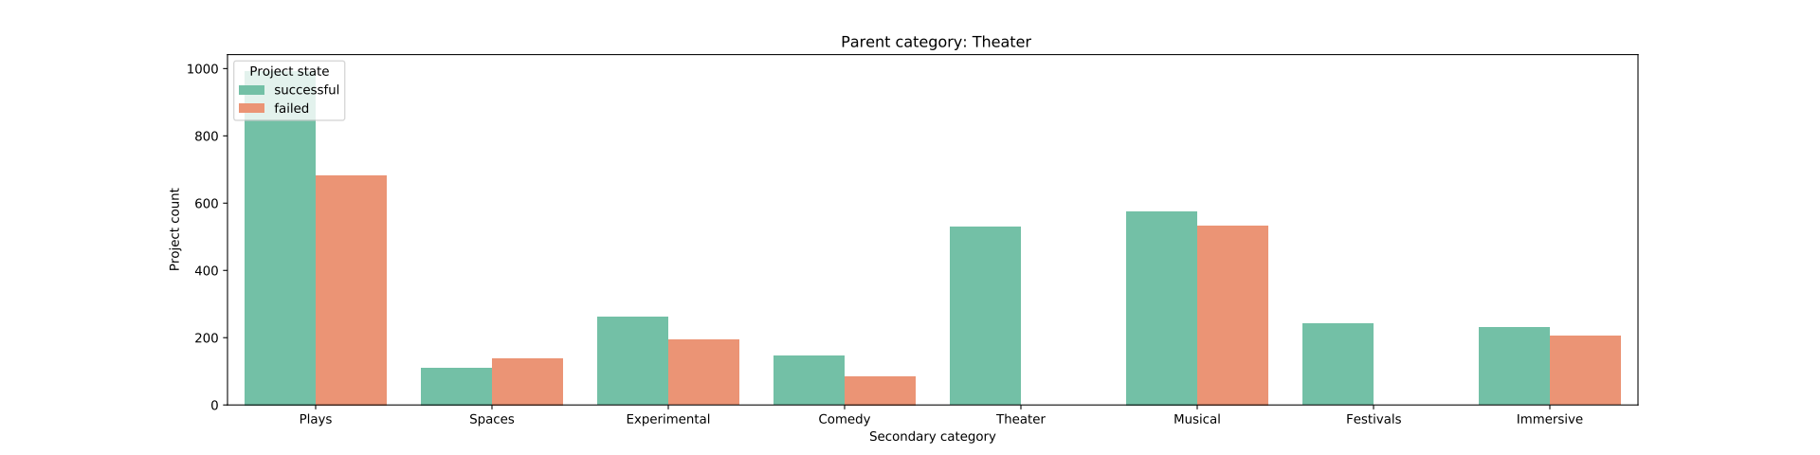
data pre-processing:
feature selection
Secondary category selection (159 subcategories) :
More than 55% of successful projects
Information non redundant to principal category (15)
Selection of 46 subcategories

Slide 9
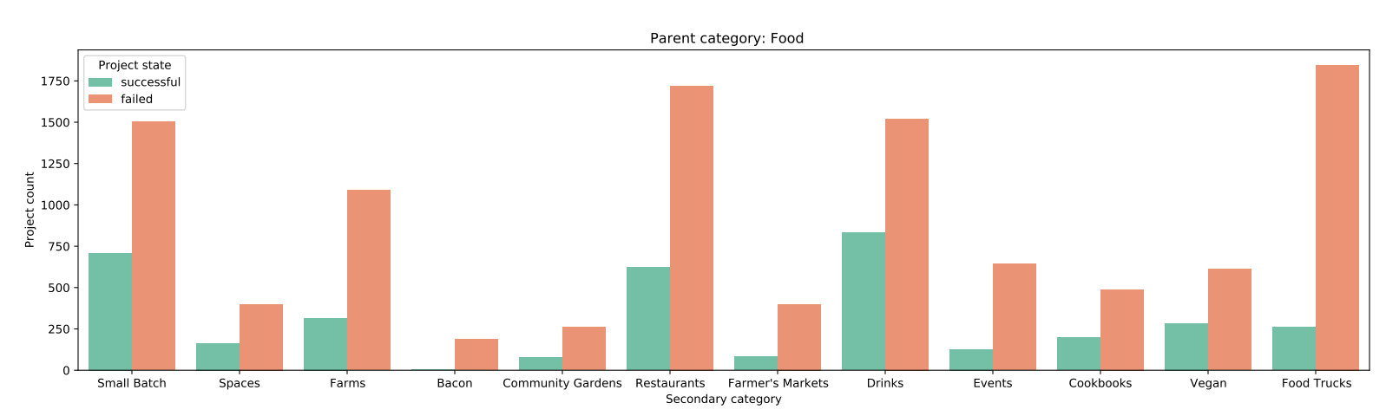
data pre-processing:
feature selection
Secondary category selection (159 subcategories) :
More than 55% of successful projects
Information non redundant to principal category (15)
Selection of 46 subcategories

Slide 10
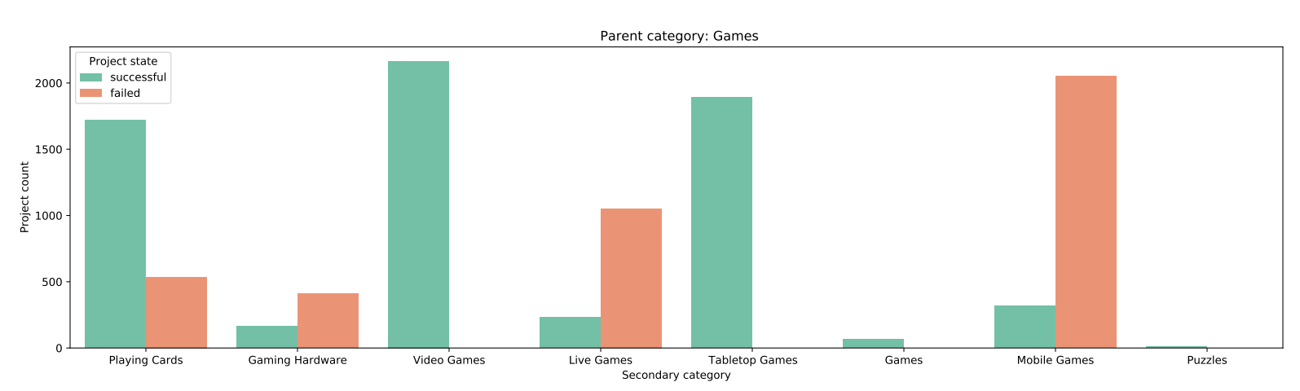
data pre-processing:
feature selection
Secondary category selection (159 subcategories) :
More than 55% of successful projects
Information non redundant to principal category (15)
Selection of 46 subcategories

Slide 11


















data pre-processing:
feature selection
Country selection(198 levels): :
More than 55% of successful projects and more than 50 projects
Selection of 18 countries
United Kingdom
Hong Kong
Japan
Singapore
China
Poland
Israel
Taiwan
Czech Republic
Greece
Indonesia
Argentina
Kenya
Iceland
Ghana
Portugal
Slovenia
Finland

Slide 12
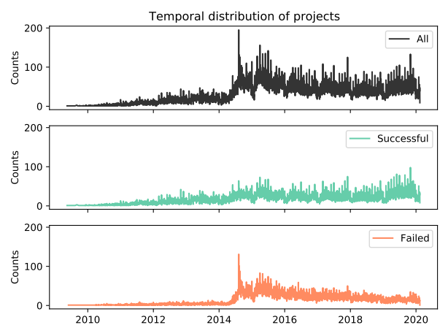
Exploratory data visualization:
temporal dimension

Slide 13
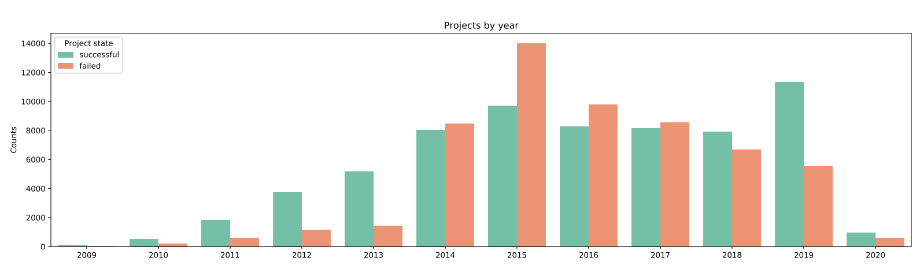
Exploratory data visualization:
temporal dimension

Slide 14


Exploratory data visualization:
wordclouds
Category: Comics

Slide 15


Exploratory data visualization:
wordclouds
Category: Fashion

Slide 16


Exploratory data visualization:
wordclouds
Category: Food

Slide 17
data pre-processing:
split train and test
Data
(122590, 93)
training
(89490, 93)
test
(33100, 93)

Slide 18
XGBoost binary classification:
bayesian hyperparameter optimization
Parameters for crossvalidation:
'objective': 'binary:logistic',
'max_depth': int(max_depth),
'gamma': gamma,
'learning_rate':learning_rate,
'subsample': subsample,
'eval_metric': 'auc'
Hyper parameter space:
'max_depth': (3, 8), # default 6
'gamma': (0, 5), # default 0
'learning_rate':(0, 1), #default 0.3
'subsample':(0, 1) # default 1
num_boost_round=100
nfold=5
early_stopping_rounds=80
as_pandas=True
seed=37

Slide 19
XGBoost binary classification:
Evaluation metrics on test set
precision recall f1-score support
0 0.83 0.89 0.86 15423
1 0.90 0.84 0.87 17677
accuracy 0.86 33100
macro avg 0.86 0.87 0.86 33100
weighted avg 0.87 0.86 0.86 33100
Confusion matrix
0 1
0 [13763 1660]
1 [ 2844 14833]

Slide 20
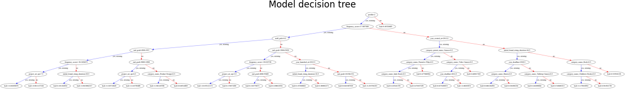
XGBoost binary classification:
model interpretation

Slide 21
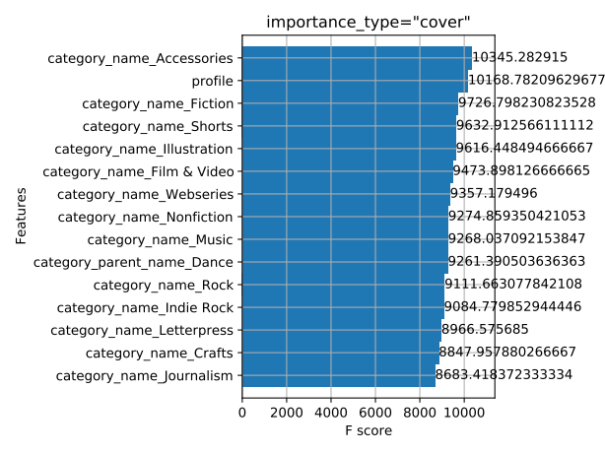
XGBoost binary classification:
model interpretation

Slide 22
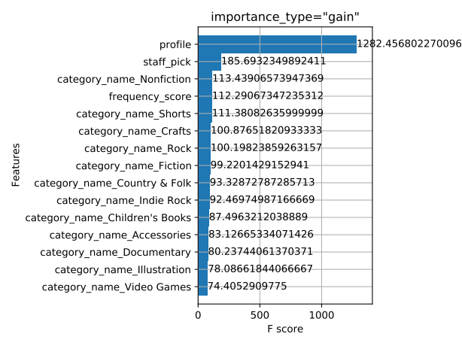
XGBoost binary classification:
model interpretation

Slide 23
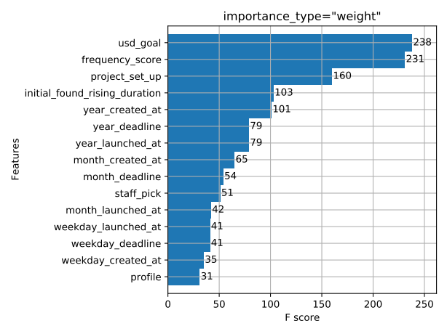
XGBoost binary classification:
model interpretation

Slide 24
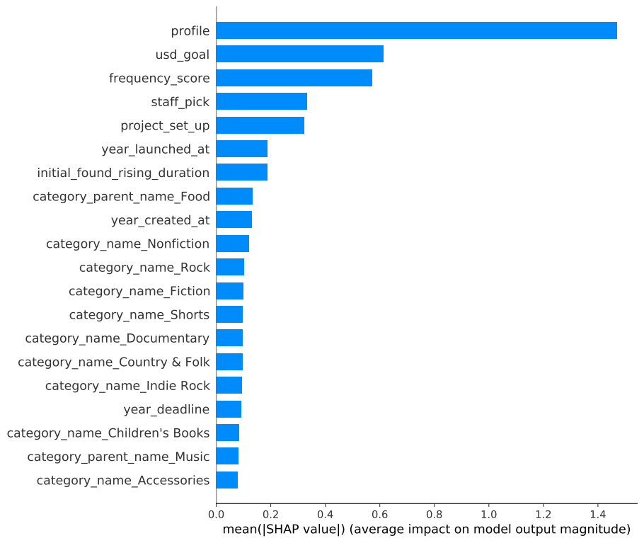
SHAP:
model interpretation

Slide 25
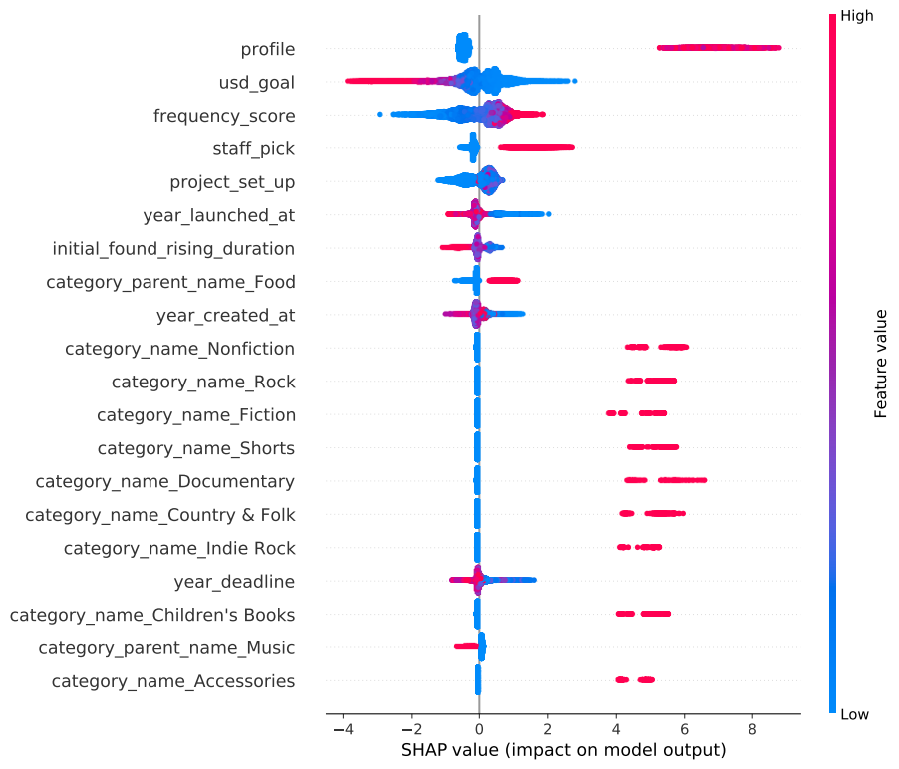
SHAP:
model interpretation

Slide 26
SHAP:
Error evaluation

Slide 27
Conclusions and perspectives

Slide 28


Development tools
Visual Studio Code
Git + GitHub

