Slide 1
Interactive Lesson on Cognitive Biases
All 22 Kahneman Experiments
(Scan the QR code to answer in real-time!)

Slide 2
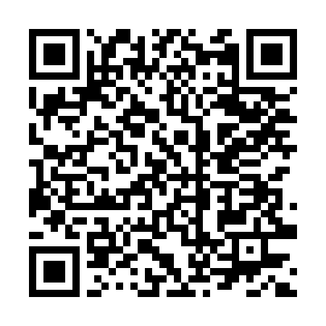
1. Car Crash Experiment (Loftus & Palmer)
🧠 Cognitive Bias: False Memories & Misinformation Effect
📌 Context & Instructions: Watch the short video clip of the car accident shown in class. Then, scan the QR code to estimate the speed of the vehicles and answer the questions on your smartphone.
📱 Scan the QR code with your smartphone camera to participate

Slide 3
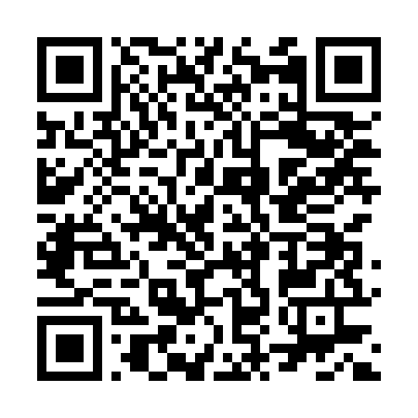
2. The Asian Disease Problem
🧠 Cognitive Bias: Framing Effect (Kahneman & Tversky)
📌 Context & Instructions: An unusual contagious disease is expected to kill 600 people. Two alternative healthcare programs have been proposed to combat the disease. Scan the QR code with your smartphone to choose the best program according to you.
📱 Scan the QR code with your smartphone camera to participate

Slide 4
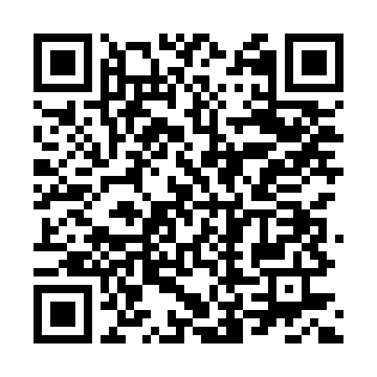
3. Robotic AI Surgery Authorization
🧠 Cognitive Bias: Medical Framing Effect (Positive vs Negative)
📌 Context & Instructions: A new AI robotic surgical software is set to perform a high-risk operation on 100 critical patients. Scan the QR code to read the statistical data and make your decision.
📱 Scan the QR code with your smartphone camera to participate

Slide 5
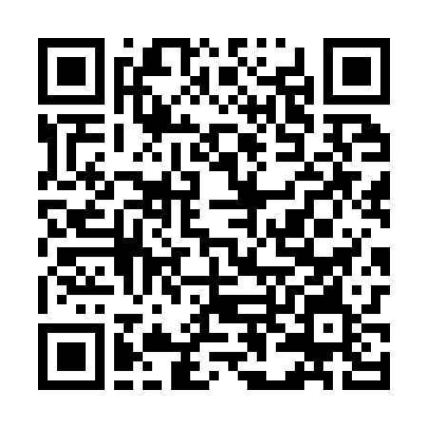
4. Mahatma Gandhi Age Estimation
🧠 Cognitive Bias: Anchoring Effect
📌 Context & Instructions: Test your knowledge with two questions regarding Mahatma Gandhi's life and age at death. Scan the QR code with your smartphone to enter your estimates.
📱 Scan the QR code with your smartphone camera to participate

Slide 6
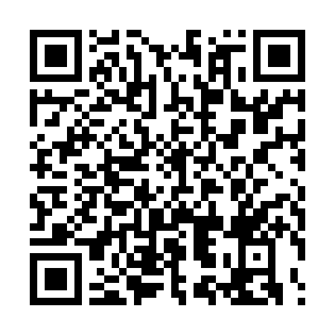
5. Hospital Misdiagnosis Estimation
🧠 Cognitive Bias: Irrelevant Numerical Anchoring
📌 Context & Instructions: Observe the number spun on the wheel of fortune shown in class. Then, scan the QR code to provide your estimate of the percentage of hospital misdiagnoses.
📱 Scan the QR code with your smartphone camera to participate

Slide 7
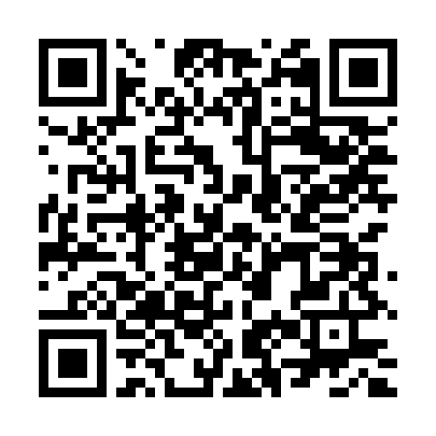
6. Financial Decision & Risk Choice
🧠 Cognitive Bias: Loss Aversion & Prospect Theory
📌 Context & Instructions: You are presented with a financial scenario involving an initial bonus and two alternative financial options. Scan the QR code on your smartphone to pick your preferred option.
📱 Scan the QR code with your smartphone camera to participate

Slide 8
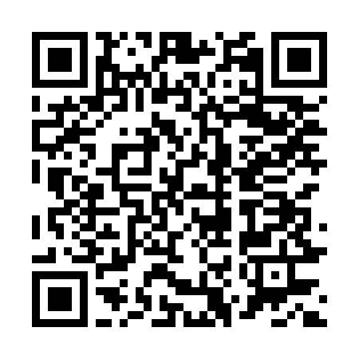
7. Scientific Statement Evaluation
🧠 Cognitive Bias: Illusion of Truth & Cognitive Ease
📌 Context & Instructions: Scan the QR code with your smartphone camera to read the scientific statement presented and rate how true it seems to you (1-10).
📱 Scan the QR code with your smartphone camera to participate

Slide 9
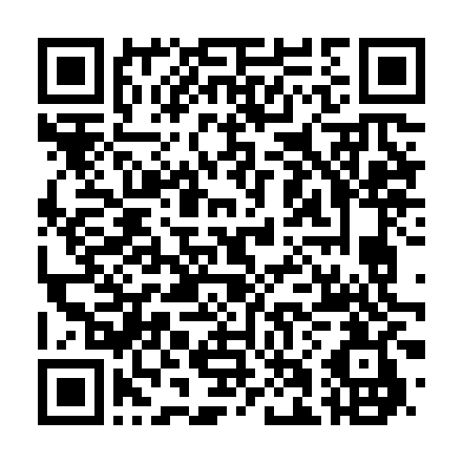
8. Personality Inventory (Assertiveness)
🧠 Cognitive Bias: Availability Heuristic & Subjective Ease of Recall
📌 Context & Instructions: Scan the QR code from your smartphone to complete a short memory recall exercise on your past behaviors and rate your personal level of assertiveness.
📱 Scan the QR code with your smartphone camera to participate

Slide 10
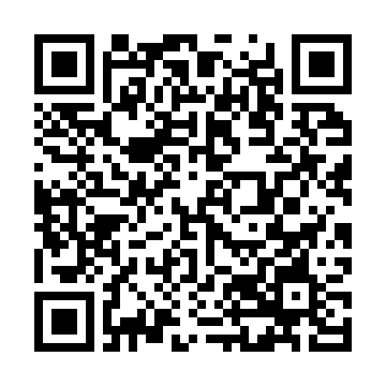
9. Linda's Profile (Kahneman & Tversky)
🧠 Cognitive Bias: Conjunction Fallacy & Representativeness Heuristic
📌 Context & Instructions: Linda is 31, single, outspoken, bright, philosophy major, concerned with social justice and anti-nuclear demonstrations. Scan the QR code to estimate the probability of her current occupation.
📱 Scan the QR code with your smartphone camera to participate

Slide 11
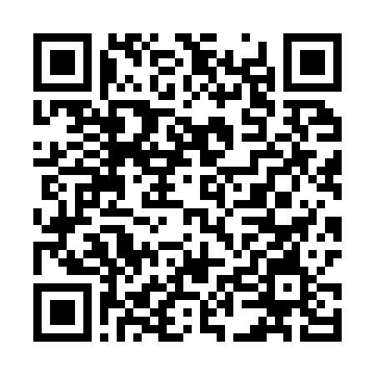
10. Workplace Profile Evaluation
🧠 Cognitive Bias: Halo Effect & Order Effect (Asch Model)
📌 Context & Instructions: Scan the QR code to read the personality description of a colleague provided by his coworkers and rate your overall impression of him.
📱 Scan the QR code with your smartphone camera to participate

Slide 12
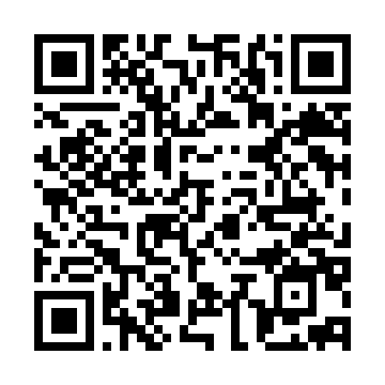
11. The University Mug Market (Thaler)
🧠 Cognitive Bias: Endowment Effect
📌 Context & Instructions: Participate in the market simulation for an official university mug. Scan the QR code with your smartphone to discover your role and submit your price.
📱 Scan the QR code with your smartphone camera to participate

Slide 13
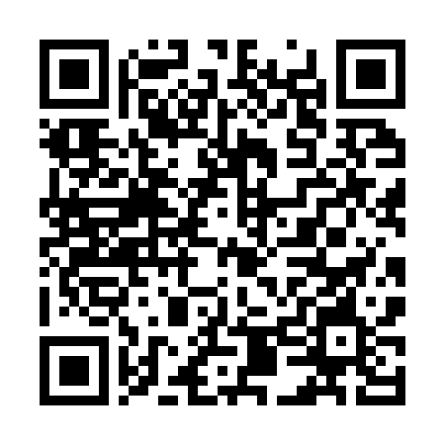
12. AI Diagnostic Software License Market
🧠 Cognitive Bias: Endowment Effect in Digital Assets
📌 Context & Instructions: Participate in the market negotiation for a rare AI diagnostic software license. Scan the QR code to discover your negotiation role and enter your valuation in Euros (€).
📱 Scan the QR code with your smartphone camera to participate

Slide 14
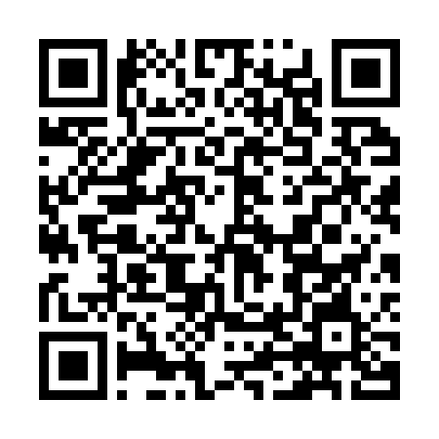
13. The Theater Ticket Scenario (Kahneman)
🧠 Cognitive Bias: Sunk Cost Fallacy
📌 Context & Instructions: It is the evening of a theater show you really want to see, but a severe snowstorm suddenly strikes. Scan the QR code from your smartphone to indicate what you decide to do.
📱 Scan the QR code with your smartphone camera to participate

Slide 15
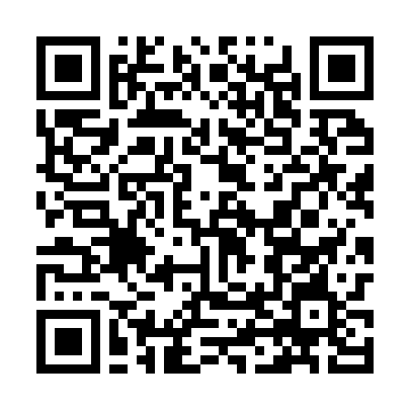
14. AI Research Project Management
🧠 Cognitive Bias: Sunk Cost Fallacy in R&D
📌 Context & Instructions: You lead an AI research team working on a new diagnostic algorithm. During development, Google releases a free superior algorithm. Scan the QR code to decide the future of your project.
📱 Scan the QR code with your smartphone camera to participate

Slide 16
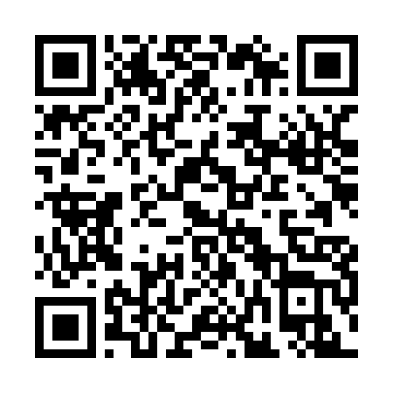
15. Hospital Employee Onboarding Form
🧠 Cognitive Bias: Default Effect & Choice Architecture (Nudge)
📌 Context & Instructions: Imagine completing your onboarding consent forms as a new hospital employee. Scan the QR code with your smartphone to make your choice on the form.
📱 Scan the QR code with your smartphone camera to participate

Slide 17
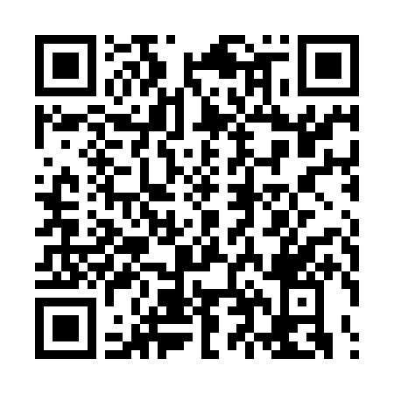
16. Word Completion Test
🧠 Cognitive Bias: Associative / Conceptual Priming
📌 Context & Instructions: Scan the QR code to quickly read the trigger words that will appear on your screen and complete the missing word as fast as possible.
📱 Scan the QR code with your smartphone camera to participate

Slide 18
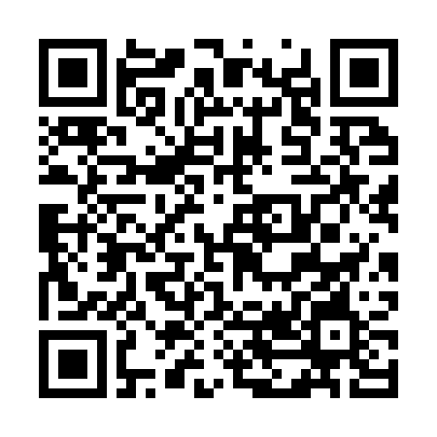
17. Academic Ability Self-Assessment
🧠 Cognitive Bias: Illusion of Superiority & Dunning-Kruger Effect
📌 Context & Instructions: Scan the QR code with your smartphone to anonymously answer a self-evaluation question about your academic abilities.
📱 Scan the QR code with your smartphone camera to participate

Slide 19
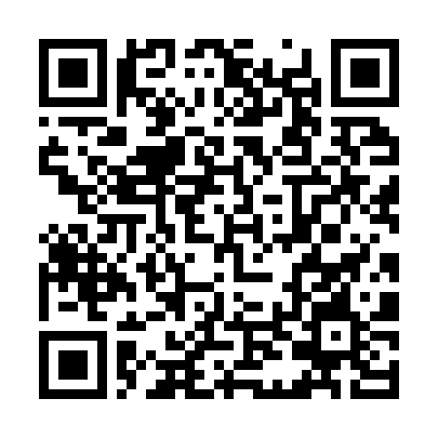
18. WYSIATI — Hypothesis Persistence (Bruner & Potter)
🧠 Cognitive Bias: WYSIATI ('What You See Is All There Is') & Belief Perseverance
📌 Context & Instructions: Observe the image shown on your smartphone after scanning the QR code. In Group A the image sharpens smoothly and continuously (video-like over 8s); in Group B it transitions through 4 discrete step frames (discrete jumps every 2s).
📱 Scan the QR code with your smartphone camera to participate

Slide 20
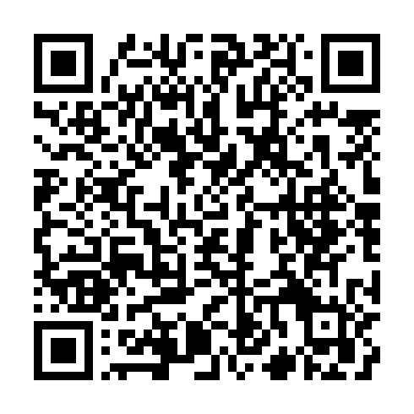
19. Personal Wellbeing Survey
🧠 Cognitive Bias: Focusing Illusion
📌 Context & Instructions: Scan the QR code to complete a short survey regarding your general wellbeing and life satisfaction.
📱 Scan the QR code with your smartphone camera to participate

Slide 21
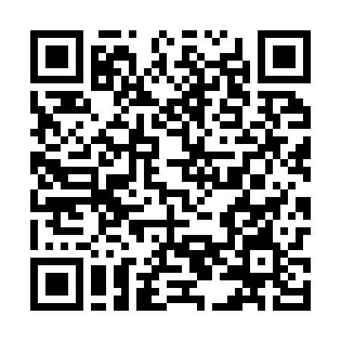
20. The Diagnostic Paradox
🧠 Cognitive Bias: Base Rate Neglect
📌 Context & Instructions: A rare disease affects 1% of the population. A diagnostic test is 95% accurate. You test POSITIVE. Scan the QR code to estimate the actual probability of having the condition.
📱 Scan the QR code with your smartphone camera to participate

Slide 22
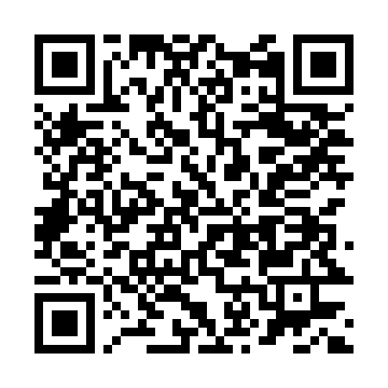
21. Subscription Choice (The Economist)
🧠 Cognitive Bias: Decoy Effect & Asymmetric Dominance
📌 Context & Instructions: You need to select a magazine subscription offer for The Economist that you find most advantageous. Scan the QR code with your smartphone to submit your choice.
📱 Scan the QR code with your smartphone camera to participate

Slide 23
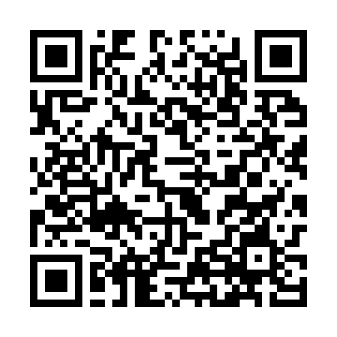
22. Flight Instruction Effect
🧠 Cognitive Bias: Causal Illusion vs Regression to the Mean
📌 Context & Instructions: Flight instructors notice reprimanding after a bad landing leads to a better next landing, while praise leads to a worse one. Scan the QR code to evaluate why this phenomenon occurs.
📱 Scan the QR code with your smartphone camera to participate

Slide 24
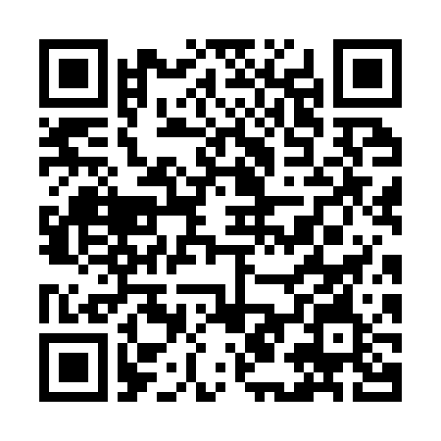
23. The 2 - 4 - 6 Task
🧠 Cognitive Bias: Confirmation Bias & Hypothesis Testing (Wason, 1960)
📌 Context & Instructions: You are shown the number sequence 2 - 4 - 6, which follows a secret rule created by the instructor. Scan the QR code to choose which triplet of numbers you will test first to discover the rule.
📱 Scan the QR code with your smartphone camera to participate

