Slide 1


Hackathon
Team : Snehal Jadhav
Ziyao Wang
Gloria Yang
13th December, 2020.

Slide 2
Demo?

Slide 3
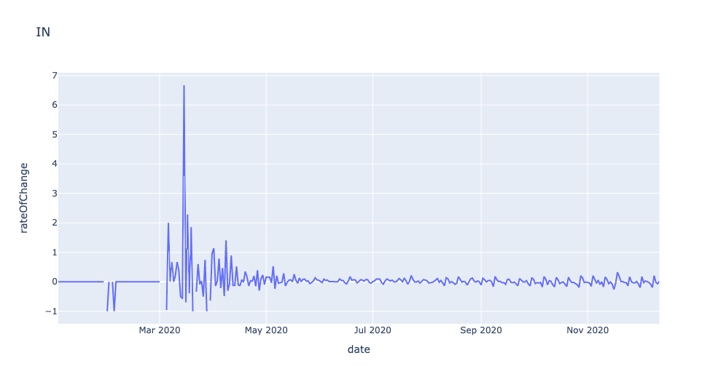
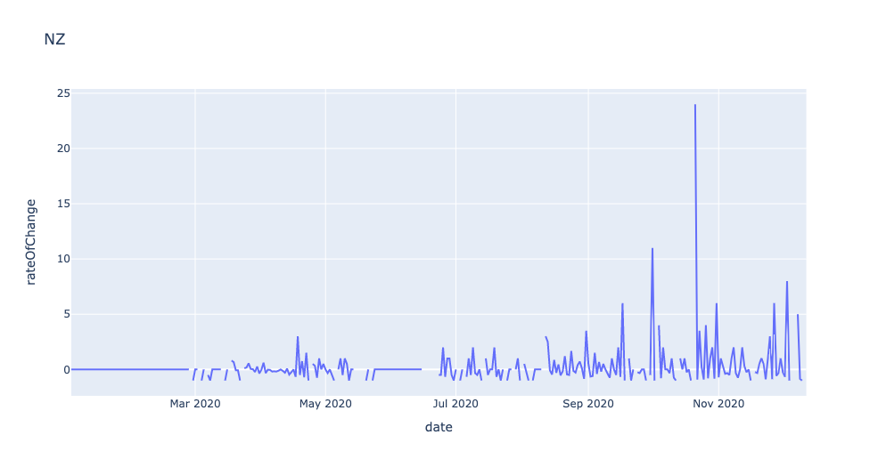
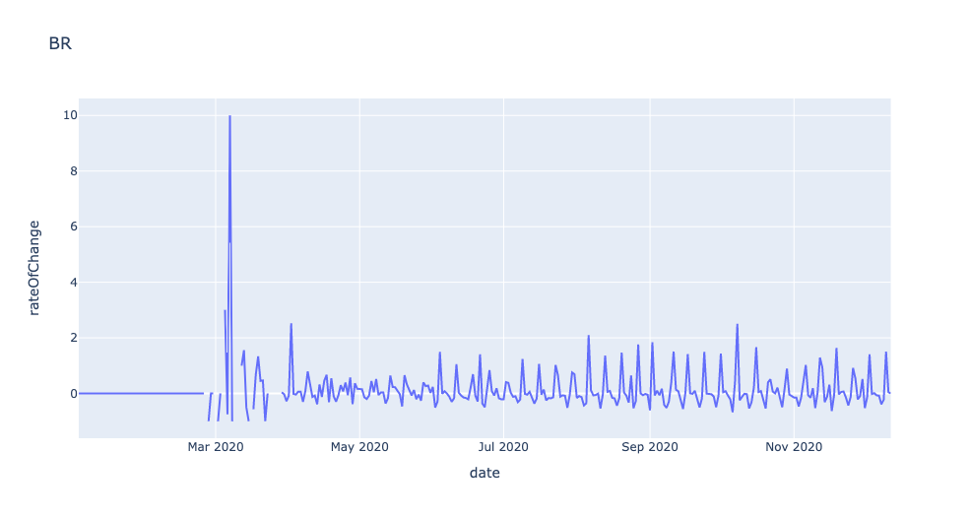
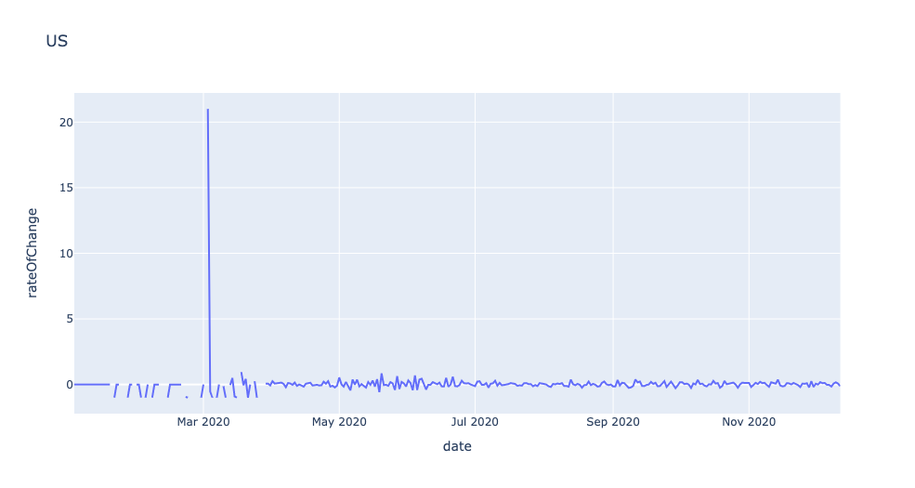
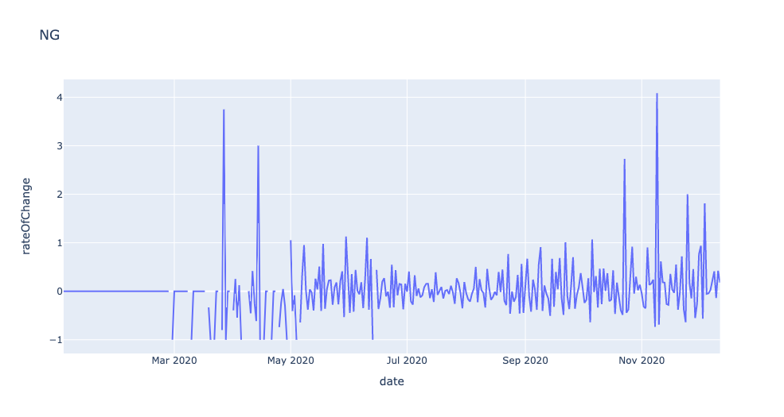
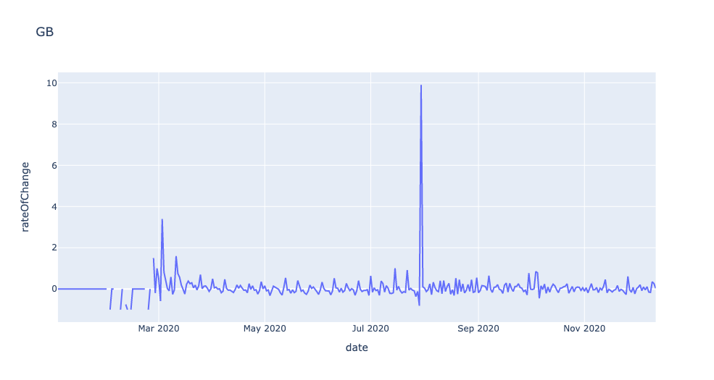

Slide 4
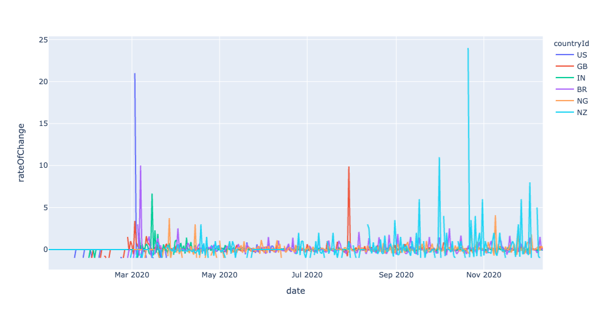
Rate of Change of New Cases
Helps us find peaks
NZ has tall spikes because it had virtually no new cases some days.
GB had a second wave b/w July and Sept
Rate of Change v/s new cases

Slide 5
Gloria’s Slides

Slide 6
Ziyao’s Slides

