Slide 1


Hackathon
Team : Snehal Jadhav
Ziyao Wang
Gloria Yang
13th December, 2020.

Slide 2
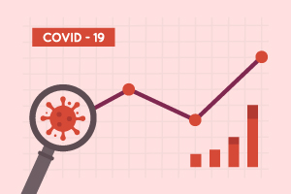
C-M Dashboard
Goal: To extract meaningful data from various data sources, by leveraging the Marquee API, and present them to users in a clear and informative manner.

Slide 3
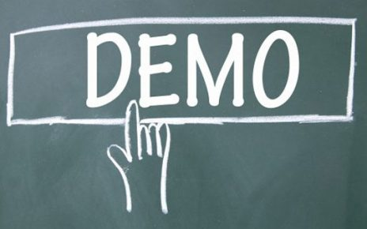

Slide 4
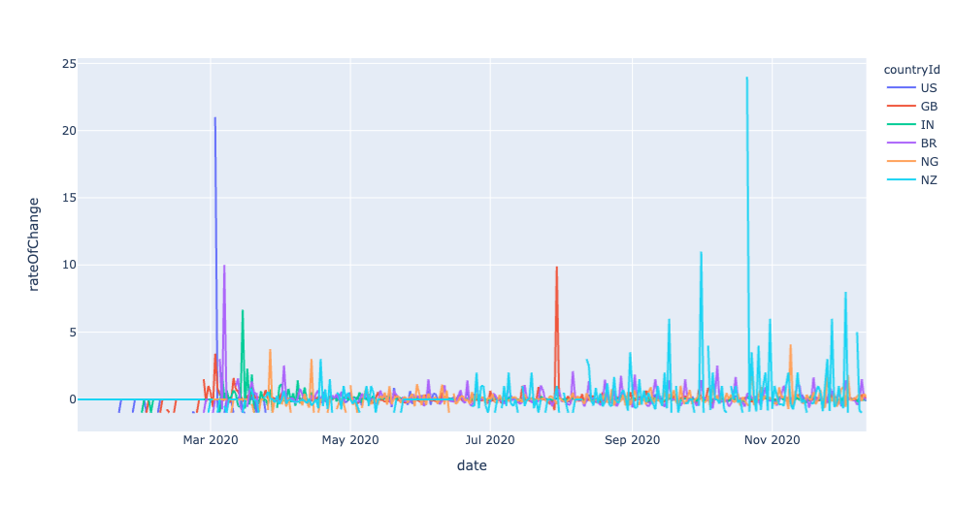
Rate of Change of New Cases
Helps us find peaks
NZ has tall spikes because it had virtually no new cases some days.
GB had a second wave b/w July and Sept
Rate of Change v/s new cases

Slide 5
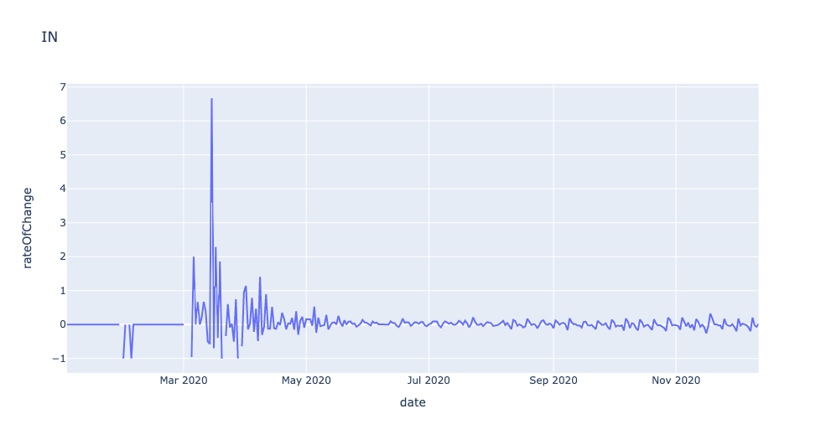
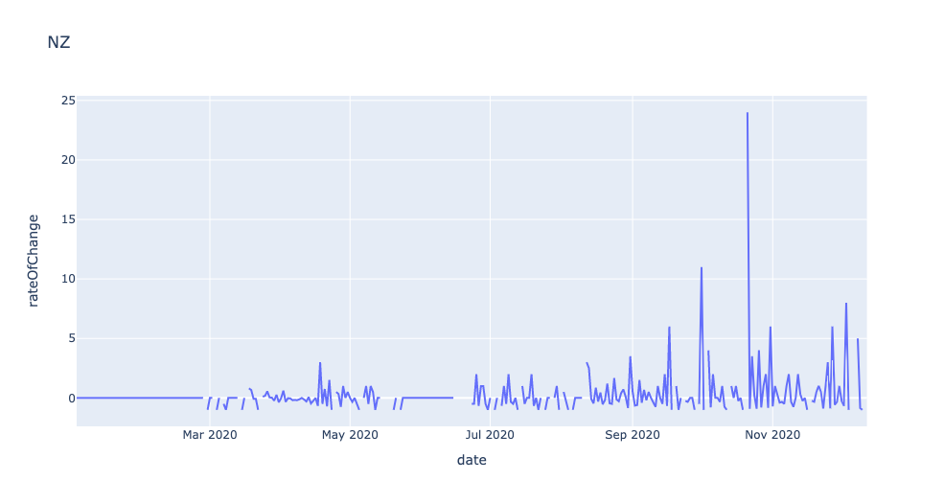
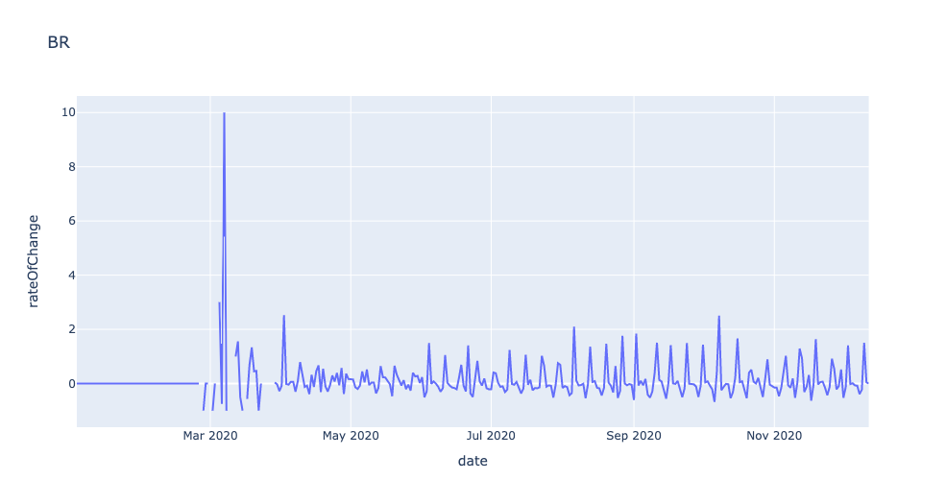
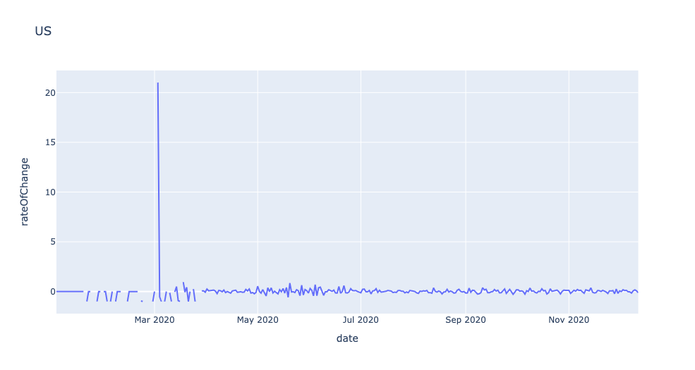
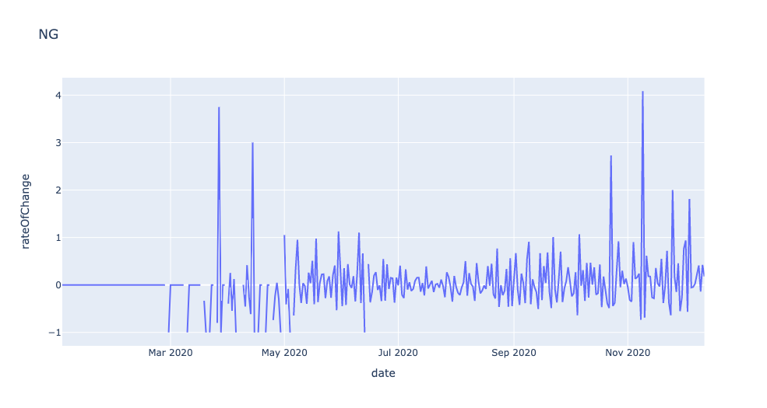
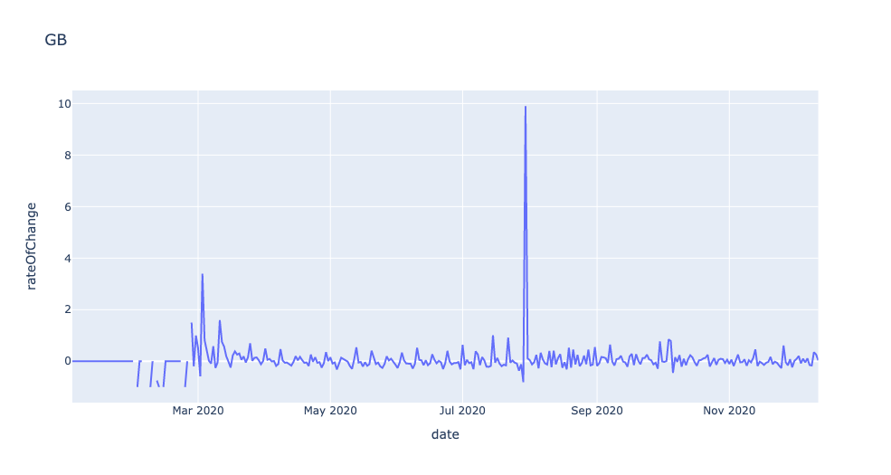
India
New Zealand
Brazil
United States of America
Nigeria
Great Britain

Slide 6

Thank You!

