Slide 1



Cıneceng
CME-1252 PROJECT PROJECT BASED LEARNING-II
PROJECT-I
BY
2016510045 ZEYNEP KIYAK
2015510093 ŞULE ŞAHAN
2400000145 MEHMET H. USLU
2017510059 OSMAN KOÇ

Slide 2
OUTLINE
INTRODUCTION
PROGRESS SUMMARY
Task Sharing and Scheduling
Completed Tasks
Incomplete Tasks: Reasons, Explanations
Changes in Requirements
Additional Improvements
PROBLEMS ENCOUNTERED
ALGORITHMS AND SOLUTION STRATEGIES
SCREENSHOTS
CONCLUSION
REFERENCES

Slide 3
INTRODUCTION
Our aim is to develop a software for CineCeng Theaters. We developed this program based on object-oriented programming. Hence, we have created some classes in our project. These classes are:
Saloon
Showtime
Movie
Seat
Star
Director
Person

Slide 4
Process: class contains command centre.
TestP: class is the main for the program(testPrimary)
Saloon: class ontains saloons, Showtime and Movie objects.
Showtime: class contains showtime and showtime operation objects
Movie: class contains Actors and Directors and other movie objects
Seat: class contains seats and seat operation objects.
Star and Director: both classes contains name, birthdate birth place objects.

Slide 5
PROGRESS SUMMARY
Task Sharing and Scheduling
Completed Tasks
Incomplete Tasks: Reasons, Explanations
Changes in Requirements
Additional Improvements

Slide 6
Task SharIng and SchedulIng
PROGRESS SUMMARY
ZEYNEP&ŞULE: We developed classes, getter and setter methods and class constructors. After that, we worked on passing commends.
MEHMET&OSMAN: These parts are including five methods which is:
addActor
addDirector
addMovie
updateSaloon
updateShowtime
Designing the Project screen
Reading input file

Slide 7
We were two separate group in the beginning of project for two week so we put our codes together after first evaluation. These parts are done after evaluation:
>sellTicket
>cancelTicket
>displayActors
>displayDirectors
>displayMovies
>displaySeats
>endTheDay

Slide 8
Completed Tasks
Designing the screen. Reading input file.
Designing classes and creating the necessary data structures. Parsing commands.
Executing add and update commands.
Ticket and display commands, and statistics
End-of- day operations, remaining parts of the project.

Slide 9
INCOMPLETE TASKS
We do not have any incomplete tasks.

Slide 10
CHANGES IN REQUIREMENTS
Requirements did not change in five week span of project.

Slide 11
PROBLEMS ENCOUNTERED
We noticed that our program was not suitable to object oriented programming in beginning and changed our course of action to more OOP friendly structure.
Our first problem was the comprehending OOP in our first semester with C# was quite different then working on Java so we had to work hard and settle some milestones in our mind.
Later on we had quite a trouble with with code not working due to different data types and mistakes when creating data types.
We learnt to use debug tool by that way we didn’t come across with any major problem.

Slide 12

solutıon strategıes
&
Algorıthms

Slide 13
CineCeng is a management program. So, it need to be working two ways. First one is reading text file that contains mass commands that users wish and second one is writing commands to the command line on Enigma console.
So we used these two methods.
*image-1 is our reader method
*Image-2 is our launcher while loop

Slide 14
Our process class.

Slide 15
As other methods can be seen. We parse all the commands given or entered. Then we find which method need to be called and process everything.
Every command comes here after read by our launcher and get processed later on.

Slide 16
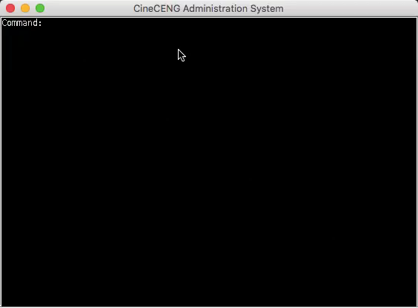
Showcase

Slide 17
CONCLUSION
Our project was concluded as planned.
We met our deadlines.
We hold a grip on OOP.
We worked as a team and showcased well oriented group can do.

Slide 18
REFERENCES
https://stackoverflow.com
https://github.com
https://reddit.com

Slide 19

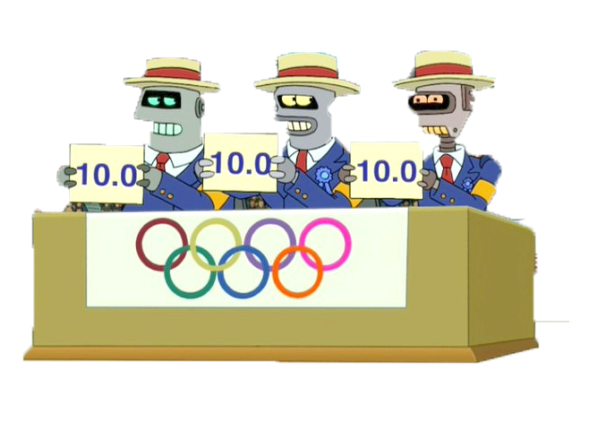
THANK YOU FOR LISTENING.
ANY QUESTIONS?

