Slide 1
Jacobian Damped Least Squares IK
Singularity-proof chain IK for Unreal Engine — from first principles to tested C++
Concept
→
Understand
→
Code
→
Validate
AnimForge Research · JacobianDLSIK module · UE 5.3–5.6
Notes:
Research project: a chain IK solver whose behavior near singular poses is provably bounded. The deck follows our pipeline: concept, understand the math, code, validate.

Slide 2
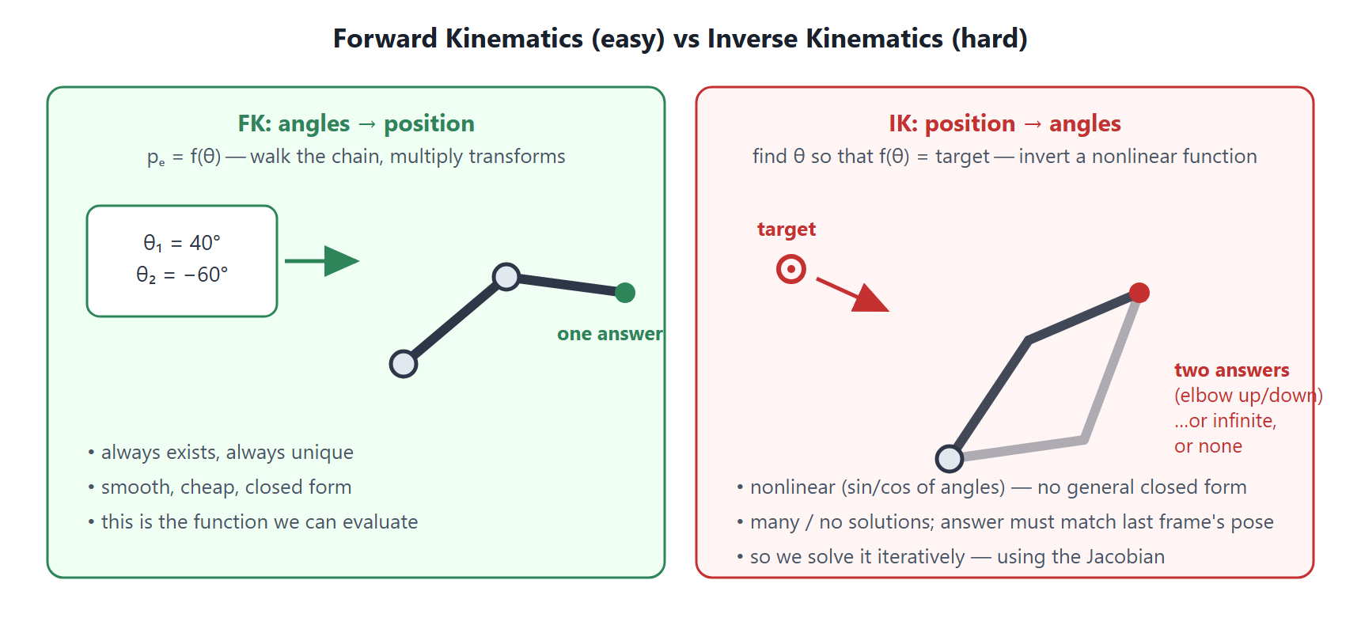
IK is FK run backwards — and that's the hard direction
CONCEPT
Why it's hard
nonlinear (sin/cos of angles) — no closed form past 2 bones
many valid poses, or none at all
frame N must stay near frame N−1, or the character pops
Two-bone chains have an exact formula (that is UE's Two Bone IK). Everything longer is solved iteratively: start at the current pose, step toward the target. The whole game is choosing a good step — that's the Jacobian's job.
2
Notes:
FK: one answer, always. IK: inverting a nonlinear function — many or no answers, and the answer must be temporally coherent.

Slide 3
What Unreal ships today — and where each breaks
CONCEPT
Two Bone IK analytic (law of cosines)
CCD greedy, one joint at a time
Exact, nearly free — but only ever 2 bones. No spines, tails, or long reaches.
Curls the chain tip-heavy, poses depend on sweep order, oscillates near the target.
FABRIK slides positions, derives rotations after
Full Body IK (PBIK) position-based dynamics
Twist is undefined (forearm roll drifts); joint limits are reprojection hacks.
Great for full-body multi-effector; heavy and empirically tuned for one chain.
And every undamped method shares a deeper flaw: near a singular pose the demanded joint step scales as 1/σ → ∞ — knee jitter, elbow pops, pose flips.
3
Notes:
Each engine solver has a structural weakness; the singularity problem is common to all undamped iterative methods.

Slide 4
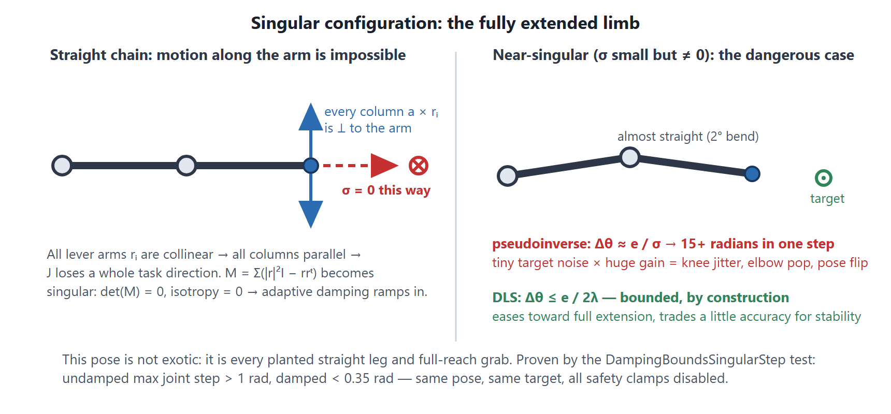
Singularities: the fully extended limb
CONCEPT
Not exotic: every planted straight leg and every full-reach grab passes through this pose.
4
Notes:
Straight chain: all lever arms collinear, a whole task direction is lost (sigma = 0). The dangerous case is NEAR singular: sigma small but nonzero means gain 1/sigma is huge.

Slide 5
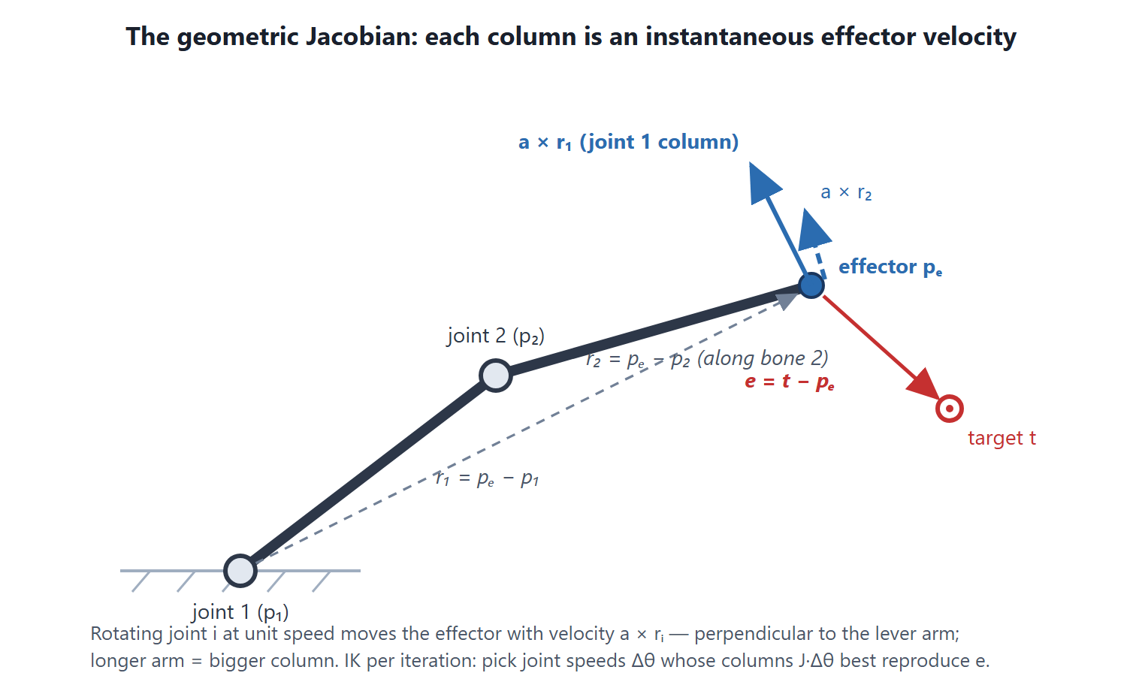
The Jacobian: wiggle each joint, watch the hand
UNDERSTAND
f(θ+Δθ) ≈ f(θ) + J·Δθ
Column j of J = effector velocity if only joint j rotates, at unit speed
Each iteration: measure e = t − pₑ, solve J·Δθ = e, apply, repeat
This is Newton's method for f(θ) = t
5
Notes:
Linearize: any smooth function looks linear up close. The Jacobian answers 'if I wiggle each joint, which way does the hand move'.

Slide 6
The columns are pure geometry
UNDERSTAND
∂pₑ/∂θᵢ = a × (pₑ − pᵢ) = a × rᵢ
From the rigid-body relation v = ω × (x − p): rotating joint i swings everything downstream of it — including the effector.
Long lever arms dominate
The tip bone contributes zero
‖a × r‖ ≤ ‖r‖: the shoulder (far from the hand) gets big columns, the wrist tiny ones. Least squares naturally favors root-side joints — tunable with weights.
r = 0 for the tip: rotating the hand can't move the hand's origin. The solver skips it — animated hand orientation survives untouched.
Ball joints: each bone = 3 revolute DOF about the axes eₓ, eᵧ, eᵩ → J is 3×3N. Looks arbitrary now — it makes the whole system collapse to 3×3 on slide 11.
6
Notes:
Geometric Jacobian: column = axis cross lever-arm. Two visible properties: lever arms dominate, tip contributes zero.

Slide 7
First attempt: the pseudoinverse
UNDERSTAND
Δθ = J⁺·e = Jᵀ·(J·Jᵀ)⁻¹·e
J is 3×3N — wide, not square. J⁻¹ doesn't exist; infinitely many Δθ move the hand identically.
J⁺ picks the minimum-norm solution: the smallest total joint motion that does the job — least pose disturbance, exactly what animation wants.
Shape trick: J·Jᵀ is only 3×3 regardless of joint count — invert in task space, never in joint space.
Works beautifully — until the arm straightens.
7
Notes:
Pseudoinverse = minimum-norm least squares. Note the JJt trick appearing already: 3x3 in task space.

Slide 8
Through the SVD: the 1/σ bomb
UNDERSTAND
J = U·Σ·Vᵀ
Δθ = Σₖ (1/σₖ)·vₖ·(uₖᵀ·e)
σ = 0.01 → gain ×100
10 cm of error → ~1000 rad of demanded joint motion
Each σₖ = how easily the effector moves along direction uₖ; the gain applied to error along it is 1/σₖ.
Exactly at σ = 0 you can just drop the direction. The disaster is the neighborhood: σ small but nonzero.
On screen: knee jitter near full extension, elbow pop to the other branch, error that grows between iterations.
This is not a numerical bug — the math is doing exactly what was asked: “reach the unreachable direction at any cost.” The fix is to change the question.
8
Notes:
SVD makes the failure visible: per-direction gain 1/sigma explodes as sigma approaches 0. Near-singular is worse than exactly singular.

Slide 9
DLS: change the question
UNDERSTAND
minimize ‖J·Δθ − e‖² + λ²·‖Δθ‖² λ = price of joint motion
Set the gradient to zero → (JᵀJ + λ²I)·Δθ = Jᵀ·e. Positive definite for λ > 0 → one unique answer, always (strictly convex).
Identity Jᵀ(JJᵀ + λ²I) = (JᵀJ + λ²I)Jᵀ lets us swap which side is inverted: 3×3 instead of 3N×3N.
Δθ = Jᵀ·(J·Jᵀ + λ²I)⁻¹·e
the equation the solver implements
9
Notes:
Tikhonov regularization: charge for joint motion. Derive normal equations, swap the inversion side via the push-through identity.

Slide 10
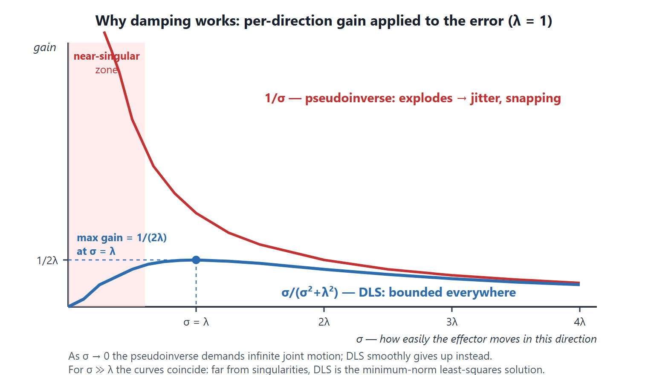
The gain curve: bounded by 1/(2λ), everywhere
UNDERSTAND
σ ≫ λ
identical to pseudoinverse — damping invisible in healthy poses
σ = λ
maximum gain 1/(2λ) — the worst case is bounded by construction
σ → 0
gain → 0 — smoothly gives up on impossible directions
Tuning: λ has length units (cm) — pick 1–5% of chain length. A 60 cm arm → λ ≈ 1–3. Near-singular poses trade a little accuracy for stability: the leg eases into extension instead of snapping.
10
Notes:
sigma/(sigma^2+lambda^2) vs 1/sigma. Bounded at 1/(2 lambda); identical to pseudoinverse far from singularities.

Slide 11
The O(N) trick: no Jacobian matrix, ever
UNDERSTAND
Identity 1 — J·Jᵀ in closed form
Identity 2 — Jᵀ·y is a cross product
M = Σᵢ wᵢ(‖rᵢ‖²I − rᵢrᵢᵀ)
ωᵢ = wᵢ·(rᵢ × y)
Sum the 3 axis columns' outer products per joint: the whole 3×3N Jacobian collapses into one running 3×3 sum.
Solve (M + λ²I)·y = e once; each joint's rotation vector is a single cross product (scalar triple product identity).
Cost per iteration: O(N) + one 3×3 Cholesky (≈35 flops) · zero heap allocations · no matrix storage at all
Physics bonus: ‖r‖²I − rrᵀ is the inertia tensor of a unit point mass at r — M is the “inertia” of the effector as seen through the joints. Singular pose ⇔ all lever arms collinear ⇔ degenerate inertia. That intuition powers the singularity detector on slide 13.
11
Notes:
Two identities eliminate the explicit Jacobian: JJt = sum of (|r|^2 I - r r^T), and per-joint update = r cross y. O(N) plus a 3x3 solve.

Slide 12
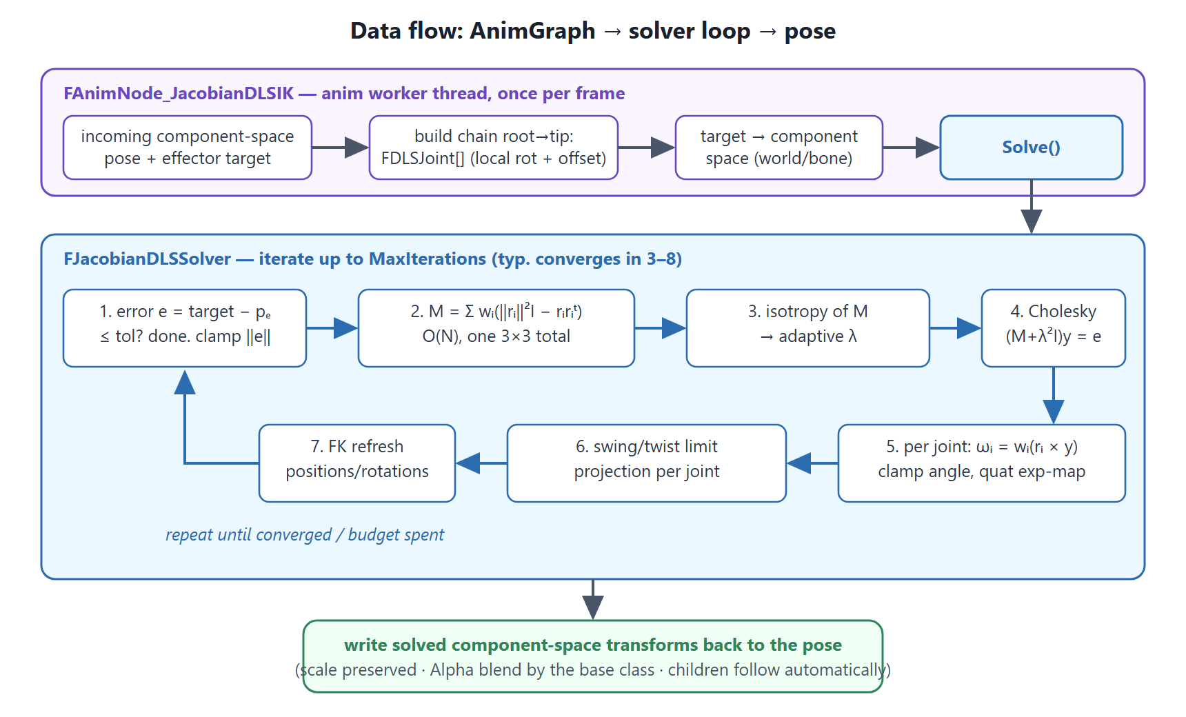
Architecture & data flow
CODE
The solver is pure math (FVector/FQuat only) — unit-testable headless, reusable from Control Rig or editor tools.
12
Notes:
Two layers: anim node handles skeletons/spaces/LODs; solver is engine-agnostic math. The loop: error, M, adaptive lambda, 3x3 solve, per-joint updates, limits, FK.

Slide 13
Per-joint control, correctly
CODE
Weights = principled stiffness
Swing/twist joint limits
Δθ = W·Jᵀ(J·W·Jᵀ + λ²I)⁻¹·e
w = 0 locks a joint exactly; w = 0.2 makes it 5× more expensive. Look-at: spine 0.15 / 0.25, neck 0.6, head 1.0 — the solve plans around stiff joints.
Decompose vs the reference pose: Rel = Swing · Twist. Cone-clamp the swing, angle-clamp the roll, recompose.
Projection after each step — later iterations re-route the error through free joints (Gauss–Seidel style).
Adaptive damping
Two safeguards
isotropy = det(M)/(tr(M)/3)³ ∈ [0,1]
Dimensionless singularity detector (~10 flops, from M we already built). Below τ = 0.1, extra λ ramps in quadratically — pay the stability tax only where needed.
Clamped error — trust the linearization only locally: cap ‖e‖ at ~half chain length per iteration.
Angle clamp — hard 10°/iteration cap per joint. Never engages with sane λ; exists so no tuning mistake ships a broken pose.
13
Notes:
Weights inside the objective (not post-scaling), swing/twist projection limits, isotropy-driven adaptive damping, plus clamped-error and angle-step safety nets.

Slide 14
Eight automation tests — each one proves a claim
VALIDATE
FiniteDifferenceJacobian
analytic columns match numerical FK probing — the solver descends the true gradient
ReachableTargetConverges
in-workspace targets hit within tolerance inside the iteration budget
DampingBoundsSingularStep
THE claim: undamped step near singularity > 1 rad; damped < 0.35 rad (clamps disabled)
UnreachableTargetStable
chain extends, points at target, settles at workspace boundary — no oscillation
JointLimitsRespected
swing/twist limits hold as hard constraints under extreme targets
LockedJointDoesNotMove
weight 0 locks a joint bit-exactly
Deterministic
identical inputs → identical outputs (worker threads, replay, net sync)
LongChainPerformance
30 joints × 12 iterations worst case — logs µs/solve for regression tracking
Headless, no assets: -ExecCmds="Automation RunTests AnimForge.JacobianDLSIK" — runs in seconds, CI-able.
14
Notes:
The test suite is the executable version of the theory doc. DampingBoundsSingularStep is the money test: it demonstrates the 1/sigma explosion and the DLS bound in one run.

Slide 15
Where to use it — and where not
VALIDATE
Right tool
Wrong tool
foot / hand planting near full extension — the singularity case, DLS's home turf
long chains: spines, tails, tentacles, cables — where CCD curls and FABRIK rolls
look-at distributed over spine + neck + head with exact per-joint weights
mech / robot arms — DLS is the robotics-industry standard
2-bone limbs with art-directed pole vectors — Two Bone IK is exact and cheaper
full-body multi-effector posing — that's PBIK's problem domain
extreme crowd scale where even 3 iterations is too much — go analytic
Status: solver + anim node + 8 tests written (UE 5.3–5.6 APIs). Next: compile in a UE project, run the tests, then the singularity-torture comparison vs CCD/FABRIK.
15
Notes:
Honest scoping: DLS for chains and singularity-prone reaches; TwoBone for simple limbs; PBIK for full body.

Slide 16
Concept → Understand → Code → Validate
1
THEORY.md the math, first principles → worked numeric trace you can check by hand
2
DESIGN.md architecture, decisions defended, edge cases, extensions (6-DOF, SDLS, nullspace)
3
JacobianDLSSolver.cpp read Solve() top-to-bottom with THEORY §4 pseudocode beside it
4
Tests + TESTING.md run the suite; every test maps to a theory section
The one-liner: Δθ = Jᵀ(JJᵀ + λ²I)⁻¹e — gain σ/(σ²+λ²) instead of 1/σ: bounded at singularities, exact everywhere else, O(N) + one 3×3 solve.
AnimForge Research · JacobianDLSIK
Notes:
Reading order for the module, and the one-line summary of the whole project.

