Slide 1

SalaryWeb
Colin Glory, Ariana Cuba, Jamie Nevin

Slide 2

Our Company
We are SalaryWeb! Our mission is to provide data scientists with rewarding job opportunities, offering salaries based on market demand and employment experience.

Slide 3
Background Information
SalaryWeb provides an online networking platform that solely focuses on the data science field. We offer the jobs, resources and information needed for users to advance in their career. Our unique focus on one field allows the search for jobs to be efficient and specialized. Users have access to the following:
Exclusive job openings from leading technology companies
Advanced filters specialized in the Data Science field
A community filled with professionals you can interact with.
Career development services
Industry updates and trends

Slide 4

Data
Gathered from employers with job postings with salaries
Job websites
Also through contracts gathered when employees are hired
Stored in a centralized database
Access to this data should be restricted to authorized personnel only, and appropriate measures should be in place to ensure data security and compliance with privacy regulations
Signing a contract
Quality checks

Slide 5
Job Postings include:
Job Titles
Experience level: mid-level, senior-level, entry-level, executive-level
Employment types: full-time, part-time, contract, freelance
Salary
Salary Currency
Salary in USD
Work year
Employee residence
Work models: Hybrid, on-site, remote
Company Location
Company Size: large, medium, small

Slide 6
Data Cleaning
Our data undergoes cleaning and close analysis to ensure the information is up to date and accurate. Using ETL (Extract, Transform, Load) , we prioritize data privacy and quality by cleaning the data before incorporating it in our systems.
Check for missing values
and duplicates
Make columns lowercase
Name first column “employee_id”
Notes:
No missing values or duplicate rows found. Make columns lowercase to make everything uniform. First column was named due to the column name being blank.

Slide 7
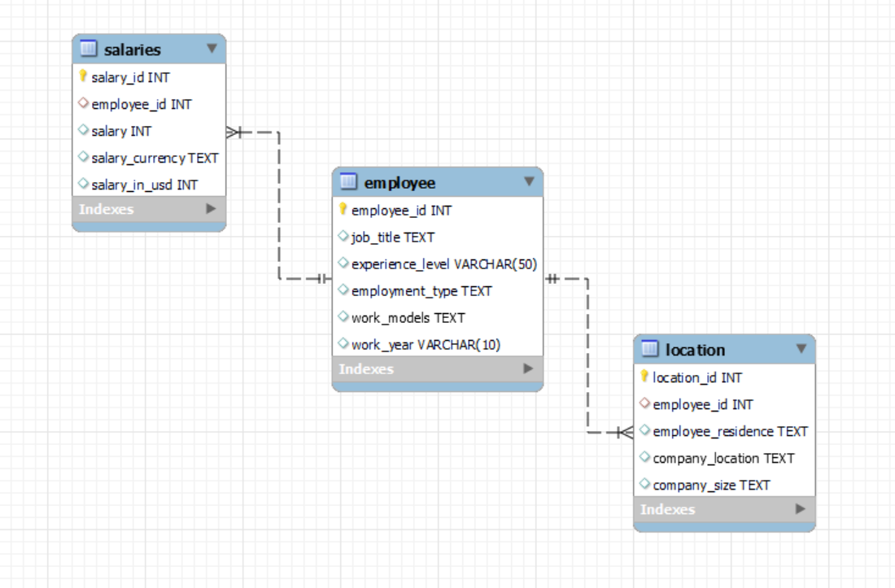
Database Design
employee_id
(FK)

Slide 8
Database Storage and Access
Stored on a server in MySQL internally and externally under company control.
Only the company has access to the database until someone pays for services
Backup Recovery Plan:
Regular Data Backups
Data Encryption
Disaster Recovery Plan

Slide 9
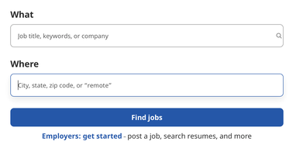
Database Analysis
Questions that will be answered:
What job positions have the highest salaries?
How do salaries differ based on experience level?
What are the locations with the highest salaries?

Slide 10
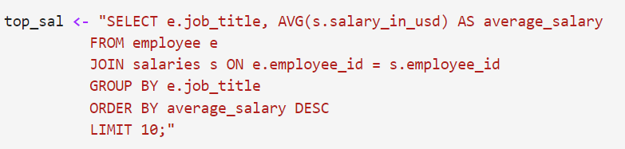
What job positions have the highest salaries?
AVG salary_in_usd
JOIN salaries and employee tables
Limit 10

Slide 11
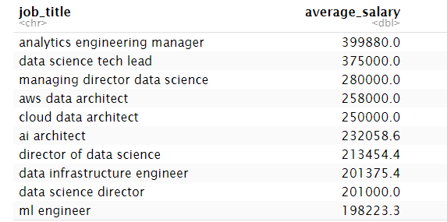
What job positions have the highest salaries?
Leadership roles
Architects
Engineers

Slide 12
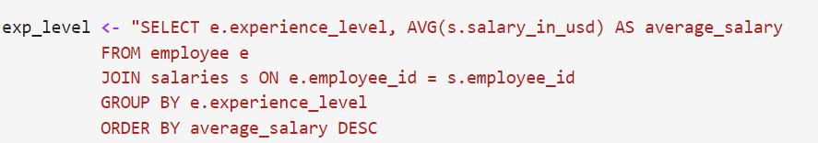
How do salaries differ based on experience?
AVG salary_in_usd
JOIN salaries and employee tables

Slide 13
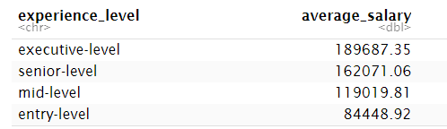
How do salaries differ based on experience?

Slide 14
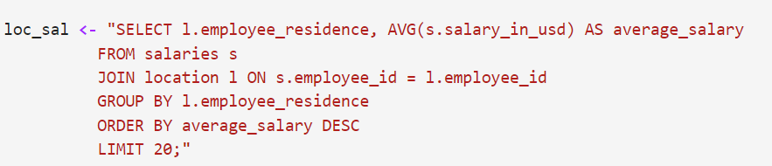
What are the locations with the highest salaries?
AVG salary_in_usd
JOIN salaries and location tables
Limit 20

Slide 15
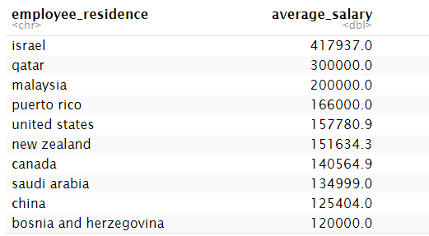
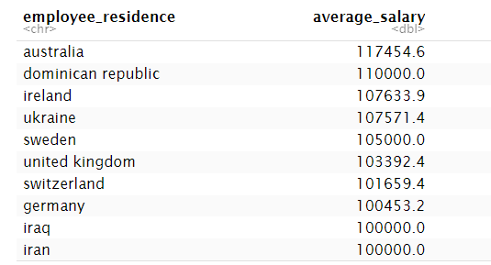
What are the locations with the highest salaries?

Slide 16
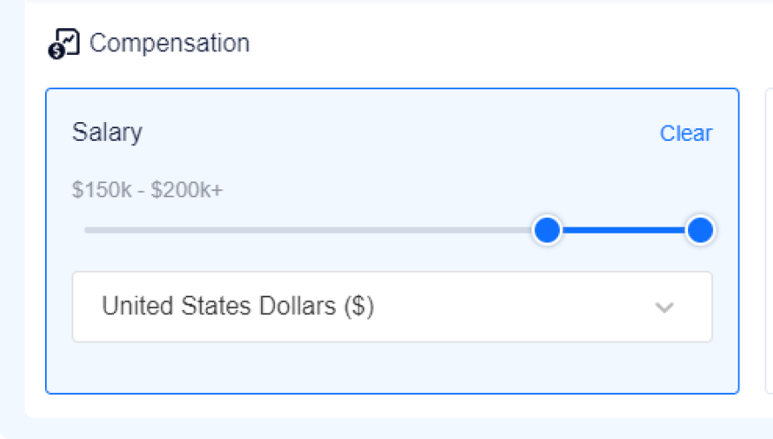
Database Analysis
Graphs:
Average salaries by experience level
Average salaries by employment type
Average salaries by work models

Slide 17
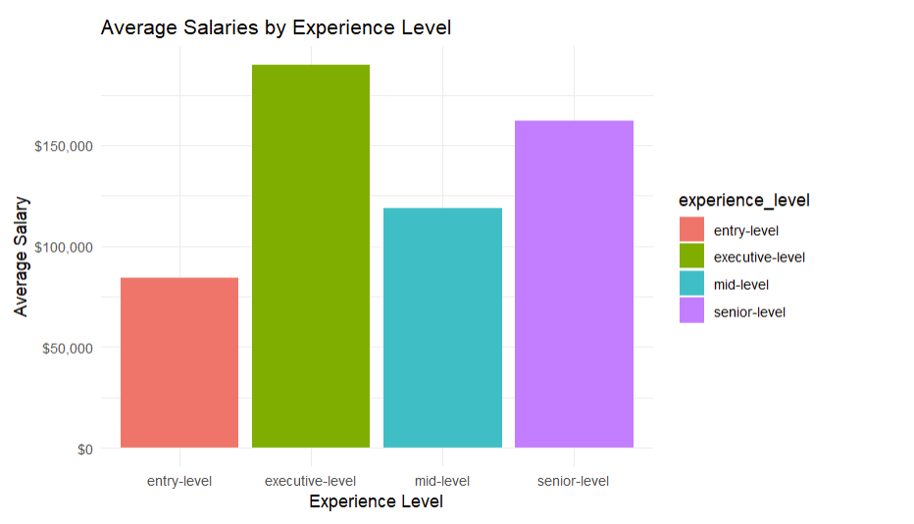
$189,687.35 - $84,448.92
Job positions with the most experience have the highest salaries.
Notes:
Add caption

Slide 18
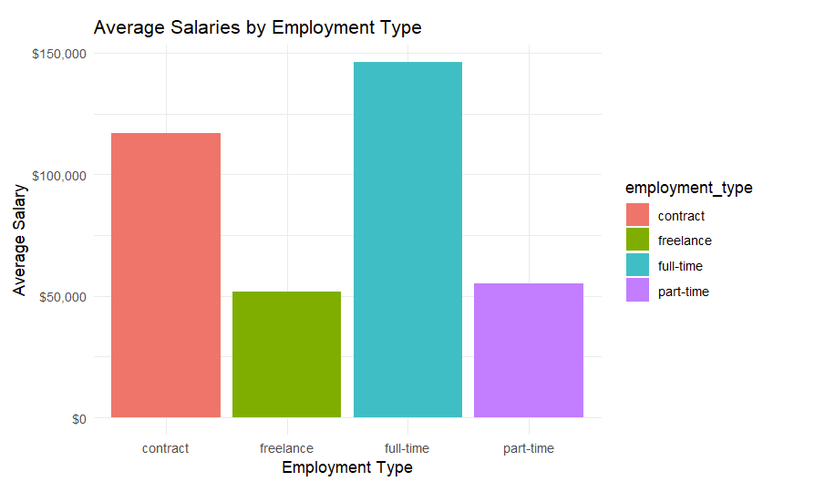
Job positions with the most hours have the highest salaries
Contract has higher salaries than part-time.

Slide 19
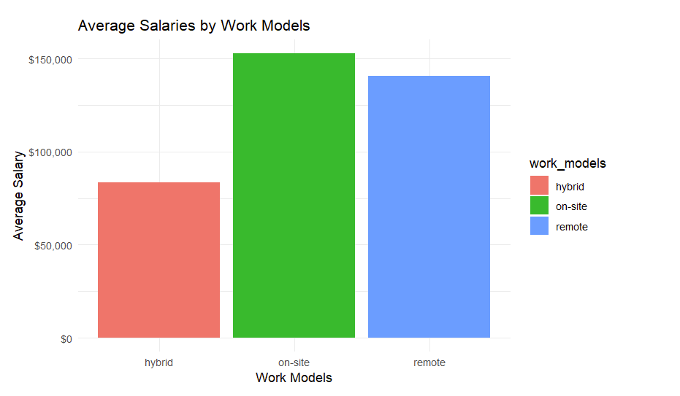
Average salaries for hybrid positions are lower than remote positions

Slide 20
Conclusion
This project is crucial for our company’s mission because we want users to be satisfied and rewarded in their jobs.
The database will be used to help prospective job seekers find the best possible jobs for them
Based on the data, the job titles with the highest average salaries include the following :
Leadership roles
Most experience
In-person

Slide 21
Sources
https://www.kaggle.com/datasets/sazidthe1/data-science-salaries/data
http://handdrawngoods.com

