Slide 1


A Capability-based Distributed Authorization System to Enforce Context-aware Permission Sequences
ACM SACMAT 2022
Adrian Shuai Li
li3944@purdue.edu
Reihaneh Safavi-Naini
rei@ucalgary.ca
Philip W. L. Fong
pwlfong@ucalgary.ca

Slide 2

Capability-based distributed authorization
Protocols include OAuth 2.0 [H,2012], UMA [MCMH, 2016], ICAP [G,1989]
request
policies
Alice
capability/token
(Digital Signature/MAC)
authorization server
Application
capability/token
resource
Alice
distributed resource servers

Slide 3
Centralized authorization systems
request
PEP
authorized
Resources
request
Application
decision
PDP

Slide 4
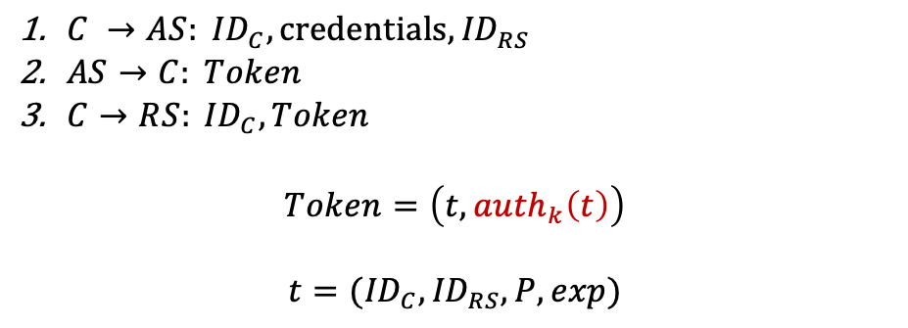
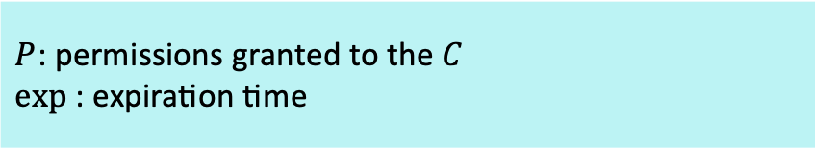
OAuth 2.0 and Proof-of-Possession Tokens
Two Legged OAuth*
$C →AS: {ID}_{C}, credentials, {ID}_{RS}$
$AS→C: Token$
$C→RS: {ID}_{C},Token$
$$Token=\left(t, {auth}_{k}\left(t\right)\right)$$
$$t=({ID}_{C},{ID}_{RS},P,exp)$$
AS
1
2
C
3
RS
4
OAuth has been successfully used for authentication and authorization in mobile applications [CPCT, 2014] [SM,2014], and web services [FKS, 2016] [SB, 2012].
$P$: permissions granted to the $C$
$exp⁡$: expiration time
However, it is missing some important features.

Slide 5
The missing usage constraints
Existing systems do not offer control over orderings of permissions
Problem: Delegated permissions can be exercised with arbitrary order
Example 1: decentralized business and financial systems:
Payment workflows require approvals of different authorities in a particular order.
Example 2: Industrial Control Systems (ICS)
The ordering of permissions to operate electronic equipment must conform to the workflow sequence
Existing systems do not limit the number of permission use.
Problem: Delegated permissions can be exercised for unlimited number of times
Security concern: unlimited access to critical assets
Existing systems do not support full “context” of access
Observation: access often depends on external conditions in the policies
Example: turn on the home camera when the user is not home
Enforcing
permission sequences

Slide 6
Our contributions
Theoretical
Proposed an efficient method of enforcing permission sequences with proof
HCAP supports history-based access control [TFS, 2018]
Less overhead, context-aware
Our capability-based system includes the “context” of access
Integrate a context server called Environmental Situational Oracle (ESO) [SST, 2018],
An ESO encapsulates the implementation of how a situation is sensed, inferred, or actuated
Our security proof is still valid with the addition of context confinement
Practical
Implemented our capability system as an extension of the OAuth framework
Showed how our proposed system can strengthen OAuth to enforce context-aware permission sequences in distributed financial systems
Performance Evaluation
Competitive performance compared with OAuth 2.0
Notes:
We evaluated our system and it shows …

Slide 7





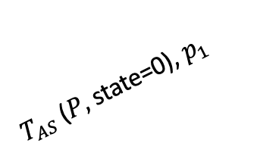



Permission Sequence
$P:p_{1}p_{2}p_{3}p_{4}$… $p_{n}$
AS
Revoke $T_{AS}$
1
0
RS1
$T_{1}$ ($T_{AS},$state=1)
$T_{AS}$ ($P,$state=0)
$T_{AS}$ ($P,$state=0), $p_{1}$
$$T_{1}$$
2
0
C
$$T_{1}, p_{2}$$
RS2
$T_{2}$ ($T_{AS},$state=2)
$T_{2}$
RSn
Inform the AS

Slide 8

Adversary model and Attacks
Token forgery and tampering
Digital Signature
Token theft
Proof-of-possession tokens
Client Impersonation
Public-key based client authentication
Replay attack
Proof of safety property
Alice
capability/token
AS
capability/token
Alice
resource
RS

Slide 9

Context Awareness
AS
ESO: environmental situation oracle [SST, 2018]
1
2
C
3
RS
4
ESO
6
5
Request master token and ESO token
Request for situation state using ESO token
2. Get tokens
$$T_{AS}, T_{ESO}(H(T_{AS}))$$
5. Return ESO state Y/N
3. Request for service by presenting
tokens together
6. Provide service/return failure

Slide 10
Adversary model and Attacks
Token forgery and tampering ✅
Token theft ✅
Client Impersonation ✅
Replay attack ✅
Client impersonates as RS
RS Authentication
Alice
Master cap
+ESO cap
AS
RS
Master cap
+ESO cap
ESO cap
resource
Context State
ESO
Alice

Slide 11
Generic flow diagram of our system
➞ fast revocation
➞ One time interaction with the AS per session
➞ Lightweight computation on the RS
➞ Verifiable integrity
➞ Inability to violate the permission sequence by replaying tokens.

Slide 12
Implementation – OAuth extension
OAuth client credential grant with proof-of-possession tokens.
We implement ABAC as the authorization mechanism in the AS.

Slide 13
Use case
Alice uses Application B that requires a paid membership. Application B offers Alice the option to pay her membership monthly using her credit card. Alice authorizes her credit card company to pay the application fee under the following conditions.
Application B can make once a month $10 charge to Alice’s account, under the condition that Alice has been using Application B for the past two months.
Thus a payment request will be rejected in the following cases,
Application B is requesting an amount different from $10.
Application B is charging $10 to Alice’s account for the second time in the same month.
Alice has stopped using Application B, but she has not canceled her subscription.
This last case will be detected by monitoring access to the application.

Slide 14
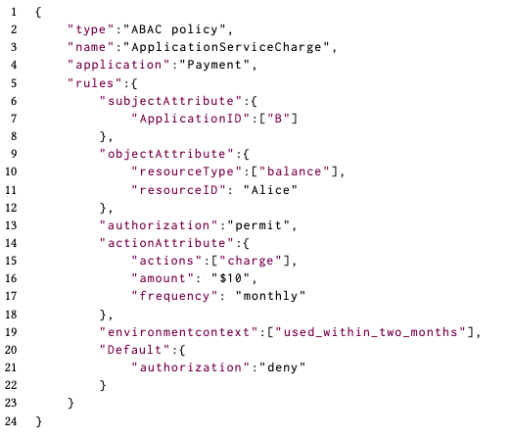
Solutions – policy example in JSON
Application B can make once a month $10 charge to Alice’s account, under the condition that Alice has been using Application B for the past two months.

Slide 15
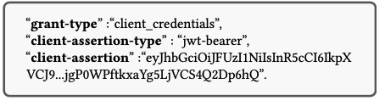
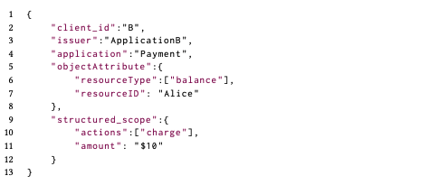
Solutions – policy example in JSON
Alice
Master cap
+ESO cap
AS
RS
Master cap
+ESO cap
ESO cap
resource
Context State
ESO
Alice

Slide 16
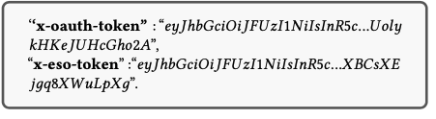
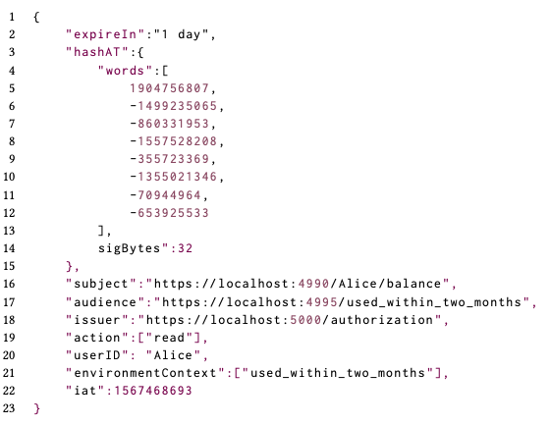
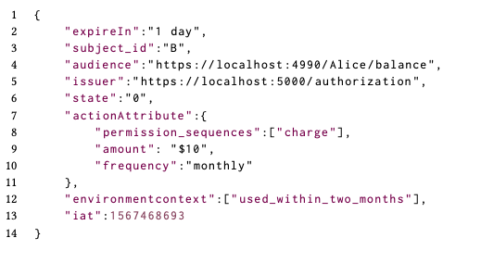
Solutions – policy example in JSON
Alice
Master cap
+ESO cap
AS that the bank maintains
RS
Master cap
+ESO cap
ESO cap
resource
Context State
ESO
Alice

Slide 17
Solutions – policy example in JSON
Alice
Master cap
+ESO cap
AS that the bank maintains
RS
Master cap
+ESO cap
ESO cap
track Alice’s login history of App B in the past two months.
resource
Context State
ESO
Alice

Slide 18
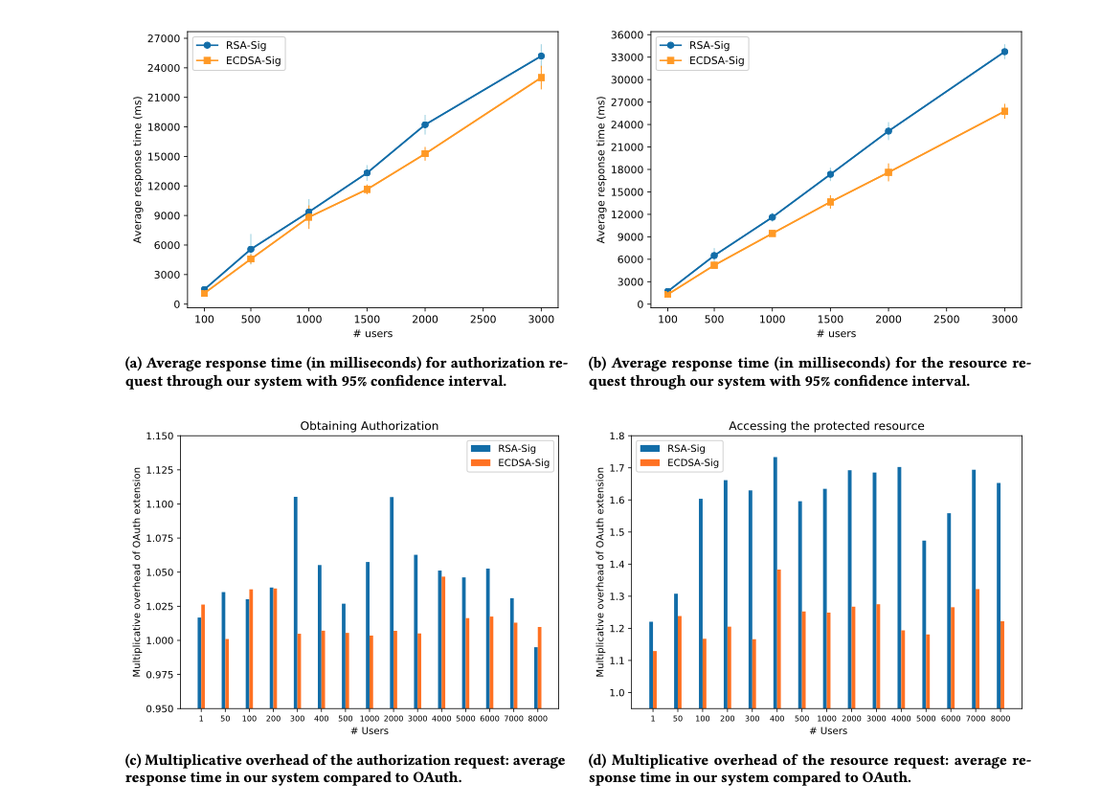
Performance Evaluation

Slide 19
Future work
Enforcing the other history-based policies using minimum state.
we will consider an honest but curious RS and ensure that the RS can not passively/actively learn more information about the user and their surrounding environment.

Slide 20
References
[TFS, 2018] L. Tandon, P. W. Fong, and R. Safavi-Naini. Hcap: A history-based capability system for iot devices. In Proceedings of the 23nd ACM on Symposium on Access Control Models and Technologies, pages 247–258. ACM, 2018.
[GPR,2013] S. Gusmeroli, S. Piccione, and D. Rotondi. A capability-based security approach to manage access control in the internet of things. Mathematical and Computer Modelling, 58(5-6):1189–1205, 2013.
[HJMS, 2016] J. L. Hernández-Ramos, A. J. Jara, L. Marín, and A. F. Skarmeta Gómez. Dcapbac: embedding authorization logic into smart things through ecc optimizations. International Journal of Computer Mathematics, 93(2):345–366, 2016.
[SST, 2018] R. Schuster, V. Shmatikov, and E. Tromer. Situational access control in the internet of things. In Proceedings of the 2018 ACM SIGSAC Conference on Computer and Communications Security, pages 1056–1073. ACM, 2018.
[CPCT, 2014] E.Y.Chen, Y.Pei, S.Chen, Y.Tian, R.Kotcher, and P.Tague.OAuthdemystifiedfor mobile application developers. In Proceedings of the 2014 ACM SIGSAC conference on computer and communications security, pages 892–903. ACM, 2014.
[SM, 2014] M. Shehab and F. Mohsen. Towards enhancing the security of OAuth implemen- tations in smart phones. In 2014 IEEE International Conference on Mobile Services, pages 39–46. IEEE, 2014.

Slide 21
References
[FKS, 2016] D. Fett, R. Küsters, and G. Schmitz. A comprehensive formal security analysis of OAuth 2.0. In Proceedings of the 2016 ACM SIGSAC Conference on Computer and Communications Security, pages 1204–1215, 2016.
[SB, 2012] S.-T. Sun and K. Beznosov. The devil is in the (implementation) details: an empirical analysis of OAuth SSO systems. In Proceedings of the 2012 ACM conference on Computer and communications security, pages 378–390, 2012.

Slide 22
Thank you!
Questions?
Email: li3944@purdue.edu

