Slide 1

Title : Utilizing Deep Learning Approaches for Text Summarization
INSTITUTE OF AERONAUTICAL ENGINEERING
Department Of Computer Science and Engineering
SUPERVISOR : Dr. J. Sirisha Devi
TEAM DETAILS
20951A0540 – G. Glory
20951A05K7 – T. Sri Vaishnavi
21955A0522 – Ch. Tarun

Slide 2
Abstract
Text summarization is an essential task in Natural Language Processing, which aims to automatically generate a condensed version of a given text while retaining its most important information.
In recent years, deep learning-based methods, such as sequence-to-sequence (seq2seq) and transformer-based models, have shown significant improvements in text summarization.
Seq2seq models use recurrent neural networks (RNNs) to encode the input text and generate the summary, while transformer-based models rely on self-attention mechanisms to learn the context of each word and generate summaries.
We propose a comparative study of seq2seq and transformer-based methods for text summarization.
Furthermore, we will analyze the limitations and challenges of each method and present the potential directions for future research in text summarization.

Slide 3
Introduction
Text summarization is the process of automatically generating a concise and coherent summary of a document. With the increasing amount of information available online, the need for effective text summarization techniques has become more crucial.
Deep learning techniques have shown promising results in this field due to their ability to learn complex representations from raw text data.
One effective deep learning technique for text summarization is the use of sequence-to-sequence models such as the encoder-decoder architecture.
These models are trained to learn the mapping between the input document and its summary by encoding the document into a fixed-length vector and decoding it into a summary.

Slide 4
Introduction
Another effective deep learning technique for text summarization is the use of transformer models, such as BERT and GPT-2, have achieved state-of-the-art results in many NLP tasks. These models use self-attention mechanisms to capture the relationship between different words in a text. For summarization, these models can be fine-tuned on a large corpus of legal texts to generate concise summaries.
There are two main types of text summarization: extractive and abstractive.
Extractive summarization involves selecting important sentences or phrases from the original text and combining them to create a summary. This method retains the original wording and structure of the text and is useful when the text is already well-structured and contains clear and distinct ideas.
Abstractive summarization, on the other hand, involves generating a summary that may not include the exact wording of the original text but still captures the essential meaning and context of the text. This method requires a deeper understanding of the text and is often achieved using natural language processing (NLP) techniques.

Slide 5
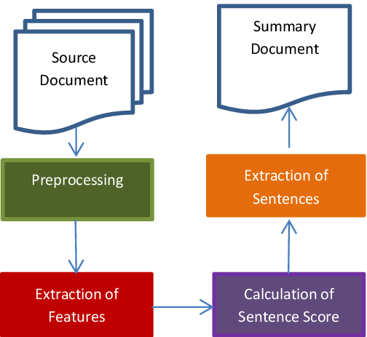
Text Summarization

Slide 6
Objectives
The objectives for text summarization using seq2seq and transformer-based methods are as follows:
To develop and implement seq2seq and transformer-based models for text summarization.
To compare the results of the seq2seq and transformer-based models with existing state-of-the-art methods for text summarization.
To examine the quality of the summaries generated by the models in terms of coherence, relevance, and informativeness.
To analyze the limitations and challenges of each method and identify potential areas for improvement.
To analyze the limitations and challenges of each method, such as handling long and complex documents, addressing domain-specific language, and overcoming the problem of generating redundant or incomplete summaries.

Slide 7
Existing System
In previous research papers they contributed a data driven semi-supervised approach to extractive legal document summarization using various neural network architectures.
Their contribution is twofold,
A novel technique of dataset generation using reference summary which eliminate the need for experts in such a complex domain.
A simple approach for generating legal document summarization without the need for feature crafting or domain knowledge.
The proposed techniques perform well as measured by Rouge scores as well as result in coherent summaries.

Slide 8
Comparative study
Here is a proposed comparative study of seq2seq and Transformer-based methods for text summarization:
Dataset: Select a suitable dataset for text summarization, such as the CNN/Daily Mail or XSum dataset.
Data Preprocessing: Preprocess the dataset by tokenizing the documents and summaries, and splitting them into training, validation, and test sets.
Model Architecture: Implement a seq2seq model with attention and a Transformer-based model, such as BART or T5, for text summarization. Both models should be trained using the same hyper parameters, such as the number of layers, hidden size, batch size, and learning rate.

Slide 9
Comparative study
Evaluation Metrics: Use standard evaluation metrics for text summarization, such as ROUGE (Recall-Oriented Understudy for Gisting Evaluation) and BLEU (Bilingual Evaluation Understudy).
Training and Testing: Train both models on the training set and validate them on the validation set. Select the best performing model based on the validation set results and test it on the test set.
Comparative Analysis: Compare the performance of the seq2seq model with attention and the Transformer-based model on the test set using ROUGE and BLEU scores. Additionally, analyze the quality of the generated summaries by conducting a manual evaluation, such as assessing the readability, coherence, and informativeness of the summaries.

Slide 10
References
https://doi.org/10.1016/j.jksuci.2019.11.015
https://dl.acm.org/doi/10.1007/s10462-017-9566-2
https://arxiv.org/abs/1802.10137
https://www.cai.sk/ojs/index.php/cai/article/view/37

Slide 11


