Slide 1
Court Case Management Software
Guided By:
K.VANISHREE AP/IT
Presented By:
V.PRAVEEN KUMAR(110817205023)
M.RANJITH(110817205026)
R.SATHISH KUMAR(110817205031)
S.SURYA(110817205034)

Slide 2
Aim
To add court case(s) and hire advocate for that case(s) and send money to advocate by a online software

Slide 3
Objective
To create online application to add case and hire advocate for that case
Transfer money to advocate by online and generate invoice

Slide 4
Abstract
It is a responsive web application used to add case and hire Advocate for that case.
Advocate is suggested using Advocate Recommendation System(ARS) based on rating, experience and practice area.
Transaction process is performed for each hearing based on different heads. Invoice generated and sent by E-mail to Petitioner and also have facility to download invoice in online.
This system will provide end to end management of court case from client perspective and easy to use.
The Advocate is suggested using Advocate Recommendation System(ARS) based on rating, experience and practice area by using submitted case details.

Slide 5
The Petitioner/Advocate must register in this application. The centralized database is used to store the case details and Petitioner/Respondent/Advocate details. Advocate are verified with help of enrolment number from previous dataset.
Once login successful Petitioner/Advocate can able to add case details.
Then the transaction process is performed using Razorpay payment gateway for each hearing based on different heads.
Invoice generated using FPDF and sent by E-mail to Petitioner with help of SMTP protocol and also have facility to download invoice in online

Slide 6
Introduction to court case management software
The court case management software is used to add case and hire advocate for that case online. This software is request advocate to handle our case once the advocate accepted our case this app will be alert petitioner/respondent about the advocate acceptance. And this app is also having a facility to transfer money online to advocate and generate invoice for each transaction with GST. The court case management software will have a cloud storage to store case evidence and important case documents those document is being encrypted using AES encryption algorithm. Here a chat app is available that will help advocate and petitioner to communicate more case details. This app is also having consultation part that will help petitioner/respondent to consult about case details before adding case and consult general law rules and regulations

Slide 7
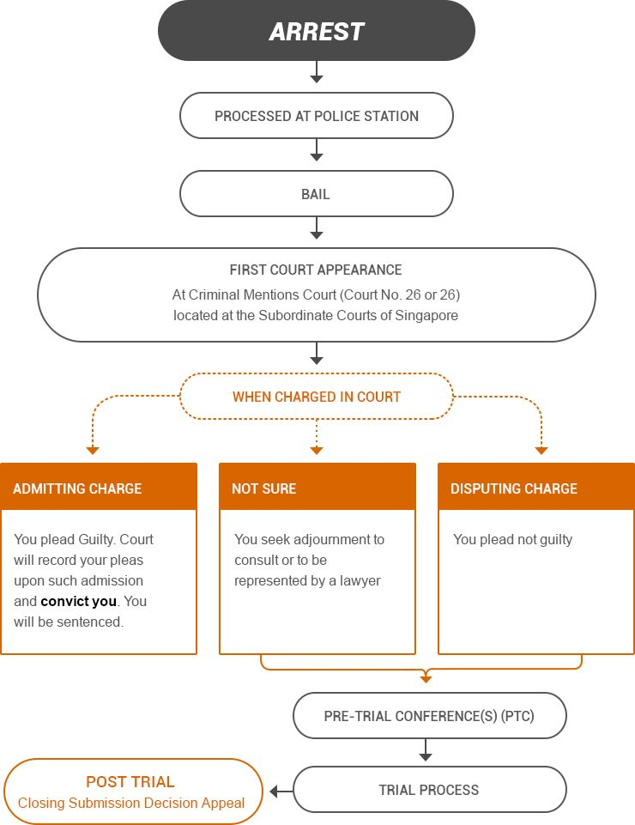
Domain Architecture Diagram

Slide 8
Advantage
This is user friendly application .
Petitioner/Respondent/Advocate can track case details .
Money transfer to advocate is simple and easy .
This app is provide invoice to Petitioner/Respondent .
Hiring of advocate to handle case is very easy .
It will reduce the time to add case .
Easy to add case .

Slide 9
Requirements
Software:
Platform : Windows 7/8/10
Front End :Xampp , PHP
Back End : MySQL
Hardware:
Processor: Core i3/i5/i7.
RAM: 2-4 GB.
HDD: 500 GB.

Slide 10
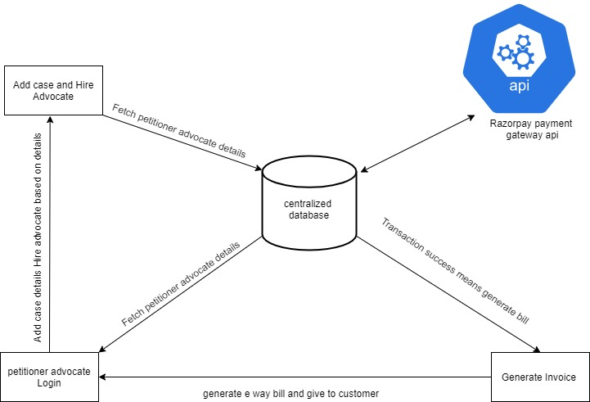
System Architecture

Slide 11
Description
The Petitioner/Advocate must register in this application after which they will get OTP confirmation.
Once login successfully petitioner can add the case details and hire Advocate.
The Advocate will submit case details to the court (offline). Then Advocate has to enter CNR number ,court order and next hearing date after receiving those details from court.
The Advocate will request to the petitioner regarding payment details.
Then the system will show the transaction alert in petitioner dashboard .
Once petitioner click pay now button the page is redirected to transaction process.
If the transaction is success then the application shows invoice to petitioner and also have facility to print invoice.

Slide 12
Modules
Login Access and Authentication
Add Case and Hire Advocate.
Online Transaction with Invoice.

Slide 13
Login Access and Authentication
In this module user want to get the services of court case management , so the user initially registers with the cloud service provider. admin provides an access code OTP only for the authorized user. User request for the access from the admin to use the data that is present in the cloud. login access is provided with the access code and authenticity is provided by issuing user name and password

Slide 14
Add Case and Hire Advocate
In this module once the petitioner / respondent is logged in the dashboard will show here the petitioner / respondent will add case and hire advocate for that case the case adding form will contain respondent name and email, mobile number, address, those field are not required field. Case description is required field that text area to fill entire case details here
Once the case adding process done it automatically recommend an advocate based on the case details the content based recommendation system will be implemented here to hire advocate for that case it will recommend advocate by practice area and rating, experience, and winning percentage of previous cases of that advocate is the process of hiring

Slide 15
Online Transaction with Invoice
In this module once the advocate will work for petitioner so he/she has send request money for their work. The online transaction will be done with help razorpay payment gateway tool the api is called to access online transaction. The transaction will contain all possible type like (credit/debit card, Net banking, upi transaction, wallet transaction, etc…) The petitioner has to select the type of transaction once the type is selected, the transaction processing if the transaction success means it will redirect to success page the petitioner / respondent has a facility to print invoice. if the transaction fail it will redirect to new transaction page

Slide 16
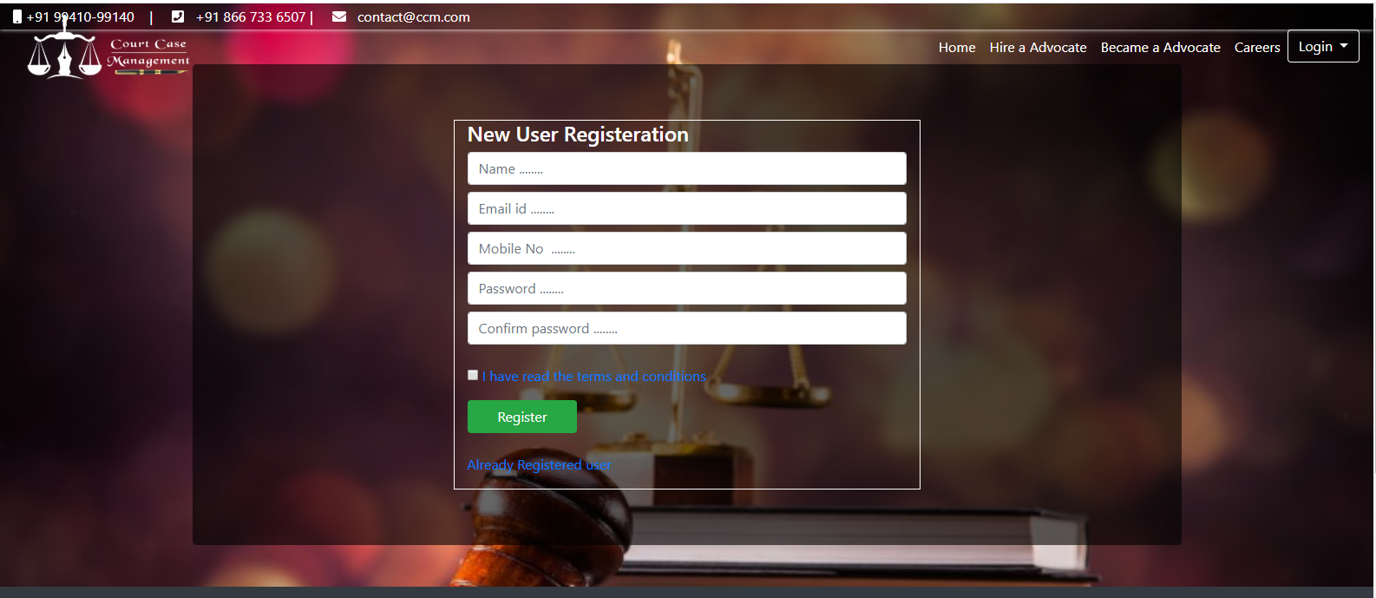
Registration

Slide 17
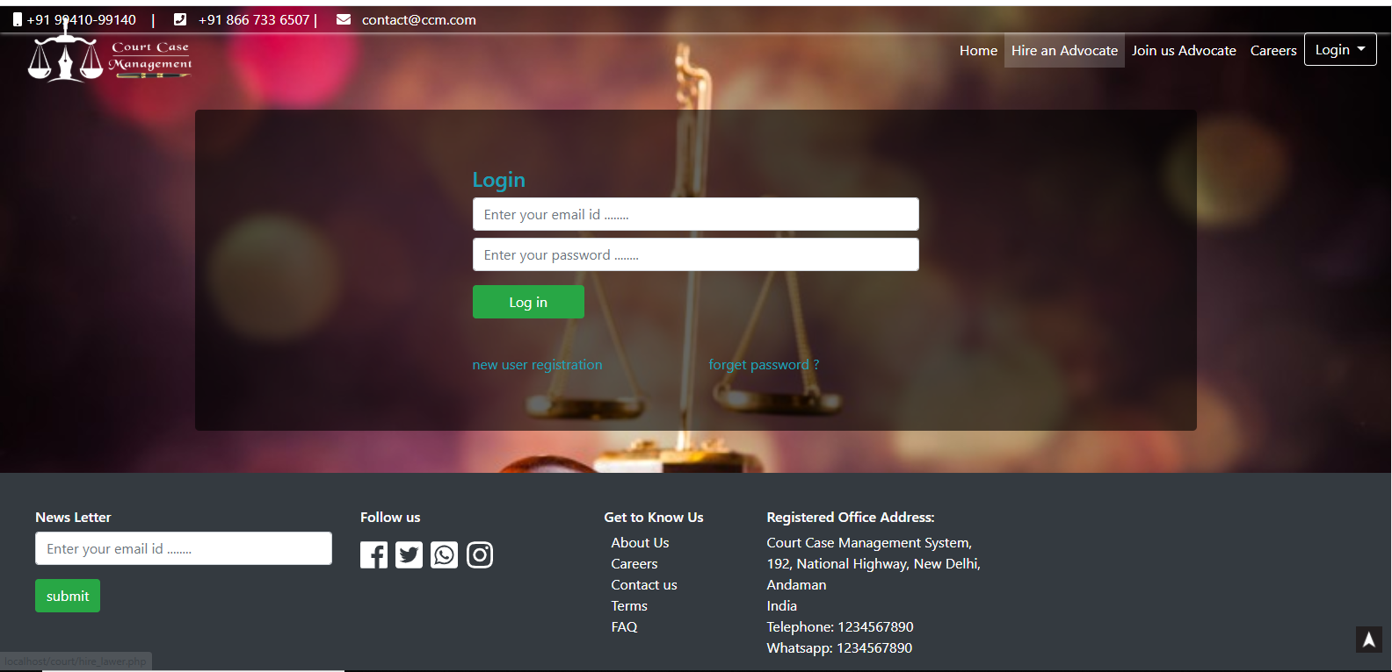
Login

Slide 18
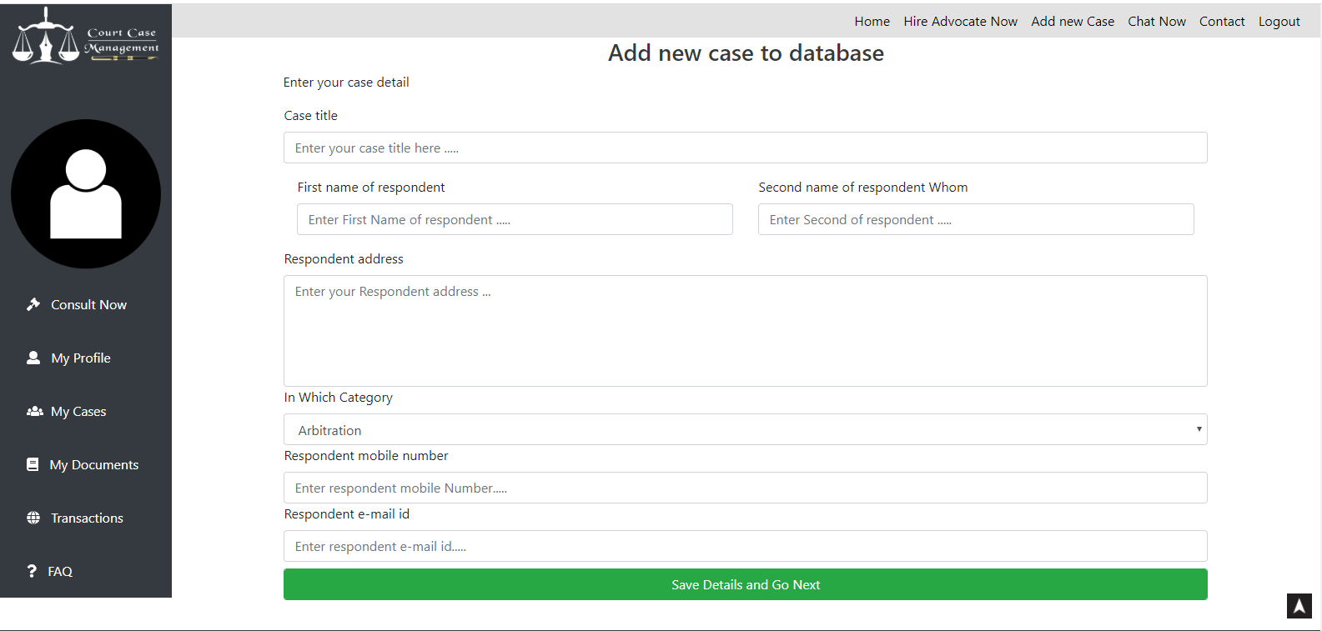
Add Case

Slide 19
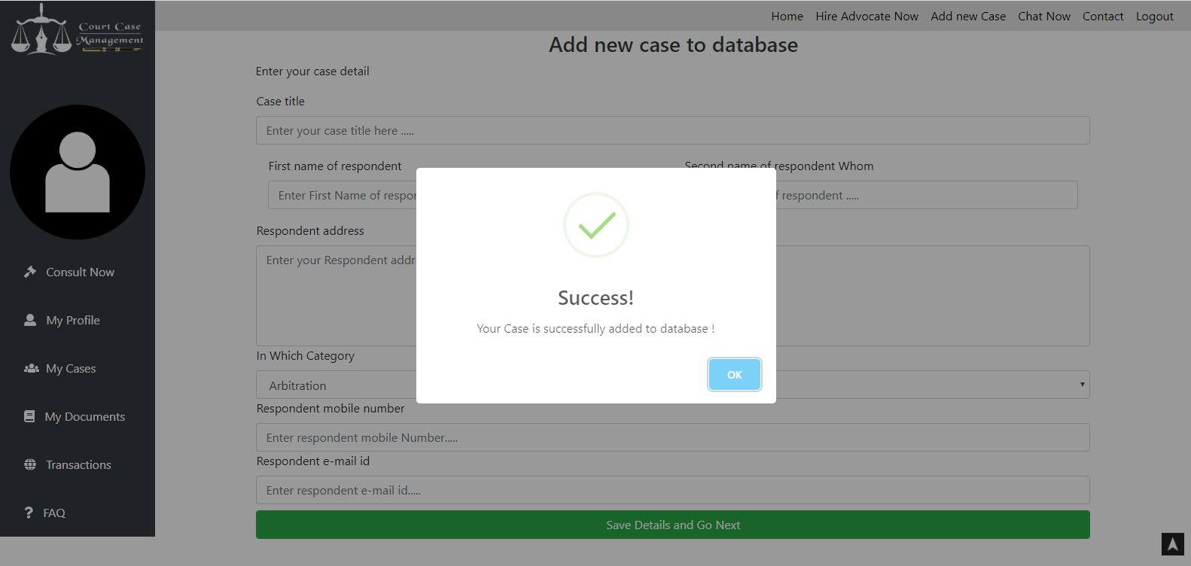
Case Added

Slide 20
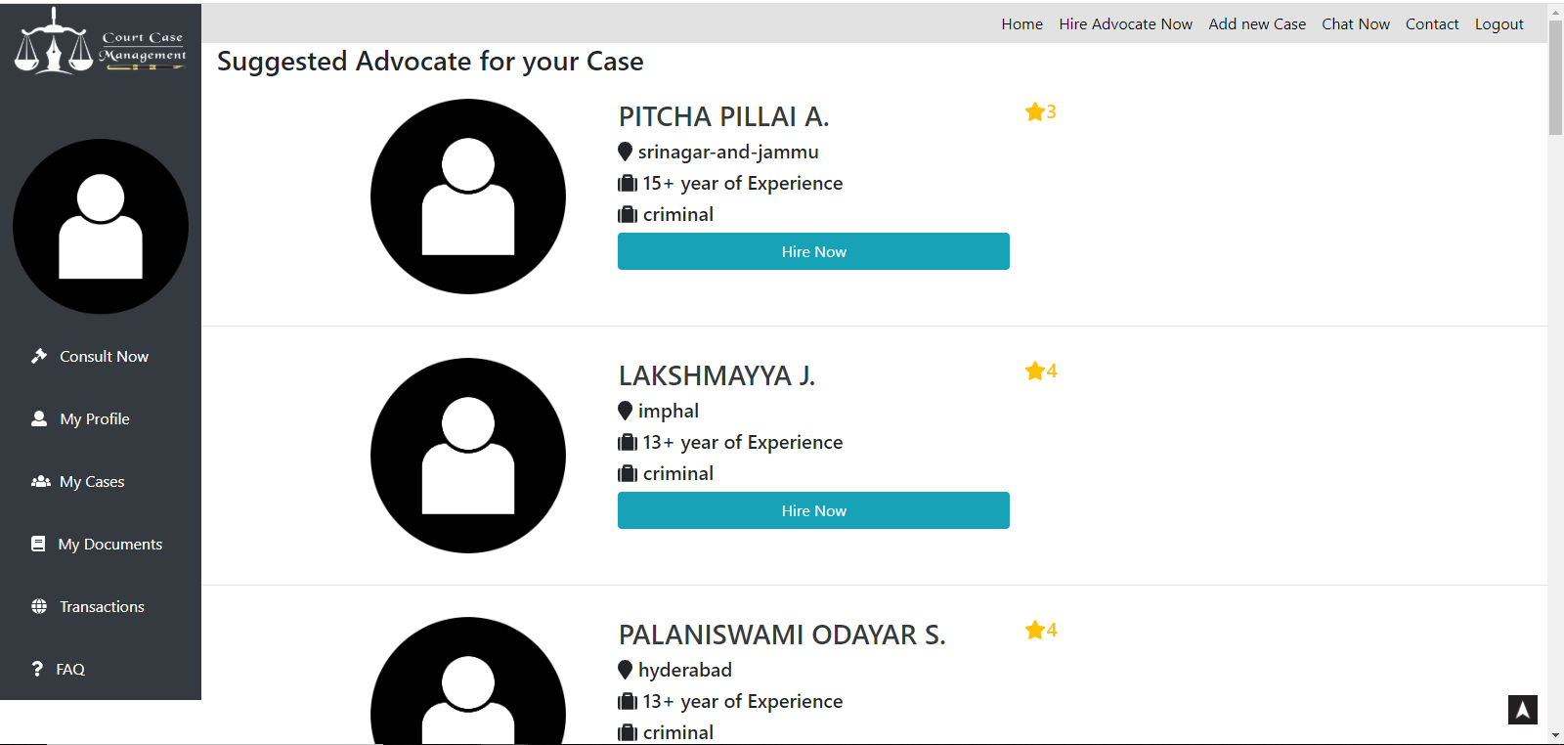
Hire Advocate

Slide 21
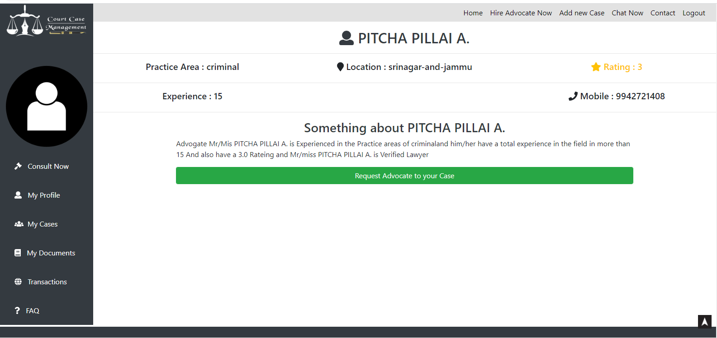
Advocate Details

Slide 22
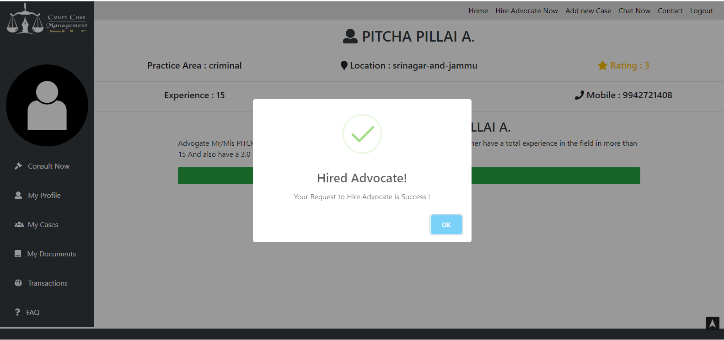
Advocate Hired

Slide 23
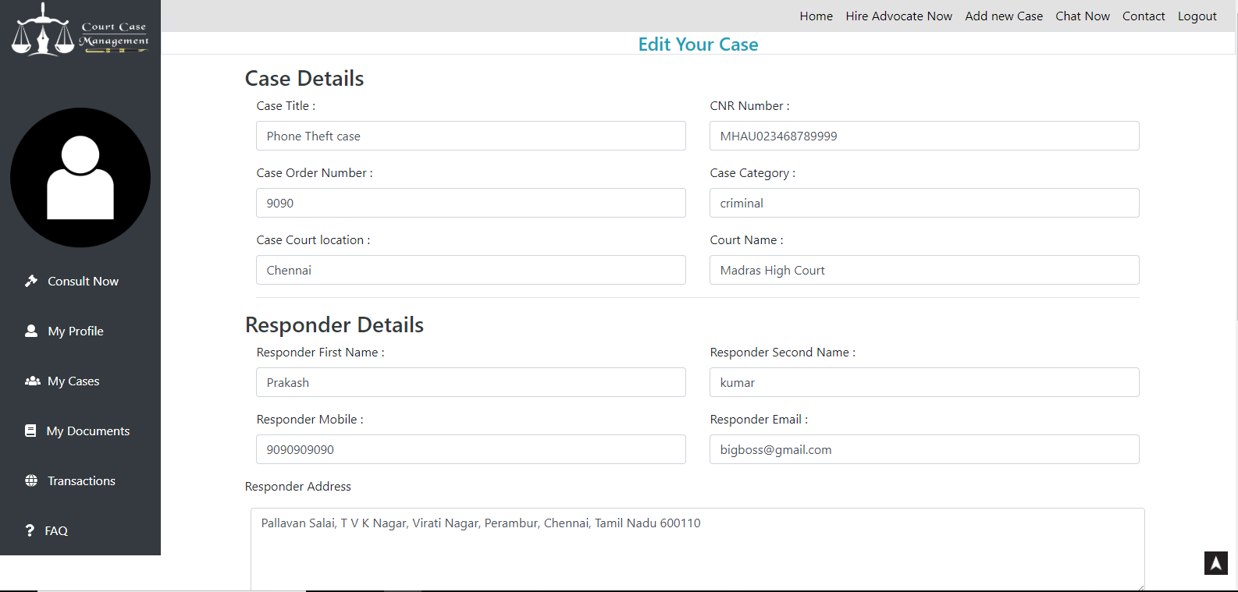
Update Case

Slide 24
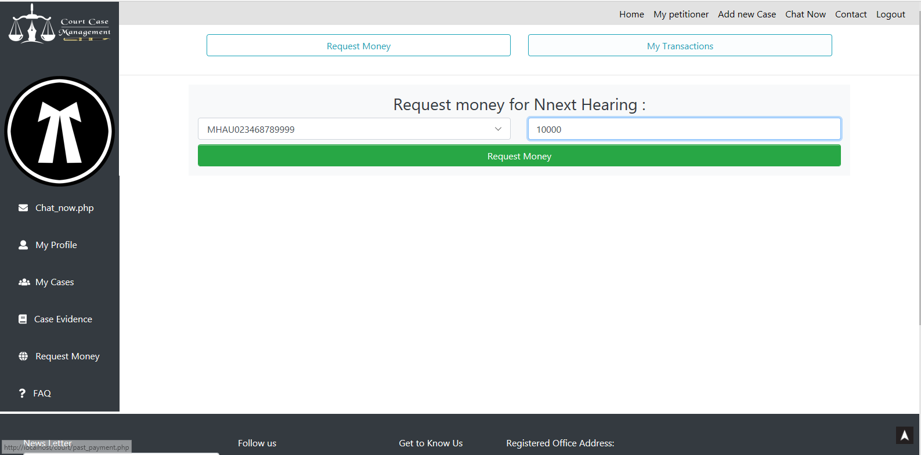
Advocate Request Money

Slide 25
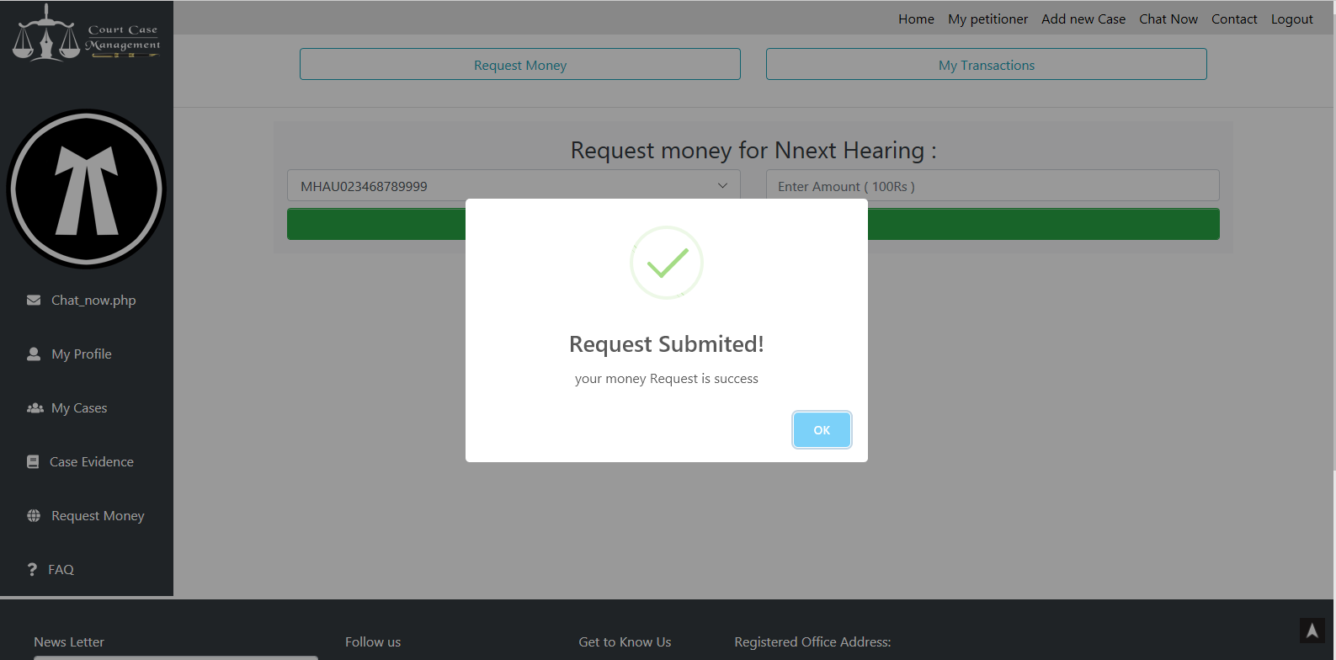
Request Submition

Slide 26
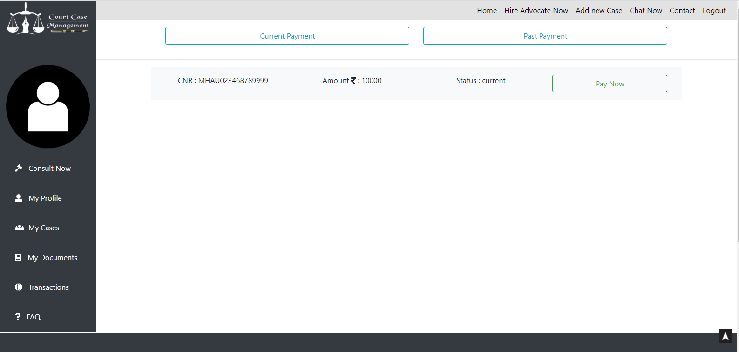
Money Request in Client Panel

Slide 27
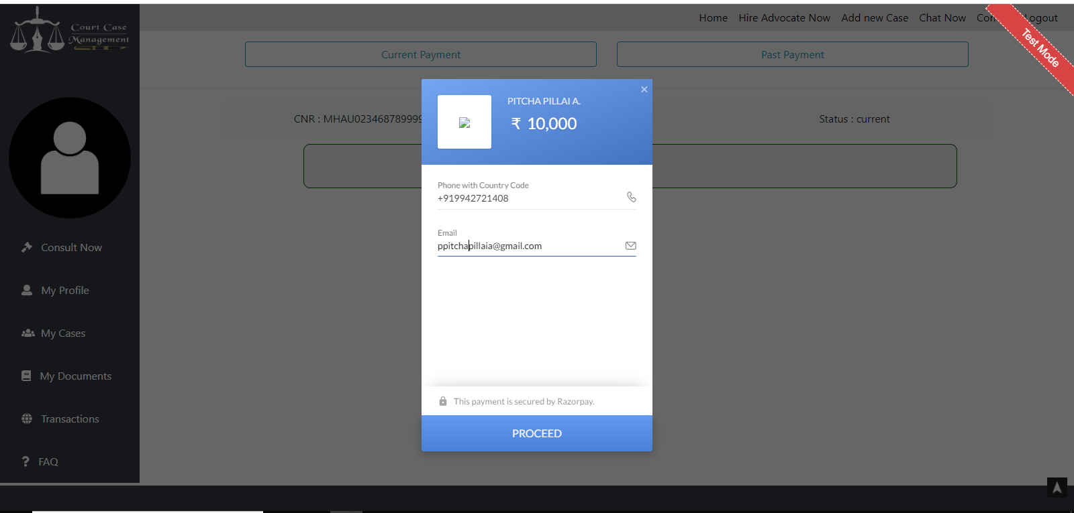
Pay Money

Slide 28
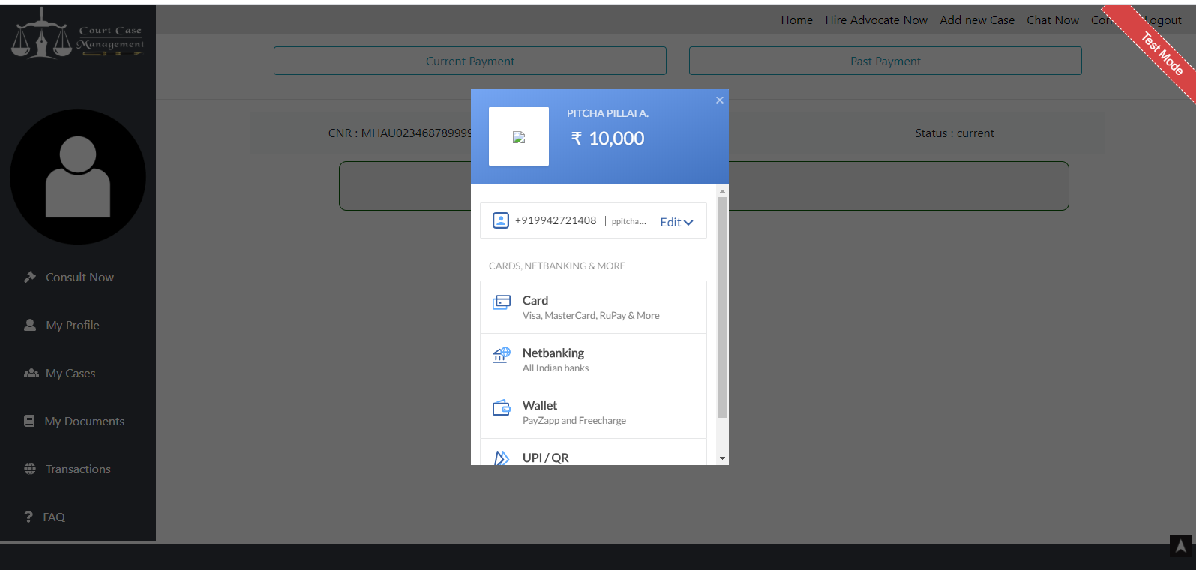
Select Transaction Process

Slide 29
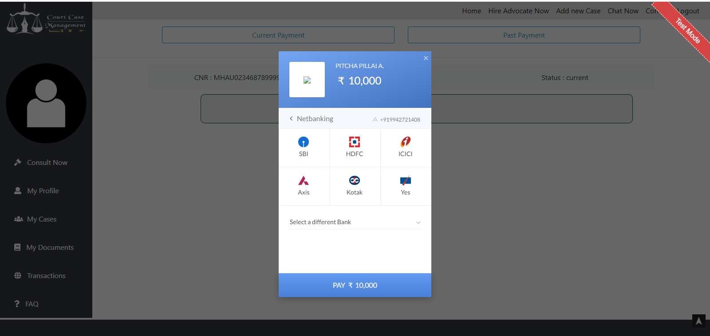
Net Banking Choosing

Slide 30
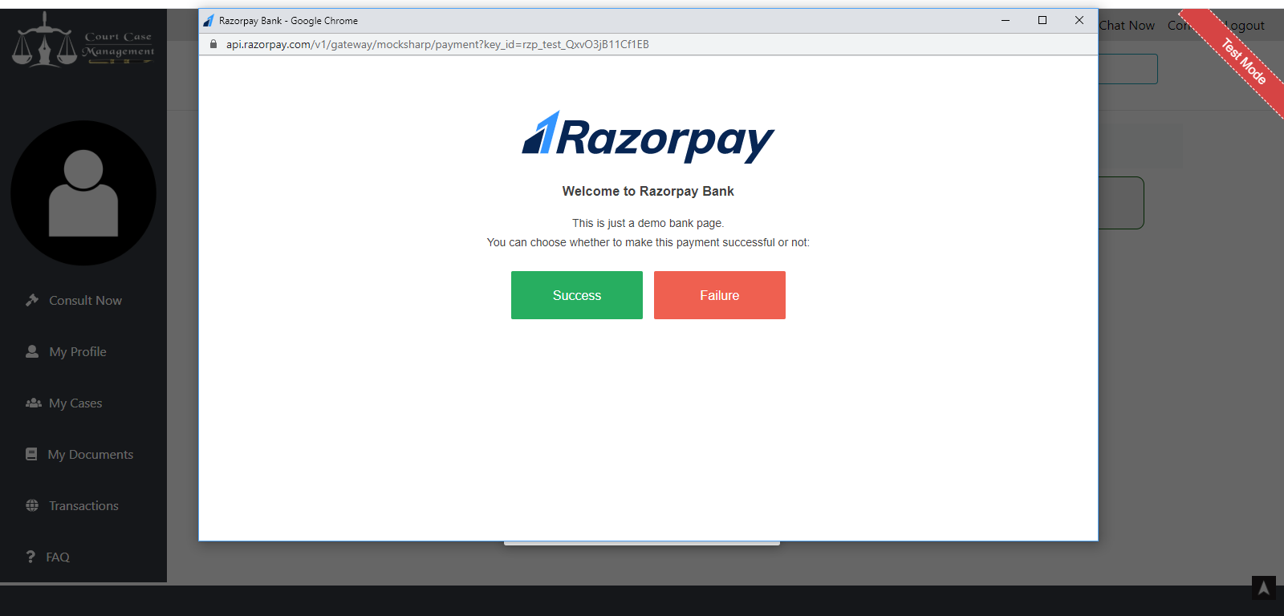
Transaction Page

Slide 31
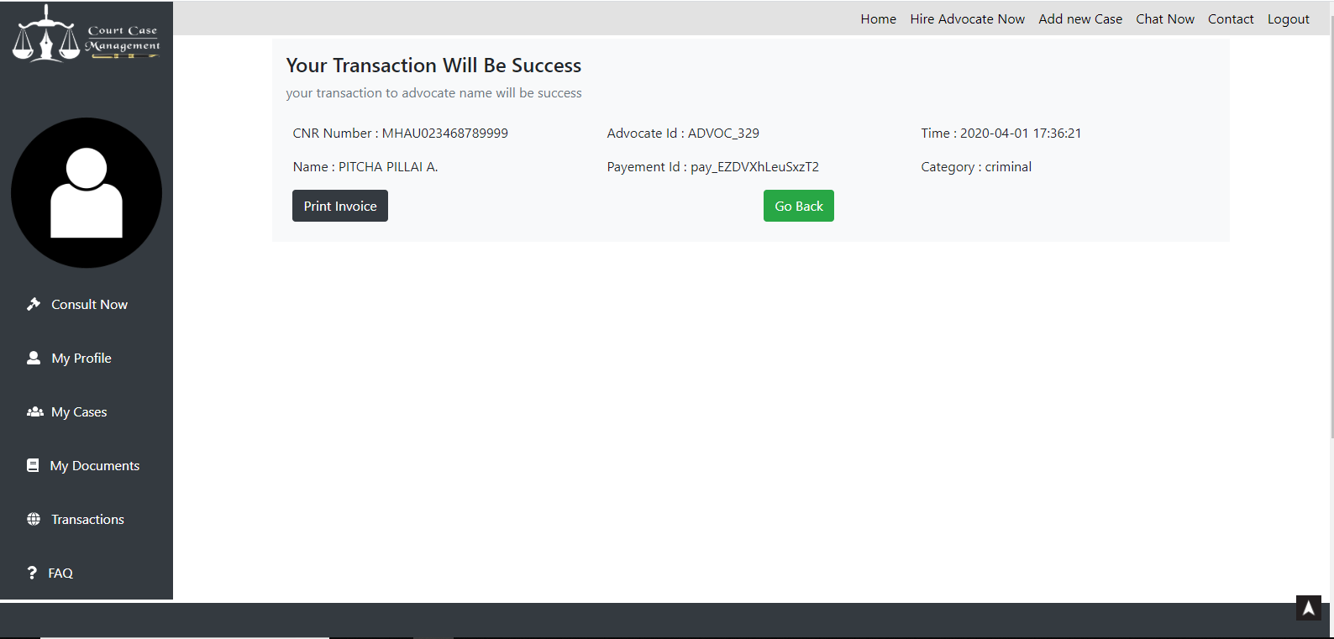
Transaction Success

Slide 32
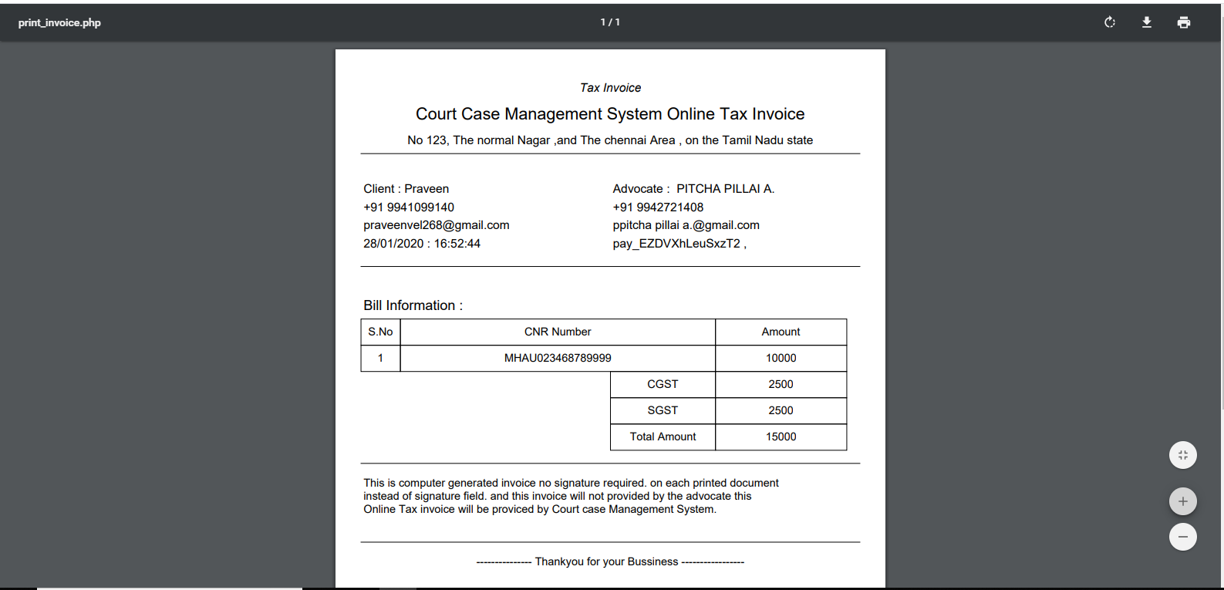
Invoice

Slide 33
Conclusion
In this paper I have provided add case and hire advocate for that case and transfer money online to the advocate

Slide 34
Future Enhancement
In future, this technique can be implemented in Online Arbitration method.
Reverse hacking may be implemented in case of intruders attack.
So that, the intruder receives only the virus content of the case file.

Slide 35
Thank You!

