Slide 1
15.4 멱집합 구하기
2016111818 김우영

Slide 2

Power Set
definition
For a set $S$, power set of $S$ is $2^{S}≡\left\{A:\text{A}⊆S\right\}$
Set of subsets
example
For set $S=\{0, 1, 2\}$, power set of $S$ is
$$2^{S}=\left\{∅,\left\{0\right\},\left\{1\right\},\left\{2\right\},\left\{0,1\right\},\left\{0,2\right\},\left\{1,2\right\},\left\{0,1,2\right\}\right\}$$

Slide 3
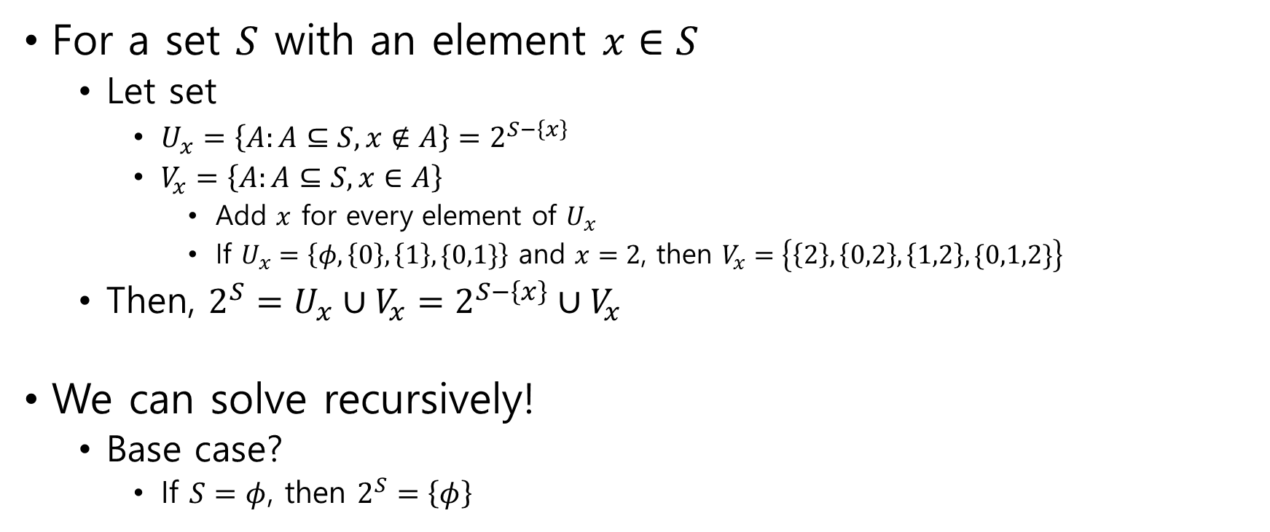
One way to get power set (1)
For a set $S$ with an element $x∈S$
Let set
$U_{x}=\left\{A:A⊆S, x∉A\right\}=2^{S−\left\{x\right\}}$
$V_{x}=\left\{A:A⊆S,x∈A\right\}$
Add $x$ for every element of $U_{x}$
If $U_{x}=\left\{φ,\left\{0\right\}, \left\{1\right\},\{0,1\}\right\}$ and $x=2$, then $V_{x}=\left\{\left\{2\right\},\left\{0,2\right\},\left\{1,2\right\},\{0,1,2\}\right\}$
Then, $2^{S}=U_{x}∪V_{x}=2^{S−\left\{x\right\}}∪V_{x}$
We can solve recursively!
Base case?
If $S=φ$, then $2^{S}=\left\{φ\right\}$

Slide 4
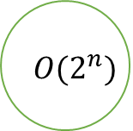
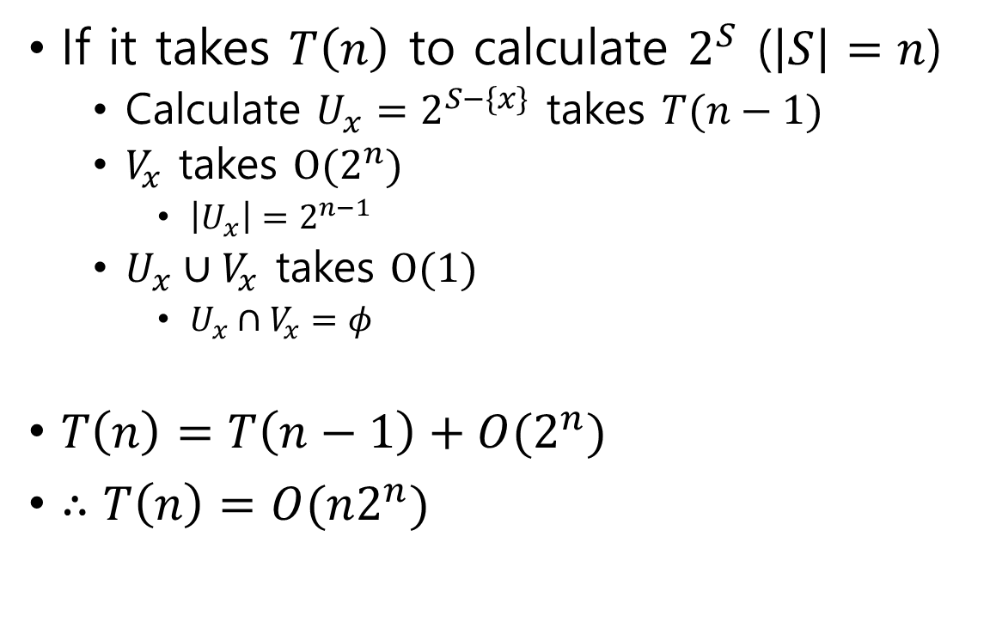

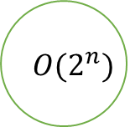
One way to get power set (2)
If it takes $T\left(n\right)$ to calculate $2^{S}$ ($\left|S\right|=n$)
Calculate $U_{x}=2^{S−\{x\}}$ takes $T(n−1)$
$V_{x}$ takes $O(2^{n})$
$\left|U_{x}\right|=2^{n−1}$
$U_{x}∪V_{x}$ takes $O(1)$
$U_{x}∩V_{x}=φ$
$T\left(n\right)=T\left(n−1\right)+O(2^{n})$
$∴T\left(n\right)=O(n2^{n})$
$$O(2^{n})$$
$$O(2^{n})$$
…
$$O(2^{n})$$

Slide 5
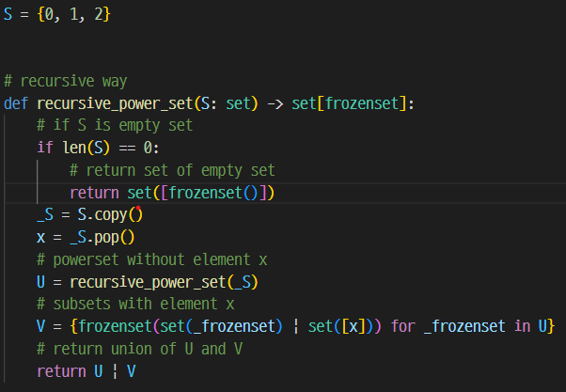
One way to get power set (3)

Slide 6
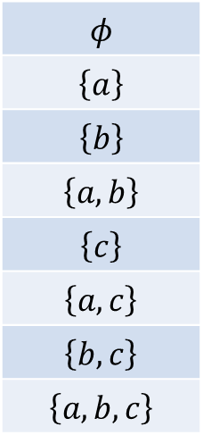


Another way to get power set (1)
$2^{n}$ n-bits correspond to subsets of set $S$ with $\left|S\right|=n$
Let set $S=\left\{a,b,c\right\}$
c
b
a
0
1
2
3
4
5
6
7
0 | 0 | 0
0 | 0 | 1
0 | 1 | 0
0 | 1 | 1
1 | 0 | 0
1 | 0 | 1
1 | 1 | 0
1 | 1 | 1
$$φ$$
$$\left\{a\right\}$$
$$\left\{b\right\}$$
$$\left\{a,b\right\}$$
$$\left\{c\right\}$$
$$\left\{a,c\right\}$$
$$\left\{b,c\right\}$$
$$\left\{a,b,c\right\}$$
Array of bits
Subsets of $S$

Slide 7
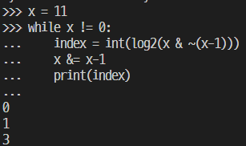

Another way to get power set (2)
indices of bit with 1 (ch.4)
Index of lowest bit with 1: $log\left(x \& \sim \left(x−1\right)\right)⁡$
Delete lowest bit with 1: $x \& (x−1)$
Example $x=11={1011}_{\left(2\right)}$

Slide 8
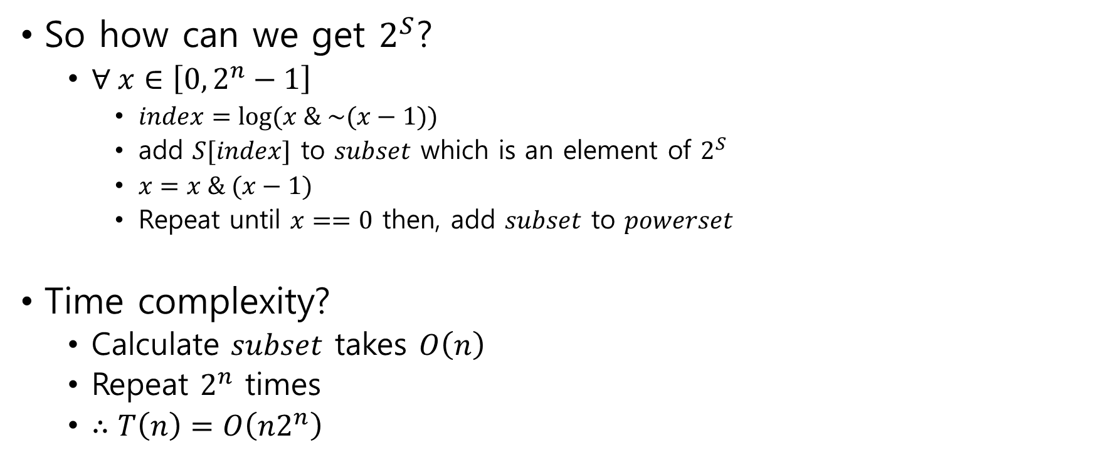
Another way to get power set (3)
So how can we get $2^{S}$?
$∀ x∈\left[0, 2^{n}−1\right]$
$index=log⁡(x \& \sim (x−1))$
add $S[index]$ to $subset$ which is an element of $2^{S}$
$x=x \& (x−1)$
Repeat until $x==0$ then, add $subset$ to $powerset$
Time complexity?
Calculate $subset$ takes $O\left(n\right)$
Repeat $2^{n}$ times
$∴T\left(n\right)=O\left(n2^{n}\right)$

Slide 9
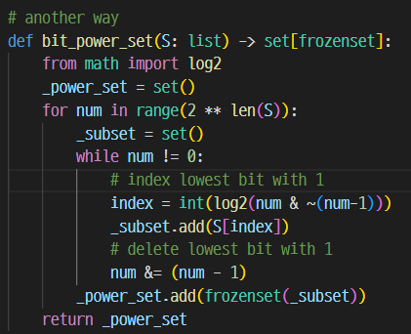
Another way to get power set (4)

