Slide 1

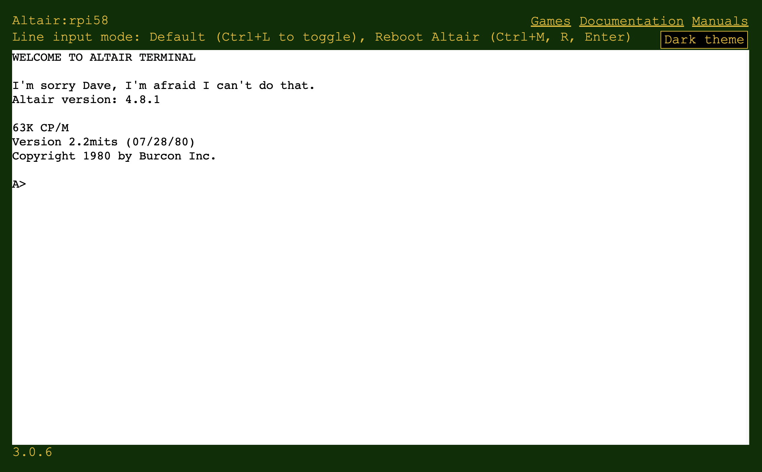
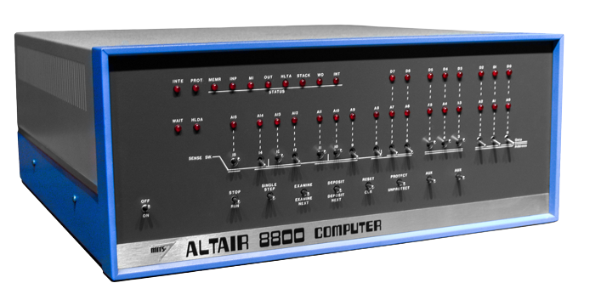

Altair Web Terminal
Altair 8800 Emulator
Cloud Services
Open Weather Map
Azure IoT Central

