Slide 1
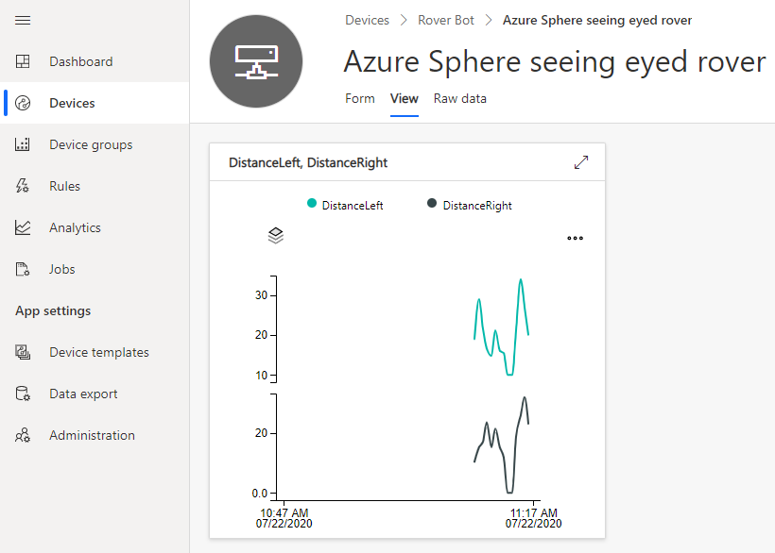
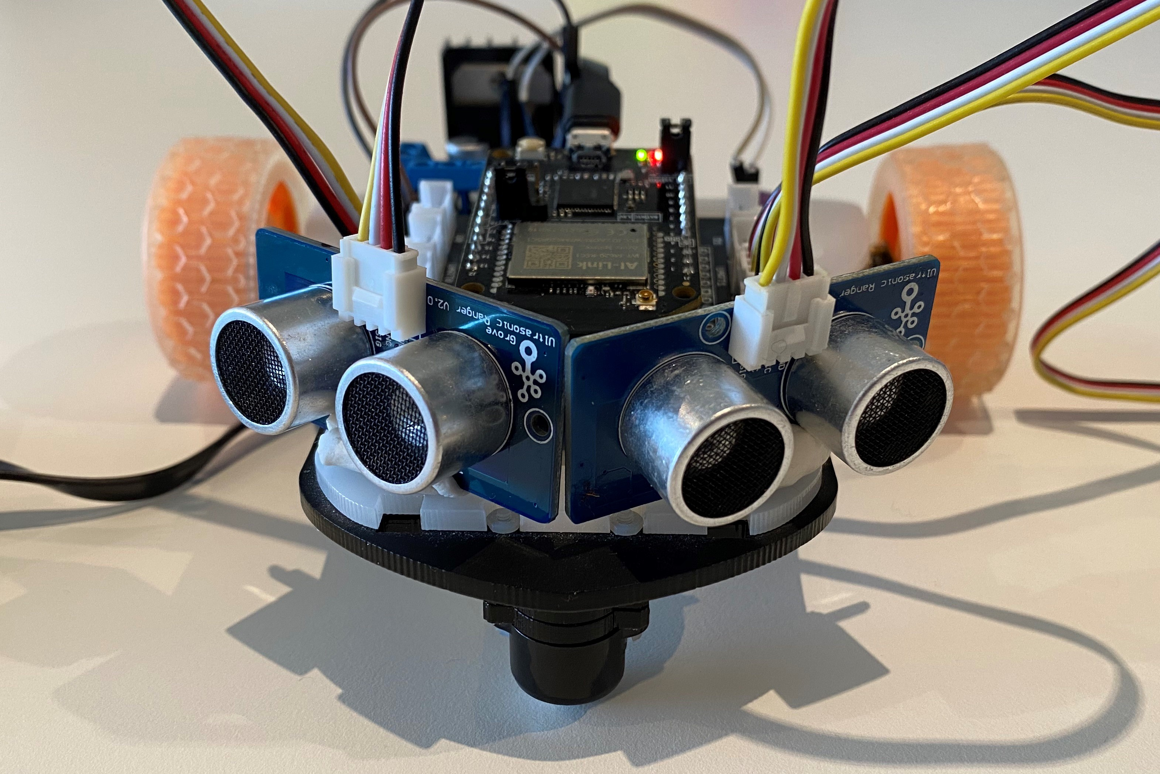
Realtime Azure RTOS ThreadX Azure IoT Integration Architecture
Azure Sphere MT3620 MCU
Azure RTOS ThreadX
Task
A7
Highlevel
core
IoT Central
Azure RTOS ThreadX
Thread
Ultrasonic distance sensor HC-SR04
Intercore bridge
M4
Realtime
core
Azure RTOS ThreadX
Thread
Intercore messaging
Intercore bridge
Azure RTOS ThreadX
Azure RTOS ThreadX
Thread
LED UI
M4
Realtime
core
MTK M4 drivers

Slide 2
Seeing Eyed Rover demo
Realtime Azure RTOS ThreadX Highlevel Azure IoT Integration Architecture
Azure Sphere MT3620
Azure RTOS ThreadX
Task
A7
Highlevel
core
IoT Central
Azure RTOS ThreadX
Task
Ultrasonic distance sensor HC-SR04
Intercore bridge
M4
Realtime
core
Azure RTOS ThreadX
Task
Intercore messaging
Intercore bridge
Azure RTOS ThreadX
Azure RTOS ThreadX
Task
LED UI
M4
Realtime
core
MTK M4 drivers

Slide 3
Azure Sphere MT3620 Application Architecture
Azure RTOS ThreadX
Task
A7
Highlevel
core
IoT Central
Azure RTOS ThreadX
Thread
Ultrasonic distance sensor HC-SR04
Intercore bridge
M4
Realtime
core
Azure RTOS ThreadX
Thread
Intercore messaging
Intercore bridge
Azure RTOS ThreadX
Azure RTOS ThreadX
Thread
LED UI
M4
Realtime
core
MTK M4 drivers

Slide 4
Azure IoT Central
Device templates, Charts, Time series analytics, Rules
Azure IoT
Messaging, Device twins, and Direct methods
Azure Sphere MT3620
Cortex A7 Application core
Inter-core
Message bridge
Cortex M4 Real-time core
High-level application
Azure RTOS ThreadX
Azure IoT Messages & Device twins (direction)
ThreadX Threads
Ultrasonic Sensor
Azure IoT
Direct methods (stop/start)
Outbound Messages
Real-time core heartbeat
Inbound Messages

Slide 5
Azure Sphere MT3620
Cortex A7 Application core
Inter-core
Message bridge
Cortex M4 Real-time core
High-level application
Azure RTOS ThreadX
Azure IoT Messages & Device twins (direction)
ThreadX Threads
Ultrasonic Sensor
Azure IoT
Direct methods (stop/start)
Outbound Messages
Real-time core heartbeat
Inbound Messages

