Slide 1


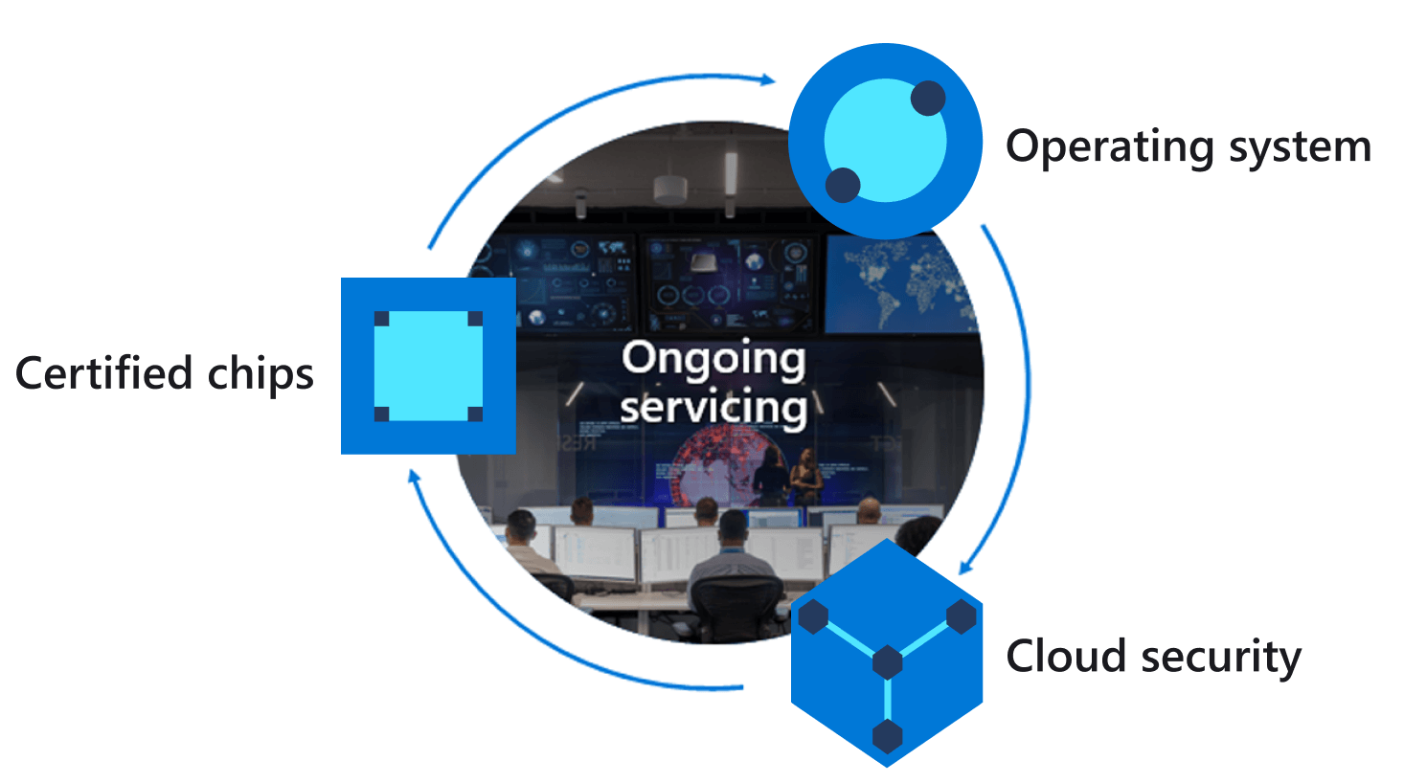
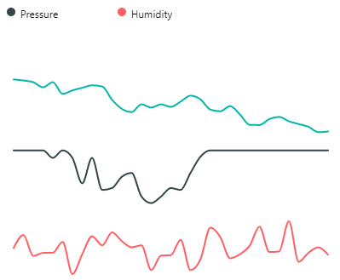
Azure IoT Central
Azure IoT Hub
Azure Sphere
Cortex A7 High-level
2
IoT Hub Messaging
Telemetry streaming
{
“Temperature”:26,
“Humidity”:55,
“Pressure”: 1100
}
1
Notes:
Change the rate the sensor os measured

