Slide 1


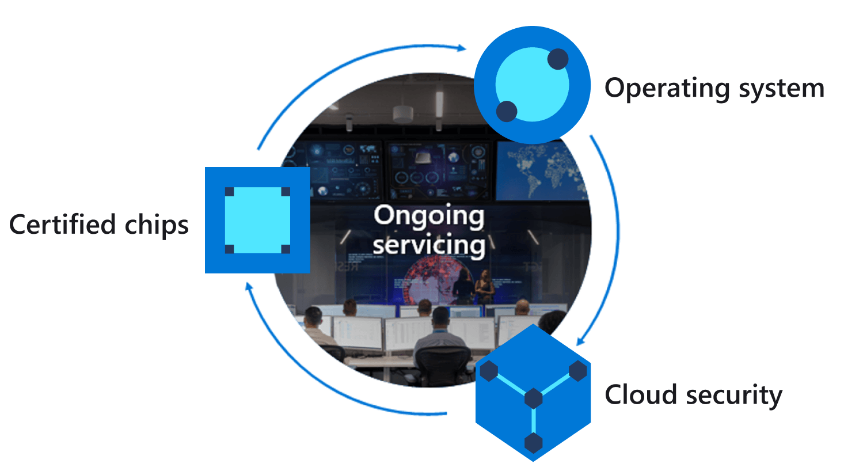
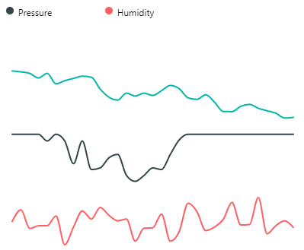
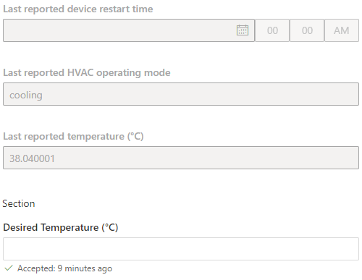
Azure IoT Central
Azure IoT Hub
Azure Sphere
Cortex A7 High-level
Intercore message bridge
Cortex M4 Real-time
5
4
2
3
IoT Hub Messaging
Telemetry streaming
Environment service thread
{
“Temperature”:26,
“Humidity”:55,
“Pressure”: 1100
}
7
Environment sensor thread
1
Device twin
Desired Temperature
Device twin virtual HVAC control
6
JSON
Notes:
Change the rate the sensor os measured

Slide 2
Azure IoT Central
Azure IoT Hub
Azure Sphere
Cortex A7 High-level
1
IoT Hub Messaging
Telemetry streaming
{
“Temperature”:26,
“Humidity”:55,
“Pressure”: 1100
}
2
Device twin
Desired Temperature
Device twin virtual HVAC control
5
5
6
JSON
Notes:
Change the rate the sensor os measured

