Slide 1


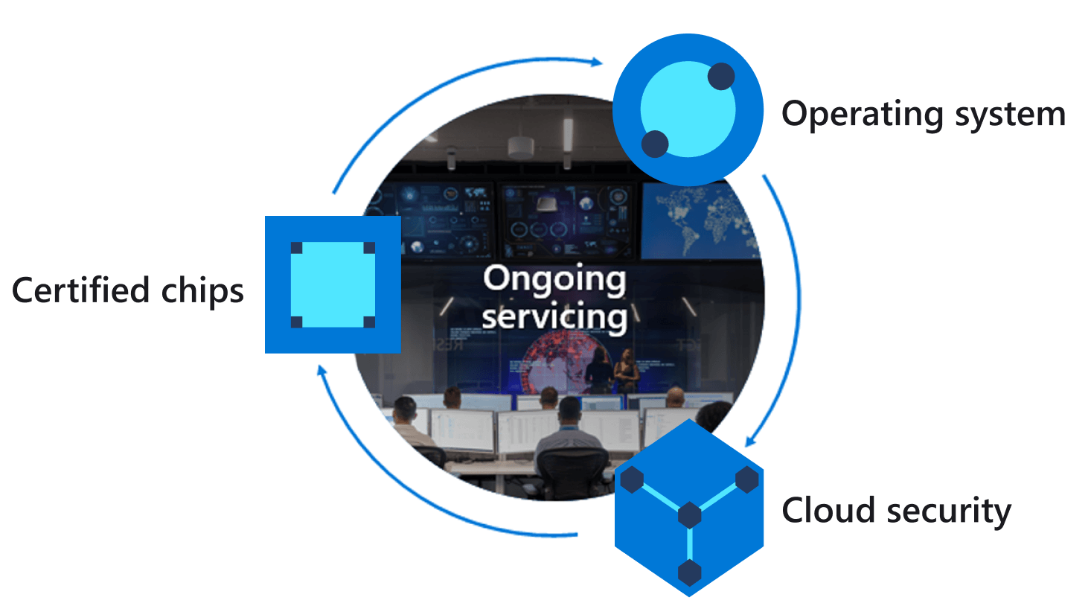
Azure IoT Central
Azure IoT Hub Device Twin
Azure Sphere
Properties.Desired
Report HVAC
operating mode.
For example the heating unit turned off
JSON
Query HVAC
Operating Mode
device twin
Properties.Reported
JSON
3
2
1
Notes:
Change the rate the sensor os measured

