Slide 1
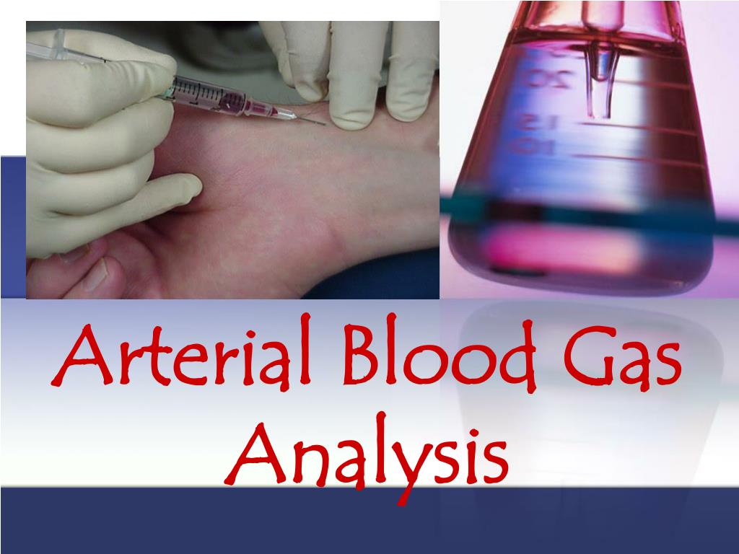
By
Hussain Bux soomro
Nursing lecturer @college of Nursing Shikarpur

Slide 2

Arterial blood Gas , ABG Monitoring
An Arterial Blood Gas (ABG) test measures the levels of oxygen (O₂), carbon dioxide (CO₂), and pH in arterial blood to assess acid-base balance and respiratory function.
Indications of ABG Test:
Diagnose respiratory disorders (e.g., COPD, asthma).
Detect metabolic imbalances (e.g., kidney disease, diabetic ketoacidosis).
Assess oxygenation in critical patients (e.g., ICU, ventilator support).
Checking response of treatments.

Slide 3
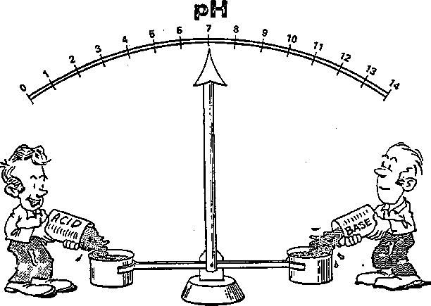

Slide 4
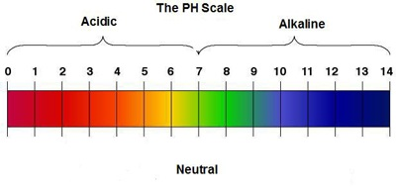
Acid Base balance
The chemical reactions that sustain life dépend on a délicate balance or homéostasis.
A slight imbalance can profoundly affect metabolism and essential body functions.
Several conditions such as infection, trauma and médications affect acid base balance

Slide 5
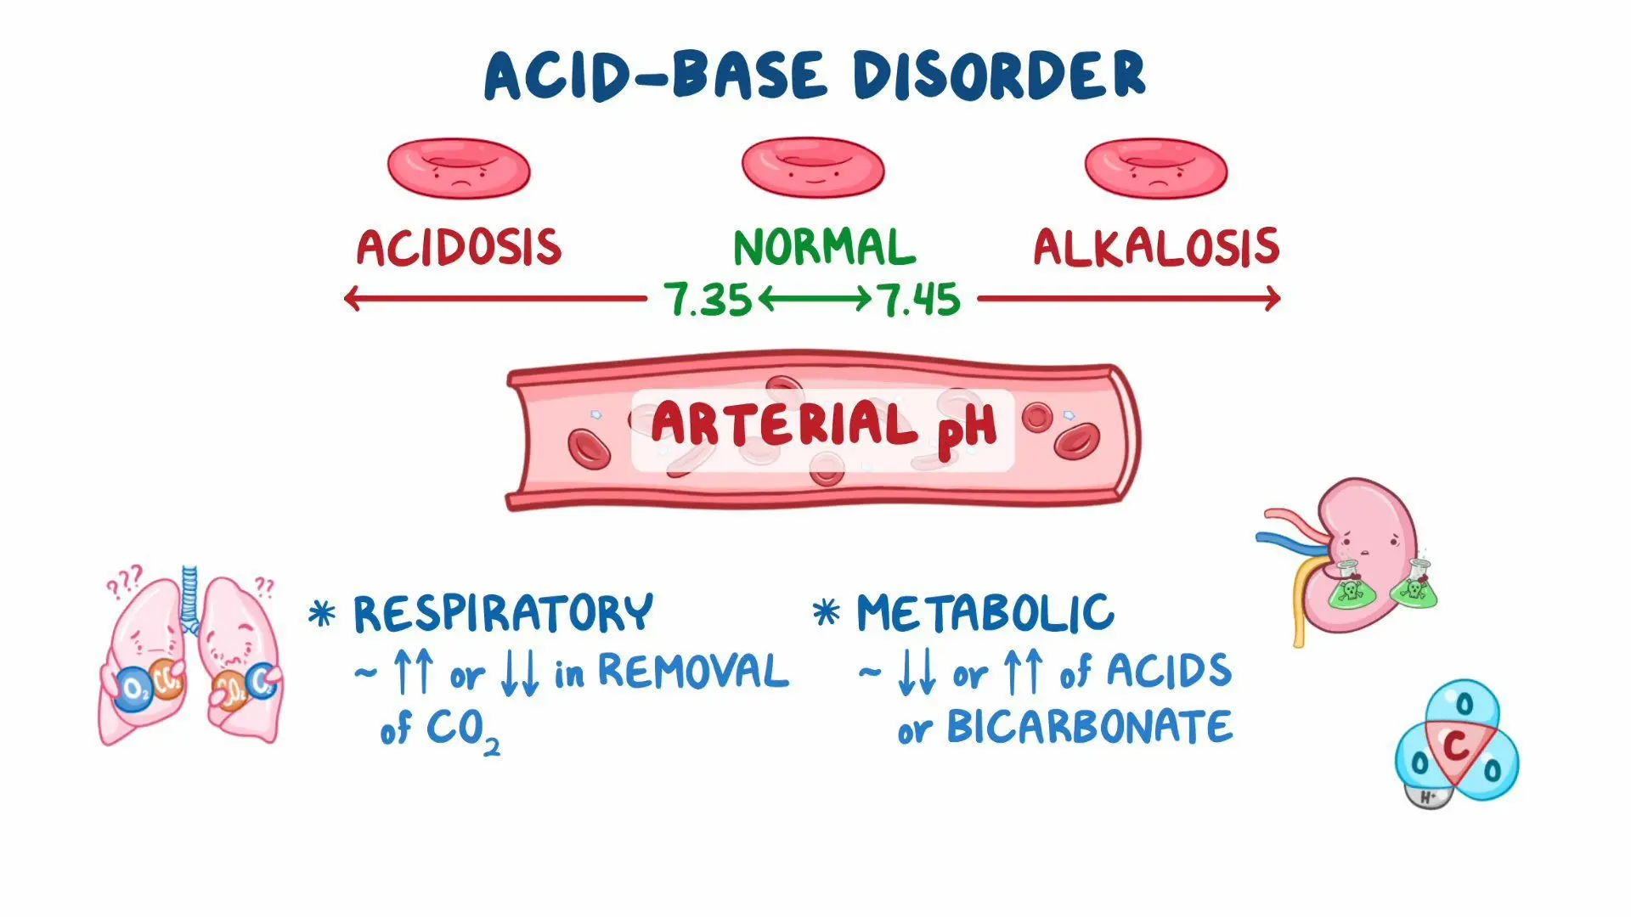
Acid Base self regulation
In order to maintain PH in normal ranges, body self régulâtes the acid base balance
It is done by the buffer mechanism between respiratory and rénal systems

Slide 6
Key Parameters in ABG Test:
Parameter | Normal Range | Function
pH | 7.35–7.45 | Measures blood acidity or alkalinity.
PaCO₂ | 35–45 mmHg | Measures CO₂ levels, indicating respiratory function.
HCO₃⁻ | 22–26 mEq/L | Measures bicarbonate, showing kidney function in acid-base balance.
PaO₂ | 80–100 mmHg | Measures oxygen level in blood.
O₂ Saturation | 95–100% | Indicates oxygen-carrying capacity of hemoglobin.

Slide 7

Getting ABG sample
It is a diagnostic procedure in which a blood is obtained from an artery directly by an arterial puncture or accessed by a way of indwelling arterial catheter

Slide 8
1. Patient Preparation:
Explain the procedure to the patient.
Check for contraindications (e.g., bleeding disorders, anticoagulant use).
Perform Allen’s test to check collateral circulation in the radial artery.
2. Equipment Required:
ABG syringe with heparin (to prevent clotting). 0.05 mL (50 IU) for 1ml
After adding heparin, expel all excess heparin from the syringe, leaving only a thin coating inside. Excess heparin can cause heparin-induced acidosis, which may affect ABG result
Alcohol swab or antiseptic solution.
Sterile gloves.
1ml syringe is best , Needle (22-25 gauge).
Ice pack (if immediate analysis is not possible).
Gauze and adhesive bandage.

Slide 9
Procedure:
Common site: Radial artery (wrist).
Alternative sites: Brachial artery (arm) or Femoral artery (groin).
Clean the site with an antiseptic solution.
Wear sterile gloves.
Arterial Puncture:
Insert the needle at a 45° angle (radial), 60° angle (brachial), or 90° angle (femoral).
Wait for pulsatile blood flow (indicating arterial access).
Withdraw 1-2 mL of arterial blood slowly.
Post-Puncture Care:
Remove the needle and apply firm pressure for 5-10 minutes to prevent hematoma. if patient has coagulation abnormalities apply pressure for 10 – 15 minutes, Apply a bandage.

Slide 10
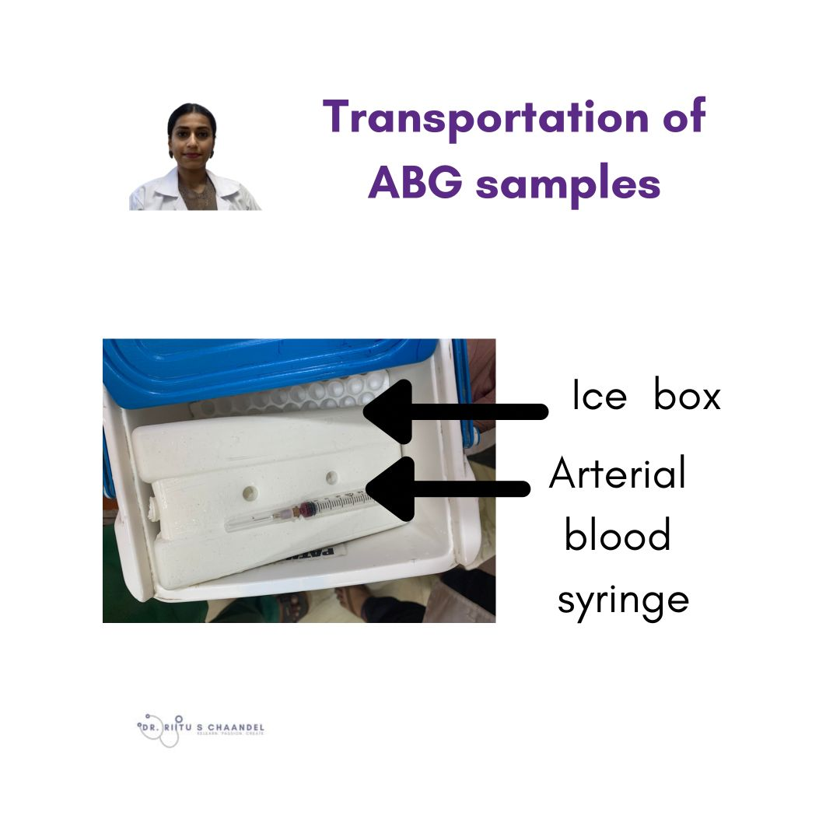
Sample Handling & Transport:
Expel air bubbles from the syringe (to avoid false oxygen readings).
Mix the sample gently to prevent clotting.
Place the sample in an ice pack if not analyzed immediately.
Transport to the laboratory within 15-30 minutes.

Slide 11
Method interpretation Tic-Tac-Toe
Disorder | Cause | pH | CO₂ | HCO₃⁻ | Compensation
Respiratory Acidosis | CO₂ retention (e.g., COPD, hypoventilation) | 7.35–7.45 ↓ | 35–45 mmHg ↑ | 22–26 mEq/L Normal | Kidneys retain HCO₃⁻
Respiratory Alkalosis | CO₂ loss (e.g., hyperventilation, anxiety) | ↑ | ↓ | Normal | Kidneys excrete HCO₃⁻
Metabolic Acidosis | HCO₃⁻ loss or acid gain (e.g., diarrhea, DKA, renal failure) | ↓ | Normal | ↓ | Lungs hyperventilate (↓ CO₂)
Metabolic Alkalosis | HCO₃⁻ gain or acid loss (e.g., vomiting, diuretics) | ↑ | Normal | ↑ | Lungs hypoventilate (↑ CO₂)

Slide 12
Acid base compensation
The body responds to acid base imbalances by activation compensatory mechanisms. Compensatory mechanisms minimizes pH changes if the body compensates only partially, pH will still be outside the normal range.
Check pH:
If pH is normal but PaCO₂ & HCO₃⁻ are abnormal → Fully compensated
If pH is abnormal & both PaCO₂ & HCO₃⁻ are abnormal → Partially compensated
If pH is abnormal & only one of PaCO₂ or HCO₃⁻ is abnormal → Uncompensated

Slide 13
Example 1
Jane Doe is a 45-year-old female admitted to the nursing unit with a severe asthma attack. She has been experiencing increasing shortness of breath since admission three hours ago. Her arterial blood gas result is as follows
Clinical Laboratory:
pH 7.22
PaCO2 55
HCO3 25
Follow the steps:
1. Assess the pH. It is low therefore, we have acidosis.
2. Assess the PaCO2. It is high and in the opposite direction of the pH.
3. Assess the HCO3. It has remained within the normal range (22-26).
Acidosis is present (decreased pH) with the PaCO2being increased, reflecting a primary respiratory problem. For this patient, we need to improve the ventilation status by providing oxygen therapy, mechanical ventilation or by administering bronchodilators.

Slide 14
Example 2
John Doe is a 55-year-old male admitted with a recurring bowel obstruction. He has been experiencing intractable vomiting for the last several hours, Here is his arterial blood gas result:
Clinical Laboratory:
pH 7.50
PaCO2 42
HCO3 33
Follow the steps again:
1. Assess the pH. It is high (normal 7.35-7.45), therefore, indicating alkalosis.
2. Assess the PaCO2. It is within the normal range (normal 35-45).
3. Assess the HCO3. It is high (normal 22-26) and moving in the same direction as the pH.
Alkalosis is present (increased pH) with the HCO3 increased, reflecting
a primary metabolic problem. Treatment of this patient might include administration of I.V. fluids and measures to reduce the excess base.
14

Slide 15
Lets practice to interpret ABGs
Case No 1 : A 60-year-old male with COPD presents with dyspnea and drowsiness. ABG results : pH 7.28, PaCO₂ 55 mmHg, HCO₃⁻ 26 mEq/L
Answer :Respiratory Acidosis due to CO₂ retention (hypoventilation)
Case No 2: A 25-year-old female with anxiety complains of rapid breathing and dizziness .ABG: pH 7.48, PaCO₂ 30 mmHg, HCO₃⁻ 23 mEq/L
Answer : Respiratory Alkalosis due to hyperventilation.

Slide 16
Case No 3: A 45-year-old diabetic patient with vomiting and confusion. ABG: pH 7.22, PaCO₂ 34 mmHg, HCO₃⁻ 15 mEq/L
Answer :Metabolic Acidosis (eg. Diabetic Ketoacidosis - DKA)
Case No 4: A 50-year-old male with severe vomiting for two days. ABG: pH 7.49, PaCO₂ 42 mmHg, HCO₃⁻ 30 mEq/L
Answer : Metabolic Alkalosis due to vomiting (loss of stomach acid).
Case No5 : A 30-year-old patient with cardiac arrest and no ventilation. ABG: pH 7.10, PaCO₂ 60 mmHg, HCO₃⁻ 14 mEq/L
Answer : Mixed Acidosis due to respiratory failure and lactic acidosis.

Slide 17
Case No.6 : A 60-year-old COPD patient with long-term shortness of breath.
ABG Results:
pH: 7.38 (Normal but on the lower side)
PaCO₂: 52 mmHg (↑ High)
HCO₃⁻: 30 mEq/L (↑ High, kidneys compensating)
Answer : Fully compensated respiratory acidosis (Kidneys retained HCO₃⁻ to balance the high CO₂, keeping pH normal).

Slide 18


