Slide 1
Exploring the Viability of Widespread Adoption of RISC-V Architecture in Mobile Phones: Prospects and Challenges
Haoting Chen U7227871

Slide 2
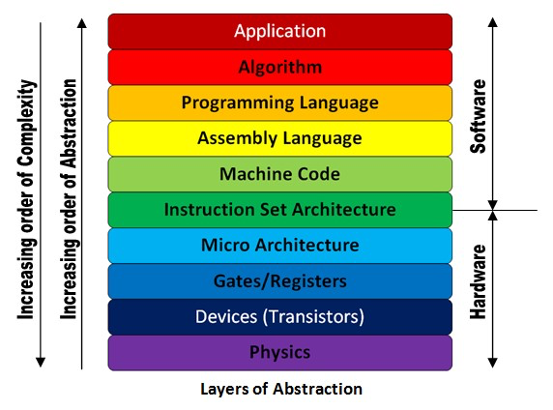
RISC-V and ISA
Exploring the Viability of Widespread Adoption of RISC-V Architecture in Mobile Phones: Prospects and Challenges
RISC-V is an instruction set architecture (ISA) first published by UC-Bakery in 2010.
ISA is the connection between software and hardware.
ARM and x86 are the current dominant ISAs in the mobile phone and PC areas.
Image From:
<https://electronics.stackexchange.com/questions/353915/what-is-the-role-of-isa-instruction-set-architecture-in-the-comp-arch-abstract>

Slide 3
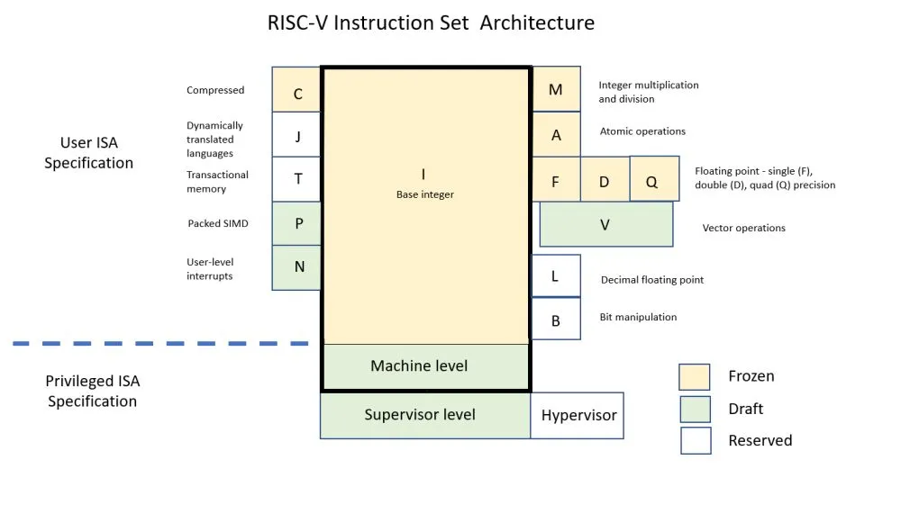
RISC-V Properties
Exploring the Viability of Widespread Adoption of RISC-V Architecture in Mobile Phones: Prospects and Challenges
Openness
RISC-V is open-source under the BSD License
Everyone can use and modify it freely
ARM and x86 are both proprietary
Modularity
RISC-V defines four basic instruction sets and various official and custom instruction extensions to provide more functionality
Every RISC-V processor must consist of one of the four basic instruction sets but can have none or multiple instruction-set extensions.
This allows you only to contain the instruction you need in your chip to suit your specific needs.
Image From:
<https://www.eetimes.eu/creating-a-custom-processor-with-risc-v/>

Slide 4
RISC-V Properties
Exploring the Viability of Widespread Adoption of RISC-V Architecture in Mobile Phones: Prospects and Challenges
Simplicity
The basic instruction set of RISC-V only contains 47 instructions.
RISC-V hardly needs to consider any backward compatibility, such as retaining many old instructions to support outdated features
The RISC-V specification document consists of only two volumes with 329 pages in total, while ARMv8-A has 8528 pages in the first volume alone.

Slide 5
Research Methodologies
Exploring the Viability of Widespread Adoption of RISC-V Architecture in Mobile Phones: Prospects and Challenges
Hardware Ecosystem
Performance of Leading RISC-V Processors
Availability of RISC-V Processors for Mobile Phones
Academic and Industrial Activeness in RISC-V Extensions Research
Software Ecosystem
Emulators
OSs
Compilers
Development toolkits
Application software
Security
Security features of RISC-V
Research progress in addressing the security weakness
Other external factors
Market strategies that Arm done against RISC-V
National and Industrial Enthusiasm

Slide 6
Research Methodologies
Exploring the Viability of Widespread Adoption of RISC-V Architecture in Mobile Phones: Prospects and Challenges
Secondary Recourses
Literature Articles
News Articles
Industrial Reports
Summits
Primary Recourses
Survey
Benchmark

Slide 7
Literature Review
Exploring the Viability of Widespread Adoption of RISC-V Architecture in Mobile Phones: Prospects and Challenges
Digital Database Visited:
ACM (Association for Computing Machinery)
CNKI (China National Knowledge Infrastructure)
IEEE (Institute of Electrical and Electronics Engineers).
Throughout the literature, some articles have been found to discuss the prospect of RISC-V explicitly. However, most are from a general perspective or the view of Internet of Things (IoT) applications instead of focusing on mobile phones.
By 18 May 2023, searching with the combination of the keywords “RISC-V” and “mobile phone” on ACM, CNKI, and IEEE would find no result, even though you can still find many personal videos and blog articles online explicitly discussing the RISC-V mobile phone prospect.
Therefore, the main research goal is to academically relate RISC-V and mobile phones.

Slide 8
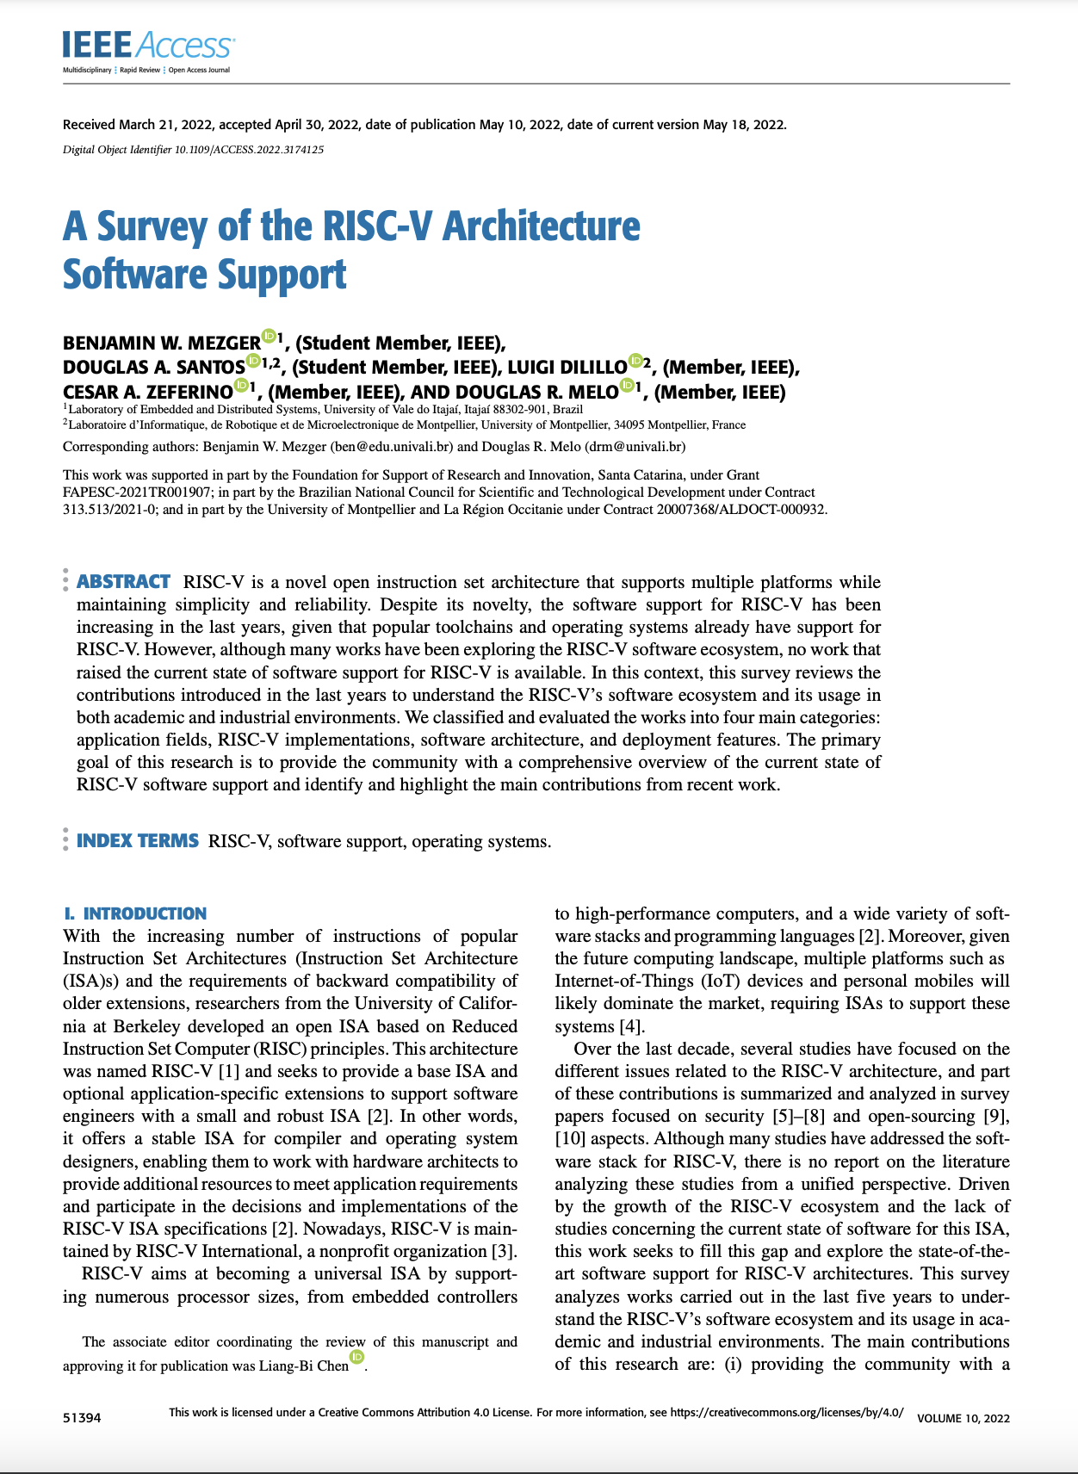
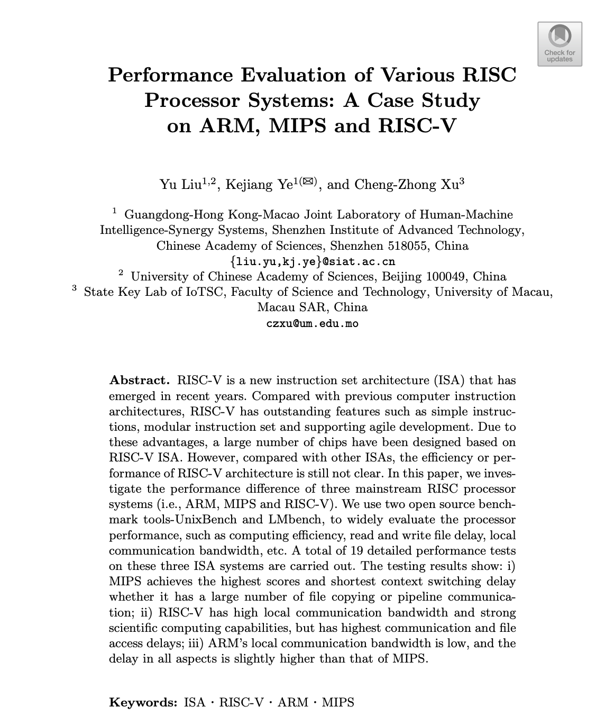
Literature Review
Exploring the Viability of Widespread Adoption of RISC-V Architecture in Mobile Phones: Prospects and Challenges
Although the existing literature may not directly mention mobile phones, some of them still provide valuable evidence to answer the research question.

Slide 9
Target Audience
Exploring the Viability of Widespread Adoption of RISC-V Architecture in Mobile Phones: Prospects and Challenges
The outcome holds significance for researchers, investors, and engineers who wonder if RISC-V has a bright future in the mobile phone area before conducting substantial studies and investments in RISC-V development.
Investors
Adopting RISC-V in mobiles requires considerable funding support, especially for developing RISC-V chips. However, investors may have limited time or domain knowledge to delve into the topic.
Engineers
The research outcome can highlight the strengths and weaknesses of RISC-V in mobile phones, which may provide board guidance for engineers when making their software or hardware product to maximise the advantage of using RISC-V.
Researchers
The adoption of RISC-V architecture into mobile phones requires a lot of domain-specific research, such as how to make the Android kernel support RISC-V processors. The outcome of my research gives an overall view of RISC-V on mobile phones, which is a good starting point for those who want to research deeper.

Slide 10
Thank you for listening
Exploring the Viability of Widespread Adoption of RISC-V Architecture in Mobile Phones: Prospects and Challenges
[1] Liu, C & Wu, Y & Wu, J & Zhao, C 2021, ‘Survey on RISC-V System Architecture Research’, Journal of Software, vol. 32, no. 12, pp. 3992-4042, viewed 19 May 2023,
<https://www.jos.org.cn/jos/article/abstract/6490>.
[2] Cui, E & Li, T & Wei, Q 2023, ‘RISC-V Instruction Set Architecture Extensions: A Survey’, IEEE, vol. 11, pp. 24696-24711, viewed 19 May 2023,
<https://ieeexplore.ieee.org/document/10049118>.
[3] Liu, Y & Ye, K & Xu, C 2021, ‘Performance Evaluation of Various RISC Processor Systems: A Case Study on ARM, MIPS and RISC-V’, Cloud Computing – CLOUD 2021: 14th International Conference, Virtual Event, 10-14 December 2021, viewed 19 May 2023,
<https://link.springer.com/chapter/10.1007/978-3-030-96326-2_5>.
[4] Mezger, B & Santos, D & Dilillo, L & Zeferino, C & Melo, D 2022, ‘A Survey of the RISC-V Architecture Software Support’, IEEE, vol. 10, pp. 51394-51411, viewed 19 May 2023,
<https://ieeexplore.ieee.org/document/9771410/authors#authors>.
[5] Ince, M & Ledet, J & Gunay, M 2019, ‘Building An Open Source Linux Computing System On RISC-V’, 2019 1st International Informatics and Software Engineering Conference (UBMYK), Ankara, Turkey, 6-7 November 2019, viewed 19 May 2023,
<https://ieeexplore.ieee.org/document/8965559>.
[6] Greegard, G 2020, ‘Will RISC-V revolutionize computing?’, Communications of the ACM, vol. 63, no. 5, pp. 30-32, viewed 19 May 2023, <https://dl.acm.org/doi/10.1145/3386377>.
[7] Li, P 2023, ‘从低功耗到高性能应用领域，RISC-V的进阶之路前景如何？’, China Integrated Circuit, no. 2023(01), viewed 19 May 2023,
<https://chn.oversea.cnki.net/KCMS/detail/detail.aspx?dbcode=CJFD&dbname=CJFDAUTO&filename=JCDI2023Z1004&uniplatform=OVERSEA&v=qJ0SijI9rjIWFJCRHW7g_nOSfVq5vIMP0xN14seEy8XmeBb1M9f7ofBTztakN2Rd>
[8] Zhong, D 2021, ‘Current Status and Future Opportunities of Open-source Chip Ecosystem based on RISC-V’, China Integrated Circuit, no. 2021(08), viewed 19 May 2023,
<https://chn.oversea.cnki.net/kcms/detail/detail.aspx?filename=JCDI202108006&dbcode=CJFD&dbname=CJFDTEMP&v=>
[9] Lu, T 2021, ‘A Survey on RISC-V Security: Hardware and Architecture’, arXiv, no. 2107.04175, viewed 19 May 2023, <https://arxiv.org/abs/2107.04175>
[10] Chen, C & Xiang, X & Liu, C & Shang, Y & Guo, R & Liu, D & LU, Y & Hao, Z & Luo, J & Chen, Z & Li, C & Pu, Y & Meng, J & Yan, X & Xie, Y & Qi, X 2020, ‘Xuantie-910: A Commercial Multi-Core 12-Stage Pipeline Out-of-Order 64-bit High Performance RISC-V Processor with Vector Extension : Industrial Product’, 2020 ACM/IEEE 47th Annual International Symposium on Computer Architecture (ISCA), Valencia, Spain, 30 May – 3 June 2020, viewed 20 May 2023, <https://ieeexplore.ieee.org/document/9138983/authors#authors>.

