Slide 1
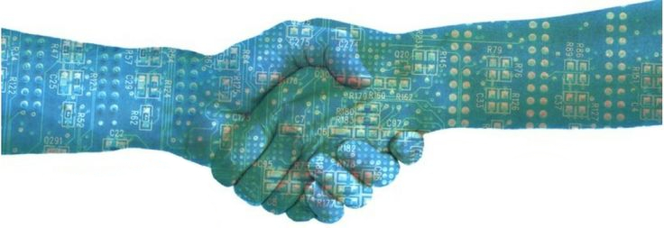

Collaborating Through Blockchains
Image courtesy of Oodles Technologies
https://www.oodlestechnologies.com
Steven Huckle
School of Engineering and Informatics

