Slide 1

DonoH
Team Prime:
Udoka Success Etus | Ejibode Ibraheem | Onwuli Valentina | Glory Okafor | Ude Abigail | Rabiu Aisha |
Chidalu Akunam | Akeem Abiodun | Chukwuma Kingsley Cephas | Ifeanyi Michael | Chukwuka
Fransisca Makuochukwu

Slide 2
INTRODUCTION
Many Nigerians are facing life-threatening medical conditions and are unable to afford the cost of their treatment. Some have resorted to circulating handbills and soliciting donations on social media but often receive little or no support. As a result, many of these individuals are unable to access the medical care they need and may succumb to their illnesses.
We have developed DonoH, a digital platform that addresses this issue by connecting Nigerians in need of medical assistance with organizations or individuals willing to provide financial support for their treatment.

Slide 3
PROJECT FEATURES
Our project features the following pages:
Homepage
Signup/ Login screen
About us page
Admin dashboard
Patient dashboard
Donor dashboard
Blog page
Privacy Policy

Slide 4
RESPONSIBILITIES
Names
Rabiu Aisha
Abigail Ude
Akeem Abiodun
Anukam Chidalu
Ifeanyi Michael
Chukwuma Kingsley Cephas
Glory Okafor
Udoka Success Etus
Ejibode Ibraheem
Onwuli Valentina
Chukwuka Fransisca Makuochukwu
Individual contributions
Designed SignUp page and contributed to the UI design of the product.
Designed the logo, brand guide, style guide of the product, the low fidelity and high fidelity UI design of the product.
Wrote the terms and conditions and contact us.
Contributed to implement the UI of the product
Wrote the privacy policy, about us, and blog
Did the final sketch of our solution
Overseeing the works of the frontend team and reviewing codes and also in charge of merging branches on GitHub.
Developed the PRD, product strategy, did competitive analysis, and managed the team.
Contributed to implement the UI of the product
Contributed to implement the UI of the product
Created the backend API and Endpoint for app

Slide 5
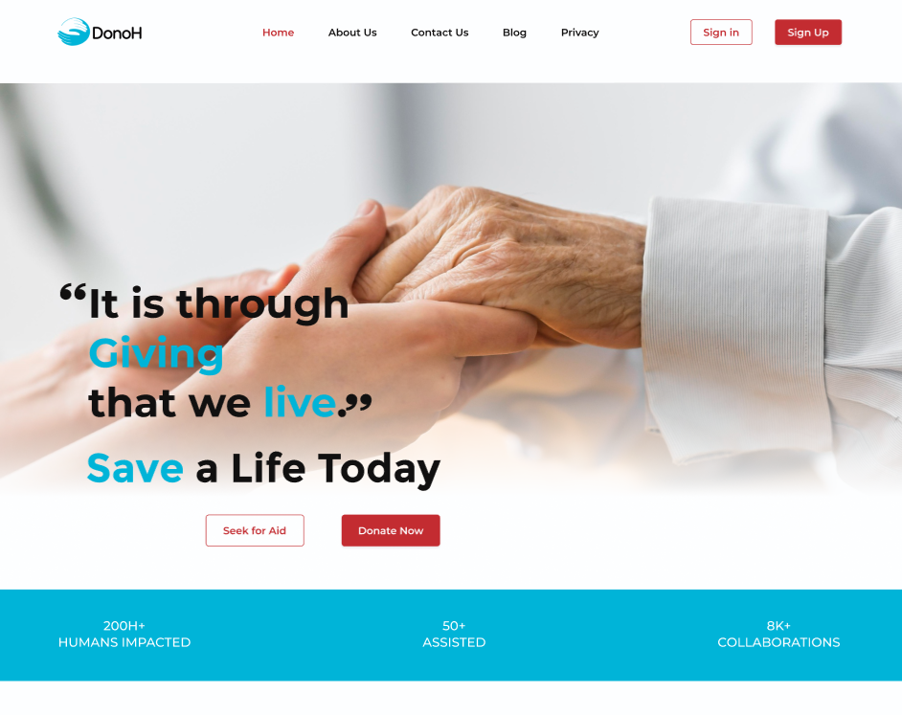
HOME PAGE
The landing page which basically serves as the home page was designed by our front end engineers, creatively creating the user interface - UI to suite the purpose and standard in other to provide hope in an enhanced user experience - UX

Slide 6
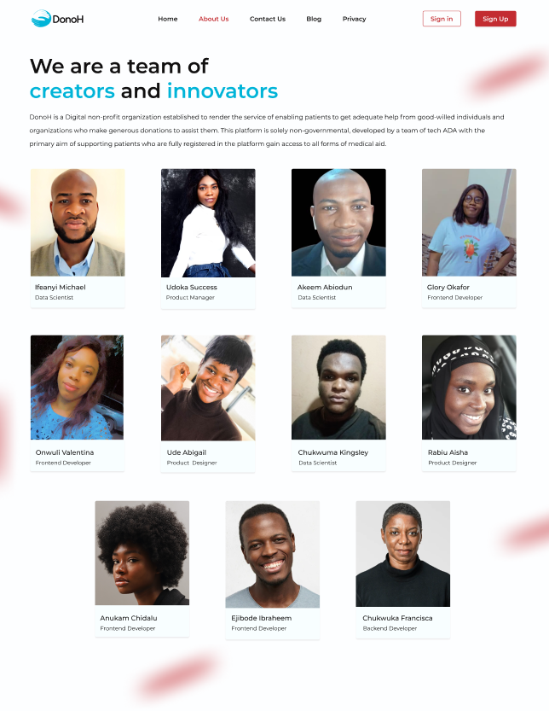
About us page
This page showcases the entire team of great minds who passionately developed this project to save lives and enhance human coexistence.

Slide 7
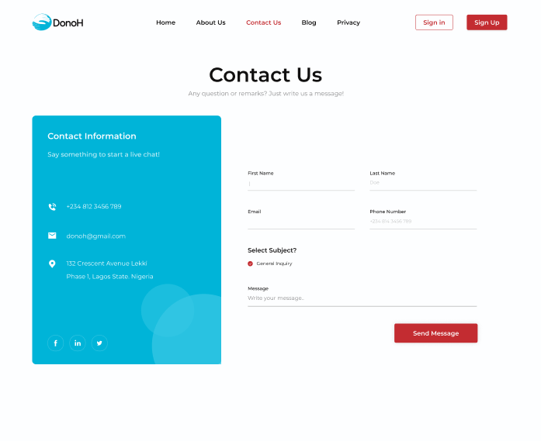
Contact Us
We have made access to the team easy and undeterred to encourage enquiries and other intended communications by the general public.

Slide 8
ADMIN PAGE
The administrator’s page takes care of all user function, ranging from patient’s request to Donor’s donation and approval which is managed by the entire team as supervised by the team lead.

Slide 9
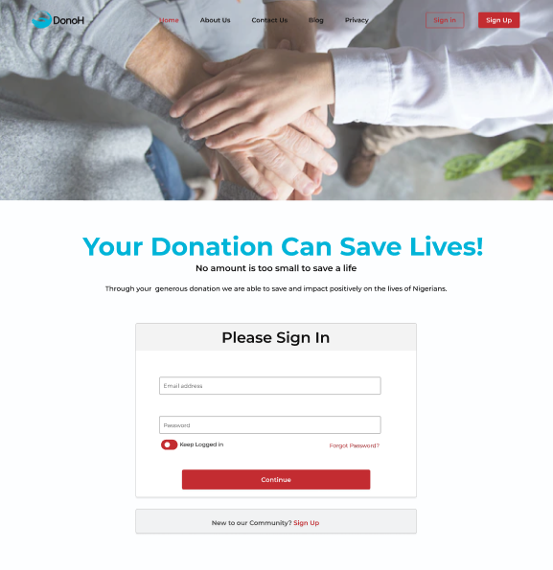
SIGNUP/LOGIN PAGE
User signs in or registers with the platform to gain access to the platform.
The user experience - UX has been structured to maintain seamless operation and ensure that even when a user forgets his/password, they tend to get adequate help navigating the platform.

Slide 10
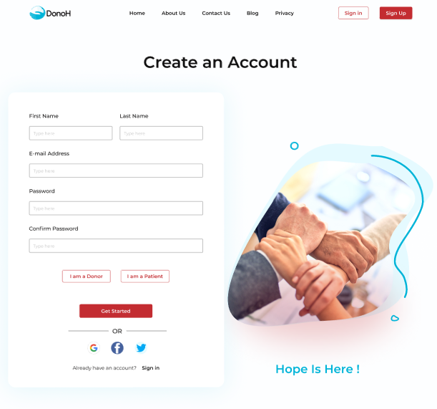
SIGNUP/LOGIN PAGE
Upon registration, new users get to select the option of patient or donor.
In a bid to make this platform more user friendly, the design also encourages signing up using other social media platforms as pictured in the account creation page.

Slide 11
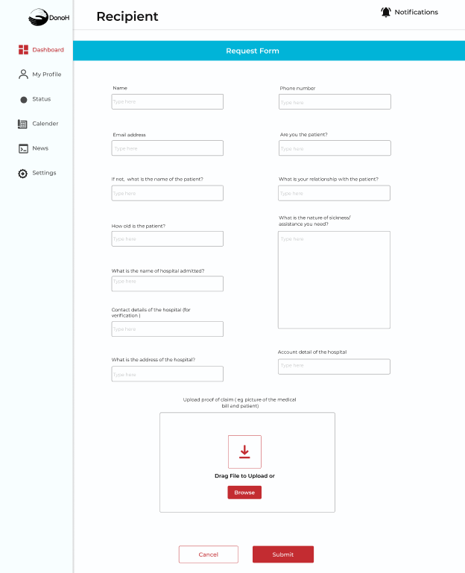
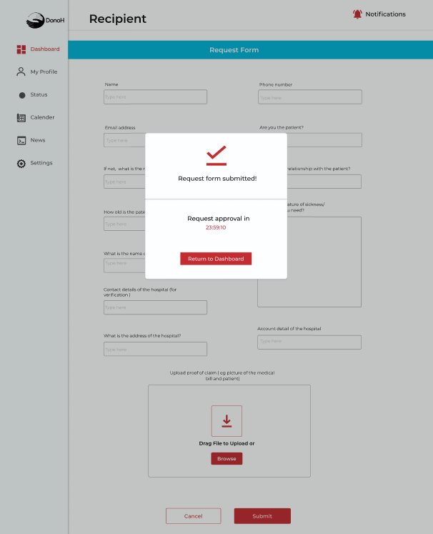
PATIENT DASHBOARD
REQUEST FORM
Users who register as patients get to fill out a request form which is captured in the database and thereafter matched with a donor.
This process is seamlessly repeated whenever a patient has need to make a help request.

Slide 12
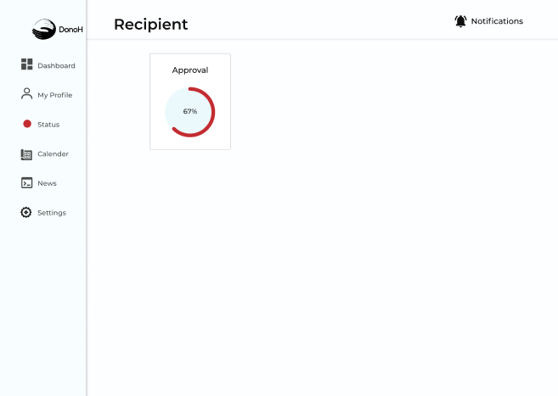
PATIENT DASHBOARD
Successfully completed request form is sent to the admin dashboard for approval.
Patients get to track this process from their individual dashboards to ascertain progress level.

Slide 13
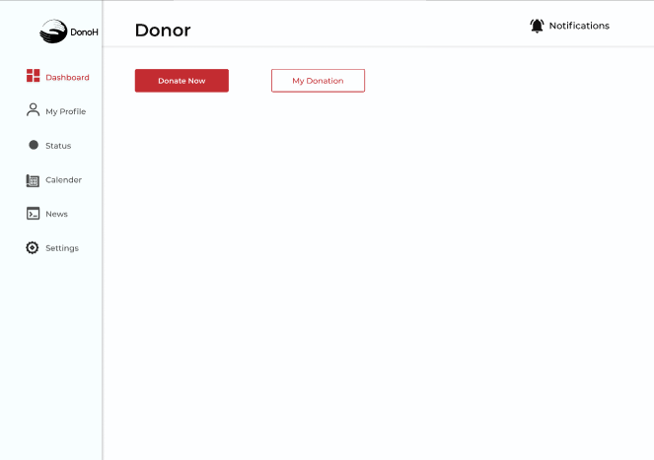
DONOR PAGE
A registered donor has the option to donate at any given time and also view previous donations made.
Same as the patients, donors can also track progress level of their donations.
This process enhances accountability and transparency.

Slide 14
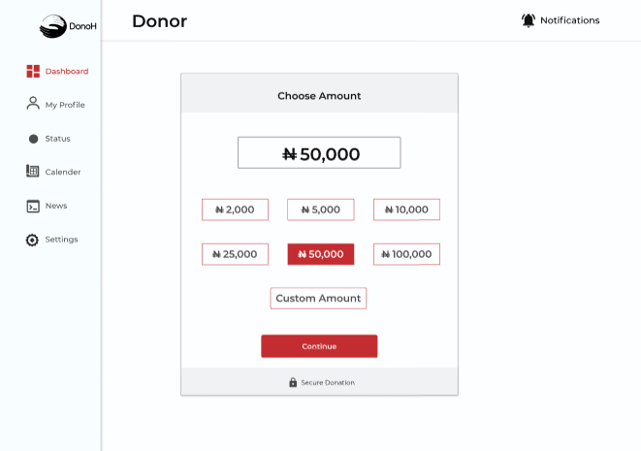
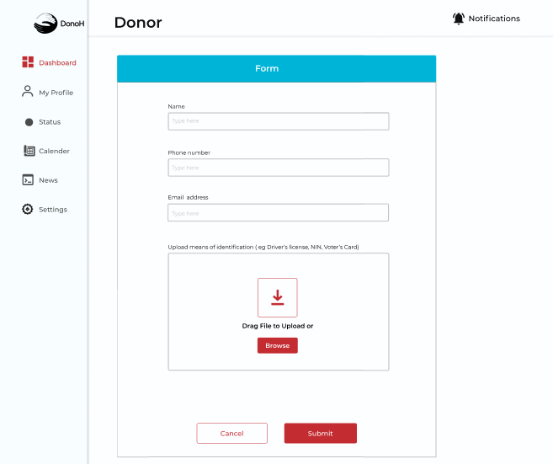
DONOR PAGE
From a wide range of options, donor gets to select the amount he/she is willing to donate after seamlessly filling a donation form.

Slide 15
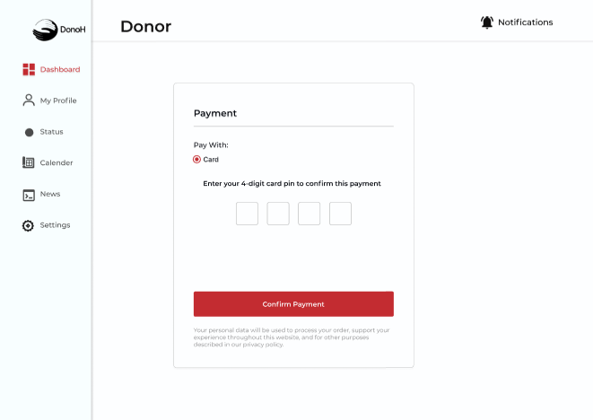
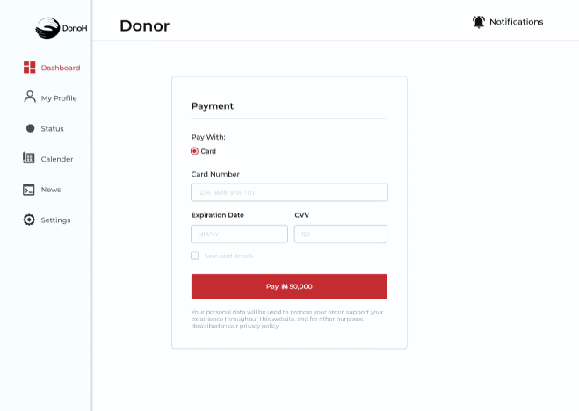
DONOR PAGE
Financial donations are made using bank debit cards and funds transferred to DonoH financial account placeholder for subsequent disbursement.

Slide 16
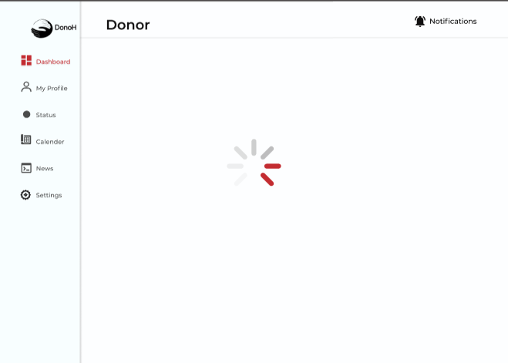
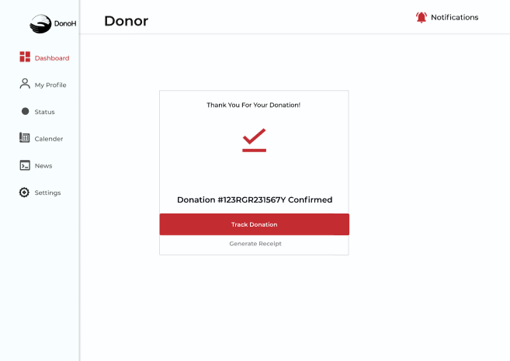
DONOR PAGE
Upon successful completion, Donation receipt is generated to authenticate transaction which also includes donation number.

Slide 17

Blog page

Slide 18
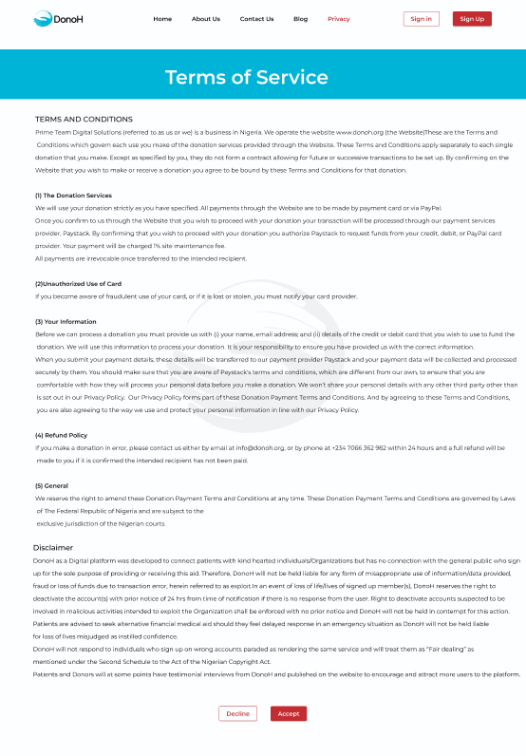
TERMS OF SERVICE
We took our time to highlight some critical and most vital parts of the services, researched, and indicating each point on the disclaimer as stated below;
Death of a registered user
Fraudulent user account
Incomplete transaction
Users who registered on the wrong platform.
etc
After perusal, user has the option to either accept or decline.

Slide 19

BUGS REPORT
DonoH
Bug Report
Fix-it-Felix 🛠️⚙️
Frontend
We did not magically arrive at success, we also experienced bugs which we fixed and documented.

Slide 20
Relevant links to all project phases.
Figjam Ideation board
User Journey Map and Solution Sketch
DonoH Github Account
Technical Requirements Documents
ClickUp Collaborative Workspace
Competitive Analysis
Link to DonoH Website

Slide 21
THANK YOU

