Slide 1
How do local observations become collective outcomes?
Can changing whom agents observe produce population-level
patterns that sustain a shared renewable resource?
Individual observations
Population-level patterns
Collective outcomes
What do my selected
information sources do?
Who becomes visible?
Which actions become common?
Resource sustainability
Welfare and inequality
HYPOTHESIS
Prediction-error-driven rewiring produces patterns that improve
sustainability beyond the same amount of random network turnover.
COGNITIVE TOOLS / SUPERVISOR DATA ROUND / PILOT v1
1 / 7
Notes:
Purpose: request feedback on a focused question and mechanism, not sell a positive result. The hypothesis is directional and is not established by this pilot. Collective organization means measured population patterns in visibility and extraction behavior; it does not mean conscious coordination. Ecology and search scope are conditions, welfare and inequality are consequences. The design is inspired by Schrama et al. (2025), https://doi.org/10.1016/j.isci.2025.112831, and Oh & Schauf (2025), https://doi.org/10.1038/s41598-025-23634-3. No published figure or model result is reproduced here.

Slide 2
One feedback loop connects agents, networks, and ecology
Agents stay in place. Information links can change; resources do not travel along them.
Learn extraction
Resource renewal
Local resource state +
observed peer behavior
Low or high extraction;
renewal and spatial coupling
Replace a source
Predict and compare
Observe previous actions
of a few selected sources
If surprise is high:
local or global search
Expected vs. observed
peer behavior → local surprise
Schematic: arrows carry
information to the focal agent.
Reward = own realized harvest. Sustainability is measured, not rewarded.
COGNITIVE TOOLS / SUPERVISOR DATA ROUND / PILOT v1
2 / 7
Notes:
Conceptual diagram; arrows summarize the feedback rather than the exact computation sequence. Training order: form state from current ecology and previous source actions; choose extraction; ecological transition; observe current actions through pre-rewiring graph; prediction error; optional rewiring; forecast update using pre-rewiring observation; next-state and Q update. Error is social surprise, not a truth/correctness label or an assessment of source competence. Current-source removal and replacement are random conditional on an observer being triggered. Agents do not move and do not share Q tables. Information arrows source->observer. Local search uses sources of sources with global fallback. Related work differs: Oh & Schauf use correctness and DeGroot consensus, whereas this model uses surprise and Q-learning.

Slide 3



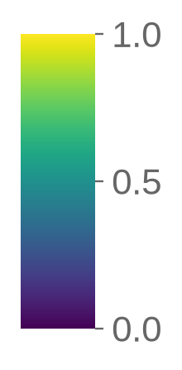
The key test holds the amount of rewiring constant
Adaptive rewiring versus matched random turnover, within the same ecological condition.
Three reference conditions
R1 / R2 / R3 ↔ matched R0
B0
Ecological learning only
Local / mixed / global search
Same event counts at every checkpoint
Different rule for which observers rewire
S1
Fixed random observation network
S2
Fixed network with uneven visibility
3 ecologies × 2 populations (32, 64)
10 replicates per condition
5,000 training + 1,000 evaluation steps
Fresh ecology; learned policies and graphs frozen
Uniform high
Patchy high
Split high / low
Capacity maps · replicate 0 · common scale 0–1
COGNITIVE TOOLS / SUPERVISOR DATA ROUND / PILOT v1
3 / 7
Notes:
Pilot v1: 9 runs x 3 scenarios x 2 populations x 10 replicates = 540 training conditions. Same seed family, ecological and learning settings; adaptive mu=.10, threshold=.25, every 50 steps, social k=4, BA m=2; theta 0,.25,1. R0 event counts match the paired adaptive run at each scenario/population/replicate/time checkpoint. SHA-256 source schedules verified. Primary analysis uses q_learning/fresh_reset/terminal graph, not continuation or reset-initial graph. Capacity maps show seed 42, replicate 0, constructed from the frozen scenario code; maps are illustrative, with shared viridis scale 0-1. Source files: pilot_v1_*/config.json; original commit b0340b10dd33499a714af5c22ab124b05f680a3a, clean. S2 varies attention capacity as well as visibility.

Slide 4
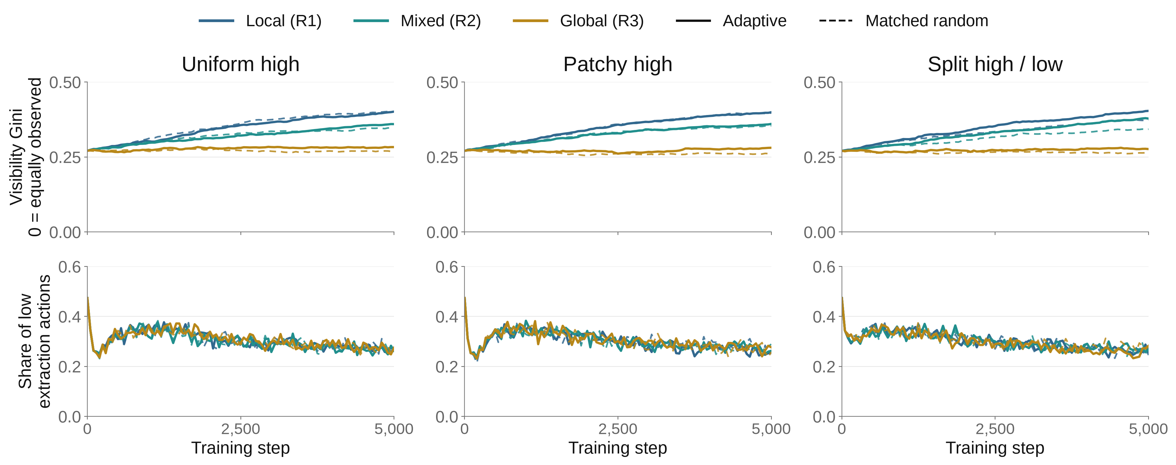
Local search concentrates attention—even with random turnover
Population-level patterns during training · N = 64 · all three ecologies
Organization appears in both adaptive and matched-random networks.
Lines: means of 10 replicates, unsmoothed; descriptive trends, not uncertainty intervals. N=32 companion supplied.
COGNITIVE TOOLS / SUPERVISOR DATA ROUND / PILOT v1
4 / 7
Notes:
This slide operationalizes collective organization as visibility concentration and prevalence of low-extraction actions. All six rewiring treatments shown, all three ecologies, N=64. Solid=adaptive; dashed=its event-count-matched R0; blue=local, teal=mixed, ochre=global. Each line is a mean of 10 independent replicate trajectories; no smoothing and no inference from line separation. The full N=32 figure is supplied to avoid presenting one population as the whole pilot. Local search visibly concentrates attention, and R0 often tracks the same pattern. This is not evidence that the error trigger uniquely organizes the population. Low extraction remains below one half in the displayed mean trajectories. Source: pilot_v1_*/data/training_timeseries.csv. Design rationale: Oh & Schauf (2025), Fig. 6 separates structure from performance over time; our metrics and mechanism differ. https://pmc.ncbi.nlm.nih.gov/articles/PMC12618610/

Slide 5
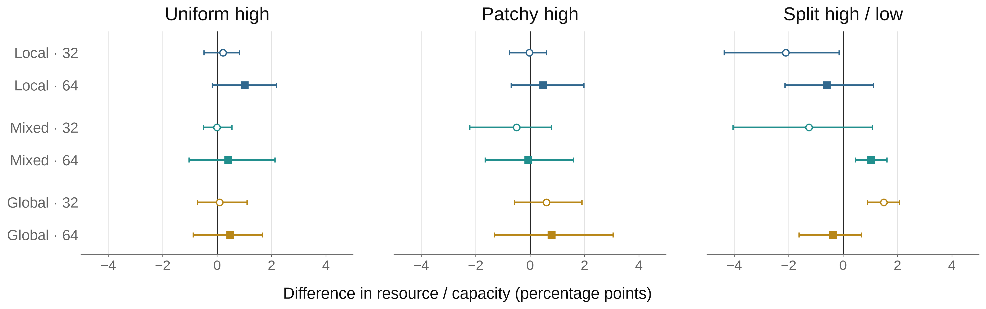
Adaptive rewiring has no clear general sustainability advantage
Difference from matched random turnover · every ecology, search scope, and population
15 of 18 intervals cross zero; the direction also changes across conditions.
Right of zero = more resource under adaptive rewiring. Rows show search scope and population.
10 paired replicates; 95% bootstrap intervals (2,000 resamples), exploratory and not multiplicity-adjusted.
COGNITIVE TOOLS / SUPERVISOR DATA ROUND / PILOT v1
5 / 7
Notes:
Outcome is the replicate-level mean resource/capacity during 1000-step fresh-reset evaluation with frozen terminal graphs and frozen Q policies. Differences are adaptive minus its own exact R0, paired by scenario, population, and replicate. Three panels share the same x range [-5,+5] percentage points. Circle/open=N32; square/filled=N64; row labels are explicit. All 18 comparisons shown. 15 intervals cross zero; this is uncertainty, not proof of equivalence. Three intervals exclude zero: local/split/N32 negative, mixed/split/N64 positive, global/split/N32 positive. They are exploratory, unadjusted intervals, not three confirmed discoveries. All point estimates span -2.105 to +1.497 pp. Underlying means and bootstrap intervals were independently reproduced from raw records. Archive analysis seed 1729, 2000 percentile-bootstrap resamples. Source: paired_adaptive_minus_r0_summary.csv. Replicate outcome distributions are supplied separately, following the distribution-preserving principle illustrated by Schrama et al. (2025), Fig. 2, https://pmc.ncbi.nlm.nih.gov/articles/PMC12226385/. This pilot is not evidence of bistability.

Slide 6
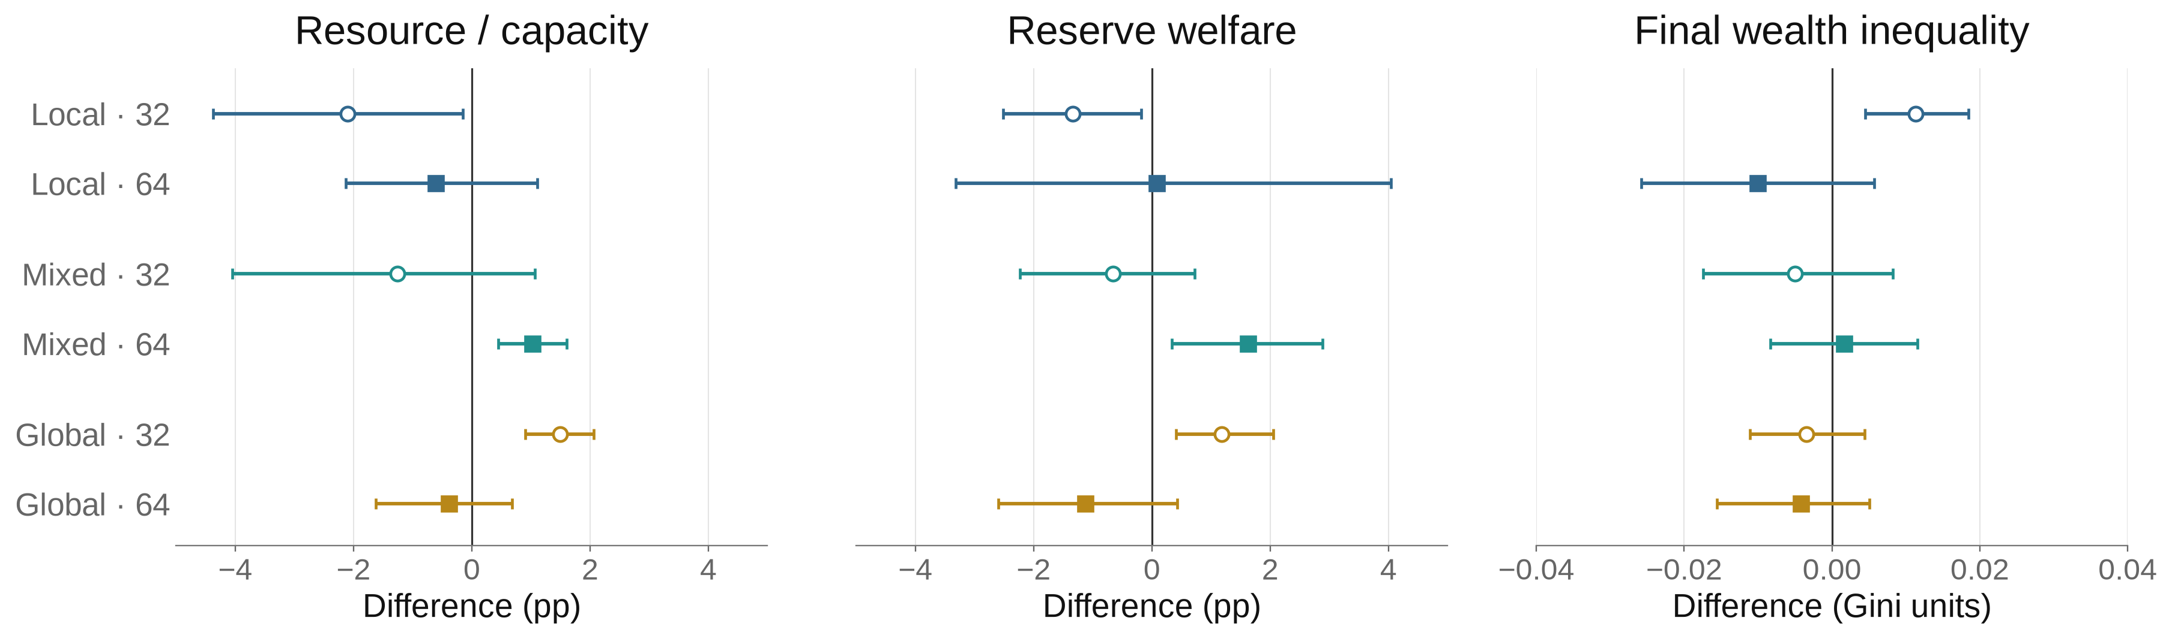
A resource gain is not a complete welfare story
Closer look: split high / low ecology · all six adaptive-versus-R0 comparisons
Mixed search, N=64: resource +1.02 pp; reserve welfare +1.62 pp.
Its wealth-inequality interval crosses zero. More resource does not establish a fairer outcome.
Positive = more resource / welfare, but more inequality. Same 10 pairs and 95% bootstrap method as slide 5.
COGNITIVE TOOLS / SUPERVISOR DATA ROUND / PILOT v1
6 / 7
Notes:
This is a transparent close-up of split_high_low, the ecology where the resource effects change sign; all six scope/population comparisons are shown, not only the favorable one. All-ecology welfare and final-wealth-Gini figures are supplied in figures/. Reserve welfare is energy/capacity, averaged during evaluation; wealth Gini is measured at the final evaluation step. R2/N64 resource effect .010238 (95% CI .004494,.016077), reserve welfare .016240 (.003325,.028887), final wealth Gini .001631 (-.008370,.011563). Percentage points are differences of 0-1 fractions, not relative percent changes. Inequality uses Gini units; negative is less unequal. Outcome dimensions need separate interpretations; the intervals are exploratory and not multiplicity-adjusted. See data/paired_summary.csv and data_audit.json.

Slide 7
The project can stay focused on one micro-to-macro test
Individual observation → population patterns → sustainability, welfare, and inequality
What the pilot shows
What remains unresolved
What the next test needs
Local search changes
who becomes visible.
Random turnover can produce
a similar concentration.
Does the error trigger create
a distinct collective pattern?
Does that pattern improve
resource outcomes?
Specify the expected
population pattern.
Keep matched R0 and
replicate-level uncertainty.
Feedback I want from you
Is the question narrow enough?
Is “collective organization” defined clearly enough to test?
Which link in the mechanism needs the strongest evidence?
COGNITIVE TOOLS / SUPERVISOR DATA ROUND / PILOT v1
7 / 7
Notes:
Closing discussion, not a claim of confirmation. Keep project scope to renewable ecology, independent extraction learning, limited peer observation, and rewiring. The pilot supports a structural search-scope pattern but does not establish an adaptive sustainability advantage. Ask the supervisor to sharpen a falsifiable prediction about population-level behavior/visibility and its relationship to resources. Avoid scope expansion into technology, inheritance, trade, misinformation, or ecological shocks in this seven-slide argument. Larger confirmatory runs should follow a fixed hypothesis and declared primary comparison, not selection of the most favorable pilot cell. Full source and figure-design rationale: figure_review.md; reproducible build: build_data_round.py; audit: data_audit.json.

