Slide 1

中文字号 | 对应磅值 (pt) | 对应像素 (px)
三号 | 16 | 21.3
小三 | 15 | 20
四号 | 14 | 18.7
小四 | 12 | 16
五号 | 10.5 | 14
小五 | 9 | 12
夏至
Summer

Slide 2
Time
Cost
Quality
Scope

Slide 3
Animation & Ring

Slide 5
git push
git commit
git add
远程仓库
Remote repository
本地仓库
Local repository
暂存区
Stage
工作区
Workspace
git revert
git reset –-soft HEAD^
git restore
git reset HEAD^
git Clone/fetch
x
git reset –-hard HEAD^
git pull

Slide 6



Mailings
域/Domain

Slide 7
maxlength
工作簿 workbook
for
text
placeholder
password
required
行 Row
value
工作表 sheet
列 Column
button
hidden
地址 Address
radio
checked
checkbox
name
excel
id
<textarea>
placeholder
maxlength
required
submit
<button>
type
reset
name
button
<select>
id
<option>

Slide 8
Central Processing Unit
Control Unit
Input Unit
Arithmetic/logic Unit
Output Unit
Memory Unit

Slide 9
10
#104ADB
ADD
#3
#104ADB
#3
立即数 Immediate
内存地址 Memory Address
操作码 OpCode
寄存器 Register
堆栈 Stack

Slide 10
1 byte
1 bit | 1 bit | 1 bit | 1 bit | 1 bit | 1 bit | 1 bit | 1 bit
7 | 6 | 5 | 4 | 3 | 2 | 1 | 0

Slide 11
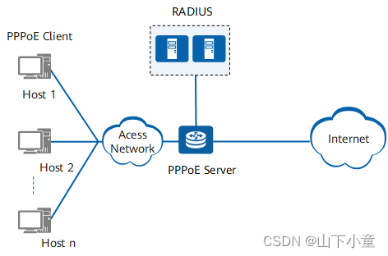

Slide 12
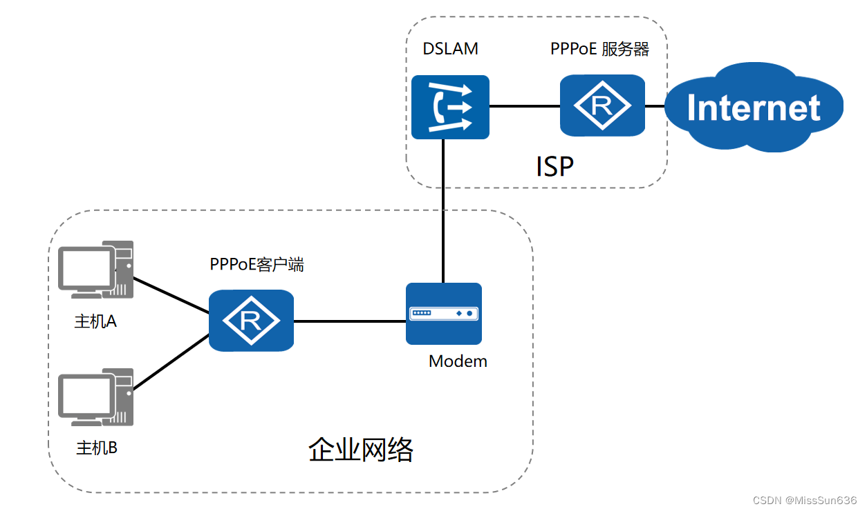

Slide 13
<caption>
<thead>
<tr>
<th>
<table>
<tbody>
<tr>
<td>
<tfoot>
<tr>
<td>

Slide 14
maxlength
text
placeholder
password
required
type
value
<input>
name
button
hidden
id
radio
checked
<label>
for
checkbox
name
<form>
id
<textarea>
placeholder
maxlength
required
submit
<button>
type
reset
name
button
<select>
id
<option>

Slide 15
src
<img>
alt
title
<figure>
<figcaption>
src
<Img>…
autoplay
<source>
controls
<audio>
<picture>
<img>
loop
Multimedia
muted
preload
<video>
<canvas>
hidden
poster
<svg>

Slide 16
background-color
background-img
background-position
background-size
background
background-repeat
background-origin
background-clip
background-attachment

Slide 17
good
goodSelected
detailsView.vue
addToCarts()
lists
lists
getLists()
cart.js
selectedLists
addToCarts()
isAll
clearCarts()
cartsView.vue
count
totalPrice
discountPrice

Slide 18
String of text
::before
Entity
Unicode
<li>
Iconfont
Unicode
::after
counter

Slide 19
Requirement Analysis
Design
Implementation
Registration
Usage
Testing
Optimization
Documentation

Slide 20
float
left
right
relative
position
absolute
fixed
sticky
<table>
Layout
flex
container
item
grid
container
item

Slide 21
left
.clear::after {
content: '';
display: block;
clear: both;
}
float
right
relative
position
absolute
z-index
fixed
sticky
<table>
Layout
flex-direction
justify-content
container
align-items
flex-wrap
flex
gap
flex-basis
item
flex-grow
flex-shrink
order
grid-template-columns
container
grid-template-rows
grid
item
grid-template-areas
order

Slide 22
properties
Array
static
from()
methods
isArray()
Array
properties
lenghth
push() unshift()
Normal
pop() shift()
join() concat()
instance
slice() splice()
forEach() map()
Iterator
some() every()
filter()
methods
find() findIndex()
Subtotal
reduce() reduceRight()
Sort
sort()

Slide 23
Number
String
Primitives
Boolean
Undefined
null
Data type
Object
Conversion
Function
Array
Reference
Map
Set
RegExp
Class

Slide 24
html
local
image
remote
href
URL
document
multimedia
<a>
target
_self
_blank

Slide 25
start
Animation Zone
end

Slide 26
start
50%
Animation Zone
end
10%

Slide 27
start
10%
Animation Zone
end
50%

Slide 28
start
40%
Animation Zone
end
60%

Slide 29
start
40%
Animation Zone
end
40%

Slide 30
function
name
parameters
Declaration
Arrow function
fn_body
Recursion
return
Function
IIFE
const
Expression
Pure function

Slide 31
Relational
< <= > >=
= += -= *= /= %=
Logical
&& || !
Assignment
== != === !==
?:
Operators
+ - * / %
…
Arithmetic
++ --
instanceOf
typeOf

Slide 32
function
name
parameters
Declaration
Arrow function
fn_body
Recursion
Function
return
IIFE
const
Expression
Pure function

Slide 33
form
key
Tag Attribute
mouse
Instance Properties
Event
window
Event AddEventListene
document/element
audio
video

Slide 34
bind:tap=‘closeModal’
form
bind:tap=‘closeModal’
key
Tag Attribute
mouse
Instance Properties
Event
window
x
catch:tap=‘NULL’
Event AddEventListene
document/element
audio
video

Slide 35
Singleton
→
1. Feature
2. Application
3. Implementation →
4. Case → Modal
Factory Method
. Basic → Closure + IIFE
. Advance → Class
. Experts → Module
Abstract Factory
Creational
Builder
Pattern
Structural
document/element
Behavioral
Prototype

Slide 36
enable-flex
容器 wrap
行内 inline
<scroll-view>
水平滚动
行内块 inline-block
网格 grid
垂直滚动
浮动 float
一个滚动视图
导航
二个滚动视图

Slide 37
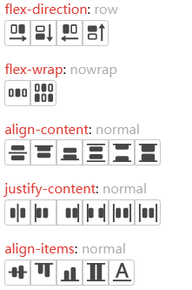

Slide 38
width : 1024px
property
value
unit

Slide 39
1 | 0 | 150*3600
2 | 1
3 | 2
4 | 3
5 | 4
6 | 5
7 | 6
8 | 7
9 | 8
10 | 9
11 | 10
12 | 11
13 | 12
14 | 13
15 | 14
16 | 15
17 | 16
18 | 17
19 | 18
20 | 19
21 | 20
22 | 21
23 | 22
24 | 23

