Slide 1





Developing an interactive R Shiny app for insect biodiversity meta-analyses
Grace Skinner

Slide 2

Introduction
Diverse taxa
Underrepresented
Diverse conclusions
Variation
Geographic, temporal, taxonomic, biodiversity metric
Drivers? Influence of species traits?
Notes:
World’s most diverse taxonomic group in terms of species richness
Represent extensive ecological functions/services – pollination, biological pest control, organic matter recycling, link in food chain
Underrepresented in long-term biodiversity studies but being somewhat rectified recently
Have sufficient evidence to warrant immediate further study and action
Diverse conclusions from papers from alarming declines to increases
Variation thought to be due to geography, time, taxa, and biodiversity metric
On top this this, we do not fully understand the drivers of population trends – including land-use and climate change, or the influence of species traits

Slide 3
Introduction
Synthesise across literature
Existing tools/approaches
Synthetic analysis – models based on collated primary data
Meta-analysis – models based on effect sizes
Living reviews
My Shiny app
Focus on insect biodiversity as tool is needed to help understand heterogenous and complex field
Metadataset and dynamic meta-analysis Shiny app
Run custom meta-meta-analytic models
Updates to include data from new meta-analyses
Meta-meta-analysis = analysing multiple meta-analysis studies together
EntoGEM database
Notes:
Therefore, we need to synthesise info across literature
Existing tools/approaches:
EntoGEM - Collation of evidence into a database to enable mapping of literature
Synthetic analysis – build models based on collated primary data (common in papers which use PREDICTS)
Meta-analysis – calculate one or more effect sizes per study to determine an overall effect size
Living reviews – repeat these kinds of analyses and update the results as new evidence becomes available
Metadataset and Dynamic meta-analysis:
Database of papers on invasive species and cover crops, and associated Shiny app to analyse them
With increasing numbers of MAs, we are able to perform MMA, which we define as the process of analysing multiple meta-analysis studies together by combining effect sizes collected for each of these
I present a Shiny app that allows users to run meta-meta-analytic models on the fly and produce graphical summaries of results.
App reads in data from living review of meta-analysis studies and updates to include data from new meta-analyses when it is uploaded
App is designed with insect biodiversity as the focus because a tool like this is needed to help understand the highly heterogenous and complex field

Slide 4

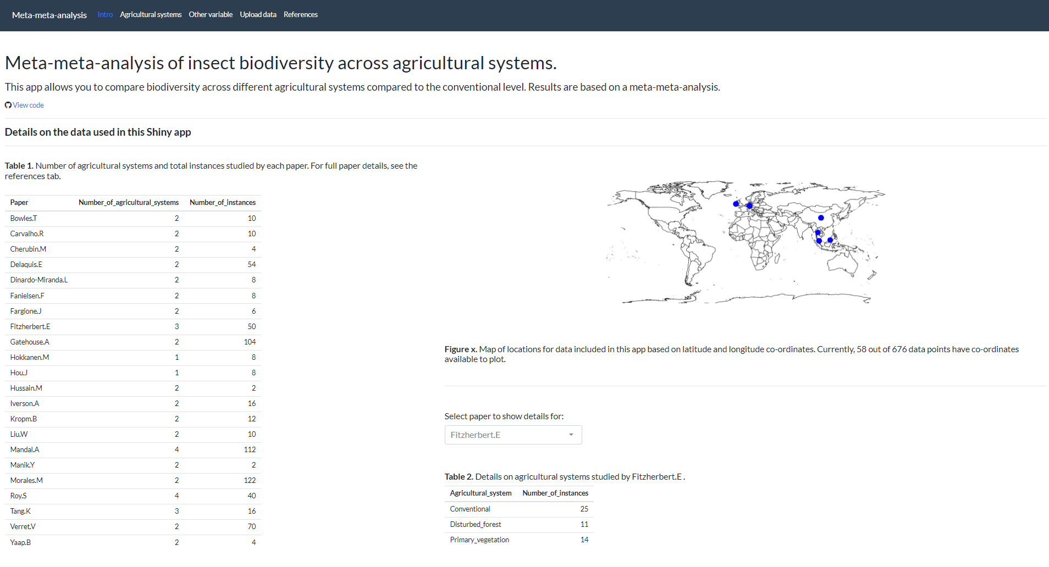
Results
Introductory tab
Notes:
Intro tab:
Main purpose is to give background on where the data used in the app comes from
List of papers included in the study and overview of the number of agricultural systems studied, and total data points per study
If want more info on certain paper, you can select a paper to see more details for
Map indicating the geographical representativeness of the data

Slide 5
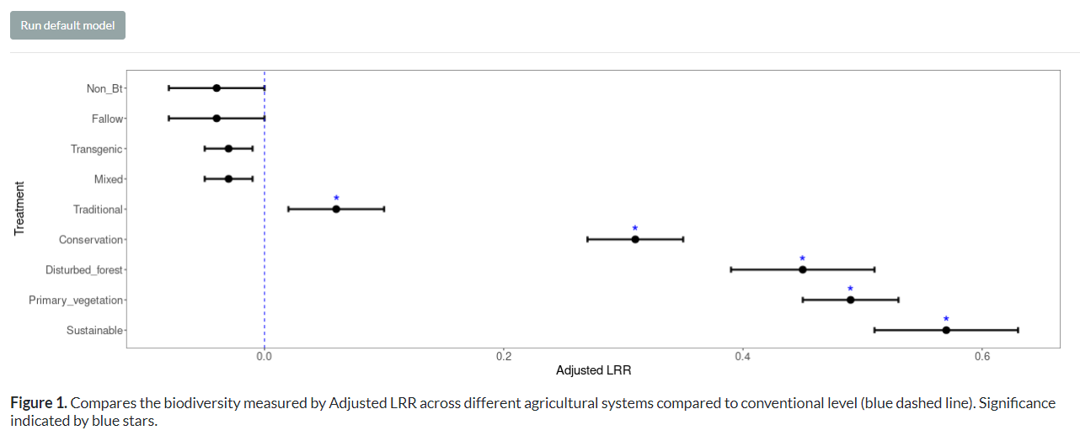
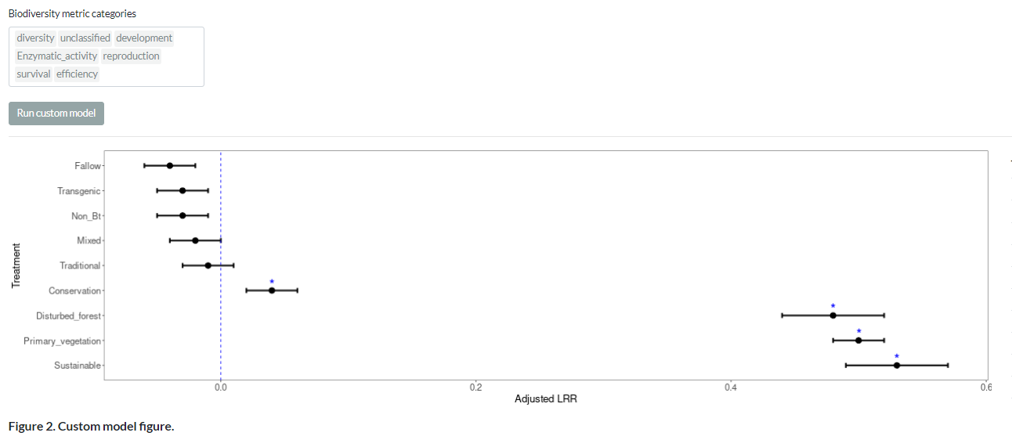
Results
Default
Formula = LRR ~ Agricultural System + (1 | Paper ID) + (1 | Crop)
Custom
Notes:
In the agricultural systems tab, the user can either run a default or a custom model.
Whichever model is run, the app runs a robust linear mixed effects model to assess the impact of different agricultural systems on biodiversity in terms of log response ratio.
The default model uses all available data
The custom model allows the user to filter the data based on their interests. At present, they can choose which data to include based on the biodiversity metric it was collected with
The app then presents a graph which shows the differences in biodiversity between the different agricultural systems and the conventional reference level (indicated by the blue dashed line). Significant results are indicated by a blue star.
Comparing the default model to a custom model run without including data with biomass as a BD metric, you can see that traditional goes having significantly higher biodiversity than the conventional level, to not being significantly different (actually has less BD)

Slide 6
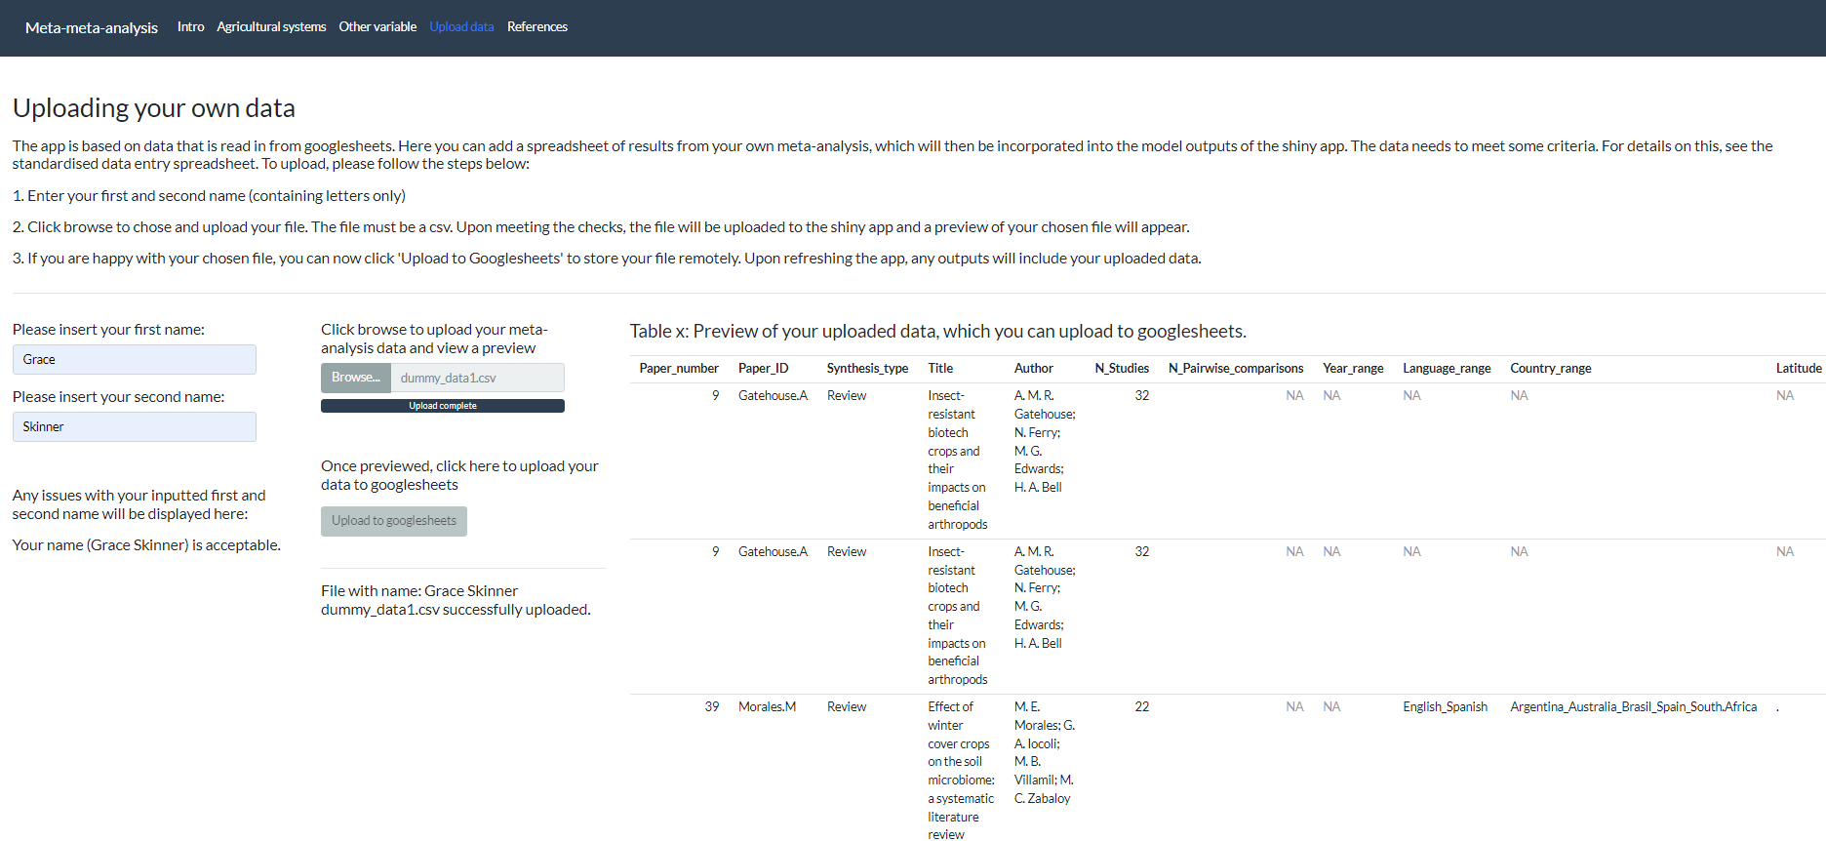
Results
Uploading data tab
Notes:
When new meta-analyses are completed, users can upload their data.
After inputting their name, they can upload a file to the app and preview it.
If all the checks are met, they can then upload it to googlesheets.
After the app is refreshed, any models run will include this new data.

Slide 7

Discussion
Usefulness
Investigate specific hypotheses and interests
Highlight future research needs
Findings
Biodiversity is affected by different agricultural systems
Choice of biodiversity metric has an effect
Comparison to dynamic meta-analysis
Metafor vs robust models
Future
Expand range of variables over which the user has choice.
Standardised protocol and data entry sheet
Efficient functionality with multiple users
Tool could be adapted for other fields
Notes:
Usefulness
Good for allowing user to investigate specific hypotheses and interests as it is unlikely literature will exist for the combination of variables that the user is interested in
Also could highlight findings that may be worth investigating further, or areas where research is lacking (e.g. if a model fails to run)
Findings
Demonstrate how biodiversity is affected by different agricultural systems – and techniques of ones we should be looking at to improve sustainability
Influence of biodiversity metrics – here, get different result if biomass isn’t included. Because literature has shown you can get declines in one metric but not corresponding declines in others
Comparison to dynamic MA
Main difference is dynamic MA uses metafor models, Shiny app uses robust models. Due to differences in the data the 2 tools use and the approach taken.
Future
Expand the range of variable over which the user has choice.
E.g. investigate other threats e.g. land-use/temperature as well as agricultural system.
E.g. provide additional filters to biodiversity metric category e.g. location, taxonomic group
To scale-up
Standardised protocol and data entry sheet for future MA
Efficient functionality when multiple users are using the app e.g. only run robust model when data is limited, relational database over googlesheets
Could be adapted to analyse other datasets and aid other fields, especially those which show high heterogeneity
Overall, app allows us to take full advantage of data we have, and will have in future to aid our understanding of the complex trends and drivers of insect populations

