Slide 1
Dose and enrichplot libraries
https://yulab-smu.top/biomedical-knowledge-mining-book/enrichplot.html

Slide 3
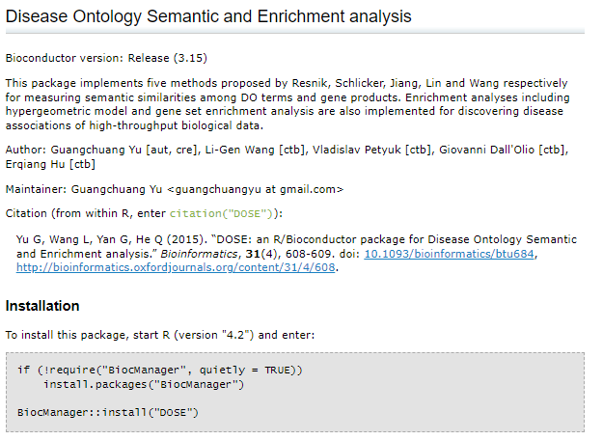
http://bioconductor.org/packages/release/bioc/html/DOSE.html

Slide 4
