Slide 1
OFFICIAL APPLICATION PRODUCT SHOWCASE • VERSION 1.2.0
KinTrace
The Real-Time Collaborative Heritage & Clan Preservation Ecosystem
An exhaustive walkthrough of features, mathematical kinship engines, vector tree navigation, and security architecture.
Notes:
Welcome everyone. Today I am presenting KinTrace, a next-generation Android application designed to solve generational record fragmentation through interactive vector family trees, statutory kinship calculations, and real-time collaborative clan federation.

Slide 2
✨ EXECUTIVE OVERVIEW
The Genealogy Problem & KinTrace Solution
Transforming scattered family records into an authoritative, living digital heritage.
The Three Genealogy Dilemmas
• Data Fragmentation: Family memories and lineages are scattered across unorganized chat groups, paper albums, and memory.
• Kinship Ambiguity: Users struggle to compute exact legal and biological degrees of relationship under Philippine civil law.
• Collaboration Friction: Multiple family branches work on isolated trees with zero automated branch-merging or conflict resolution.
The KinTrace Architectural Solution
• Single Source of Truth: Centralized Cloud Firestore repository with real-time reactive sync across all relatives simultaneously.
• Exact Statutory Math: Automated MRCA (Nearest Common Ancestor) & Civil Kinship calculation (Family Code Art. 963–966).
• Clan Federation Engine: Non-destructive 3-step multi-tree branch stitching with granular role-based privacy (RBAC).
Notes:
Traditional genealogy apps are either single-user silos or overly academic. KinTrace addresses three core pain points: scattered memories, legal confusion regarding civil degrees, and the technical challenge of merging two distinct family branches.

Slide 3
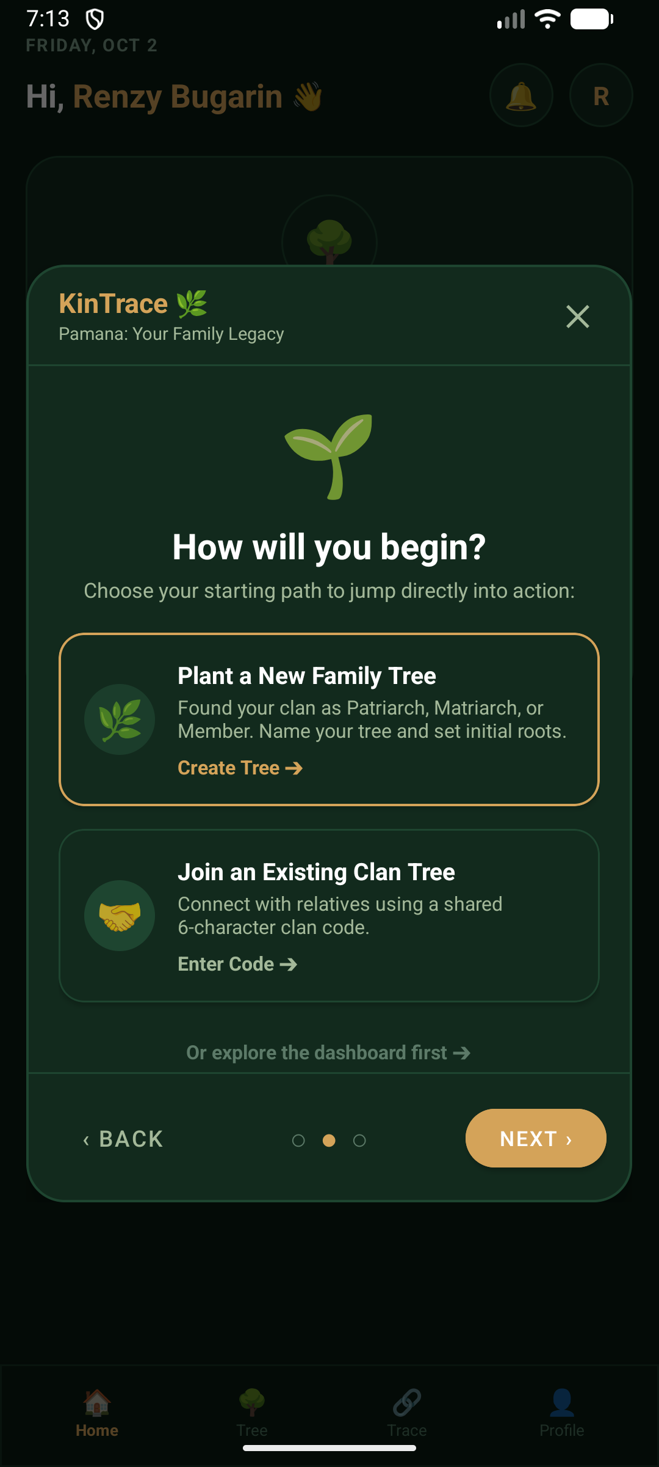
✨ USER JOURNEY
Seamless Onboarding & Clan Initiation
Guiding new and veteran relatives into the family ecosystem with zero friction.
Onboarding Feature Walkthrough
• Dual-Mode Authentication: Secure email/password with verification safeguards, password recovery, and live credential validation.
• Terms of Clan Stewardship: Explicit 10-clause privacy covenant ensuring mutual family consent and data ethics.
• Interactive Welcome Storybook: 3-slide visual orientation introducing the canvas, bloodline tracing, and collaborative archiving.
• Clan Quest HUD: Gamified progress checklist on the home screen guiding users to complete key milestones.
• Instant Demo Vault: 1-click evaluation access with pre-configured personas (Clan Leader, Editor, Viewer).
Notes:
From the first launch, KinTrace prioritizes engagement and transparency. Users are greeted by a 3-slide Welcome Storybook, sign a clear Stewardship covenant, and receive interactive onboarding milestones via the Clan Quest HUD.

Slide 4
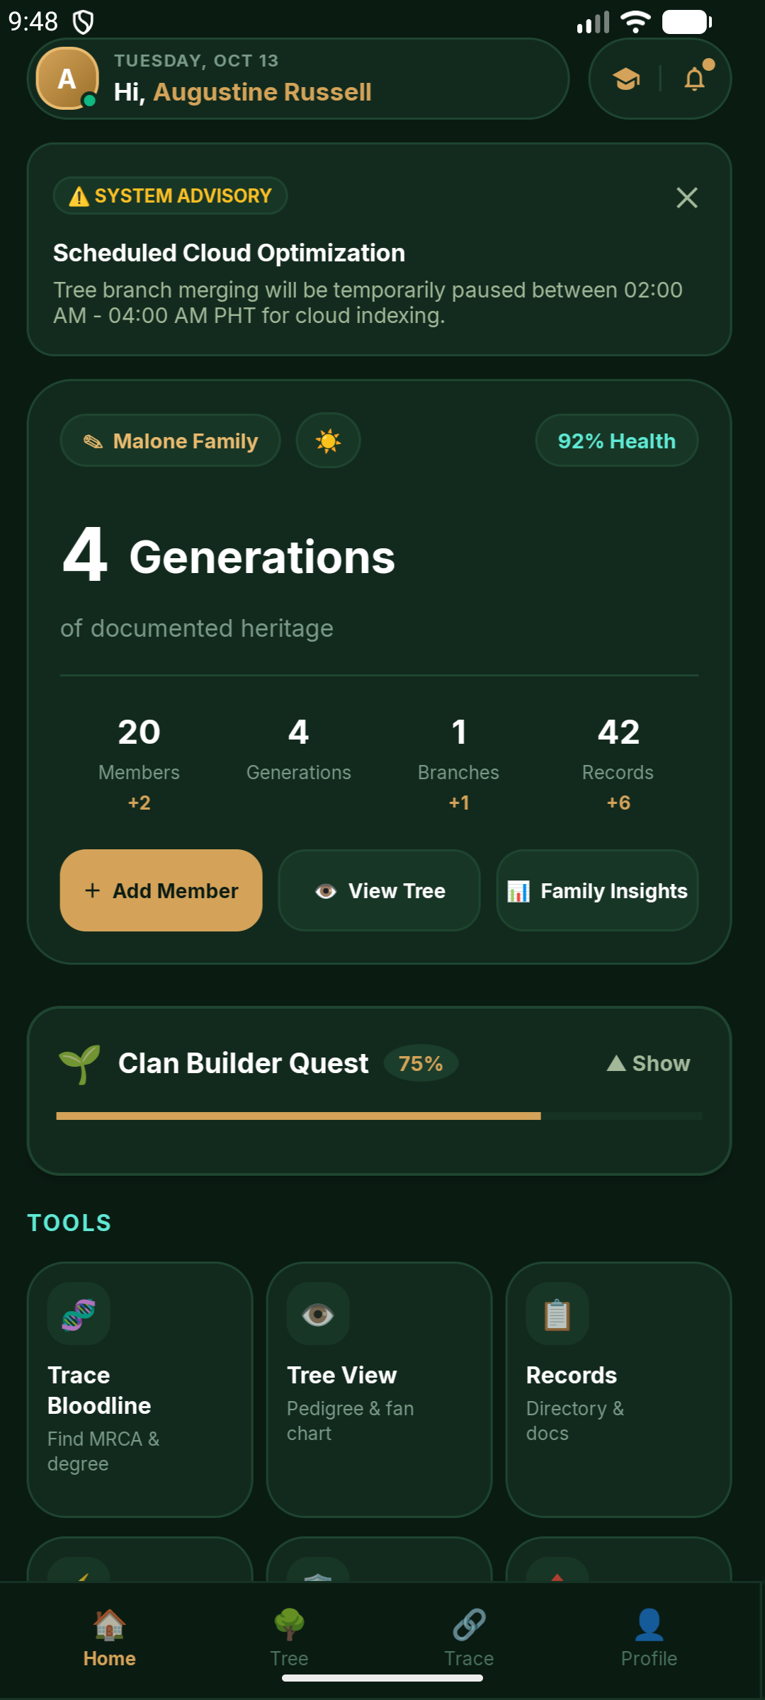
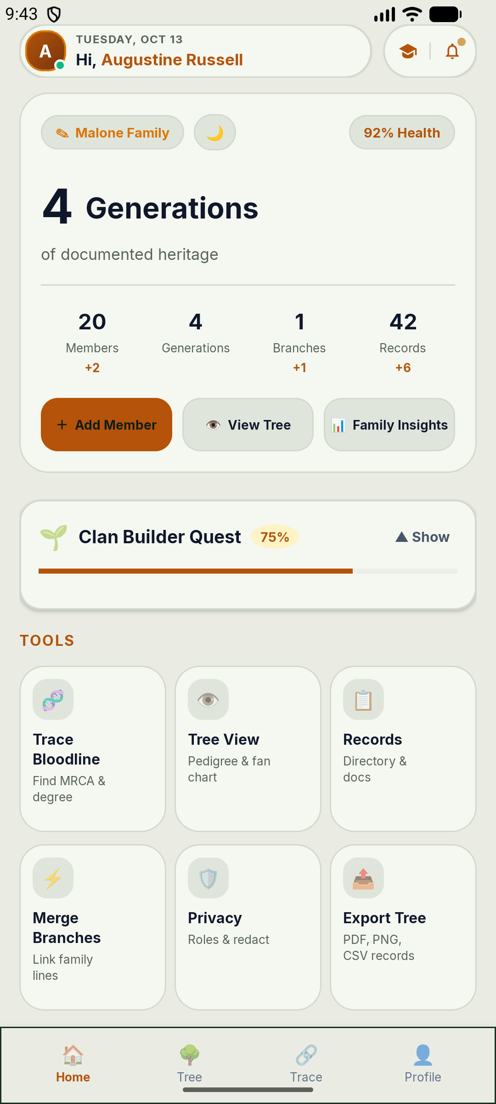
✨ HOME DASHBOARD
The Twin-Pod Executive Command Center
DARK EMERALD MODE
LIGHT LINEN MODE
High-craft floating micro-islands paired with comprehensive heritage analytics.
Dashboard Architecture & Components
• Twin-Pod Floating Islands: Ultra-slim 44dp split-capsule header separating User Identity from the Utility Dock.
• Live Presence Beacon: Real-time green cloud sync indicator reflecting active Firestore handshake status.
• Heritage Hero Analytics Card: Prominently highlights total documented generations ('4 Generations') and real-time health score (92%).
• 4-Stat Real-Time Counters: Dynamic counts of Members, Branches, Generations, and Archival Records.
• One-Touch Theme Switcher: Instant seamless transition between Dark Emerald and Light Linen modes without reload.
Notes:
Here is the newly engineered Twin-Pod Executive Header shown in both Dark Emerald and Light Linen themes. The left pod handles identity, while the right pod docks quick tools, flowing cleanly into the 4-Generation Hero Analytics card.

Slide 5
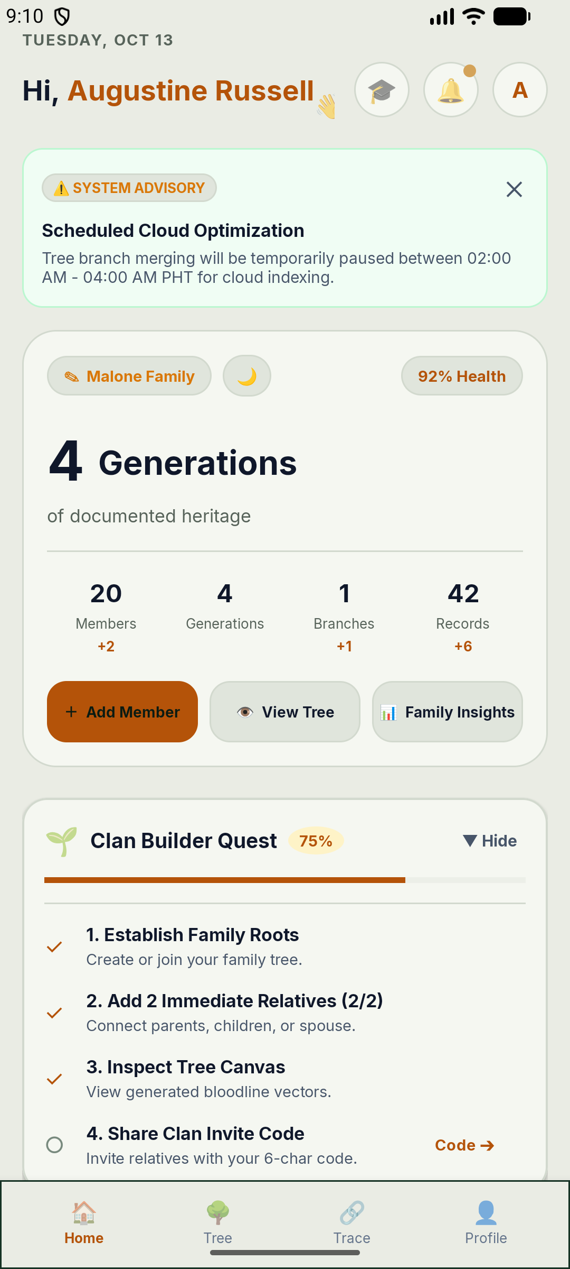
✨ CORE CANVAS ENGINE
Interactive Family Tree Canvas Navigator
Multi-touch, hardware-accelerated vector tree rendering with full generation mapping.
Canvas Capabilities & Navigation
• Infinite Pan & Pinch-Zoom: Fluid multi-touch navigation across expansive multi-generational family trees without stutter.
• Custom Vector Tree Rendering: Bespoke anti-aliased connector curves joining parent-child nodes and marital unions.
• Generational Badge Hierarchy: Gold Ahnentafel badges and generation indicators distinguish patriarchs from newest descendants.
• Color-Coded Status Badges: Distinct visual markers for biological relatives, spouses, and in-law connections.
• Interactive Node Selection: Tapping any member instantly summons a contextual bottom sheet showing relationships and actions.
Notes:
The Interactive Canvas is the crown jewel of KinTrace. It uses Android hardware-accelerated Custom Views to draw vector connecting lines, manage pinch-to-zoom gestures, and render color-coded relationship badges across an infinite virtual layout.

Slide 6
✨ GENEALOGICAL SCIENCE
Ancestor Pedigree & Ahnentafel Traversal
Systematic lineage mapping based on standardized binary genealogical mathematics.
Ahnentafel Math & Traversal
• Strict Binary Tree Formula: Root person is 1; father is always 2n; mother is 2n+1.
• Generational Depth Calculation: Immediate computation of direct patrilineal and matrilineal ascent lines.
• Pedigree Collapse Prevention: Algorithms safely manage endogamy (cousin marriages) without infinite recursive loops.
• Instant Direct Ancestry Filter: Quickly isolates direct forebears while temporarily hiding lateral collateral branches.
Fan Chart Visualization
• Concentric Generation Rings: Renders ancestral lines radiating outwards like a classic pedigree fan.
• Color-Coded Quadrants: Paternal grandfather, paternal grandmother, maternal grandfather, maternal grandmother branches.
• High-Density Overview: Displays 5 to 7 ancestral generations on a single mobile viewport without panning.
Notes:
Beyond simple box-and-line trees, KinTrace supports standard Ahnentafel pedigree numbering. This ensures mathematical accuracy when tracking direct ancestors, avoiding loop recursion in complex intermarried lineages.

Slide 7
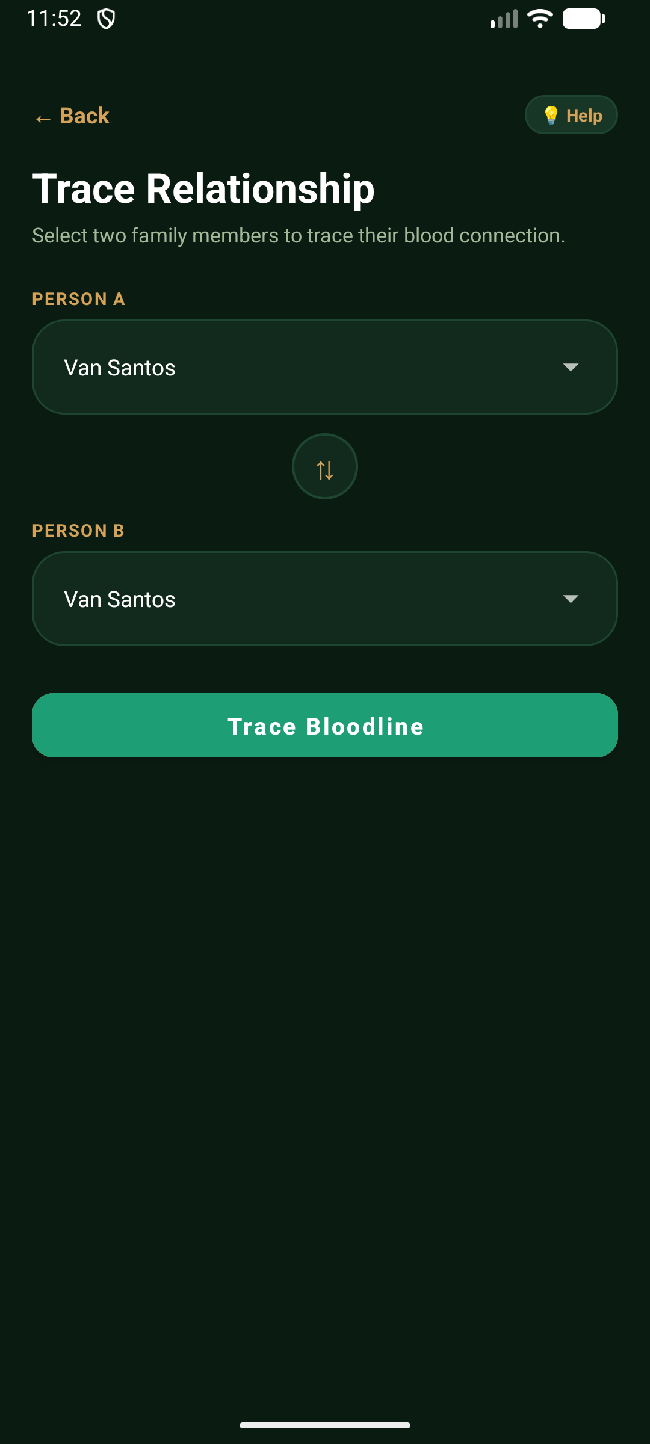
✨ KINSHIP INTELLIGENCE
Bloodline Tracing Engine & Statutory Degrees
Automated Nearest Common Ancestor (MRCA) pathing and Philippine Family Code compliance.
Tracing Engine Specifications
• MRCA Graph Traversal: Automated algorithm calculates the Lowest Common Ancestor connecting any two arbitrary tree members.
• Civil Law Degrees (Family Code Art. 963–966): Computes exact civil relationship degrees (1st degree parent, 2nd degree sibling/grandparent, 3rd degree uncle/aunt, 4th degree 1st cousin).
• Direct vs. Collateral Line Differentiation: Distinguishes direct ascending/descending lines from collateral sibling branches.
• Visual Step-by-Step Path Breakdown: Displays the step-by-step ascendant and descendant trail connecting the two selected relatives.
• Legal & Succession Relevance: Vital for inheritance validation, marriage impediment verification, and reunion introductions.
Notes:
Our Bloodline Tracing Engine is grounded in real statutory law. By implementing Articles 963 to 966 of the Philippine Family Code, the app counts generation steps up to the common ancestor and down to the relative, presenting the exact legal civil degree.

Slide 8
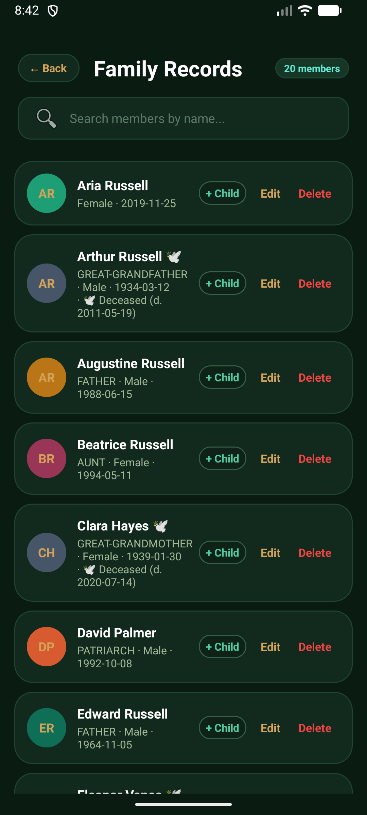
✨ ARCHIVAL VAULT
Member Records & Biographical Archival
Preserving oral history, physical portraits, and historical milestones for posterity.
Record Vault Capabilities
• Rich Biographical Cards: Detailed profiling including full legal names, maiden names, aliases, birthdates, and resting places.
• Multimedia Memory Attachments: High-resolution profile photos, historical family heirloom snapshots, and recorded voice notes.
• Geographical Heritage Tags: Documenting ancestral hometowns, birth municipalities, and migration history.
• Fast Search & Generational Filtering: Instant indexed search by first name, surname, or generation badge.
• Live Relational Anchors: Direct navigation from a member's record straight into their position on the interactive canvas.
Notes:
KinTrace is not just a diagram; it's a digital archive. Every member has a rich profile containing biographical dates, historical hometowns, multimedia attachments, and oral history recordings preserved in cloud storage.

Slide 9
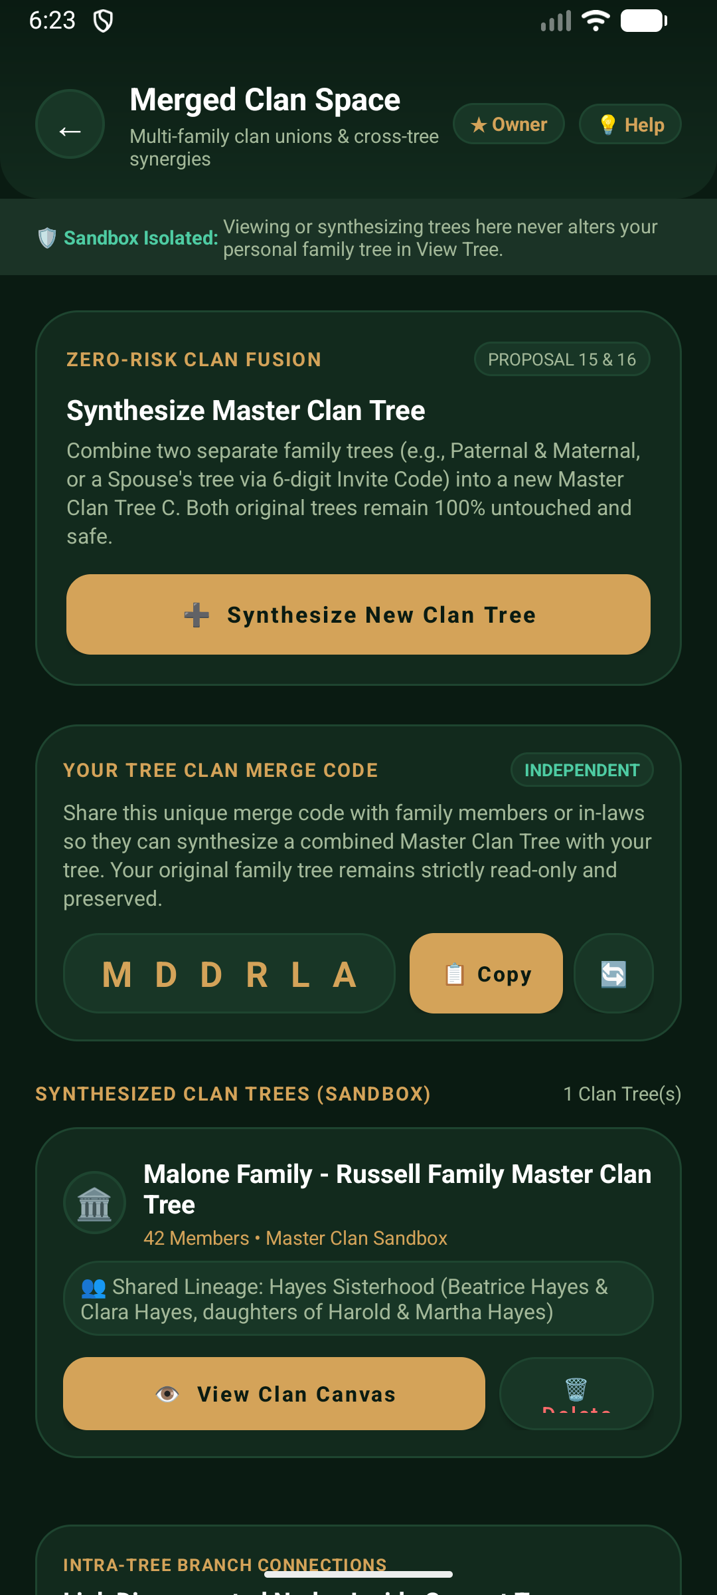
✨ ADVANCED COLLABORATION
Multi-Tree Merging & Clan Federation
Unifying separate family branches without data loss through guided synthesis.
3-Step Merge Engine Workflow
• Step 1 — Tree Selection: Select an external tree branch via secure Tree Invite Code or shared Clan Federation Pass.
• Step 2 — Bridge Person Linking: Pinpoint the shared relative or marriage bridge that connects the two distinct lineages.
• Step 3 — Conflict & Duplicate Resolution: Visual side-by-side reconciliation of overlapping records and differing dates.
• Zero-Risk Master Tree Synthesis: Synthesizes a unified Master Tree C while keeping original trees A and B safe as pristine backups.
• Automatic Relationship Bidirectionality: Ensures parent, child, and spouse pointers are reciprocally updated across both branches.
Notes:
When two cousins build separate trees, merging them is notoriously risky. KinTrace provides a 3-step Merge Wizard that identifies a shared bridge relative, resolves conflicting records, and synthesizes a master tree without touching the original backups.

Slide 10
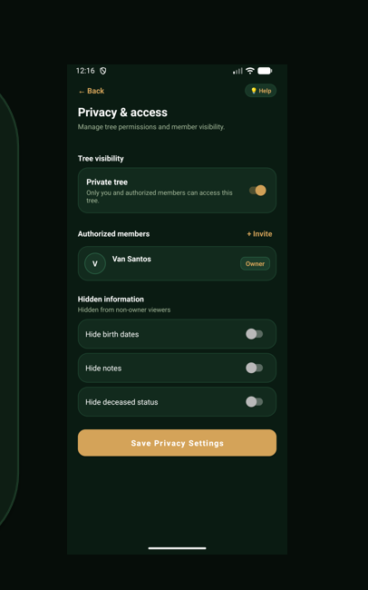
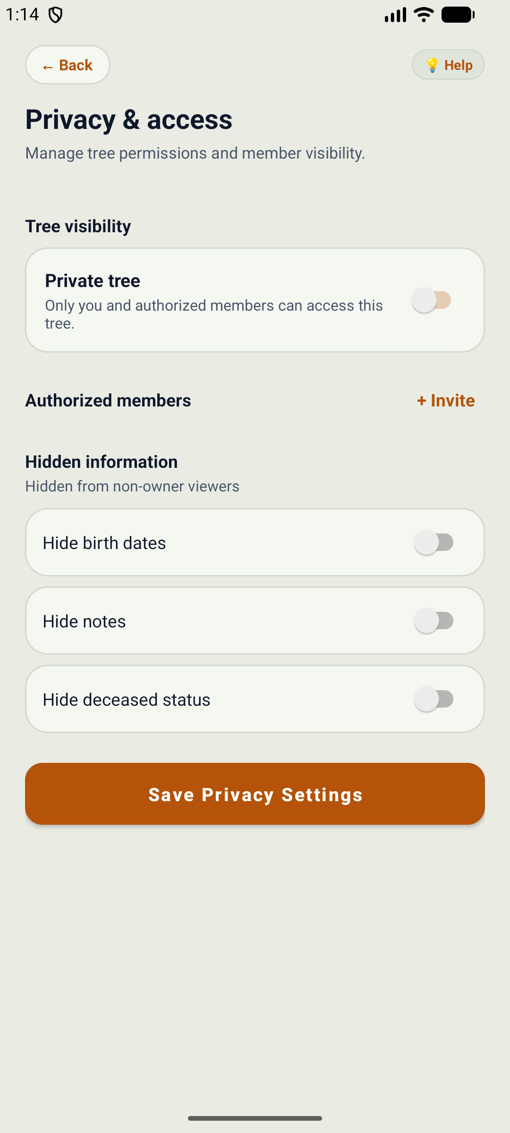
✨ GOVERNANCE & SECURITY
Family Privacy & RBAC Security Matrix
DARK EMERALD PRIVACY VIEW
LIGHT LINEN PRIVACY VIEW
Granular role-based access control protecting living relatives from unauthorized exposure.
Privacy Engine & Controls Walkthrough
• Tree Visibility Switch: Instant one-tap toggle between completely Private tree (authorized only) and Shared Clan access.
• Granular Member Masking: Selective switches to hide birth dates, personal notes, and sensitive deceased statuses from non-owners.
• 4-Tier Role Hierarchy: Clan Owner (full rights), Editor (branch updates), Contributor (suggestions), and Viewer (read-only).
• Authorized Members Management: Real-time list of delegated clan managers with quick Invite Code generation.
• Legal Ethics Standard: Prevents data harvesting while keeping heritage discovery accessible to verified descendants.
Notes:
Privacy is paramount. Here is the Privacy & Access control center shown in both themes. Clan owners can toggle tree visibility, invite authorized relatives with specific roles, and mask birth dates or sensitive notes for living relatives.

Slide 11
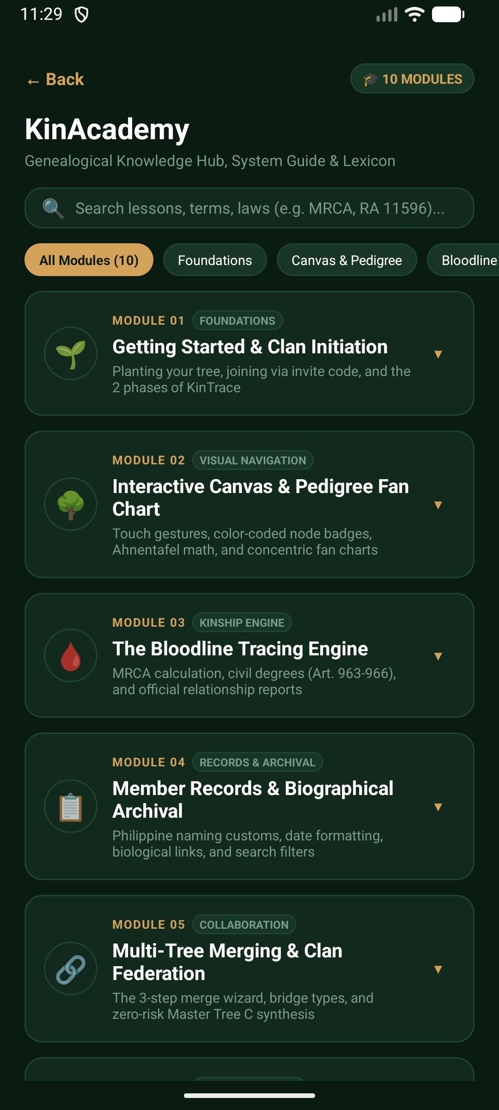
✨ EDUCATION & STEWARDSHIP
KinAcademy Genealogical Hub & Lexicon
A built-in 10-module curriculum teaching relatives the science of family preservation.
KinAcademy Learning Modules
• 10 Structured Lessons: Covers Clan Initiation, Canvas Navigation, Ahnentafel Math, Bloodline Tracing, Archival Ethics, and Multi-Tree Merging.
• Searchable Genealogical Lexicon: Comprehensive glossary explaining terms like MRCA, Consanguinity, Collateral Kin, and Pedigree Collapse.
• Statutory Law Primer: Interactive explanations of Philippine civil laws regarding inheritance, legitimate succession, and civil degrees.
• Offline Educational Access: All courseware and glossaries are bundled locally for instant access during rural family reunions.
• Interactive Knowledge Quests: Users unlock Clan Builder achievements by exploring lessons and applying principles.
Notes:
KinTrace is also an educational platform. The KinAcademy features 10 comprehensive modules and a built-in genealogical lexicon, teaching family members how genealogy works, legal definitions of kinship, and oral history best practices.

Slide 12
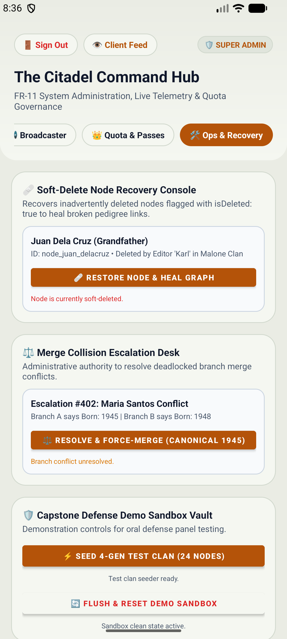
✨ SYSTEM OPERATIONS
System Admin Citadel & Live Operations
Centralized operational control, live aggregate telemetry, and broadcast advisories.
Admin Citadel Controls
• Real-Time Aggregate Telemetry: Live metrics monitoring total active trees, registered users, relationship links, and cloud storage health.
• System Broadcast Announcer: Instant global delivery of maintenance notices, update advisories, and system alerts to all client home screens.
• Demo Account Vault: Pre-populated test environment for live demonstrations, auditor inspections, and test verifications.
• Emergency Maintenance Switch: Instant toggle to pause branch merges during server indexing or scheduled cloud database migrations.
• Audit Trail Logging: Immutable log tracking administrative changes, system announcements, and security modifications.
Notes:
For system managers, the Admin Citadel provides real-time telemetry, broadcast announcement tools, and security controls. Admins can broadcast maintenance notices directly to all users' dashboards in real time.

Slide 13
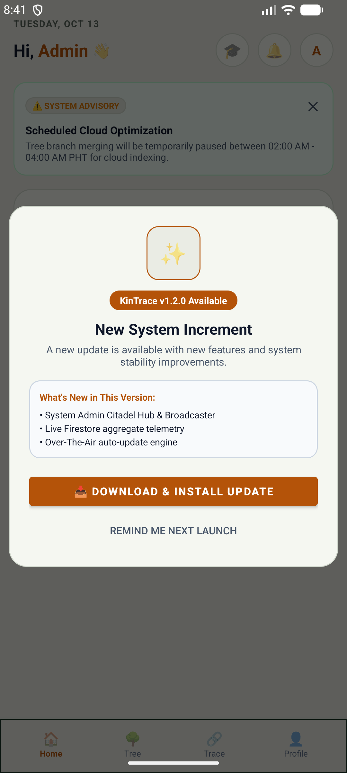
✨ DEVOPS & DELIVERY
Over-The-Air (OTA) Updates & Cloud Sync
Zero-friction client updates and reactive multi-device state synchronization.
Continuous Delivery & Reactive Sync
• In-App Version Handshake: Automatically checks Firebase remote configuration on launch for new APK releases.
• Zero-Friction In-App Download: Integrated download progress dialog with SHA-256 hash verification and direct package install prompt.
• CentralTreeSynchronizer Bus: Reactive event bus ensuring that changes made on one phone propagate to other family members within milliseconds.
• Offline-First SQLite Cache: Full tree view and records remain completely browseable even in remote provincial areas without cellular coverage.
• Automatic Conflict Merging: Debounced network retries and automated conflict reconciliation prevent state corruption.
Notes:
Updates are seamless. KinTrace features an Over-The-Air update manager that detects new releases, downloads the patch with progress feedback, and prompts the user to install. Meanwhile, our reactive sync engine guarantees real-time multi-device consistency.

Slide 14
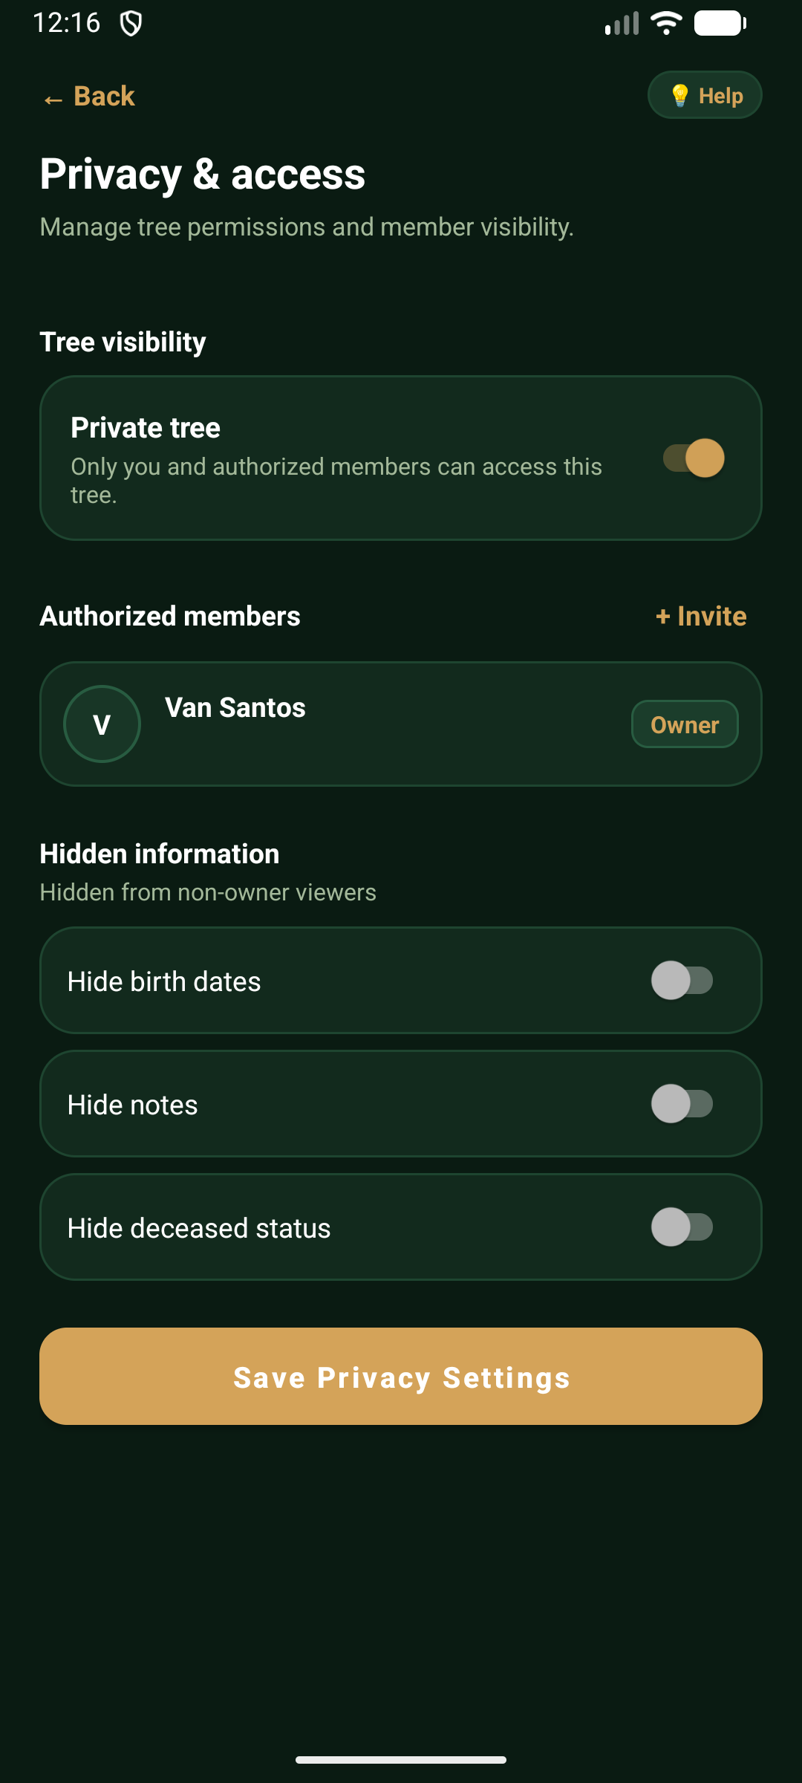
✨ PRESERVATION & OUTPUT
Export, Archival & Physical Heritage
Delivering timeless physical and digital artifacts for clan reunions and legal records.
Export & Archival Outputs
• High-Resolution PDF Tree Posters: Renders vector family trees into publication-ready PDF documents suitable for large-format reunion banners.
• Standard Genealogical CSV Export: Exports structured tabular member directories for import into desktop genealogy suites or legal proceedings.
• Encrypted Cloud Backup: Automated snapshot creation ensuring family heritage is shielded from phone loss, theft, or hardware failure.
• Physical Heirloom Framing Guide: Pre-formatted printable ancestral cards highlighting patriarchs, matriarchs, and generational statistics.
• Legal Relationship Certificates: Formatted relationship degree summaries ready for civil registry submissions or estate validation.
Notes:
KinTrace connects digital agility with physical heirloom preservation. Relatives can export high-resolution vector PDF posters for clan reunion printouts, generate CSV files for legal documentation, or produce certified relationship reports.

Slide 15
✨ DESIGN & CRAFT
Dark Emerald & Light Linen Dual-Theme Engine
DARK EMERALD HERITAGE
LIGHT LINEN MODE
Bespoke executive visual craftsmanship tailored for both day and night viewing.
Executive Visual Identity
• Dark Emerald Heritage (#060D09): Rich obsidian-green surfaces conveying prestige, permanence, and historical legacy.
• Warm Gold Accents (#D4AF37): Metallic gold badges and indicators highlighting key generation milestones.
• Light Linen Mode (#EAECE4): Eye-comfortable warm linen surfaces that avoid harsh glare in outdoor reunion environments.
• Executive Typography: Custom Sora (display), Inter (UI), and JetBrains Mono (dates & codes) typefaces.
• Instant One-Tap Switch: Theme toggle right in the hero banner allows instant switching without restarting the app.
Notes:
Visual design reflects the gravity of family heritage. KinTrace provides two carefully calibrated themes: Dark Emerald Heritage for high-craft executive elegance, and Light Linen for non-glare daytime outdoor viewing.

Slide 16
SUMMARY & NEXT STEPS
KinTrace: Built for Generations
• 100% Native Android Architecture (Kotlin, Material You, Hardware-Accelerated Vector Canvas)
• Statutory Compliance with Philippine Family Code Kinship Degrees (Articles 963–966)
• Full Collaborative Federation: Non-destructive multi-branch tree synthesis & live sync
• Executive Modern Aesthetics: Minimalist Executive Typography & Twin-Pod Island design
Thank you! We will now proceed with a live interactive demonstration.
Notes:
In conclusion, KinTrace is a fully realized, battle-tested heritage management system. It combines statutory legal math, custom vector canvas rendering, and modern collaborative engineering. I am now open for questions and live app demonstration.

