Slide 1
CS 0449 Recitation 2
Gordon Lu

Slide 2
Plans for Today
Bit Masks
Bit Puzzles
Hints for the Lab
Pointers

Slide 3
Bit Masks

Slide 4
Bit Masks
In the computer, there instructions are divided into 3 formats:
R types, I types, and J types
Each of these have a different bitfields.
There is a special bitfield called the opcode that is important in the CPU for identifying what needs to be performed from the ALU, etc.
Suppose we want to retrieve the opcode, which is typically the upper 6-bits. How would we do that?
With masking…

Slide 5

Example
Suppose we have an R type instruction:
int instruction = 110010 01110 10101 00111 11011 01111
We want to extract the opcode. How would we retrieve the opcode?
int opcode = instruction >> 26;
What about the funct?
int funct = instruction << 26;
What about the rt?
int rt = (instruction >> 16) & 0x5;

Slide 6
How to Approach Any Problem

Slide 7

A Friendly Reminder
You are smart.
If you ever have trouble grasping something… THAT’S OKAY
No one is perfect, everyone struggles…
What’s worse than struggling, is cheating….

Slide 8
Enter: The Decision Tree (Gordon Variant)
To be a great Computer Scientist, Mathematician, etc., you must be able to think about how to solve problems, and how to do it well…
1) Start with what you’re given
2) Write down what you want a couple lines down
Starting from what’s given:
Consider what operations/theorems/facts that can apply to the problem
For each one of the thoughts, create a branch
Continue to branch out, until the conclusion is reached

Slide 9
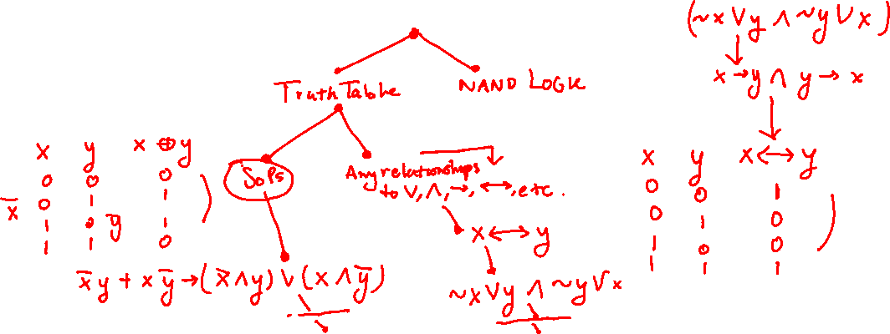
Example: Bit XOR
Given: Two integers x and y
Goal: x XOR y (using &s and ~)

Slide 10
Bit Puzzles

Slide 11
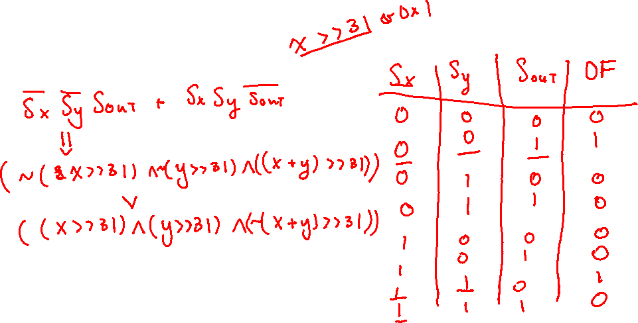
AddOK
Given: Two integers x and y,
Goal: Whether x+y can be computed without overflow

Slide 12
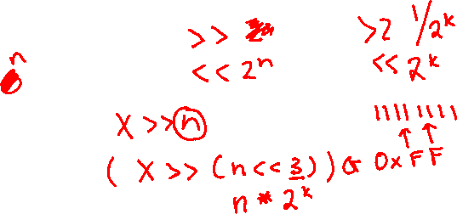
getByte
Given: Two integers x and y
Goal: Extract the nth byte from word x.

Slide 13
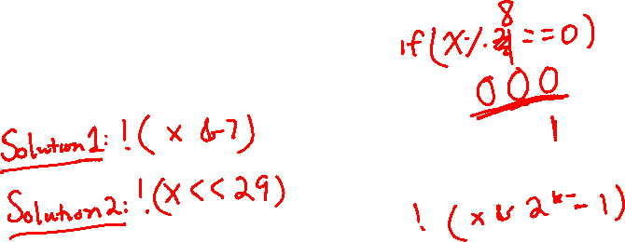
divisible_by_eight
Given: An integer x
Goal: If x%8 == 0

Slide 14
equals
Given: Two integers x and y
Goal: If x == y

Slide 15
Hints for the Lab

Slide 16
General Advice
!(x^y) is the equivalent of checking x == y
It’s always a good idea to take a break :)
Use print_binary() or make your own print function for binary.
Remember ARITHMETIC and LOGICAL shifts
Masking is your friend!!!

Slide 17
binprintf()
void binprintf(int v)
{
unsigned int mask=1<<((sizeof(int)<<3)-1);
while(mask) {
printf("%d", (v&mask ? 1 : 0));
mask >>= 1;
}
printf("\n");
}

Slide 18
Logical Shift
Given: Integer x, and a shamt n
Challenges:
For positive numbers, shifting by n is fine…
But for negative numbers, we perform a signed shift, and carry the 1 over..
Idea:
Use a bitmask
Shift n-1 positions to the right, then zero out the leading bits

Slide 19
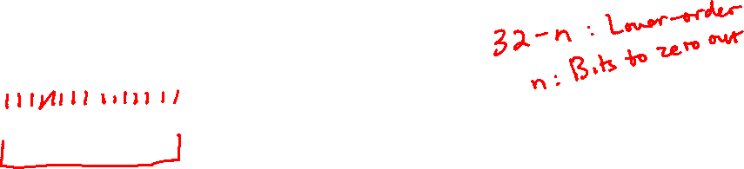
Example
x = 10011110100110000110010011100001
n = 12
mask = 00000000000011111111111111111111
12 bits leading zero
1’s elsewhere to maintain shifted data
One last step to get the result, what is it?

Slide 20
Logical Negation
Given: Integer x
Challenges:
We need to generalize non-zero numbers to some value
Idea:
Map all non-zero values to -1
Map zero to 0
Add 1 to this, and we will have:
Nonzero -> return 0, zero return 1
HINT: Consider two’s complement inverses, what operation when combined, yields -1? Better yet, what is -1 in Binary or Hex?

Slide 21
twosBits
Given: Integer x, and n-bit representation
Challenges:
Where do I even begin???
Idea:
Split up x into n-lower bits and (32 – n) high-order bits
Sign extend the number…
Check if the (32-n) high-order bits are the same as the original number…
Observe that if the (32-n) order bits are all 1s, this will fail…

Slide 22
Example: Can’t fit
n = 9
x = 00000000000000000000001010111011
black_box = 00000000000000000000000010111011
Clearly x != black_box, return false

Slide 23

Example: Leading Bits Problem
n = 10
x = 00000000000000000000001010111011
black_box = 11111111111111111111111010111011
Only leading bits differ, so return false!

Slide 24
Example: Fits
n = 11
x = 00000000000000000000001010111011
black_box = 00000000000000000000001010111011
Only leading bits match, so return true!
What operation do we need to perform?

Slide 25
floatFloat2Int
Given: Number uf
Challenges:
Yuck! IEEE 754? In my Program en
Idea:
Break up the number into different pieces, as if it was in IEEE 754
Consider edge cases

Slide 26
floatFloat2Int
What can happen with the exponent?
This mostly follows from the IEEE 754 format and knowing the edge cases!!

Slide 27
Questions?

