Slide 1
CS 0449 Recitation 4
Gordon Lu

Slide 2
Plans for Today
Introduction to C
C and Java correspondences
Structs
Basic Memory Allocation
Dynamic and Static allocation
Hints for the Lab

Slide 3
Introduction to C

Slide 4
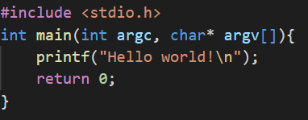
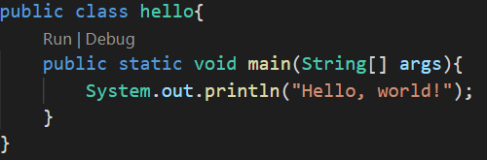
Getting Down to the Basics
For now, we can think of #include as C’s way of doing import…
These are two sides of the same coin….

Slide 5

Java but also not Java....
What will be printed out?
In Java, this would print out: “The value of x is 5
In C, this would print out: “alue of x is: “
Here’s the thing… no matter what you do with x, it’ll never actually print x…

Slide 6
C Versions
The most portable, but annoying version of C is: C89
It’s the syntax where you must do:
int i;
i = 0;
A more modern version of C is: C17 or C99
You can do normal variable declarations and initializations there…

Slide 7
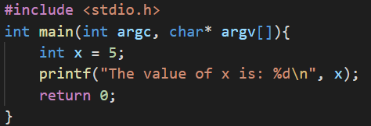
Format Specifiers
C likes to use a format string with format specifiers, like:

Slide 8

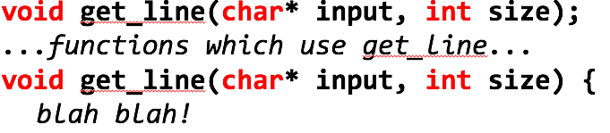
Function Prototypes
Suppose I want to call a function: get_line(), and I move it after main(), I will get the following error
C does not know about functions if you try to access them before you declare them!!
Instead, we can make a function prototype like:

Slide 9
Function Prototypes
Suppose I want to call a function: get_line(), and I move it after main(), I will get the following error
C does not know about functions if you try to access them before you declare them!!
Instead, we can make a function prototype like:

Slide 10
Returning Arrays
In Java, we can return Arrays….
In C, we can’t, in fact gcc will actually force your function to return NULL if you try to….
So, instead we typically fill in pointers that we pass into functions instead of returning them…
Remember strcpy(), strcat()?
We fill the pointer in…
This is a C standard...

Slide 11
Structs

Slide 12
Structs: Classes’ Ancestors
A struct is just a class without most of the cool stuff…
All you can do with a struct is store data…
Example:
struct 449{
char name[10];
double grade;
int num_labs_aced;
};
A struct created like this needs to be declared like this: struct 449 help_me;

Slide 13
The Memory Representation of a Struct
All the struct fields are allocated inside the struct variable:
struct cs449{
char name[10];
double grade;
int num_labs_aced;
};

Slide 14
Alignment and Padding
When you compile your program, it won’t be size you expect… gcc will align the fields!
It will align the struct, so each field is a multiple of the maximum alignment of the largest data member.

Slide 15
Initializing Struct Fields
You can initialize structs pretty nicely, it kind of looks like the hard coded array initialization!
struct 449 s1 = {“gordon”, 98.0, 100.0};
You can also make struct arrays!
struct 449 students[ ] = {
{“gordon”, 100.0, 100.0},
{“wilkie”, 100.0, 100.0},
{“petrucci“, 100.0, 100.0},
};

Slide 16
Field Access (The . Operator)
Regular structs require the . Operator:
students[0].grade = 10000.0;
Struct pointers require the -> Operator:
student_1 = &students[0];
student_1 -> grade = 10000.0;

Slide 17
Passing and Returning Structs
If you pass a struct to or return a struct from a function…the whole struct is copied!!
typedef struct bigStruct{
int arr[256];
} bigStruct;
void func(bigStruct big){ }
…
bigStruct big;
func(big); //This will copy 256 * 4 bits…

Slide 18
Passing by Reference
Rather than pass by value, structs are often passed as a pointer: “by reference”
void func(bigStruct* big){ }
…
bigStruct big;
func(&big);
This will copy the size of 1 pointer!!

Slide 19
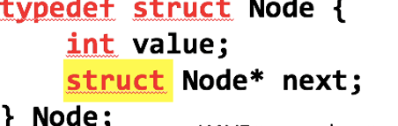
Data Structures with Structs
Linked Lists, Trees, etc … have “nodes” that point to each other
To make a pointer inside a struct to the same type, you have to do:

Slide 20
Uninitialized Variables
Suppose, I have a Node* node.
node -> value = 449
Now, I try to print out node->next…
What’s printed out?
Some arbitrary memory address…

Slide 21
Basic Memory Allocation

Slide 22
Stack vs Heap
The Stack is an area of memory that is managed by the program…
Any statically defined variables, locals, etc.
The Heap on the other hand is an area of memory that is managed by the user…
You can DESTROY pieces of memory on demand…

Slide 23
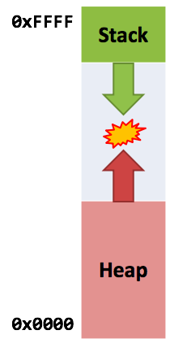

Stack $↑$, Heap $↓$
The stack and heap both change size…
Stack grows down (higher to lower)
Heap grows up (lower to higher)
When they meet, your program is out of memory…

Slide 24
Heap Functions
Heap functions are in <stdlib.h>
To allocate memory, we use malloc:
int* arr = malloc(sizeof(int) * 20);
This will allocate a 20-item int array on the heap
malloc will take the number of bytes to allocate, and create a block of bytes at least that big, and returns a pointer to it.
When you’re done with that block of memory, you use free:
free(arr);

Slide 25
Heap Functions
When you malloc something, it initially contains garbage.
To fix this, we can use memset from <string.h>
memset(arr, 0, 20*sizeof(int));
This says “fill the memory at arr with 0s…”
We can also use calloc:
int* arr = calloc(sizeof(int) * 20, 1);
This says “allocate 1*sizeof(int)*20 bytes and fill them with 0s”

Slide 26
Caveats
If you do this:
while(1)
malloc(1048576);
Your program will run out of memory…
But you won’t get an error…
This will loop forever because…
If you run out of memory, malloc returns NULL!!

Slide 27
Caveats
Now, if you do this:
int* arr = malloc(sizeof(int) * 20);
free(arr);
arr[0] = 1000;
You don’t know what will happen!
When you free heap memory, all pointer to it become invalid, and it’s your responsibility to never use them again…

Slide 28
Garbage Collection

Slide 29
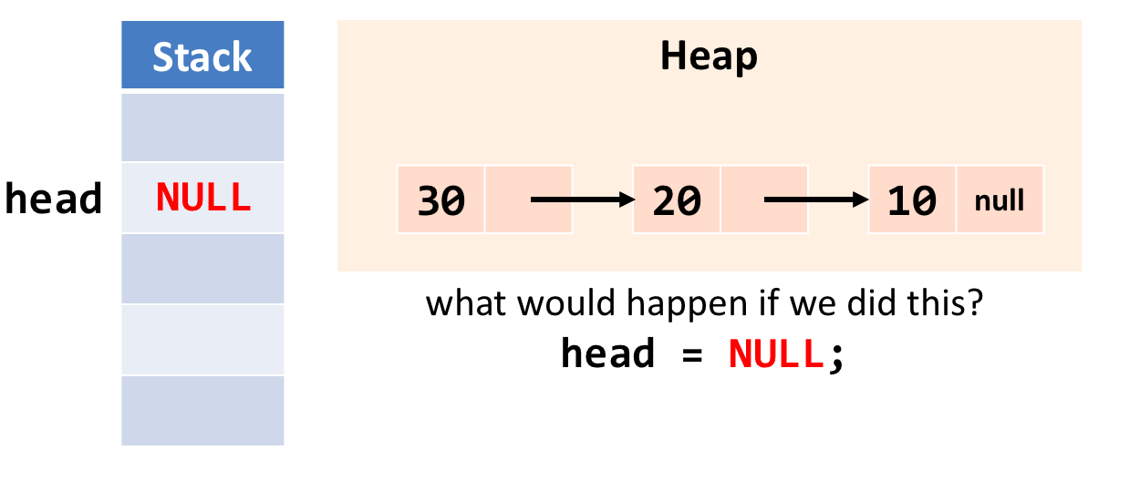
An Example….
Suppose we had a linked list…

Slide 30
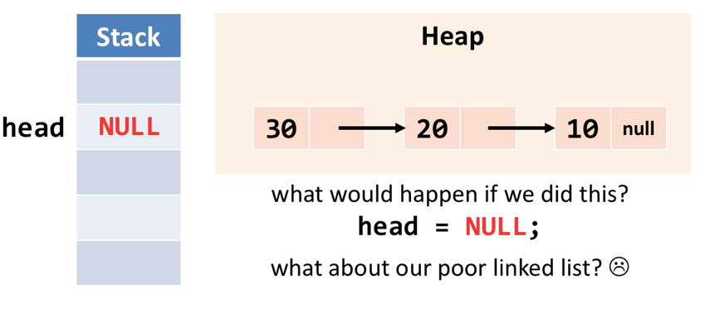
An Example….
If the head is made NULL…
What happened to our linked list?
Well, nobody points to it…
anddd it’s still there…

Slide 31
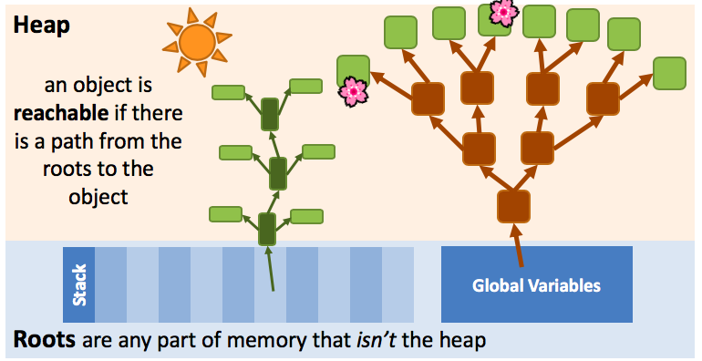
Roots and Reachability

Slide 32
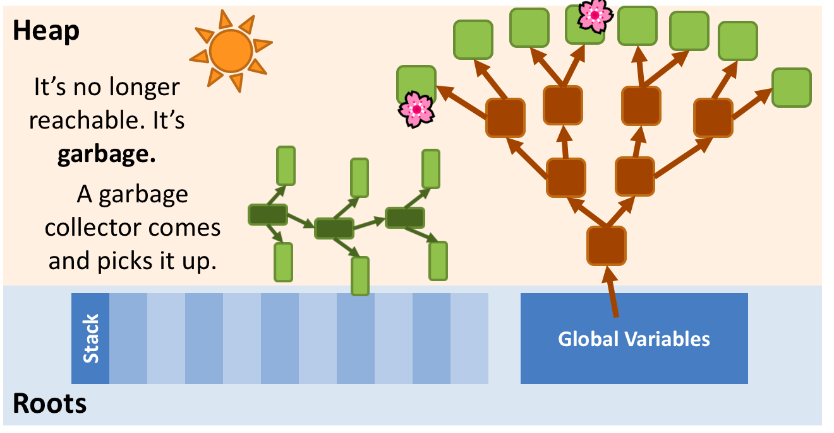
Pruning
If we remove the only link to an object…
We cause a whole graph of objects to become unreachable by removing only one link

Slide 33
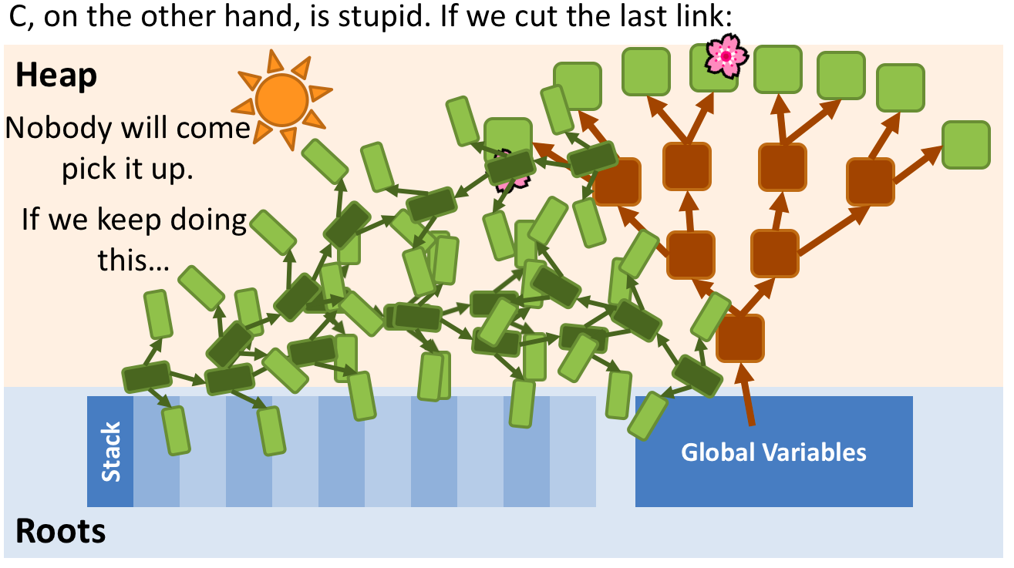
C Leaves it To You
In C, if we cut the last link….
Nobody will come to pick it up…

Slide 34
Memory Leak
In C, if heap memory becomes unreachable, it’s a memory leak.
We can never deallocate it. It’s like it leaked out of your program
The only way to deallocate it, is to exit your program…

Slide 35
Hints for the Lab

Slide 36
A Review of Big O
What is the Runtime of inserting an item into a linked list?
At the end?
O(n) if ____________
O(1) if ____________
At the head?
O(1)
What is the Runtime of retrieving the size of a linked list?
O(n) if __________
O(1) if __________

Slide 37
Adding to the Struct
Based on the previous slide, what should we add?

Slide 38
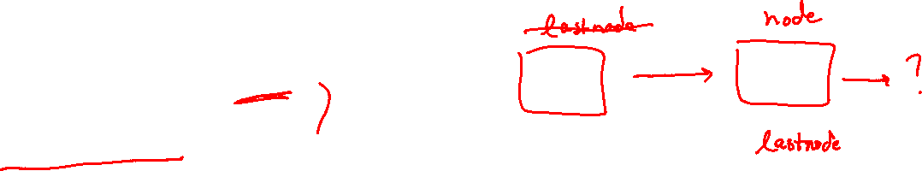
A Common Error
Suppose I have the following code: Assume lastnode is globally declared.
node -> value = 10;
lastnode -> next = node;
lastnode = node;
What is the problem here?

Slide 39
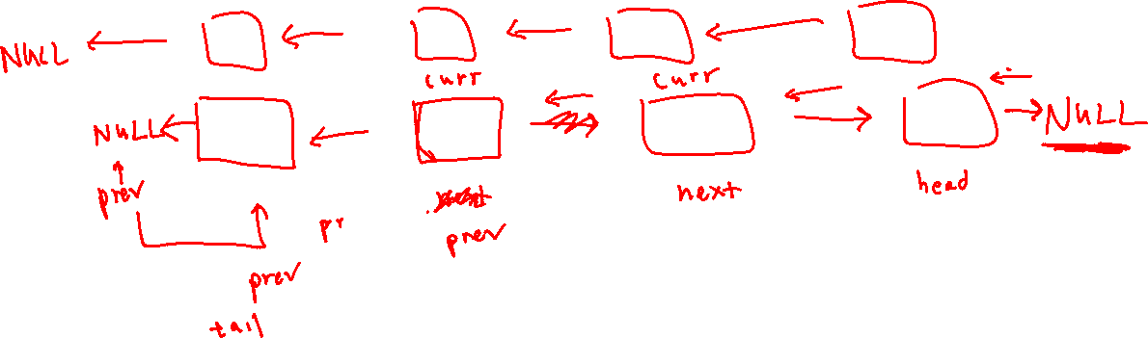
Queue Reverse, Visualized

Slide 40
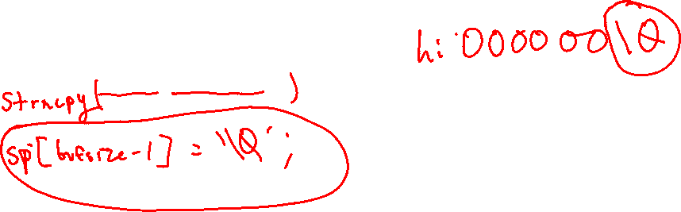
Remove Head
Remember, that you want to copy up to bufsize-1 characters to sp.
Remember to account for the null-terminating character

Slide 41
Insert Head and Tail
Remember to copy the string into the new nodes value….
Remember sizeof() on a pointer does not allocate bytes equivalent to the length of a string….
Remember to initialize your next pointer!!
If the string cannot be allocated, is it worth keeping the node we just allocated?

Slide 42
Using q_test
q_test is your friend for this lab…
After running make
You can test your code by doing: ./qtest
This will open a cmd:
new: creates a new queue
ih [value]: inserts a new node with value at the head
it [value]: inserts a new node with value at the tail
rh : removes the head
reverse: reverses the queue
free: frees the queue

Slide 43
Using q_test
q_test is your friend for this lab…
After running make
You can test your code by doing: ./qtest
This will open a cmd:
new: creates a new queue
ih [value]: inserts a new node with value at the head
it [value]: inserts a new node with value at the tail
rh : removes the head
reverse: reverses the queue
free: frees the queue
show: displays current contents of queue

Slide 44
Questions?

