Slide 1
CS 1501 Recitation
Gordon Lu

Slide 2
Agenda for Today
Red-Black BSTS
Live-Coding
Hints on Project

Slide 3
Sidenote
Office Hours will be held in a hybrid fashion.
Preferably in-person at 5806 SENSQ
But also on Zoom (give me a heads up if you plan on coming virtually)
Also, feel free to drop-by my tutoring hours if my office hours don’t suit your schedule!
https://pathways.campus.eab.com/pal/5N9M2n7yZj

Slide 4
2-3 Trees

Slide 5
2-3 Trees Review
In a 2-3 search tree, we have either: 1) 2 nodes (nodes that we’re used to seeing in a standard BST)
Left key < parent key, Right key < parent key
2) 3 nodes: 2 keys, 3 links
Left link and right link defined same as in BST, middle links to key between 2 keys of parent

Slide 6
2-3 Tree Example
M
3-node
2-node
E J
R
A C
L
P
S X
H
E < H < J

Slide 7
2-3 Tree Search
Let’s try to search for H:
M
H < M, go left
M
E J
E J
R
E < H < J, go middle
A C
L
P
S X
H
H
H
Found H!

Slide 8
2-3 Tree Insertion
Generally, to insert into a 2-3 tree, we will do an unsuccessful search, then attach a node with the key at the bottom.
This may result in an unbalanced tree… defeating the purpose of a 2-3 tree
There are 4 cases that may arise when inserting into a 2-3 tree:
Insert into a 2-node
Insert into a tree consisting of a single 3-node
Insert into a 3-node whose parent is a 2-node
Insert into a 3-node whose parent is a 3-node

Slide 9
Case 1: Insert into a 2-node
This is relatively simple to do: simply replace the node with a 3-node containing its key and the new key to be inserted.
If the node where the search terminates is a 3-node, there’s a lot more to do…

Slide 10
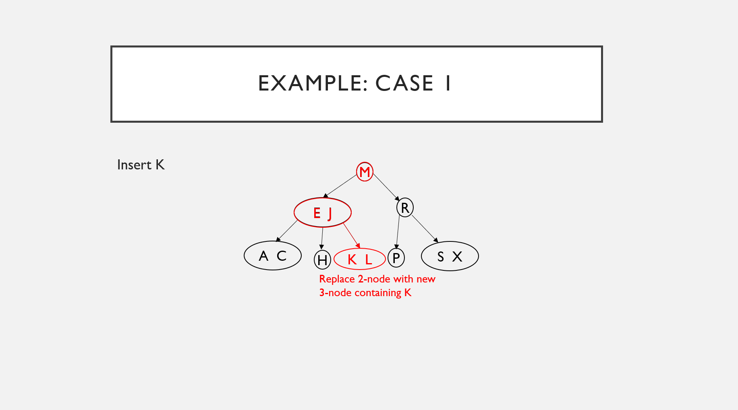
Example: case 1
Insert K
M
M
E J
R
E J
A C
L
P
S X
K L
H
L
Replace 2-node with new 3-node containing K
Search for K stops here

Slide 11
Case 2: Insert into tree consisting of a single 3-node
Suppose we have the following tree:
Clearly, we have no room for an additional key in the 3-node.
So, we temporarily put the new key into a 4-node (3 keys, 4 links)
A 4-node is easy to convert to a 2-3 node.
Convert to three 3-nodes
Middle key becomes root
A E

Slide 12
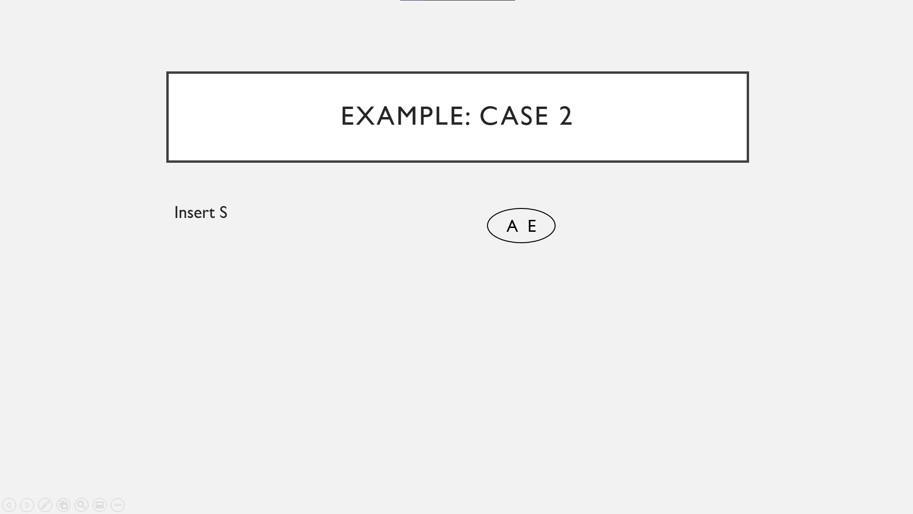
Example: Case 2
Insert S
Make a 4-node
A E S
No room for S
A E
Split 4-node into 2-3 tree
E
A
S

Slide 13
Case 3: Insert into 3-node whose parent is a 2-Node
In this case, we can make room for the new key while maintaining perfect balance in the tree.
First, by making a temporary 4-node
Splitting the 4-node just like in Case 2.
Instead of creating a new node to hold the middle key, we move the middle key to the node’s parent.
This transformation will maintain perfect balance!

Slide 14
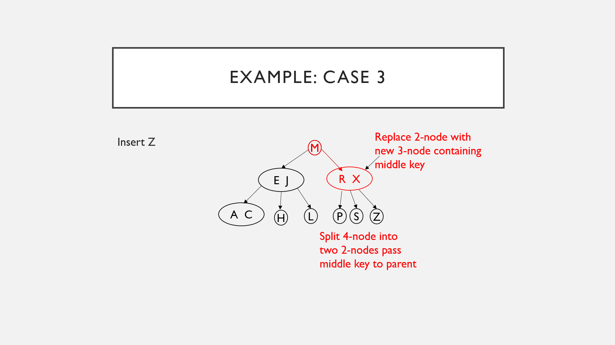
Example: Case 3
Replace 2-node with new 3-node containing middle key
Insert Z
M
M
E J
R X
Replace 3-node with temporary 4-node containing Z
R
R
Search for Z ends at this 3-node
A C
S X
S X Z
L
P
S
S X
H
Z
Split 4-node into two 2-nodes pass middle key to parent

Slide 15
Case 4: Insert into a 3-node whose parent is a 3-node
In this case we can do the following:
Make a temporary 4-node as in Case 2/3.
Split it and insert its middle key into the parent
Since the parent was a 3-node, we can replace it with a temporary new 4-node containing the middle key from the 4-node split.
Then, split the new 4-node and insert its middle key on its parent
So, we can see that the general case is clear: continue up the tree, splitting 4-nodes and inserting their middle keys in their parents until reaching a 3-node, which we replace with a 4-node that does not need to be further split. (or reaching a 3-node at the root).

Slide 16
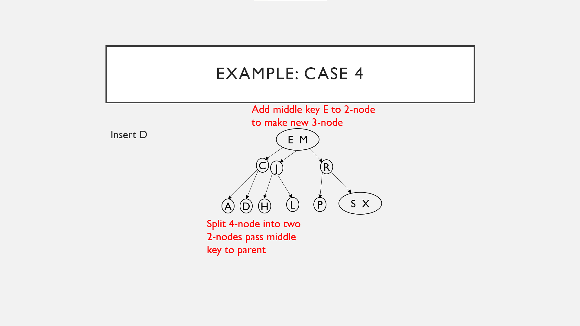
Example: Case 4
Add middle key E to 2-node to make new 3-node
Add middle key C to 3-node to make temporary 4-node
Insert D
E M
M
M
Add new key D to 3-node to make temporary 4-node
Search for D ends here
C
C E J
E J
E J
R
J
A C
A C
A C D
L
P
S X
A
D
H
Split 4-node into two 2-nodes pass middle key to parent
Split 4-node into two 2-nodes pass middle key to parent

Slide 17
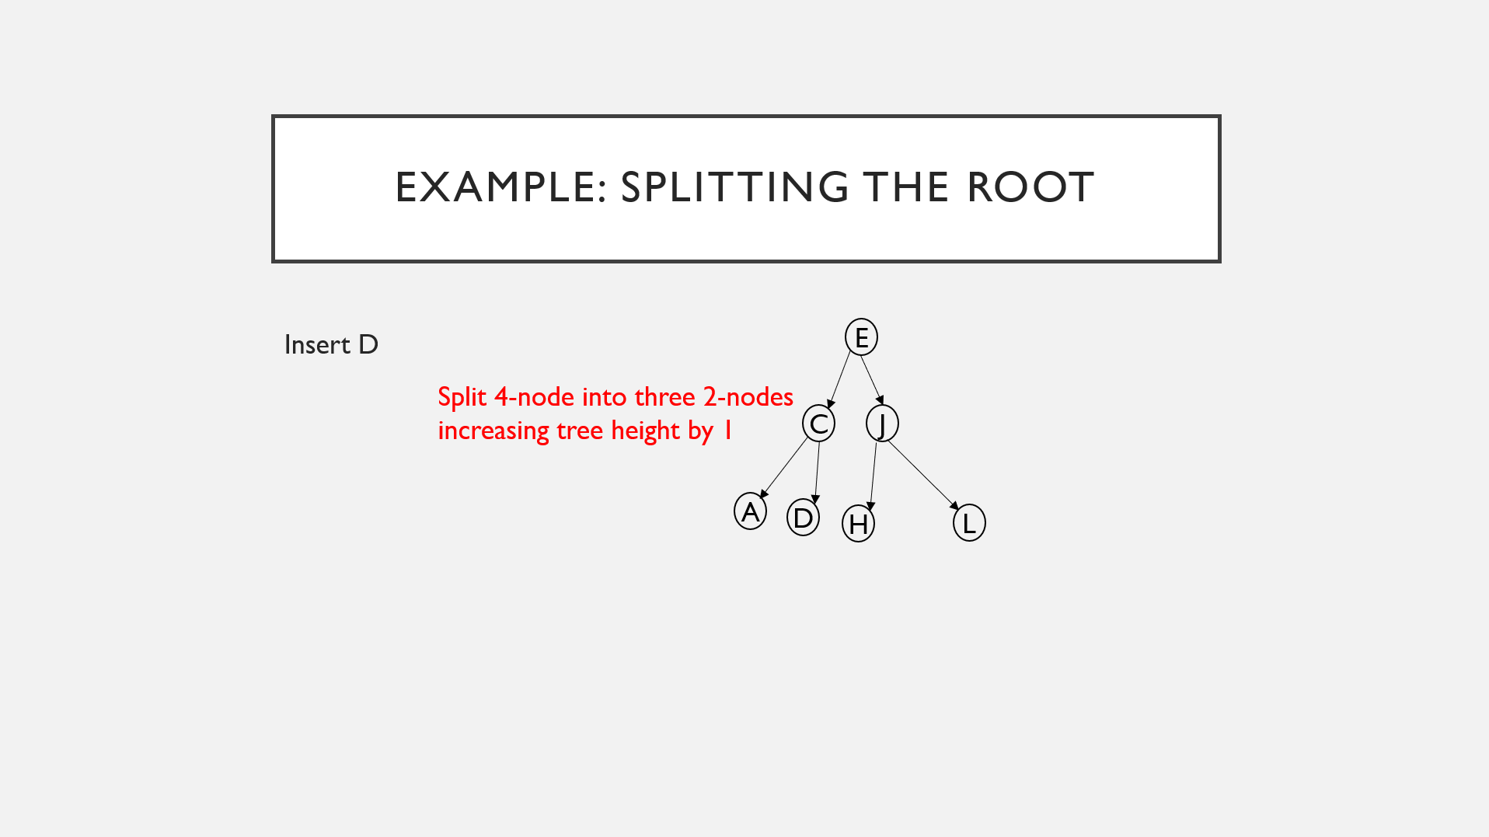
Example: Splitting the Root
Add middle key C to 3-node to make temporary 4-node
E
Insert D
Split 4-node into three 2-nodes increasing tree height by 1
C E J
E J
E J
C
J
Search for D ends at this 3-node
A C
A C D
A C
A
D
H
L
Add new key D to 3-node to make temporary 4-node
Split 4-node into two 2-nodes pass middle key to parent

Slide 18
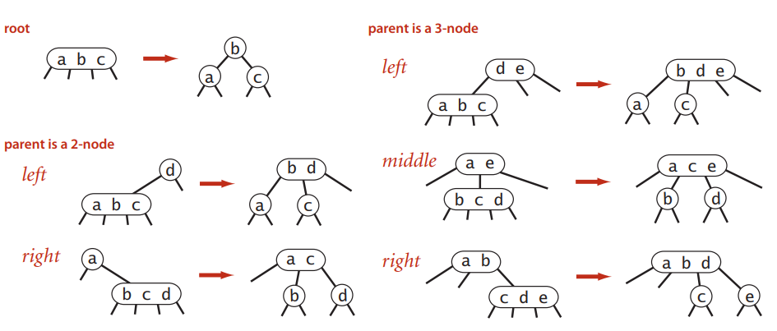
Splitting a temporary 4-node in a 2-3 tree
Below is a summary of cases that arise for splitting a temporary 4-node in a 2-3 tree:

Slide 19
Red-Black Bsts

Slide 20
(Left-Leaning) Red-Black BSTs Review
The idea behind red-black BSTs is to encode 2-3 trees by starting with typical BSTs and adding extra information to encode 3-nodes.
We have two kinds of links:
Red links bind together two 2-nodes to represent 3-nodes
Black links bind together the 2-3 tree

Slide 21
Red-Black BST rules
Red links lean left
No node has two red links connected to it
The tree has perfect black balance:
Every path from the root to a null link has the same number of black links (black height)

Slide 22
Red-Black BST Insertion
We use rotations in tandem with insertion in order to maintain a one-to-one correspondence between 2-3 trees and red-black BSTs.
More importantly, rotations help us preserve order and perfect black balance
There are 4 cases that may arise when inserting into a red-black BST:
Insert into a single 2-node
Insert into a 2-node at the bottom
Insert into a tree with two keys (in a 3-node)
Insert into a 3-node at the bottom

Slide 23
Case 1: Insert into a single 2-Node
There are a couple subcases here, but regardless we will need to rotate:
1) If the new key < key in the tree: Simply make a new red node with a new key
No rotation is necessary, as we have a red-black BST equivalent to a single 3-node.
2) If the new key > key in the tree: Attaching a new red node will yield a right-leaning red link, so we rotateLeft

Slide 24
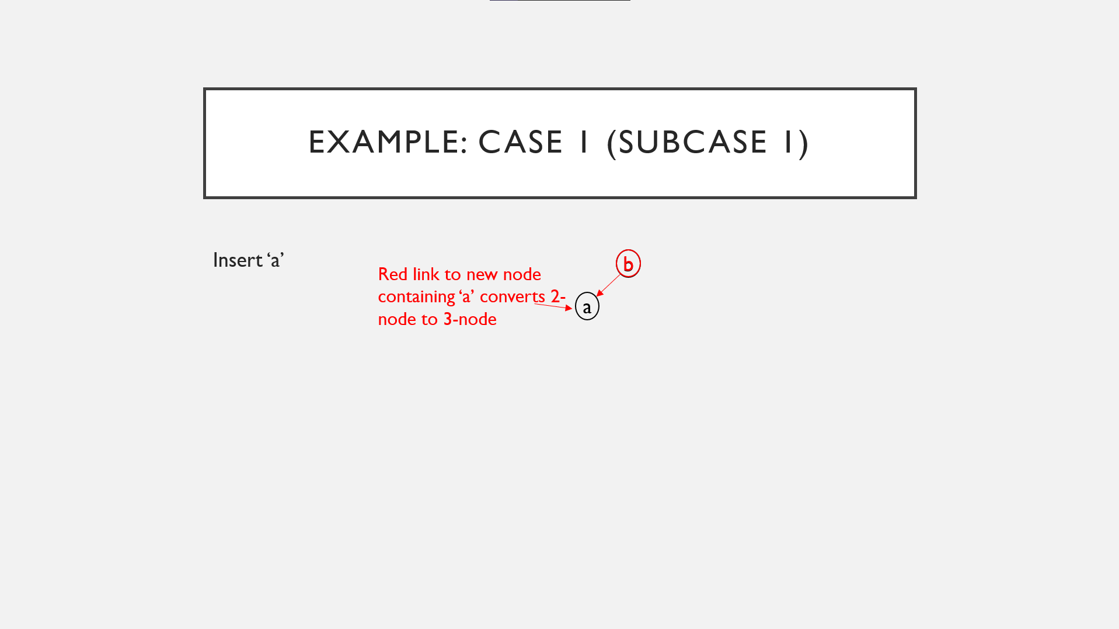
Example: Case 1 (Subcase 1)
Search ends here
Insert ‘a’
b
Red link to new node containing ‘a’ converts 2-node to 3-node
b
a

Slide 25
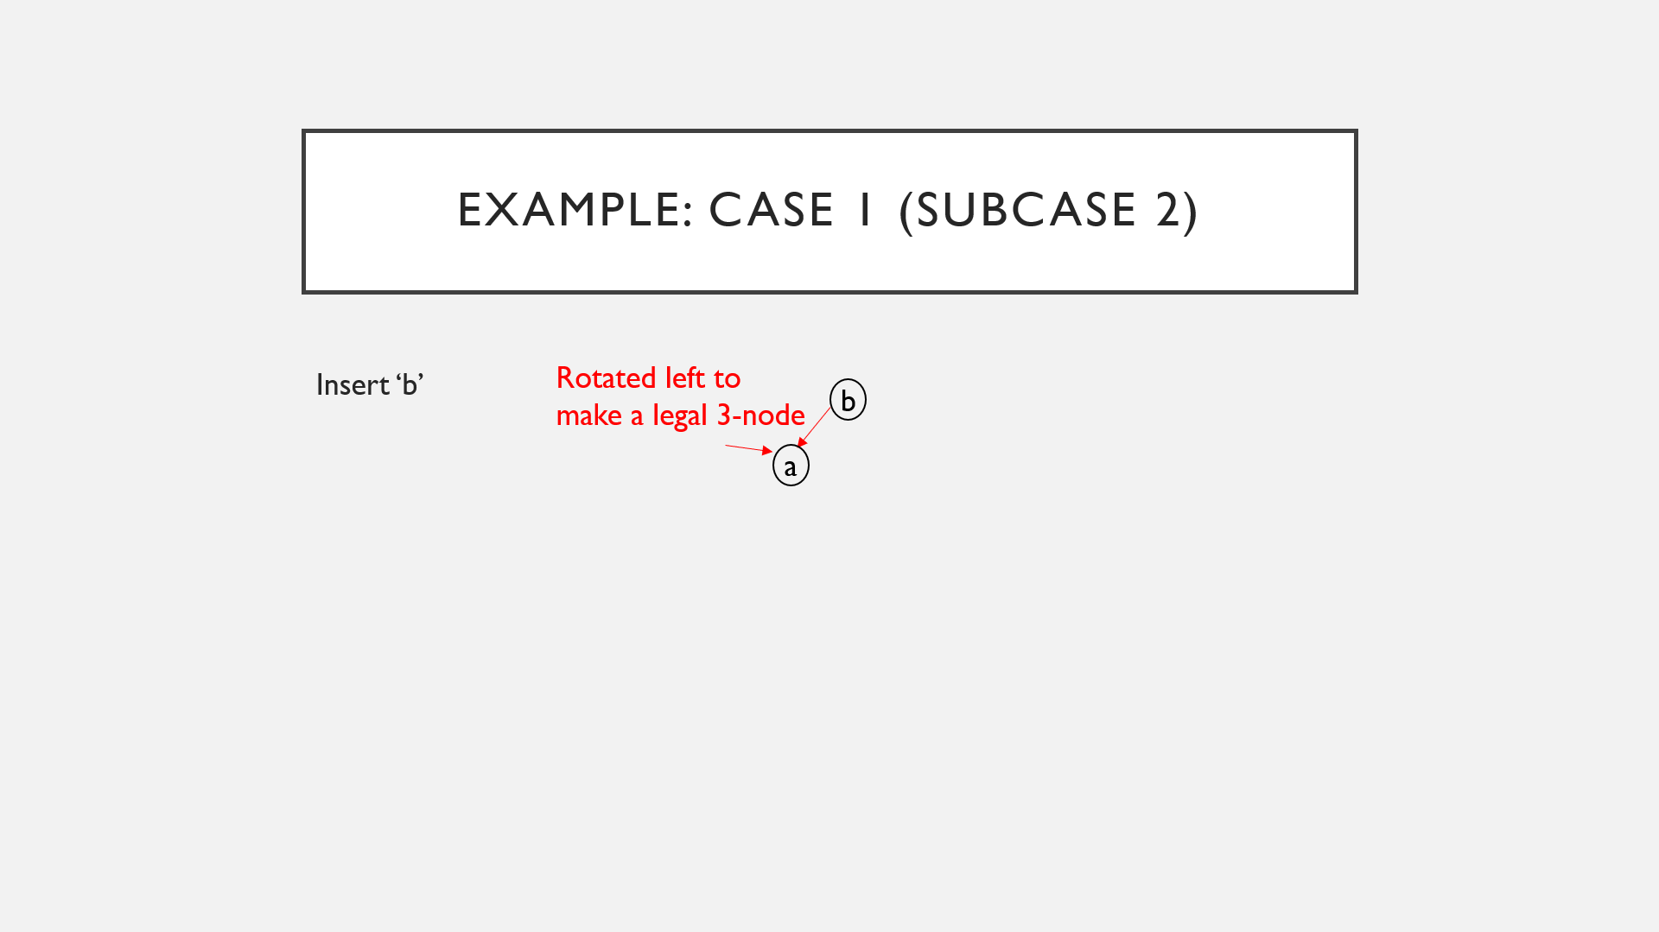
Example: Case 1 (Subcase 2)
Rotated left to make a legal 3-node
Insert ‘b’
a
Search ends here
b
a
Attached new node with red link
a
b

Slide 26
Case 2: Insert into a 2-node at the bottom
We insert keys into a red-black BST by adding a new node at the bottom, but always connected to its parent with a red-link.
If the parent is a 2-node, then the two cases from Case 1 apply
If the new node is attached to the left link, the parent simply becomes a 3-node
If the new node is attached to a right-link, we have a 3-node leaning the wrong way, and a left rotation finishes the job for us.

Slide 27
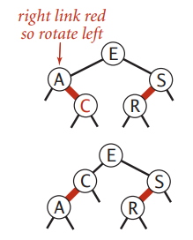
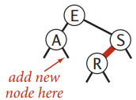
Example: Case 2
Insert C

Slide 28
Case 3: Insert into a tree with two keys (in a 3-Node)
There are three subcases:
New key > both keys
New key < both keys
New key between both keys

Slide 29
Case 3 Subcase 1
When the new key is larger than the two keys, we attach the node on the rightmost link of the 3-node
Results in a balanced tree with the middle key at the root, connected with red links to nodes containing a smaller and a larger key.
Thus, a simple color flip of the two links from red to black results in a balanced tree of height 2 with three nodes, which maintains the 1-1 correspondence.
Note: The other subcases reduce to this case.

Slide 30
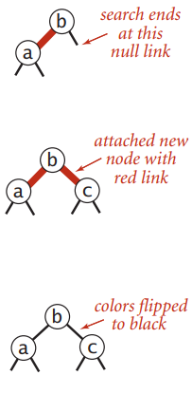
Example: Case 3 Subcase 1
Insert ‘c’

Slide 31
Case 3 Subcase 2
If the new key is smaller than the two keys in the tree and goes on the left link, then we have two red links in a row, both leaning to the left, which can be reduced to subcase 1 by rotating the top link to the right.

Slide 32
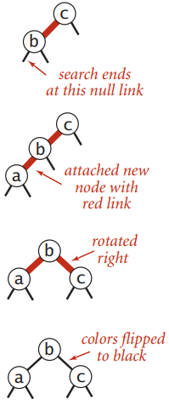
Example: Case 3 Subcase 2
Insert ‘a’

Slide 33
Case 3 Subcase 3
If the new key goes between the two keys in the tree, we again have two red links in a row, a right-leaning one below a left-leaning one, which can reduce to subcase 2 (two red links in a row, to the left) by rotating left the bottom link.

Slide 34
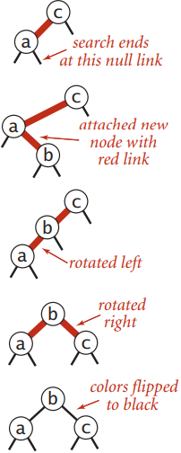
Example: Case 3 Subcase 3
Insert ‘b’

Slide 35
Keeping the root Black
A red root implies that the root is part of a 3-node, however this is not the case, so after each insertion, we color the root black.
Observe that the black height of the tree increases by 1 whenever the color of the root is flipped from black to red.

Slide 36
Case 4: Insert into a 3-node at the bottom
In this case, the same three subcases arise.
1) The new link is connected to the right link of the 3-node
We simply flip colors
2) The new link is connected to the left link of the 3-node
We rotate the top link right and flip colors
3) The new link is connected to the middle link of the 3-node
We rotate the bottom link left, then rotate the top link right, then flip colors.

Slide 37
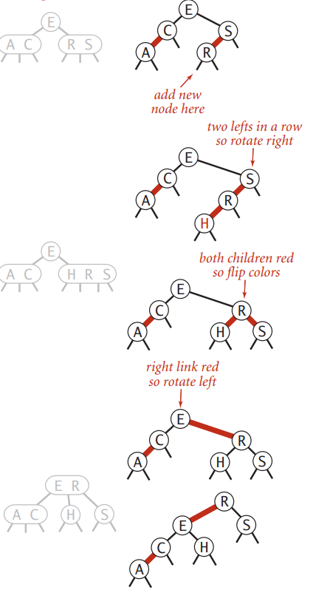
Example: Case 4
Insert H

Slide 38
Summary
We can maintain our 1-1 correspondence between 2-3 trees and red-black BSTs during insertion through judicious use of the following operations:
Left rotations/Right rotations
Color flip
Insertion is accomplished by performing the following operations, one after the other, on each node, as we pass up the tree:
If the right child is red and the left child is black, rotate left
If both the left child and its left child are red, rotate right
If both children are red, flip colors.

Slide 39
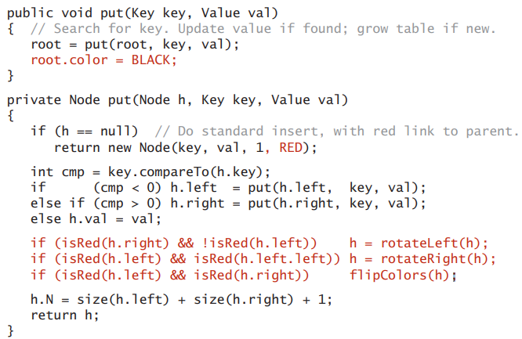
Red-Black BST Put Function
Identical to BST code
Rotates left any right-leaning 3-node (or right-leaning red link at the bottom of a temporary 4-node)
Rotates right the top link in a temporary 4-node with two left-leaning red links
Flips colors to pass a red link up the tree

Slide 40
Project Hints

Slide 41
So yeah… there’s a project
PHEWWWW!!! That was a lot… let’s get into the juicy stuff now!!
Unfortunately, with all programming classes, there are projects… but BSTs are fun!!

Slide 42
Codespace Error
If you are getting the following error:
"General error during semantic analysis: Unsupported class file major version 61“
This means you are missing the Dockerfile, to fix this error, add the following to your repository:
https://github.com/PittCS1501/devcontainer1501
Then you will need to restart your Codespace once the files are added.

Slide 43
Adding your sanity Checks in App.java
Whenever you run ./gradlew run, App.java is also run.
I highly recommend that you write more explicit tests in this file.

Slide 44

Hints for Height Function
Let$lh$be the height of the left subtree
Let $rh$ be the height of the right subtree
Then, the height of the BST will be the $1+max⁡(lh,rh),$why?

Slide 45
Live Example

Slide 46
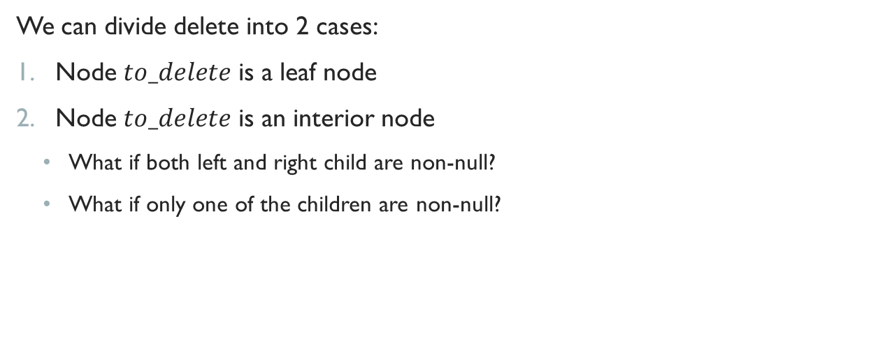
Hints for Delete Function
We can divide delete into 2 cases:
Node $to_delete$ is a leaf node
Node $to_delete$ is an interior node
What if both left and right child are non-null?
What if only one of the children are non-null?

Slide 47
Live Example

Slide 48
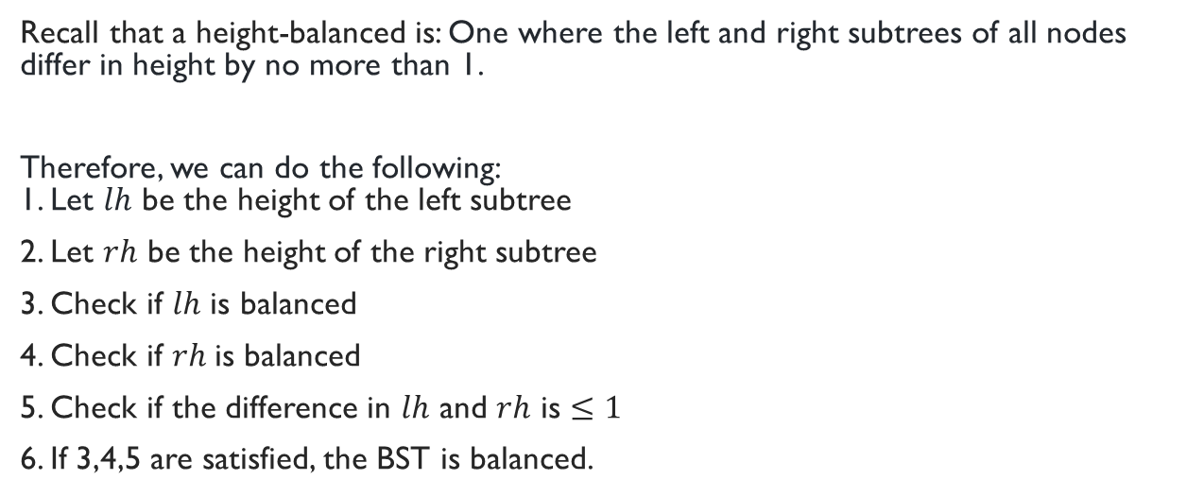
Hint for IsBalanced Function
Recall that a height-balanced is: One where the left and right subtrees of all nodes differ in height by no more than 1.
Therefore, we can do the following: 1. Let $lh$ be the height of the left subtree
2. Let $rh$ be the height of the right subtree
3. Check if $lh$ is balanced
4. Check if $rh$is balanced
5. Check if the difference in $lh$ and $rh$ is $≤1$
6. If 3,4,5 are satisfied, the BST is balanced.

Slide 49
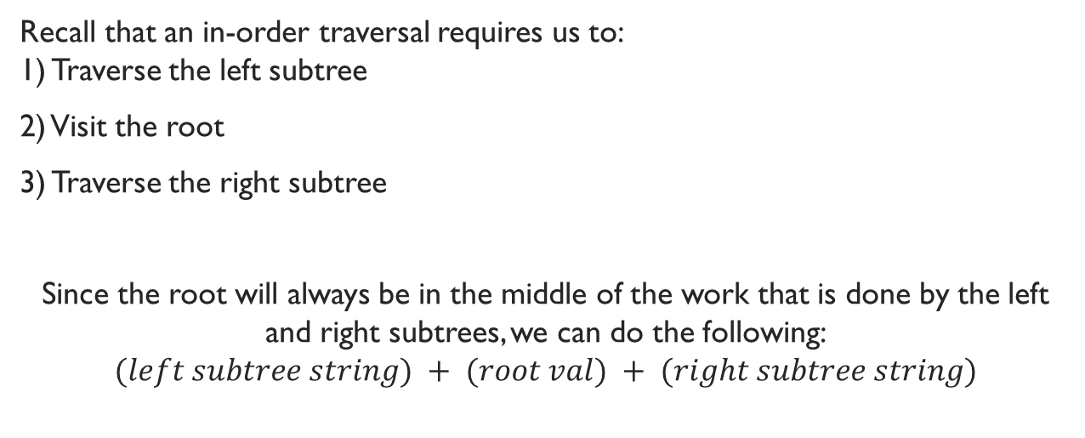
Hint for In-Order Traversal
Recall that an in-order traversal requires us to: 1) Traverse the left subtree
2) Visit the root
3) Traverse the right subtree
Since the root will always be in the middle of the work that is done by the left and right subtrees, we can do the following: $$(left subtree string) + (root val) + (right subtree string)$$

Slide 50
Live Example

Slide 51
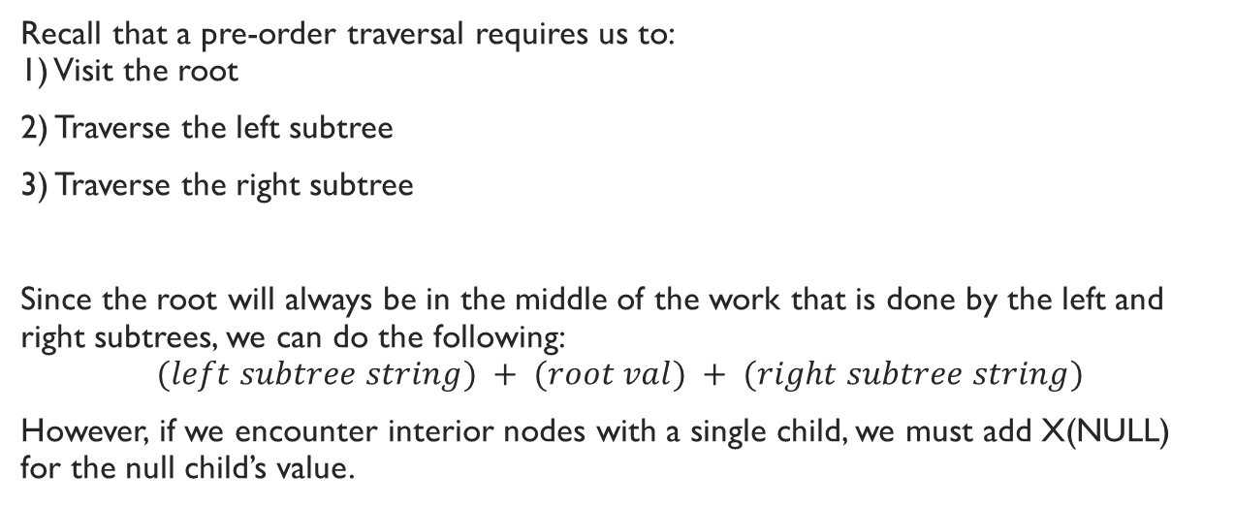
Hint for Serialize Function
Recall that a pre-order traversal requires us to: 1) Visit the root
2) Traverse the left subtree
3) Traverse the right subtree
Since the root will always be in the middle of the work that is done by the left and right subtrees, we can do the following: $$(left subtree string) + (root val) + (right subtree string)$$
However, if we encounter interior nodes with a single child, we must add X(NULL) for the null child’s value.

Slide 52
Live Example

