Slide 1
CS 1501: Algorithm Analysis
Gordon Lu

Slide 2
A brief note on these slides
Visually, slides don’t look the most appealing….
Work best in present mode! Each algorithm is animated, so all the messy stuff is from all the animations…

Slide 3
Metrics
Engineering Effort: How difficult it is to implement?
Runtime: How much time does your program take?
Space: How intensive is your program on memory?

Slide 4
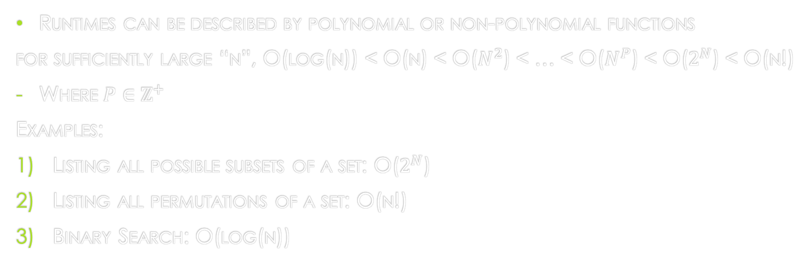
Simple orders of growth
Runtimes can be described by polynomial or non-polynomial functions
for sufficiently large “n”, O(log(n)) < O(n) < O($N^{2}$) < … < O($N^{P}$) < O($2^{N}$) < O(n!)
Where $P∈ℤ^{+}$
Examples:
Listing all possible subsets of a set: O($2^{N}$)
Listing all permutations of a set: O(n!)
Binary Search: O(log(n))

Slide 5
Asymptotic Performance
Typically, we drop lower order terms and constants.
Dropping lower order terms is regarded as a Tilde Approximation.
For example, binary search is Log base 2 of n, but the base of the logarithm is a constant, so we just stick with the typical log(n) as the runtime.

Slide 6
Some definitions
Big O: a set of functions that are the upper bound of a given function n.
The least upper bound of this set is typically what we say with Big O.
Big Omega: A set of functions that are the lower bound of a given function n.
The greatest lower bound of this set is typically what we say with Big Omega.
Big Theta: Occurs where big O and Big Omega Converge.

Slide 7
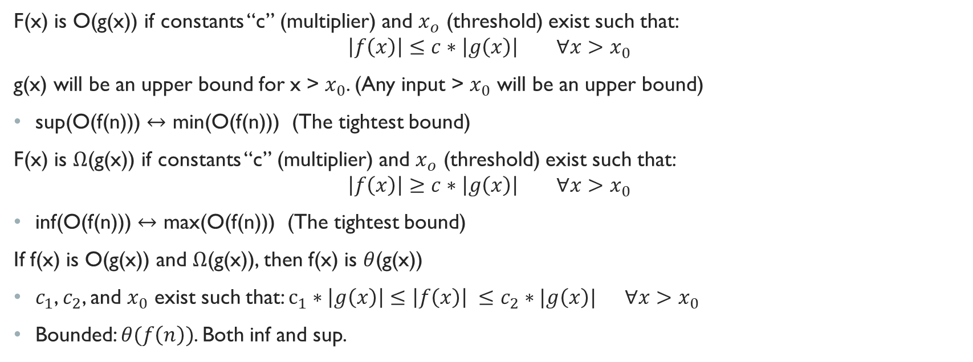
Formal Definitions
F(x) is O(g(x)) if constants “c” (multiplier) and $x_{o}$ (threshold) exist such that:
$$\left|f\left(x\right)\right|≤c∗\left|g\left(x\right)\right| ∀x>x_{0}$$
g(x) will be an upper bound for x > $x_{0}$. (Any input > $x_{0}$ will be an upper bound)
sup(O(f(n))) $↔$ min(O(f(n))) (The tightest bound)
F(x) is $Ω$(g(x)) if constants “c” (multiplier) and $x_{o}$ (threshold) exist such that:
$$\left|f\left(x\right)\right|≥c∗\left|g\left(x\right)\right| ∀x>x_{0}$$
inf(O(f(n))) $↔$ max(O(f(n))) (The tightest bound)
If f(x) is O(g(x)) and $Ω$(g(x)), then f(x) is $θ$(g(x))
$c_{1}$, $c_{2}$, and $x_{0}$ exist such that: $c_{1}∗\left|g\left(x\right)\right|≤\left|f\left(x\right)\right| ≤c_{2}∗|g\left(x\right)| ∀x>x_{0}$
Bounded: $θ(f\left(n\right))$. Both inf and sup.

Slide 8
Sorting
Given a collection of items, sort all the items in a specific order.
Can be ascending/descending, alphabetically, numerically!

Slide 9
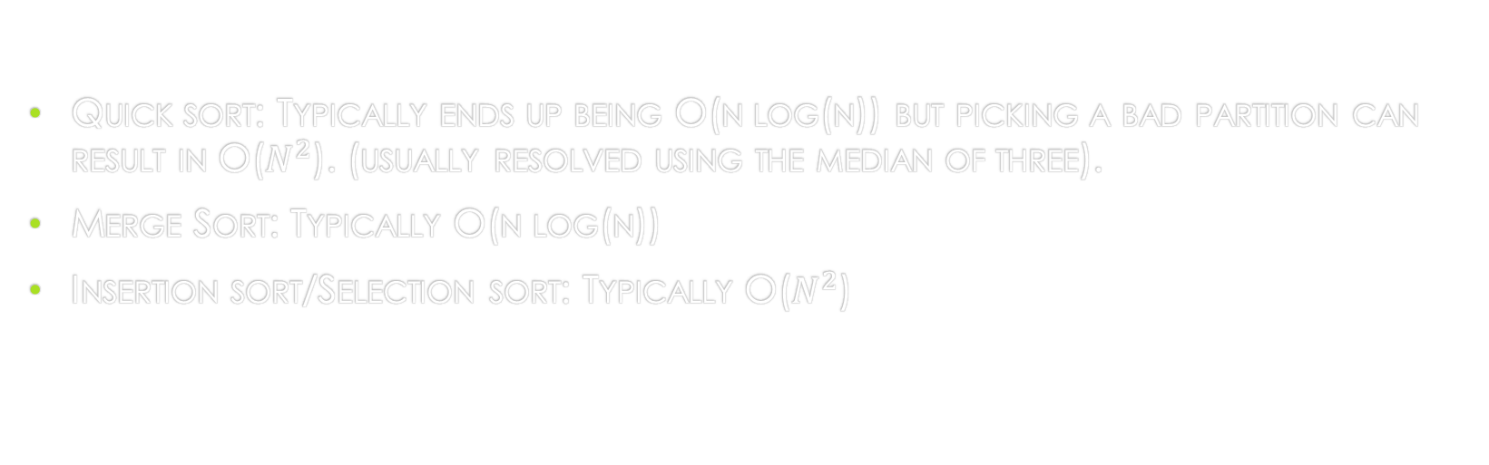
Quick Review
Quick sort: Typically ends up being O(n log(n)) but picking a bad partition can result in O($N^{2}$). (usually resolved using the median of three).
Merge Sort: Typically O(n log(n))
Insertion sort/Selection sort: Typically O($N^{2}$)

Slide 10
What are the similarities?
Well, they all require direct comparisons along elements in the collection, so you’ll always have that linear term.
Thus, we’ll regard this class of sorting algorithms as: Comparison based.

Slide 11
A corollary
The best a comparison-based sorting algorithm can perform in is O(n log(n))

Slide 12
Non-comparison-based Sorting
What if we tried something else?
Suppose we have a collection of integers n
Each have up to k digits.
What if we incrementally sorted the items by digit, then plopped them back, and sorted by the next digit….
…from LSD to MSD…
This is LSD Radix Sort.
(MSD Radix Sort is a bit tougher, so let’s just skip it ;))

Slide 13
LSD Radix Sort: Example
Let’s try to sort the following collection of items:
[12, 103, 212, 23, 3, 113, 121, 200]

Slide 14
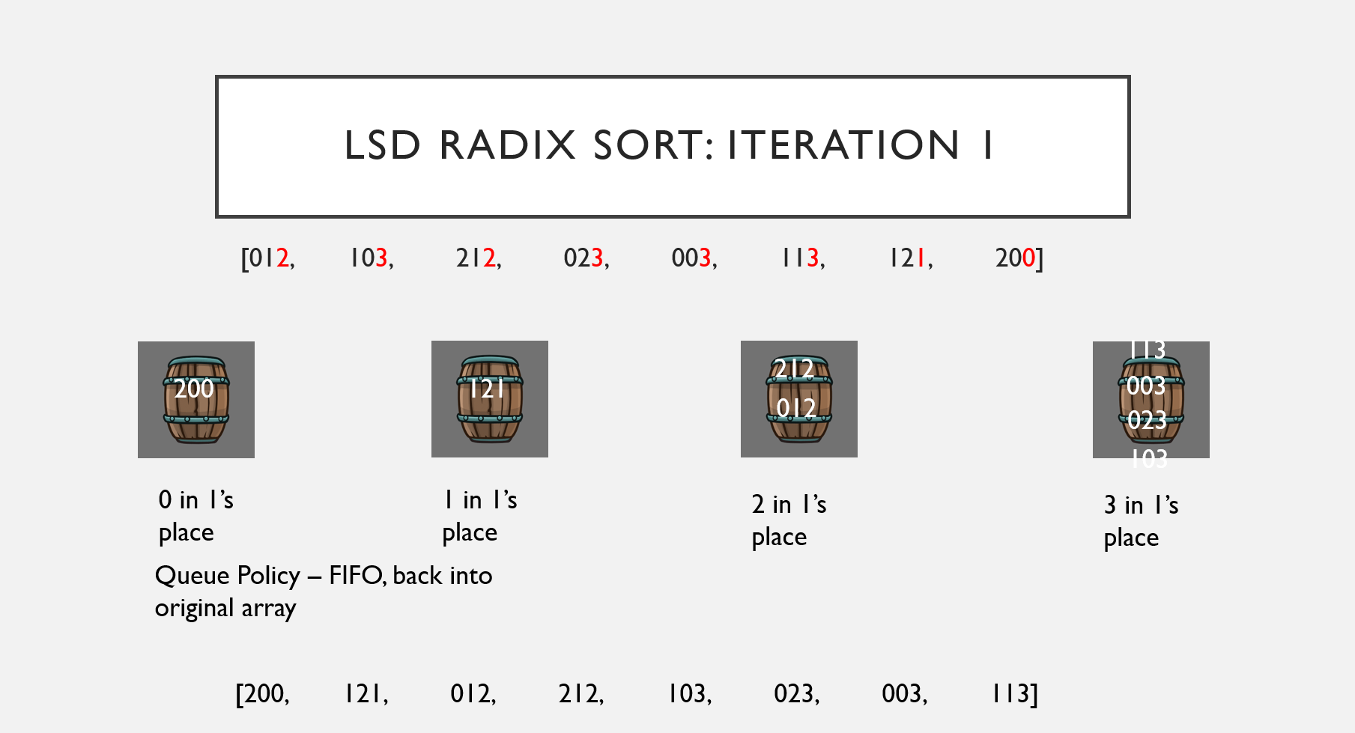
lSD RADIX SORT: Iteration 1
[012, 103, 212, 023, 003, 113, 121, 200]
113
212
200
121
003
012
023
103
0 in 1’s place
1 in 1’s place
2 in 1’s place
3 in 1’s place
Queue Policy – FIFO, back into original array
[200, 121, 012, 212, 103, 023, 003, 113]

Slide 15
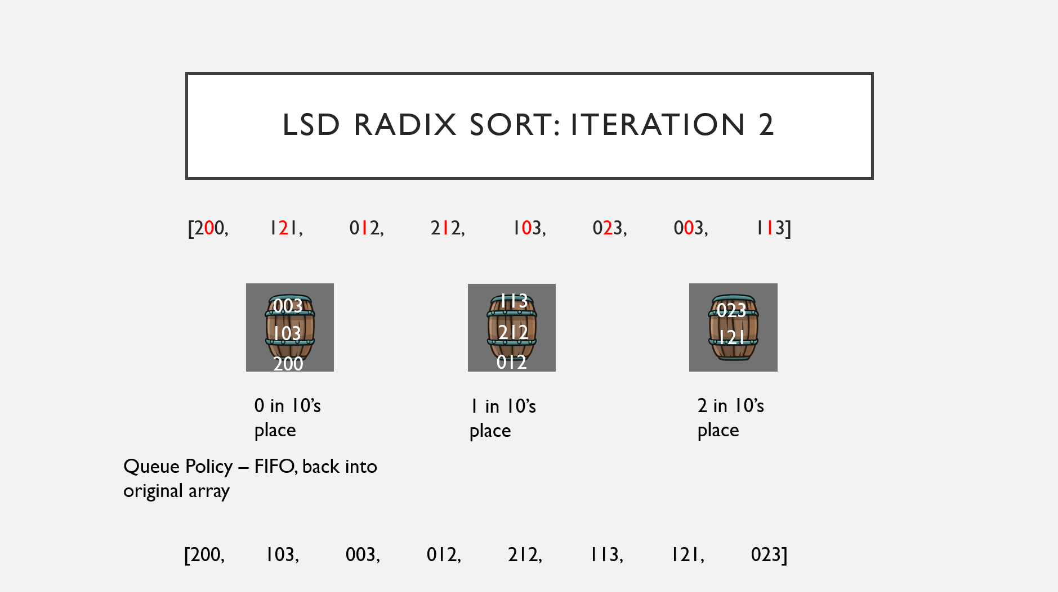
lSD RADIX SORT: Iteration 2
[200, 121, 012, 212, 103, 023, 003, 113]
003
113
023
103
212
121
200
012
0 in 10’s place
1 in 10’s place
2 in 10’s place
Queue Policy – FIFO, back into original array
[200, 103, 003, 012, 212, 113, 121, 023]

Slide 16
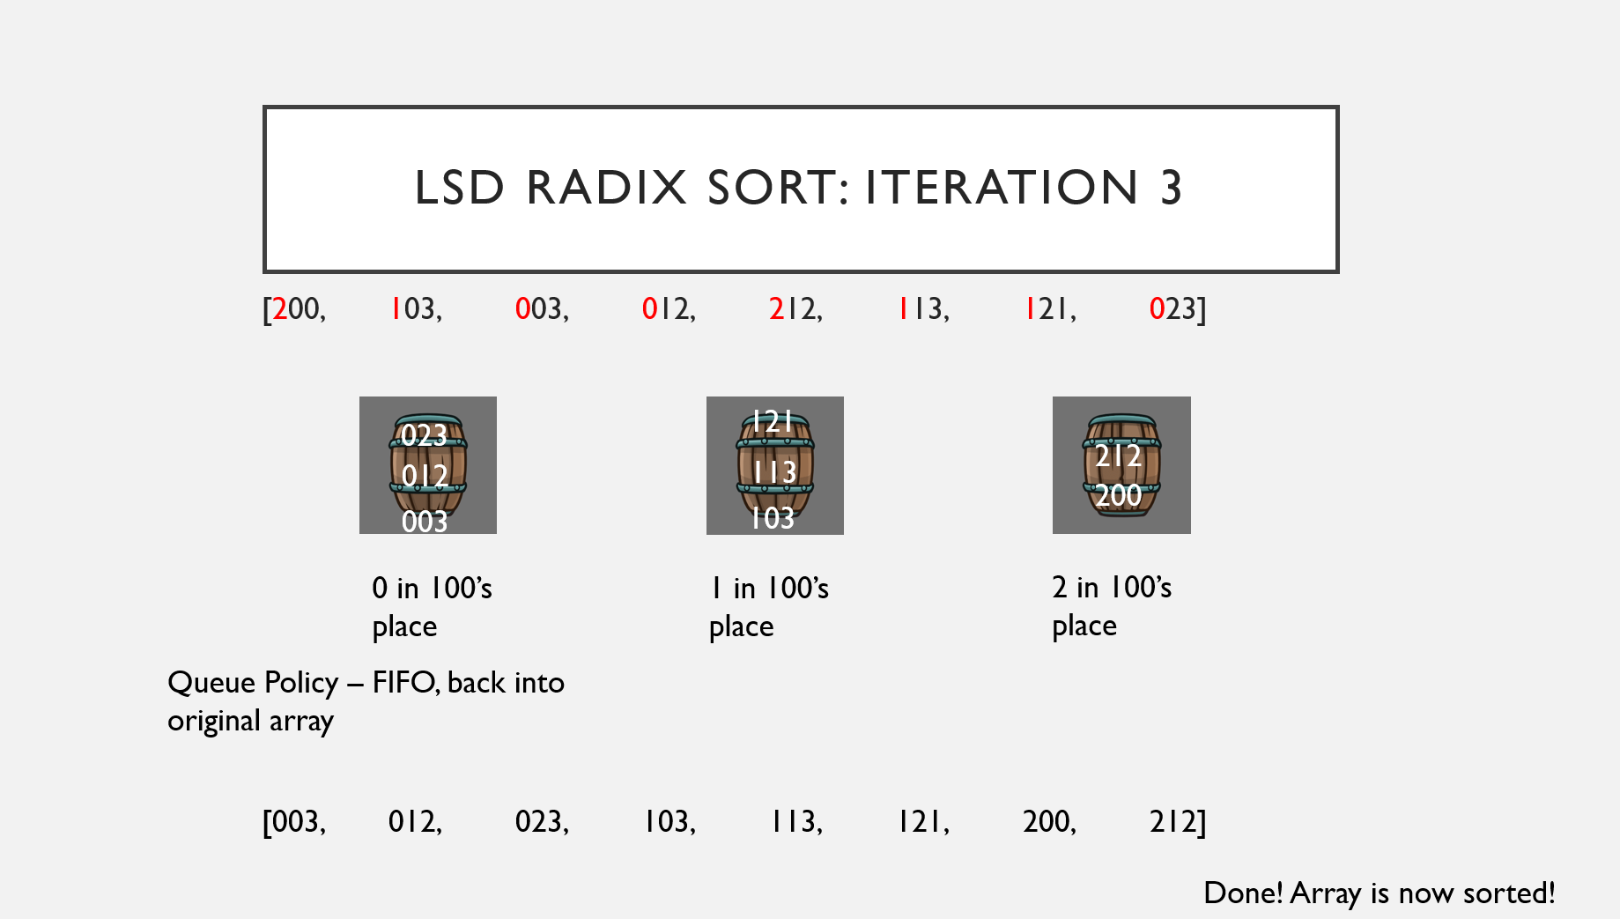
lSD RADIX SORT: Iteration 3
[200, 103, 003, 012, 212, 113, 121, 023]
023
121
113
212
012
200
003
103
0 in 100’s place
1 in 100’s place
2 in 100’s place
Queue Policy – FIFO, back into original array
[003, 012, 023, 103, 113, 121, 200, 212]
Done! Array is now sorted!

Slide 17

So… What’s the Runtime?
Let w be the width of the largest digit in our collection.
Thus, the runtime is: $θ(wn)$

Slide 18
Uh, okay, but how does this compare to n log n
This boils down to a PRACTICAL Improvement, not an ASYMPTOTIC Performance.
Suppose we have 1,000 items in a collection, and 3-digit numbers
Is it possible to have 1001 distinct values for 3-digit numbers? Nope.
So…for log(n) to increase beyond w, we need to allow duplicates.

Slide 19
Thus, we have the following:
If there are distinct values, log(n) can be at most equal to w.
If the collection contains less than the max number of distinct values for whatever w is, log(n) will be practically lower than w.

Slide 20
In-Place/Stability of Algorithms
An In-Place Algorithm is an algorithm that does not require additional memory.
A Stable Algorithm is an algorithm that maintains relative ordering.

Slide 21
Radix Sort: In-Place/Stability
Radix Sort is not In-Place: We must move items into an auxiliary Array, then copy back.
Radix Sort is Stable, as it maintains the relative ordering among digits to not lose much work.

