Slide 1
CS 1501: Searching
Gordon Lu

Slide 2
A brief note on these slides
Visually, slides don’t look the most appealing….
Work best in present mode!

Slide 3
The classic Search Problem
Given a collection of items, how do we search for a value, with a given key?

Slide 4
A recap of Operations on some Data Structures
We will be considering the operations: Insert and Search.

Slide 5
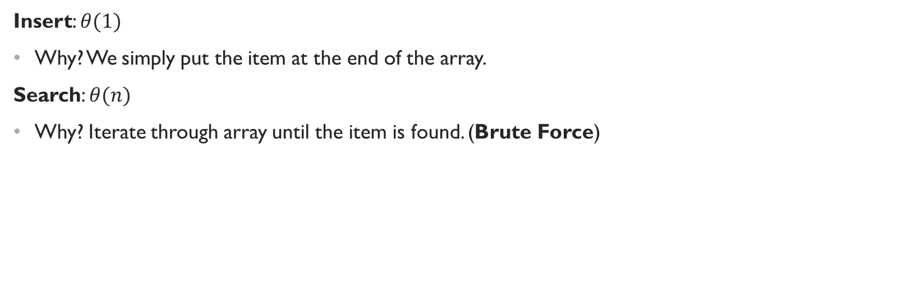
Unsorted Array
Insert: $θ(1)$
Why? We simply put the item at the end of the array.
Search: $θ(n)$
Why? Iterate through array until the item is found. (Brute Force)

Slide 6
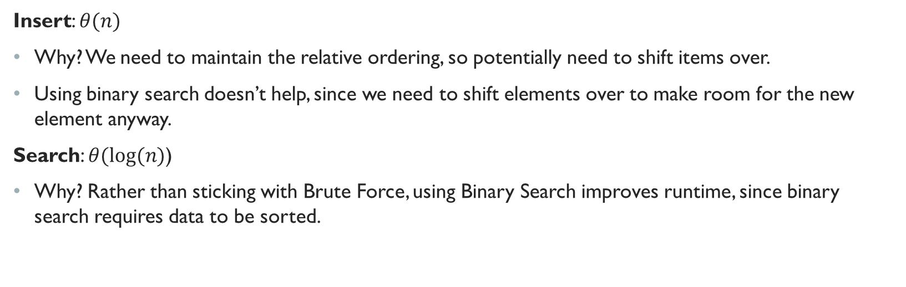
sorted Array
Insert: $θ(n)$
Why? We need to maintain the relative ordering, so potentially need to shift items over.
Using binary search doesn’t help, since we need to shift elements over to make room for the new element anyway.
Search: $θ(log⁡(n)$)
Why? Rather than sticking with Brute Force, using Binary Search improves runtime, since binary search requires data to be sorted.

Slide 7
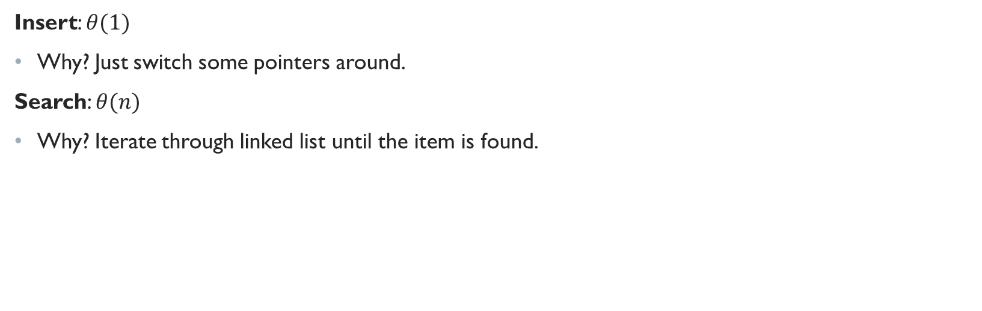
Unsorted Linked list
Insert: $θ(1)$
Why? Just switch some pointers around.
Search: $θ(n)$
Why? Iterate through linked list until the item is found.

Slide 8
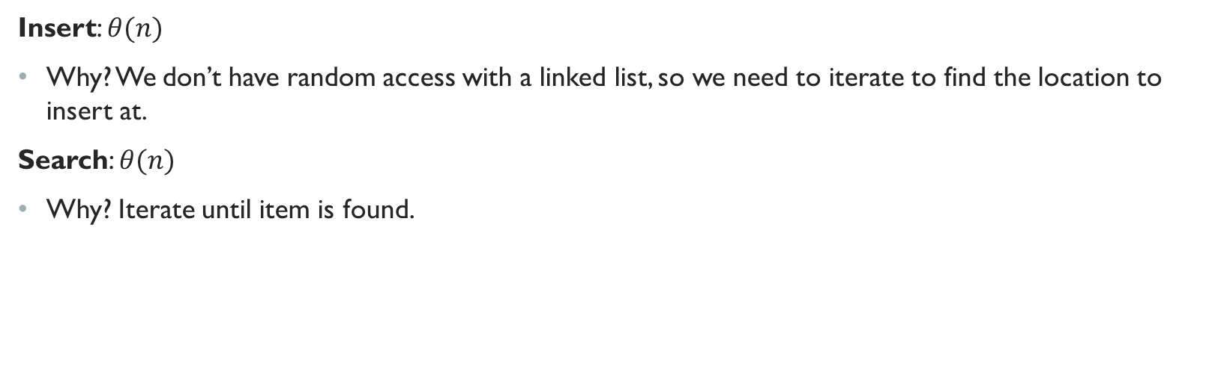
sorted Linked list
Insert: $θ(n)$
Why? We don’t have random access with a linked list, so we need to iterate to find the location to insert at.
Search: $θ(n)$
Why? Iterate until item is found.

Slide 9
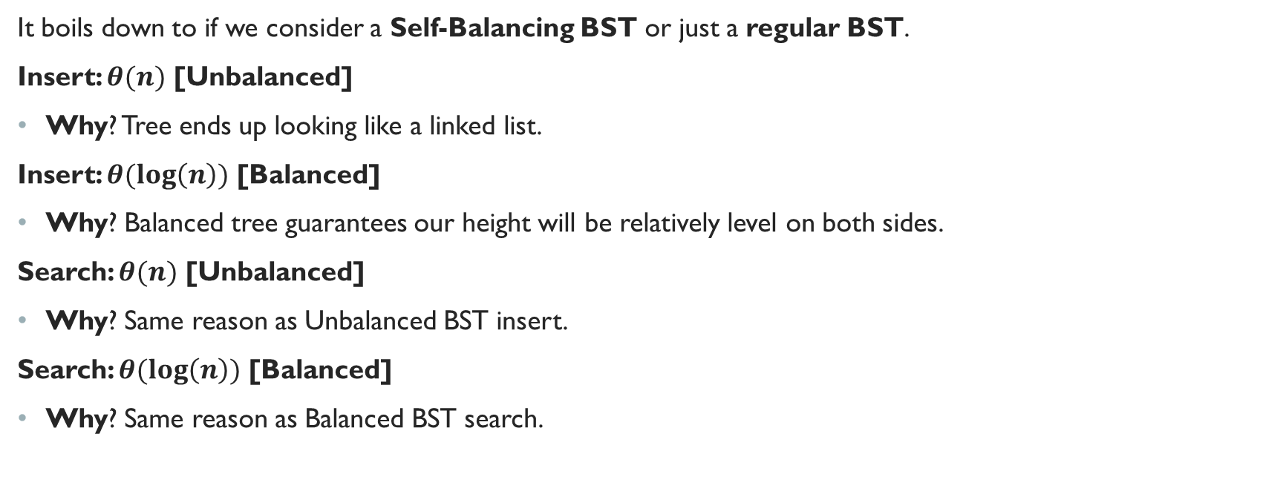
Binary Search Tree (BST)
It boils down to if we consider a Self-Balancing BST or just a regular BST.
Insert: $θ(n)$ [Unbalanced]
Why? Tree ends up looking like a linked list.
Insert: $θ(\log\left(n\right))$ [Balanced]
Why? Balanced tree guarantees our height will be relatively level on both sides.
Search: $θ(n)$ [Unbalanced]
Why? Same reason as Unbalanced BST insert.
Search: $θ(\log\left(n\right))$ [Balanced]
Why? Same reason as Balanced BST search.

Slide 10
Something New… Symbol Tables!
A Symbol Table is an Abstract Data Type that links keys to values
(In java, this is a Map!!!)
The Key is used to search for a Value!
It’s like the index in an array!!
A Symbol Table is like an Interface!!
Applications:
Dictionaries!
Histograms!

Slide 11
Symbol Tables: Key Functions
put(): Adds a new key-value pair
contains(): Membership operation, checks if there is a key in the symbol table. If so, what value is associated with it?
Any solution to the search problem can be solved using a Symbol Table!
So.. an Array, Linked List, BST, etc… can be represented using a Symbol Table!

Slide 12
Binary Search Tree: Review
For every node we traverse to in a BST, we have the following decisions:
If the node traversed to is NULL, the key is not found.
If the key is equal to the current node’s key, we found the key.
If the key is less than the current node’s key, go to the left child.
If the key is greater than the current node’s key, go to the right child.

Slide 13
Remember the discussion of Comparison vs. Non-comparison?
So… it turns out all the data structures presented so far revolve around direct comparisons against keys...
Is there a way we could make searching faster by using a method like Radix Sort?

Slide 14
Enter: Digital Search Trees (Dst)
So, instead of comparing with less than/greater thans, let’s decide based on the current bit of the key…
So, we’ll have the following options:
First two options are the same as BST…
If current bit of key == 0, go left
If current bit of key == 1, go right

Slide 15
DST example
Let’s assume we have 4-bit integers and going from MSB to LSB
Let’s try to insert the following numbers:
4
4-bit representation: 0100
3
4-bit representation: 0011
2
4-bit representation: 0010
6
4-bit representation: 0110
5
4-bit representation: 0101

Slide 16
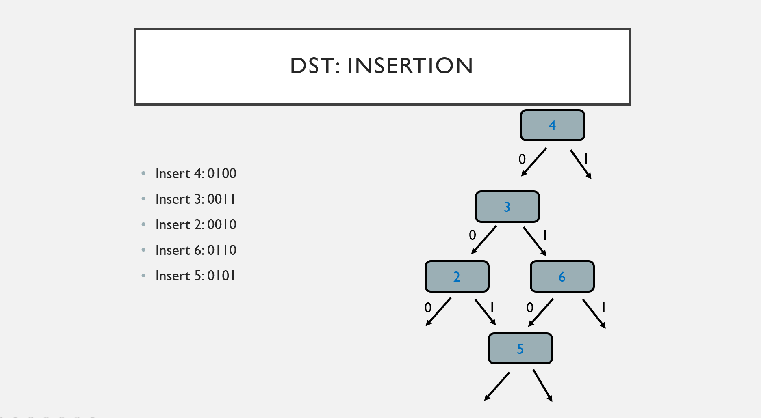
DST: Insertion
4
0
1
Insert 4: 0100
Insert 3: 0011
Insert 2: 0010
Insert 6: 0110
Insert 5: 0101
3
0
1
2
6
0
1
0
1
5
0
1

Slide 17
DST Search:
Now suppose we want to search for the following:
3
4-bit representation: 0011
7
4-bit representation: 0111

Slide 18
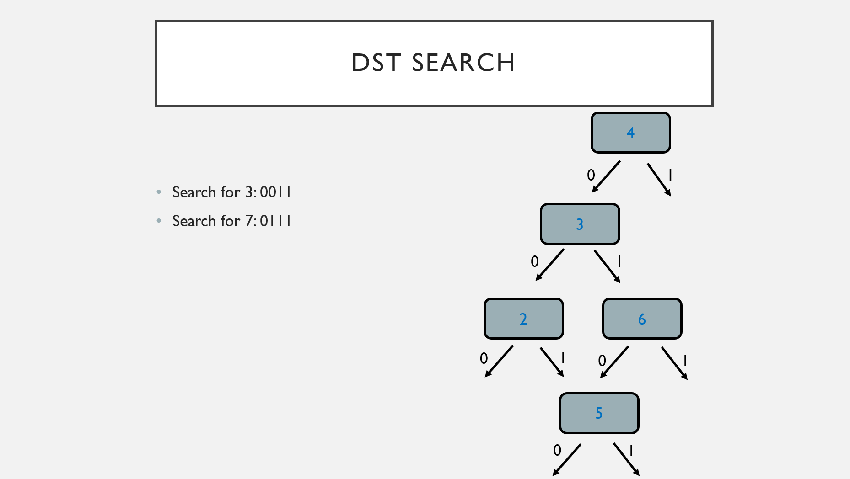
DST Search
3 = 4? NOPE
4
7 = 4? NOPE
0
1
Search for 3: 0011
Search for 7: 0111
3 = 3? YUP
7 = 3? NOPE
3
0
1
7 = 6? NOPE
2
6
0
1
0
1
NULL, not found
5
0
1

Slide 19
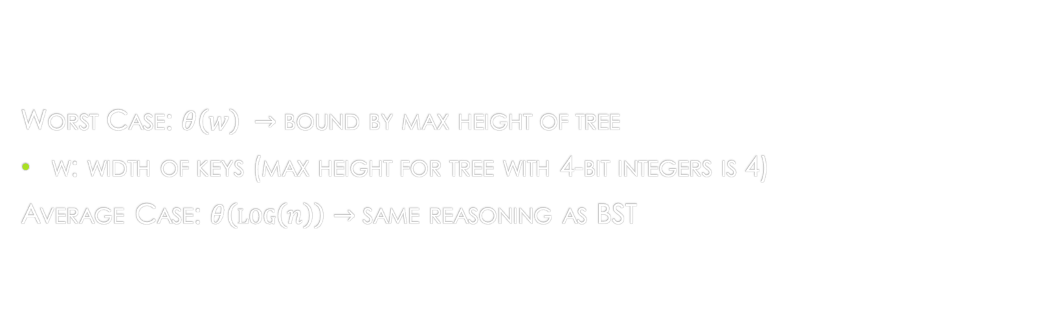
DST Analysis:
Worst Case: $θ\left(w\right) →$ bound by max height of tree
w: width of keys (max height for tree with 4-bit integers is 4)
Average Case: $θ\left(\log\left(n\right)\right)→$ same reasoning as BST

Slide 20
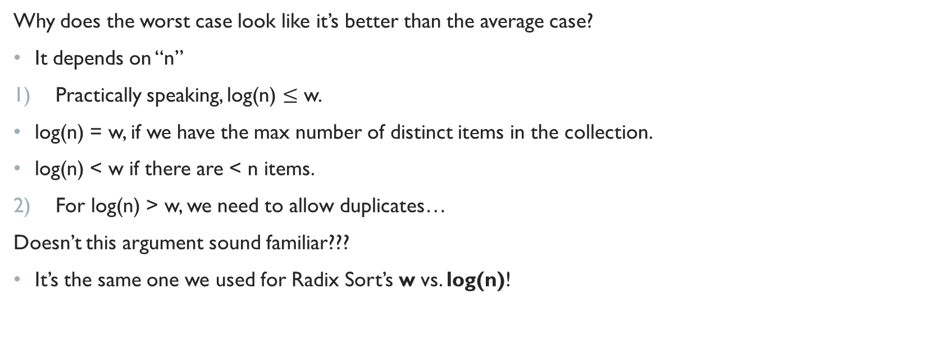
Wait a second…
Why does the worst case look like it’s better than the average case?
It depends on “n”
Practically speaking, log(n) $≤$ w.
log(n) = w, if we have the max number of distinct items in the collection.
log(n) < w if there are < n items.
For log(n) > w, we need to allow duplicates…
Doesn’t this argument sound familiar???
It’s the same one we used for Radix Sort’s w vs. log(n)!

Slide 21
Something’s Still troubling…
We still end up doing a lot of comparisons against the full key…
Can we do better?

Slide 22
Enter: Tries
Trie as in reTRIEve (pronounced “try”)
Here’s the idea:
Rather than storing keys as nodes in the tree, we store them implicitly as paths down the tree!
Interior nodes of the tree serve to navigate us based on the characters of the key
Values are then stored at the end of the key’s bit string path
What’s an Interior node?
Nodes that aren’t the root or leaves.

Slide 23
Radix Search Tries (RST)
Keys are bitstrings and are directed down a path based on the current bit of the key!
Same decisions are DST, but store values at the end of the path.

Slide 24
RST Example:
Let’s assume we have 4-bit integers and going from MSB to LSB
Let’s try to insert the following numbers:
4
4-bit representation: 0100
3
4-bit representation: 0011
2
4-bit representation: 0010
6
4-bit representation: 0110
5
4-bit representation: 0101

Slide 25
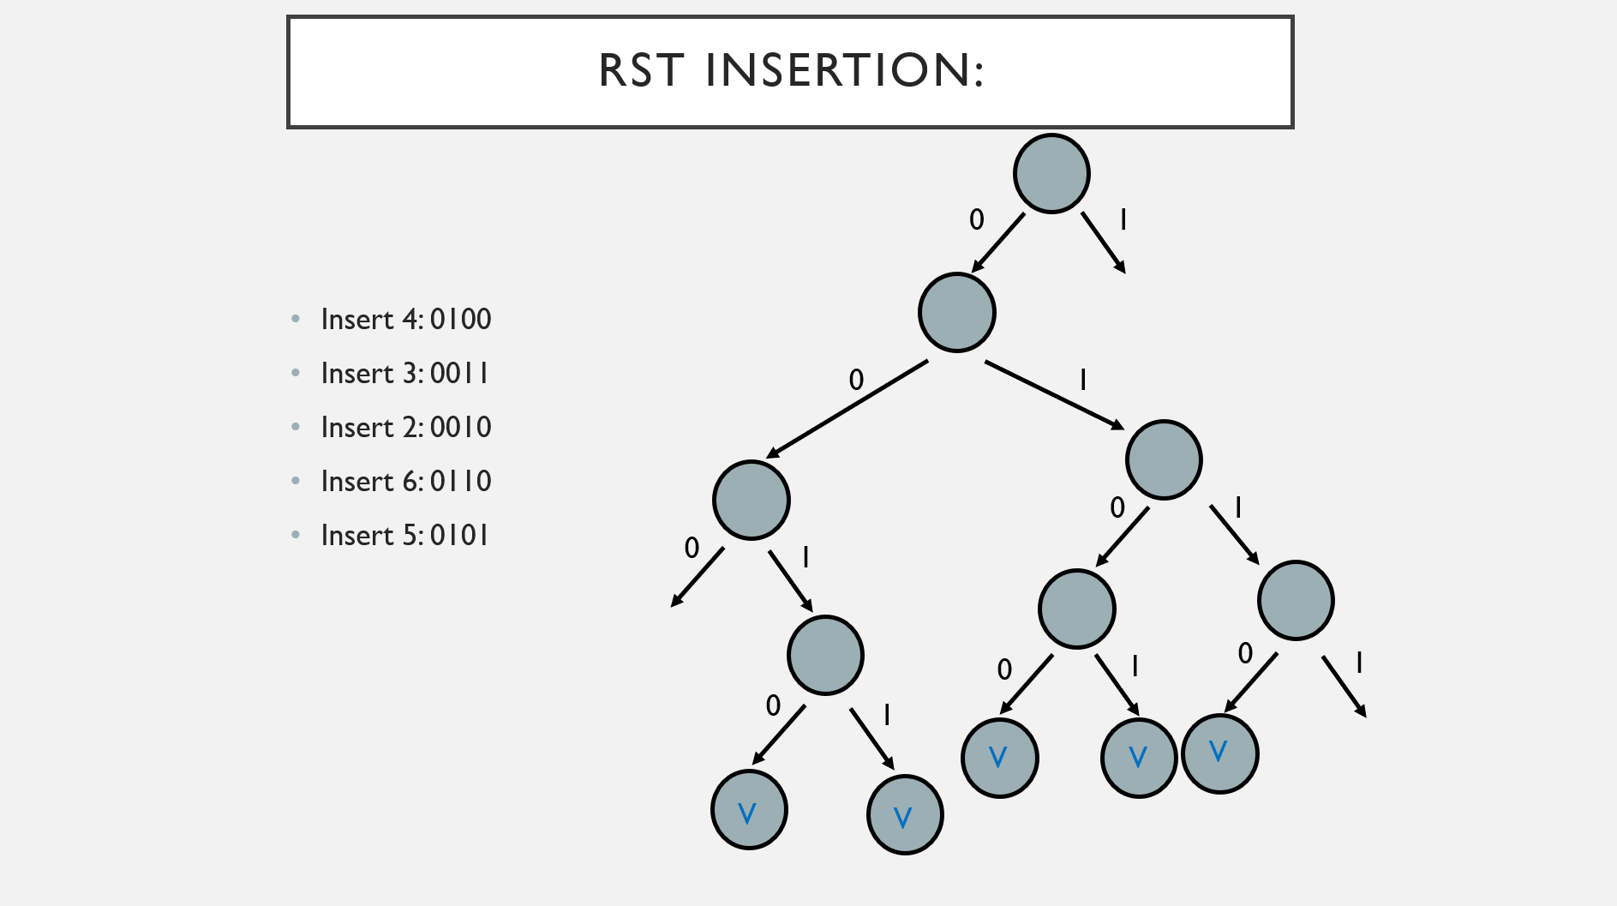
RST Insertion:
First bit 0: go left
First bit 0: go left
First bit 0: go left
First bit 0: go left
First bit 0: go left
0
1
Insert 4: 0100
Insert 3: 0011
Insert 2: 0010
Insert 6: 0110
Insert 5: 0101
Non-NULL, do nothing
Non-NULL, do nothing
Non-NULL, do nothing
Non-NULL, do nothing
NULL value, create node
2nd bit 1: go right
2nd bit 1: go right
2nd bit 1: go right
0
1
Non-NULL, do nothing
Non-NULL, do nothing
2nd bit 0: go left
NULL value, create node
2nd bit 0: go left
Non-null, do nothing
NULL value, create node
0
1
3rd bit 1: go right
3rd bit 0: go left
3rd bit 0: go left
3rd bit 1: go right
0
3rd bit 1: go right
NULL value, create node
1
Non-null, do nothing
NULL value, create node
4th bit 1: go right
Non-null, do nothing
4th bit 0: go left
NULL value, create node
4th bit 0: go left
0
0
1
1
0
4th bit 1: go right
4th bit 0: go left
1
V
V
V
NULL value, create node
NULL value, create node
V
V
End of path, store val
End of path, store val
End of path, store val
End of path, store val
End of path, store val
NULL value, create node
NULL value, create node
NULL value, create node

Slide 26
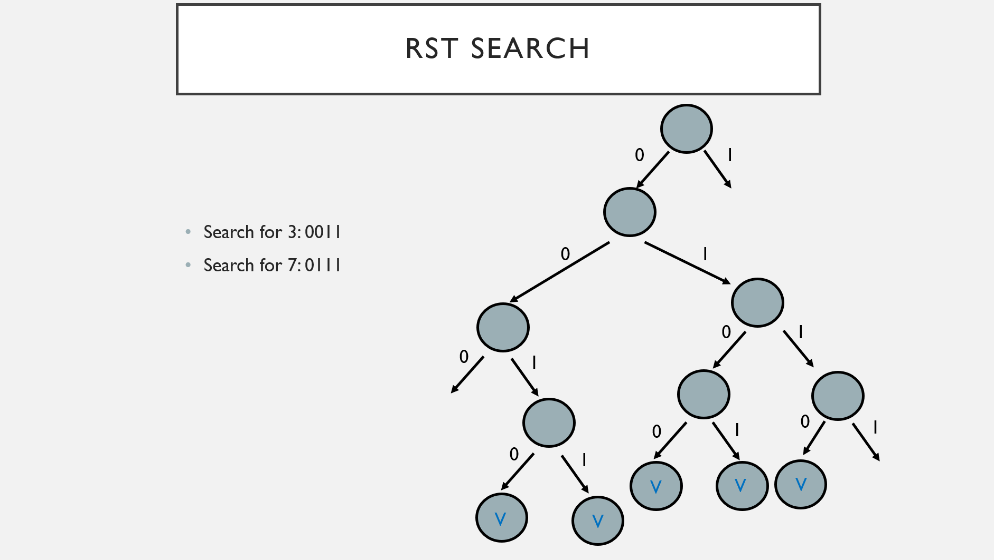
RST Search
0
1
First bit 0: go left
First bit 0: go left
2nd bit 0: go left
2nd bit 1: go right
Search for 3: 0011
Search for 7: 0111
0
1
0
1
3rd bit 1: go right
0
3rd bit 1: go right
1
4th bit 1: go right
0
1
0
1
0
4th bit 1: go right
1
V
V
V
V
V
End of path, null ref
Key found
Key not found
End of path, found val

Slide 27
But…
Oh no… what now??
Well, we’ve been working with numbers, but what about other data types?
Characters? Yup just convert the character to its ascii representation
How many Bits? 7.
Strings? I mean we could… but you’d end up with a VERY TALL TREE
Example: length-10 string requires 160 bits!

Slide 28
Enter: Large Branching Factor Tries
Instead of having 2 branches per node, have more branches based on a given alphabet!
Ex: English alphabet, 26 branches per node!
Consider the same approach as RST, but instead of going one bit at a time, go one char at a time instead

Slide 29
Large Branching factor trie: Example
Let’s try to insert the following strings:
She
Sells
Sea
Shells
By
The
Shore

Slide 30
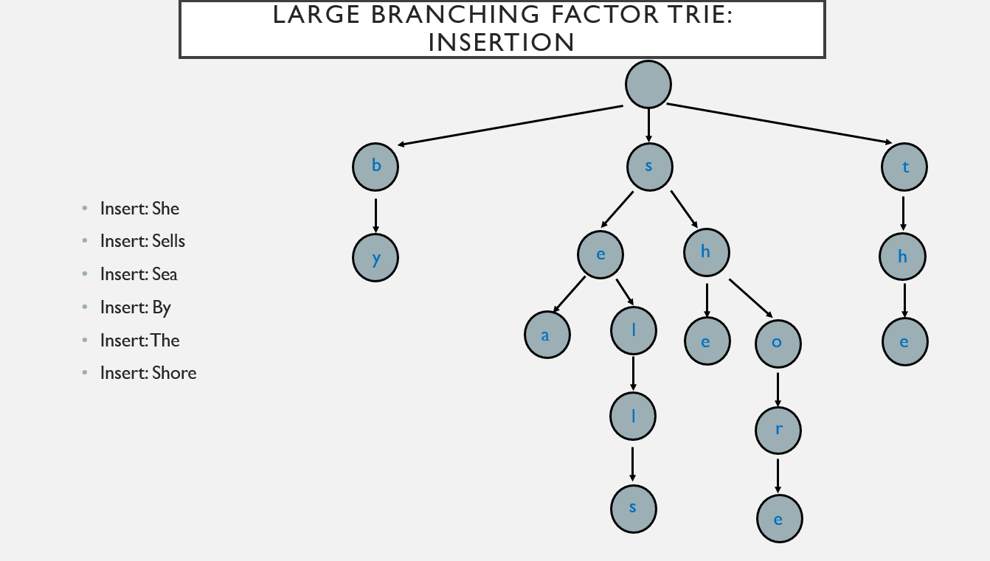
Large Branching Factor Trie: Insertion
Navigate to “b” ref
Navigate to “t” ref
Navigate to “s” ref
Navigate to “s” ref
Navigate to “s” ref
“b” ref null, create node
Navigate to “s” ref
Navigate to “y” ref
“t” ref null, create node
b
s
“s” ref null, create node
“s” ref not null, don’t do anything
“s” ref not null, don’t do anything
“s” ref not null, don’t do anything
t
Navigate to “e” ref
Navigate to “h” ref
Navigate to “e” ref
Insert: She
Insert: Sells
Insert: Sea
Insert: By
Insert: The
Insert: Shore
Navigate to “h” ref
Navigate to “h” ref
“y” ref null, create node
“h” ref null, create node
h
“h” ref null, create node
“e” ref not null, don’t do anything
e
“h” ref not null, don’t do anything
“e” ref null, create node
h
y
Navigate to “a” ref
Navigate to “l” ref
Navigate to “e” ref
Navigate to “e” ref
Navigate to “o” ref
“a” ref null, create node
“l” ref null, create node
l
a
e
o
e
“e” ref null, create node
Navigate to “l” ref
“e” ref null, create node
“o” ref null, create node
“l” ref null, create node
l
Navigate to “r” ref
r
Navigate to “s” ref
“r” ref null, create node
“s” ref null, create node
Navigate to “e” ref
s
e
“e” ref null, create node

Slide 31
Implementation Concerns: Tries
Two Approaches: Linked List or Array.
At a basic level, we need to at least have a node-representation.
The array-based node approach is referred to as a: R-way Trie
The linked list-based node approach is referred to as a: De La Briandais Trie

Slide 32
The R-way Trie: Implementation
Node object looks like the following:
private static class Rway_Node<T>{
private T val;
private Rway_Node<T>[] next = new Rway_Node[R];
}

Slide 33
The R-way Trie: In action
Let’s try to add she and shell into an R-way Trie

Slide 34
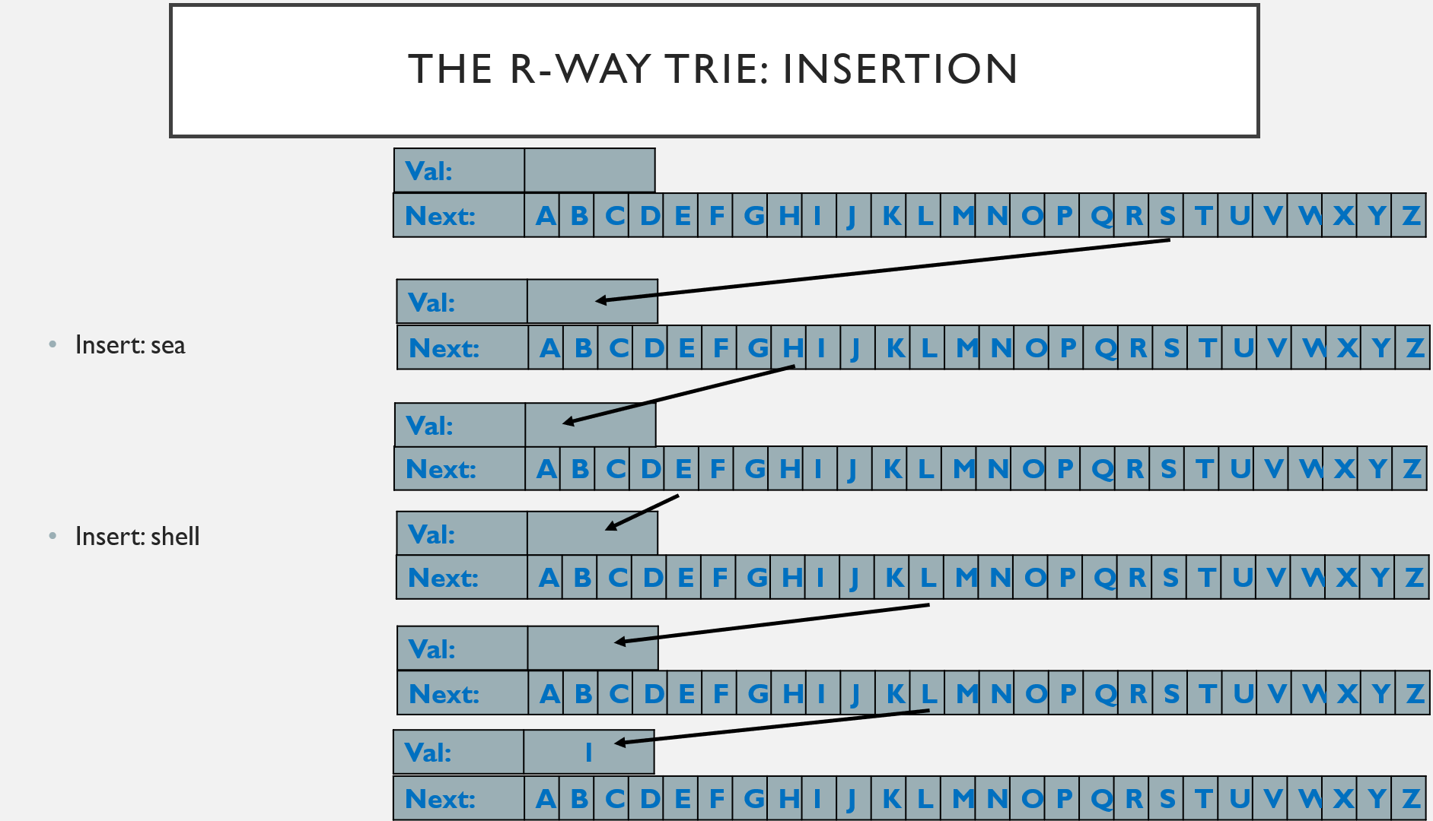
The R-Way Trie: Insertion
Val:
Val:
Next: | A | B | C | D | E | F | G | H | I | J | K | L | M | N | O | P | Q | R | S | T | U | V | W | X | Y | Z
Next: | A | B | C | D | E | F | G | H | I | J | K | L | M | N | O | P | Q | R | S | T | U | V | W | X | Y | Z
INSERT “S”
INSERT “S”
Val:
Val:
Insert: sea
Insert: shell
Next: | A | B | C | D | E | F | G | H | I | J | K | L | M | N | O | P | Q | R | S | T | U | V | W | X | Y | Z
Next: | A | B | C | D | E | F | G | H | I | J | K | L | M | N | O | P | Q | R | S | T | U | V | W | X | Y | Z
INSERT “E”
INSERT “H”
Val:
Val:
Next: | A | B | C | D | E | F | G | H | I | J | K | L | M | N | O | P | Q | R | S | T | U | V | W | X | Y | Z
Next: | A | B | C | D | E | F | G | H | I | J | K | L | M | N | O | P | Q | R | S | T | U | V | W | X | Y | Z
INSERT “E”
INSERT “A”
Val: | 0
Val:
Next: | A | B | C | D | E | F | G | H | I | J | K | L | M | N | O | P | Q | R | S | T | U | V | W | X | Y | Z
Next: | A | B | C | D | E | F | G | H | I | J | K | L | M | N | O | P | Q | R | S | T | U | V | W | X | Y | Z
INSERT “L”
Val:
Next: | A | B | C | D | E | F | G | H | I | J | K | L | M | N | O | P | Q | R | S | T | U | V | W | X | Y | Z
INSERT “L”
Val: | 1
Next: | A | B | C | D | E | F | G | H | I | J | K | L | M | N | O | P | Q | R | S | T | U | V | W | X | Y | Z

Slide 35
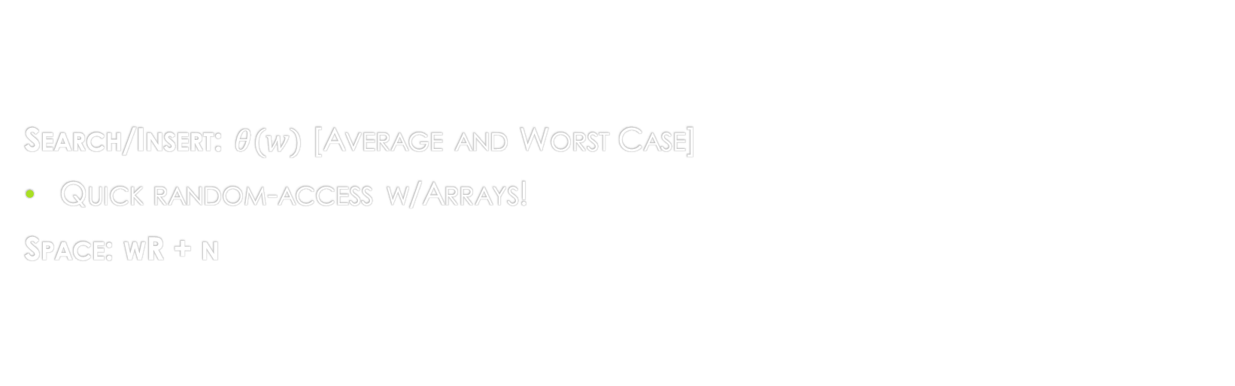
R-Way Trie analysis:
Search/Insert: $θ(w)$ [Average and Worst Case]
Quick random-access w/Arrays!
Space: wR + n

Slide 36
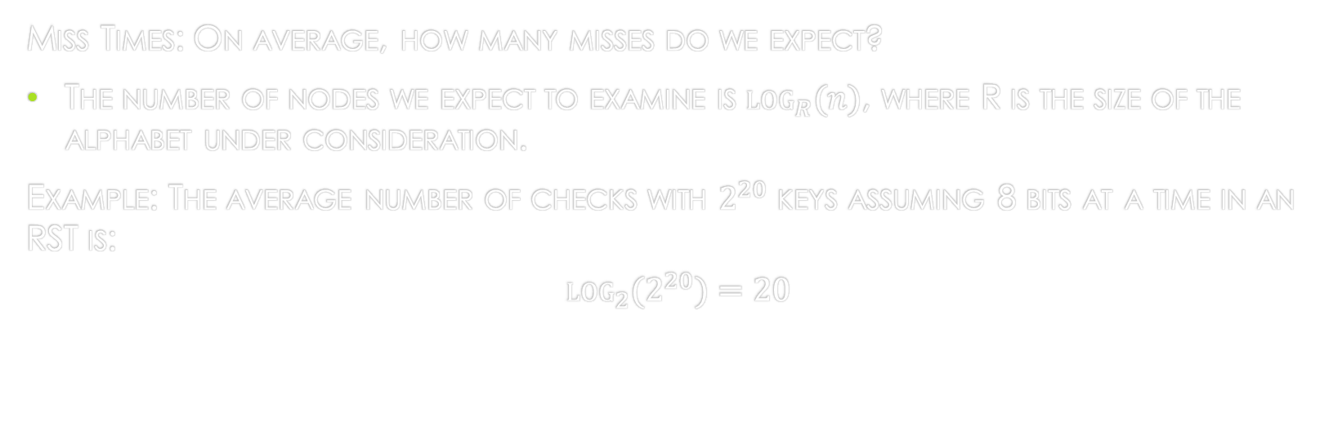
R-Way Trie Further Analysis
Miss Times: On average, how many misses do we expect?
The number of nodes we expect to examine is $\log_{R}{(n)}$, where R is the size of the alphabet under consideration.
Example: The average number of checks with $2^{20}$ keys assuming 8 bits at a time in an RST is:
$$\log_{2}{(2^{20})}=20$$

Slide 37
R-Way Trie vs RST Miss Times
R-way tries will have a lower miss time.
Why? Since our alphabet is longer, we can determine whether a key is a miss faster.
RSTs will require us to dive pretty deep to determine if we have a miss.

Slide 38
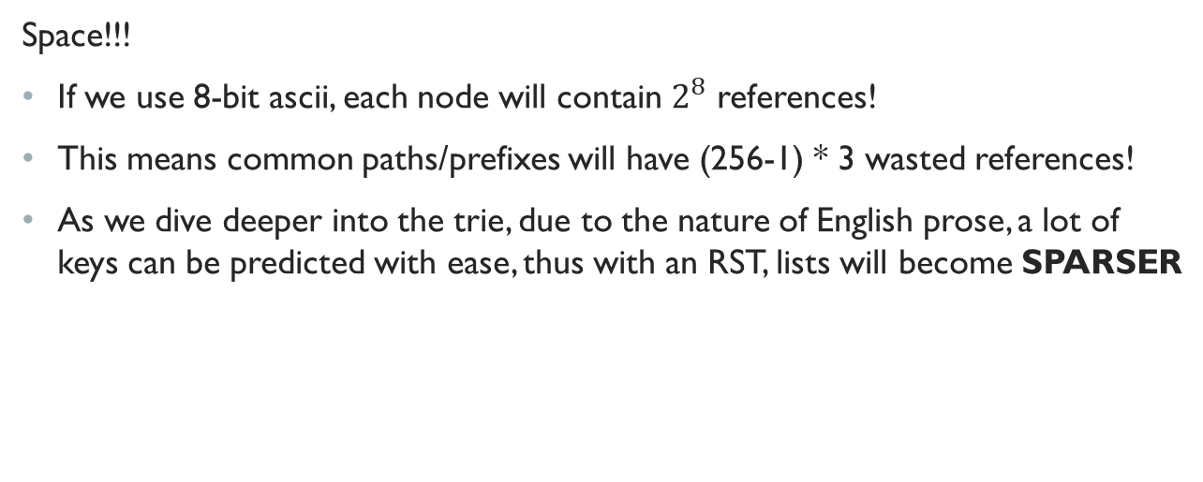
Are there any drawbacks of using a rst?
Space!!!
If we use 8-bit ascii, each node will contain $2^{8}$ references!
This means common paths/prefixes will have (256-1) * 3 wasted references!
As we dive deeper into the trie, due to the nature of English prose, a lot of keys can be predicted with ease, thus with an RST, lists will become SPARSER

Slide 39
Enter: De La Briandais Tries (DLB)
Node object looks like the following:
private static class DLB_Node<T>{
private T val;
private DLB_Node<T> child_node;
private DLB_Node<T> sibling_node;
}
A terminator character will indicate the end of a word!

Slide 40
De la Briandais Trie: Insertion
Append Terminator char to key to insert.
Ex: If we have “She”, we’ll insert “She$” into the DLB.
Navigate down If:
Char at curr node == Curr char of Key
Create new node if Child is NULL and not at end of word.
Navigate to Sibling if:
Char at curr node != Curr char of Key
Create new node if Sibling is NULL and not at end of word

Slide 41
DLB: Edge case
What about inserting the first word?
Just insert all vertically!

Slide 42
DLB In action
Let’s try to insert:
She
Sells
Sea
By
Let’s use ^ as the terminating character

Slide 43
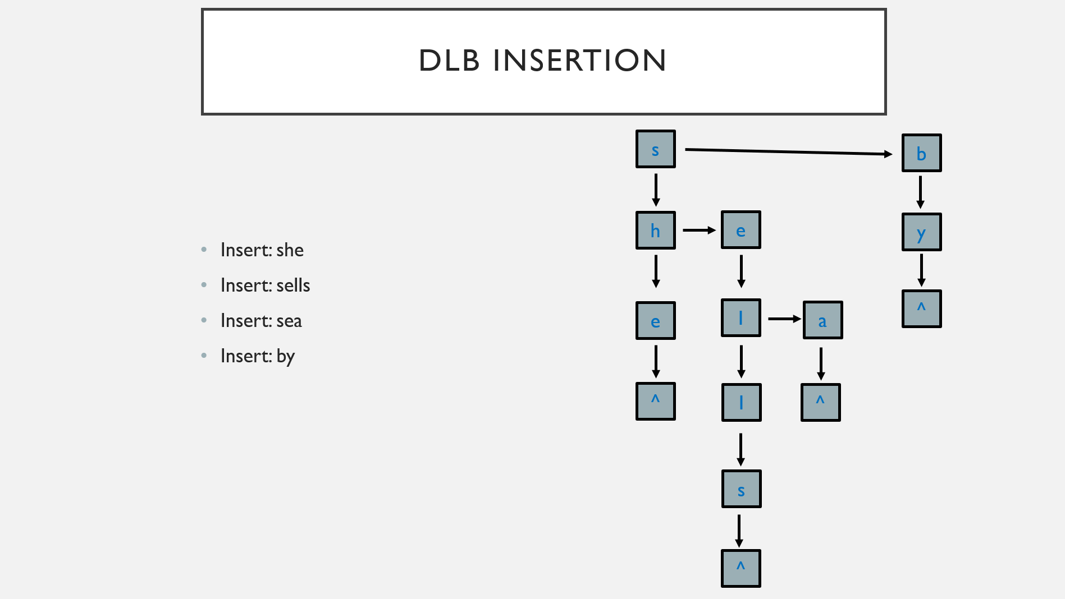
DLB Insertion
s == s, navigate down
b != s, check sibling
s == s, navigate down
s
b
Edge case!
Look at sibling
sibling null,
create sibling
Add vertically!
navigate down
node ref not null, but e != h
node ref not null, but e != h
sibling null, create
sibling
Sibling not null,
and e == e
h
e
child null, create
child
y
Look at sibling
Insert: she
Insert: sells
Insert: sea
Insert: by
navigate down
navigate down
navigate down
child null, create
child
^
child null, create
child
l
child non-null,
but a != l
e
a
Look at sibling
sibling null, create
sibling
navigate down
navigate down
child null, create
child
^
child null, create
child
l
^
navigate down
s
child null, create
child
navigate down
^
child null, create
child

Slide 44

DLB Analysis
Typically, runtime is: $θ(Rw)$

Slide 45
DLB vs. R-Way Trie
If data is sparse (Long and Non-discrete): DLB
Using very few references per node
If we use an R-way trie, we’ll end up with a lot of wasted references!
Essentially, the overhead for linked lists is minimized! (linked list chains very short)
If data is dense (Short and Random): R-way Trie
Using many references per node
Runtime of DLB is maximized
The wasted space of R-way tries are minimized

Slide 46
Hybrid Approach
What if we somehow combined the two approaches, so we could get the best of both worlds?
What would this look like?
For a small number of branches, use an RST, then switch to a DLB as the number of branches increases!
What’s the downside? Engineering Effort!

