Slide 1
CS 1501: B-trees
Gordon Lu

Slide 2
A brief note on these slides
Visually, slides don’t look the most appealing….
Work best in present mode!

Slide 3
An introduction to the problem
Most symbol table implementations assume <Key, Value> pairs will be stored in memory
But… what if we need to store it on disk?

Slide 4
A motivating Example
Suppose you’re writing a database to store records of online store transactions, each with a unique id…
Ideally, you’d want to store these records on disk
Why? You have a high expectation of a large volume of transaction records.
And… you want transaction records stored in non-volatile memory

Slide 5
A review of disk i/o
Data stored on disk is grouped in 4kb blocks (pages)
Disk i/o is performed at the block level
In order to read a file from disk, the OS will fetch all blocks that store some portion of that file and read the data from each block.

Slide 6
Enter: B-Trees
You can Kind of think of a B tree as a Generalized BST.
Rather than being a limited to a branching factor of 2, there’s no real limit to the number of branches.
The order of a b-tree determines the max branching factor.

Slide 7
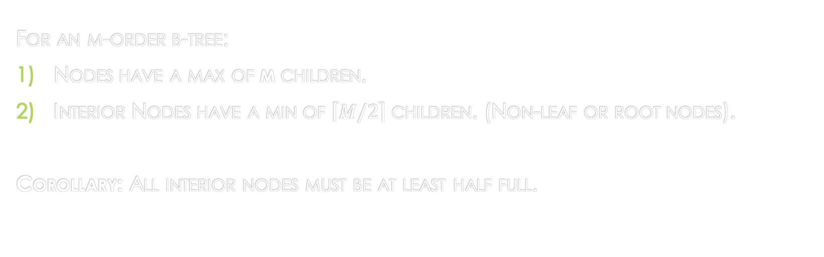
B-tree Rules
For an m-order b-tree:
Nodes have a max of m children.
Interior Nodes have a min of $\left\lceil M/2\right\rceil$ children. (Non-leaf or root nodes).
Corollary: All interior nodes must be at least half full.

Slide 8
B-Tree Rules (continued)
Any node that is not half full, is considered deficient
Only the root node can be deficient.
The root node must have at least two children.
Non-leaf nodes with k children, have k-1 keys stored.
All leaves must appear on the same level.

Slide 9
B-Tree Insertion
1) Start with a single node.
2) Add keys until the node is filled up
I.e. Until is contains m-1 keys and has M children
3) In adding the mth key, split the node in half.
Promote the median of the keys up to the parent node (this is regarded as a promotion)
This could potentially cause us to create a new parent node, cascade, and split the parent, etc….

Slide 10

B-tree Example
In order to make the concept of a b-tree more concrete, the following is an example of how an order 5 b-tree could look like:
Notice, we have 5 references, and 4 entries.
If we were to add another entry, say 42, we would promote the median, 42, and split.
Everything on the left would be < 42, and everything on the right would be > 42.

Slide 11
B-tree Insertion Example:
Let’s say we’re working with an order 5 B-Tree.

Slide 12
B-tree Insert: 10
Let’s try to insert 10:
Root node null!
Create root node and
insert 10!
10

Slide 13
B-tree Insert: 20
Let’s try to insert 20:
Root node non-null
and not full!
10
20
Insert 20 to right of 10!

Slide 14
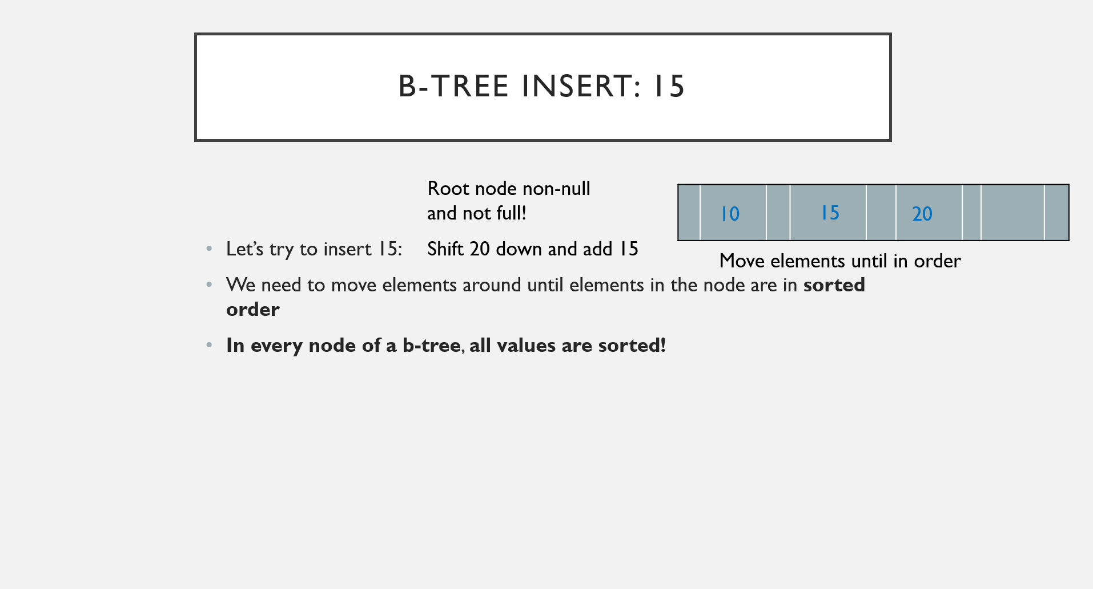
B-tree Insert: 15
Root node non-null
and not full!
10
15
20
15
20
Let’s try to insert 15:
We need to move elements around until elements in the node are in sorted order
In every node of a b-tree, all values are sorted!
Shift 20 down and add 15
Move elements until in order

Slide 15
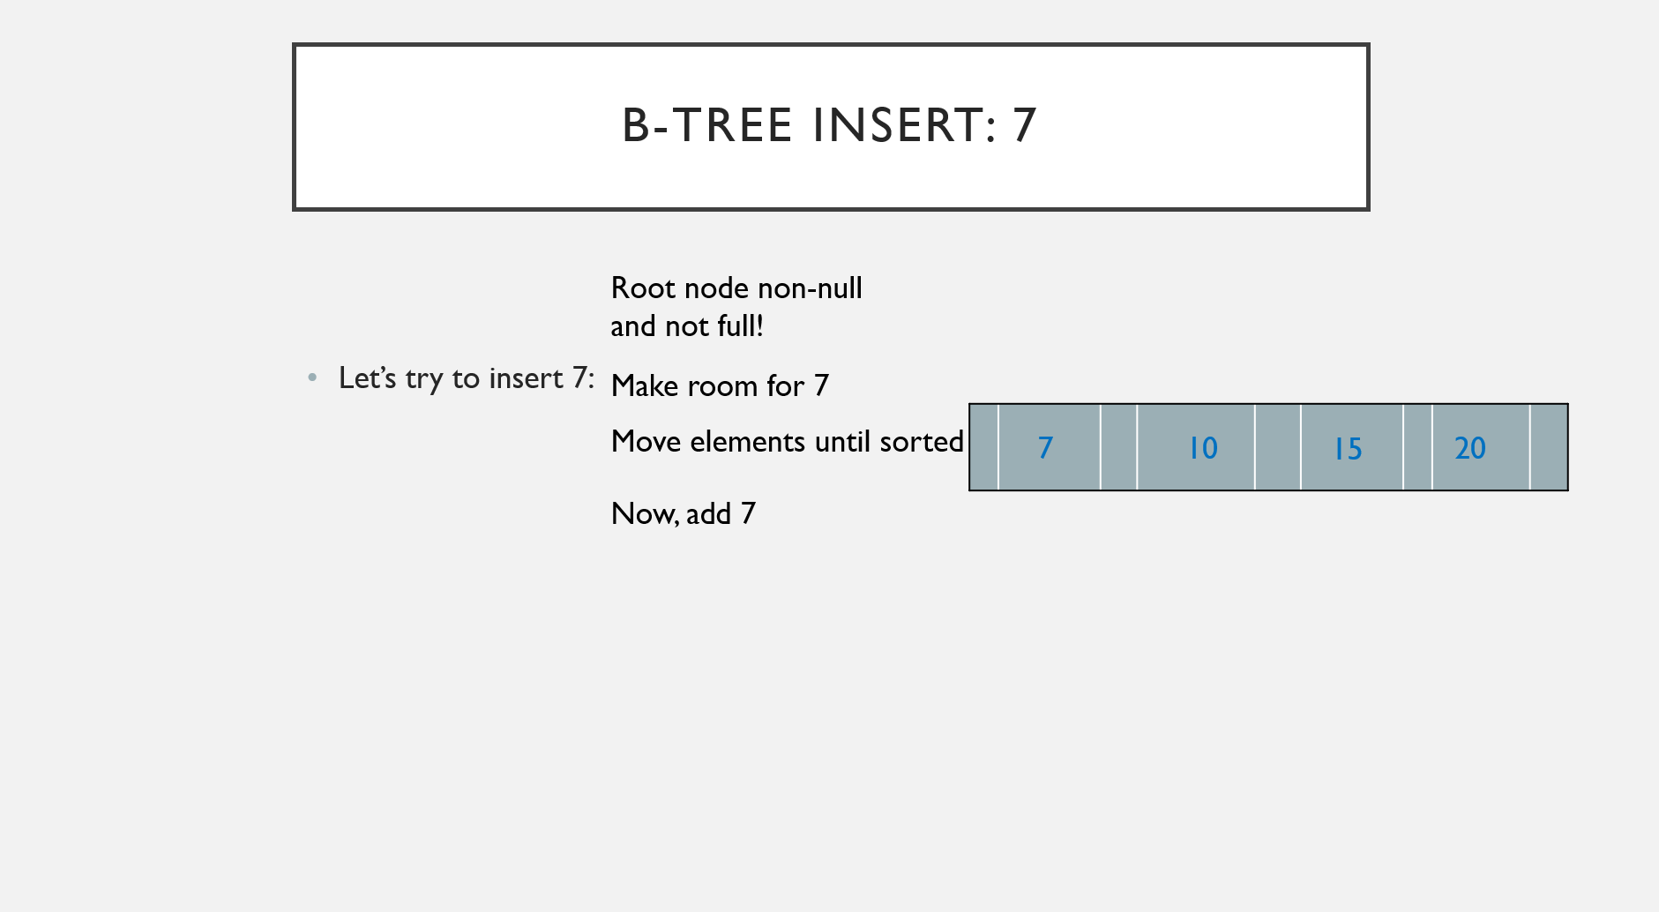
B-tree Insert: 7
Root node non-null
and not full!
Let’s try to insert 7:
Make room for 7
Move elements until sorted
7
10
20
20
10
20
15
15
15
Now, add 7

Slide 16
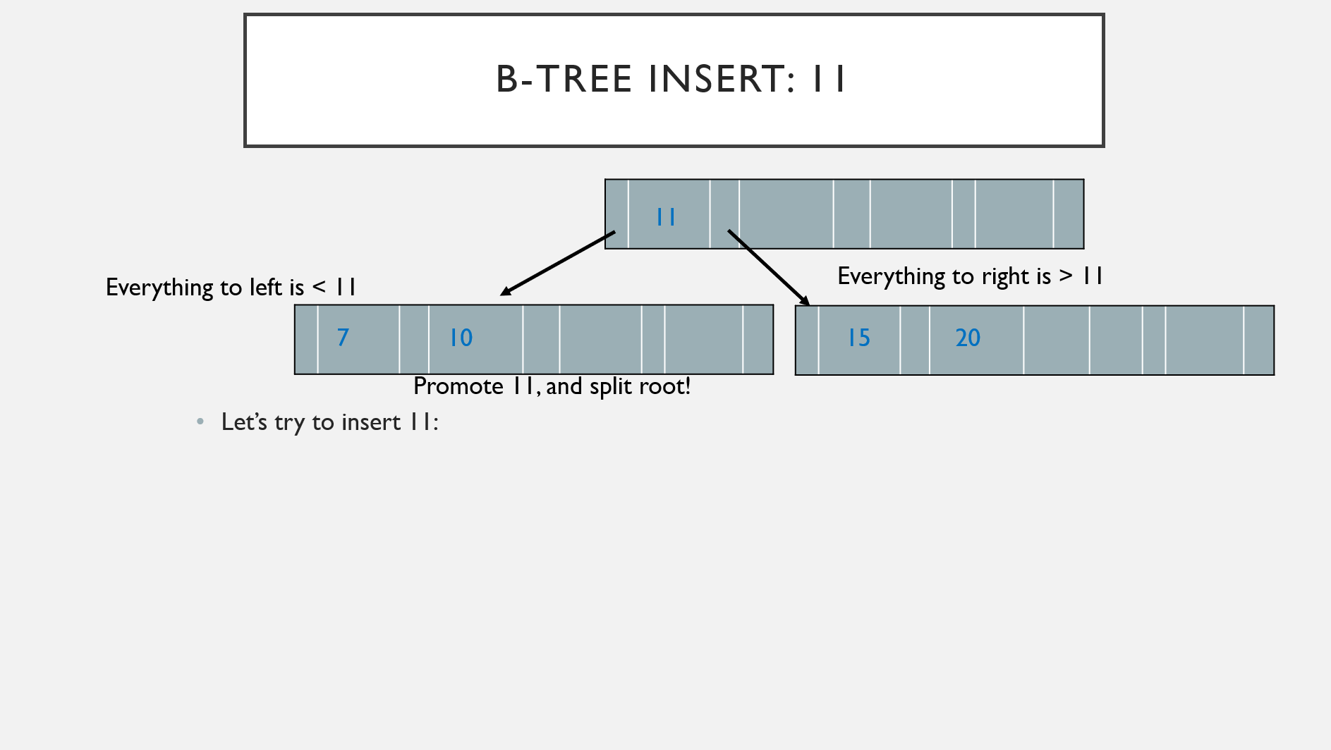
B-tree Insert: 11
Root node non-null
but full!
11
Everything to left is < 11
Everything to right is > 11
Determine median of:
7, 10, 11, 15, 20
7
10
15
20
7
10
15
20
Promote 11, and split root!
Let’s try to insert 11:

Slide 17
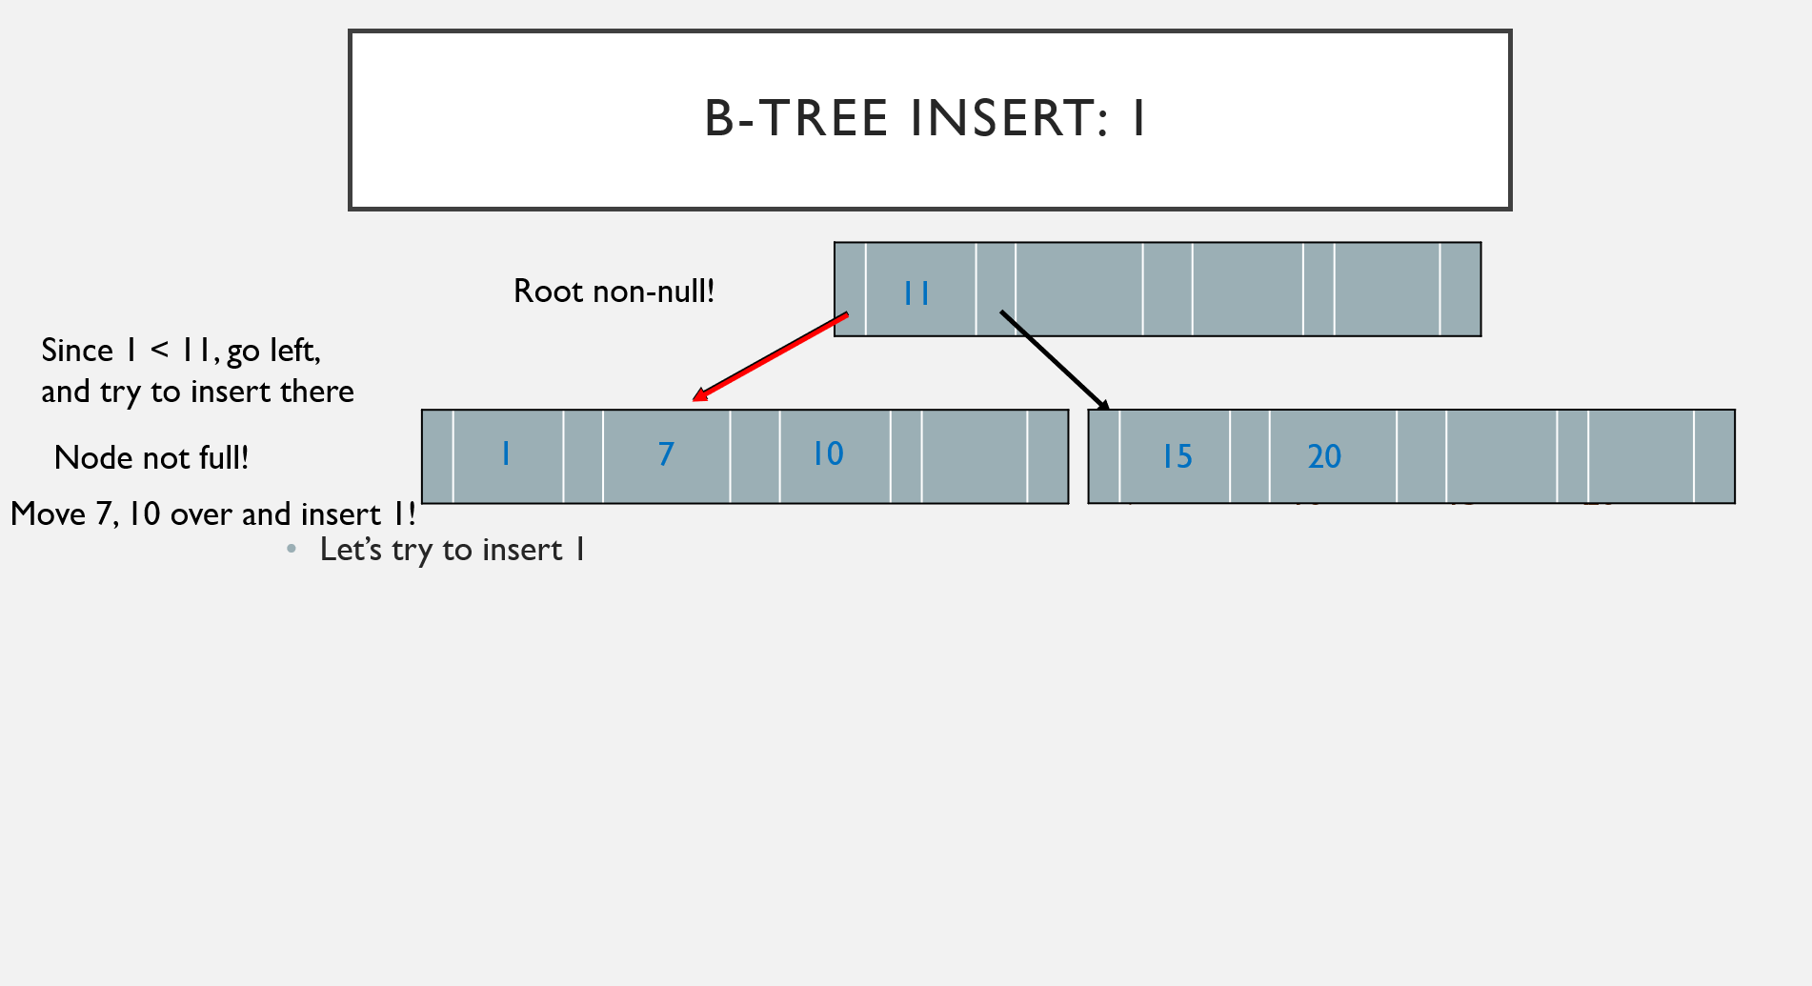
B-Tree Insert: 1
Root non-null!
11
Since 1 < 11, go left,
and try to insert there
1
7
10
Node not full!
7
10
15
20
Move 7, 10 over and insert 1!
7
10
15
20
Let’s try to insert 1

Slide 18
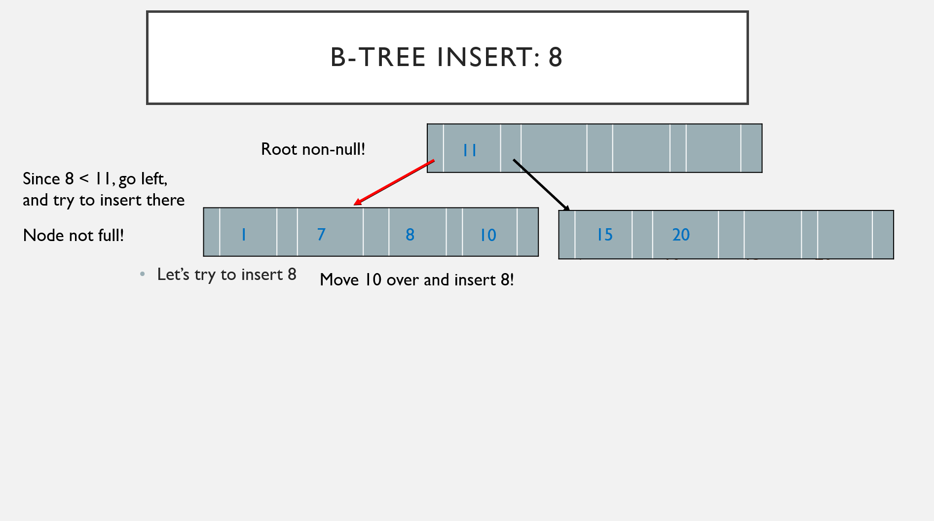
B-Tree Insert: 8
Root non-null!
11
Since 8 < 11, go left,
and try to insert there
10
Node not full!
1
7
8
10
15
20
7
10
15
20
Let’s try to insert 8
Move 10 over and insert 8!

Slide 19
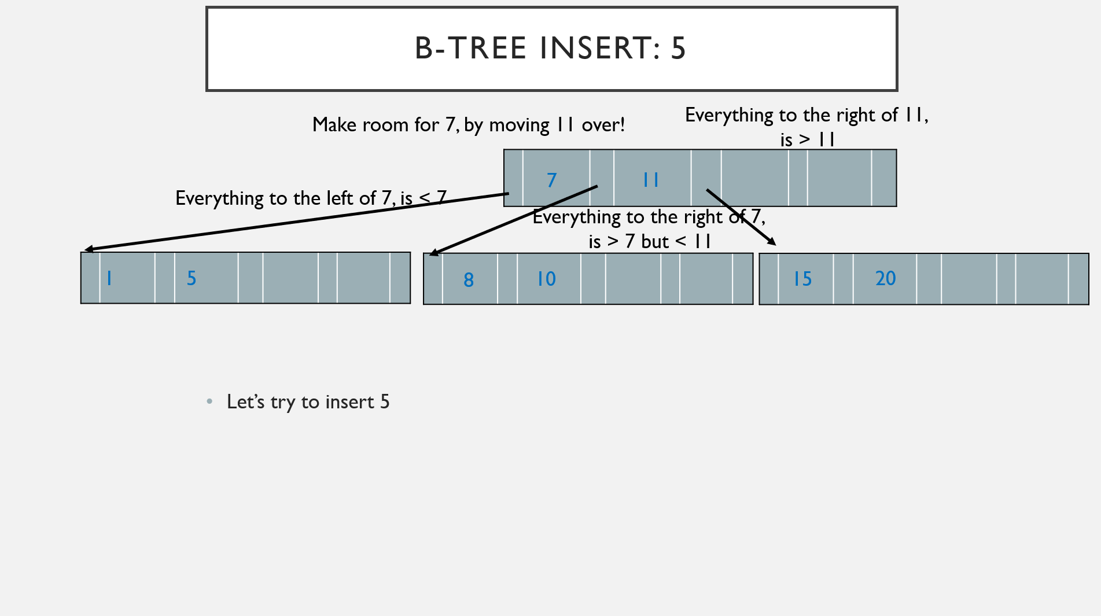
B-Tree Insert: 5
Make room for 7, by moving 11 over!
Everything to the right of 11,
is > 11
Root non-null!
7
11
11
Everything to the left of 7, is < 7
Since 5 < 11, go left,
and try to insert there
Everything to the right of 7,
is > 7 but < 11
Let’s try to insert 5
Determine median of:
7, 10, 11, 15, 20
1
5
1
7
10
15
15
20
Node full!
8
8
10
20
7
10
15
20
Find the median of the following:
1,5,7,8,10
Promote 7, and split.

Slide 20
B-tRee Insertion
You get the gist of it now…
B-trees can get very messy…
Always remember to maintain the invariants
For those interested, there is a unique case:
What if the root splits?

Slide 21
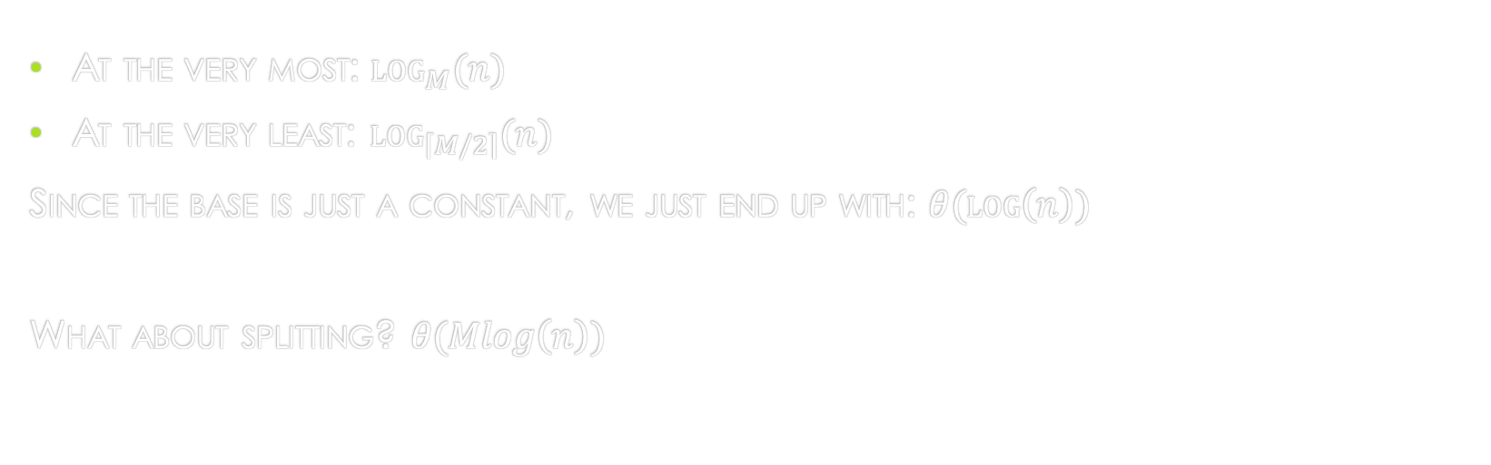
B-tree Insertion Runtime
At the very most: $\log_{M}{(n)}$
At the very least: $\log_{\left\lceil M/2\right\rceil }{(n)}$
Since the base is just a constant, we just end up with: $θ(\log\left(n\right))$
What about splitting? $θ(Mlog\left(n\right))$

Slide 22
B-tree Deletion
This is much more difficult to handle!
Find and delete the key
If the key is not in a leaf node, find a replacement!
Next, rebalance the tree
Is there a direct sibling node with more than the min keys? (is it more than half-full?)
If so, rotate right/left accordingly (Donate, as long as it doesn’t leave said donor deficient)
Otherwise, merge with the left or right sibling

Slide 23
B-tree Deletion Example
Alright… that was a lot, let’s run through a couple deletions…

Slide 24
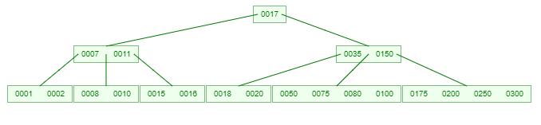
B-tree Starting TRee
Suppose we’re working with the following b-tree:
Just as a warning, it is incredibly difficult to animate B-tree deletion, and fit it on a slide :(

Slide 25
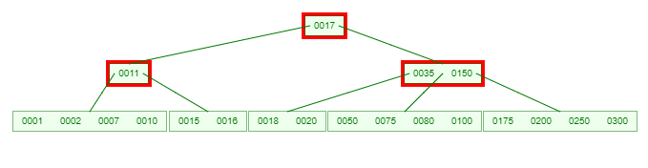
B-tree Removal: 8
Let’s try to remove 8
Since 8 is in a leaf node, that is less than half-full, we need to either donate or merge.
Since both its direct siblings are half-full, we can’t donate. So, we need to merge.
So, we will take the contents of either the left or right sibling. Let’s stick with the left sibling here, and take the parent key that separates them, which is 7, and merge the contents of the deficient node, the left sibling and 7.

Slide 26
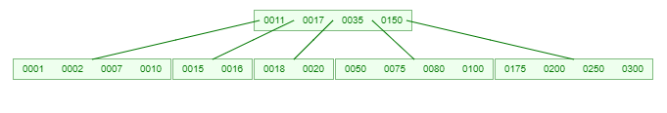
B-tree Removal: 8
But wait… there’s more
Now the parent is deficient… and so is its direct sibling…
So, we need to merge.
We’ll take the contents of the deficient node, the contents of its sibling, and the parent key that separates them, and put them in a single node…

Slide 27
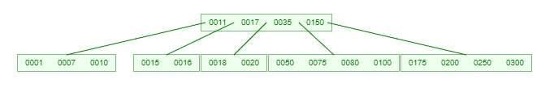
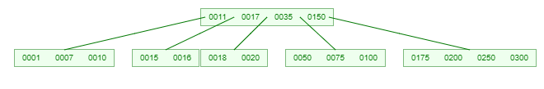
B-tree Removal: 80
Let’s try to remove 80.
Since 80 is in leaf node that is more than half-full, just delete 80.

Slide 28
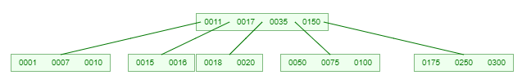
B-tree Removal: 200
Let’s try to remove 200.
Since 200 is in leaf node that is more than half-full, just delete 200.

Slide 29

B-tree Removal: 75
Let’s try to remove 75.
Since 75 is in leaf node that is more than half-full, just delete 75.

Slide 30

B-tree Removal: 100
Let’s try to remove 100.
If we tried to delete 100, the node containing 100 would become deficient.
Also, notice that if we tried to directly donate one of the right sibling’s values, we would have the node contain: 50, 100, (one of: 175, 250, 300), but that violates the definition of the references of the right reference of 35 and left reference of 150
We can get around this by rotating the value 150 down and promoting 175 as the replacement value in the root.
Generally: Donate Right, rotate smallest key from donor up.

Slide 31
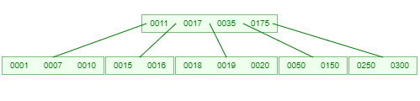
Let’s try to cause a left Rotation
Insert 19, to get the following:

Slide 32
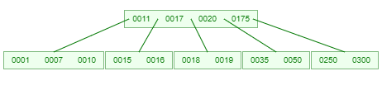
B-tree Deletion: 150
Let’s try to delete 150:
We need to donate from the left sibling, so instead, we take the largest key, rotate it up, and move the old root value down!
Generally: Donate Left, rotate largest key from donor up.

Slide 33
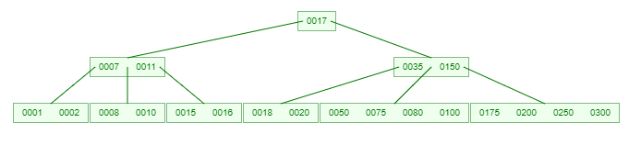
Now, let’s consider an edge case
Let’s suppose we had the original tree before performing any deletions:

Slide 34
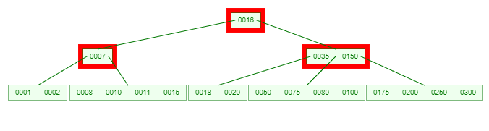
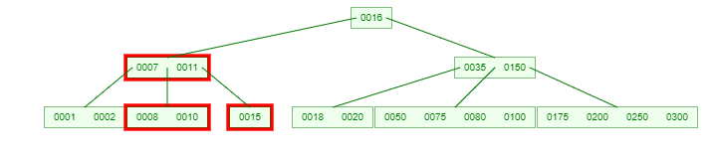
B-tree Deletion: Removing the root
Let’s try to remove 17
We need to find a replacement, since we’re deleting from a non-leaf node.
We can use the greatest key from the left subtree or the smallest key from the right subtree.
Let’s use 16 as our replacement…
But now we’ve made a deficient leaf node. Also note that both direct siblings are half-full, so we need to merge.
Let’s stick with the left sibling. So we’ll merge the contents of the left sibling, the deficient node, and the parent key that separates them, which is 11.

Slide 35

B-tree Deletion: Removing the root
But wait… there’s more
Now the parent is deficient… and so is its direct sibling…
So, we need to merge.
We’ll take the contents of the deficient node, the contents of its sibling, and the parent key that separates them, and put them in a single node…

Slide 36
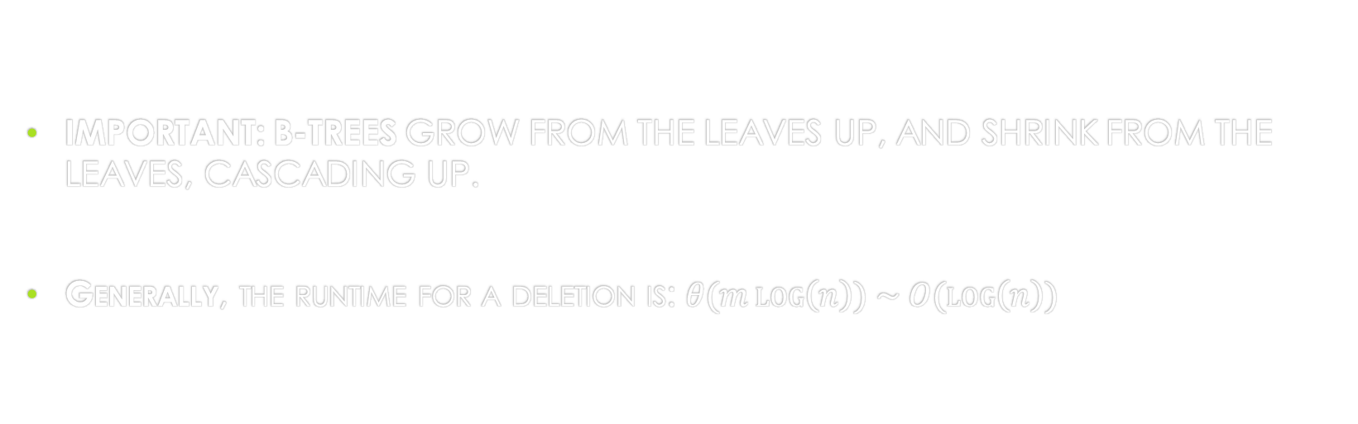
B-tree Deletion Runtime
IMPORTANT: B-TREES GROW FROM THE LEAVES UP, AND SHRINK FROM THE LEAVES, CASCADING UP.
Generally, the runtime for a deletion is: $θ(m\log\left(n\right)) \sim O(\log\left(n\right))$

Slide 37
What does this have to do with disks?
Remember at the beginning of this slide deck, where I mentioned disk I/O?
We can tune M so that every node is a disk block according to the CPU architecture
So, we’d have a collection of M disk block references and (M + 1) keys whose total amount is 1 disk block with relatively little space!

Slide 38
Slightly less important: B+ Trees
If you’re invested in this stuff, take CS 1555, you’ll learn a variant known as B+ trees.
A B+ tree will practically speed up runtime by speeding up the time to enumerate keys.
In each leaf node, there is a copy of every key.
Essentially each leaf node is a linked list of every key encountered thus far.
Insertion and deletion are more complicated for B+ trees but are fairly similar.

