Slide 1
CS 1501: Hashing
Gordon Lu

Slide 2
A brief note on these slides
Visually, slides don’t look the most appealing….
Work best in present mode!

Slide 3


An introduction to the problem
What’s something you’ve noticed about our symbol table implementations thus far?
The runtime for a search operation usually requires a traversal of the key…
Or… requires a lot of memory… (memory vs speed tradeoff)
…But wouldn’t it be great if we could get the best of both worlds, and search through a collection in $θ(1)$ with little memory??

Slide 4

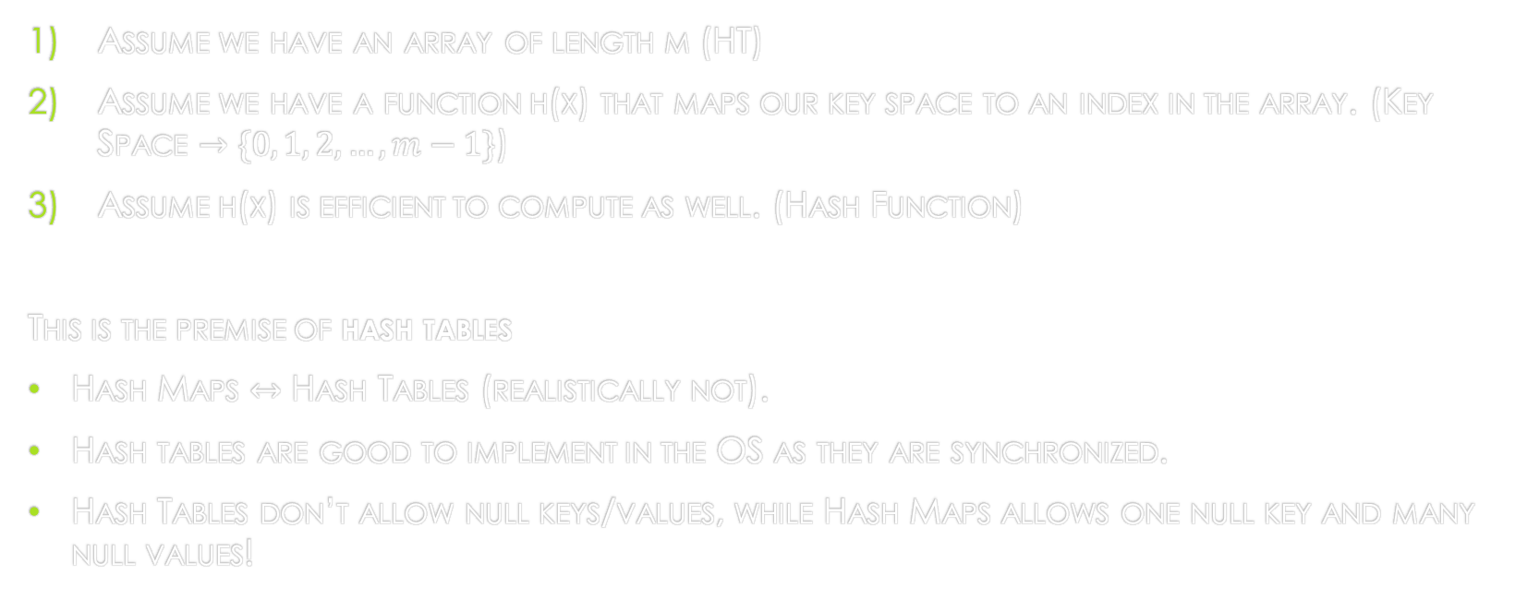
Let’s Try something new
Assume we have an array of length m (HT)
Assume we have a function h(x) that maps our key space to an index in the array. (Key Space $→$ $\{0, 1, 2, …, m−1\}$)
Assume h(x) is efficient to compute as well. (Hash Function)
This is the premise of hash tables
Hash Maps $↔$ Hash Tables (realistically not).
Hash tables are good to implement in the OS as they are synchronized.
Hash Tables don’t allow null keys/values, while Hash Maps allows one null key and many null values!
Notes:
There’s a common saying… if you don’t know the solution, just hash map it up!

Slide 5

Hash Map: Insertion
To insert the key $x$ into our hash table:
1) First, run $x$through our hash function to generate an index to store x in the hash table:
$$i=h\left(x\right)$$
2) Then, we will place $x$ at index $i$ in the array-backing the hash table:
$$HT\left[i\right]=x$$
It’s just like adding into an array, but our index is passed through a function before hand…
Notes:
Oooh, looks awfully familiar, right?

Slide 6

Hash Map: Search
To search for the key $x$in our hash table:
1) First, run $x$through our hash function that will give us our index: $$i=h\left(x\right)$$
2) Then, check if $x$ is stored at that index:
$$if\left(HT\left[i\right]==x\right) return true;$$
It’s just like searching if a given index in an array is populated, just with some extra steps…

Slide 7
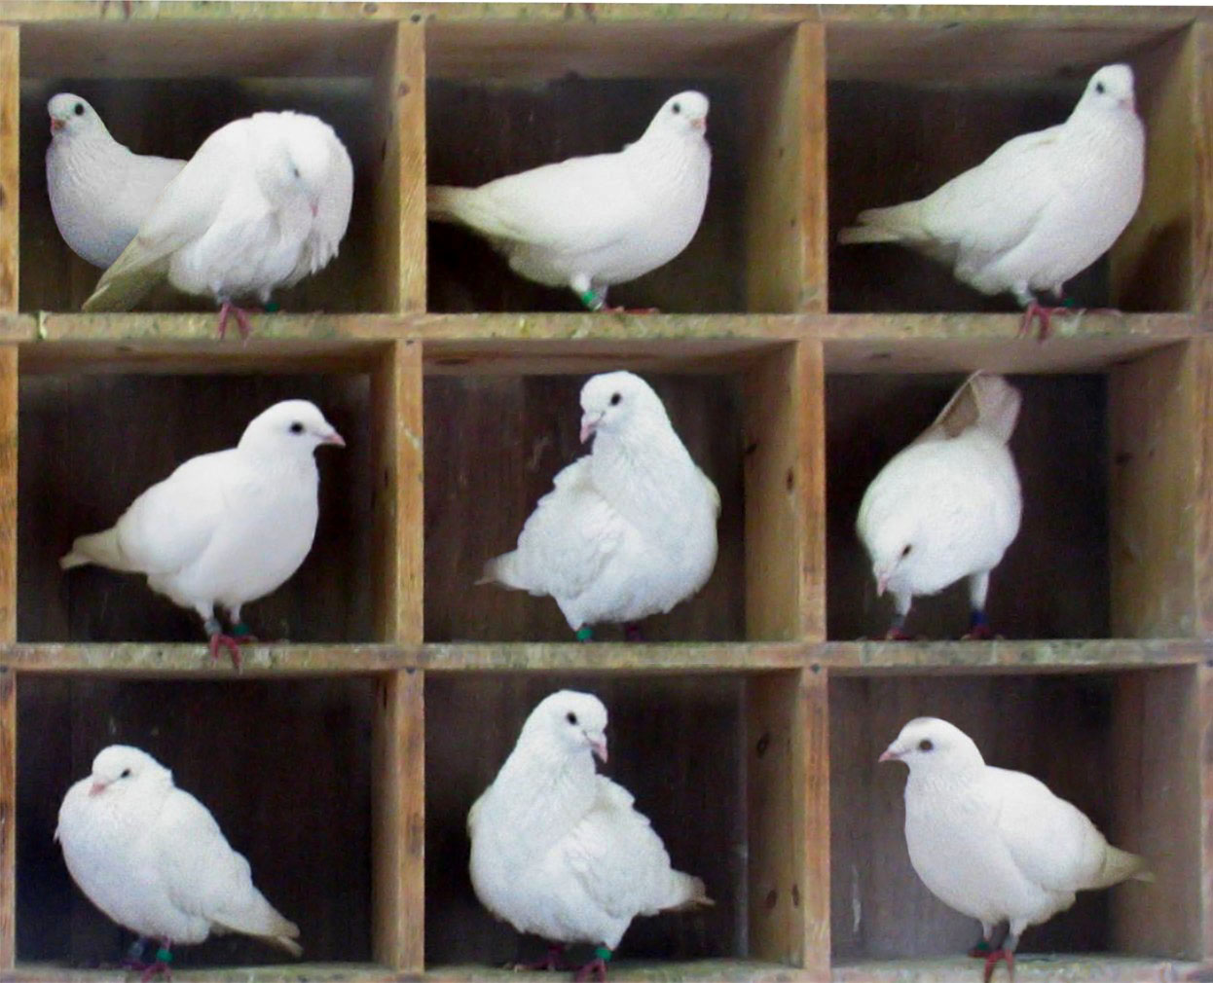
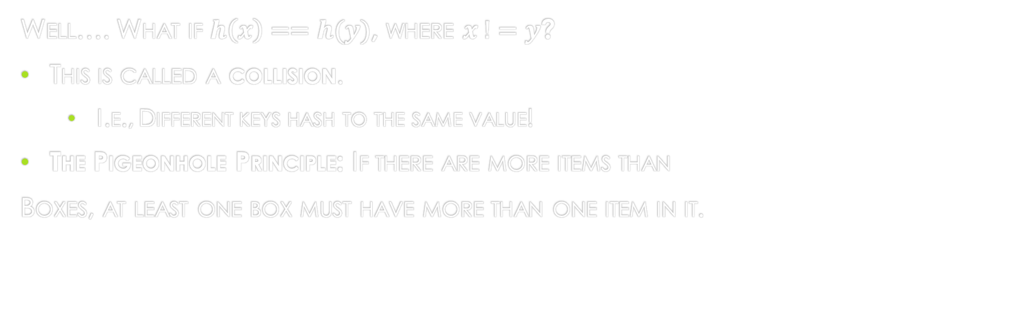
Hm… are there any problems with this approach??
Well…. What if $h\left(x\right)==h(y)$, where $x !=y$?
This is called a collision.
I.e., Different keys hash to the same value!
The Pigeonhole Principle: If there are more items than
Boxes, at least one box must have more than one item in it.

Slide 8
Pigeonhole Principle Tip:
Pigeonholes are indices, and the Pigeons are the Keys we could potentially insert.
For our hash function, the domain represents the pigeons, and the range represents the pigeonholes!

Slide 9
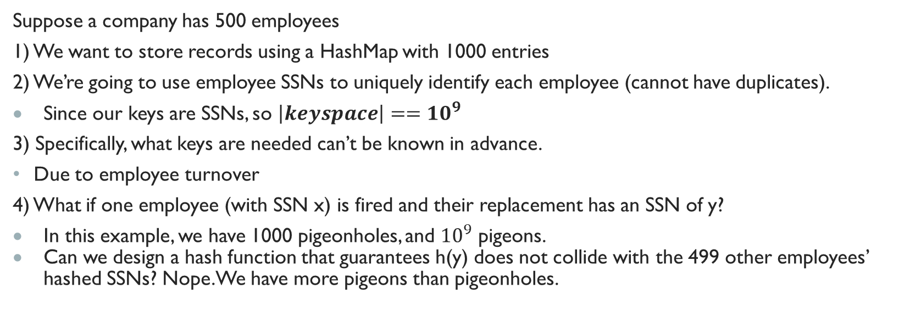
Pigeonhole Principle Example:
Suppose a company has 500 employees
1) We want to store records using a HashMap with 1000 entries
2) We’re going to use employee SSNs to uniquely identify each employee (cannot have duplicates).
Since our keys are SSNs, so $\left|keyspace\right|=={10}^{9}$
3) Specifically, what keys are needed can’t be known in advance.
Due to employee turnover
4) What if one employee (with SSN x) is fired and their replacement has an SSN of y?
In this example, we have 1000 pigeonholes, and ${10}^{9}$ pigeons.
Can we design a hash function that guarantees h(y) does not collide with the 499 other employees’ hashed SSNs? Nope. We have more pigeons than pigeonholes.

Slide 10
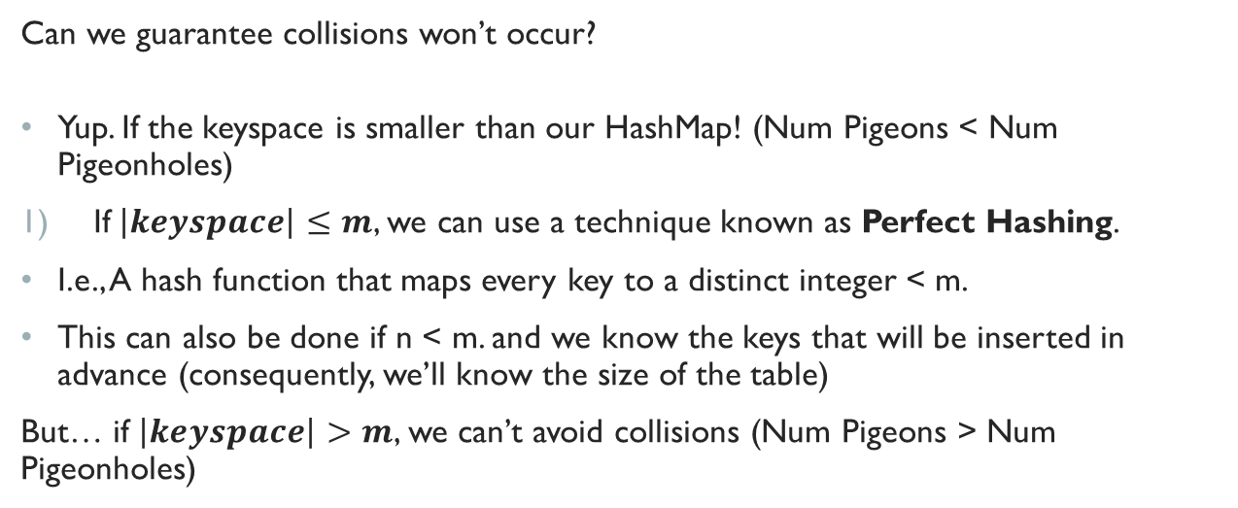
Caveats: Avoiding collisions?
Can we guarantee collisions won’t occur?
Yup. If the keyspace is smaller than our HashMap! (Num Pigeons < Num Pigeonholes)
If$\left|keyspace\right|≤m$, we can use a technique known as Perfect Hashing.
I.e., A hash function that maps every key to a distinct integer < m.
This can also be done if n < m. and we know the keys that will be inserted in advance (consequently, we’ll know the size of the table)
But… if $\left|keyspace\right|>m$, we can’t avoid collisions (Num Pigeons > Num Pigeonholes)

Slide 11
Handling Collisions
Can we reduce the number of collisions?
Well… a good hash function is a good start!
I.e., a hash function that:
Utilizes the entire key
Exploits differences between keys
Uniform distribution of hash values should be produced. (For a given key, each index is equally probable).
Notes:
NOT A NORMAL DISTRIBUTION!! Often times there will always be one student who mixes this up!!!

Slide 12
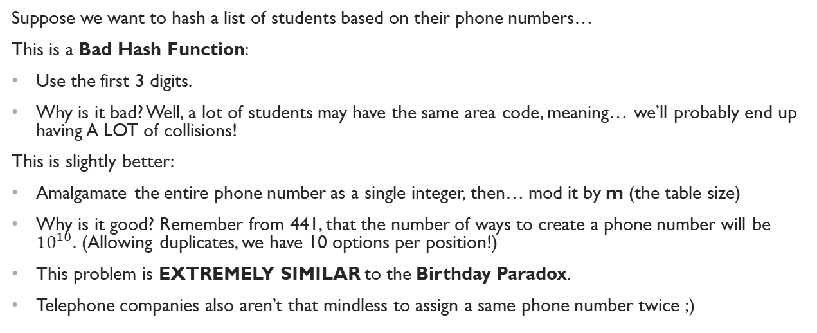
Hash Function: Examples
Suppose we want to hash a list of students based on their phone numbers…
This is a Bad Hash Function:
Use the first 3 digits.
Why is it bad? Well, a lot of students may have the same area code, meaning… we’ll probably end up having A LOT of collisions!
This is slightly better:
Amalgamate the entire phone number as a single integer, then… mod it by m (the table size)
Why is it good? Remember from 441, that the number of ways to create a phone number will be ${10}^{10}.$ (Allowing duplicates, we have 10 options per position!)
This problem is EXTREMELY SIMILAR to the Birthday Paradox.
Telephone companies also aren’t that mindless to assign a same phone number twice ;)
Notes:
The Birthday Paradox is an extremely interesting combinatorics/statistics problem! I encourage you to look more into its implications!

Slide 13
Hash Function: Examples (Continued)
Suppose we want to generate a hash of each word for a dictionary:
This is a Bad Hash Function
Take a similar approach as the previous slide and sum up values (ASCII).
Why is this bad? We’re not exploiting differences.
Consider dab vs. bad, both will hash to the same value, resulting in a collision!
This is slightly better:
Use modular hashing!
Notes:
dab = bad, get it?? ;)

Slide 14
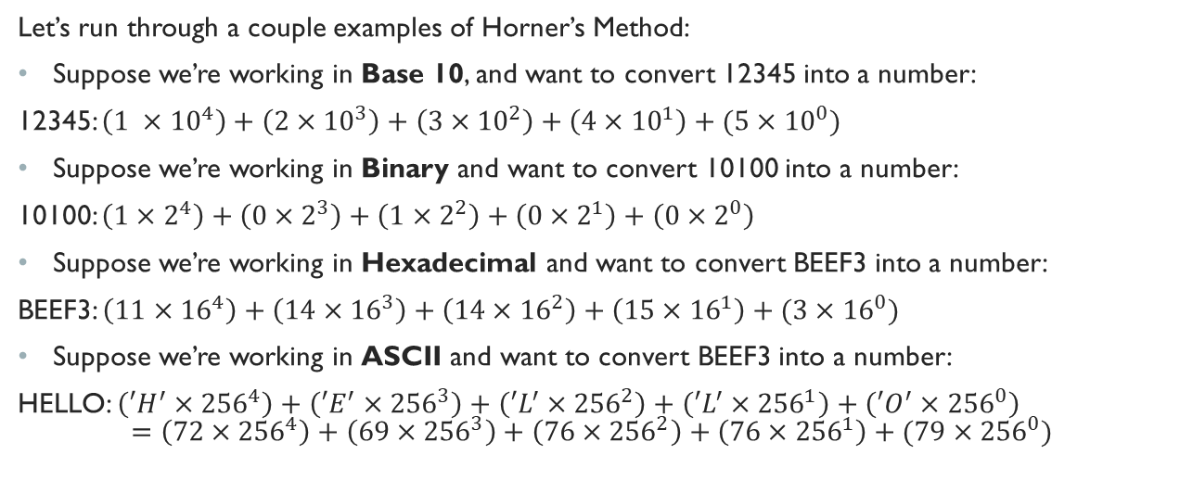
Horner’s Method: A way to get efficient Hash values
Let’s run through a couple examples of Horner’s Method:
Suppose we’re working in Base 10, and want to convert 12345 into a number:
12345: $\left(1 ×{10}^{4}\right)+\left(2×{10}^{3}\right)+\left(3×{10}^{2}\right)+\left(4×{10}^{1}\right)+(5×{10}^{0})$
Suppose we’re working in Binary and want to convert 10100 into a number:
10100: $\left(1×2^{4}\right)+\left(0×2^{3}\right)+\left(1×2^{2}\right)+\left(0×2^{1}\right)+\left(0×2^{0}\right)$
Suppose we’re working in Hexadecimal and want to convert BEEF3 into a number:
BEEF3: $\left(11×{16}^{4}\right)+\left(14×{16}^{3}\right)+\left(14×{16}^{2}\right)+\left(15×{16}^{1}\right)+(3×{16}^{0})$
Suppose we’re working in ASCII and want to convert BEEF3 into a number:
HELLO: $\left(′H^{′}×{256}^{4}\right)+\left(′E^{′}×{256}^{3}\right)+\left(′L^{′}×{256}^{2}\right)+\left(′L^{′}×{256}^{1}\right)+\left(′O^{′}×{256}^{0}\right)$ $$=\left(72×{256}^{4}\right)+\left(69×{256}^{3}\right)+\left(76×{256}^{2}\right)+\left(76×{256}^{1}\right)+(79×{256}^{0})$$
Notes:
Huh… this seems familiar...

Slide 15
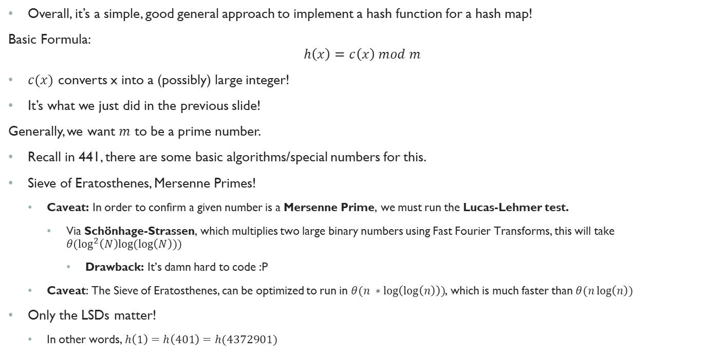
Enter: Modular Hashing
Overall, it’s a simple, good general approach to implement a hash function for a hash map!
Basic Formula: $$h\left(x\right)=c\left(x\right) mod m$$
$c(x)$ converts x into a (possibly) large integer!
It’s what we just did in the previous slide!
Generally, we want $m$ to be a prime number.
Recall in 441, there are some basic algorithms/special numbers for this.
Sieve of Eratosthenes, Mersenne Primes!
Caveat: In order to confirm a given number is a Mersenne Prime, we must run the Lucas-Lehmer test.
Via Schönhage-Strassen, which multiplies two large binary numbers using Fast Fourier Transforms, this will take $θ(\log^{2}\left(N\right)log⁡(\log\left(N\right)))$
Drawback: It’s damn hard to code :P
Caveat: The Sieve of Eratosthenes, can be optimized to run in $θ(n ∗\log\left(\log\left(n\right)\right))$, which is much faster than $θ(n\log\left(n\right))$
Only the LSDs matter!
In other words, $h\left(1\right)=h\left(401\right)=h(4372901)$
Notes:
Don’t worry about Schönhage-Strassen, that will come MUCH later in the term ;)
Just know that the Sieve of Eratosthenes is MUCH easier to code up! THANK YOU, ANCIENT GREEKS!

Slide 16
Back to collisions
What we’ve just done in the previous couple slides, is cut down the number of collisions
But… we still must deal with them!

Slide 17
Collision Resolution
There are two main approaches:
Open Addressing
If a pigeonhole is occupied, find another one!
Closed Addressing
If a pigeonhole is occupied, just live with a roommate!

Slide 18

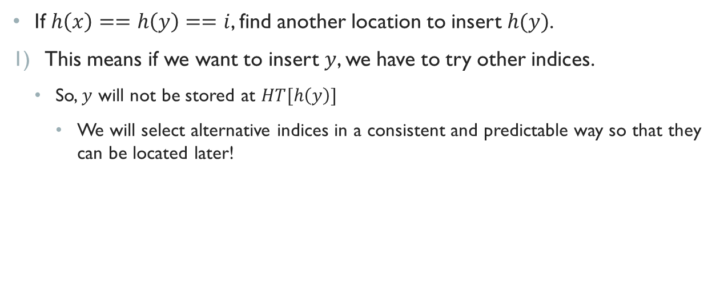
Open addressing
If $h\left(x\right)==h\left(y\right)==i$, find another location to insert $h(y)$.
This means if we want to insert $y$, we have to try other indices.
So, $y$ will not be stored at $HT[h\left(y\right)]$
We will select alternative indices in a consistent and predictable way so that they can be located later!

Slide 19
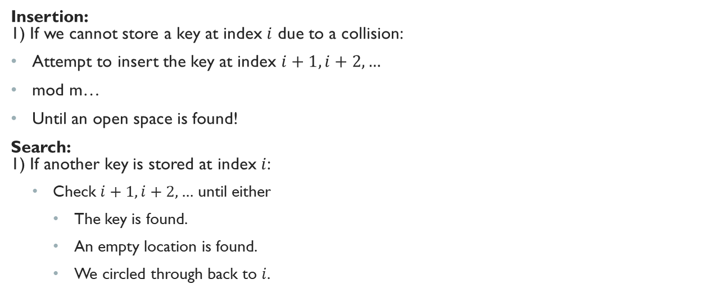
Linear Probing
Insertion: 1) If we cannot store a key at index $i$ due to a collision:
Attempt to insert the key at index $i+1,i+2,…$
mod m…
Until an open space is found!
Search: 1) If another key is stored at index $i$:
Check $i+1,i+2,…$ until either
The key is found.
An empty location is found.
We circled through back to $i$.

Slide 20

Linear Probing Example
Suppose our hash function, $h(x)$ is: $h\left(x\right)=x mod 11$
We want to insert the following: $14, 17, 25, 37, 34, 16$

Slide 21
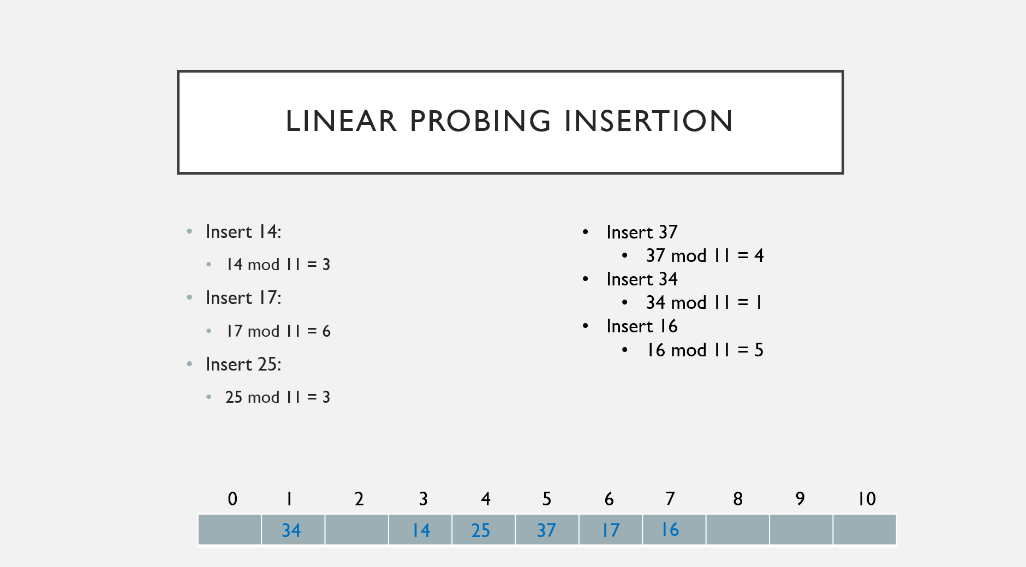
Linear Probing Insertion
Insert 14:
14 mod 11 = 3
Insert 17:
17 mod 11 = 6
Insert 25:
25 mod 11 = 3
Insert 37
37 mod 11 = 4
Insert 34
34 mod 11 = 1
Insert 16
16 mod 11 = 5
Uh oh! Already populated
Empty, so insert here!
Look at next index
Uh oh! Already populated!
Uh oh! Already populated
Empty, so insert here!
Empty, so insert here!
Look at next index
Look at next index
Look at next index
Uh oh! Already populated
0 1 2 3 4 5 6 7 8 9 10
34
14
25
37
17
16
Notes:
Remember your mods!!! This is such a common mistake on 1501 exams! Remember, we assume that you know how to compute a mod, so any errors are assumed to be errors in understanding the algorithm! I recommend you practice through many examples of linear probing! If you have any confusion, do not hesitate to schedule a meeting with me, and we can work it out together!

Slide 22

Insertion Runtime
What’s the runtime for an Insertion using Linear Probing?
At the very worst, we will collide at every index except for one…
Thus, the runtime is $θ(n)$
Notes:
I will not cover searching for a value in the hash table, but should you have questions, feel free to shoot me an email, and we can walk through a couple examples! ☺

Slide 23
Handling Deletion
Well, we handled insertion, but what about deletion?
If we deleted 17, what would we have to do?
Rehash! If we try to look for 16, we wouldn’t be able to, since we would stop prematurely at index 5!
We need to rehash until the next empty space.
From the index 17 was deleted from, index 6, we would rehash up to the next empty space.
So, we would just reinsert 16.
0 1 2 3 4 5 6 7 8 9 10
34
14
25
37
17
16

Slide 24

Handling Deletion
Alternative Approach:
Leave a flag to indicate that a value was deleted.
This is known as a Sentinel Key/Tombstone
Or we could maintain a parallel array of Booleans
Tradeoffs:
Tombstone/Sentinel Key
Deletes are very fast, but search takes unnecessarily long!
Rehashing
Deletion very expensive, but search is fast!
0 1 2 3 4 5 6 7 8 9 10
34
14
25
37
17
16

Slide 25

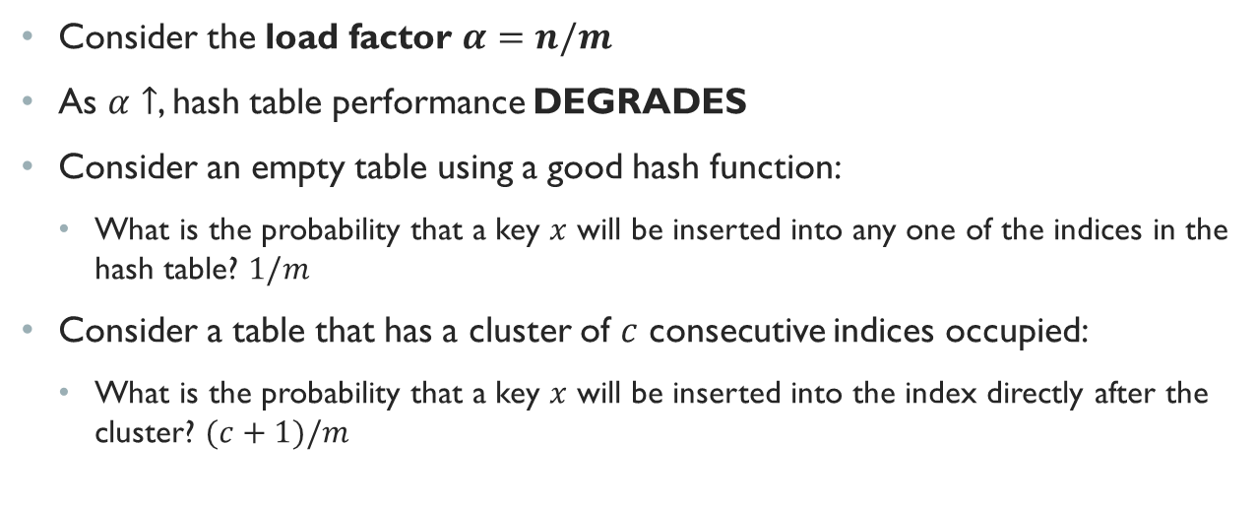
YAY! we solved collisions!
Consider the load factor $α=n/m$
As $α↑$, hash table performance DEGRADES
Consider an empty table using a good hash function:
What is the probability that a key $x$ will be inserted into any one of the indices in the hash table? $1/m$
Consider a table that has a cluster of $c$ consecutive indices occupied:
What is the probability that a key $x$ will be inserted into the index directly after the cluster? $(c+1)/m$

Slide 26
Avoiding Clustering
We need to also make sure that after a collision, all the indices of the hash table are equally probable for the key.
The probability of filled locations needs to be evenly distributed throughout the table!

Slide 27
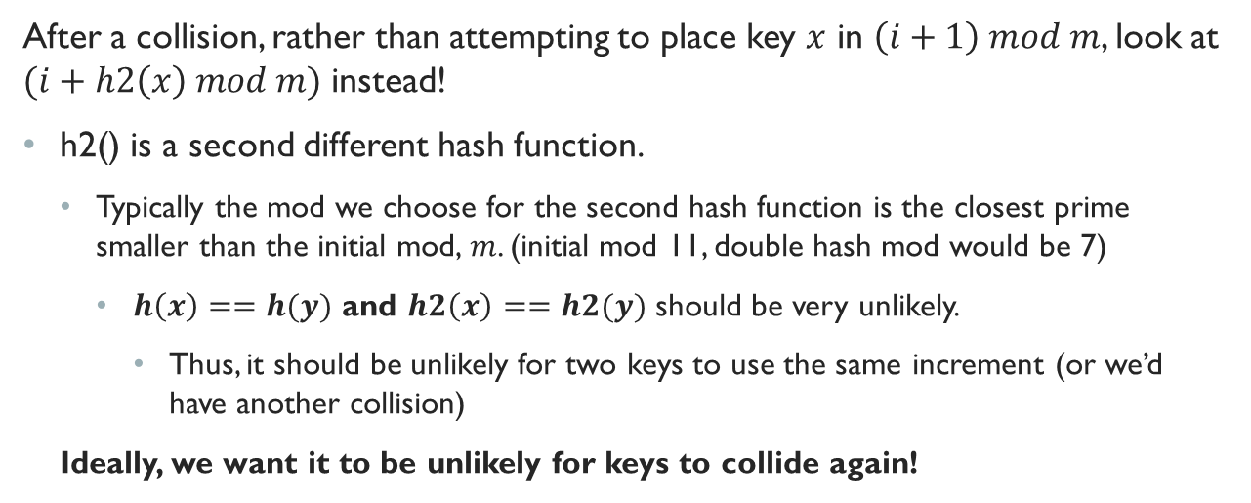
Enter: Double Hashing
After a collision, rather than attempting to place key $x$ in $\left(i+1\right) mod m$, look at $(i+h2\left(x\right) mod m)$ instead!
h2() is a second different hash function.
Typically the mod we choose for the second hash function is the closest prime smaller than the initial mod, $m$. (initial mod 11, double hash mod would be 7)
$h\left(x\right)==h(y)$ and $h2\left(x\right)==h2(y)$ should be very unlikely.
Thus, it should be unlikely for two keys to use the same increment (or we’d have another collision)
Ideally, we want it to be unlikely for keys to collide again!

Slide 28

Double Hashing Example
Suppose $h\left(x\right)=x mod 11$, $h2\left(x\right)=\left(x mod 7\right)+1$
We want to insert the following: $14, 17, 25, 37, 34, 16, 26$

Slide 29
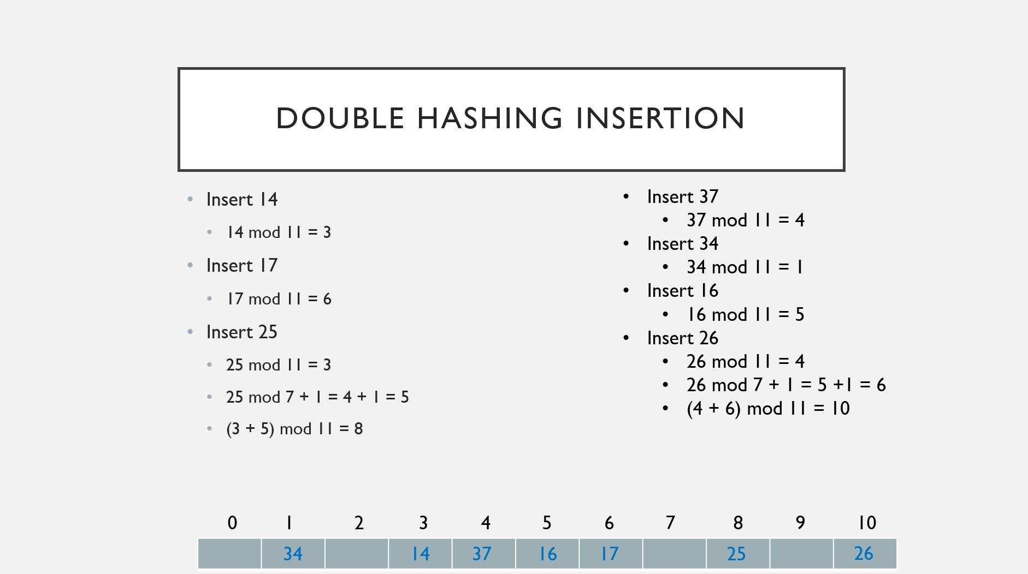
Double Hashing Insertion
Insert 37
37 mod 11 = 4
Insert 34
34 mod 11 = 1
Insert 16
16 mod 11 = 5
Insert 26
26 mod 11 = 4
26 mod 7 + 1 = 5 +1 = 6
(4 + 6) mod 11 = 10
Insert 14
14 mod 11 = 3
Insert 17
17 mod 11 = 6
Insert 25
25 mod 11 = 3
25 mod 7 + 1 = 4 + 1 = 5
(3 + 5) mod 11 = 8
Compute second hash value
Compute second hash value
Uh oh! Already populated
Uh oh! Already populated!
Empty, so insert here!
Check index 8
Check index 10
Empty, so insert here!
0 1 2 3 4 5 6 7 8 9 10
34
14
37
16
17
25
26
Notes:
An important thing to note here, is if we get another collision, we would keep adding on the second hash value, we would not use another hash function, that would be TRIPLE HASHING!!

Slide 30

Hm…There’s something weird
Notice how the second hash function is calculated like: $h2\left(x\right)+1$
Why not $h2\left(x\right)$?
Well, if the second hash value mapped to 0, we wouldn’t increment by anything, and we would get another collision!!

Slide 31
Extra rules for the second hash function
The second hash function cannot map to a value of 0.
Otherwise, we’d end up with a collision!
We must try all indices once before trying one again
Every index must have an equal probability of being inserted into.

Slide 32
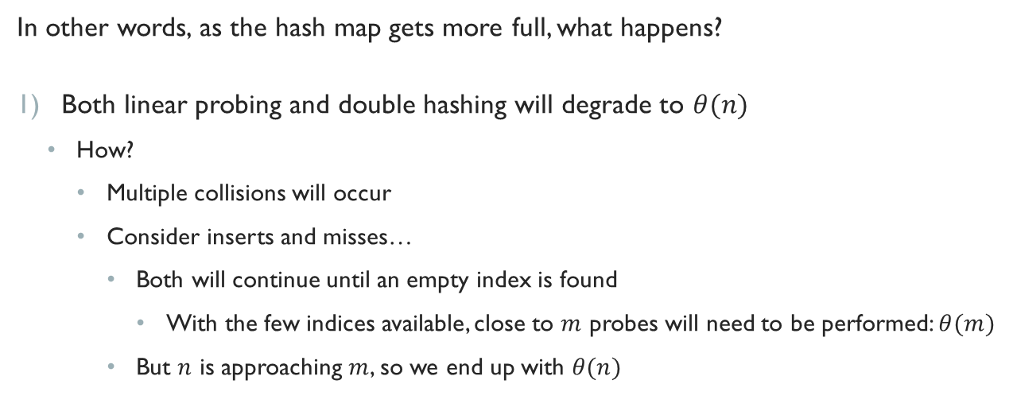

As $α→1$…
In other words, as the hash map gets more full, what happens?
Both linear probing and double hashing will degrade to $θ(n)$
How?
Multiple collisions will occur
Consider inserts and misses…
Both will continue until an empty index is found
With the few indices available, close to $m$ probes will need to be performed: $θ(m)$
But $n$ is approaching $m$, so we end up with $θ(n)$

Slide 33
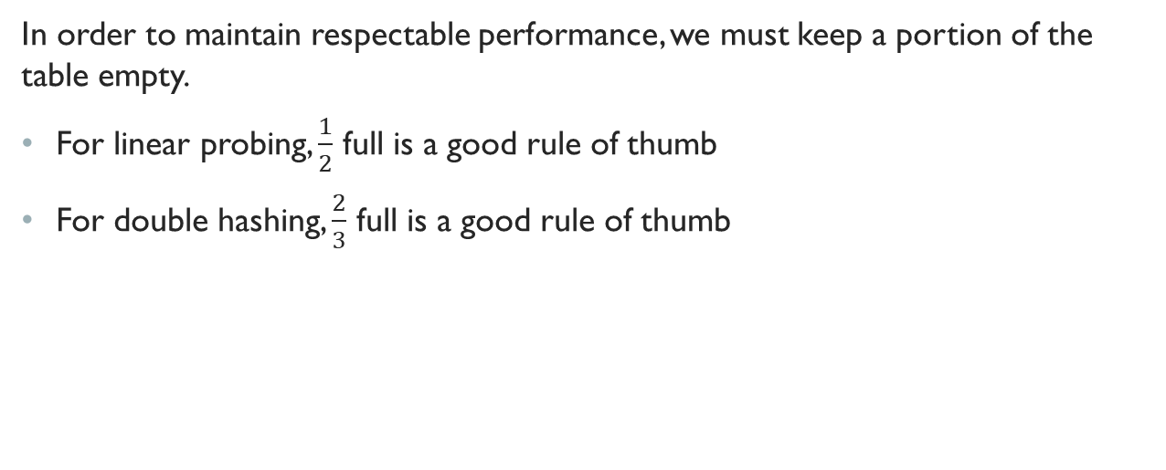
Open Addressing Issues
In order to maintain respectable performance, we must keep a portion of the table empty.
For linear probing, $\frac{1}{2}$ full is a good rule of thumb
For double hashing, $\frac{2}{3}$ full is a good rule of thumb

Slide 34
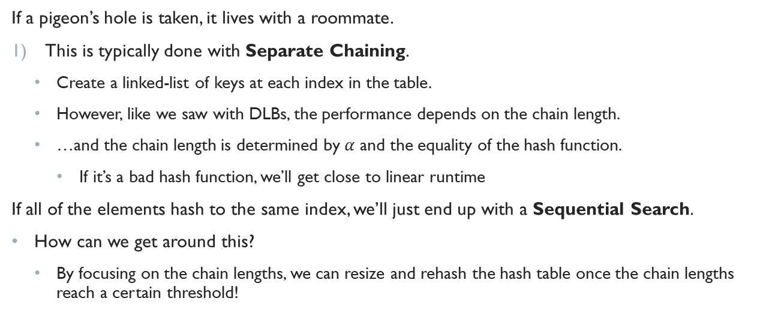
Enter: Closed Addressing
If a pigeon’s hole is taken, it lives with a roommate.
This is typically done with Separate Chaining.
Create a linked-list of keys at each index in the table.
However, like we saw with DLBs, the performance depends on the chain length.
…and the chain length is determined by $α$ and the equality of the hash function.
If it’s a bad hash function, we’ll get close to linear runtime
If all of the elements hash to the same index, we’ll just end up with a Sequential Search.
How can we get around this?
By focusing on the chain lengths, we can resize and rehash the hash table once the chain lengths reach a certain threshold!

Slide 35
Closed Addressing Caveats
You don’t necessarily need to use a linked-list for each key in the hash table.
If we want something faster, we can use a trie, or a self-balancing BST
Notes:
Refer to the code I have posted. I created a hash table using separate chaining, with a prime generated using the Sieve of Eratosthenes, where each index is a Red-Black Tree!

Slide 36
In General…
Generally, Closed-Addressing Hash Tables are fast and efficient for many applications!
But… it really depends:
Strict Memory: Open Addressing
Memory Available: Closed Addressing

