Slide 1
CS 447 Recitation 2
Gordon Lu

Slide 2
Logistics
A (very) brief introduction to pointers
Pointers and Arrays
Q&A on Lab 3?
(If you have me as your 449 TA, a lot of this was covered last recitation)

Slide 3
Pointers

Slide 4
What is a Pointer?
A pointer is a variable that holds a memory address of another variable.
You can access a value a pointer points to using the dereference operator (*).

Slide 5
Address-OF (&) Operator
You can get the address of a variable via the address-of operator (&)
int x;
int* p = &x;

Slide 6

Pointers Example
int x = 10;
int y = 20;
int* p = &x;
We say “p points to x”
10
x
20
y
address of x
p

Slide 7



Pointers Example
p = &y;
int** pp = &p;
10
x
20
y
address of x
address of y
p
address of p
pp

Slide 8
Pointers And Arrays

Slide 9
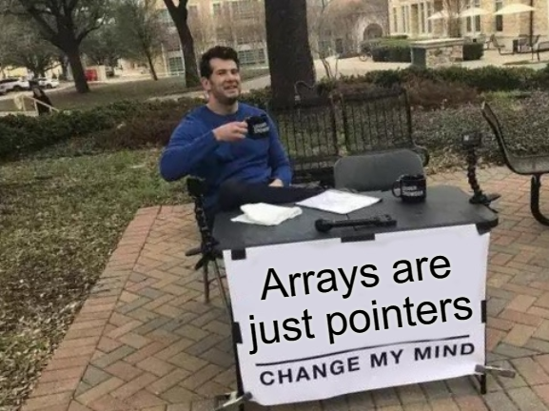
Pointers and Arrays
A pointer can point to one or more values.
A char* may point to a single char, or to an array of chars.

Slide 10


Arrays Example
char c = ‘x’;
char* s = &c;
s = “hi!”;
“Pointing to a single value” is the same as “pointing to an array of length 1”!
‘x’
c
address of c
address of
string literal
s
‘h’ | ‘i' | ‘!’ | ‘\0’

Slide 11

The value-at (Dereference) operator
1) * is the value-at operator: it’s the inverse of &
Every time you use it, you remove a star.
2) It accesses the variable that a pointer points to
We say that it “dereferences” a pointer

Slide 12
Array-Indexing Operators

Slide 13




What the Brackets Actually do
p[n] in C really means “dereference address p + n”
s[2]
= *(s+2)
= *(2+s)
= 2[s]
What about values bigger than a char?

Slide 14

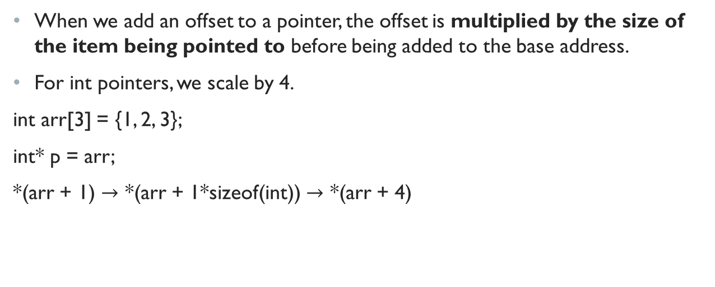
Scaling
When we add an offset to a pointer, the offset is multiplied by the size of the item being pointed to before being added to the base address.
For int pointers, we scale by 4.
int arr[3] = {1, 2, 3};
int* p = arr;
*(arr + 1) $→$ *(arr + 1*sizeof(int)) $→$ *(arr + 4)

Slide 15
Strings

Slide 16
Strings are just char arrays
Strings are just sequences of characters!
We indicate the end of a String using a NULL TERMINATOR: ‘\0’
If we lose track of the NULL TERMINATOR, we’re pretty much screwed.

Slide 17
Hints for the Lab

Slide 18
TIPS For the Lab
It’s always easier to think about the opposite condition when we write loops and conditions in MIPS.
We always want to think about the exit condition first.
Remember what stores and loads do!
When we perform an instruction like: lb a0, (t0) we are getting the value of the pointer t0, at position 0.
When we pass things into a function, take note of the argument registers.
When we want to use additional variables that we want to persist through different function calls, we ask for more stack space.
Note: We must balance our stack out. Otherwise, we’ll get A LOT of errors!! An unbalanced stack is no fun!!

