Slide 1
CS 0449 Recitation 1
Gordon Lu

Slide 2
Contact Information
I will be holding office hours during the following time:
Friday: 4:00PM – 6:00PM (There’s additional scheduling if you visit the link below)
You can also find more details on my website: https://glu99331.github.io/index.html
Slides and Notes will be posted to help with reviewing
I am willing to help with CS 0447, CS 1501, and CS 1502 as well (I have performed well in all said classes)
(I am more willing to help with subjects in the following order (CS 0449 always coming first): CS 0449, CS 1501, CS 0447, CS 1502).

Slide 3
The Programming Language Continuum
You might be asking yourself: Why are we learning C?
Going from left to right:
Each hides a further layer of abstraction
Where we are:
Low-Level
High-Level
MIPS, x86
C, C++
Java, Python

Slide 4
Setting up Aliases on Thoth
Once you ssh into Thoth, you can set up aliases to reduce the amount of typing you do!
To add an alias, first open the bash_source file like so: nano .bash_profile
Scroll down to the portion of text that says ALIASES, this might take a little bit to find!
Add the aliases you want, like this: alias compile=“gcc –Wall –Werror --std=c99 -o”
Now CTRL+O, and then CTRL+X
Then refresh the bash environment like so: source ~/.bash_profile
Then try to compile a program like so: compile filename filename.c
YAY! LESS TYPING ☺

Slide 5
The Lab
The purpose of this lab is to get you familiar with Bit Manipulations.
I’m gonna hit you up with some hints that’ll make this lab less of a pain in the butt ;)
I’m not gonna be giving you code, but I’ll provide the base to let ya breeze right through this lab!

Slide 6
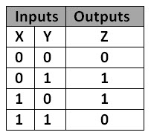
XOR
What was the truth table for XOR again?
Yep.

Slide 7
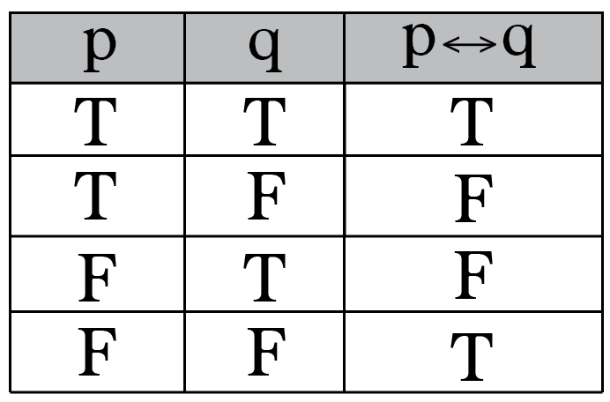
Biconditional
What was the truth table for Biconditional again?
Yep.

Slide 8
Notice anything?
Well, they have the opposite truth tables!
Why did I show you this?
- Cough cough, it’s gonna be helpful for the lab ;)))

Slide 9
Boolean Expression
What’s the Boolean Expression for XOR?
Erm…. I DON’T KNOW!
What about the Boolean Expression for the Biconditional?
It’s two implications connected with an AND:
(~p or q) and (~q or p)

Slide 10
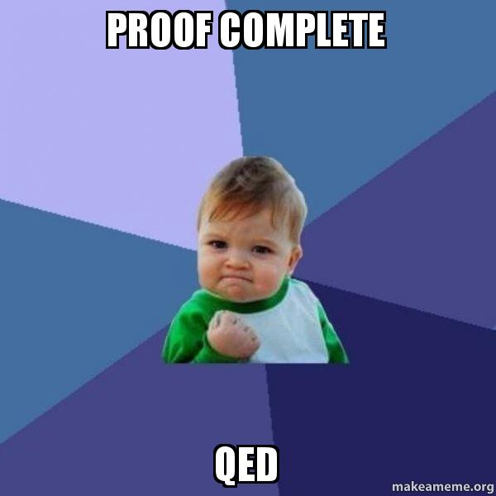
Derivation of Equivalent Expression
We want XOR only in terms of NOTs and ANDs
We know that Biconditional has the opposite truth table
We know the Boolean Expression for the Biconditional
Given:(~p or q) and (~q or p)
By negating this expression, we get:
(p and ~q) or (q and ~p)
Notice, that we’re only off by one AND.
Let (p and ~q) = A, and (q and ~p) = B
Then, we can rewrite the expression as: A or B
How do we invert an or statement?
DeMorgan’s Law!
A or B = ~((~A) and (~B))
Now, let’s plug in what A and B are:
~(~(p and ~q) and ~(q and ~p))

Slide 11
Two’s Complement
What would the Maximum Two’s Complement Number in Binary look like? Yep. Everything is a 1 except for the MSB.
I.e. 0111 1111
What would the Minimum Two’s Complement Number in Binary look like?
Yep. Everything is a 0 except for the MSB.
I.e. 1000 0000

Slide 12
Left Shifting Example
If I want to left shift 1111 1111, all the way to the right, what would that look like?
1) 1111 1111
2) 1111 1110
3) 1111 1100
4) 1111 1000
5) 1111 0000
6) 1110 0000
7) 1100 0000
8) 1000 0000
Hm… what does this number represent?
- It’s the Smallest Two’s Complement Number!!
How many total shifts did I do?
For n bits, I performed n left shifts!

Slide 13
Why I told you this
For most modern computers, memory is represented using words, which are 4 bytes, or 32 bits…
If we continually left shift the LSB into the MSB, we will fill all other spaces with 0s.
How many spaces are there excluding the MSB position?
31.
So, we need to left shift the 1st bit 31 positions. (I.e., 1 << 31)

Slide 14
Determining whether all bits are odd
We need to generate some sort of test to determine whether all the bits in a given number are odd…
We can’t use comparison operators…

Slide 15
Procedure for allBitsOdd
First, let’s generate a bit mask that has every odd bit as odd.
So, let’s divide our 32 bit representation into 4 bytes.
So what would the all odd bits look like a byte?
Yep. 1010 1010 (let’s consider 0 as even, it does fulfill even parity: 0 mod 2 = 0)
What would this value be in Hex? 0xAA
How do we combine two bits? Bitwise Or ( | )
So, we need to use a combination of logical or, and left shifted variants of this Hex value, 0xAA
We want this: 1010 1010 | 1010 1010 | 1010 1010 | 1010 1010 by multiples of 8!
We want something like: 0xAA | 0xAA << 8 | 0xAA << 16 | 0xAA << 24

Slide 16
Procedure for allBitsOdd
Okay, that’s cool and all, but we still haven’t compared the actual number to it…
What logical operator will determine equivalence between two things? AND
So, let’s use the Bitwise AND: x & mask
But we want a value that’s either 0 or 1, but AND does not guarantee this.
So, we do the following: !(mask XOR (x & mask))

Slide 17
The hardest one: floatFloat2Int
I’ll leave this one to you guys ;)
Who likes IEEE 754?
I will provide you some hints:
1) We need to extract the sign bit, exponent bits, and the fractional bits!
2) Sign Bit can be extracted by right shifting 31: num >> 31
3) Exponent Bit can be extracted how? num >> 23 & 0xFF
4) What about the Fractional Bits?
5) Then it’s a bunch of if statements…

