Slide 1
CS 0449 Recitation 2
Gordon Lu

Slide 2
Quick Quiz!
How well do you understand pointers and string manipulation?
A practice lab is available on my website: There is one to practice user input, and one to practice linked lists.

Slide 3
A friendly reminder
Never return an array in C.
Arrays don’t exist in C.
When you pass an array into a function, it becomes a Pointer.

Slide 4
Lab 2 will be out on Monday (probably)!
The focus on Lab 2 will be pointer arithmetic
So, I’ll be talking about pointers!

Slide 5
Memory

Slide 6
Memory
In order to gain a more solid understanding of a pointer, let’s try and understand memory a little better.
Memory is a big one-dimensional array of bytes
Every byte value has an address
This is its "array index"
Addresses start at 0, like arrays in C/Java
For values bigger than a byte, we use consecutive bytes
The address of any value, regardless of size, is the address of the first byte (smallest address)

Slide 7
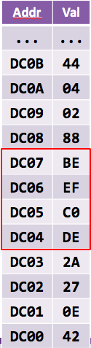
Let’s zoom in at a piece of memory!
Here is an int variable
What is its sizeof()?
Its sizeof() is 4 in this case - 4 bytes long
What is its address?
Its address is 0xDC04
What is its value?
Its value could be either 0xDEC0EFBE (big-endian) or 0xC0DEBEEF (little-endian)

Slide 8
Lockers: Pointer Analogy

Slide 9
Lockers
1) Think about a locker. what is its purpose?
- To contain things.
2) How are lockers identified?
- They're numbered.
3) How do you access a locker?
- By knowing the locker's number and combination.
- but for this example, let's assume there are no locks.
4) How would you give someone else access to your (lock-less) locker?
- Would you rip it out of the wall?
- No… you give them the locker number.

Slide 10
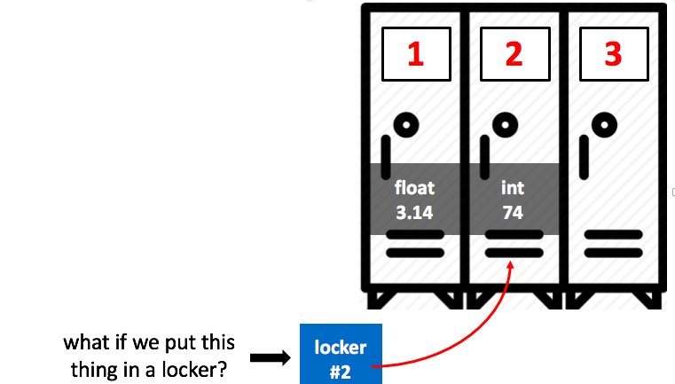
Like a Locker Room!
1) Just like a locker contains things…
- Variables contain values
- But a variable is a thing itself
2) Each variable is like a locker:
- It has a number: its address
- It contains something: its value
- It belongs to someone: its owner
3) How do you give someone else access to your variable?
- You give them the locker number.
- Which is its memory address.
- Variable names are just a convenient way to refer to their addresses!

Slide 11
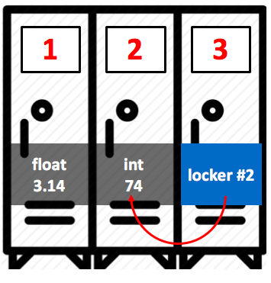
Pointers!!
1) If we put a slip of paper in locker 3 which says "locker #2"…
2) Now we can access two things:
- The locker itself (3), and
- The locker that it points to (2)
3) A pointer is a variable which holds another variable's memory address.
4) If you have a pointer, now you can access two things:
- The pointer variable itself, and
- The variable that it points to
5) "every problem in CS can be solved with another level of indirection."

Slide 12
What is a Pointer?
A pointer is a variable that holds a memory address of another variable.
Essentially, anytime you would do [ ] in Java, you’d do * in C.
You can access a value a pointer points to using the dereference operator (*).

Slide 13
Address-Of (&)
You can get the address of a variable via the address-of operator (&)
int x;
int* p = &x;

Slide 14
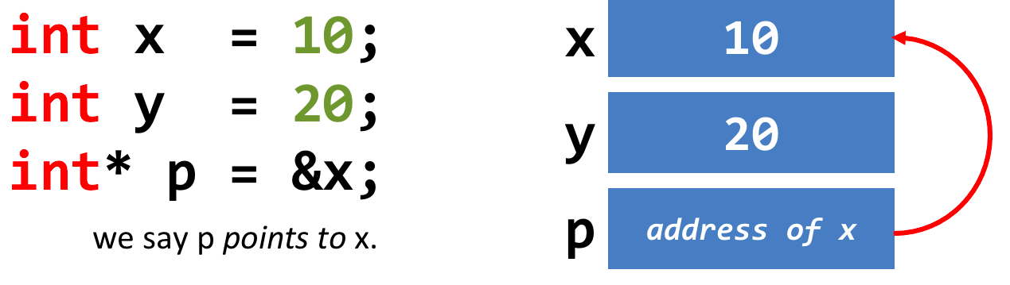
A Quick Example with Pointers
int x = 10;
int y = 20;
int* p = &x; does the following:

Slide 15
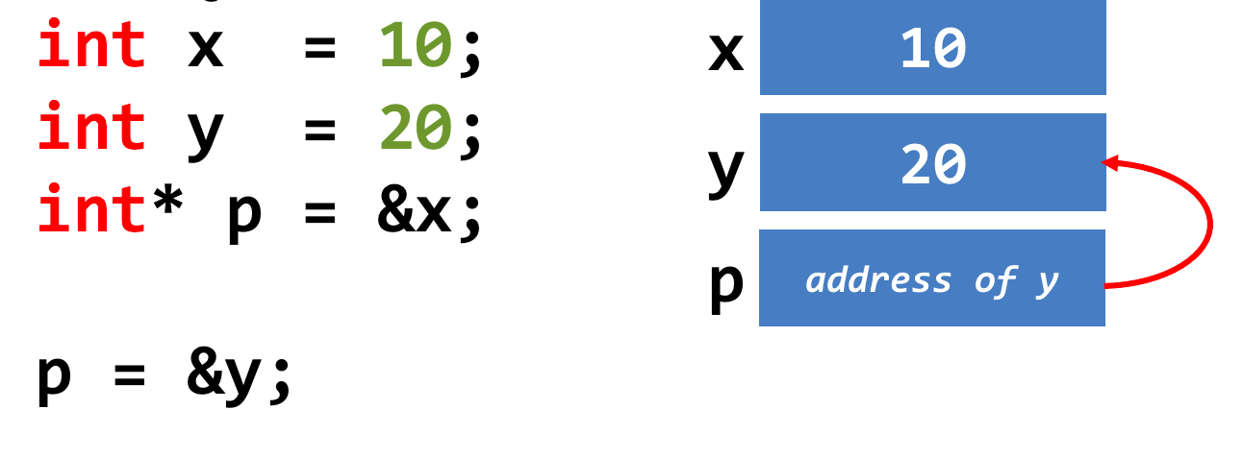
A Quick Example with Pointers
int x = 10;
int y = 20;
int* p = &y; does the following:

Slide 16
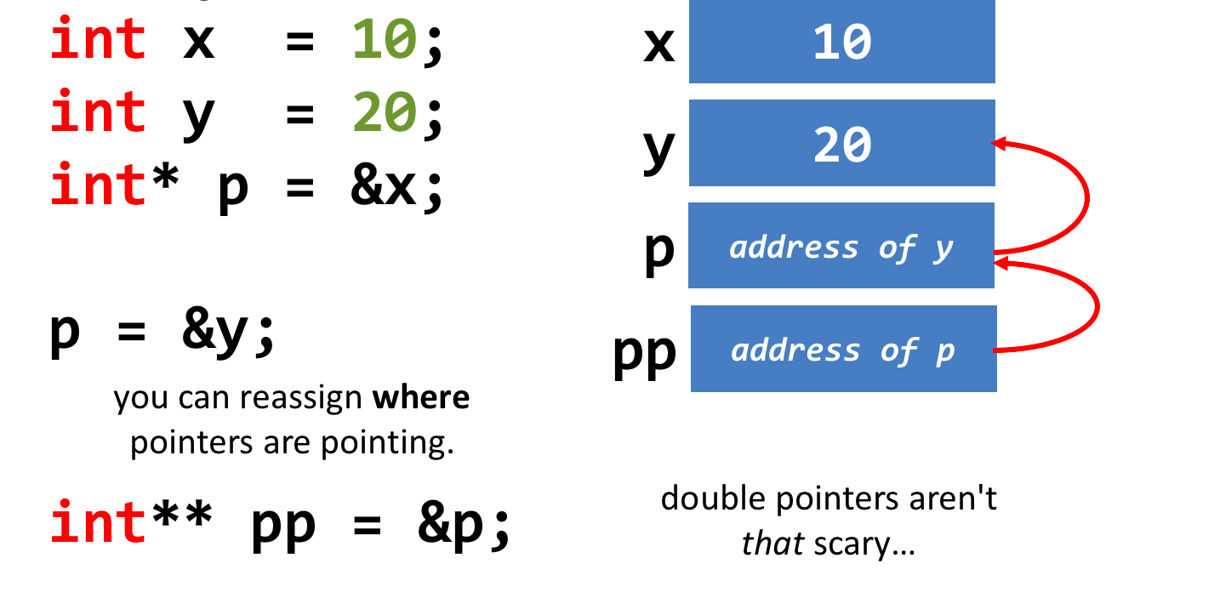
A Quick Example with Pointers
int x = 10;
int y = 20;
int** pp = &p; does the following:

Slide 17
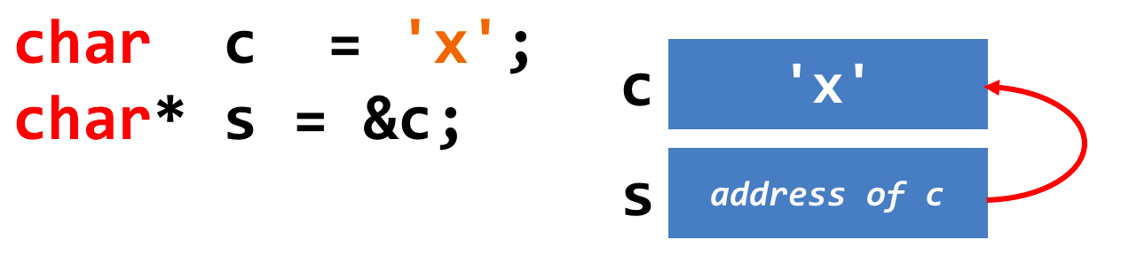
Pointers and Arrays
1) A pointer can point to one or more values.
2) A char* may point to a single char, or to an array of characters.
Initially, with the following code:

Slide 18
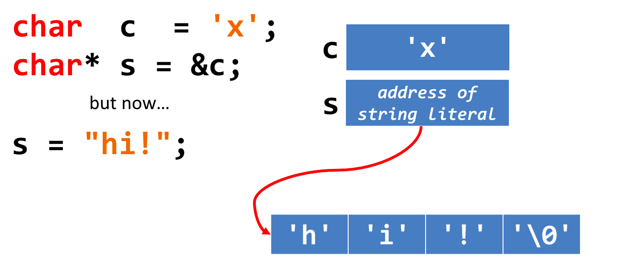
Pointers and Arrays
But now if we do:
“Pointing to a single value" is the same as “pointing to an array of length 1"…

Slide 19
Accessing the Value at a Pointer

Slide 20
The Value-At (or "Dereference") Operator:
1) * is the value-at operator - it's the inverse of &
- Every time you use it, you remove a star
2) It accesses the variable that a pointer points to
- We say that it "dereferences" a pointer

Slide 21
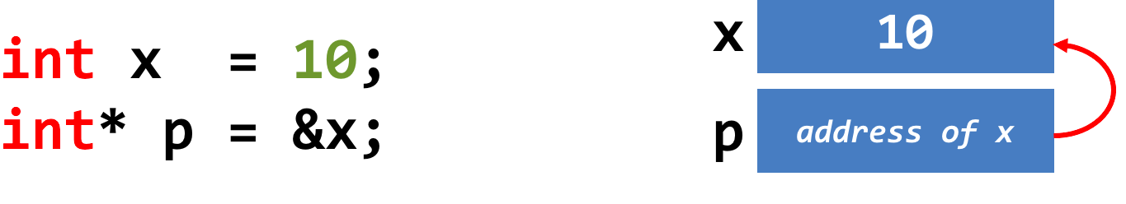
A Quick Example:
In the following code, p currently points to x’s memory address:

Slide 22
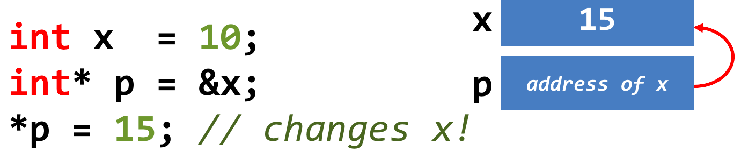
A Quick Example:
Changing the value of p (via dereference) will change x’s original value!

Slide 23
A Quick Example:
Changing the value of p (via dereference) will change x’s original value!

Slide 24
Array-Indexing Operators

Slide 25
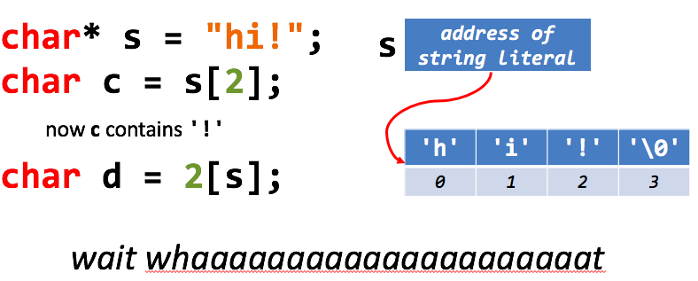
The Array-Indexing Operators:
p[n] means "access the nth item pointed to by p."

Slide 26
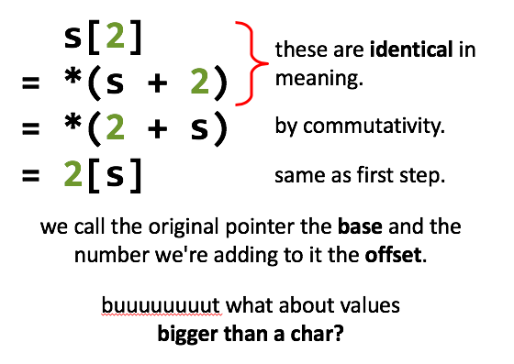
What the brackets actually do
1) p[n] in C really means "dereference address p + n"

Slide 27
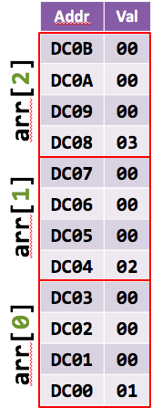

Tipping the Scales!
Let's say we have an array of ints:
Let's say arr points to address 0xDC00
What is sizeof(int)?
4 bytes.
arr[1] means *(arr + 1)…
but where is the next value? at 0xDC01?
No! at 0xDC04.
and arr[2] is at 0xDC08…
When you add an offset to a pointer, the offset is multiplied by the size of the item being pointed to before being added to the base address.
This is called "scaling."

Slide 28
Pointer Arithmetic

Slide 29
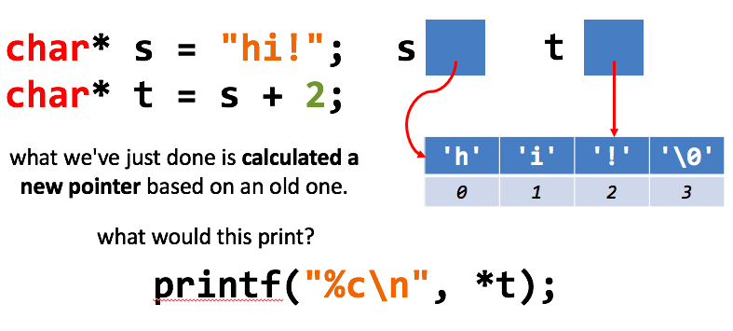
Memory Addresses are just numbers!
1) Pointers hold memory addresses.
- Memory addresses are numbers.
2) It's useful to do arithmetic on memory addresses.
This will print !, since t points to !
There is no dereferencing happening in the pointer arithmetic.
We are operating on the pointer itself.

Slide 30
Void Pointers

Slide 31
What is a void pointer?
Think of a void pointer like a universal pointer
It can point to anything.
int x; float y;
void* vp = &x; //good!
vp = &y; //good!
But… you can’t access the data from a void* without a cast…

Slide 32
String Manipulation in C

Slide 33
What’s the difference here?
char* name = “hello!”;
char name[100] = “hello”;
When we declare char* name = “hello”; this puts “hello” into the static data segment.
This means we can’t modify this variable!
When we declare char name[100] = “name”, this allocates space for 100 characters, fills the first however many with that string, and fills the rest with \0 characters
Do this if you want to do String Manipulation!!

Slide 34
Strings in C
The end of a String is indicated by the NUL Terminator: ‘\0’
Therefore, if we want to truncate a string, we would move the location of ‘\0’!
You can find the string manipulation functions in <string.h>

