Slide 1
CS449 Recitation 2 Quiz
Gordon Lu

Slide 2
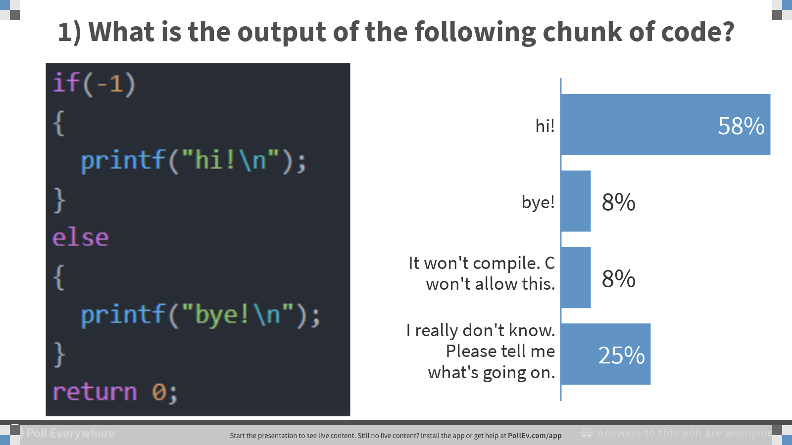
Notes:
Poll Title: 1) What is the output of the following chunk of code? https://www.polleverywhere.com/multiple_choice_polls/FPnTS4FG0qjx6EsCPKbQi

Slide 3
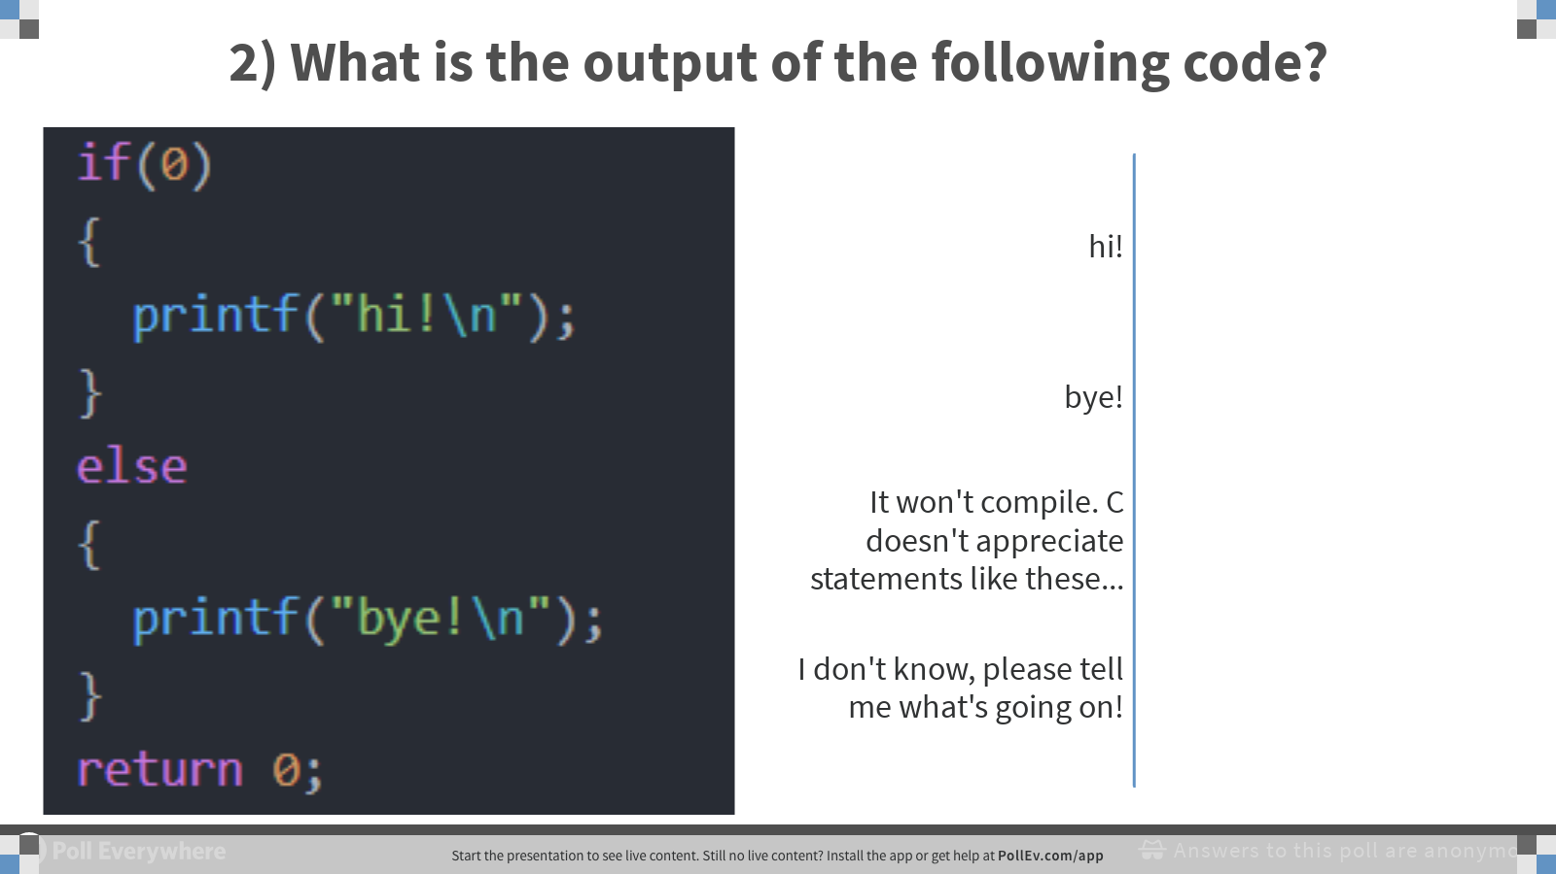
Notes:
Poll Title: 2) What is the output of the following code? https://www.polleverywhere.com/multiple_choice_polls/4FXtGLIi87SpLgccoPYG8

Slide 4
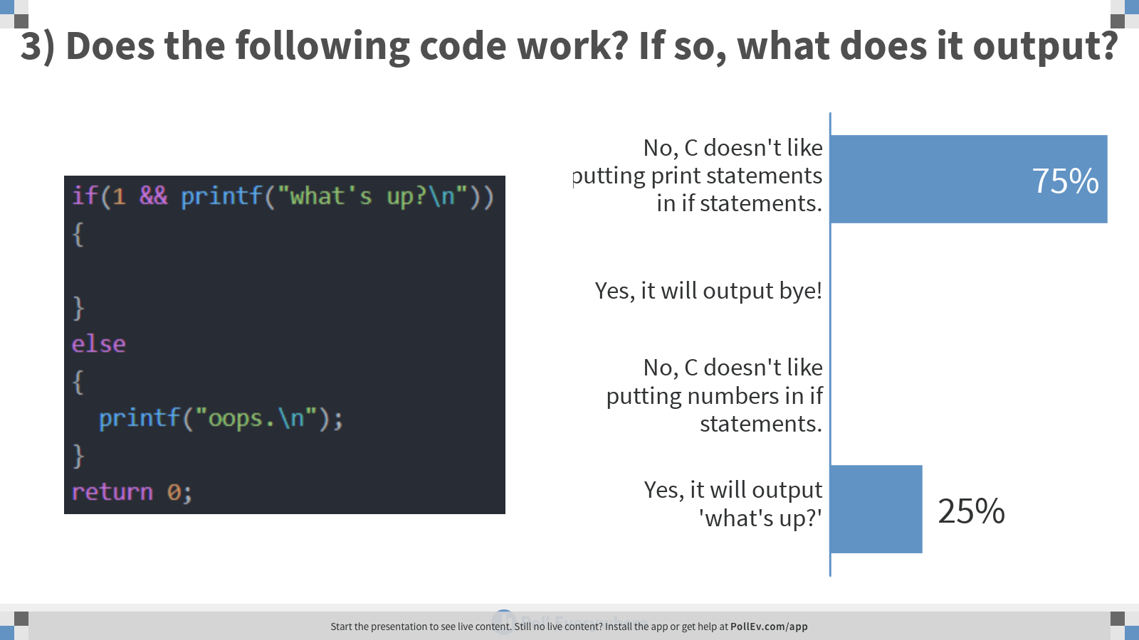
Notes:
Poll Title: 3) Does the following code work? If so, what does it output? https://www.polleverywhere.com/multiple_choice_polls/p9bfLcplL8xdO8iX0Ejlv

Slide 5
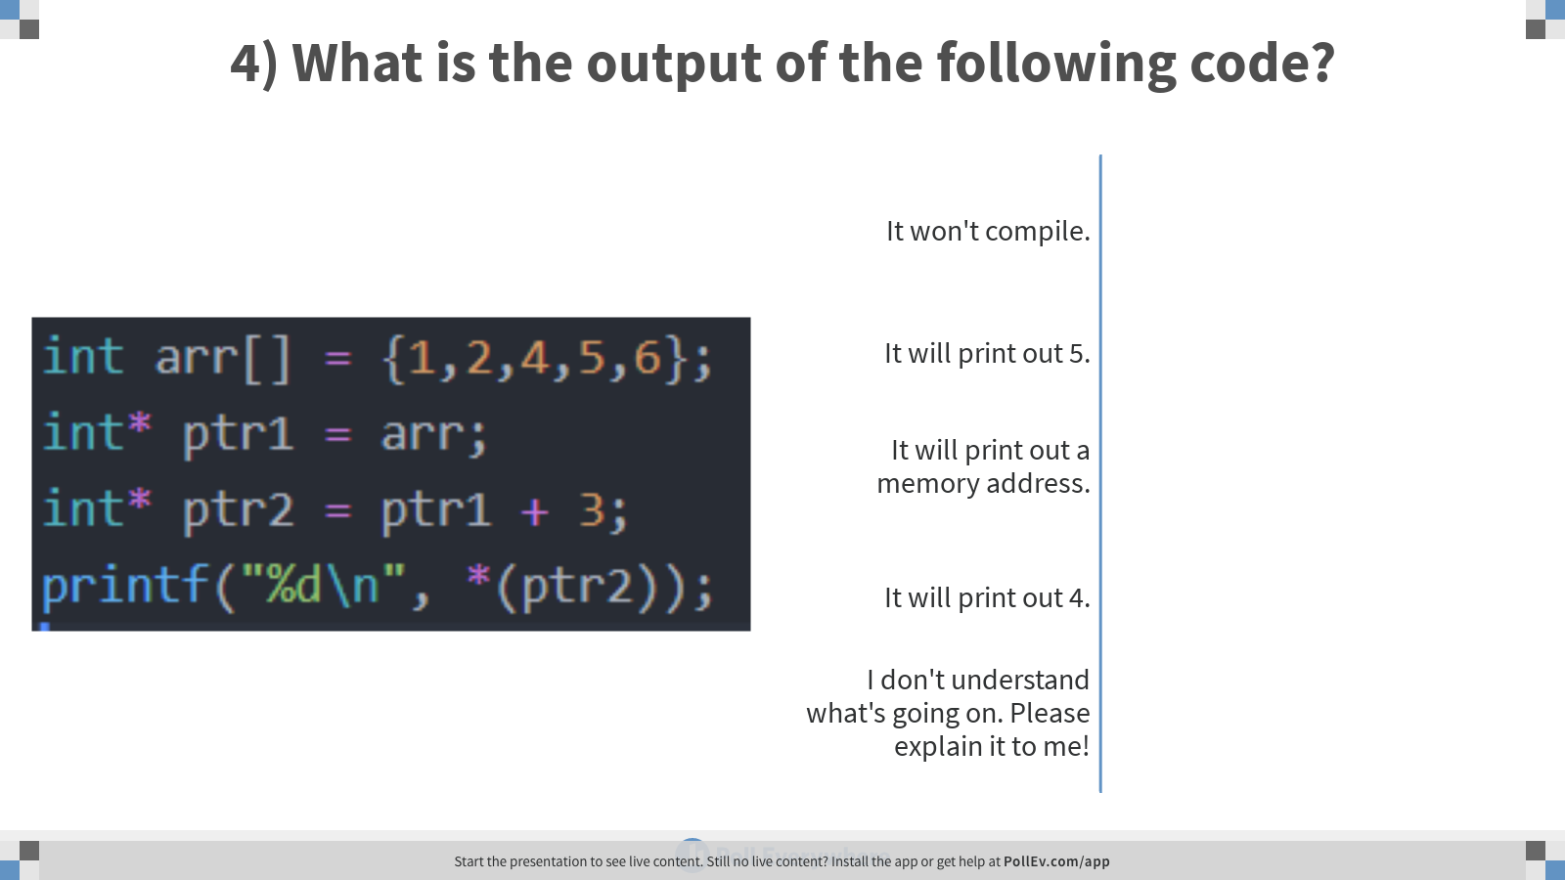
Notes:
Poll Title: 4) What is the output of the following code? https://www.polleverywhere.com/multiple_choice_polls/PvsLICwLTaEoaBELzD9QZ

Slide 6
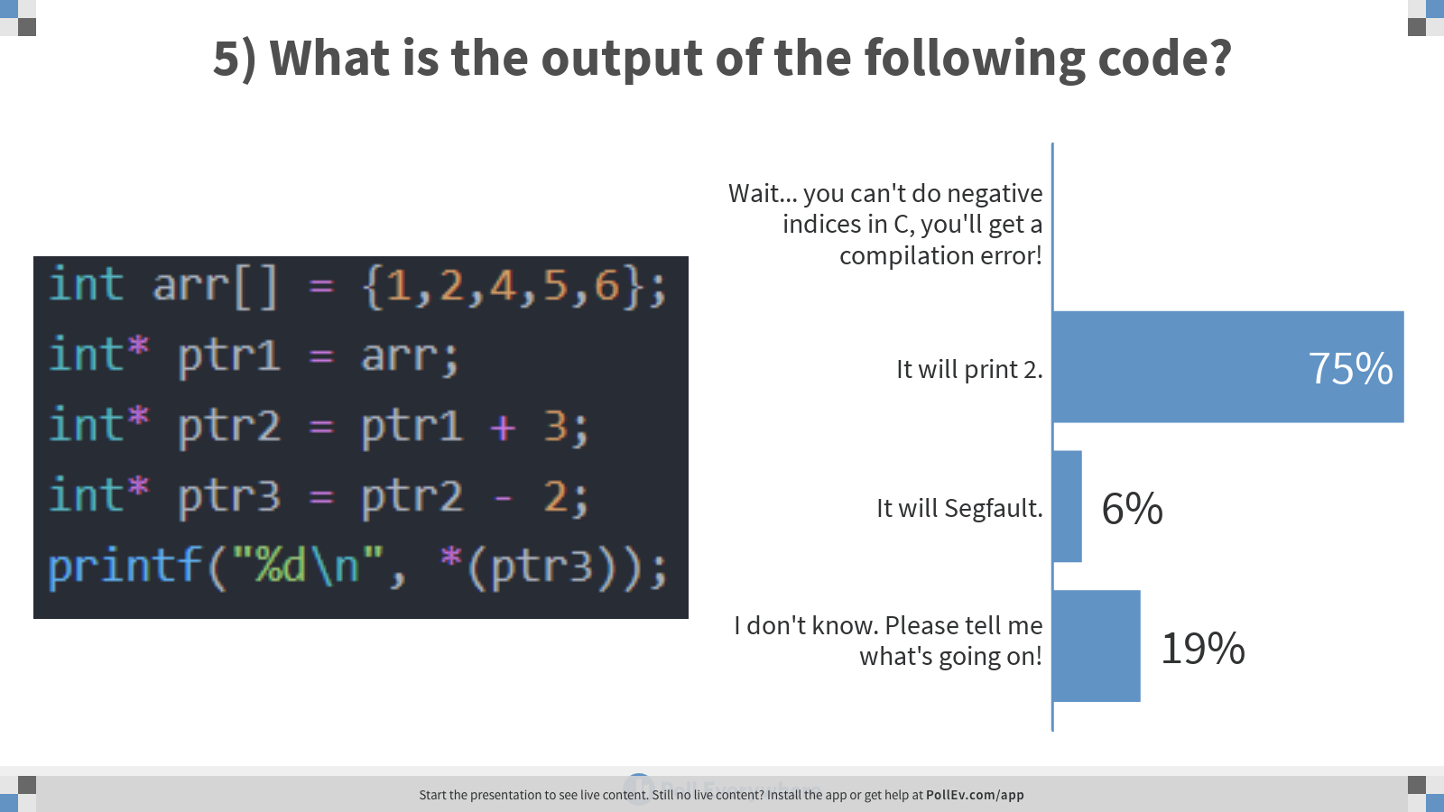
Notes:
Poll Title: 5) What is the output of the following code? https://www.polleverywhere.com/multiple_choice_polls/8yWtp60mGPiKQrL2MTkxs

Slide 7
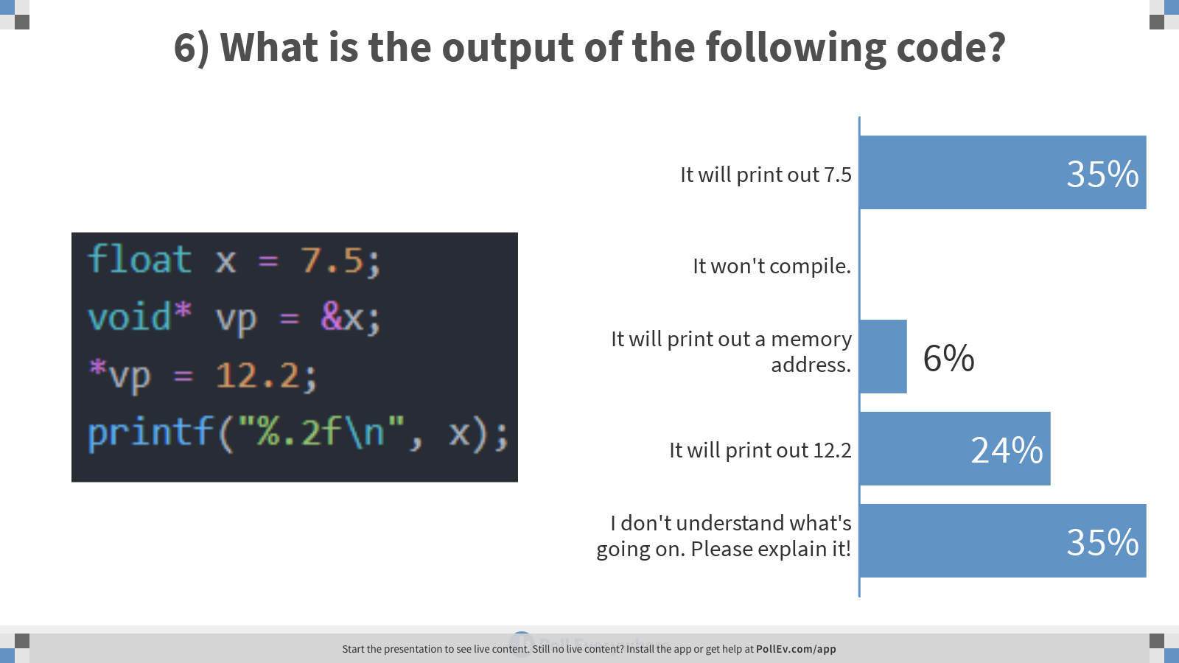
Notes:
Poll Title: 6) What is the output of the following code? https://www.polleverywhere.com/multiple_choice_polls/NVt1Qz6TIuzeCFIts0j1I

Slide 8
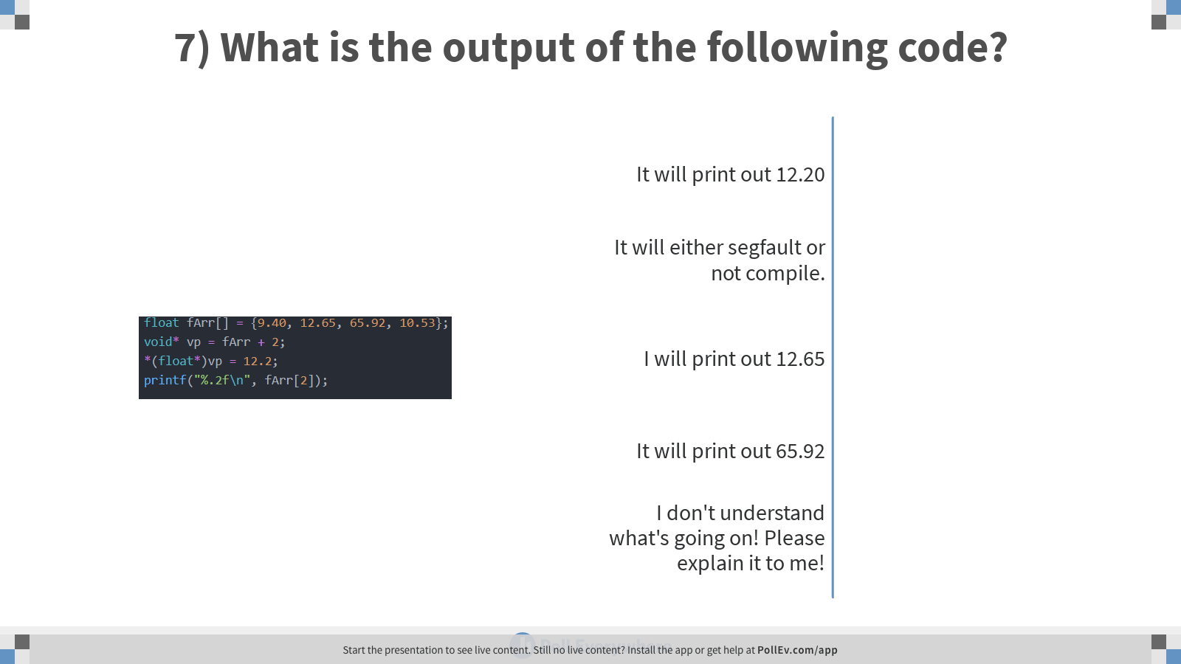
Notes:
Poll Title: 7) What is the output of the following code? https://www.polleverywhere.com/multiple_choice_polls/M4AE2uk9DgLKyAK5OlQJE

Slide 9
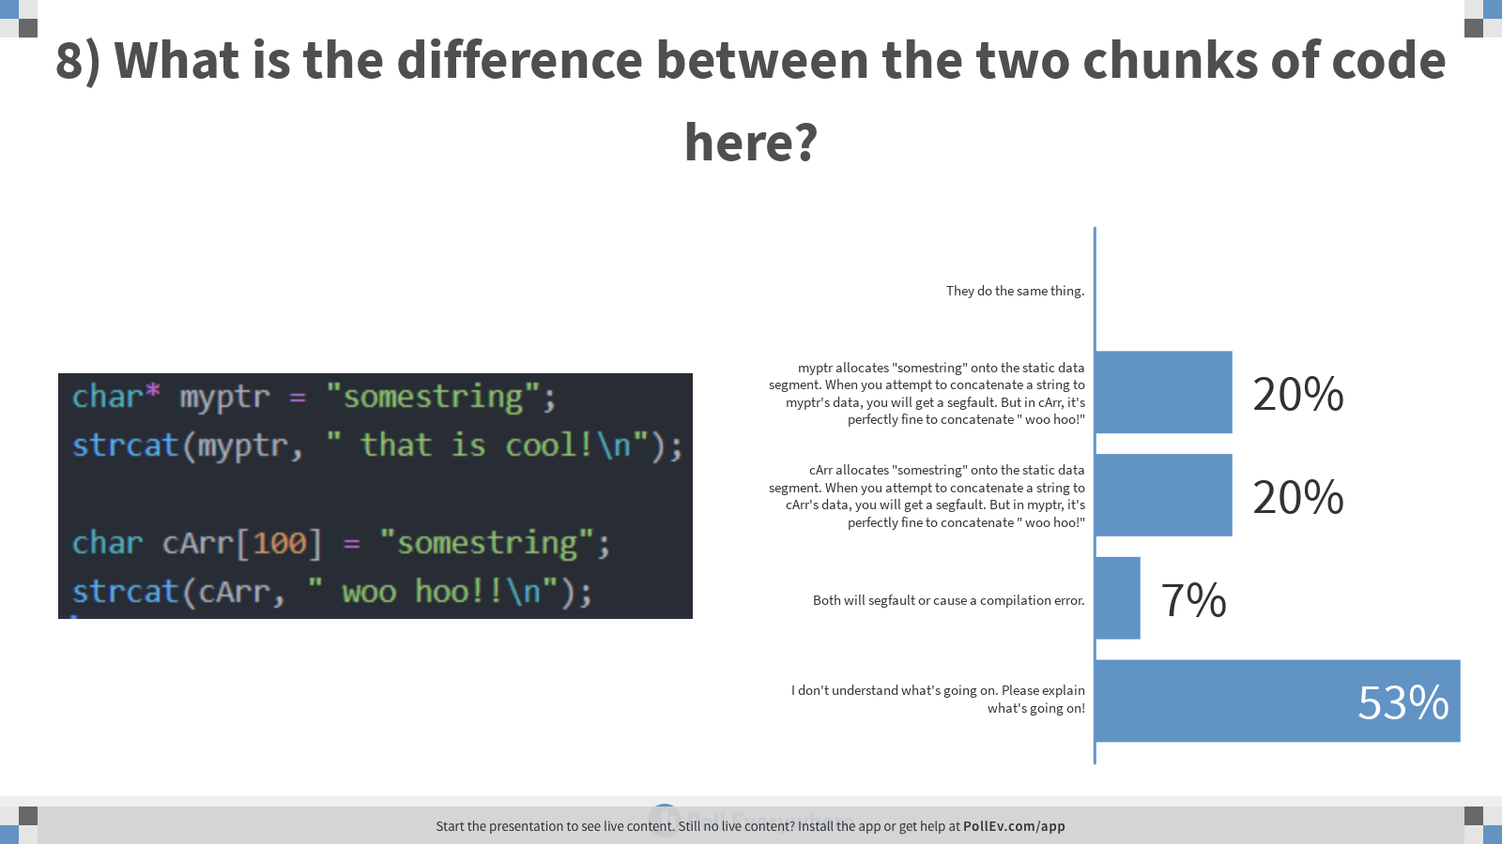
Notes:
Poll Title: 8) What is the difference between the two chunks of code here? https://www.polleverywhere.com/multiple_choice_polls/CeQxW2zvFiSzNZ2wW6nbY

Slide 10
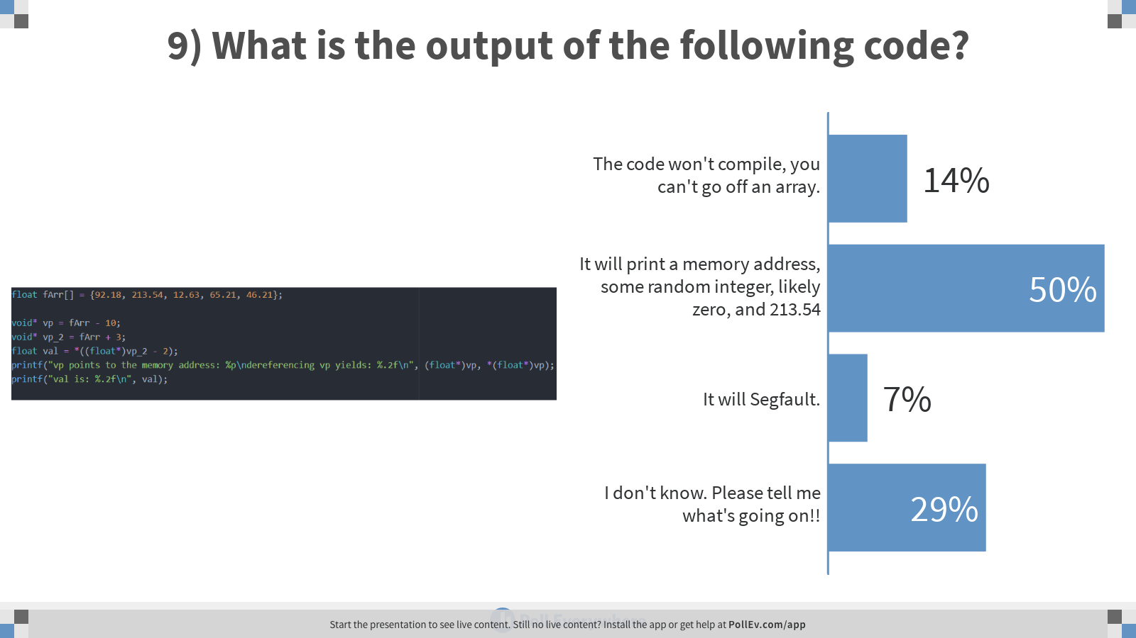
Notes:
Poll Title: 9) What is the output of the following code? https://www.polleverywhere.com/multiple_choice_polls/OR8D5tZGlE8fm0Kr09BYU

