Slide 1
CS 0449 Recitation 4
Gordon Lu

Slide 2
Some notes!!
When you send me code, please create a pastebin and send the link that contains the paste! (go to pastebin.com)
This way I don’t need to redownload files. and when I send it back, you won’t have to either – It’s a Win-Win ☺

Slide 3
Additional notes
The practice code posted on my website should get you used to FILE *’s, and structs.
I looked at Wilkie’s slides, and it’s a lot of stuff, so I’ve decided to dedicate this recitation to memory allocation and answering questions on the lab!
Next week, I’ll cover Memory Deallocation and the Compilation Toolchain!

Slide 4
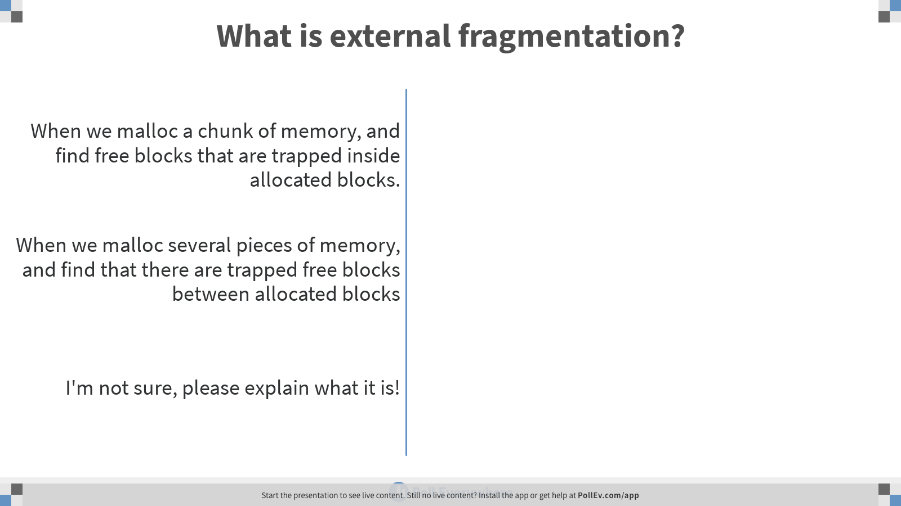
Notes:
Poll Title: What is external fragmentation? https://www.polleverywhere.com/multiple_choice_polls/BFFz8xioSXyrfw7bL4wZ0

Slide 5
The correct answer is B!

Slide 6
A Brief Introduction to Memory Allocation

Slide 7
The Heap is just a big chunk of data!

Slide 8

Every time we call malloc, we slice a chunk off of it!

Slide 9

Freeing memory leaves gaps!

Slide 10
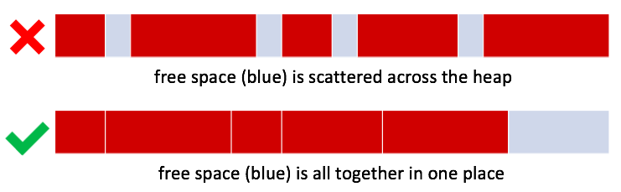
External Fragmentation
External Fragmentation is the result of having free memory split into lots of small fragments
- External because the free memory is outside the allocated blocks

Slide 11
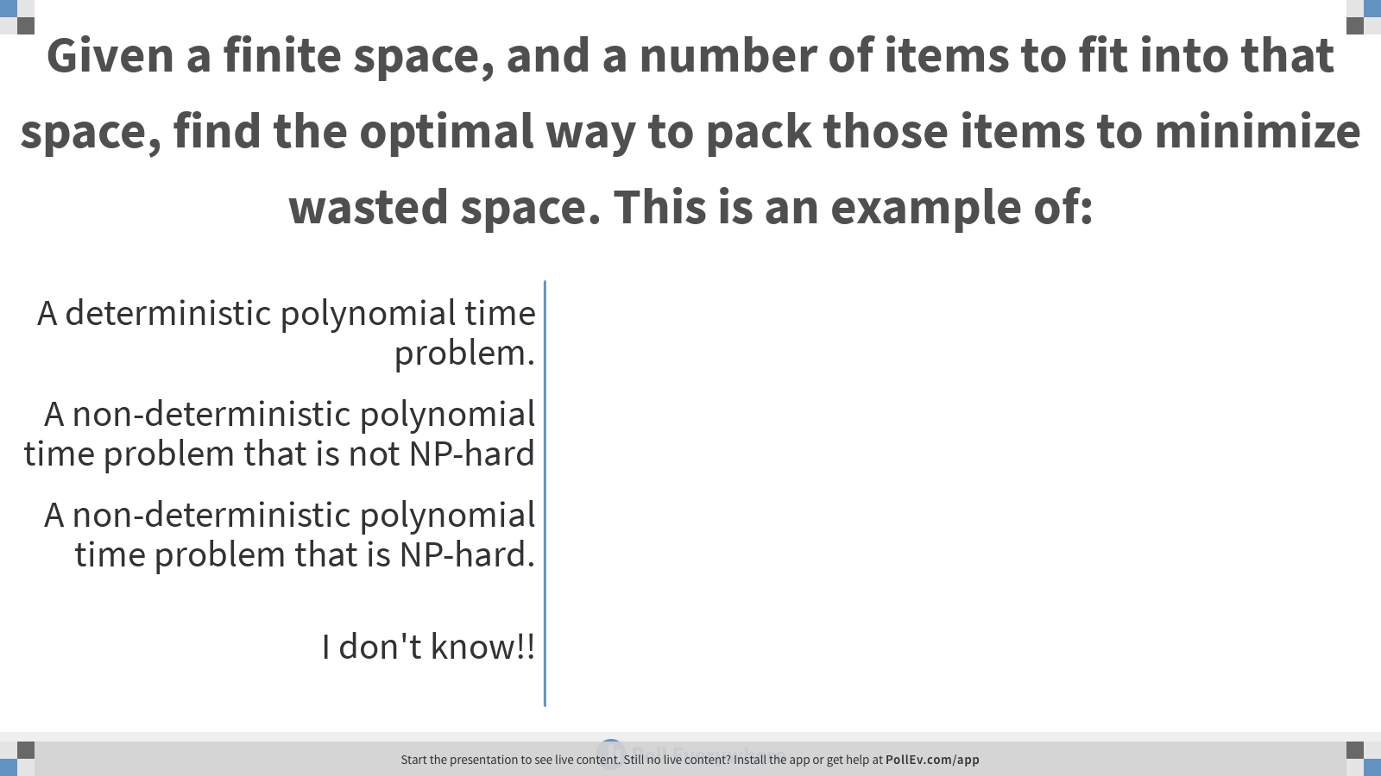
Notes:
Poll Title: Given a finite space, and a number of items to fit into that space, find the optimal way to pack those items to minimize wasted space. This is an example of: https://www.polleverywhere.com/multiple_choice_polls/C8naCXcUXCcAiQE323em3

Slide 12
The correct answer is C!

Slide 13
Bit Maps!

Slide 14

Bit Maps
If we divided the heap into uniformly sized chunks:
What's a simple way to say which are used and which are free?
Use a boolean (true/false) per chunk!
We can use one bit for each, and pack all those bits into one int
11011100 01101111₂ = 0xDC6F
This is a bitmap
The bits are a map of the heap
Bitmaps are forced to use uniform size chunks.

Slide 15
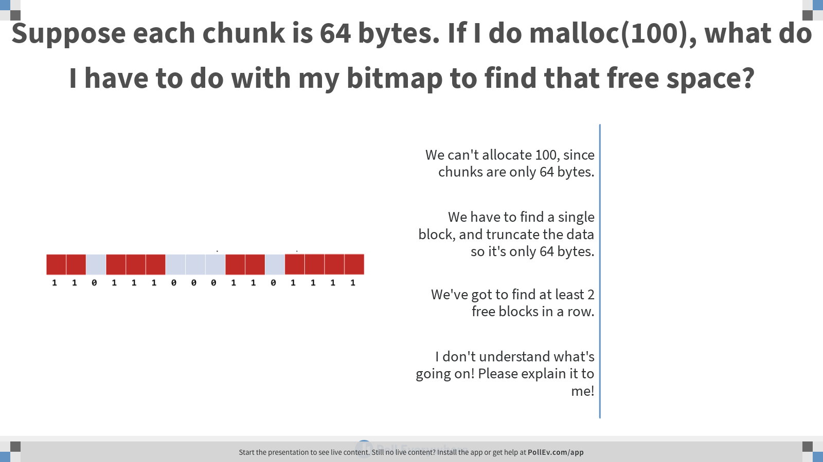
Notes:
Poll Title: Suppose each chunk is 64 bytes. If I do malloc(100), what do I have to do with my bitmap to find that free space? https://www.polleverywhere.com/multiple_choice_polls/kxrnOZ5W51SaJQxlXUlbn

Slide 16
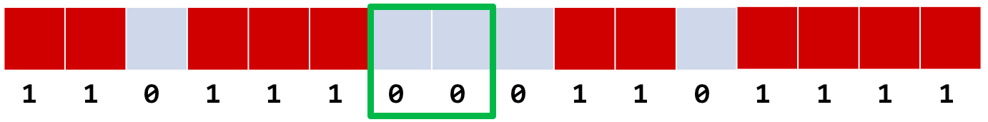
Allocation via Bit Maps
We've got to find at least 2 0s in a row

Slide 17
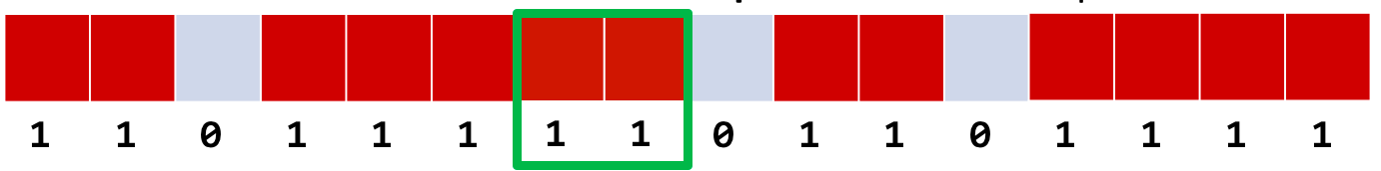
Allocation via Bit Maps
Then mark them as used! (Set the bits to 1)

Slide 18
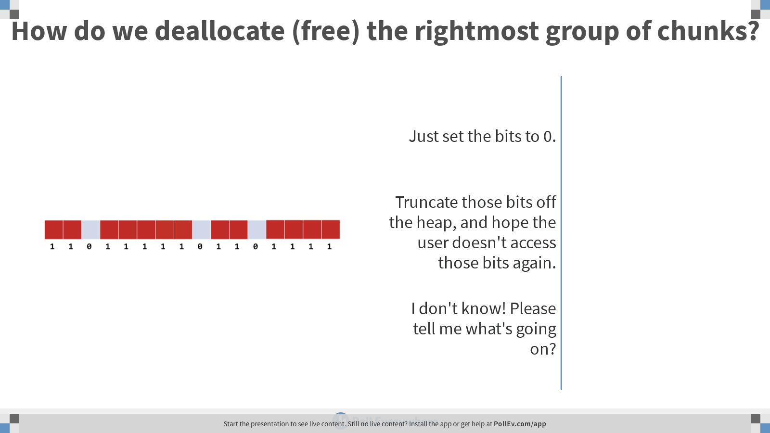
Notes:
Poll Title: How do we deallocate (free) the rightmost group of chunks? https://www.polleverywhere.com/multiple_choice_polls/S8uYsHHYbfEu4z9XAk3Ci

Slide 19
Deallocation via Bit Maps
So, what's the catch?
Since the bits are adjacent to one another, whenever you set some bits to 0, you "automatically" get bigger blocks of free memory

Slide 20
Entropy

Slide 21
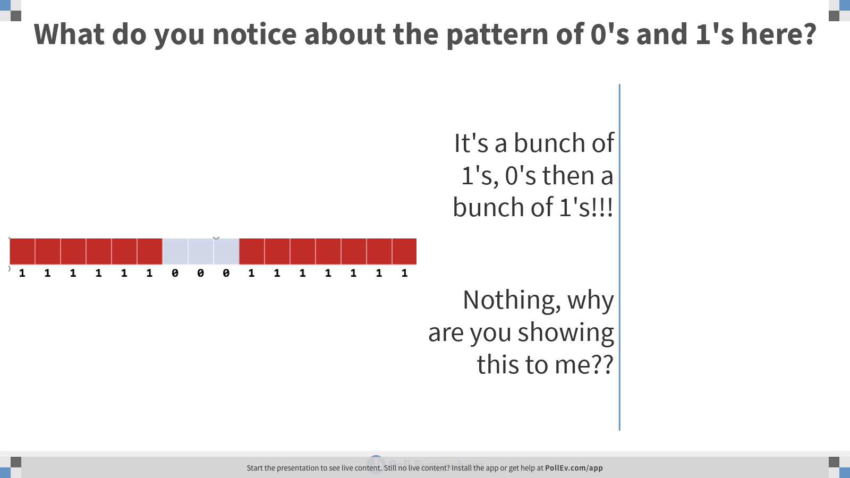
Notes:
Poll Title: What do you notice about the pattern of 0's and 1's here? https://www.polleverywhere.com/multiple_choice_polls/rQxp9KMGgsE7dNQJYxutr

Slide 22
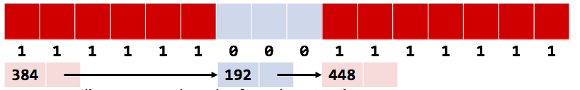
It seems silly to store a bunch of 1’s, 0’s then 1’s
What if we did this instead:
Record the exact sizes of each contiguous block
Then link em together… into a list

Slide 23

We can embed the list within the free and allocated blocks
Every block starts with a header that includes the size, pointer, and its status (used or not)
So, a 100B block will take up maybe 112B total:
12B for the header
100B for the space the user asked for
The allocator is the only one who sees these headers.

Slide 24
Allocation Algorithms

Slide 25

Tabula Rasa
When your program first starts up, the heap looks like this:

Slide 26
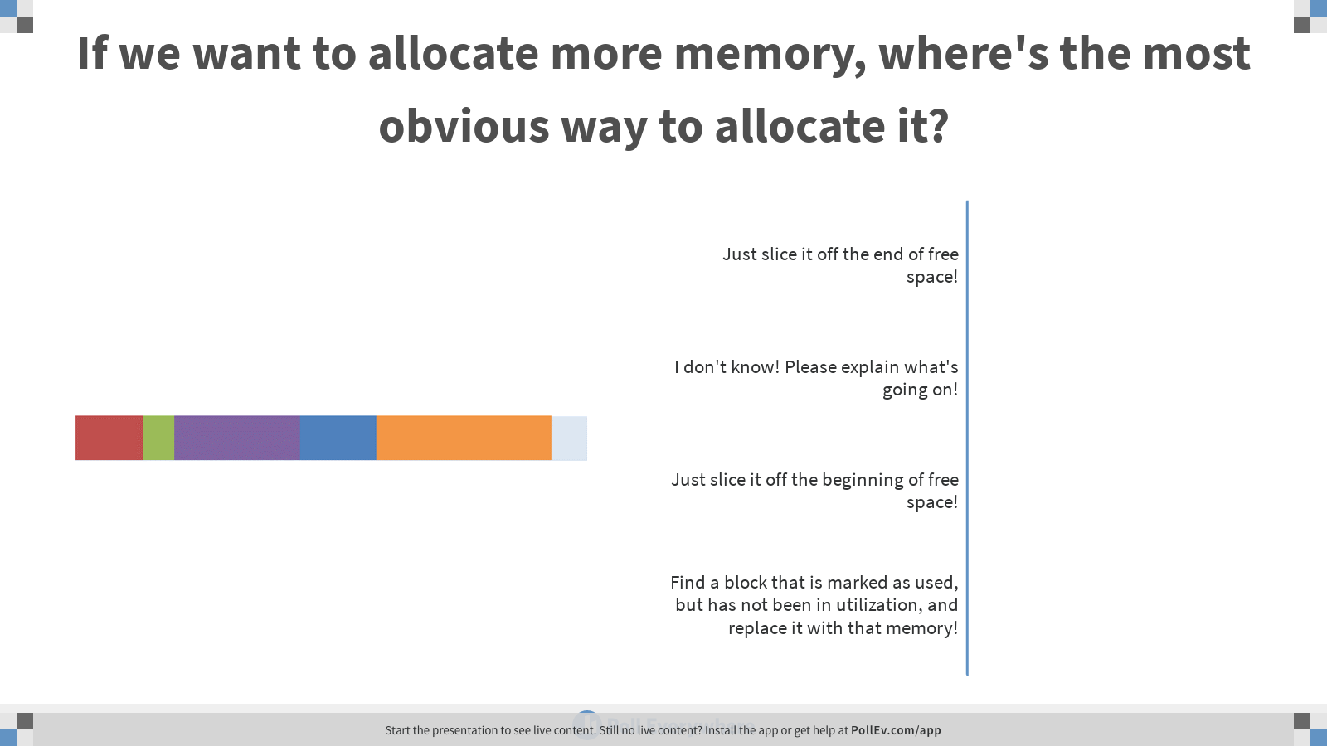
Notes:
Poll Title: If we want to allocate more memory, where's the most obvious way to allocate it? https://www.polleverywhere.com/multiple_choice_polls/WKjC36kmqZwwKTLlSOXQ3

Slide 27


Uh oh, something’s not right
In the middle of the program, the heap will look more like this:

Slide 28
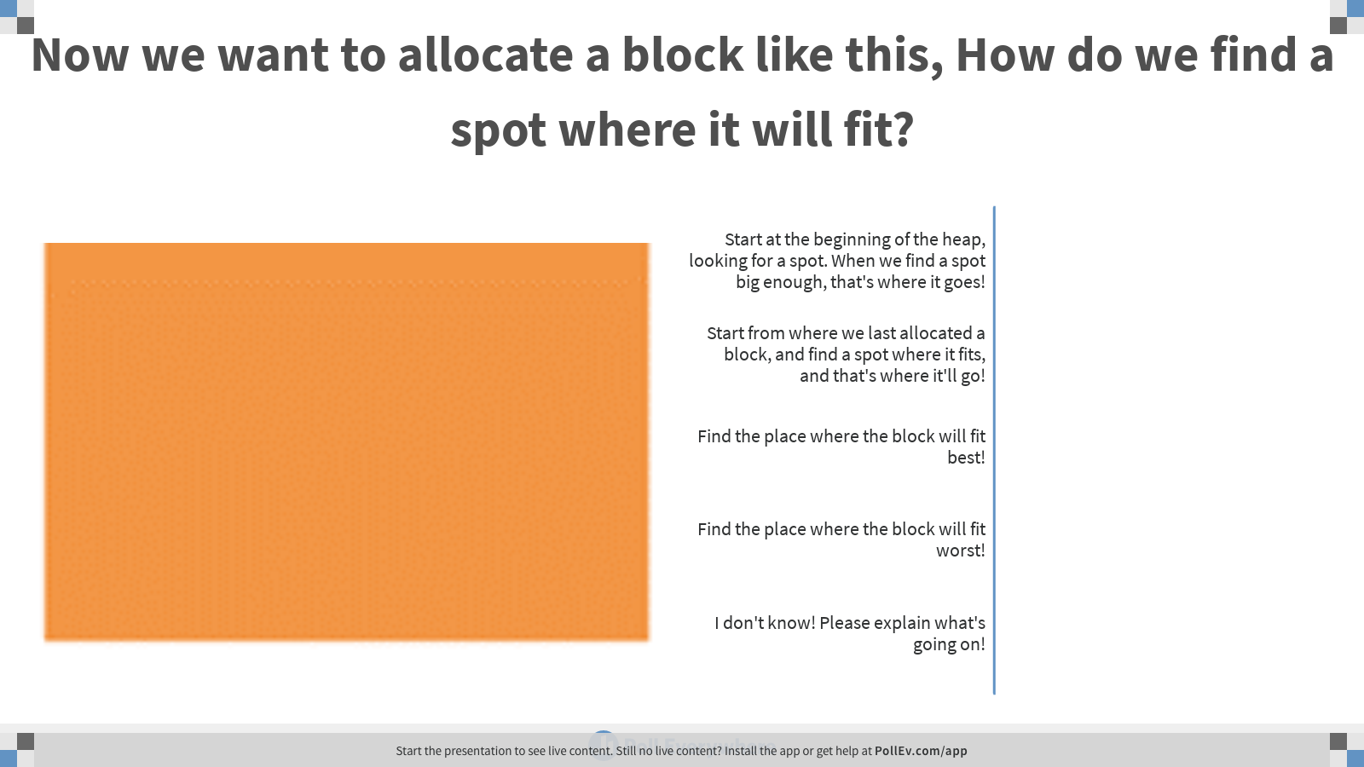
Notes:
Poll Title: Now we want to allocate a block like this, How do we find a spot where it will fit? https://www.polleverywhere.com/multiple_choice_polls/tHcJBcBPV6GFQK3g8QMHG

Slide 29
First Fit
We start at the beginning of the heap, looking for a spot
When we find a spot big enough, that's where it goes
This is called first-fit cause it puts it in the first spot it fits.
How long does it take to find that free block?
It's linear in the number of blocks

Slide 30
Downsides of First-Fit
With first-fit, the heap will often end up looking like this:
Everything's clustered around the beginning. This is good actually!
Cause it leaves us with a nice big empty space
But…
There are lots of holes
The holes will likely be small and therefore useless (wasted)
We waste a lot of time looking through those small holes before we get to that big empty space
Why start from the beginning every time?

Slide 31

Next Fit
What if we start looking from where we last allocated a block?
Next-Fit makes it faster to find a block, but spaces things out more:
Since it starts from the last allocation, it spreads things out and misses what might be good spaces earlier in the heap

Slide 32

A Square Peg in a Slightly Larger Square Hole:
Let's say our heap looks like this, and the orange block is the most-recently-allocated one:
Now we want to allocate this:

Slide 33
Where would First-Fit put this block?
Yep, at the first place it fits!

Slide 34
Where would Next-Fit put it?
Yep, the next place it fits starting from the orange block that was just allocated!!

Slide 35
But what place would make the most sense?
At wherever, the free space is closest to the right size!
This is best-fit.

Slide 36
But what if you wanted the worst possible case?
You’d put the chunk wherever it'll leave a bigger block of free space!
This is worst-fit.

Slide 37
The Best of Intentions

Slide 38
Neither of these schemes really makes things any better
Best-Fit will leave tons of tiny unusable holes
Worst-Fit will "clump" allocations better, but tends to leave several similarly-sized large holes that all gradually get smaller

Slide 39
But… there’s a corollary!
Worst of all, both algorithms force us to look at every free block in the heap on every allocation
Best-Fit can stop early by finding an exactly-sized hole for the desired block, but Worst-Fit HAS to look at all the free blocks.

Slide 40
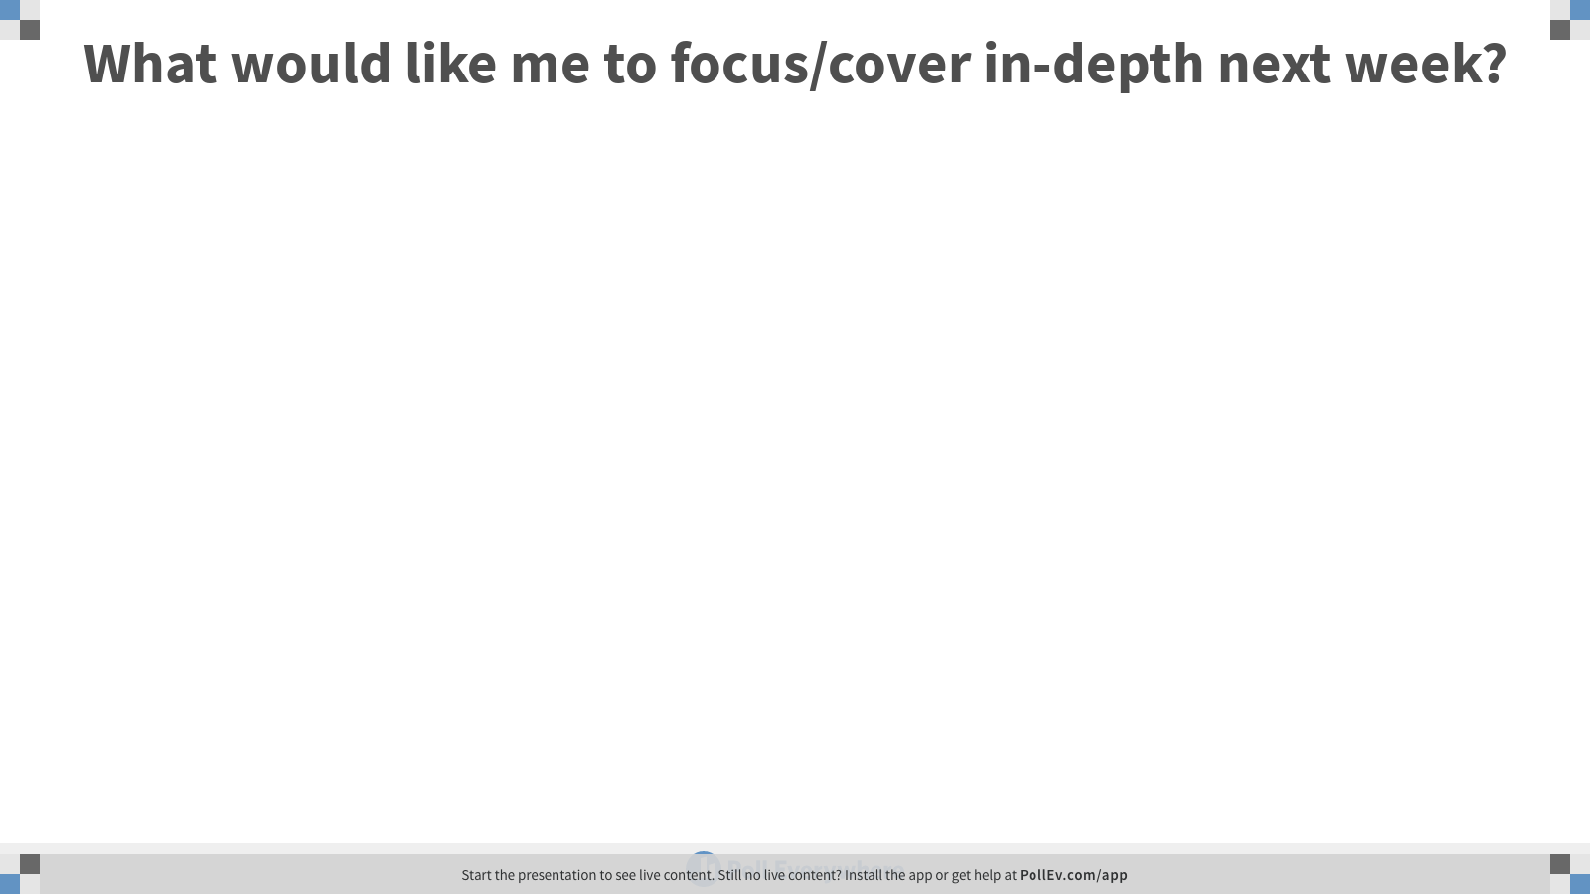
Notes:
Poll Title: What would like me to focus/cover in-depth next week? https://www.polleverywhere.com/free_text_polls/goKnGtFBcbNeWXvRzfeY6

Slide 41
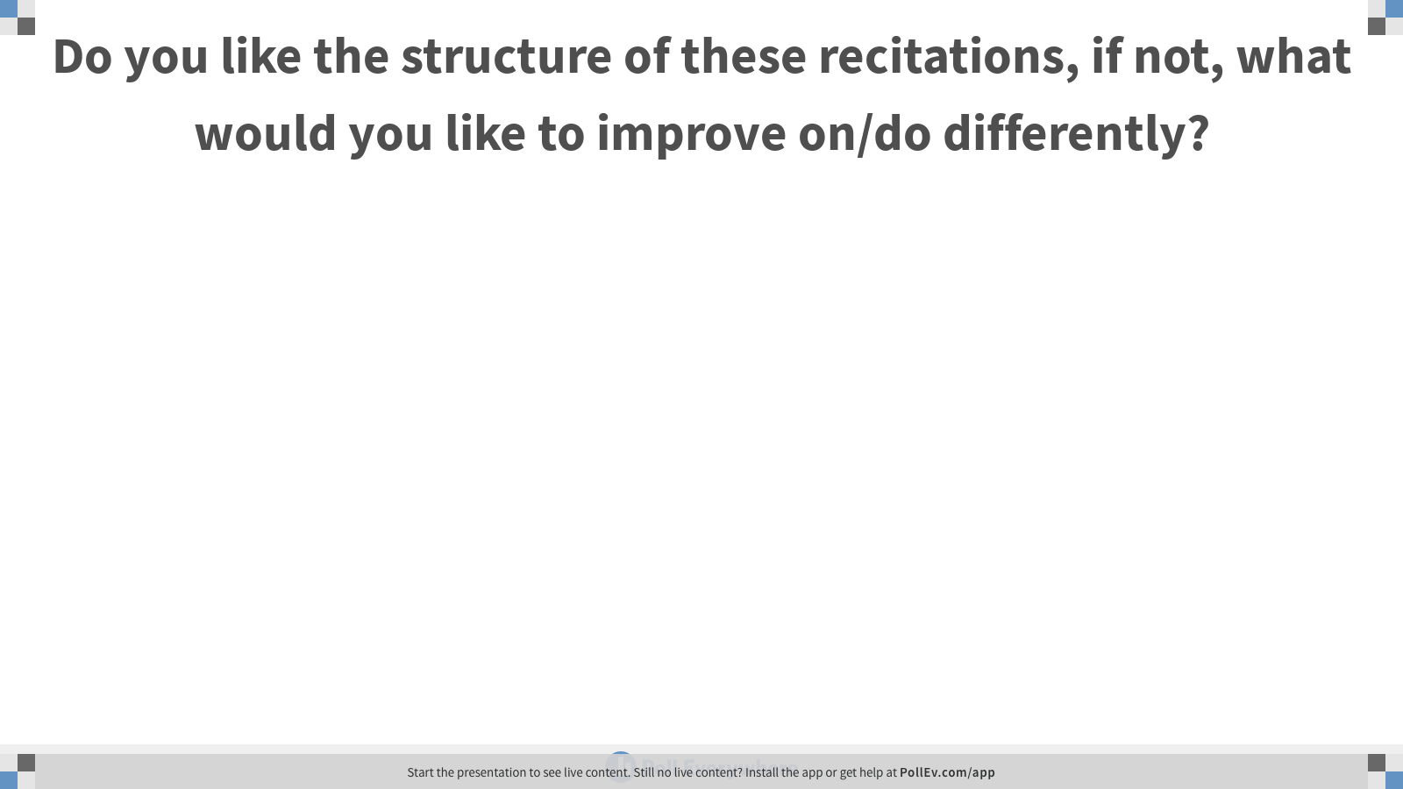
Notes:
Poll Title: Do you like the structure of these recitations, if not, what would you like to improve on/do differently? https://www.polleverywhere.com/free_text_polls/m5B9ZZzlj67tFqZHCb6P1

